Slide 1
NUS Money App Database test case
By Harry Tan
^{6th} September 2020

Slide 2
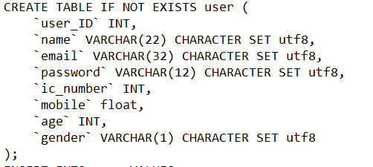
1, Design a database schema to store information
“user” table

Slide 3
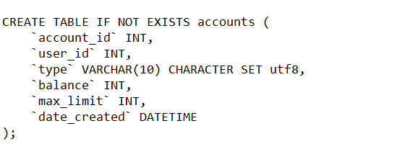
1, Design a database schema to store information
“accounts” table

Slide 4
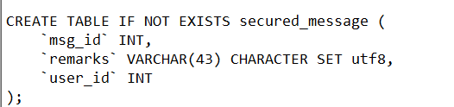
1, Design a database schema to store information
“secured_message” table

Slide 5
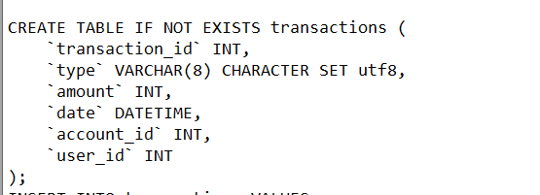
1, Design a database schema to store information
“transactions” table

Slide 6
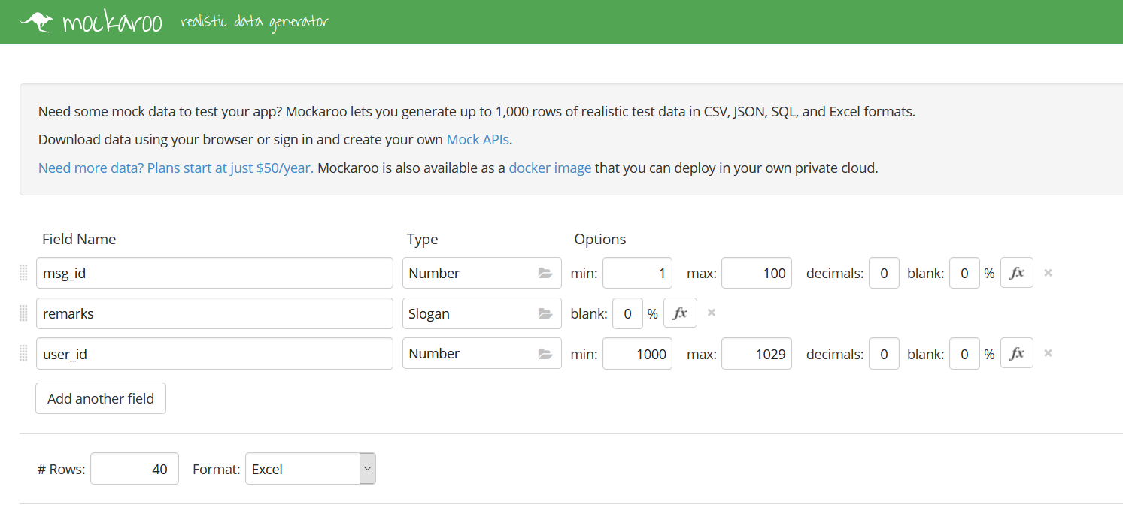
Create random data for tables with Mockaroo
2, Create Database with random data

Slide 7
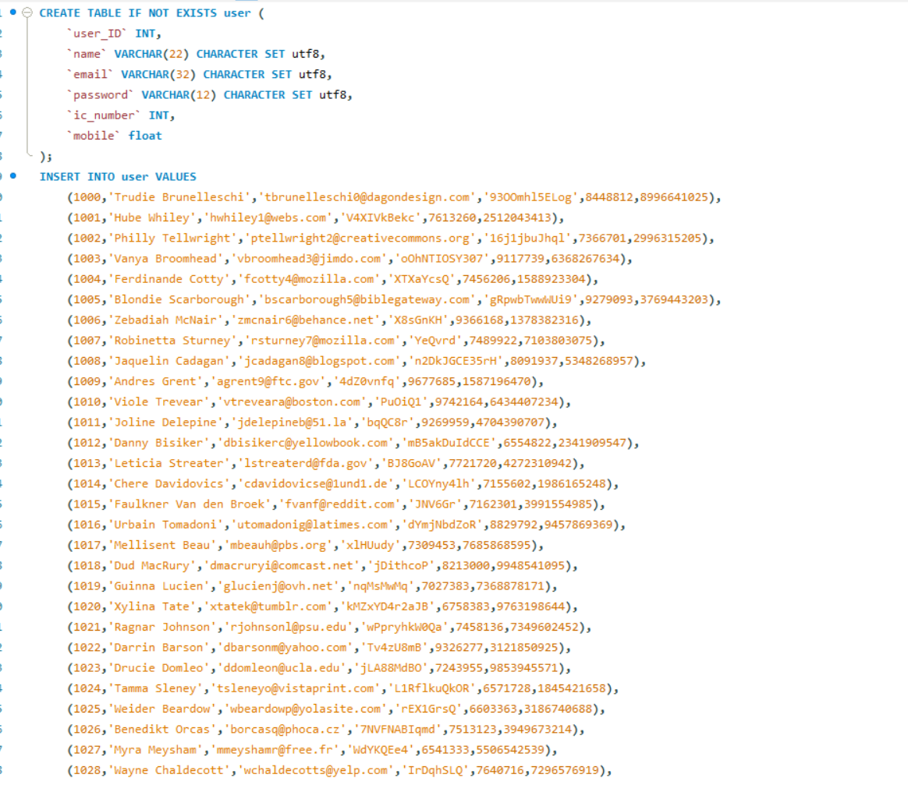
Create all the Tables and insert data into tables for “NUSmoney.sql”
2, Create Database with random data

Slide 8
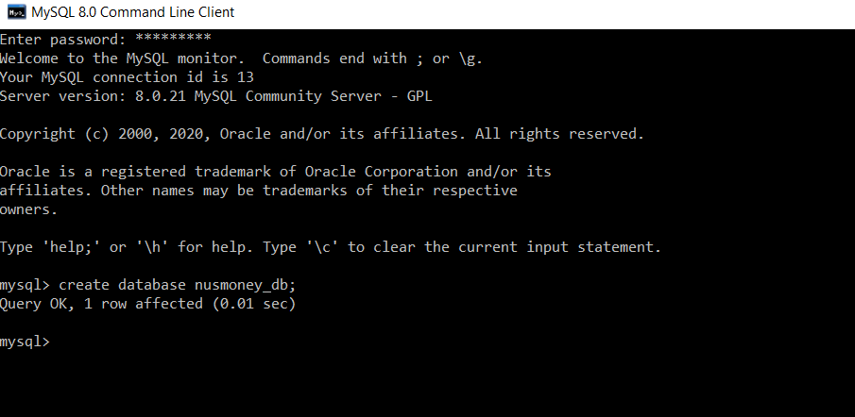
Create database “nusmoney_db”
2, Create Database with random data

Slide 9
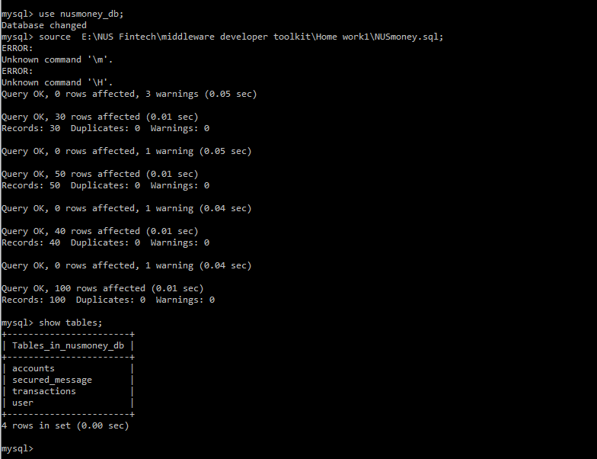
Load data “NUSmoney.sql” into database and show tables
2, Create Database with random data

Slide 10
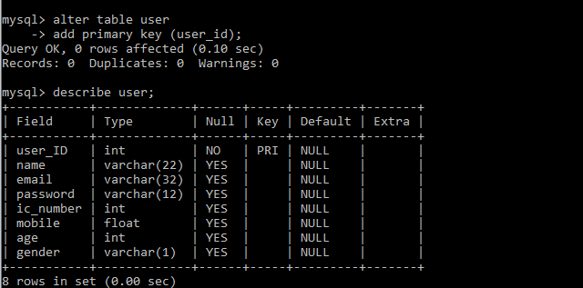
Set “user_id” as primary key for the user table
2, Create Database with random data

Slide 11
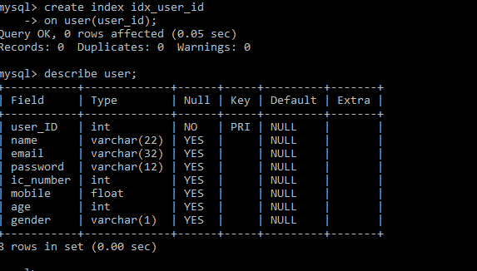
Create Index for “user_id” in user table
2, Create Database with random data

Slide 12
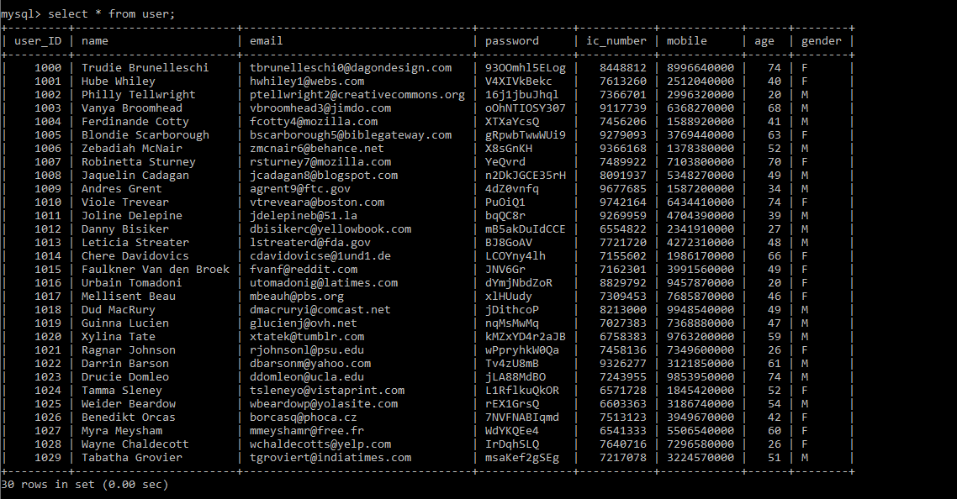
Select * from user; to see all data in user table
2, Create Database with random data

Slide 13
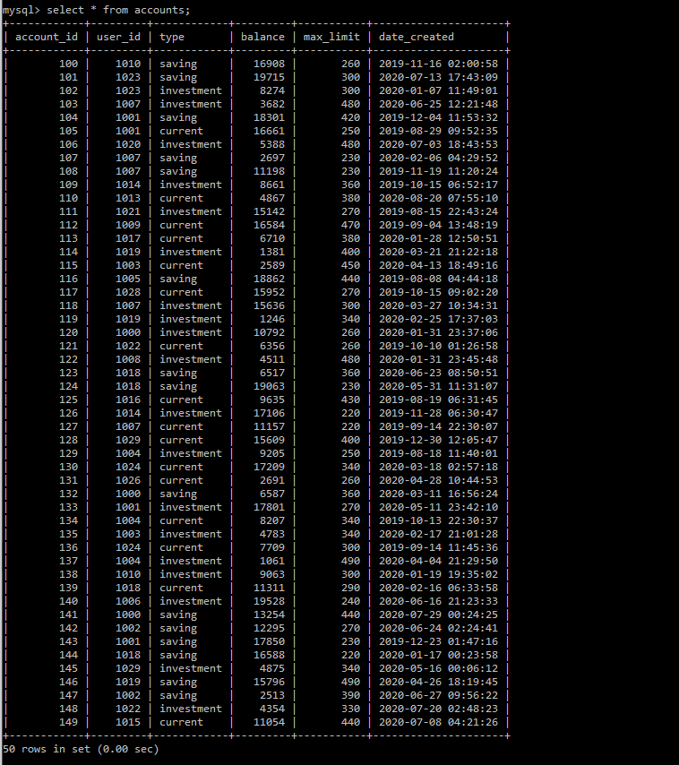
Select * from accounts; to see all data in accounts table
2, Create Database with random data

Slide 14
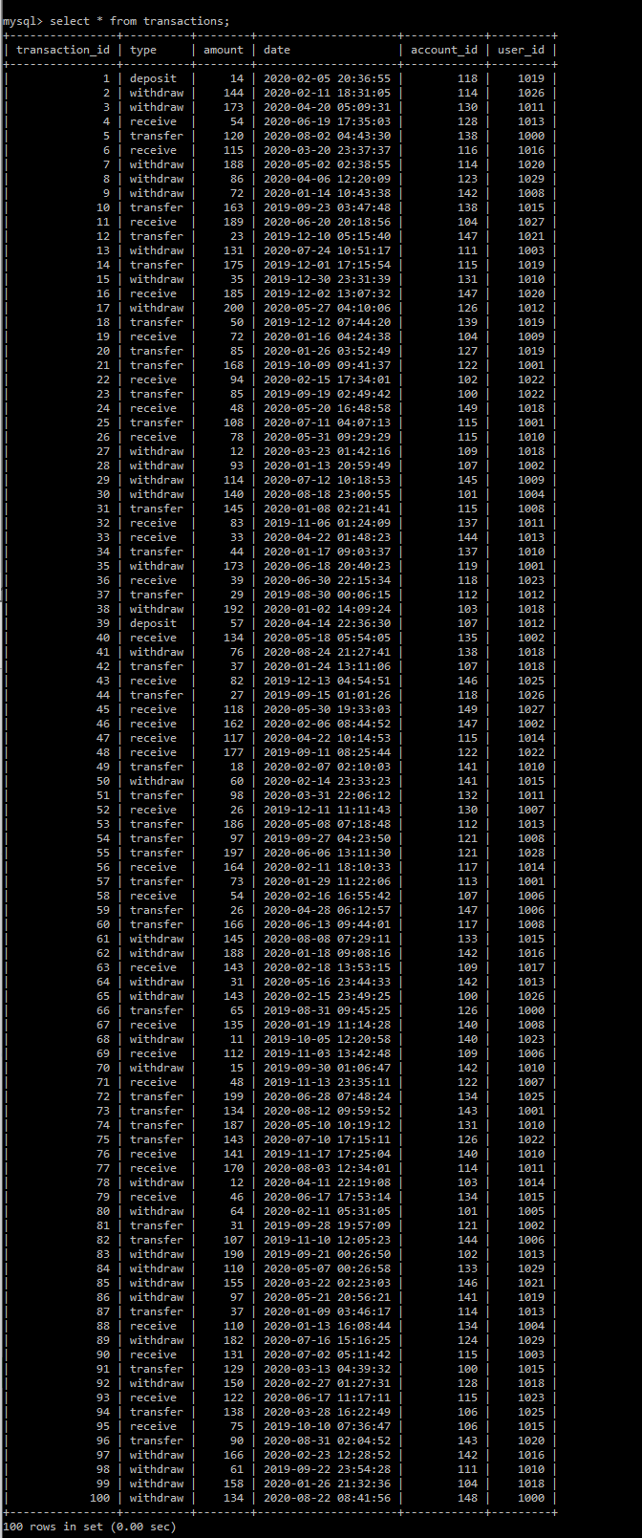
Select * from transactions; to see all data in transactions table
2, Create Database with random data

Slide 15
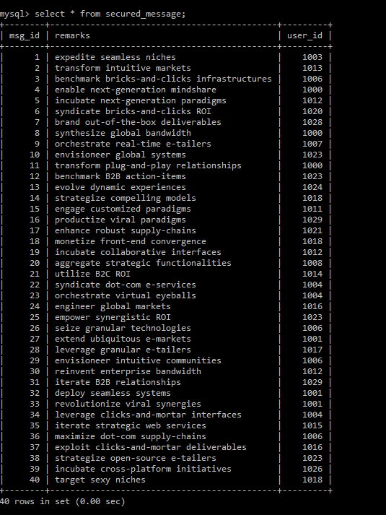
Select * from secured_message; to see all data in secured_message table
2, Create Database with random data

Slide 16
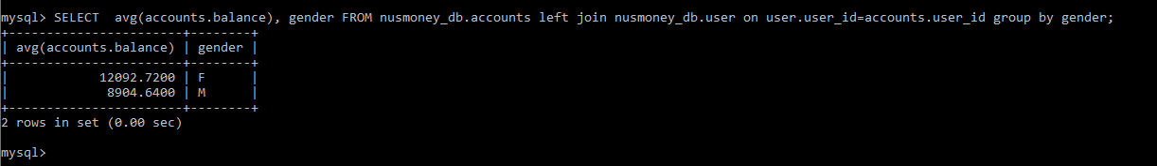
SELECT avg(accounts.balance), gender FROM nusmoney_db.accounts left join nusmoney_db.user on user.user_id=accounts.user_id group by gender;
3, Query the database to find
a. the spending patterns like the average balance for different genders, age
By Gender

Slide 17
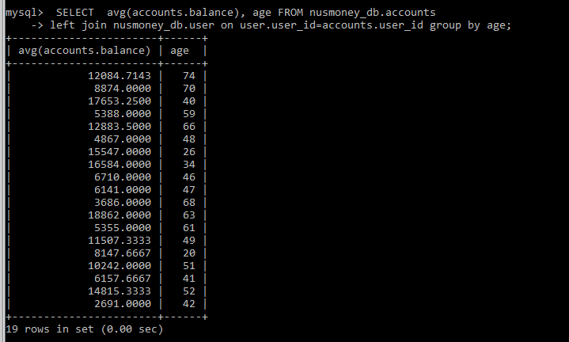
SELECT avg(accounts.balance), age FROM nusmoney_db.accounts left join nusmoney_db.user on user.user_id=accounts.user_id group by age;
3, Query the database to find
a. the spending patterns like the average balance for different genders, age
By age

Slide 18
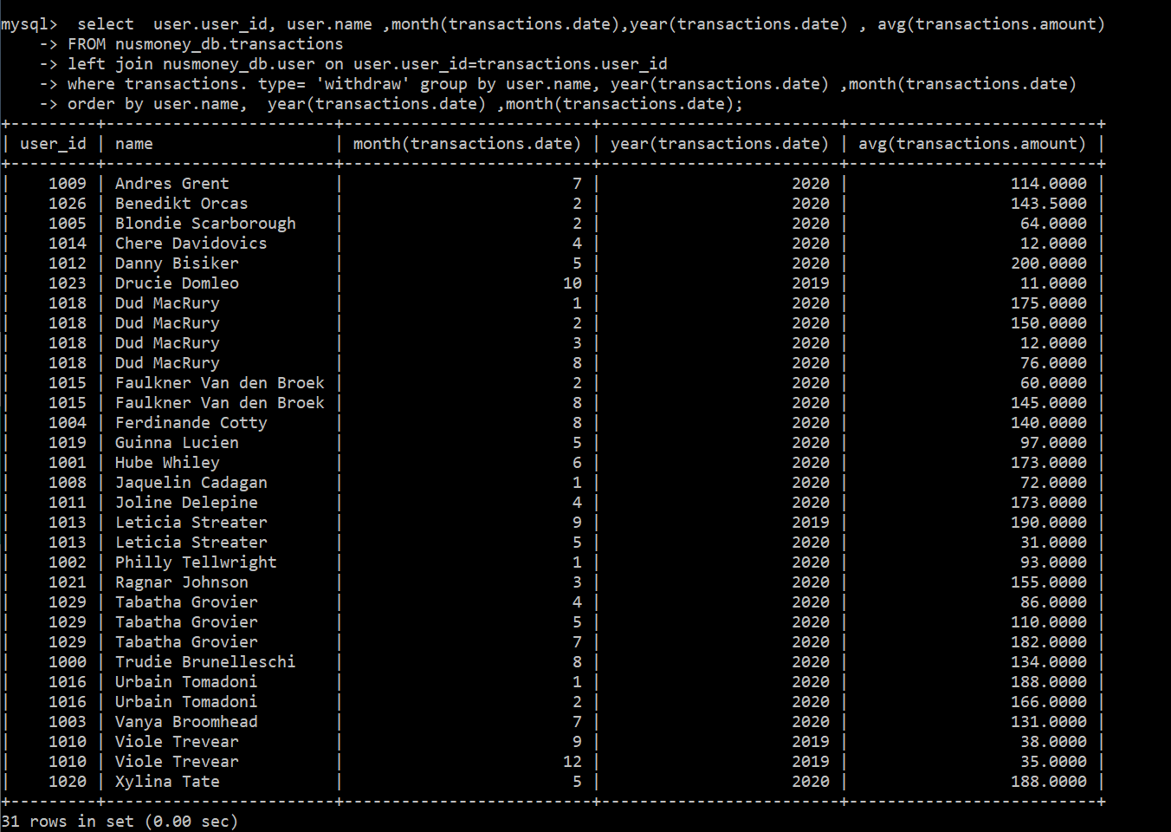
select user.user_id, user.name ,month(transactions.date),year(transactions.date) , avg(transactions.amount) FROM nusmoney_db.transactions left join nusmoney_db.user on user.user_id=transactions.user_id where transactions. type= 'withdraw’ group by user.name, year(transactions.date) ,month(transactions.date) order by user.name, year(transactions.date) ,month(transactions.date);
3, Query the database to find
b. monthly average spending for each user

Slide 19
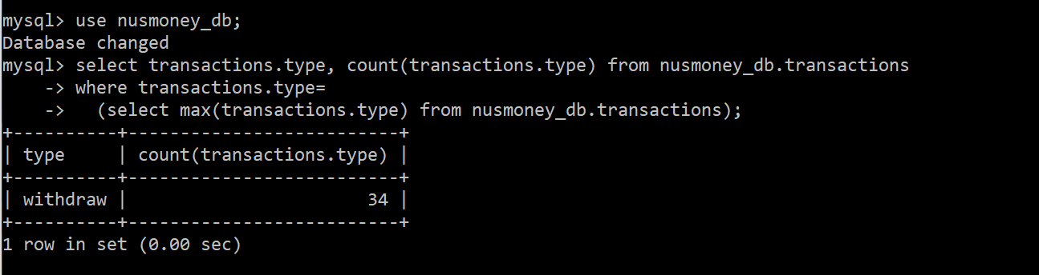
select transactions.type, count(transactions.type) from nusmoney_db.transactions where transactions.type= (select max(transactions.type) from nusmoney_db.transactions);
3, Query the database to find
c. the most frequent transaction type
Version 2 : show only the most frequent type and its count

Slide 20
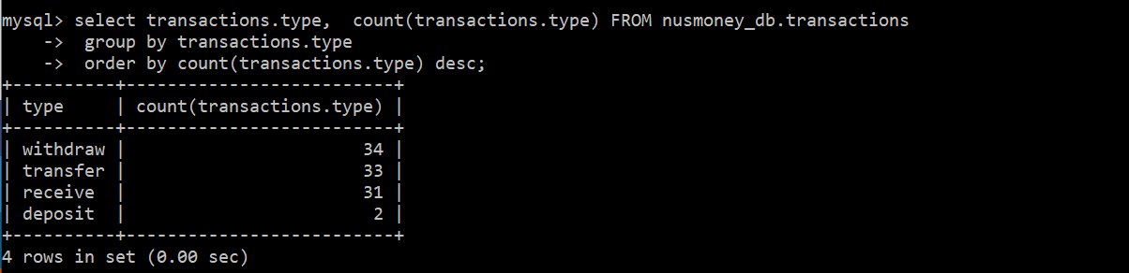
select transactions.type, count(transactions.type) FROM nusmoney_db.transactions group by transactions.type order by count(transactions.type) desc;
3, Query the database to find
c. the most frequent transaction type
Version 2 : show all type and their count in ascending order

Slide 21
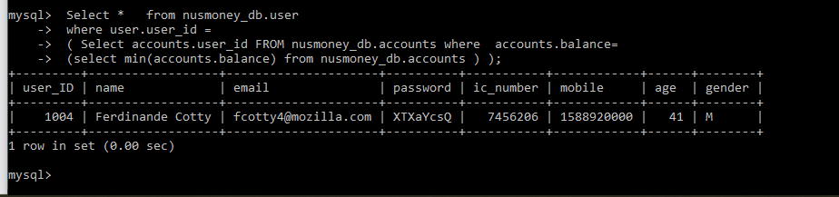
Select * from nusmoney_db.user where user.user_id = ( Select accounts.user_id FROM nusmoney_db.accounts where accounts.balance= (select min(accounts.balance) from nusmoney_db.accounts ) );
3, Query the database to find
d. information of the customers who have the highest and the lowest balance.
Lowest Balance

Slide 22
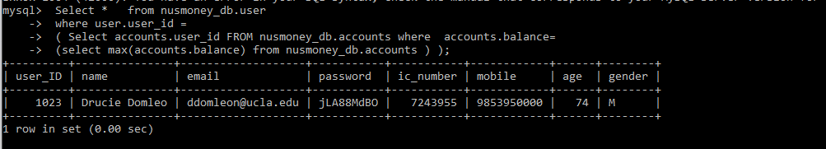
Select * from nusmoney_db.user where user.user_id = ( Select accounts.user_id FROM nusmoney_db.accounts where accounts.balance= (select min(accounts.balance) from nusmoney_db.accounts ) );
3, Query the database to find
d. information of the customers who have the highest and the lowest balance.
Highest Balance

Slide 23
select transactions.user_id, count( transactions.user_id), month(transactions.date),year (transactions.date) , from nusmoney_db.transactions group by (transactions.user_id),month(transactions.date),year (transactions.date) order by year (transactions.date),month(transactions.date), count( transactions.user_id) desc ;
4, View the users who made the most number of transactions (including all transaction types) for each month.

Slide 24
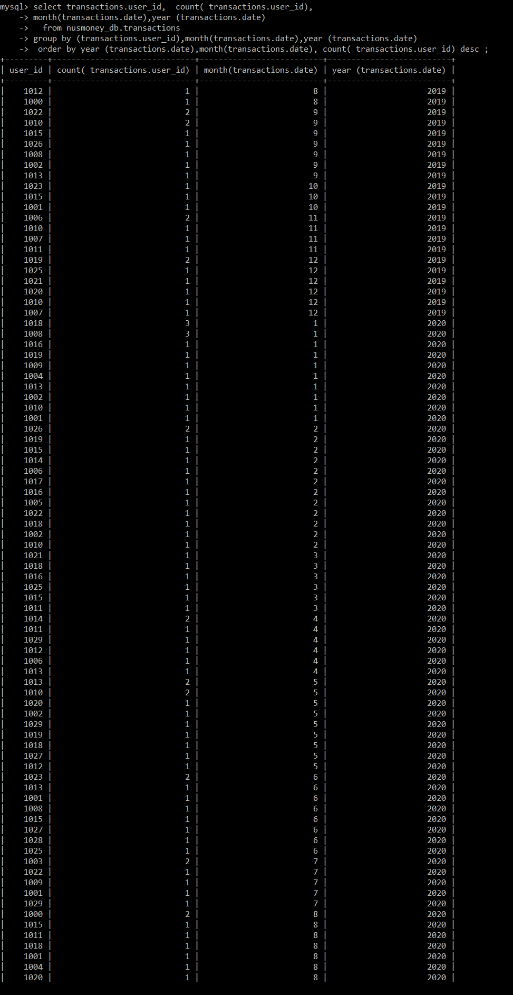
results
4, View the users who made the most number of transactionsfor each month.

