Slide 1














Hatta Project Hatta – Architecture AIP Non-Prod
Universal Feeds
Deploy to Staging Pipeline
Pull artefacts
Azure Subscription AIP Non-Prod
Deploy Notebooks & ETL Package
Virtual Machine Azure DevOps Self Hosted Agent
Shared Workspace
JumpBox Virtual Machine
Virtual Machine Windows Server 2019 Power BI Desktop
Azure
Legend
Azure DevOps
DevOps Pipeline
Artifacts
Git Repo
Resource Group
Azure DevOps
DevOps Pipeline
Artifacts
Git Repo
Log Analytics
Application Insights
Key Vault
Virtual Machine
Databricks Cluster
Data Lake Store
Synapse
Key Vault
Virtual Machine
Databricks Cluster
Data Lake Store

Slide 2



Hatta Project Hatta – Architecture AIP Non-Prod
Universal Feeds
Deploy to Staging Pipeline
Pull artefacts
Azure Subscription AIP Non-Prod
Deploy Notebooks & ETL Package
Virtual Machine Azure DevOps Self Hosted Agent
Shared Workspace
JumpBox Virtual Machine
Virtual Machine Windows Server 2019 Power BI Desktop
Azure
Legend
Azure DevOps
DevOps Pipeline
Artifacts
Git Repo
Network Interface
Resource Group
Azure DevOps
DevOps Pipeline
Artifacts
Git Repo
Log Analytics
Network Security Group
Virtual Network
Application Insights
Key Vault
Virtual Machine
Databricks Cluster
Data Lake Store
Synapse
Key Vault
Virtual Machine
Databricks Cluster
Data Lake Store

Slide 3



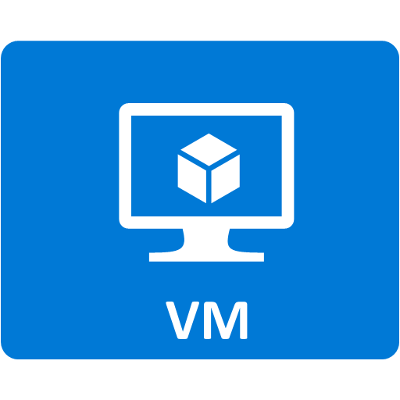









RTMP Ingest Architecture
Azure
Region
Internet
PUBLIC IP
ADDRESS
NGINX RTMP
Capture Live RTMP streams
NIC 10.0.0.1
FFMPEG
Split the RTMP stream into MP4 files
AZ CLI
Scripts and ARM Template GITHUB
Copy the MP4 Files on Azure Storage
CAMERA RTMP stream
Computer FFMPEG RTMP stream
SUBNET 10.0.0.0/24
Azure Storage
Audio/Video
Chunks
Azure Log Analytics
Azure App Insights
Resource Group

Slide 4




Architecture
Azure
Region
Internet
Azure Kubernetes Service
nginx-ingress-default-backend
Azure
Container
Registry
ingest-WebApi-1
http://<IP>:10254/metrics
nginx-ingress-controller-1
ingest-WebApi-2
keda-operator-metrics
Azure Key Vault
NICE Building
PUBLIC IP
ADDRESS
ingest-WebApi-3
nginx-ingress-controller-2
http://<IP>:10254/metrics
keda-operator
http://<IP>:8383/metrics
Source code
ingest-WebApi-N
http://<IP>:9090/metrics
prometheus-server
Prometheus metrics
Azure Active Directory
Azure App Insights
Resource Group

Slide 5
Threat Model: dev-sandbox – Azure DevOps
Azure VNET Boundary
Https Request Publish Python scripts ETL Packages Jupyter Notebook
Azure VNET Boundary
Https Request Publish Python scripts ETL Packages Jupyter Notebook
Azure Databricks Cluster
Azure DevOps
Data Engineer
Https Request Get/Set Data
Https Request Get Python Packages
Azure VNET Boundary
Internet Boundary
Azure Storage
Python Package Repository

Slide 6
Audio/Video Source Server Component
Component environment
Target parameters
COMPONENT Name Description Dependencies
OUTPUT FLOW Name Content
Protocol Target parameters Min Instance = 0 Max Instance >= 1
Storage

Slide 7
Audio/Video Adaptor Server Component
Component environment
Target parameters
COMPONENT Name Description Dependencies
OUTPUT FLOW Name Content
Protocol != Input Protocol Target parameters Min Instance = 0
Max Instance = 1
INPUT FLOW Name
Content Protocol Target parameters
Target parameters

Slide 8
Audio/Video Adaptor Client Component
Component environment
COMPONENT Name Description Dependencies
OUTPUT FLOW Name Content
Protocol != Input Protocol Target parameters Min Instance = 0
Max Instance = 1
INPUT FLOW Name
Content Protocol Target parameters
Target parameters
Target parameters

Slide 9
Audio/Video Splitter Server Component
Component environment
Target parameters
INPUT FLOW Name
Content Protocol Target parameters
COMPONENT Name Description Dependencies
OUTPUT FLOW Name Content
Protocol == Input Protocol Target parameters Min Instance = 0
Max Instance > 1
Target parameters

Slide 10
Audio/Video Renderer Client Component
Component environment
INPUT FLOW Name
Content Protocol Target parameters
COMPONENT Name Description Dependencies
Target parameters
Hardware: Speaker, Screen

Slide 11
Architecture
Azure
Region
Internet
NICE Building
PUBLIC IP
ADDRESS
Source code
prometheus-server
Azure Active Directory
Resource Group

Slide 12
Audio/Video Renderer Server Component
Component environment
INPUT FLOW Name
Content Protocol Target parameters
COMPONENT Name Description Dependencies
Target parameters
Hardware: Speaker, Screen

