Slide 1















Azure
Legend
Azure DevOps
DevOps Pipeline
Artifacts
Git Repo
Network Interface
Resource Group
Azure DevOps
DevOps Pipeline
Artifacts
Git Repo
Log Analytics
Network Security Group
Virtual Network
Application Insights
Key Vault
Virtual Machine
Databricks Cluster
Data Lake Store
Synapse
Key Vault
Virtual Machine
Databricks Cluster
Data Lake Store

Slide 2



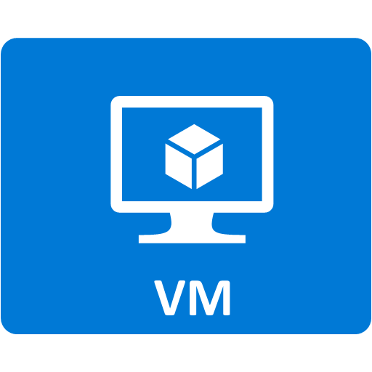









RTMP Ingest Architecture
Azure
Region
Internet
PUBLIC IP
ADDRESS
NGINX RTMP
Capture Live RTMP streams
NIC 10.0.0.1
FFMPEG
Split the RTMP stream into MP4 files
AZ CLI
Scripts and ARM Template GITHUB
Copy the MP4 Files on Azure Storage
CAMERA RTMP stream
Computer FFMPEG RTMP stream
SUBNET 10.0.0.0/24
Azure Storage
Audio/Video
Chunks
Azure Log Analytics
Azure App Insights
Resource Group
Azure

Slide 3




Architecture
Azure
Region
Internet
Azure Kubernetes Service
nginx-ingress-default-backend
Azure
Container
Registry
ingest-WebApi-1
http://<IP>:10254/metrics
nginx-ingress-controller-1
ingest-WebApi-2
keda-operator-metrics
Azure Key Vault
Building
PUBLIC IP
ADDRESS
ingest-WebApi-3
nginx-ingress-controller-2
http://<IP>:10254/metrics
keda-operator
http://<IP>:8383/metrics
Source code
ingest-WebApi-N
http://<IP>:9090/metrics
prometheus-server
Prometheus metrics
Azure Active Directory
Azure App Insights
Resource Group
Azure

Slide 4
Audio/Video Source Server Component
Component environment
Source parameters
COMPONENT Name Description Dependencies
OUTPUT FLOW Name Content
Protocol Source parameters Min Instance = 0 Max Instance >= 1
Storage

Slide 5
Audio/Video Source Client Component
Component environment
COMPONENT Name Description Dependencies
OUTPUT FLOW Name Content
Protocol Target parameters Min Instance = 0 Max Instance >= 1
Target parameters
Storage

Slide 6
Audio/Video Adaptor Server Component
Component environment
Source parameters
COMPONENT Name Description Dependencies
OUTPUT FLOW Name Content
Protocol != Input Protocol Source parameters Min Instance = 0
Max Instance = 1
INPUT FLOW Name
Content Protocol Target parameters
Target parameters

Slide 7
Audio/Video Adaptor Client Component
Component environment
COMPONENT Name Description Dependencies
OUTPUT FLOW Name Content
Protocol != Input Protocol Target parameters Min Instance = 0
Max Instance = 1
INPUT FLOW Name
Content Protocol Target parameters
Target parameters
Target parameters

Slide 8
Audio/Video Splitter Server Component
Component environment
Source parameters
INPUT FLOW Name
Content Protocol Target parameters
COMPONENT Name Description Dependencies
OUTPUT FLOW Name Content
Protocol == Input Protocol Source parameters Min Instance = 0
Max Instance > 1
Target parameters

Slide 9
Audio/Video Splitter Client Component
Component environment
INPUT FLOW Name
Content Protocol Target parameters
COMPONENT Name Description Dependencies
OUTPUT FLOW Name Content
Protocol == Input Protocol Target parameters Min Instance = 0
Max Instance > 1
Target parameters
Target parameters

Slide 10
Audio/Video Renderer Client Component
Component environment
INPUT FLOW Name
Content Protocol Source parameters
COMPONENT Name Description Dependencies
Source parameters
Hardware: Speaker, Screen

Slide 11
Audio/Video Receiver Client Component
Component environment
INPUT FLOW Name
Content Protocol Source parameters
COMPONENT Name Description Dependencies
Source parameters
Storage

Slide 12
Audio/Video RTMP Splitter
Component environment
Source parameters: IP Address TCP Port
INPUT FLOW Name: Live RTMP
Content: Audio/Video Protocol: RTMP Target parameters
COMPONENT Name: RTMP Splitter Description: Support live RTMP feed which can be consumed by several apps/services
OUTPUT FLOW Name: Live RTMP Content: Audio/Video
Protocol: RTMP Source parameters Min Instance = 0
Max Instance > 1
Target parameters: IP Address TCP Port

Slide 13
Audio/Video RTMP HLS Adaptor Server
Component environment
Source parameters: IP Address TCP Port
INPUT FLOW Name: Live RTMP
Content: Audio/Video Protocol: RTMP Target parameters
COMPONENT Name: RTMP Splitter Description: Support live RTMP feed converted into HLS stream
OUTPUT FLOW Name: Live HLS Content: Audio/Video
Protocol: HLS Source parameters
Target parameters: IP Address TCP Port

Slide 14
Audio/Video RTMP RTSP Adaptor Server
Component environment
Source parameters: IP Address TCP Port
INPUT FLOW Name: Live RTMP
Content: Audio/Video Protocol: RTMP Target parameters
COMPONENT Name: RTMP Splitter Description: Support live RTMP feed converted into RTSP stream
OUTPUT FLOW Name: Live RTSP Content: Audio/Video
Protocol: RTSP Source parameters
Target parameters: IP Address TCP Port

Slide 15
MP4 RTMP Source Server Component
Component environment
Source parameters: IP Address TCP Port
COMPONENT Name: MP4 RTMP Source Description: Create live RTMP feed from MP4 file
OUTPUT FLOW Name: Live RTMP Content: Audio/Video
Protocol: RTMP Source parameters Min Instance = 0 Max Instance >= 1
MP4 file

Slide 16
RTMP MP4 Receiver Client Component
Component environment
INPUT FLOW Name: Live RTMP
Content: Audio/Video Protocol: RTMP Source parameters
COMPONENT Name: RTMP MP4 Receiver Description: Capture live RTMP feed and convert it into MP4 files
Source parameters: IP Address TCP Port
Azure Storage

Slide 17
Architecture
Azure
Region
Internet
Building
PUBLIC IP
ADDRESS
Source code
Container
Azure Active Directory
Resource Group

Slide 18
Audio/Video Renderer Server Component
Component environment
INPUT FLOW Name
Content Protocol Target parameters
COMPONENT Name Description Dependencies
Target parameters
Hardware: Speaker, Screen

