Slide 1

Augment the Study
-Finding our lower bound-
Has to be:
Lower Bound cost ≤ Optimal cost ≤ Approx cost
It is important because it provides a baseline so we know how close our approximation is to our optimal
Poly time
Exp time
Poly time
Approximation Solution
Optimal Solution
Lower bound

Slide 2

How to get our lower bound – 1 tree bound
Step 1 - pick a root
Step 2 - build an MST with on all nodes except the root
Step 3 - add the two cheapest edges incident to the root
Runtime O(n² log n)

Slide 3
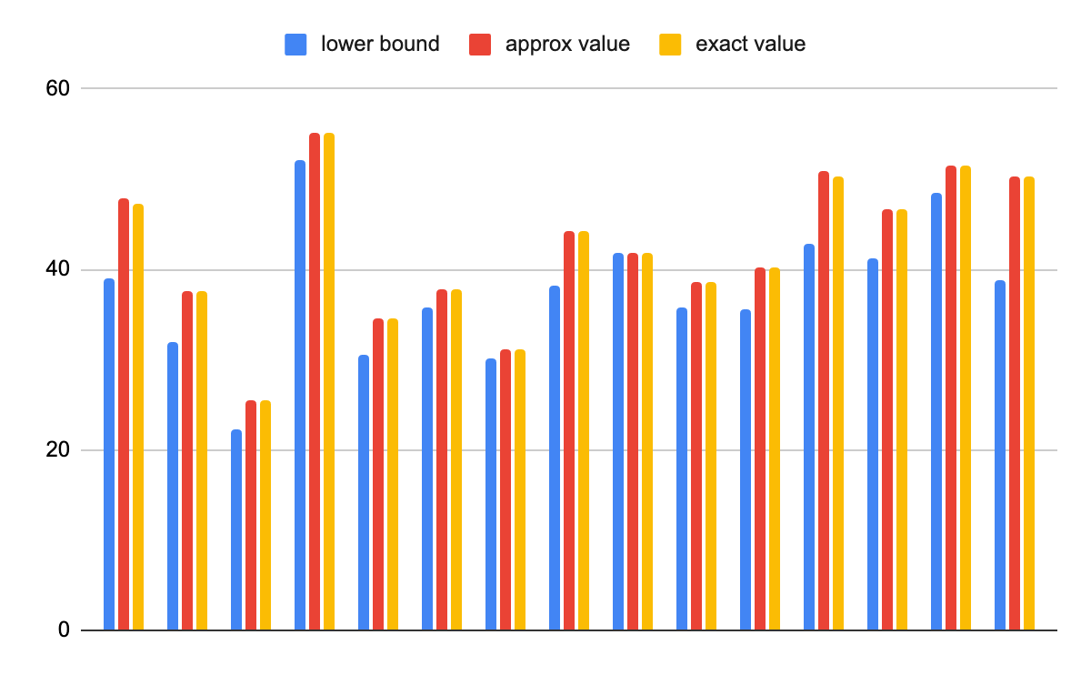
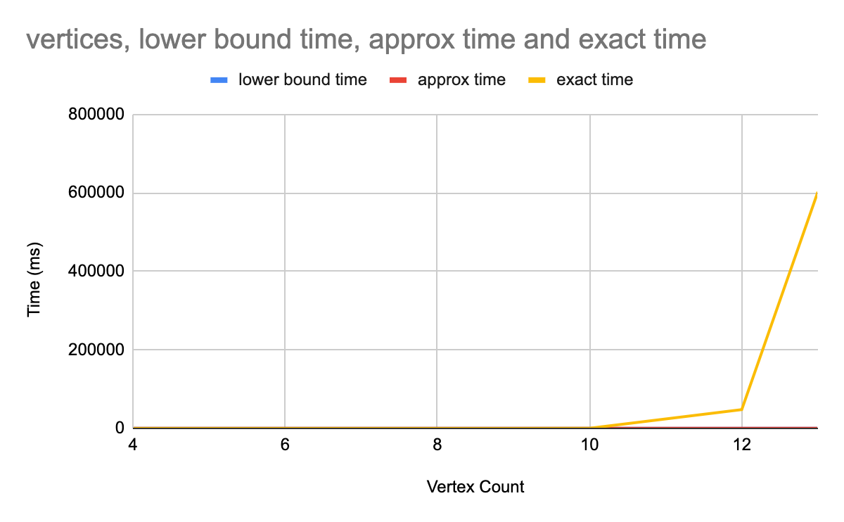
Comparing - lower bound / approx / exact-

Slide 4
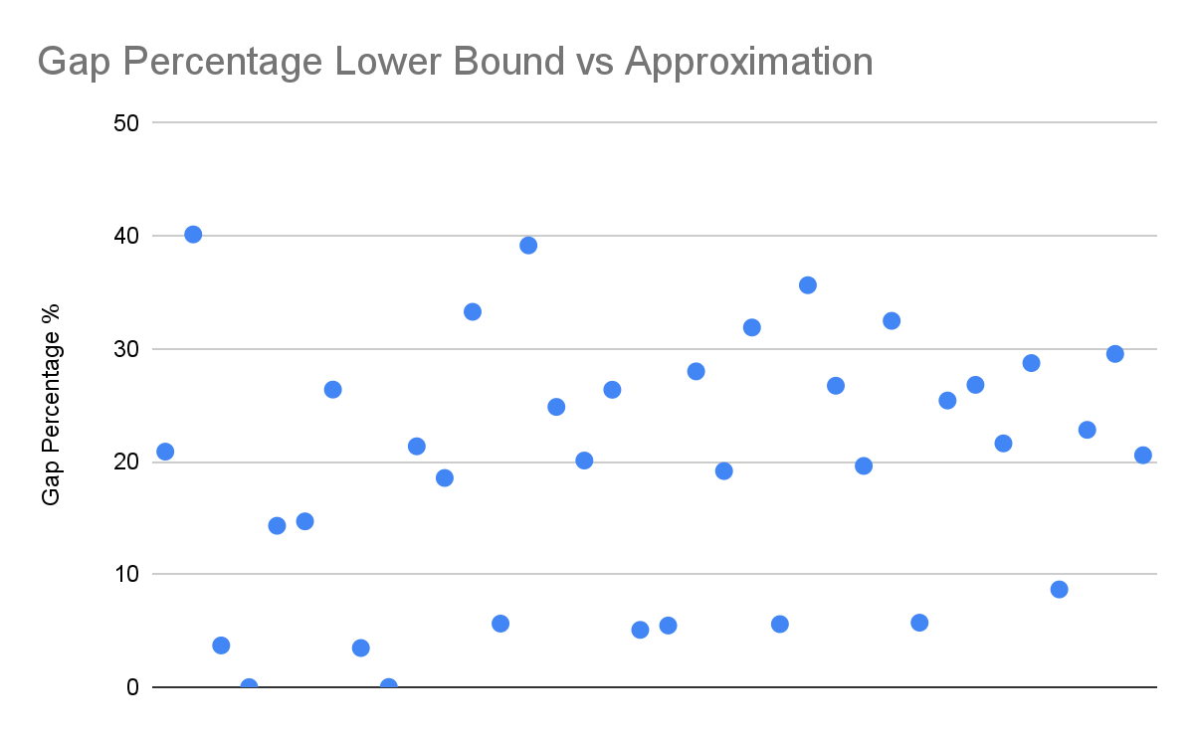

Comparing values - Gap Percentage
= (approx - lower) / lower
The average:
19.9%

Slide 5

What does this mean?

Slide 6


Thank you

