Slide 1




The uhh…. Traveling Salesmanperson Problem???
John Henry Adams, Dylan Dao, Harry Williams

Slide 2
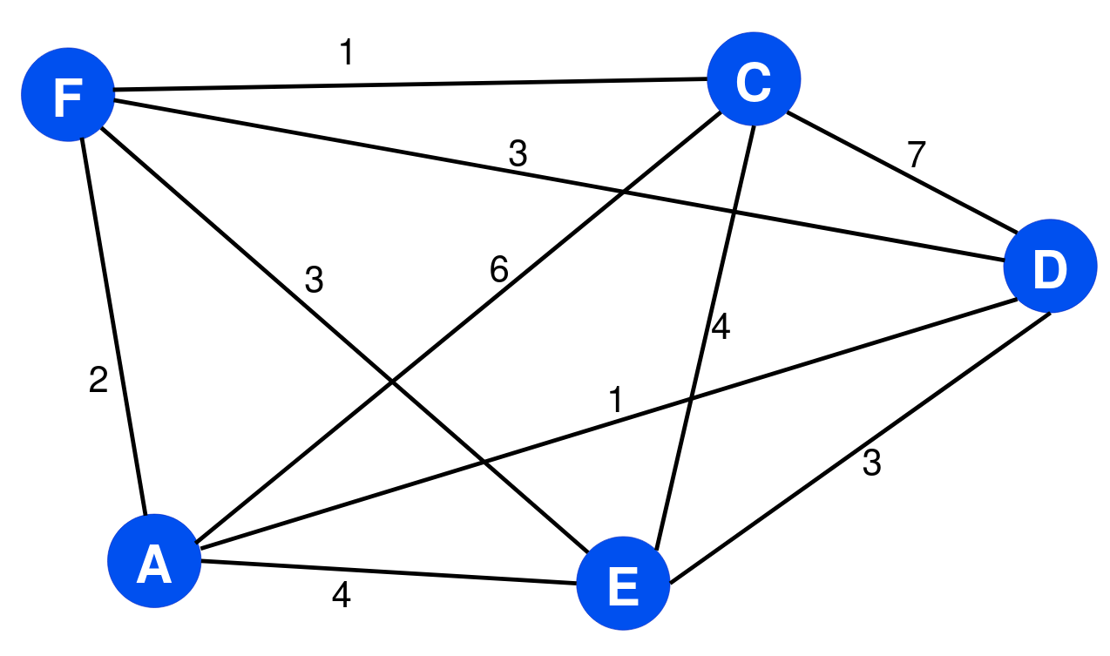
What is the Traveling Salesman Problem?
Optimal:
Complete, weighted graph
Visit every vertex once, except start
Find least cost path

Slide 3

Optimal vs Decision
Optimal:
Decision:
Visit every vertex once, except start
Find a tour that visits each city exactly once, total cost ≤ k
Find least cost path
returns a yes or no answer to this
F→C→E→D→A→F
Cost: 11

Slide 4
Certifier Process
A certificate is just a given tour, e.g.:
Tour: F→C→E→D→A→F
Verifier checks:
Does the tour visit every city once?
Does it return to the starting city?
Is the total weight ≤ k?
This takes O(n) time → polynomial.

Slide 5
Certifier Process
create array seen[1..n] initialized to false
total = 0
for i = 1 to n-1:
u = tour[i]
v = tour[i+1]
if no edge (u,v) exists:
return REJECT
total = total + w(u,v)
if no edge (tour[n], tour[1]) exists:
return REJECT
total = total + w(tour[n], tour[1])
n-constant time steps:
perform one weight lookup for each of the n edges
perform one addition per edge
all constant-time operations for n
T(n) = n ⋅ O(1) = O(n)

Slide 6
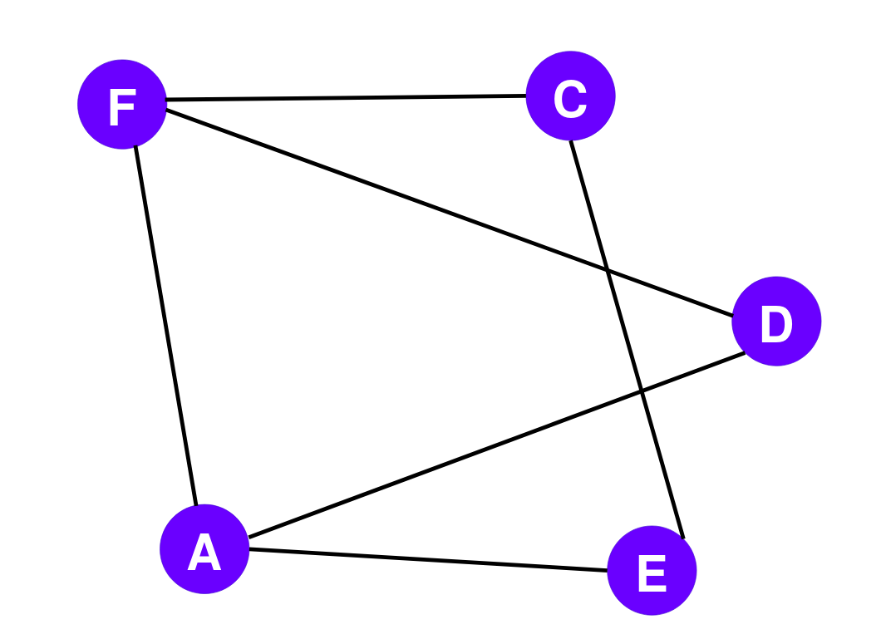
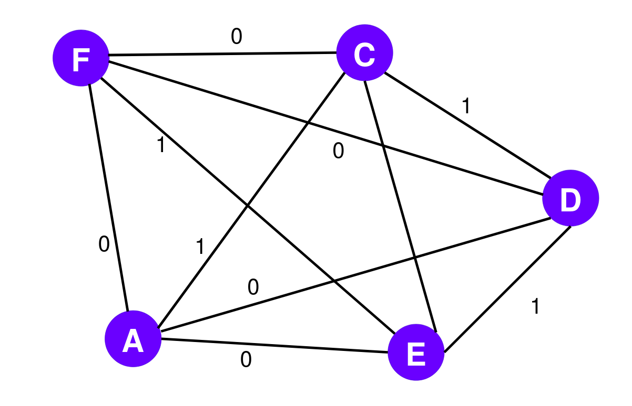
Reduction
Hamiltonian Cycle
Traveling Salesman Problem

Slide 7
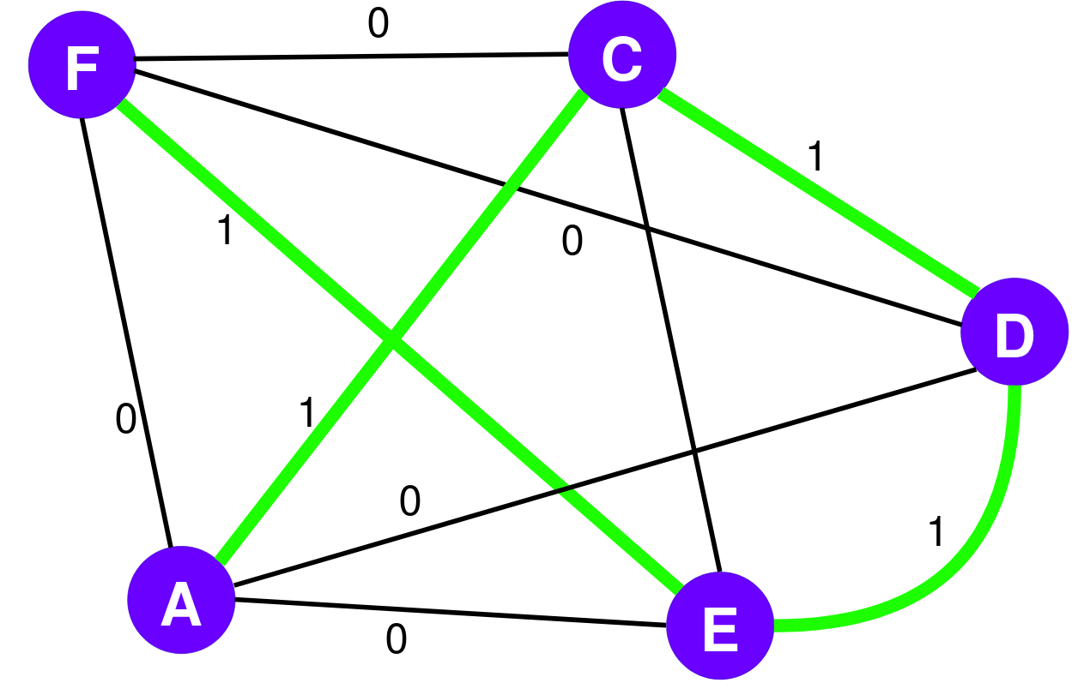

Reduction
Let G′ be a new graph with edges between all pairs of vertices
Edges present in G assigned weight 0, new edges in G′ assigned weight 1
Constructed in polynomial time

Slide 8
Reduction
Graph G has HC if cycle in G′ passes through all vertices once, and has length of 0
Cycle contains only edges originally present in graph G
If HC in G, it forms cycle in G′ with length of 0.
Solution exists for TSP in G′ with length of 0

Slide 9
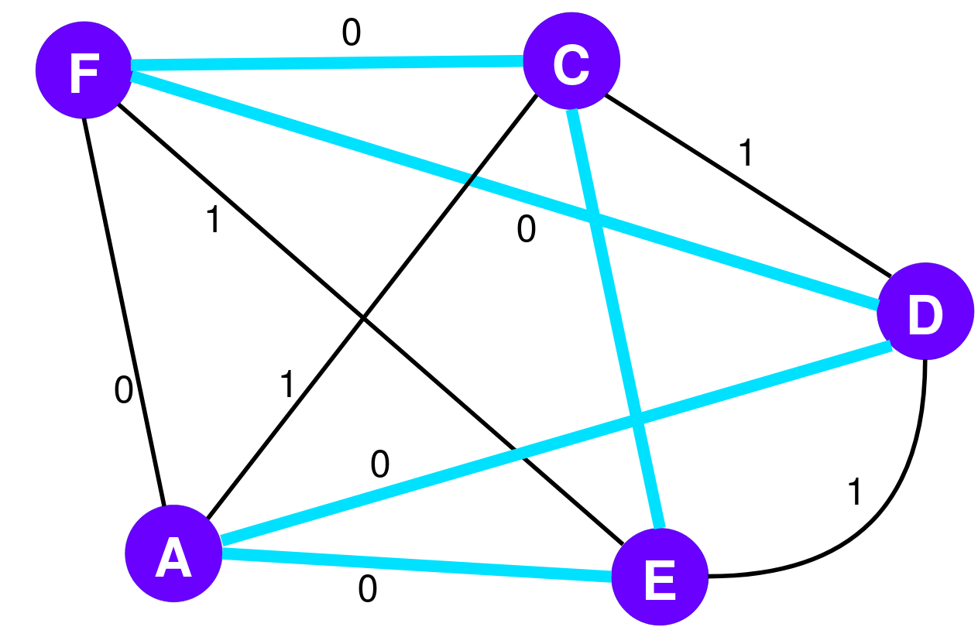
Reduction
G′ has cycle passing through all vertices once with length of 0. This is a Hamiltonian Cycle in G.

Slide 10

Analytical Runtime
Using a brute-force algorithm for TSP, every possible tour of the cities is examined:
Dominant term:
for perm in itertools.permutations(range(1, n)) producing (n - 1)! tours
cost = sum(dist[tour[i]][tour[i + 1] for i in range(n)) is O(n) for every tour
Algorithm complexity: O(n!) factorial time, dominates everything

Slide 11
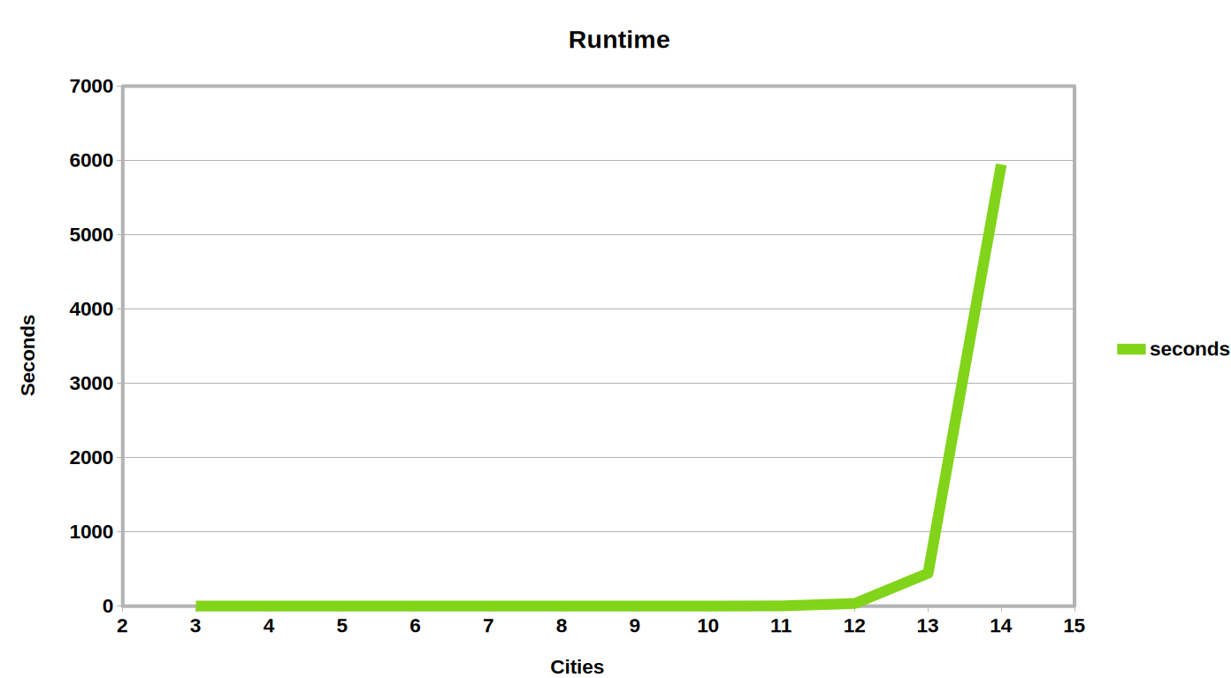

Wallclock Runtime

Slide 12
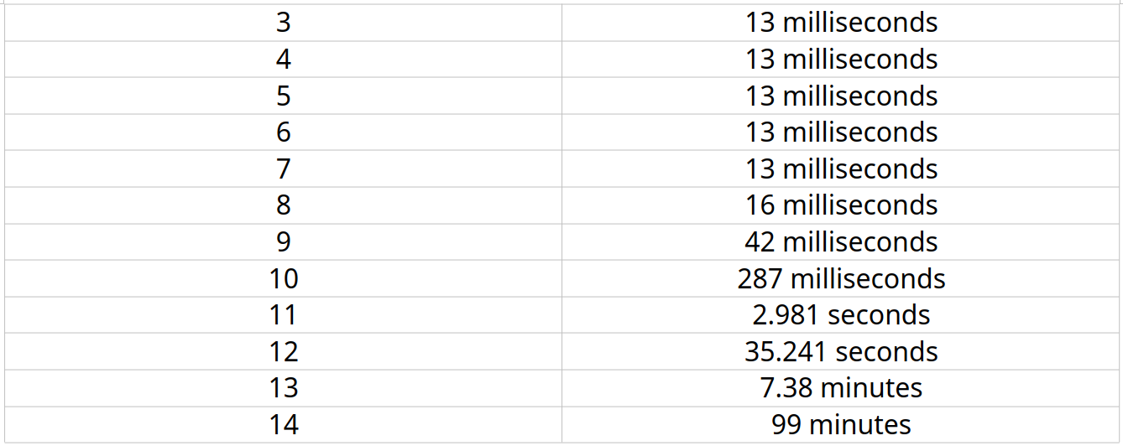
Wallclock Runtime
Input Size
Runtime

