Slide 1

Approximation Solution

Slide 2



Strategy
Greedy Anytime 2-opt
With Restarts

Slide 3
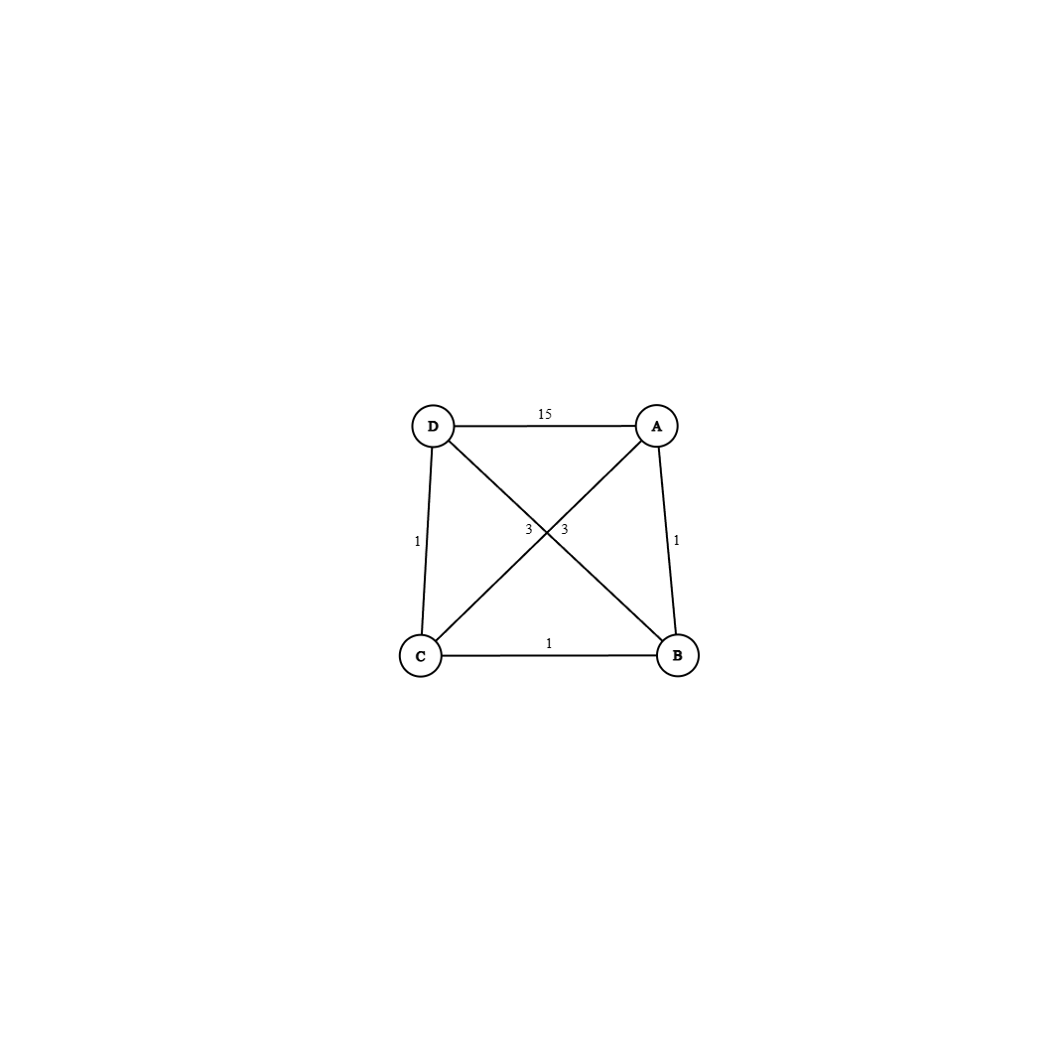
Greedy
Iteratively selects nearest unvisited neighbor
Connects back to starting node
Produces quick but (usually) nonoptimal solutions

Slide 4
Where It Can Go Wrong
Shortsighted Greediness

Slide 5
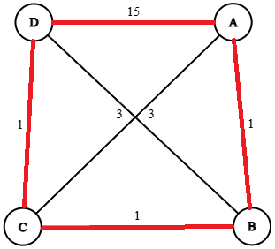
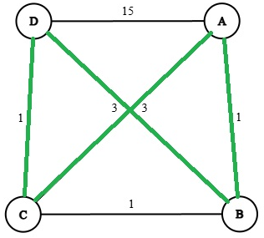


Bad Cycle
Correct Cycle

Slide 6
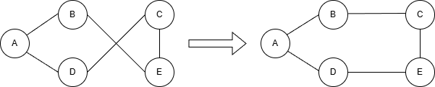
2-Opt
Uses constructed greedy tour
Looks for pairs of edges that, if swapped, shorten the path
Reverses that path segment
Continues until no improvements

Slide 7
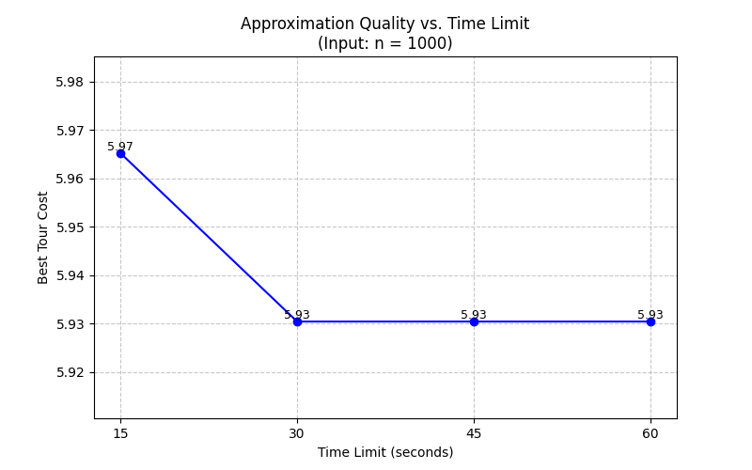
Anytime with Restarts

Slide 8



Approximation Strategy
Constructs Initial tour using Nearest Neighbor
Refines tour using 2-Opt
Repeats process with Random Start Nodes
approx(graph, deadline):
best = NULL
while time < deadline:
tour = greedy(random start node)
tour = 2-opt(tour)
if current path is shorter:
update best
return best

Slide 9


Analytical Runtime Analysis
Greedy: O(n²)
2-Opt: O(n²)
Total Complexity - O(n²)

Slide 10

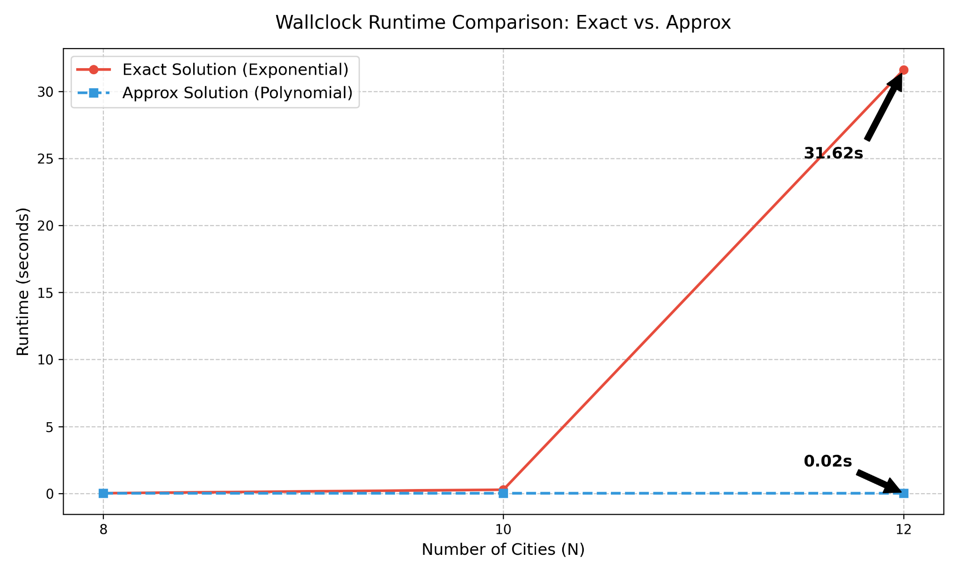
Approximate vs Exact
Wallclock Runtime Comparison: Exact vs. Approx

Slide 11
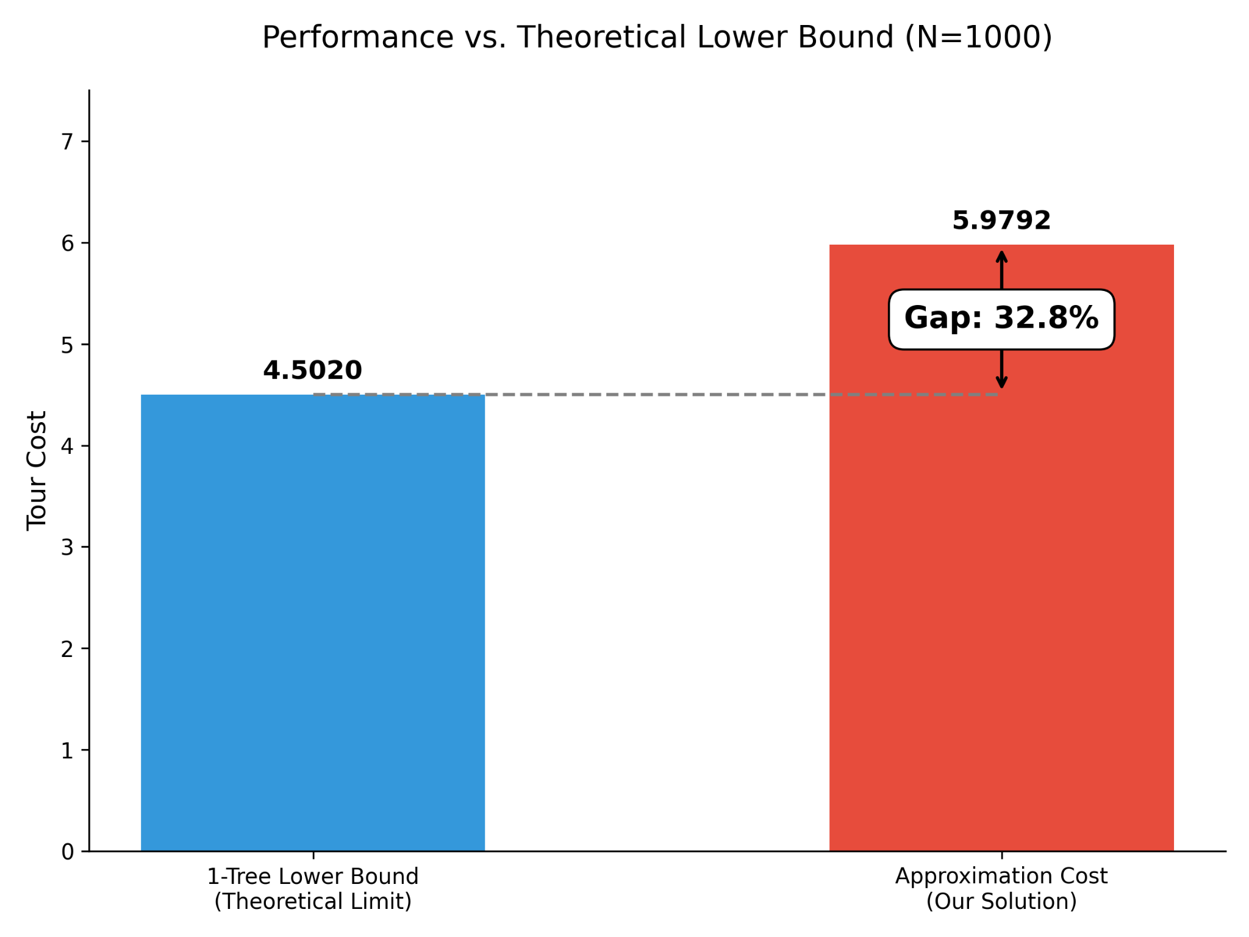
Lower Bound

