Slide 1
Research Question
How is resting blood pressure affected by cholesterol levels, and does this effect differ by Age and Sex?

Slide 2
Description of the Data
We took a dataset that had 918 observations measuring a range of factors for blood pressure including Cholesterol, and personal information such as Age and Sex.
Out of these 918 observations, there were 172 observations for Cholesterol missing which were cleaned using awk in the shell script and the cleaned dataset was stored.

Slide 3
Modelling of the Data
We first did some data exploration using the shiny app.
Then 2 and 1 term fractional polynomial models were attempted for the relationship between Cholesterol and Resting Blood pressure but found to be insignificant compared to the linear model.
We therefore plotted stratified linear models first by Sex and then by Age.

Slide 4
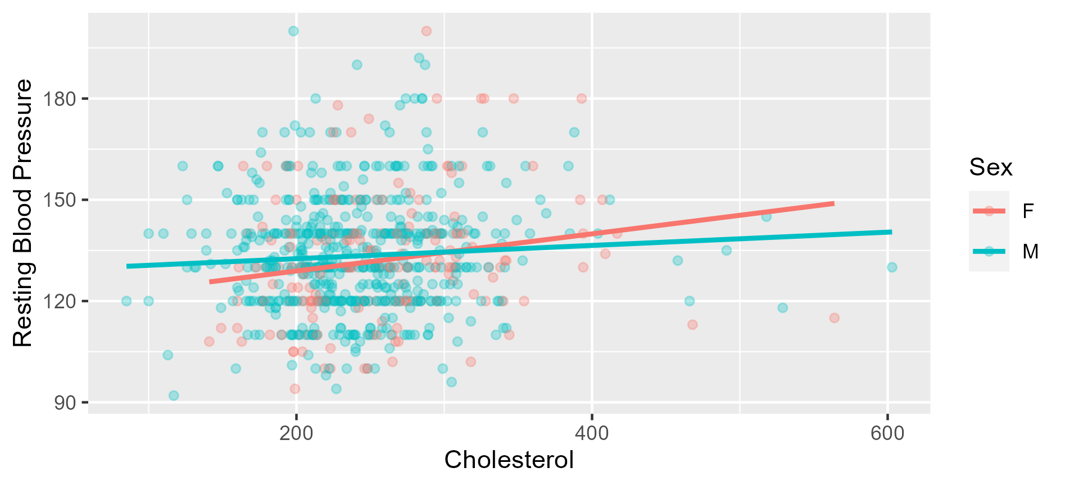

Slide 5
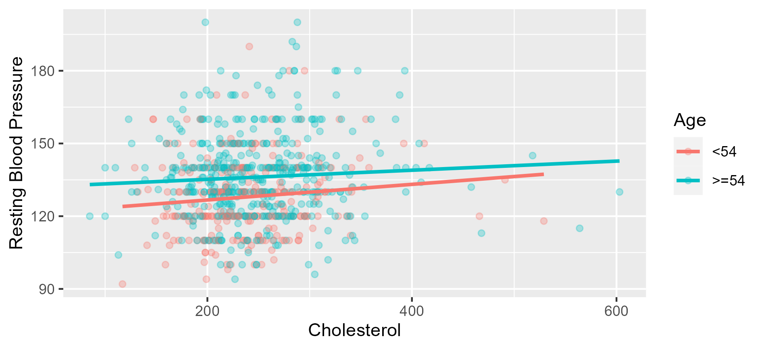

Slide 6
Results

