Slide 2
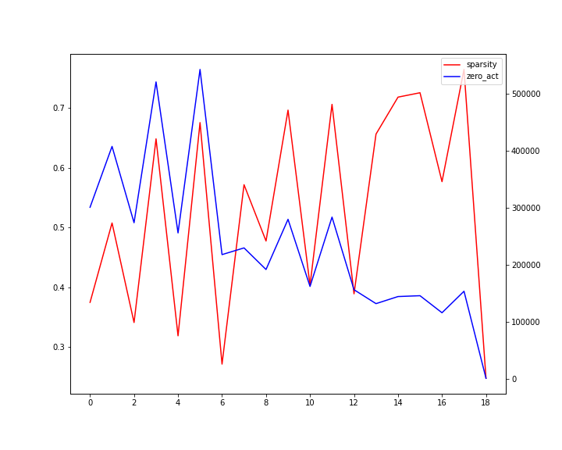
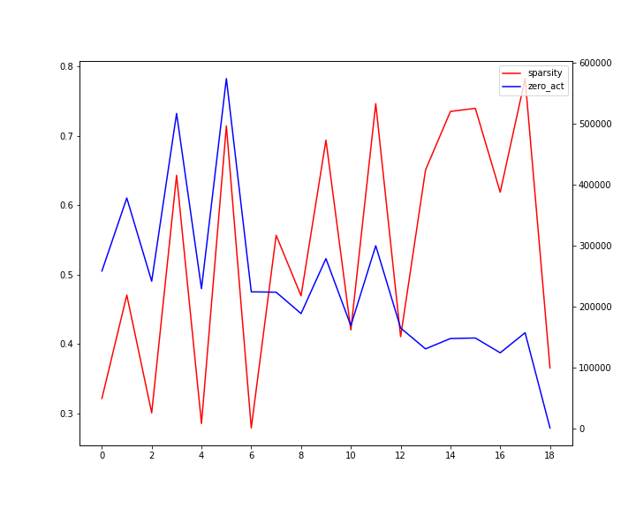
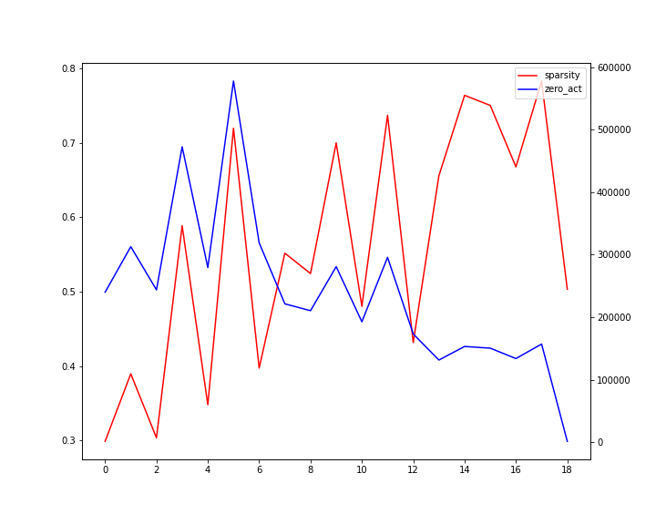
Activation distribution under different training weight noise
Weight noise : 0 %
Weight noise : 10 %
Weight noise : 20 %
Residual network decrease activation sparsity
Weight noise injection during training seems to increase activation sparsity

Slide 3
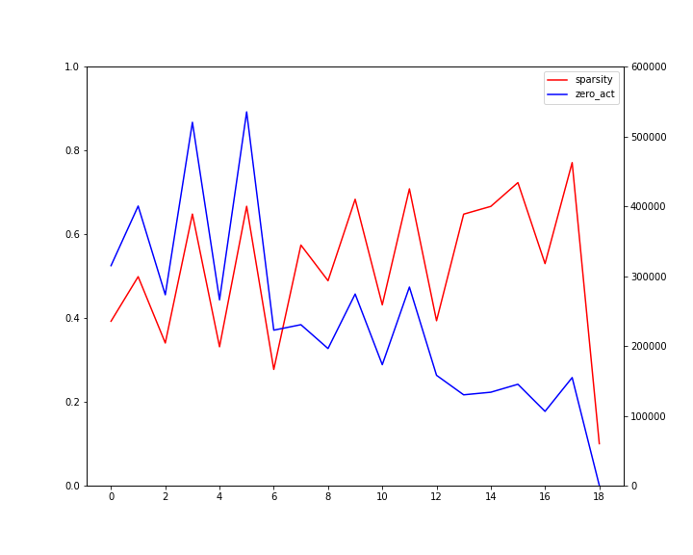
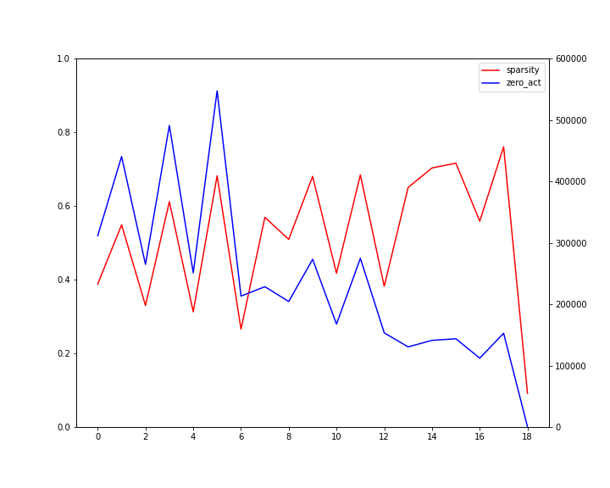
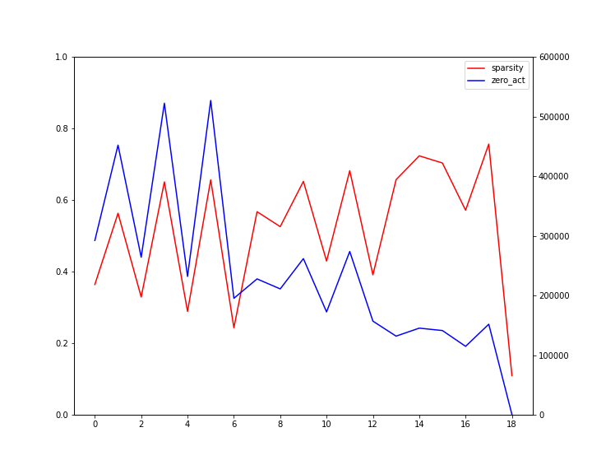
Activation distribution under different initial bias magnitude
init bias = 0
init bias = -0.1
init bias = -0.5

