Slide 1
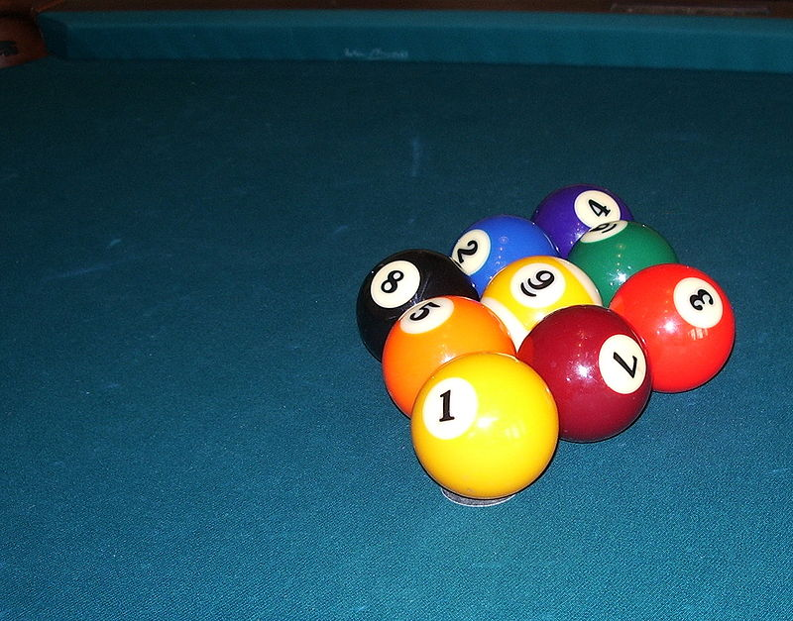
OpenCV Project Introduction
Group: CV_Master
Group Member:
Hang Jiang, ?
Xiao Wang, z3480870
Tracking Pool Ball Game…

Slide 2
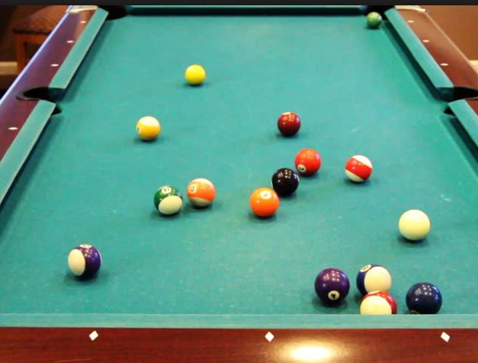
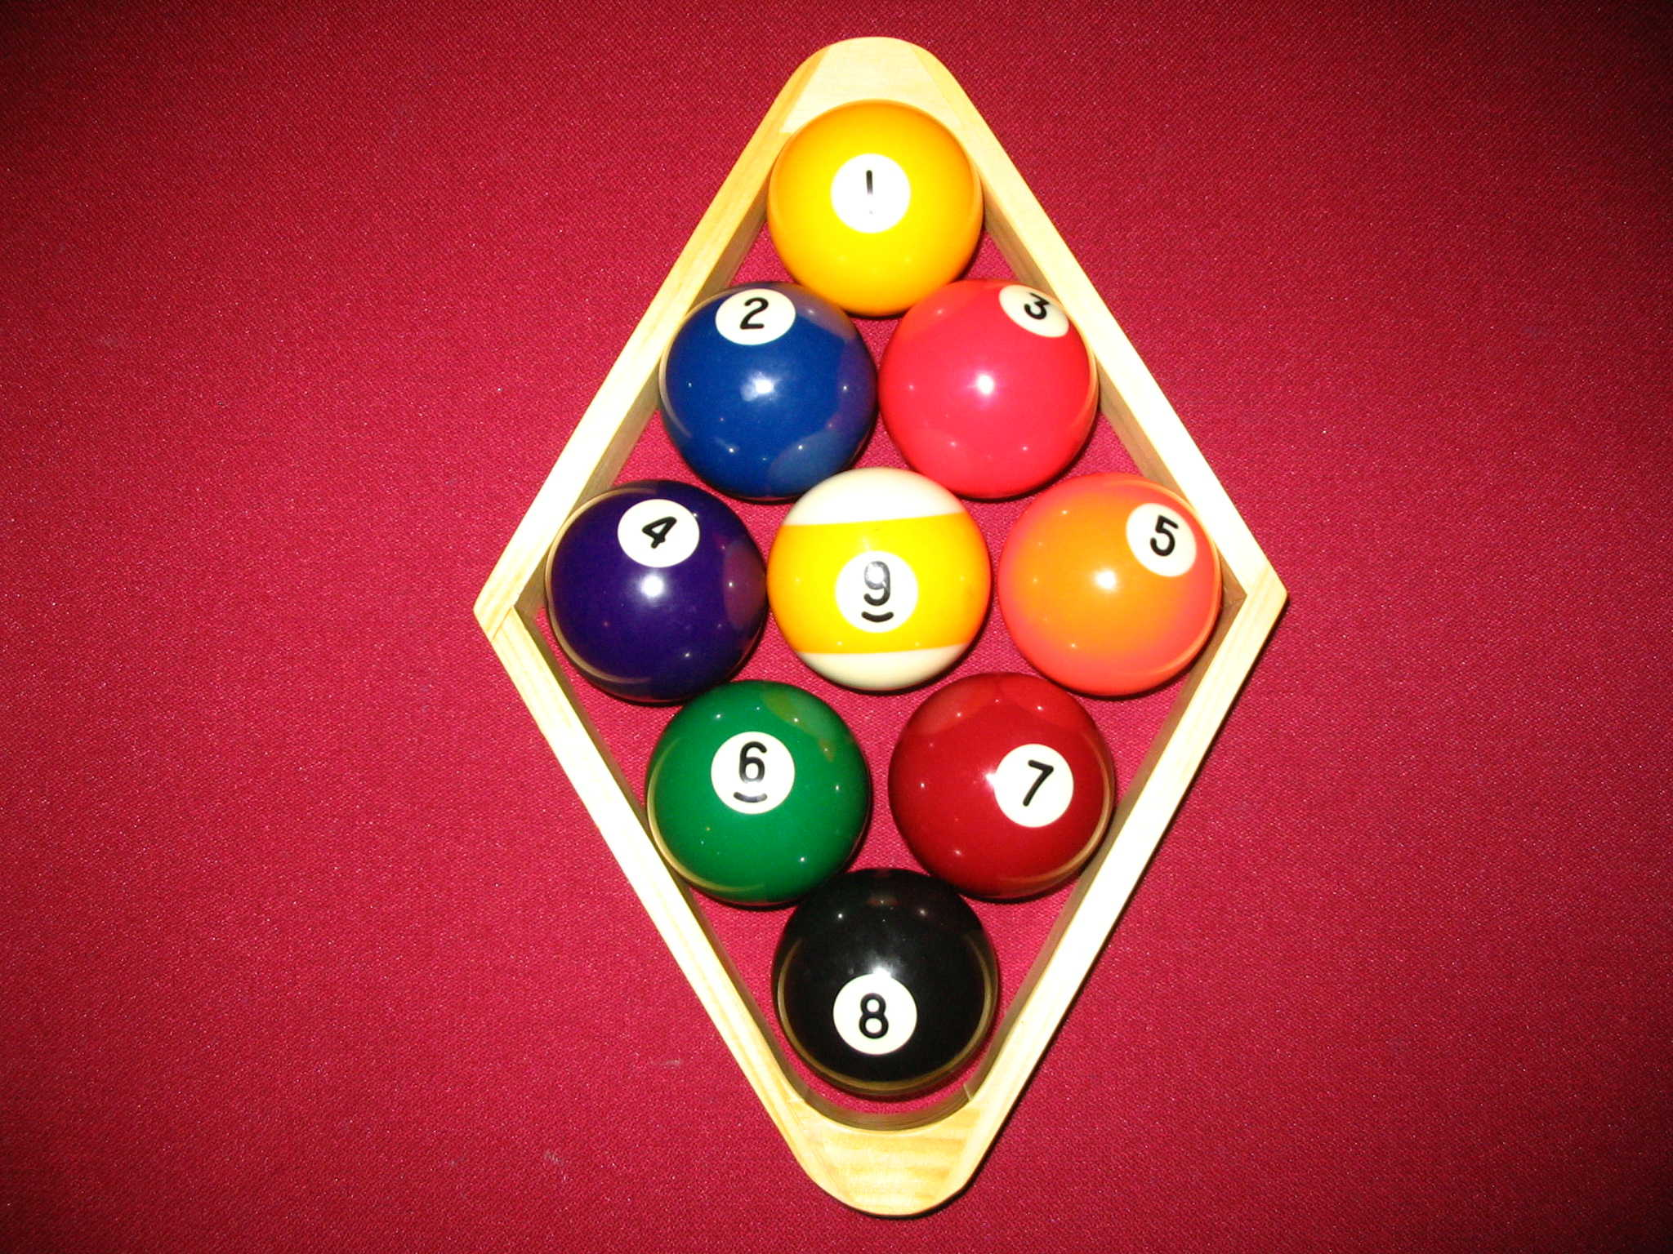
Background Introduction
We love pool game.
Pool Ball Game is a suitable context for computer vision.
The objects: table/ball/pocket
They have some typical features, both regard of shape and color.

Slide 3
Our Goal!
Real-time track of different number of balls in the video.
Project and record the real game to 2D animation board. – used for further purpose.
Game analysis,
Game process record,
Training,
Automatic Scoring

Slide 4
Problem Analysis
1. Detect the pool table in the video. We need to identify the pool table area, especially some key points such as 4 corner and maybe pockets.
2. Match pool table points in the video to the 2D animation board. This will help us to find the homography – it will be used in the projection and animation.
3. Detect & identify balls. Our application need to detect all balls and tell exactly which number the balls are
4. Tracking the ball in the real-time video.
5. Project balls to animation board

Slide 5
Pool table detection
Pool table detection: find the key points (4 Corner!! Pocket!!) → find Homography to 2D animation board → store the parameters
How?
First try: SURF/SHIFT Match. Result is not good!
Now: Color Contours (opencv: color inrange mask function)→ Convex Hull → Hough Transform

Slide 6
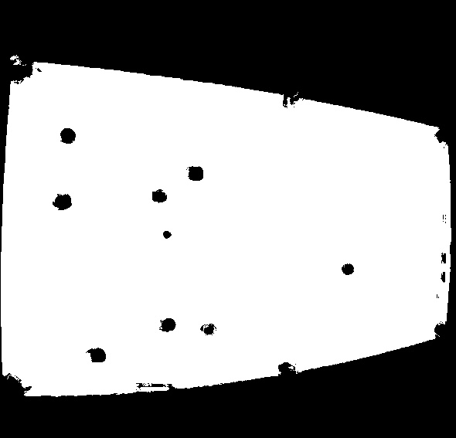
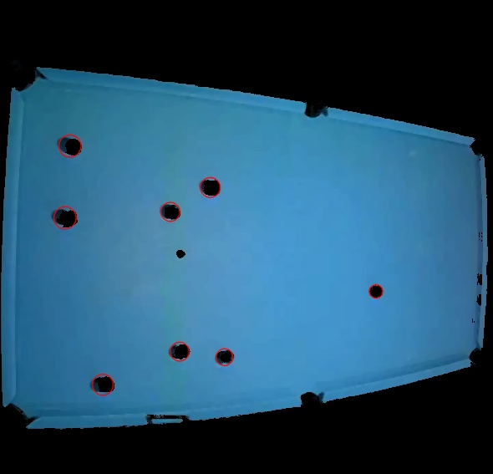
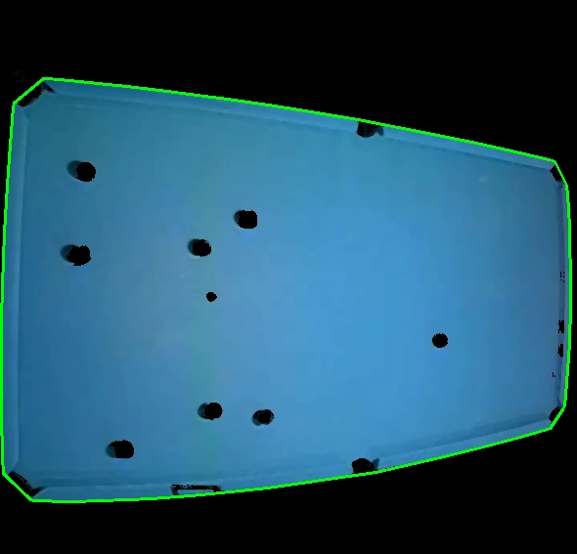

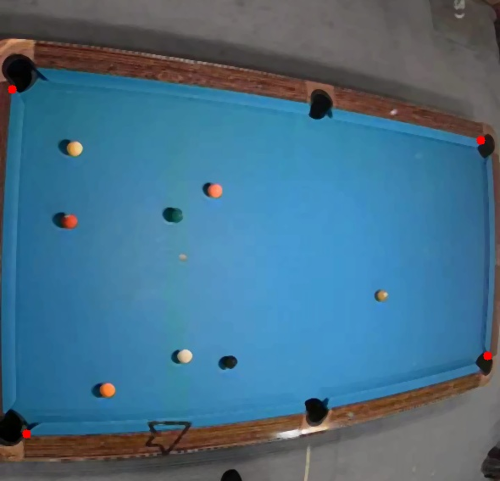
Pool table detection

Slide 7
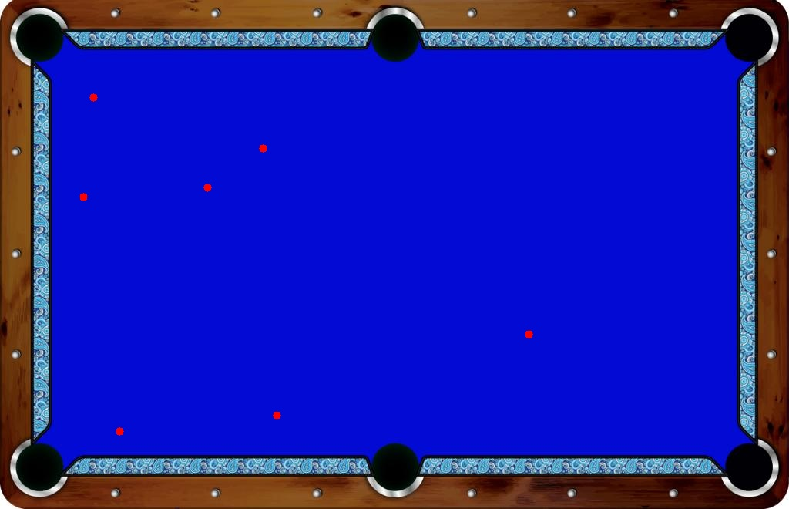
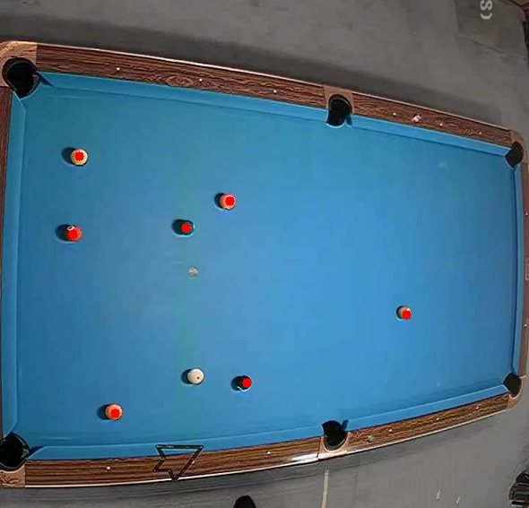
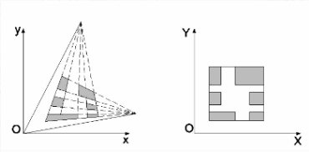
Find Homography (video points – 2D board)
Compute based on video pool table key points (4 corner.) and its corresponding key points on the 2D board.

Slide 8
Detect & identify the balls
First Try: Hough Circle finding. → Not Good!
Ball Shadows!

Slide 9
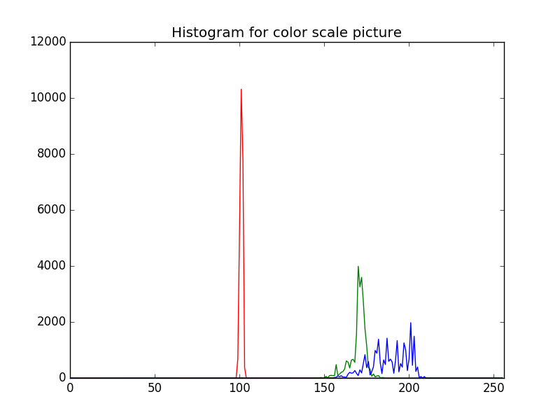
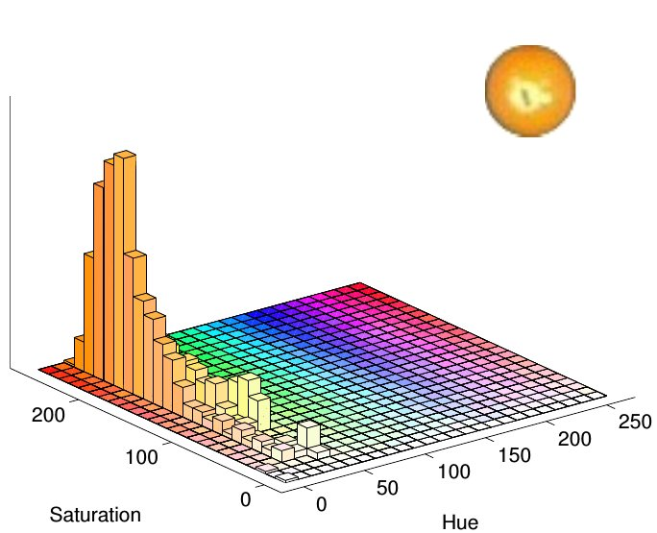
Detect & identify the balls
Second Try: Pure Color Range Filter.
RGB → HSV (It’s easier to apply range filter, as in RGB the color is too dispersed)

Slide 10
Pool Ball Dynamic Tracking
Now we can recognize the balls in one frame (static image), but for real-time tracking we need to consider the efficiency. Further more, we can analyze the movement status to adjust our detection and improve the performance, both on efficiency and accuracy.

Slide 11
Projection
Use Homography acquired in table detection to do the transformation from video position to animation board position. Draw basic ball shape and trajectory.

Slide 12
Evaluation
1. The accuracy of identifying pool balls.
* accuracy. check its correct/incorrect identification distribution. Using Confusion Matrix to analyze.
* compare real ball position & identified ball position
2. The efficiency of real-time pool ball tracking.
* trade-off between efficiency and accuracy. We need to do further adjustment.

Slide 13
Futhure Work
1. Ball Detection & identification accuracy
2. Real-time tracking efficiency
3. Projection and animation interface
4. Testing and evaluation
...

Slide 14
Thanks!

