Slide 1
Book A Doctor Using MERN Stack
TEAM MEMBER(BATCH NO:09 )
Gowtham B(211520205044)
Harish S (211520205057)
Hari Vignesh (211521205050)
Gokul Krishnan K (211521205043)
GUIDED BY:
Dr.S.SUMA CHRISTAL MARY M.E.,Ph.D.,
ASSOCIATE PROFESSOR
HEAD OF THE DEPARTMENT
DEPARTMENT OF INFORMATION & TECHNOLOGY
PANIMALAR INSTITUTE OF TECHNOLOGY

Slide 2
Abstract
This project focuses on developing a "Book a Doctor" web application using the MERN stack (MongoDB, Express, React, Node.js). The application aims to streamline the process of booking medical appointments, providing a user-friendly interface for patients to search for doctors by specialty, location, and availability, and make instant bookings.
The application leverages MongoDB for managing data, Express.js for backend logic, React.js for a responsive user interface, and Node.js for server-side functionality. The integration of these technologies enables a full-stack, highly scalable, and robust web solution that optimizes the process of scheduling doctor appointments.

Slide 3
Introduction
In today's fast-paced world, access to healthcare services must be as seamless and efficient as possible. Traditional methods of scheduling doctor appointments, such as phone calls or in-person visits to clinics, can often lead to long waiting times, miscommunication, and a lack of transparency. With the increasing digitization of services, there is a growing need for a modern, user-friendly solution that simplifies the process of finding and booking medical professionals
The "Book a Doctor" application is designed to address this need by offering a comprehensive, online platform where patients can easily search for doctors, view their availability, and book appointments with just a few clicks. Built using the MERN stack—a powerful combination of MongoDB, Express.js, React.js, and Node.js—the application ensures a responsive, scalable, and highly efficient experience for both patients and doctors.
This system allows patients to filter doctors based on specialties, locations, and available time slots. Doctors, in turn, have access to a dashboard where they can manage appointments, update availability, and communicate with patients. The platform also includes robust authentication mechanisms to ensure privacy and security of user data.

Slide 4
Proposed system
The proposed system for the "Book a Doctor" web application aims to create a seamless, efficient, and user-friendly platform for patients to book appointments with doctors. By leveraging the MERN stack (MongoDB, Express.js, React.js, and Node.js), the system ensures scalability, responsiveness, and ease of maintenance. Below is a detailed breakdown of the proposed system.
This proposed system will allow patients and doctors to interact efficiently, automating and streamlining the entire booking process. It leverages the power of the MERN stack to deliver a robust, scalable, and responsive solution for modern healthcare needs.

Slide 5
Front-end Model
The frontend of the "Book a Doctor" web application will be built using React.js, which is a powerful and popular JavaScript library for creating user interfaces. React will be responsible for rendering the components and managing the state of the application to deliver a smooth, interactive, and responsive experience to both patients and doctors. Below is a breakdown of how the frontend will be designed and its key components.
The frontend, powered by React.js, ensures a responsive, fast, and scalable user interface for the "Book a Doctor" platform. It integrates seamlessly with the backend APIs, ensuring real-time booking and appointment management while delivering a great user experience.

Slide 6
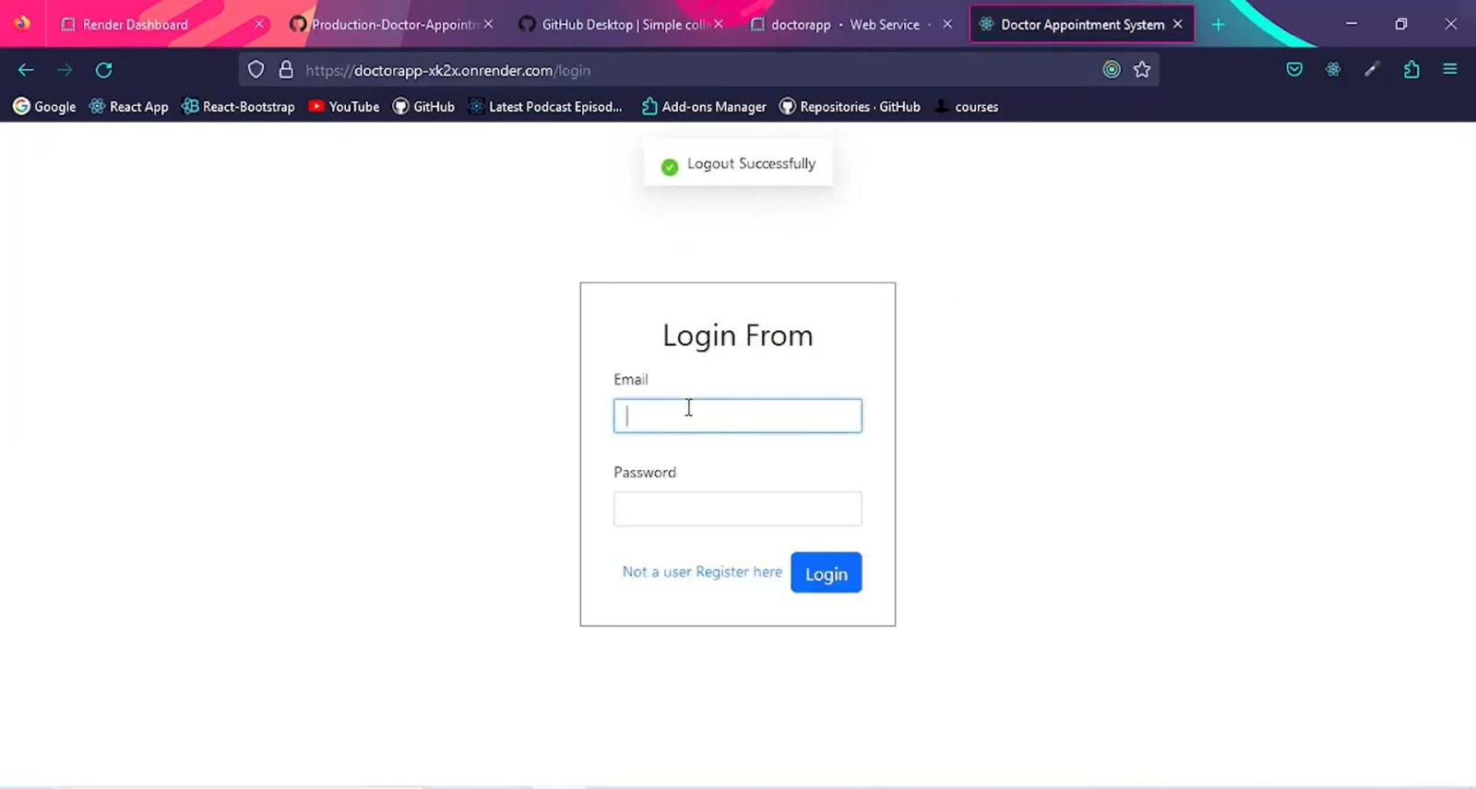
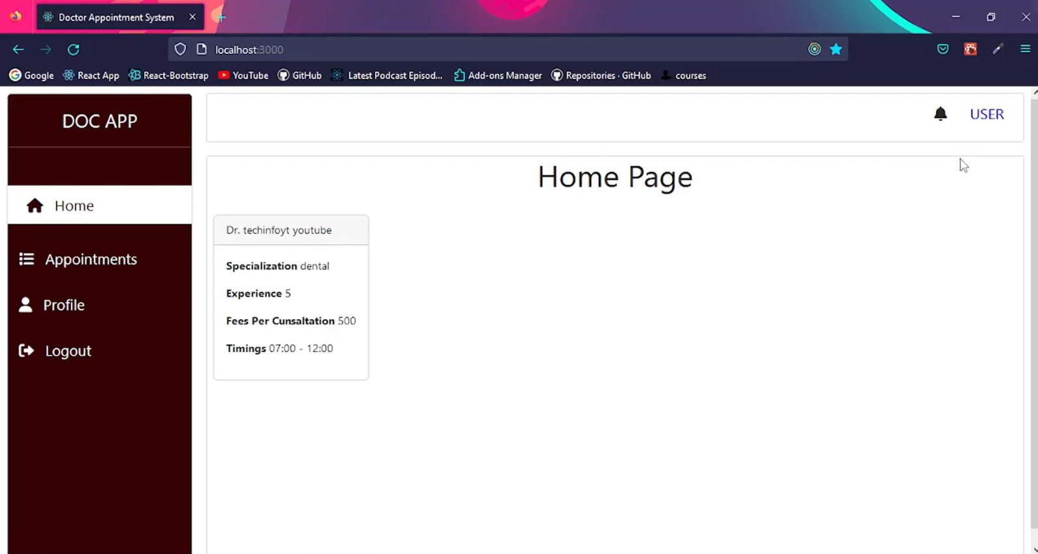

Slide 7
Back-end Model
The backend of the "Book a Doctor" web application is the core that handles business logic, manages data, and communicates between the frontend and the database. The backend will be built using Node.js and Express.js, with MongoDB as the database. The backend handles user authentication, data storage, appointment management, and API endpoints that the frontend interacts with.
This backend model ensures a structured and secure approach to managing the "Book a Doctor" application, providing efficient data storage, user management, and seamless integration with the frontend through a RESTful API.

Slide 8
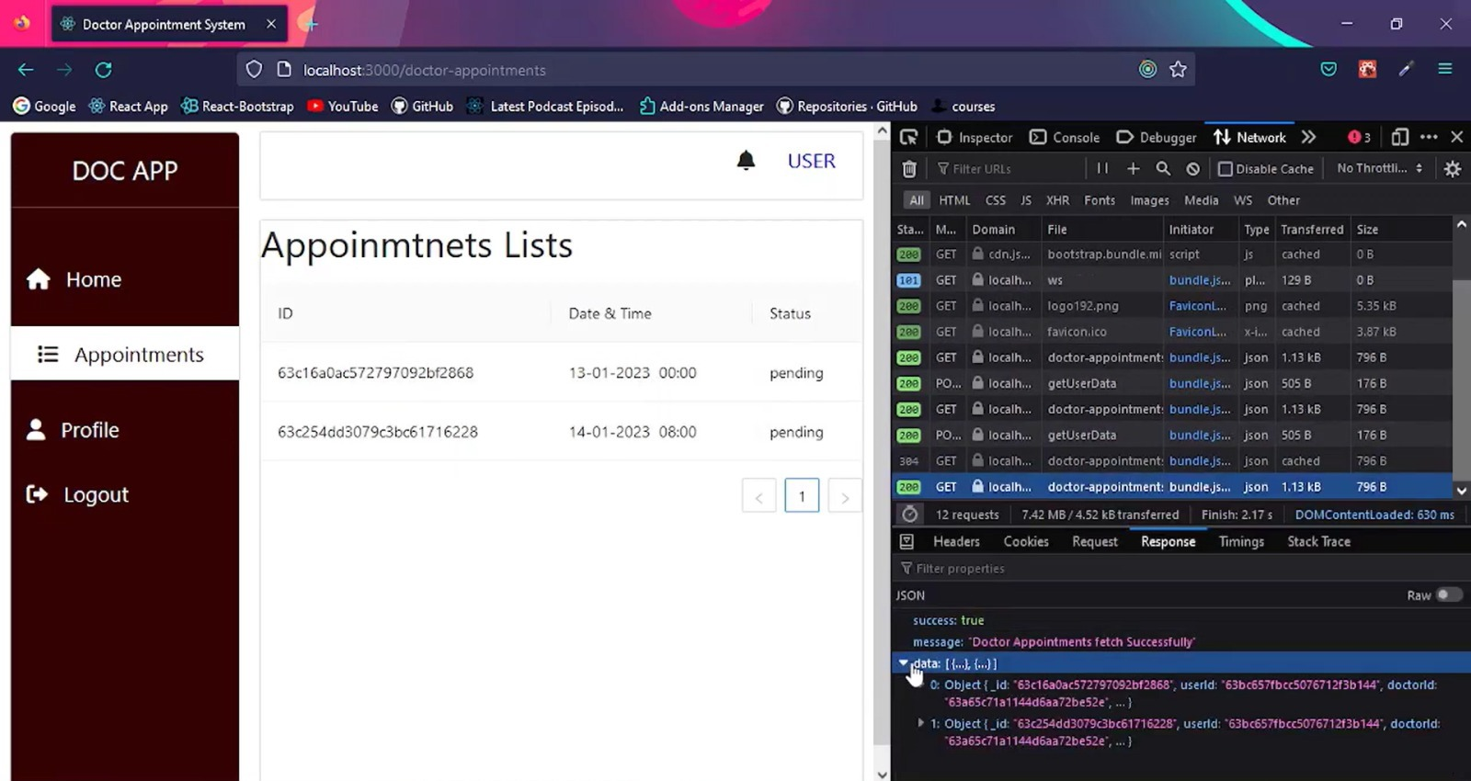

Slide 9
Working model
The "Book a Doctor" web application is designed to streamline the process of booking medical appointments, allowing patients to search for doctors and book appointments based on real-time availability. The application will use the MERN stack (MongoDB, Express.js, React.js, Node.js) for both backend and frontend development, creating a full-stack solution.
This working model demonstrates how the "Book a Doctor" application functions end-to-end using the MERN stack. By integrating a user-friendly frontend with a robust backend and database, the system provides a seamless and efficient way for patients to book appointments and for doctors to manage their schedules.

Slide 10
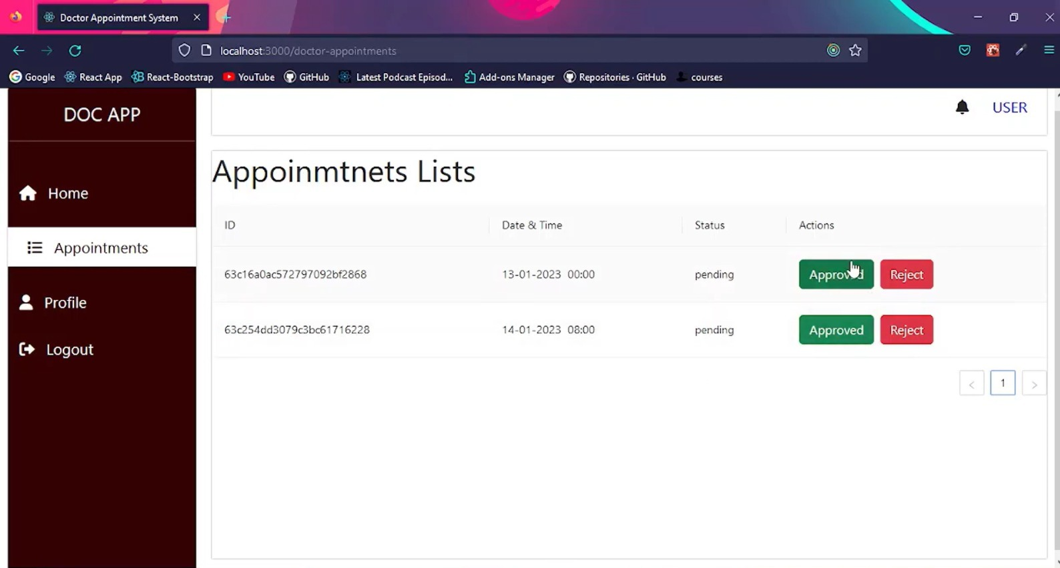

Slide 11
THANK YOU

