Slide 1
bootstrap v.4

Slide 2
Why?
Easy to use: Anybody with just basic knowledge of HTML and CSS can start using Bootstrap
Responsive features: Bootstrap's responsive CSS adjusts to phones, tablets, and desktops
Mobile-first approach: In Bootstrap, mobile-first styles are part of the core framework
Browser compatibility: Bootstrap 4 is compatible with all modern browsers (Chrome, Firefox, Internet Explorer 10+, Edge, Safari, and etc.)

Slide 3
cdn(Content delivery network)
<!-- Latest compiled and minified CSS --> <link rel="stylesheet" href="https://maxcdn.bootstrapcdn.com/bootstrap/4.5.2/css/bootstrap.min.css"> <!-- jQuery library --> <script src="https://ajax.googleapis.com/ajax/libs/jquery/3.5.1/jquery.min.js"></script> <!-- Popper JS --> <script src="https://cdnjs.cloudflare.com/ajax/libs/popper.js/1.16.0/umd/popper.min.js"></script> <!-- Latest compiled JavaScript --> <script src="https://maxcdn.bootstrapcdn.com/bootstrap/4.5.2/js/bootstrap.min.js"></script>

Slide 4
two ways to use it
Download from https://getbootstrap.com/
Include it from a CDN

Slide 5
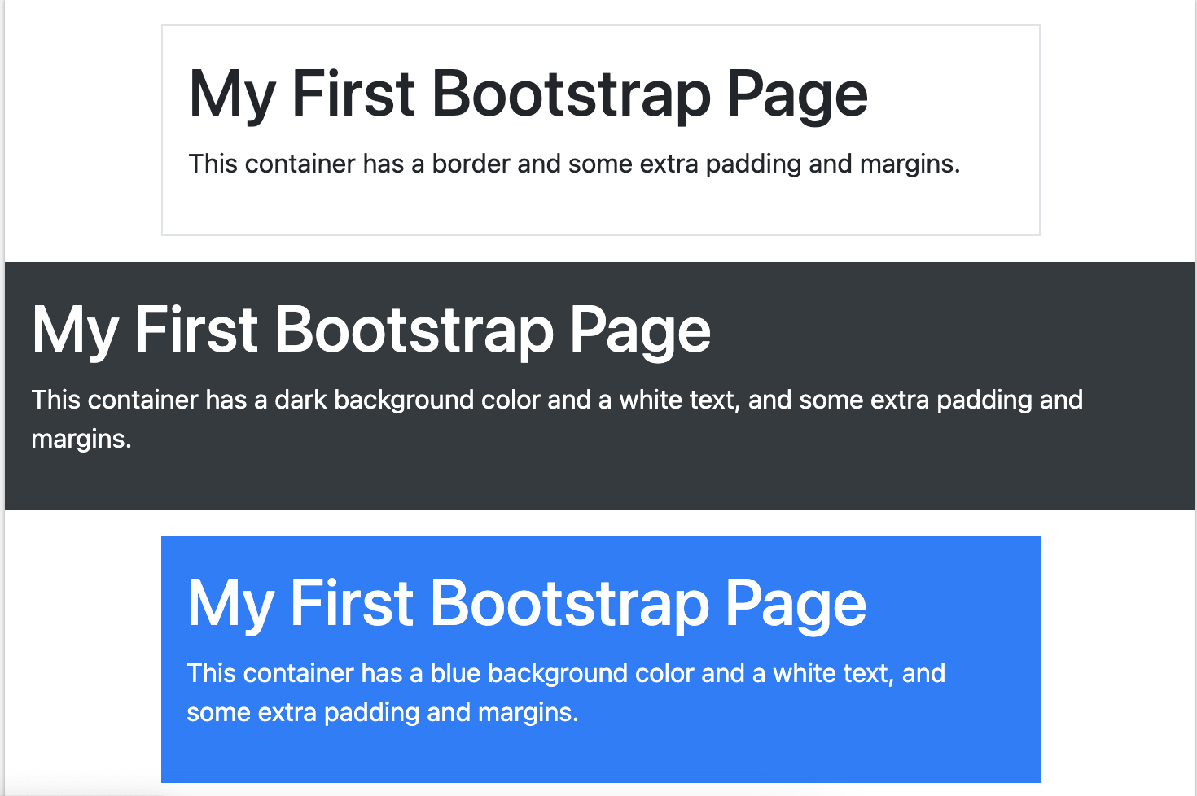
Sample
<div class="container p-3 my-3 border">
<h1>My First Bootstrap Page</h1>
<p>This container has a border and some extra padding and margins.</p>
</div>
<div class="container-fluid p-3 my-3 bg-dark text-white">
<h1>My First Bootstrap Page</h1>
<p>This container has a dark background color and a white text, and some extra padding and margins.</p>
</div>
<div class="container p-3 my-3 bg-primary text-white">
<h1>My First Bootstrap Page</h1>
<p>This container has a blue background color and a white text, and some extra padding and margins.</p>
</div>

Slide 6
Cheatsheet
https://hackerthemes.com/bootstrap-cheatsheet/
Attachment

