Slide 1


Team Details
Team name: Titan Core
Team leader name: Vishv Jani
Problem Statement: Global supply chains lose billions annually due to weather disruptions, port congestion, and geopolitical instability - with no unified real-time risk intelligence tool for logistics teams.

Slide 2
Supply Chain Intelligence API
A real-time supply chain risk intelligence platform combining:
Geolocation Services (OpenStreetMap/OSRM) - Distance & maritime routing for 30+ global ports
Real-Time Weather Data (OpenWeatherMap) - Live port weather with risk scoring
ML Risk Scoring - 6-factor weighted model: weather, ports, carrier, geopolitical, anomaly, dwell time
Real-Time WebSocket Updates + Route Optimization for high-risk shipments
Key Result: Risk Score 44.68/100 for Mumbai→Rotterdam (9,696.8 km) in under 2 seconds. All 8 endpoints tested and verified. Zero cost using free public APIs.

Slide 3
Opportunities & USP
Unified Intelligence: Most tools handle weather OR routing OR risk separately. This API combines all three in a single POST /risk/analyze call - no other free solution does this.
Solves the Problem: Logistics teams get a single risk score (0-100) with component breakdown, top risk factors, distance, transit time, real-time weather, and a recommended action - all in under 2 seconds.
USP: Zero API cost (all free public APIs), production-ready async FastAPI supporting 100+ concurrent connections, graceful fallbacks, 110+ pages of documentation, and code examples in Python, JavaScript, Java, and cURL.

Slide 4
Features of Supply Chain Intelligence API
POST /risk/analyze - Combined ML + Maps + Weather risk score (0-100) with component breakdown and recommendations
GET /distance - Maritime distance & transit time between 30+ global ports (e.g. Mumbai-Rotterdam: 9,696.8 km, 14.4 days)
GET /weather & GET /route-weather - Live port weather with risk scoring (Dubai: 32.5°C, 18.3 km/h wind)
GET /shipments/live & GET /alerts - Active shipment tracking with positions, ETAs, and real-time disruption alerts
POST /reroute/{id} - Alternate route suggestions with cost/time comparisons for high-risk shipments
WS /ws/shipments & WS /ws/alerts - WebSocket streaming for live position updates and real-time disruption alerts (<50ms latency)

Slide 5
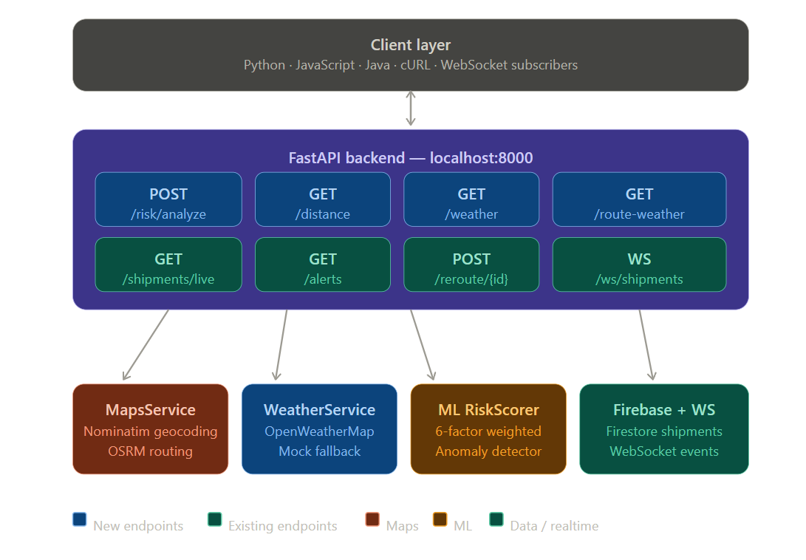
Process Flow: Risk Analysis Pipeline
Step 1 [User] POST /risk/analyze {shipment_id, origin, destination, carrier}
↓
Step 2 [MapsService] Nominatim geocoding → OSRM maritime routing → Distance & transit days calculated
Step 3 [WeatherService] OpenWeatherMap API → Live weather at origin & destination ports → Weather risk score
Step 4 [ML RiskScorer] 6-factor weighted scoring: Weather(22%) + Ports(18%) + Carrier(15%) + Geopolitical(20%) + Anomaly(15%) + Dwell(10%)
Step 5 [Response] Risk score + level + component breakdown + top risk factors + recommended action (if risk > 70: auto-generate /reroute)

Slide 6
Sample API Response - POST /risk/analyze
{ "shipment_id": "SHP-TEST-001",
"risk_score": 44.68, "risk_level": "medium",
"distance_km": 9696.8, "transit_days": 14.4,
"top_risk_factors": ["Severe weather at current location", "Elevated geopolitical risk", "High port congestion at destination"],
"recommended_action": "Monitor closely. Consider notifying consignee."
}
{ "shipment_id": "SHP-TEST-002",
"risk_score": 10.58, "risk_level": “Low",
"distance_km": 5006.8, "transit_days": 11.0,
"top_risk_factors": ["Severe weather at current location“,"High port congestion at destination"],
"recommended_action": "Monitor closely. Consider notifying consignee."
}

Slide 7
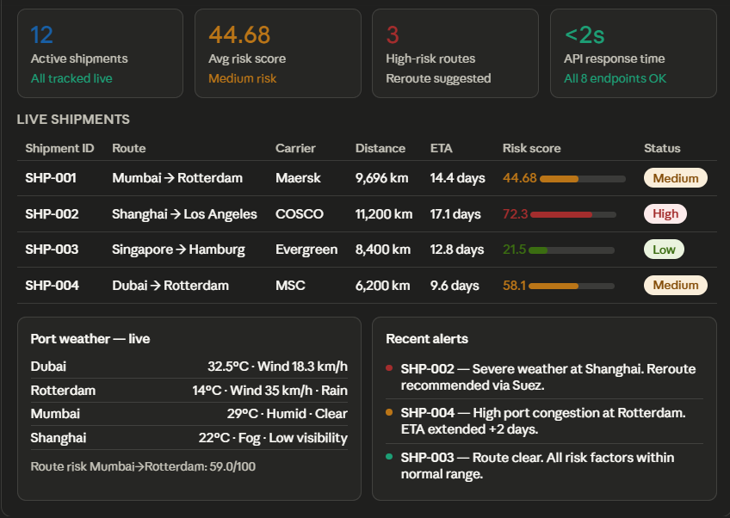
System Architecture
FastAPI Backend (localhost:8000)
NEW: POST /risk/analyze | GET /distance | GET /weather | GET /route-weather
Existing: GET /shipments/live | GET /alerts | POST /reroute | WS /ws/{topic}
Backend Services Layer
MapsService (Nominatim geocoding + OSRM maritime routing + Haversine fallback)
WeatherService (OpenWeatherMap API + mock fallback)
ML RiskScorer (6-factor weighted model + anomaly detector + route optimizer)
FirebaseClient (Firestore shipment data + WebSocket manager for real-time events)

Slide 8
Technologies Used
Backend: Python 3.10, FastAPI, asyncio, uvicorn, Pydantic - Async/non-blocking, 100+ concurrent connections
Maps & Geo: OpenStreetMap Nominatim (geocoding), OSRM (maritime routing), Haversine formula (fallback)
Weather: OpenWeatherMap API (free tier, 60 calls/min) with mock fallback for resilience
ML & Data: Custom weighted risk scorer, anomaly detector, route optimizer, 500K shipment dataset
Google Cloud: Firebase Firestore (shipment data), Docker-ready for Cloud Run deployment
Future - Google AI: Gemini for natural language risk explanations, Vertex AI for enhanced anomaly detection

Slide 9
Estimated Implementation Cost
MVP Total Cost: $20
Component Current (MVP) Scale-Up Option
Maps API: $10 (OpenStreetMap/OSRM) → Google Maps Platform
Weather API: $10 (free tier, 60 calls/min) → OpenWeatherMap Pro
ML Model: $0 (self-hosted) → Vertex AI
Database: $0 (Firebase free tier) → Firebase Blaze plan
Hosting: $0 (local/dev) → Google Cloud Run (~$10-30/month for production)

Slide 10
MVP - Tested Endpoints (All Green)
GET /health → 200 OK {"status": "healthy"} (<100ms)
GET /distance → 200 OK Mumbai-Rotterdam: 9696.8 km, 14.4 days (~500ms)
GET /weather → 200 OK Dubai: 32.5°C, wind 18.3 km/h (~1s)
GET /route-weather → 200 OK Mumbai-Rotterdam route risk: 59.0/100
POST /risk/analyze → 200 OK Risk: 44.68/100 (medium) + full breakdown (<2s)
GET /shipments/live | GET /alerts | POST /reroute → 200 OK All verified. 8/8 endpoint categories passing.
Future Development
Gemini Integration: Natural language risk explanations - "Your shipment is at medium risk due to port congestion in Rotterdam, here’s what to do"
Vertex AI: Enhanced anomaly detection using historical patterns from the 500K international shipment dataset
Google Maps Platform: Premium maritime routing with real-time port traffic and lane-level congestion data
Google Cloud Run: Auto-scaling containerized deployment, multi-region support for enterprise customers

Slide 11
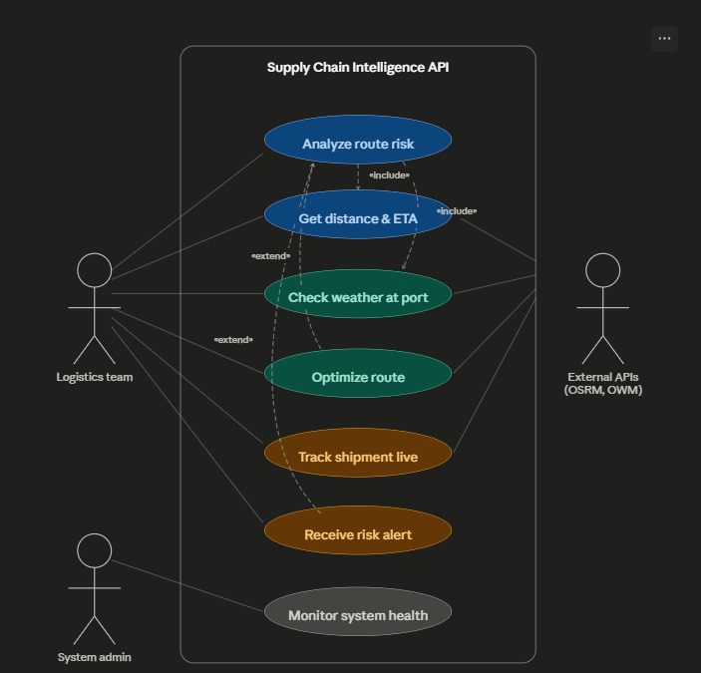
User Case Diagram

Slide 12
Project Links
GitHub Public Repository: https://github.com/Hars505/Smart-chain-supply
Demo Video Link (3 Minutes): https://github.com/Hars505/Smart-chain-supply/blob/main/Smart-chain-supply_demo_video.mp4
MVP Link: https://hars505.github.io/Smart-chain-supply/
Working Prototype: http://localhost:8000/docs (FastAPI auto-docs)

Slide 13
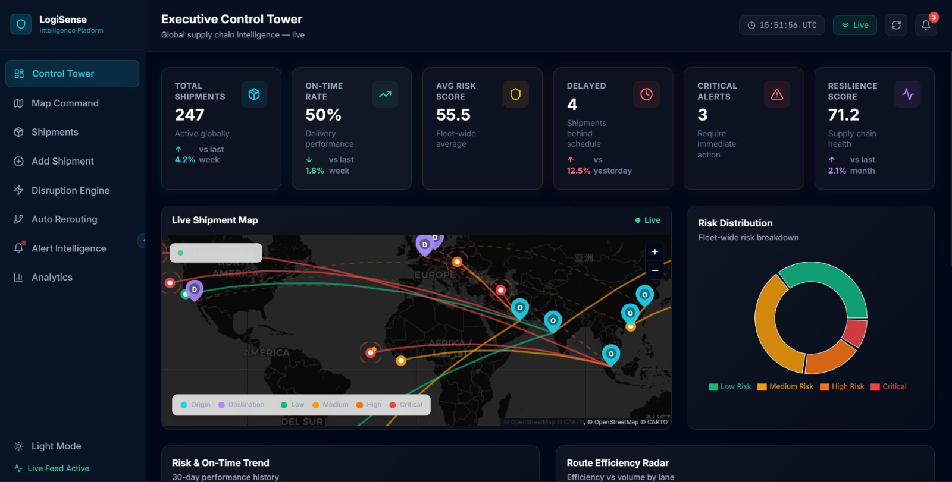

Slide 14


