Slide 1


Sparsham
A HELPING HAND

Slide 2
Introduction
The web application entitled “Sparsham” is an online platform for managing activities performed in Sparsham club of MACE.
Managing activities performed in Sparsham club of MACE.
Schedule charity activities
financial support from students and public.
Public can request for services.
Public can provide financial aid.

Slide 3
Existing system
Existing system is a pen and paper system.
The financial transaction is not much transparent.
Inefficient storage mechanism.
Absence of a common channel for Sparsham members.

Slide 4
Proposed system
Sparsham is a web application to automate the activities of Sparsham club in MACE.
Here the services can be requested through this website without direct visit to the college.
Provides quick responses.
Efficient storage mechanism.
Traditional pen and paper system replaced by a complete online system.

Slide 5


implementation
FRONTEND: HTML,CSS,JAVASCRIPT,PHP
BACKEND:MYSQL SERVER

Slide 6
Future scope
RESOURCE ALLOCATION
WORK FOR ALL COLLEGE
HELPS IN EMERGENCY SITUATION

Slide 7
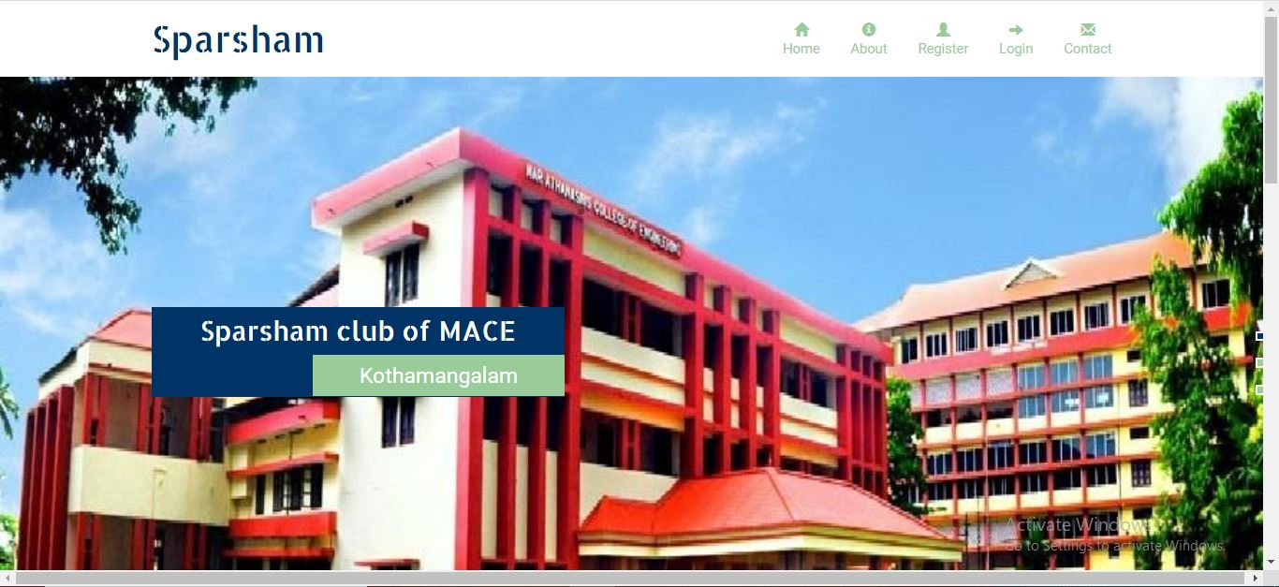
Screenshots

Slide 8
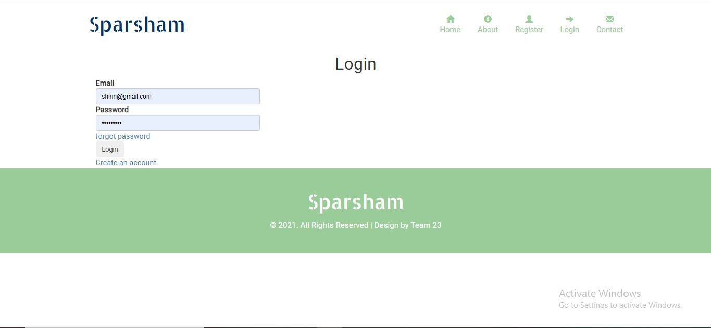
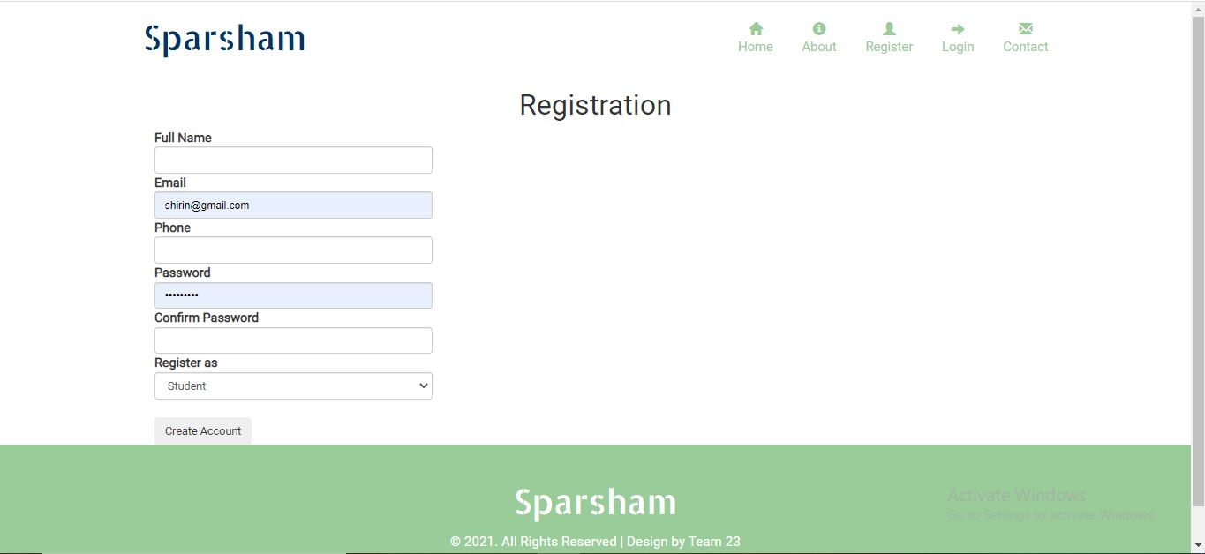
Screenshots

Slide 9
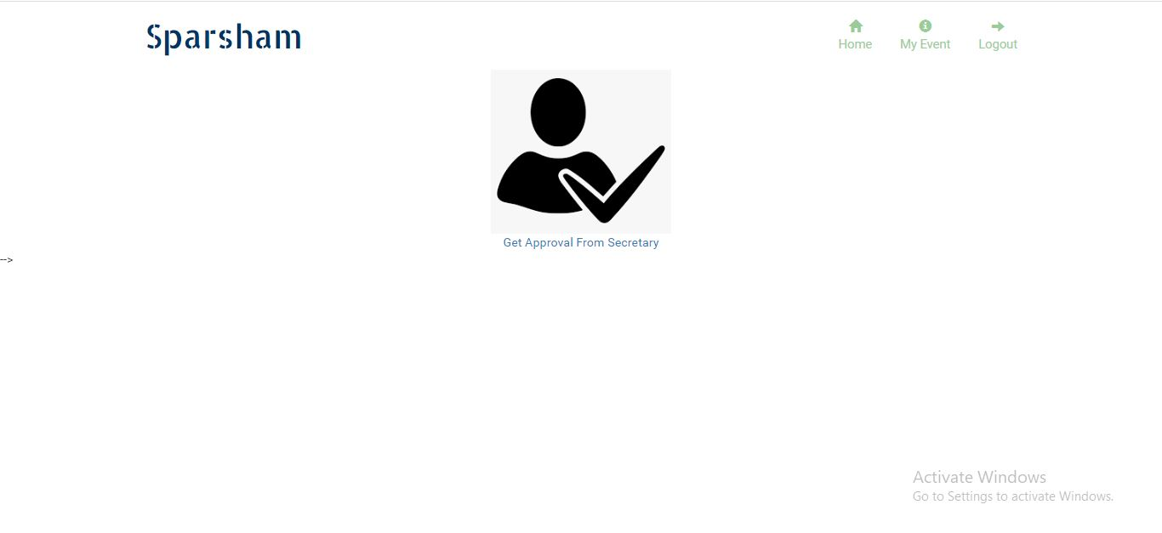
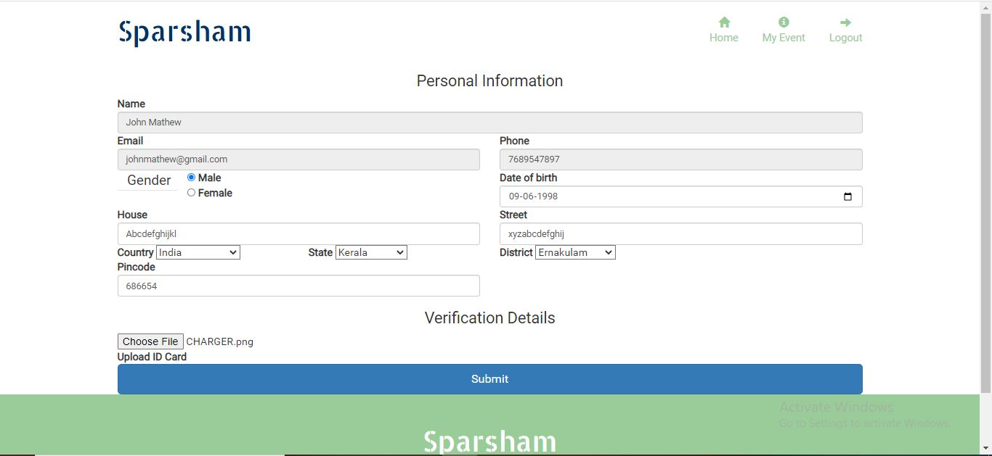
Screenshots

Slide 10
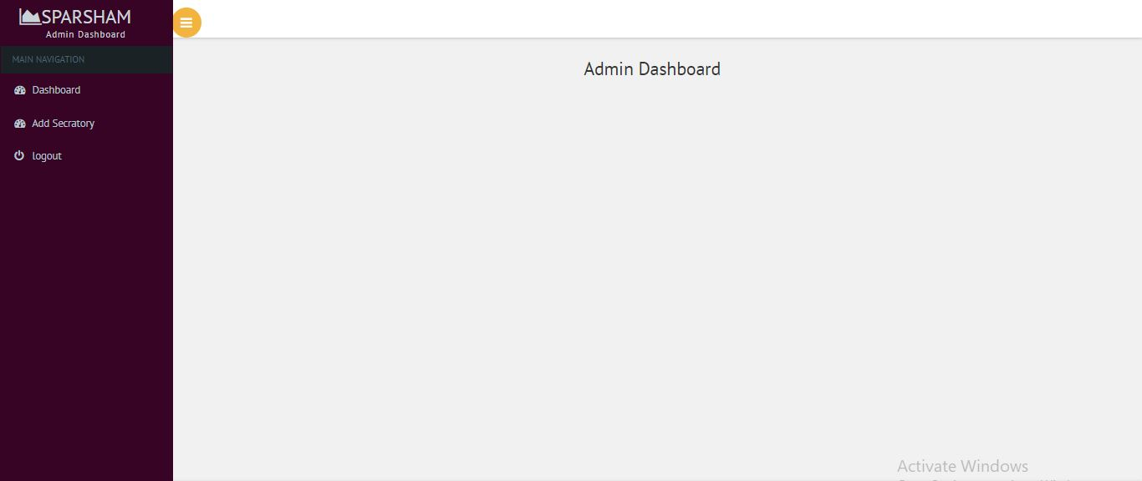
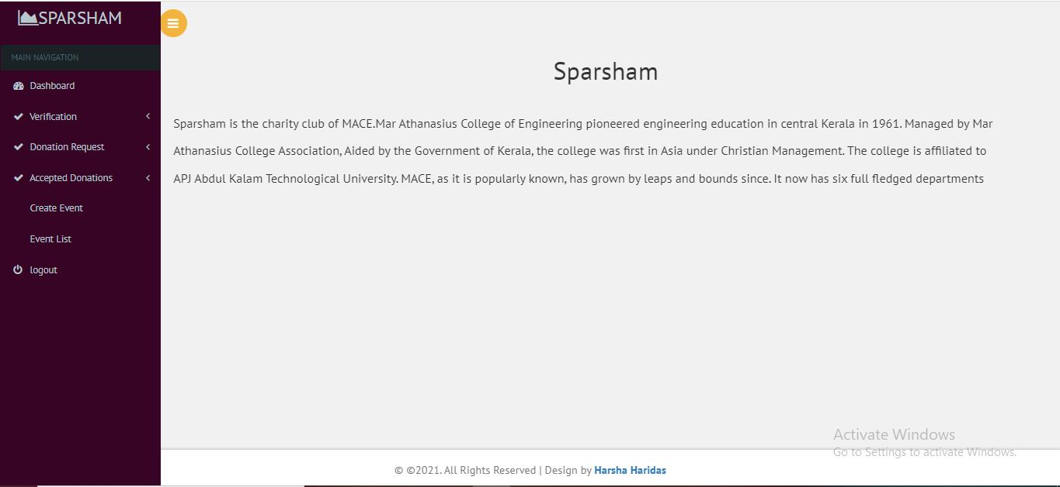
Screenshots

Slide 11
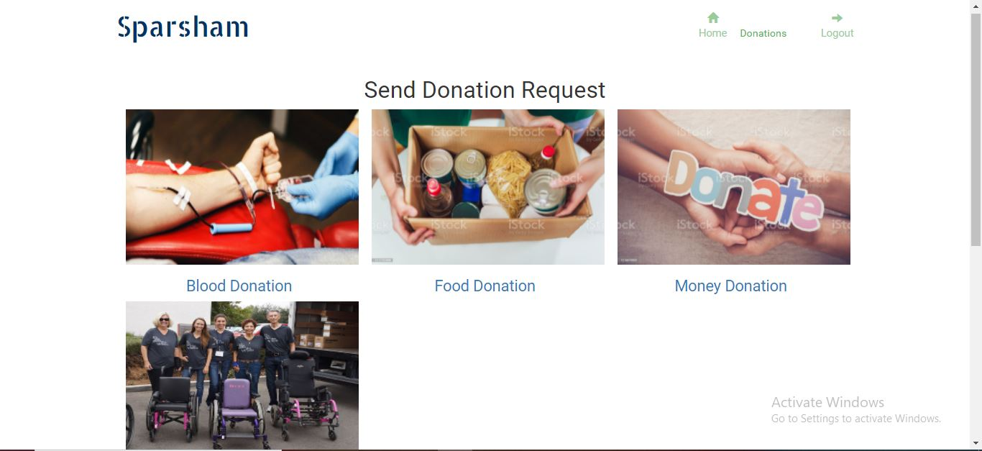
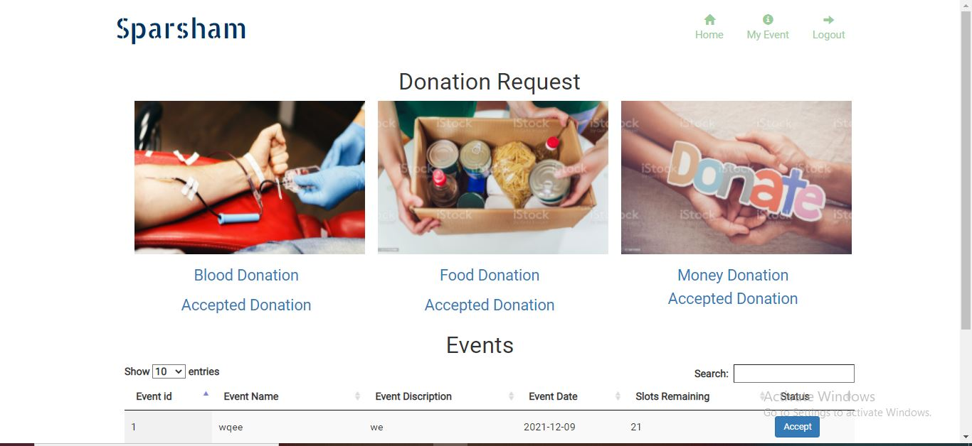
Screenshots

Slide 12
THANK YOU

