Slide 1
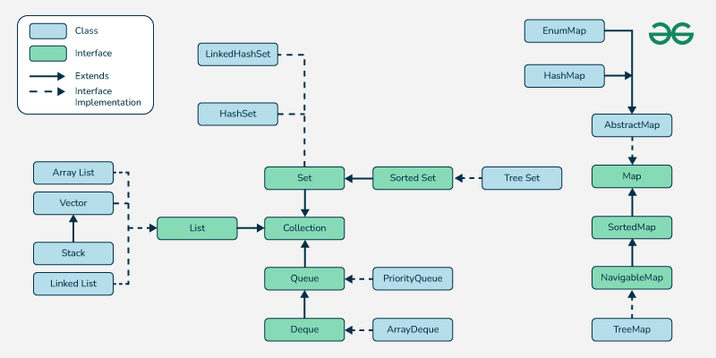
Hierarchy

Slide 2
Array
Normally, an array is a collection of similar type of elements which have a contiguous memory location.
Java array is an object which contains elements of a similar data type.
The elements of an array are stored in a contiguous memory location.
Array is a data structure where we store similar elements.
We can store only a fixed set of elements in a Java array.
Array in Java is index-based, the first element of the array is stored at the Oth index, 2nd element is stored on 1st index and so on.

Slide 3
Disadvantage:
Fixed size. Can not be increased or decreased once declared.
Arrays does not have add or remove methods.
To delete an element in an array we need to traverse through out the array so this reduce performance

Slide 4
ArrayList
ArrayList is a dynamic array that can grow and shrink in size. It allows duplicate elements and maintains the insertion order.
Allows random access (like an array).
Allows Duplicates.
We can remove elemently easy.

Slide 5
Methods:
Method | Description
add(element) | Adds an element
add(index, element) | Adds at a specific index
get(index) | Returns element at index
set(index, element) | Updates element at index
remove(index) | Removes element at index
size() | Returns number of elements
clear() | Removes all elements
contains(element) | Checks if element exists

Slide 6
Linked List
Linear data structures.
Not stored in contiguous locations.
Separate object with a data part and address part.
Start from the head and follow through the link
Allow duplicate elements.

Slide 7
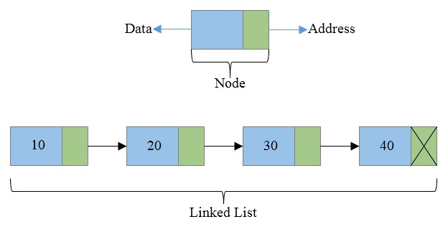
Example:

Slide 8
Common Methods
Method | Description | Example
add(E element) | Adds to the end | list.add("A");
add(int index, E element) | Adds at specific position | list.add(1, "B");
addFirst(E element) | Adds to the front | list.addFirst("First");
addLast(E element) | Adds to the end | list.addLast("Last");
remove() | Removes head (like queue) | list.remove();
removeFirst() | Removes first element | list.removeFirst();
removeLast() | Removes last element | list.removeLast();
get(int index) | Gets element at index | list.get(2);
getFirst() | Gets first element | list.getFirst();
getLast() | Gets last element | list.getLast();
set(int index, E element) | Updates element at index | list.set(1, "Updated");
contains(Object o) | Checks if element exists | list.contains("A");
indexOf(Object o) | Gets index of first occurrence | list.indexOf("A");
lastIndexOf(Object o) | Gets index of last occurrence | list.lastIndexOf("A");
size() | Number of elements | list.size();
isEmpty() | Checks if list is empty | list.isEmpty();
clear() | Removes all elements | list.clear();
offer(E e) | Adds to end (like queue) | list.offer("X");
poll() | Removes head and returns it (queue) | list.poll();
peek() | Gets head without removing | list.peek();

Slide 9
Vector
In Java, the Vector class is a legacy implementation of the List interface that provides a growable array of objects.
It is part of the java.util package and is fully compatible with the Java Collections Framework.
Vector is similar to ArrayList but is synchronized, making it thread-safe by default.

Slide 10
Methods:
Method | Description
add(element) | Adds an element
add(index, element) | Adds at a specific index
get(index) | Returns element at index
set(index, element) | Updates element at index
remove(index) | Removes element at index
size() | Returns number of elements
clear() | Removes all elements
contains(element) | Checks if element exists

Slide 11
Stack:
A Stack is a Last-In-First-Out (LIFO) data structure. This means the last element added to the stack is the first one to be removed.
Java provides a built-in Stack class in the java.util package.
It extends the Vector class.
Operates on push, pop, peek, search, and empty operations.

Slide 12
Methods:
Method | Description
push(item) | Adds item to the top of the stack
pop() | Removes and returns top element
peek() | Returns top element (no remove)
isEmpty() | Checks if the stack is empty
search(item) | Returns 1-based position from top

Slide 13
Queue
A Queue in Java is a First-In-First-Out (FIFO) data structure — elements are added at the rear and removed from the front.
Method | Description
add(e) | Inserts element, throws exception if full
offer(e) | Inserts element, returns false if full
remove() | Removes head, throws exception if empty
poll() | Removes head, returns null if empty
element() | Returns head, throws exception if empty
peek() | Returns head, returns null if empty

Slide 14
Dequeue
In Java, a Deque (pronounced "deck") stands for Double Ended Queue, which allows insertion and removal of elements from both ends (head and tail). It's part of the java.util package and is an interface that extends the Queue interface.
Common Implementations:
ArrayDeque<E> — Resizable-array implementation (most commonly used).
LinkedList<E> — Can also be used as a deque.

Slide 15
Methods
Method | Description
addFirst(e) | Adds to the front
addLast(e) | Adds to the rear
removeFirst() | Removes from the front
removeLast() | Removes from the rear
peekFirst() | Returns front without removing
peekLast() | Returns rear without removing
offerFirst(e) | Adds to front (returns false if full)
offerLast(e) | Adds to rear (returns false if full)

Slide 16
Priority Queue
A Priority Queue in Java is a special queue where elements are processed based on their priority, not just their insertion order. It is implemented by the PriorityQueue class in the java.util package and internally uses a heap data structure.
Elements are ordered by their natural order (Comparable) or by a provided Comparator.
The element with the highest priority (lowest value if natural order is used) is at the head
When you remove elements, the highest priority element is always removed first.

Slide 17
Methods
add(e) : Inserts element, throws exception if full
offer(e) :Inserts element, returns false if full
remove() :Removes head, throws exception if empty
poll() :Removes head, returns null if empty
element(): Returns head, throws exception if empty
peek():Returns head, returns null if empty

Slide 18
Set
Represents a collection of unique elements where duplicates are not allowed.
No duplicate elements allowed.
At most one null value (in HashSet/LinkedHashSet).
No guaranteed order, unless using ordered variants.

Slide 19
Methods:
Method | Description
add(E e) | Adds element (ignores duplicates)
remove(Object o) | Removes specific element
contains(Object o) | Checks if element exists
isEmpty() | Checks if set is empty
size() | Returns number of elements
clear() | Removes all elements

Slide 20
HashSet
HashSet stores the elements by using a mechanism called hashing.
HashSet contains unique elements only.
HashSet allows null value.
HashSet class is non synchronized.HashSet doesn't maintain the insertion order.
Here, elements are inserted on the basis of their hashcode.

Slide 21
LinkedHashSet
Java LinkedHashSet class contains unique elements only like HashSet.
LinkedHashSet class provides all optional set operation and permits null elements.
Java LinkedHashSet class maintains insertion order.

Slide 22
TreeSet
SortedSet interface.
Duplicate values are not allowed.
Ascending orderElements are sorted by keys.
No null values.

Slide 23
Map
A Map is an object that maps keys to values. Each key is unique, and each key maps to at most one value.
Map implements:
HashMap
LinkedHashMap
TreeMap

Slide 24
Methods
Method | Description
put(K key, V value) | Adds or updates a key-value pair
get(Object key) | Returns the value for the key
remove(Object key) | Removes the mapping for the key
containsKey(Object k) | Checks if key exists
containsValue(Object v) | Checks if value exists
keySet() | Returns a Set of keys
values() | Returns a Collection of values
entrySet() | Returns a Set of key-value pairs

Slide 25
HashMap
Contains values based on the key.
Contains only unique keys.
Has one null key and multiple null values.
It is non synchronized.
Maintains no order.

Slide 26
LinkedHashMap
LinkedHashMap class is Hash table and Linked list implementation of the Map interface, with predictable iteration order.
It inherits HashMap class and implements the Map interface.
Contains values based on the key.
Contains unique elements.
Has one null key and multiple null values.
It is non synchronized.
Maintains insertion order.

Slide 27
TreeMap
TreeMap class is a red-black tree based implementation.
Provides an efficient means of storing key-value pairs in sorted order.
contains values based on the key.
It implements the NavigableMap interface extends AbstractMap class.
Contains only unique elements.
Cannot have a null key but can have multiple null values.
It is non synchronized.
Maintains ascending order.

