Slide 1
Bhavdeep Singh 07
Sukhdeep Singh Dhillon 08
Harsh Aggarwal 09
K18AP

Slide 2
SCIENTIFIC CALCULATOR
As the name suggests this project in on a scientific calculator having most common required functions any other scientific calculator would have in them.
It is a fully featured scientific calculator with proper functions being implemented accordingly. We have added all different types of trigonometric functions and logarithmic functions as well.
It also contains simple functions such as addition, subtraction ,multiplication and division as well for performing simple operations depending on the what the users really wants.

Slide 3
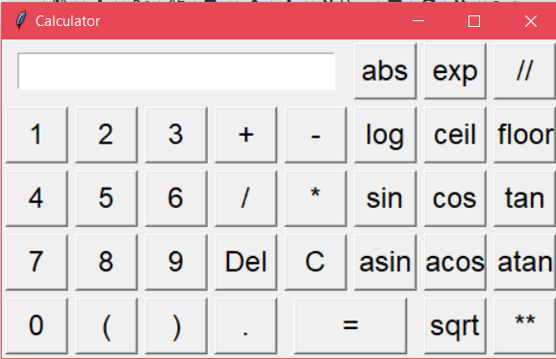
Since it is an GUI based project, Tkinter and its inbuilt functions are used to built this project.
Python is being used as logic building for the backend operations of the calculator.

Slide 4
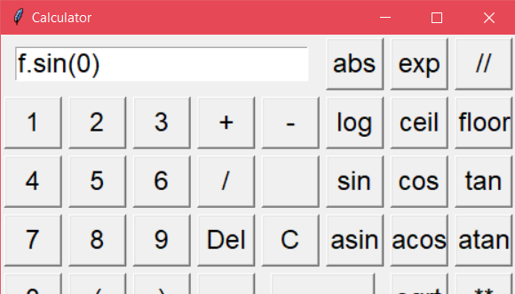
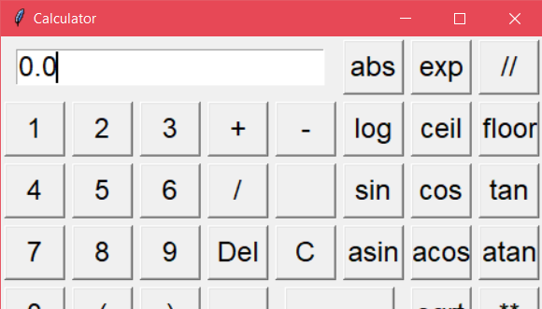

Slide 5
Thank you

