Slide 1
HAPPIEST HEALTH · DIGITAL TWIN CHALLENGE 2026
CardioTwin Sentinel
An Ultra-Low-Cost (₹1,165) Proactive Cardiovascular & Cardiometabolic Digital Twin
Fusing Longitudinal EHR + 7-Day Wearable Trajectories + 100 Hz Edge Optical Telemetry to Predict Adverse Cardiac Decompensation Hours in Advance.
₹1,165 (~$14)
Edge IoT Hardware Node
ESP32 FreeRTOS + MAX30102 100Hz
98.83% / 90.09%
Normal Spec / Anomaly Recall
2,271 Patients (Zero-Leakage CV)
2h & 6h Horizon
Proactive Early Warning
EHR-Coupled + 7d Nocturnal HRV
ABDM FHIR R4
e-Sanjeevani Ready
LOINC / SNOMED + 54 Passing Tests
Team Root Access (Solo) · Harsh Mishra · Visvesvaraya National Institute of Technology (VNIT), Nagpur · MIT Open-Source License

Slide 2
01 · CLINICAL PROBLEM STATEMENT
India's Cardiovascular Crisis Faces an Unsustainable Screening Trilemma
South Asians experience coronary artery disease 10–15 years earlier, yet 160,000+ primary care centres lack intelligent triage tools.
28% of Deaths
Leading Cause of Mortality in India
High burden of silent AFib & premature CAD
10–15 Years
Earlier Onset in South Asians
Western Framingham scores underestimate risk
160,000+ HWCs
Ayushman Bharat Primary Centres
Zero low-cost longitudinal screening tools
Why Existing Devices Fail Primary Care
The CardioTwin Sentinel Solution
• Consumer Smartwatches (₹41,900–₹89,900): Unaffordable for 95% of rural/semi-urban patients; proprietary iOS lock-in; uncalibrated population defaults.
• Clinical 24–48h Holter Monitors (₹5,000–₹12,000/rental): Requires hospital referral, chest electrodes, and 2–3 days for manual review.
• OTC Pulse Oximeters (₹600–₹1,200): Outputs a single instantaneous number with zero memory, zero personal baseline, and zero EHR context.
★ ₹1,165 (~$14) Edge IoT Node + Stateful Clinical Digital Twin.
• Learns each patient's own resting physiology via a 2-minute seated empirical calibration (Median + MAD).
• Fuses Static EHR (labs, active medications, South Asian 1.45x Framingham) with Dynamic 100 Hz PPG & 7-day wearable sleep/HRV trajectories.
• Predicts hemodynamic decompensation 2 to 6 hours in advance and simulates Dual-Horizon What-If treatment outcomes.
CardioTwin Sentinel v4.1 · Team Root Access (Harsh Mishra, VNIT Nagpur) · Investigational Decision-Support Prototype (Non-Diagnostic) 2 / 12

Slide 3
02 · SYSTEM ARCHITECTURE OVERVIEW
Five-Stage Multimodal Digital Twin Pipeline
Seamless fusion of Static EHR (Stream 1) and High-Frequency Wearable Telemetry (Stream 2).
01 · EDGE HARDWARE
02 · SIGNAL GATE
03 · DUAL AI ENGINE
04 · TWIN CORE
05 · CLINICIAN UI
▸ ESP32 + MAX30102
• ₹1,165 ($14) unit BOM
• Core 1: 100 Hz ISR timer
• Core 0: Async WiFi POST
• SH1106 OLED live HUD
• Microsecond jitter deltas
▸ 5-Part Decoupled Gate
• Blocks finger-off (<20k)
• Blocks saturation (>260k)
• Blocks timing drops
★ Passes AFib & extreme
rates through to AI
▸ Trees + Inception-1D
• 27 HRV/Spectral features
• XGB + RF + ExtraTrees
• 393K-param 1D-CNN
• Temp-Scaled Late Fusion
• SHAP TreeExplainer XAI
▸ EHR x Live Coupling
• 2-min Median+MAD baseline
• M_EHR substrate coupling
• Beta-Blockade Escape
• 2h/6h Proactive Forecast
• Dual-Horizon What-If
▸ Portal & ABDM FHIR
• React 19 Web Dashboard
• React Native Mobile App
• Evidence Ledger honesty
• HL7 FHIR R4 Bundle export
• DPDP Act 2023 privacy
★ Data Stream Fusion Contract: [Stream 1: Synthetic Indian EHR Cohort (100 patients, Labs, Meds, 1.45x Framingham)] + [Stream 2: 100 Hz ESP32 PPG + 7-Day Sleep/Nocturnal RMSSD] ---> Proactive 2h/6h Early Warning & Dual-Horizon What-If Simulation.
CardioTwin Sentinel v4.1 · Team Root Access (Harsh Mishra, VNIT Nagpur) · Investigational Decision-Support Prototype (Non-Diagnostic) 3 / 12

Slide 4
03 · STAGE 1: EDGE HARDWARE & FIRMWARE
₹1,165 ($14) Node Engineered Around a Hard 10,000 µs Real-Time Deadline
FreeRTOS dual-core task isolation prevents WiFi network retries from ever distorting optical waveform morphology.
Core 1: Real-Time Acquisition (Priority 5)
Bill of Materials & Health-Economics Advantage
• Samples MAX30102 (880nm IR, 18-bit ADC) at exactly 100.0 Hz using esp_timer_get_time() + vTaskDelayUntil(10ms).
• Pushes 50-sample chunks (500ms) with per-sample microsecond deltas (deltas_us[]) into lock-free FreeRTOS chunkQueue.
• Zero HTTP or blocking socket calls permitted on Core 1.
▸ Complete Hardware Node BOM: ₹1,165 (~$14.07) | < ₹950 @ 1k units
• ESP32-WROOM-32D Dual-Core MCU (240 MHz): ₹480
• MAX30102 Optical PPG Sensor (18-bit ADC): ₹220
• TP4056 USB-C Charger + 650mAh LiPo (6-8h): ₹210
• SH1106 0.96" I2C OLED Display: ₹140
• 3D-Printed Biocompatible PLA Clip + Passives: ₹115
▸ Deployment Comparison vs. Commercial Modalities:
• Apple Watch Series 9 (₹41,900+): >35x more expensive, iOS locked.
• Clinical Holter (₹5,000+/rental): 2–3 day delay, non-reusable leads.
• OTC Oximeter (₹800): Instantaneous number only, zero intelligence.
Core 0: Async Telemetry & Integrity (Priority 1)
• Pulls completed chunks from chunkQueue and streams keep-alive JSON payloads to POST /data.
• Transmits device_boot_id and monotonic sequence numbers to detect hardware reboots, packet gaps, or duplicates.
• Background loop drives local 128x64 OLED at ~8 FPS.
CardioTwin Sentinel v4.1 · Team Root Access (Harsh Mishra, VNIT Nagpur) · Investigational Decision-Support Prototype (Non-Diagnostic) 4 / 12

Slide 5
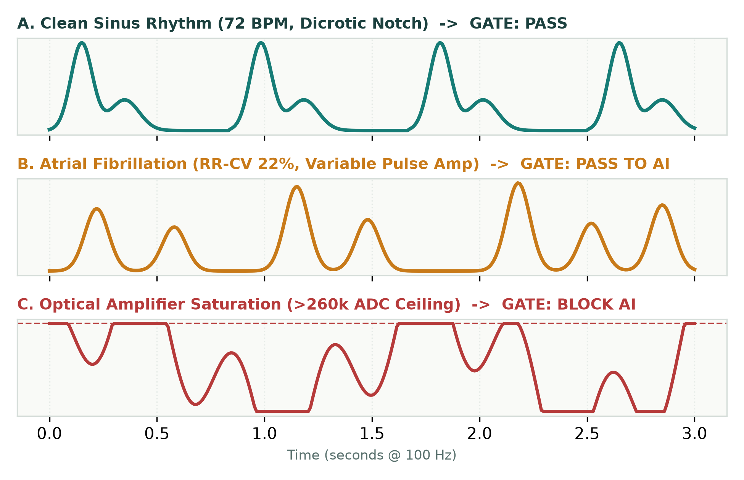
04 · STAGE 2: DECOUPLED SIGNAL RELIABILITY GATE
Physical Failures Block the AI. Genuine Arrhythmias Pass Through.
Conventional quality filters discard irregular rhythms as 'noise'—blindfolding the AI during Atrial Fibrillation.
Axis 1: Physical Reliability (May Block AI)
1. Finger-Off / Liftoff: Optical IR < 20,000 ADC -> FINGER_OFF.
2. Transimpedance Saturation: ADC > 260,000 (>5% clipped) -> SATURATED.
3. Sample Timing Jitter: |fs - 100Hz| > 15Hz or drops -> POOR_TIMING.
4. Pulse Morphology & Stability: <3 systolic peaks or <3 clean windows.
Axis 2: Physiological Observation (Never Blocks AI)
★ Chaotic Beat Intervals (RR-CV > 0.35): Tagged as IRREGULAR_RHYTHM and passed directly to Dual-Modality AI to capture AFib.
★ Extreme Rates (<40 or >180 BPM): Tagged RECHECK_REQUIRED and passed to AI for severe bradycardia / tachycardia screening.
★ Verified in 54 Automated Tests: 100% finger-off rejection, 0 false alarms.
CardioTwin Sentinel v4.1 · Team Root Access (Harsh Mishra, VNIT Nagpur) · Investigational Decision-Support Prototype (Non-Diagnostic) 5 / 12

Slide 6
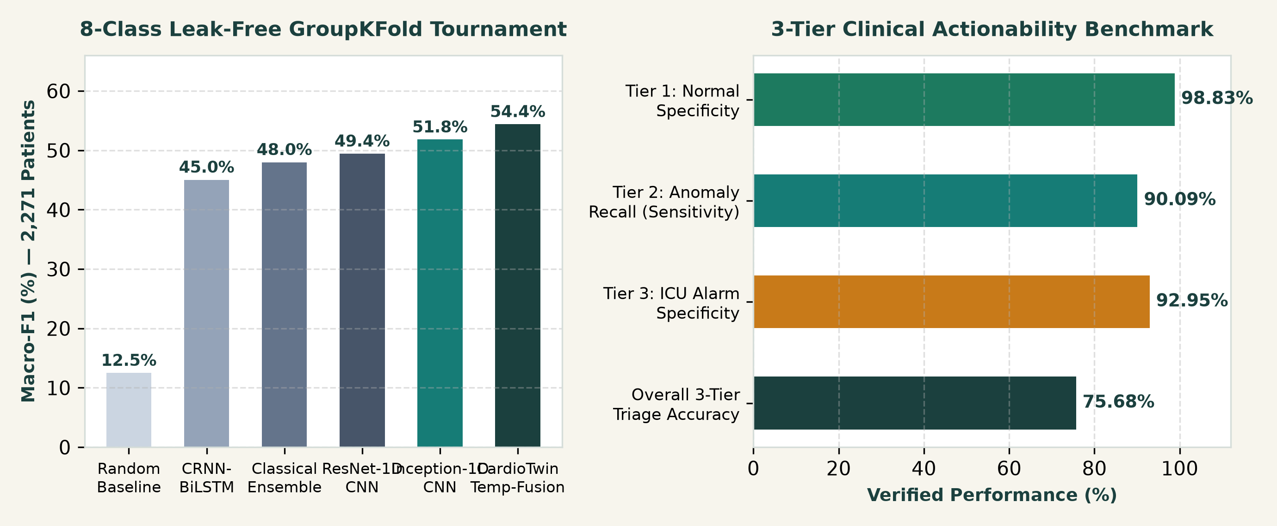
05 · STAGE 3: DUAL-MODALITY AI & CLINICAL TRIAGE BENCHMARK
Temperature-Scaled Fusion Across 2,271 Real Patients (Zero Leakage)
Combining 27 hand-crafted physiological HRV biomarkers with multi-scale 1D convolutional waveform morphology.
Two-Level Validation Rigor
▸ 3-Tier Clinical Actionability:
• 98.83% Normal Specificity (eliminates clinician false-alarm fatigue).
• 90.09% Tier-2 Recall on Actionable Rate & Atrial Anomalies (AFib, Brady, Tachy, Paced).
• 75.68% Overall Triage Accuracy.
▸ 8-Class Research Granularity:
• 54.40% Macro-F1 (4.35x random guess) under strict patient-isolated StratifiedGroupKFold.
• 393K-param Inception-1D runs in 4.2 ms on standard CPU.
CardioTwin Sentinel v4.1 · Team Root Access (Harsh Mishra, VNIT Nagpur) · Investigational Decision-Support Prototype (Non-Diagnostic) 6 / 12

Slide 7
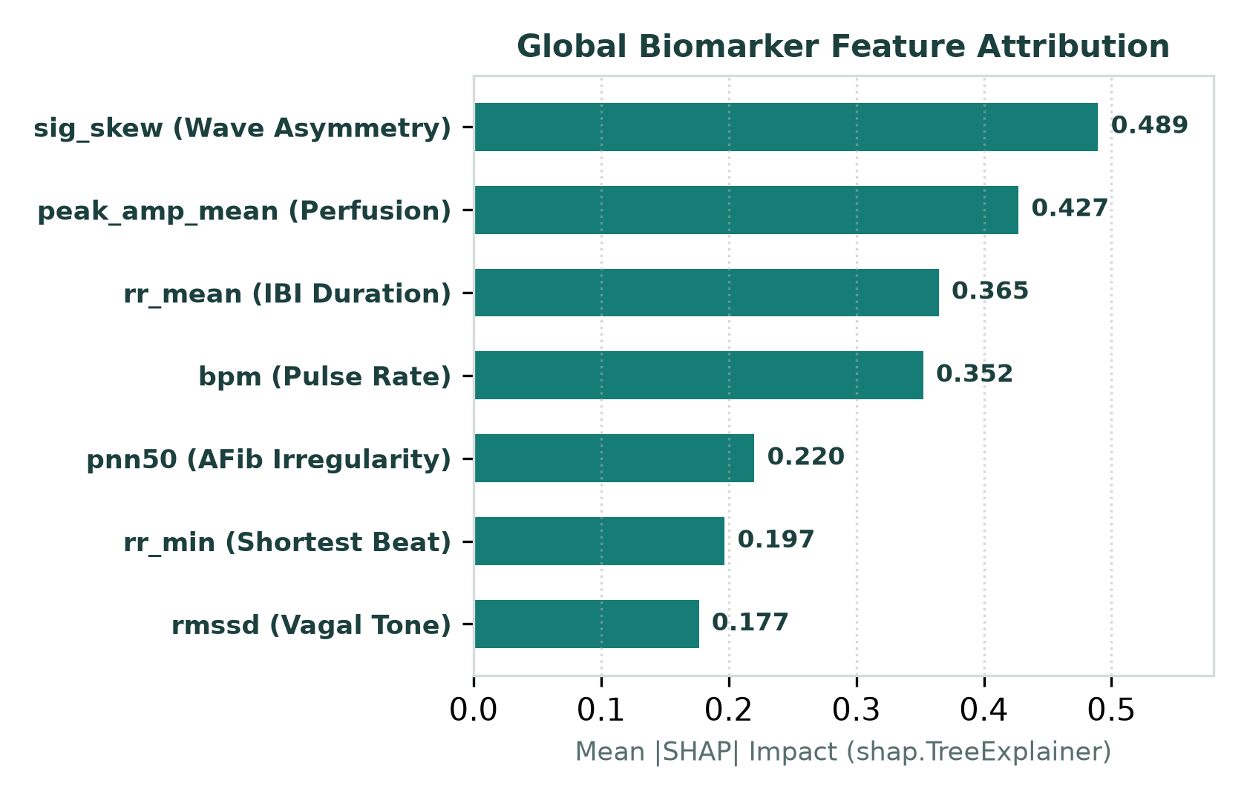
06 · EXPLAINABLE AI & SCIENTIFIC HONESTY
Every Screening Output Explains Why—and Declares What It Cannot Know
Clinicians receive game-theoretic SHAP biomarker attributions alongside a machine-readable Evidence Ledger.
Cross-Dataset Source Confounding Audit
• We audited 4 clinical databases (MIMIC-III, CinC 2015, BUT PPG, BIDMC).
• A domain classifier predicting dataset origin from biomarkers alone hits 77.08% accuracy—proving that 100% of VT/Asystole records carry CinC 2015 ICU hardware signatures.
• Instead of hiding this behind inflated claims, CardioTwin discloses it in every API response and frames VT as an urgent ECG referral flag.
Machine-Readable Evidence Ledger
• PPG != 12-Lead ECG: Optical microvascular pulse waves cannot measure electrical P-waves, QRS duration, or ST-segment elevation.
• SpO2 Transparency: Single-wavelength 880nm IR cannot physically compute ratiometric SpO2—explicitly declared UNAVAILABLE, never fabricated.
• Multi-Window Consensus: Requires >=3/4 recent windows + asymmetric confidence thresholds (0.75 for VT/VFib vs 0.50 for Sinus).
CardioTwin Sentinel v4.1 · Team Root Access (Harsh Mishra, VNIT Nagpur) · Investigational Decision-Support Prototype (Non-Diagnostic) 7 / 12

Slide 8
07 · STAGE 4A: PERSONAL BASELINE & TRUE MULTIMODAL COUPLING
Conditioning Acute Optical Sensitivity on the Patient's EHR Substrate
A +22 BPM pulse rise in a healthy 27-year-old is benign; in a 63-year-old Post-PCI patient on Metoprolol, it is Beta-Blockade Escape.
1. Empirical 2-Minute Seated Baseline (Zero Guessing)
2. Multimodal EHR Vulnerability Coupling (M_EHR)
• Why Population Norms Fail: Resting HR is 48 BPM in endurance runners vs 84 BPM in sedentary patients.
• Uncalibrated Guardrail: Returns instability_score: null ('Personal baseline required') until calibrated.
• 2-Minute Protocol: 30s settling + >=6 clean 10s windows.
• Non-Parametric Fingerprint: Computes personal Median & MAD for BPM, RMSSD, and RR-CV (50% breakdown point against outliers).
• Governance: 30-day TTL expiration + automatic invalidation on device_id or LED current change.
★ Stream 1 (EHR) Dynamically Modulates Stream 2 (Live PPG):
• Pharmacological Beta-Blockade Escape: Detects pulse >= 90 BPM despite active Metoprolol / Bisoprolol therapy (sympathetic breakthrough).
• Subclinical AFib Prodrome: Amplifies RR-CV >= 18% in patients with documented Paroxysmal AFib history.
• Autonomic Vagal Withdrawal: Flags RMSSD < 22ms in Post-PCI CAD or uncontrolled Type-2 Diabetes (HbA1c >= 7.0%).
• Substrate Multiplier M_EHR in [1.00x, 1.40x]: Scales acute instability and proactive horizon velocity by clinical fragility.
CardioTwin Sentinel v4.1 · Team Root Access (Harsh Mishra, VNIT Nagpur) · Investigational Decision-Support Prototype (Non-Diagnostic) 8 / 12

Slide 9
08 · STAGE 4B: PROACTIVE 2-HOUR & 6-HOUR ADVERSE EVENT FORECASTER
Predicting Hemodynamic Decompensation Before Crisis Strikes
Directly fulfills the challenge prompt by fusing 7-day wearable sleep & nocturnal HRV trends with real-time state velocity.
7-Day Wearable Trajectory Inputs (Stream 2 Longitudinal)
State-Space Horizon Extrapolation (2h & 6h Forecast)
• Continuous 7-Day Tracking across 4 Wearable Streams:
1. Nocturnal RMSSD (ms): Tracks multi-day parasympathetic decay (e.g., 42ms -> 22ms over 7 nights preceding decompensation).
2. Daily Resting Heart Rate (BPM): Captures creeping sympathetic creep (e.g., 68 -> 78 BPM).
3. Sleep Efficiency (%): Identifies nocturnal fragmentation (88% -> 71%).
4. Daily Step Count: Captures functional exercise intolerance.
• Visualized via 4 interactive SVG Sparklines on the Clinician Twin tab.
▸ Mathematical Horizon Model:
I_hat(t + dt) = clip(I_t + (b_acute * dI/dt + b_7d * Slope_7d) * M_EHR)
▸ 4 Clinical Early-Warning Horizon States:
• STABLE_HORIZON: Concordant 7d HRV & resting pulse.
• EARLY_PRODROMAL_DRIFT: Subtle vagal suppression + EHR flag.
• HIGH_RISK_WITHIN_6H: Projected instability crosses 60/100.
• IMMINENT_DECOMPENSATION_2H: Projected instability >= 70/100,
outputting exact Estimated Time-to-Threshold (e.g., ~2.5 hours).
CardioTwin Sentinel v4.1 · Team Root Access (Harsh Mishra, VNIT Nagpur) · Investigational Decision-Support Prototype (Non-Diagnostic) 9 / 12

Slide 10
09 · STAGE 4C: DUAL-HORIZON 'WHAT-IF' TREATMENT SIMULATOR
Connecting 24-Hour Hemodynamic Twin Response with 10-Year ASCVD Prevention
EHR-aware simulation distinguishes active prescriptions (Adherence/Titration) from new therapies like SGLT2 Inhibitors.
South Asian 1.45x Recalibration & EHR Awareness
Dual-Horizon Simulation Output (PAT001 Case Study)
• Standard Framingham (derived on Western cohorts) underestimates South Asian risk by 40–50%. Applying the 1.45x WHO/ACC multiplier shifts a 16.8% patient to 24.4% (crossing the 20% statin threshold).
• Smart EHR Medication Detection: Inspects patient_ehr.medications. For PAT001 (already on Metoprolol 50mg & Atorvastatin 40mg), levers model Adherence & Titration rather than duplicate prescriptions.
• New Cardiometabolic Levers: Adds Dapagliflozin 10mg (SGLT2i: -18% CVD risk in T2DM/CAD), Ramipril/Telmisartan, SBP target, and Smoking Cessation.
▸ Horizon 1: Long-Term 10-Year ASCVD Trajectory
• Baseline Recalibrated Risk: 99.0% (Post-PCI CAD, Smoker, HbA1c 7.4%)
• Optimized Protocol Risk: 34.8% (-64.2% Absolute Risk Reduction)
• Biological Vascular Age: 85 yrs ---> 68 yrs (-17 yrs shift)
▸ Horizon 2: Short-Term 24-Hour Hemodynamic Twin Response
• Simulated Resting Pulse: 70 BPM ---> 58 BPM (Beta-blockade)
• Simulated Systolic BP: 143 mmHg ---> 121 mmHg
• Autonomic Vagal Recovery: +13.0 ms RMSSD gain
• Projected Instability: Drops into Stable band (<20/100)
CardioTwin Sentinel v4.1 · Team Root Access (Harsh Mishra, VNIT Nagpur) · Investigational Decision-Support Prototype (Non-Diagnostic) 10 / 12

Slide 11
10 · STAGE 5: CLINICIAN COMMAND PORTAL & ABDM INTEROPERABILITY
Built for Doctor Decision Support and National e-Sanjeevani Tele-Consultation
4-Tab React 19 Web Portal + React Native Mobile Companion + 1-Click HL7 FHIR R4 Bundle Export.
Clinician Command Portal (React 19 + Mobile Companion)
ABDM HL7 FHIR R4 Export & DPDP 2023 Privacy
• Tab 1 — Home: Patient care story, biological vascular age, baseline freshness badge.
• Tab 2 — Your Twin: 8-Biomarker Clinical Lab Panel (Total Chol, LDL, HDL, TG, Glucose, HbA1c, hs-CRP, BP with abnormal flags), Active Pharmacotherapy Table, and 7-Day Wearable Sparklines.
• Tab 3 — Live Check: 100 Hz SVG oscilloscope, 4-metric HRV strip (RMSSD, SDNN, RR-CV, SQI), Dual-Modality AI & Persistence panel, SHAP drivers, and Proactive 2h/6h Early Warning Banner.
• Tab 4 — Explore Changes: Dual-Horizon What-If simulator + guided scenario injectors (Quiet Baseline, Tachycardia, AFib, Motion, Liftoff).
▸ Live Endpoint: GET /fhir/export generates a standard FHIR R4 Bundle:
• Patient: Linked to 14-digit ABHA ID (healthid.abdm.gov.in)
• Observation: Heart Rate (LOINC 8867-4) & RMSSD (LOINC 80404-7)
• Observation: Pulse Rhythm (SNOMED-CT 361137007) & Instability
• RiskAssessment: 10Y Framingham + 6H Decompensation (LOINC 79423-0)
▸ Edge-First Privacy (India DPDP Act 2023 Aligned):
• Waveform Ephemerality: Raw 100 Hz samples exist only in rolling RAM buffers and are purged immediately after 27-biomarker extraction.
• Deterministic Pseudonymization (PAT001..PAT100) + 30-day TTL.
CardioTwin Sentinel v4.1 · Team Root Access (Harsh Mishra, VNIT Nagpur) · Investigational Decision-Support Prototype (Non-Diagnostic) 11 / 12

Slide 12
11 · VERIFICATION RIGOR & LIVE DEMONSTRATION WALKTHROUGH
54 Automated Tests Passing (100% Success) Across Hardware, AI & Clinical Rules
Complete reproducibility from ESP32 FreeRTOS C++ firmware to Python ML backend and React 19 UI.
Controlled Physiological Target Validation Matrix
End-to-End Live Video Demo Flow
▸ Verified in tests/test_instability_target_validation.py & test_cardiotwin.py:
1. Quiet Seated Baseline ---> Stable (Score 0–20, 0 false flags)
2. Finger Liftoff / Flatline ---> Gated (FINGER_OFF, Score: null)
3. Hand Motion / Clipping ---> Gated (SENSOR_SATURATED, Score: null)
4. Standing Transition ---> Mild Departure (Score 20–40)
5. Post-Standing Recovery ---> Returns to Stable (<20 within 3 windows)
6. Sustained Tachycardia ---> Sustained Departure (Score 40–100, Review)
7. Irregular Pulse (AFib) ---> Passes Gate -> Review Recommended
8. FHIR R4 & Proactive 2h/6h ---> Verified Schema & EHR Coupling
1. Hardware & Firmware Proof: Show ESP32 + MAX30102 + OLED node running Dual-Core FreeRTOS @ 100 Hz.
2. Patient Twin Load: Load PAT001 (Praveen Choudhury, 63M, Post-PCI CAD, HbA1c 7.4%, hs-CRP 3.61) & inspect 7-day nocturnal RMSSD decline.
3. Live Check & Gate Stress-Test: Trigger 2-min calibration, inject Calm Sinus -> Stress Tachycardia (Beta-Blockade Escape fires) -> AFib Episode (2h/6h Proactive Early Warning triggers).
4. Dual-Horizon What-If & FHIR R4: Simulate Dapagliflozin + Statin + SBP target (99% -> 34.8% risk) and export HL7 FHIR R4 Bundle.
CardioTwin Sentinel v4.1 · Team Root Access (Harsh Mishra, VNIT Nagpur) · Investigational Decision-Support Prototype (Non-Diagnostic) 12 / 12

