Slide 1




SMART INDIA HACKATHON 2026
Deadlock
THERMALINTEL - AI-Powered Geospatial Intelligence for Industrial Fire & Thermal Anomaly Detection
  Problem Statement ID - SIH26162
  Problem Statement Title - AI-Based Detection and Classification of Industrial Fires and Persistent Thermal Sources Using NASA FIRMS, OSM & Satellite Data
  Theme - Disaster Management
  PS Category - Software
  Team ID -
  Team Name - Deadlock

Slide 2
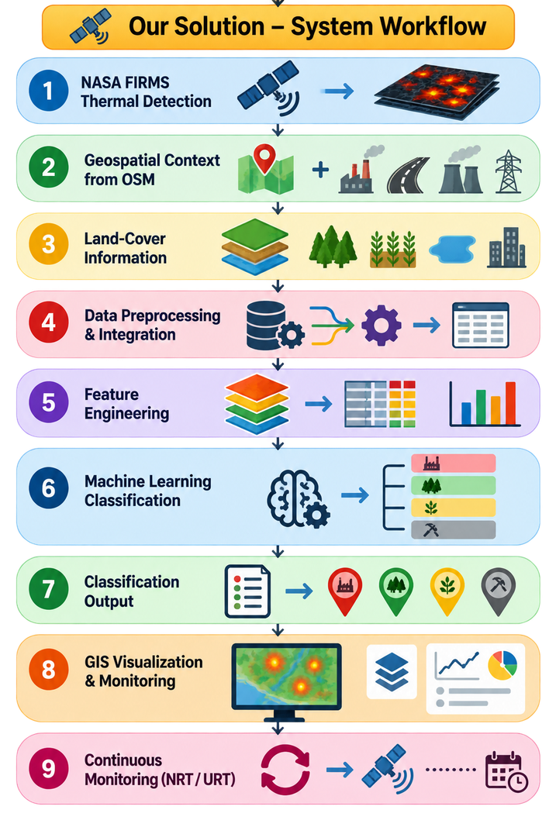
Deadlock
IDEA TITLE
From Satellite Hotspots to Actionable Industrial Risk Intelligence
Uniqueness
Proposed Idea / Approach
Current satellite fire-monitoring systems such as NASA FIRMS detect thermal anomalies but cannot reliably distinguish industrial fires and persistent thermal sources from forest, agricultural and other fires. Our system addresses this gap by combining thermal, geographic and land-cover intelligence with AI-based classification.
Following is our Idea/Approach:
  Multi-Source Thermal Dataset: Integrates NASA FIRMS, OSM and Land-Cover data to build a contextualized dataset of detected thermal anomalies.
  Geospatial Feature Engineering: Extracts thermal, spatial, temporal, proximity and land-cover features around each FIRMS detection.
  AI Fire Classification Engine: Uses Machine Learning to learn patterns and classify FIRMS-detected anomalies into industrial and non-industrial fire/thermal-source categories.
  Dynamic FIRMS Monitoring: Applies the trained pipeline to NASA FIRMS NRT/URT detections to classify newly detected thermal anomalies.
  GIS-Based Intelligence: Displays classified anomalies as map overlays with location, source category and confidence, enabling easier monitoring and decision-making.
  Multi-Source Fire AI — Contextualizes and classifies FIRMS thermal anomalies.
  Facility Thermal Fingerprint — Detects deviations from each facility’s normal behaviour.
  Dynamic Fire-Risk Map — Maps changing fire risk from fuel and environmental conditions.
  Regulatory Cross-Check — Adds regulatory context to identified industrial events.
  Continuous FIRMS Monitoring — Tracks new and persistent thermal sources.
How it Addresses the Problem
  NASA FIRMS detects the initial thermal anomalies.
  OSM and land-cover data provide context around each detected location.
  Feature engineering extracts meaningful spatial, thermal and temporal patterns.
  Machine learning classifies the detected anomalies into relevant fire/thermal-source categories.
  NRT/URT FIRMS data enables the pipeline to process new detections for ongoing monitoring.
  GIS visualization overlays the classified results on maps, helping authorities identify and prioritize industrial and persistent thermal sources.
@SIH Idea submission- Template
2
Notes:
2

Slide 3
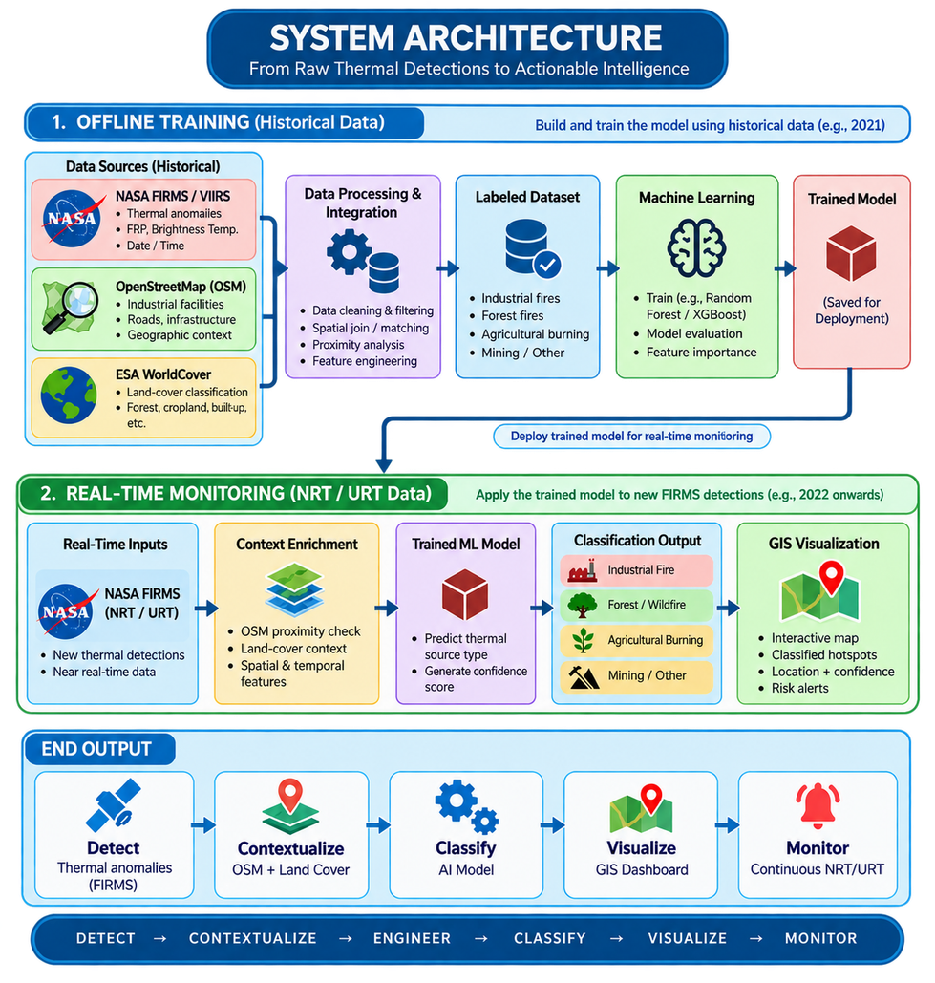








TECHNICAL APPROACH
Deadlock
TECHNICAL STACK
Frontend : Web GIS Dashboard
React + TypeScript | Google Maps API + Leaflet.js | Leaflet-Heat + Chart.js | Vanilla CSS3
Backend : API & ML Inference
FastAPI |Pydantic v2 | GeoJSON
AI/ML Engine : Thermal Classification
Weighted XGBoost | Scikit-Learn | NumPy | Pandas | Feature Engineering
Satellite & Geospatial Data
NASA FIRMS/VIIRS | ESA WorldCover 10m | OpenStreetMap | GeoPandas | Rasterio | Shapely
Persistence Tracking
DBSCAN Spatial Clustering | SciPy cKDTree | Recurrence & Persistence Algorithms
@SIH Idea submission- Template
2
Notes:
2

Slide 4
FEASIBILITY AND VIABILITY
Deadlock
Feasibility
Challenges
  Incomplete OSM Data: Missing or outdated facility records can affect classification.
  Class Imbalance: Uneven classes can reduce ML performance.
  Label Uncertainty: Automated labels may contain noise and require validation.
  Limited Resolution: Small or closely located thermal sources may be difficult to distinguish.
  Evolving Industrial Landscape: New industries, facility changes and regulatory updates require periodic model updates.
❖ Ready-to-Use Data Ecosystem – NASA FIRMS thermal data, OSM industrial features and WorldCover land-cover data provide the required inputs for source classification.
❖ AI-Ready Geospatial Pipeline – Spatial matching, feature engineering and ML classification transform raw thermal detections into classified fire/thermal sources.
❖ Low-Cost & Scalable Architecture – Built using open-source Python, GeoPandas, Rasterio and Scikit-learn, enabling cost-effective processing without specialized hardware.
❖ Continuous Monitoring Capability – The trained pipeline can process NASA FIRMS NRT/URT detections and update GIS outputs for ongoing monitoring of emerging and persistent thermal sources.
Strategies to Overcome Challenges
  Multi-Source Fusion: Combine FIRMS, OSM and land-cover data.
  Balanced Training: Use class balancing and stratified sampling.
  Label Validation: Refine automated labels through filtering and manual checks.
  Feature Fusion: Combine thermal, spatial, land-cover and temporal features.
  Model Updating: Periodically update the model for new industries and regulatory changes.
@SIH Idea submission- Template
2
Notes:
2

Slide 5
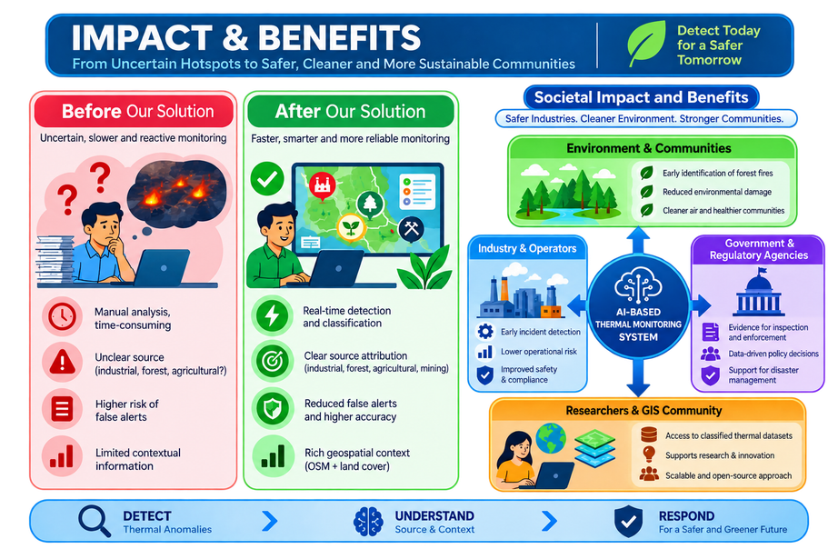
IMPACT AND BENEFITS
Deadlock
TARGET AUDIENCE / IMPACT
❖ Industrial Operators:
Early identification of abnormal thermal activity around industrial facilities.
❖ Disaster Management:
Faster prioritization of potentially hazardous thermal events for timely response.
❖ Forest & Environmental Agencies:
Better separation of industrial thermal sources from forest and natural fires.
❖ Regulatory Authorities:
Geospatial evidence to support inspection, investigation and data-driven decisions.
❖ GIS & Monitoring Teams:
Unified map-based view of classified and persistent thermal sources for continuous monitoring.
Benefits of the Solution
  Early detection & monitoring: Automatically identifies industrial fires and persistent thermal hotspots using satellite data, enabling faster response.
  Environmental & public safety: Helps monitor forest, vegetation, and industrial thermal activity to identify potential environmental and safety risks.
  Cost-effective & scalable: Reduces dependence on extensive ground monitoring and can be scaled to monitor large regions through FIRMS, ML, and GIS.
@SIH Idea submission- Template
5
Notes:
5

Slide 6

RESEARCH AND REFERENCES
Deadlock
Research
Data Sources
Github Link
Live Demo
@SIH Idea submission- Template
2
Notes:
2

Slide 7
RESEARCH AND REFERENCES
Deadlock
RESEARCH & DATA SOURCES
PROTOTYPE LINKS
▶ NASA FIRMS — Fire Information for Resource Management System.
Project Repository
Available at: firms.modaps.eosdis.nasa.gov/active_fire/
(Active-fire / thermal-anomaly data from MODIS, VIIRS and Landsat; VIIRS products provide ~375 m observations.)
ADD GITHUB / GITLAB LINK
▶ Giglio et al. / NASA MODIS & VIIRS Active Fire Research.
Prototype / Demo
Available at: doi.org/10.1016/j.rse.2015.11.030
(Scientific foundation for satellite active-fire detection and thermal anomaly analysis.)
ADD LIVE DEMO LINK
▶ ESA WorldCover.
Available at: esa-worldcover.org/en/data-access
(Global 10 m land-cover data used to provide environmental and land-use context around thermal events.)
RESEARCH & DATA STACK
▶ Copernicus Sentinel-2.
NASA
FIRMS thermal anomalies
Available at: dataspace.copernicus.eu/data-collections/copernicus-sentinel-missions/sentinel-2
WorldCover land cover
(Multispectral satellite imagery for vegetation, burn-scar and industrial-area contextual analysis.)
ESA
▶ OpenStreetMap.
COPERNICUS
Sentinel-2 imagery
Available at: www.openstreetmap.org/
(Open geospatial infrastructure data for industrial facilities, roads, settlements and nearby assets.)
OSM
Industrial / infrastructure context
▶ Lundberg & Lee, 2017 — A Unified Approach to Interpreting Model Predictions.
FSI
Forest-fire validation
Available at: proceedings.neurips.cc/paper/2017/hash/8a20a8621978632d76c43dfd28b67767-Abstract.html
(SHAP-based explainability for interpreting machine-learning predictions.)
@SIH Idea submission- Template
6
Notes:
6

