Slide 1

Basic Details of the Team and Problem Statement
Ministry/Organization Name/Student Innovation: Policy Planning Cell, Ministry of Information & Broadcasting
PS Code: NS1230
Problem Statement Title: An AI/ML based solution that generates short summaries of press releases for easy and more targeted dissemination of information to the people. Such a TL,DR (Too Long, Didn’t Read) software may be integrated in an app-based solution.
Team Name: Team Meta
Team Leader Name: Harsh Harode
Institute Code:
Institute Name: Datta Meghe College of Engineering
Theme Name: Smart Automation

Slide 2
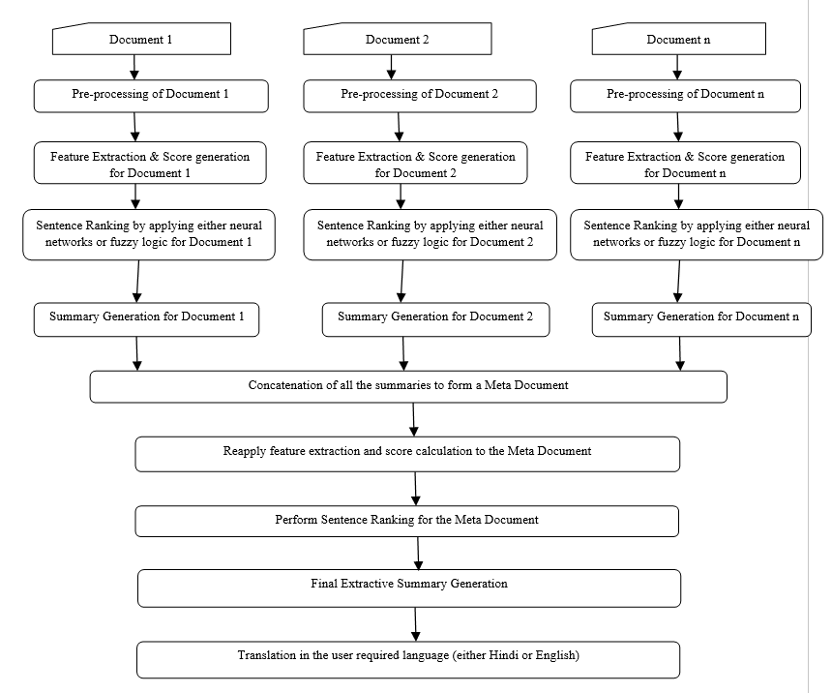
Idea/Approach Details
Describe your idea/Solution/Prototype here:
By scanning press release we will identity type of press release with language
Fit Into algorithm
Ask user to choose language if user want to convert summary into other language
Fit into LSTM/Hybrid Approach if user selects language translation
Display Summary
Technology stack
Frontend : HTML, CSS
Backend : Python, Machine Learning, Fuzzy Logic, Deep Learning, Django Framework, Sqlite3
API : Tensorflow

Slide 3
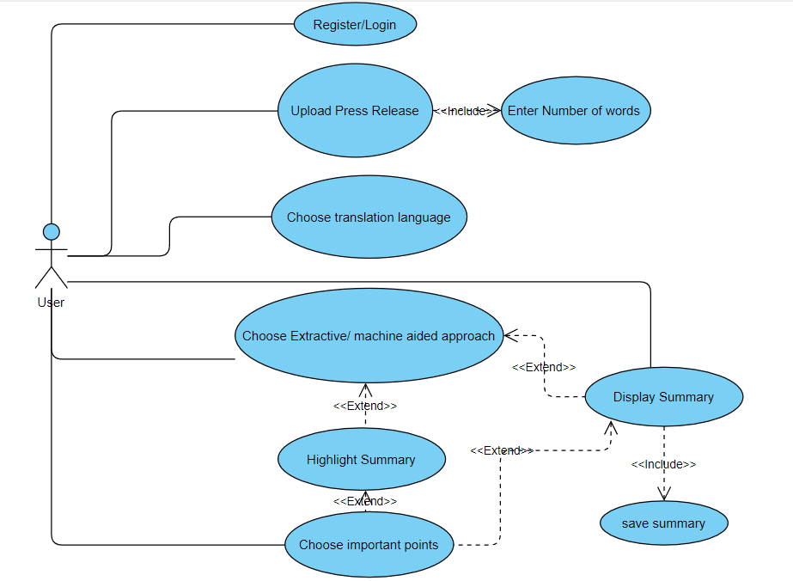
Idea/Approach Details
Describe your Use Cases here
Describe your Dependencies / Show stopper here
It should be valid URL if user want to summarize press release from particular weblink
While uploading press release photo, it should have visible text
Image should not be too blur.

Slide 4
Team Member Details
Team Leader Name: Harsh Narendra Harode
Branch : BE Stream : CSE Year : III
Team Member 1 Name: Amit Balaji Jadhav
Branch : BE Stream : CSE Year : III
Team Member 2 Name: Ankush Pradeep Gupta
Branch : BE Stream : CSE Year : III
Team Member 3 Name: Makarand Milind Bhalerao
Branch : BE Stream : CSE Year : III
Team Member 4 Name: Pratiksha Dattatraya Chikane
Branch : BE Stream : CSE Year : III
Team Member 5 Name: Omkar Chandrakant Pate
Branch : BE Stream : CSE Year : III
Team Mentor 1 Name: Type Your Name Here
Category (Academic/Industry): Expertise (AI/ML/Blockchain etc): Domain Experience (in years):
Team Mentor 2 Name: Type Your Name Here
Category (Academic/Industry): Expertise (AI/ML/Blockchain etc): Domain Experience (in years):

