Slide 1
Logistics Optimization for Delivery Routes – Flipkart
Name: Harsh Srivastav
Course: Data Science (15th Jan Batch)
Tools used: MYSQL, Workbench, PowerPoint

Slide 2
TASK 1: Data Cleaning & Preparation
CASE 1:- Identify and delete duplicate Order_ID records.
QUERY:-
SELECT Order_ID, COUNT(*)
FROM orders
GROUP BY Order_ID
HAVING COUNT(*) > 1;
Output:- No duplicate records found
Insight:- Dataset is clean with no duplicate Order_ID entries.
CASE 2:- Replace null Traffic_Delay_Min with the average delay for that route.
QUERY:-
SELECT *
FROM routes
WHERE Traffic_Delay_Min IS NULL;
Output: No NULL values found

Slide 3
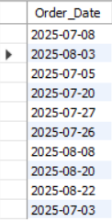
CASE 3:- Convert all date columns into YYYY-MM-DD format using SQL functions.
QUERY:
SELECT Order_Date FROM orders;
Result: Dates are already in (YYYY-MM-DD) format.
Insight: All date fields were already in the required (YYYY-MM-DD) format.
No transformation was needed.
Output:
CASE 4:- Ensure that no Actual_Delivery_Date is before Order_Date (flag such records).
QUERY:
SELECT *
FROM orders
WHERE Actual_Delivery_Date < Order_Date
Result:- No records found where Actual Delivery Date is before Order Date.
Insight:- All delivery dates are valid, ensuring data consistency and reliability.

Slide 4
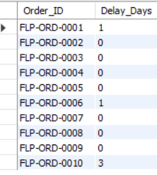
TASK 2: Delivery Delay Analysis
CASE 1:- Calculate delivery delay (in days) for each order
QUERY:
SELECT Order_ID, DATEDIFF(Actual_Delivery_Date, Expected_Delivery_Date) AS Delay_Days
FROM orders
LIMIT 10;
Output:
CASE 2:- Find Top 10 delayed routes based on average delay days.
QUERY:
SELECT Route_ID, AVG(DATEDIFF(Actual_Delivery_Date, Expected_Delivery_Date)) AS avg_delay_days
FROM orders
GROUP BY Route_ID
ORDER BY avg_delay_days DESC
LIMIT 10;

Slide 5
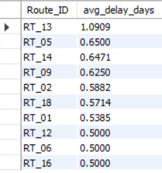
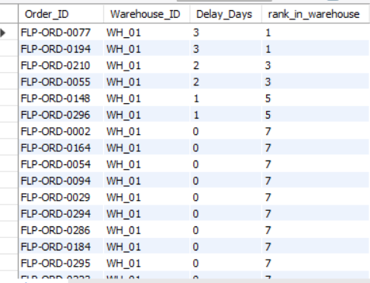
Output:-
CASE 3:- Use window functions to rank all orders by delay within each warehouse.
QUERY:
SELECT Order_ID, Warehouse_ID, DATEDIFF(Actual_Delivery_Date, Expected_Delivery_Date) AS Delay_Days,
RANK() OVER(PARTITION BY Warehouse_ID ORDER BY DATEDIFF(Actual_Delivery_Date, Expected_Delivery_Date) DESC) AS rank_in_warehouse
FROM orders;
Output:-

Slide 6
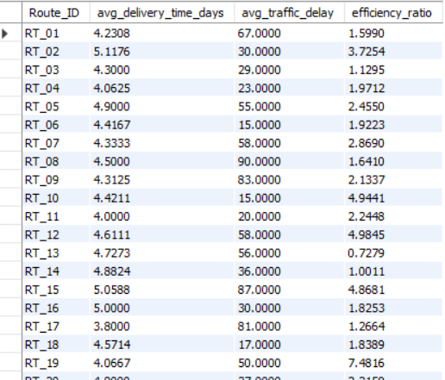
TASK 3: Route Optimization Insights
CASE 1:- For each route, calculate: Average delivery time (in days), Average traffic delay, Distance-to-time efficiency ratio:
Distance_KM / Average_Travel_Time_Min.
QUERY:
SELECT o.Route_ID, AVG(DATEDIFF(o.Actual_Delivery_Date, o.Order_Date)) AS avg_delivery_time_days,
AVG(r.Traffic_Delay_Min) AS avg_traffic_delay,
(r.Distance_KM / r.Average_Travel_Time_Min) AS efficiency_ratio
FROM orders o
JOIN routes r
ON o.Route_ID = r.Route_ID
GROUP BY o.Route_ID, r.Distance_KM, r.Average_Travel_Time_Min
ORDER BY o.Route_ID
Output:

Slide 7
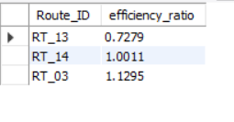
CASE 2:- Identify 3 routes with the worst efficiency ratio.
QUERY:
SELECT Route_ID,
(Distance_KM / Average_Travel_Time_Min) AS efficiency_ratio
FROM routes
ORDER BY efficiency_ratio ASC
LIMIT 3;
Output:
Insight: Routes with lowest efficiency ratio indicate poor travel performance and require optimization.
CASE 3:- Find routes with >20% delayed shipments.
QUERY:
SELECT Route_ID,
SUM(CASE
WHEN Actual_Delivery_Date > Expected_Delivery_Date THEN 1
ELSE 0
END) AS delayed_orders,
COUNT(*) AS total_orders,
ROUND(SUM(CASE
WHEN Actual_Delivery_Date > Expected_Delivery_Date THEN 1
ELSE 0
END)* 100 / COUNT(*), 2) AS delay_percentage
FROM orders
GROUP BY Route_ID
HAVING delay_percentage > 20;

Slide 8
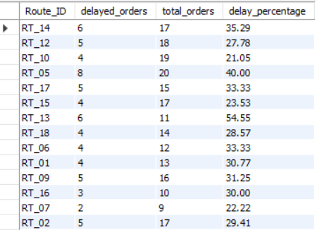
Output:
Insight: Routes with more than 20% delayed shipments indicate consistent inefficiencies.
CASE 4: Recommend potential routes for optimization.
Recommendations:
Routes with low efficiency (such as RT_13, RT_14, RT_03, RT_17) should be improved by optimizing route planning and selecting shorter or faster paths.
Routes with high traffic delays (like RT_08, RT_15, RT_17, RT_09) should use alternate routes and avoid peak traffic hours to reduce congestion(overcrowding).
Routes experiencing both high delay and high traffic (e.g., RT_15, RT_17) requires advanced traffic management strategies such as adjust delivery timings (like early morning or at night) and apply dynamic routing (change route during travel).
Routes with high delivery time (such as RT_02, RT_16) should be improving by assigning experienced agents and improving warehouse processing efficiency.
High-performing routes (like RT_10. RT_12, RT_19) should be used as benchmarks for optimizing other routes.

Slide 9

TASK 4: Warehouse Performance
CASE 1: Find the top 3 warehouses with the highest average processing time.
QUERY:
SELECT Warehouse_ID, Warehouse_Name, Average_Processing_Time_Min
FROM warehouses
ORDER BY Average_Processing_Time_Min DESC
LIMIT 3;
Output:
Insight: Warehouses with the highest processing time indicate slower internal operations and require optimization.
CASE 2: Calculate total vs. delayed shipments for each warehouse.
QUERY:
SELECT
Warehouse_ID,
COUNT(*) AS total_shipments,
SUM(CASE WHEN Actual_Delivery_Date > Expected_Delivery_Date THEN 1 ELSE 0 END) AS delayed_shipments
FROM orders
GROUP BY Warehouse_ID;

Slide 10
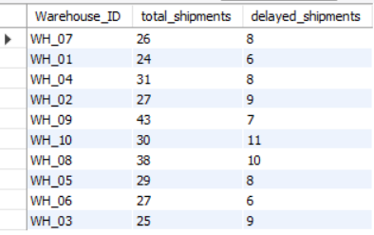
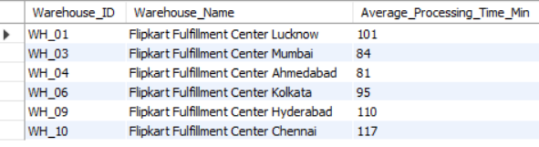
Output:
Insight: Warehouses with higher delay percentages show inefficiencies in order processing and delivery coordination.
CASE 3: Use CTEs to find bottleneck warehouses where processing time > global average.
QUERY:
WITH fly AS (SELECT AVG(Average_Processing_Time_Min) AS global_average
FROM warehouses)
SELECT w.Warehouse_ID, w.Warehouse_Name, w.Average_Processing_Time_Min FROM warehouses AS w, fly AS f
WHERE w.Average_Processing_Time_Min > f.global_average
Output:

Slide 11
Insight: Warehouses with processing time above the global average act as bottlenecks in the logistics system. A bottleneck is a stage in a process that reduces overall efficiency because it operates slower than others.
CASE 4: Rank warehouses based on on-time delivery percentage.
QUERY 1:
SELECT Warehouse_ID,
ROUND(
SUM(CASE
WHEN Actual_Delivery_Date <= Expected_Delivery_Date THEN 1
ELSE 0
END)*100 / COUNT(*), 2
) AS on_time_delivery_percentage,
RANK() OVER(
ORDER BY SUM(CASE WHEN Actual_Delivery_Date <= Expected_Delivery_Date THEN 1 ELSE 0 END)*100 / COUNT(*) DESC
) AS performance_rank
FROM orders
GROUP BY Warehouse_ID;
QUERY 2:
WITH warehouse_rank AS (
SELECT Warehouse_ID,
ROUND(
SUM(CASE WHEN Actual_Delivery_Date <= Expected_Delivery_Date THEN 1 ELSE 0 END)*100 / COUNT(*), 2 )AS on_time_delivery_percentage
FROM orders
GROUP BY Warehouse_ID
)
SELECT Warehouse_ID, on_time_delivery_percentage,
RANK() OVER(ORDER BY on_time_delivery_percentage DESC) AS performance_rank
FROM warehouse_rank;
Insight: Warehouses were ranked based on on-time delivery percentage, with higher percentages indicating better performance.

Slide 12
Task 5: Delivery Agent Performance
CASE 1: Rank agents (per route) by on-time delivery percentage.
QUERY 1:
WITH fly AS (
SELECT Agent_ID, Route_ID,
ROUND(
SUM(CASE
WHEN Actual_Delivery_Date <= Expected_Delivery_Date THEN 1
ELSE 0
END)*100 / COUNT(*),2
) AS on_time_delivery_percentage,
DENSE_RANK() OVER(
PARTITION BY Route_ID
ORDER BY (
SUM(CASE
WHEN Actual_Delivery_Date <= Expected_Delivery_Date THEN 1
ELSE 0
END)*100 / COUNT(*)) DESC
) AS performance_rank
FROM orders
GROUP BY Route_ID, Agent_ID
)
SELECT Agent_ID, Route_ID, on_time_delivery_percentage, performance_rank
FROM fly;

Slide 13
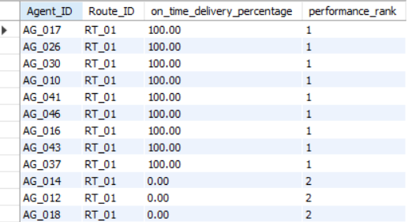
QUERY 2:
SELECT Agent_ID, Route_ID,
ROUND(
SUM(CASE
WHEN Actual_Delivery_Date <= Expected_Delivery_Date THEN 1
ELSE 0
END)*100 / COUNT(*),2
) AS on_time_delivery_percentage,
DENSE_RANK() OVER( PARTITION BY Route_ID
ORDER BY (
SUM(CASE
WHEN Actual_Delivery_Date <= Expected_Delivery_Date THEN 1
ELSE 0
END)*100 / COUNT(*)) DESC
) AS performance_rank
FROM orders
GROUP BY Route_ID, Agent_ID;
Output:
Insight: Agents were ranked within each route based on their on-time delivery performance.

Slide 14
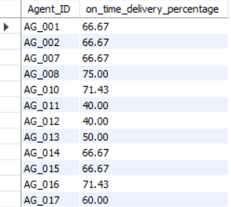
CASE 2: Find agents with on-time % < 80%.
QUERY:
SELECT Agent_ID,
ROUND(
SUM(CASE
WHEN Actual_Delivery_Date <= Expected_Delivery_Date THEN 1
ELSE 0
END)*100 / COUNT(*),2
) AS on_time_delivery_percentage
FROM orders
GROUP BY Agent_ID
HAVING on_time_delivery_percentage < 80;
Output:
Insight: Agents with on-time delivery percentage below 80% are identified as low performers.

Slide 15

CASE 3: Compare average speed of top 5 vs bottom 5 agents using subqueries.
QUERY:
SELECT
AVG(temp1.Avg_Speed_KMPH) AS Top_5_Avg_Speed,
AVG(temp2.Avg_Speed_KMPH) AS Bottom_5_Avg_Speed
FROM
(SELECT Avg_Speed_KMPH
FROM delivery_agents
ORDER BY Avg_Speed_KMPH DESC
LIMIT 5) AS temp1,
(SELECT Avg_Speed_KMPH
FROM delivery_agents
ORDER BY Avg_Speed_KMPH ASC
LIMIT 5) AS temp2
Output:
CASE 4: Suggest training or workload balancing strategies for low performers
Targeted Training Program: Provide route specific training for agents with 0 – 40% delivery performance. Agents like AG_020, AG_034, AG_011 need immediate training and needs to focus on time management, route optimization, handling delays.
Mentorship by Top Performers: Pair low performers with high performers (like AG_017, AG_026, AG_030). This improves real-world learning faster than theory.
Workload Balancing: Reduce workload on low performers initially and assign shorter routes and less complex deliveries to low performers and then gradually increase workload after improvement.
Route Optimization: Some routes may be harder (like traffic, distance) so reassign difficult routes from low performers to experienced agents.
Speed Improvement Strategies: Since bottom agents have low avg speed (35 KMPH) so provide navigation tools (GPS optimization) and improve vehicle efficiency.

Slide 16
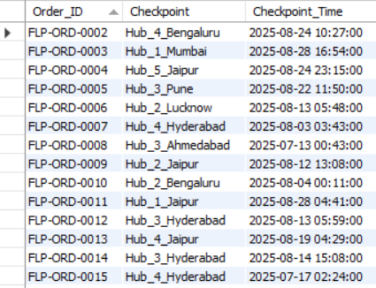
Task 6: Shipment Tracking Analytics
CASE 1: For each order, list the last checkpoint and time.
QUERY 1:
SELECT Order_ID, Checkpoint, Checkpoint_Time
FROM shipment_tracking
WHERE Checkpoint_Time IN (SELECT
MAX(Checkpoint_Time)
FROM shipment_tracking
GROUP BY Order_ID);
Output:
Insight: Each order’s latest location is identified using the last checkpoint time. It helps track current shipment status and find delayed orders.

Slide 17
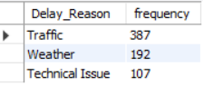
CASE 2: Find the most common delay reasons (excluding None).
QUERY:
SELECT Delay_Reason, COUNT(*) AS frequency
FROM shipment_tracking
WHERE Delay_Reason <> 'None’
GROUP BY Delay_Reason
ORDER BY frequency DESC;
Output:
CASE 3: Identify orders with >2 delayed checkpoint
QUERY:
SELECT Order_ID, COUNT(*) AS Delayed_Checkpoints_Count
FROM shipment_tracking
WHERE Delay_Minutes > 0
GROUP BY Order_ID
HAVING COUNT(*) > 2;

Slide 18
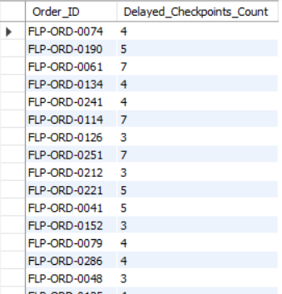
Output:

Slide 19
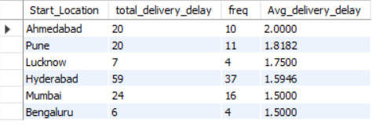
Task 7: Advanced KPI Reporting
CASE 1: Average Delivery Delay per Region (Start_Location).
QUERY:
SELECT
r.Start_Location,
SUM(DATEDIFF(o.Actual_Delivery_Date, o.Expected_Delivery_Date)) AS total_delivery_delay,
COUNT(*) AS freq,
AVG(DATEDIFF(o.Actual_Delivery_Date, o.Expected_Delivery_Date)) AS Avg_delivery_delay
FROM orders o
JOIN routes r
ON o.Route_ID = r.Route_ID
WHERE o.Actual_Delivery_Date > o.Expected_Delivery_Date
GROUP BY r.Start_Location
ORDER BY Avg_delivery_delay DESC;
Output:
Insight: Ahmedabad has the highest (2.00) delay and needs immediate improvement. Ahmedabad, Pune, and Lucknow need improvement, while Mumbai and Bengaluru show better delivery performance.

Slide 20

CASE 2: On-Time Delivery % = (Total On-Time Deliveries / Total Deliveries) * 100.
QUERY:
SELECT
ROUND(
(SUM(CASE
WHEN Actual_Delivery_Date <= Expected_Delivery_Date THEN 1
ELSE 0
END) * 100.0) / COUNT(*), 2) AS on_time_delivery_percentage
FROM orders;
Output:
Insight: Around 73% deliveries are on time, but reducing delays can significantly improve customer satisfaction.
CASE 3: Average Traffic Delay per Route.
QUERY:
SELECT
Route_ID,
Start_Location,
End_Location,
AVG(Traffic_Delay_Min) AS Avg_Traffic_Delay
FROM routes
GROUP BY Route_ID, Start_Location, End_Location;

Slide 21
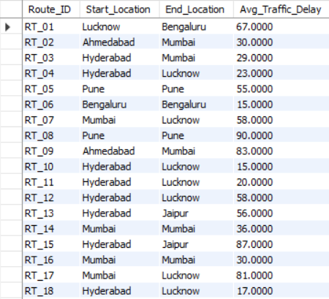
Output:
Insight: RT_01(67 min) has the highest traffic delay, while RT_06 and RT_10 (both 15 min) performs best with minimal delays.
Recommendation:
Improve high delay routes by:
Better route planning.
Avoid peak traffic hours.
Alternative routes.

Slide 22
Thank
You

