Slide 1
IBM University Engagement Project Submission
“Exploring the Power of Agentic AI with IBM Granite “

Slide 2

Project Tile – Health Symptom Checker Agent
Domain of Project – Healthcare
Student Name | Recent Passport Photo | Email ID | Mobile number [WhatsApp]
Harsh Aanand |  | datastotage112001@gmail.com | 72558590XX

Slide 3
Problem Statement - Health Symptom Checker Agent
The Challenge
Individuals often struggle to understand sudden health symptoms or find reliable medical information quickly. Searching online leads to "cyberchondria" where users find alarming and inaccurate diagnoses. There is a lack of personalized, real-time triage guidance to help users decide whether they need home care, a clinic visit, or emergency attention.
The Objective
Build an AI-powered Health Symptom Checker Agent that:
Assesses Symptoms: Analyzes user-reported symptoms through natural conversation.
Medical Knowledge RAG: Fetches accurate health data from trusted medical knowledge bases.
Triage Recommendations: Suggests the urgency of care (Self-care, Primary Doctor, or ER).
Specialist Referral: Recommends the appropriate medical specialist (e.g., Cardiologist, Dermatologist).
Multi-Agent System: Coordinates Intake, Knowledge, and Referral agents for a seamless experience.

Slide 4
Technology Used
Tech Stack (Mandatory)
Tech Stack Selection
Selected Approach: LangFlow + IBM watsonx.ai + Granite Models
Intelligence: IBM Granite Models (Reasoning and Medical Text Processing)
Orchestration: LangFlow (Visualizing Multi-Agent Workflows)
Infrastructure: IBM Cloud & Watsonx Orchestrate
I used Watsonx Orchestrate + Granite Models .

Slide 5
Proposed Solution -
Proposed Solution: AI-Powered VitalCheck
VitalCheck AI is a multi-agent AI-powered Health Symptom Checker built using LangFlow and IBM Granite Models.
Intelligent Triage: Unlike a static search engine, VitalCheck acts as an autonomous agent that asks follow-up questions to narrow down potential causes.
RAG Integration: Uses a Retrieval-Augmented Generation pipeline to pull information from verified medical datasets, ensuring the agent provides facts, not "hallucinations."
Modular Architecture: The system uses specialized agents—one to gather symptoms, one to query medical literature, and one to provide a final triage report.
Safety First: Includes automated medical disclaimers and prioritizes high-risk symptoms (like chest pain) for immediate emergency alerts.

Slide 6
Langflow component Used -
LangFlow Component Integration
Chat Input: Interface where users describe their symptoms (e.g., "I have a sharp pain in my lower back").
IBM watsonx AI Agent: The brain that interprets the severity and context of the symptoms using Granite.
IBM Granite Model (Granite-3.0-8B-Instruct): Chosen for its high efficiency in logical reasoning and medical summarization.
Medical Vector Database: Stores medical guidelines and first-aid protocols for RAG retrieval.
Chat Output: Delivers a structured triage summary, potential causes, and next-step recommendations.
Prompt Templates: Customized "System Instructions" that force the agent to act as a professional medical assistant.

Slide 7
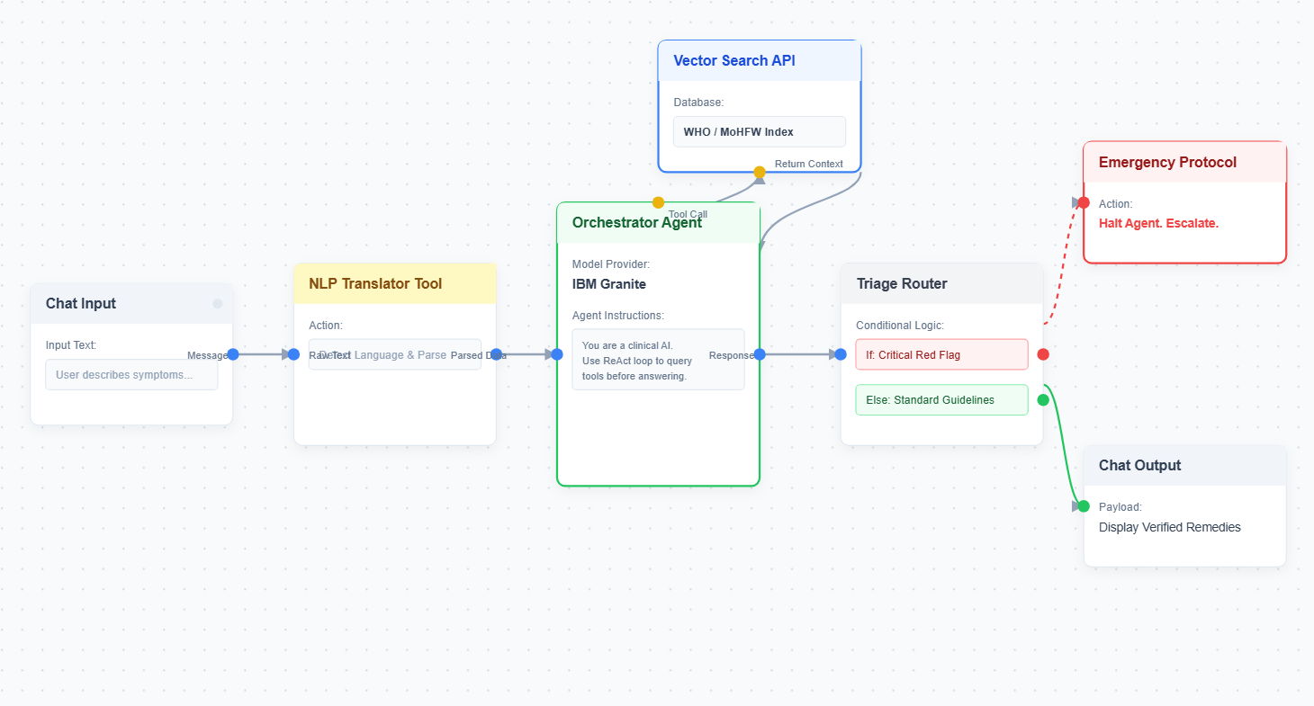
Langflow workflow -

Slide 8
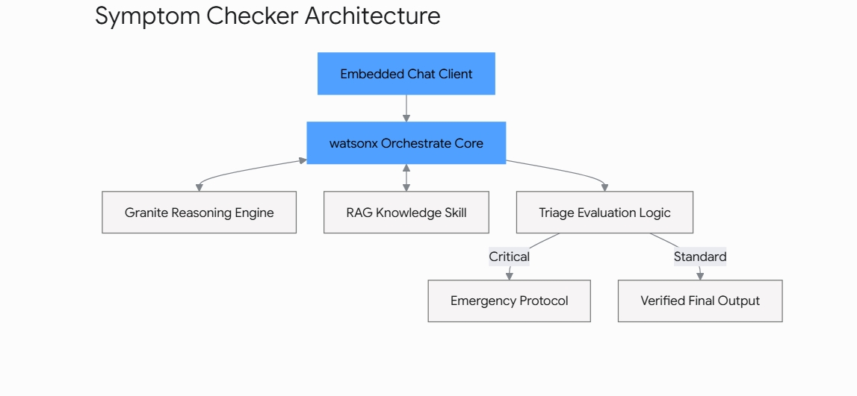
Architecture blueprint

Slide 9

Role of Agentic AI in the solution
Role of Agentic AI in the Solution
Agentic AI transforms the checker from a basic form into an active health companion:
Autonomous Reasoning: It doesn't just list possibilities; it reasons why a symptom might be concerning based on user age and history.
Task Decomposition: It breaks a query into sub-tasks: (1) Assess Urgency, (2) Search Knowledge Base, (3) Generate Advice.
Self-Correction: If the user provides conflicting information, the agent asks for clarification before providing a triage recommendation.
Proactive Triage: The agent "acts" by immediately flagging emergency symptoms and providing first-aid steps while the user waits for professional help.

Slide 10
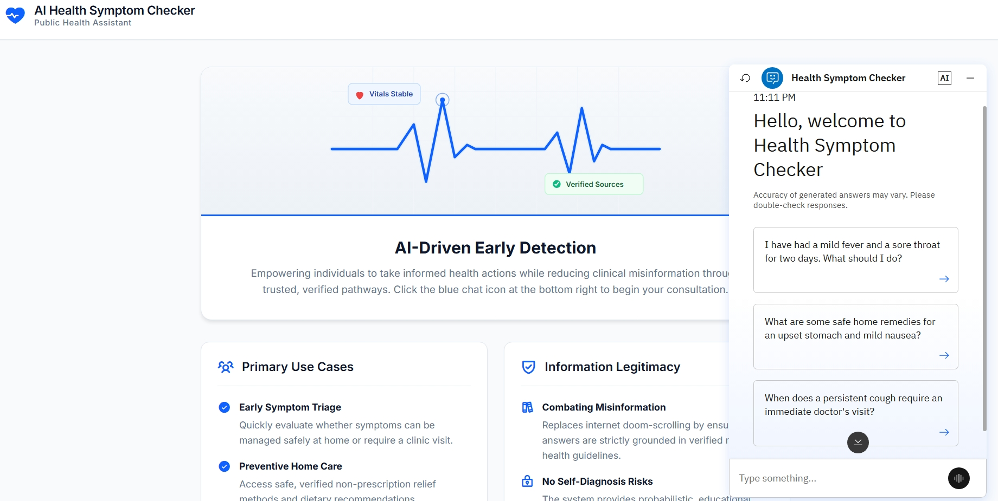
Screenshot- Website

Slide 11
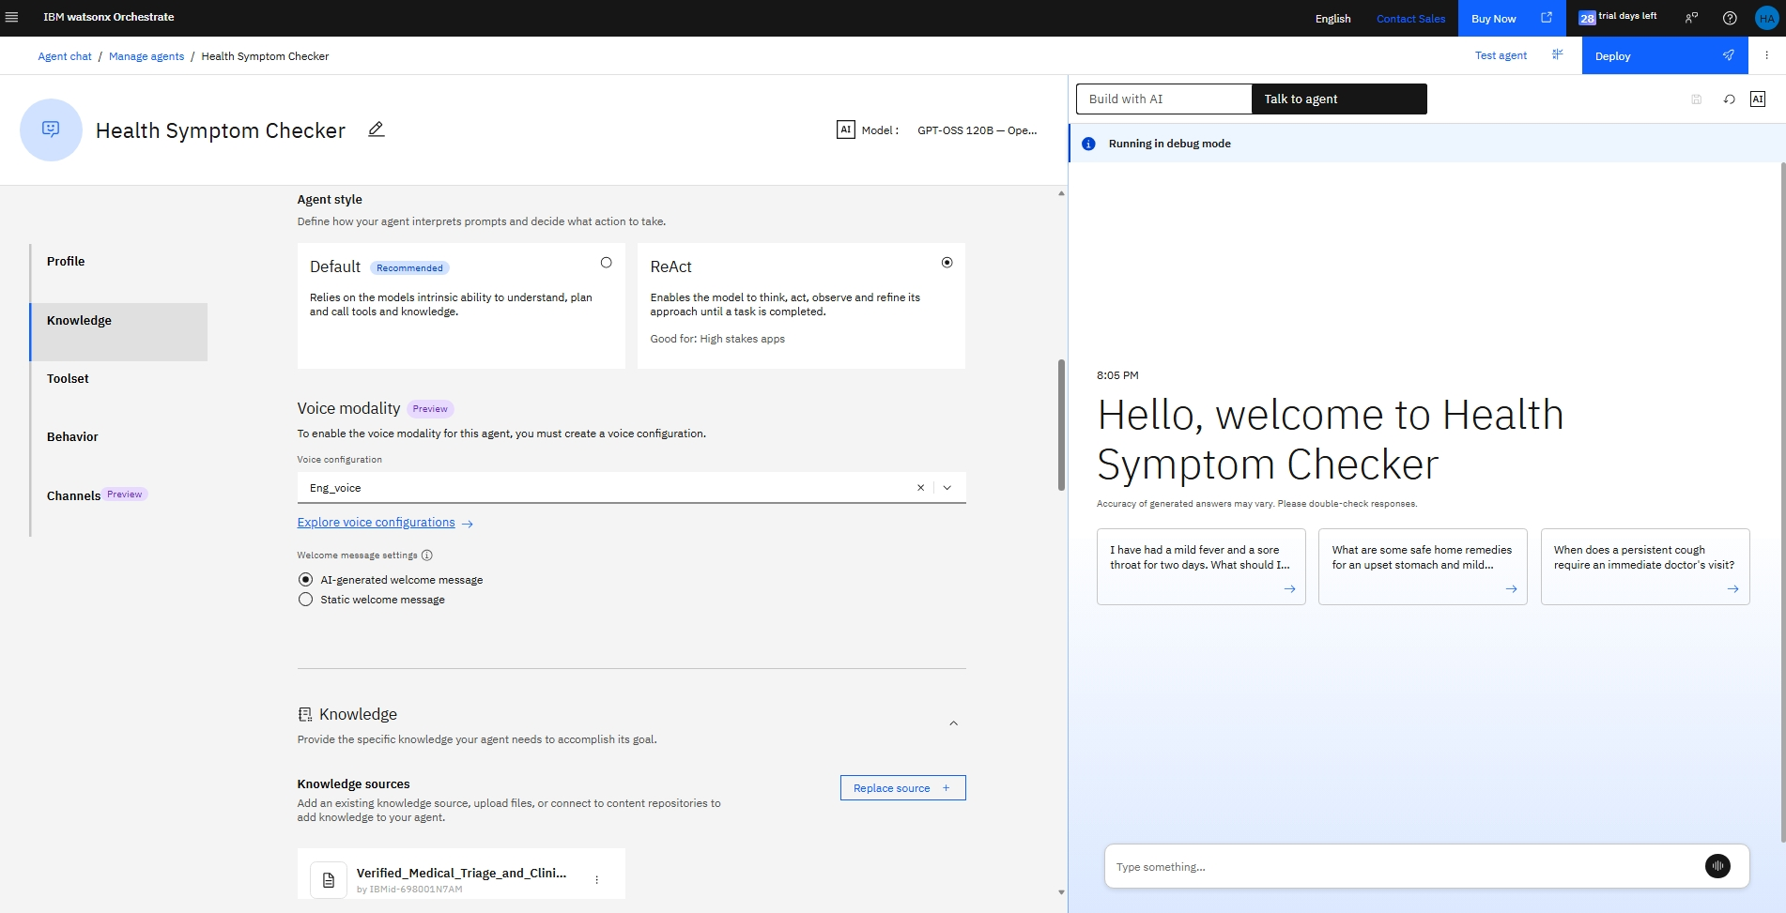
IBM Watsonx Orchestrate view

Slide 12
Novelty and Uniqueness
The proposed Why health Symptoms Checker AI Stands Out
Specialist Mapping: It doesn't just name the problem; it tells the user exactly which type of doctor to book (e.g., "You should see an ENT specialist").
Fact-Checked Responses: By using RAG with Granite, it reduces the risk of incorrect medical advice common in standard LLMs.
Urgency Scoring: Provides a clear "Red, Yellow, Green" urgency status for every check.
User-Centric UX: Natural language interaction makes it accessible to elderly users who struggle with complex medical forms.
Enterprise-Grade Security: Built on watsonx.ai, ensuring user health data is handled with strict governance.

Slide 13
Git Hub Link
Github URL –
https://github.com/Harsh-Aanand/Health-Symptoms-Analysis-using-AI
It includes:- 1) app.json file , 2) problemstatement.pdf file 3) projectpresntation.pptx file 4)html.css
5)style.css 6)readme.md
·
·
·

Slide 14
Future Scope
Future Scope & Enhancements
Wearable Sync: Integration with Apple Health or Fitbit to monitor real-time heart rate and oxygen levels during a symptom check.
Multilingual Medical Support: Expanding the agent to understand and respond in local languages to help rural populations with limited access to doctors.
Telemedicine Link: A direct button to "Call a Doctor" or "Book Appointment" based on the triage result within the chat interface.
·
·
·

Slide 15


