Slide 1

Project Title- Seasonal Agriculture Performance Analysis
Student Name – Harsh Aanand
College Name – Shri Phanishwar Nath Renu Engineering College
AICTE STU ID : STU6831cc8df173b1748094093

Slide 2

PROBLEM STATEMENT
Agricultural activities are influenced by seasonal variations in environmental conditions, farming practices, resource availability and market conditions. As a result, agricultural performance may differ from one season to another. However, raw agricultural data does not clearly explain how agricultural performance changes across seasons or what patterns can be observed in different seasonal conditions. The problem is to analyze the given agricultural dataset and investigate seasonal differences in agricultural performance by identifying meaningful patterns, trends, relationships and variations within the available data.

Slide 3
Project Description
The project analyzes agricultural data across varying seasons, regions, and farming conditions to uncover patterns in farming performance.
It addresses the challenge of raw farm data failing to explain seasonal variations in environmental conditions, practices, and resource usage.
The primary objective is to clean the dataset, evaluate seasonal performance shifts, and identify key trends using statistical analysis and visualizations.
Core dimensions analyzed include agro-climatic factors, irrigation methods, crop yield productivity, and farm economic profitability.
The analysis yields evidence-based insights, revealing severe resource and profit disparities across seasons and irrigation practices.
The final outcome delivers data-driven recommendations to support stakeholders in better seasonal agricultural planning and resource management.

Slide 4

WHO ARE THE END USERS?
Farmers & Farm Managers: To make informed decisions on seasonal crop selection, choose cost-effective irrigation methods (e.g., drip vs. flood), and optimize water and pesticide usage to avoid net financial losses.
Agricultural Policy Makers & Government Bodies: To plan regional resource allocations, design seasonal subsidies, and support evidence-based agricultural planning and water-conservation policies.
Agri-Tech & Input Suppliers: To forecast seasonal demand for fertilizers, pesticides, and specialized irrigation equipment based on regional farming needs.
Agricultural Researchers & Extension Officers: To investigate environmental-yield relationships, address seasonal vulnerabilities (such as pest risks or dry-season drop-offs), and provide actionable advisory services to local farming communities.

Slide 5

Technology Used
Core Platform & Environment
Google Colab (Jupyter Notebook): .
Python 3:
Data Manipulation & Numerical Computing Libraries
Pandas , NumPy
Data Visualization & Charting Libraries
Matplotlib (pyplot) Seaborn
Statistical & Analytical Techniques Applied
Descriptive Statistics , Outlier Detection ,Correlation Analysis

Slide 6
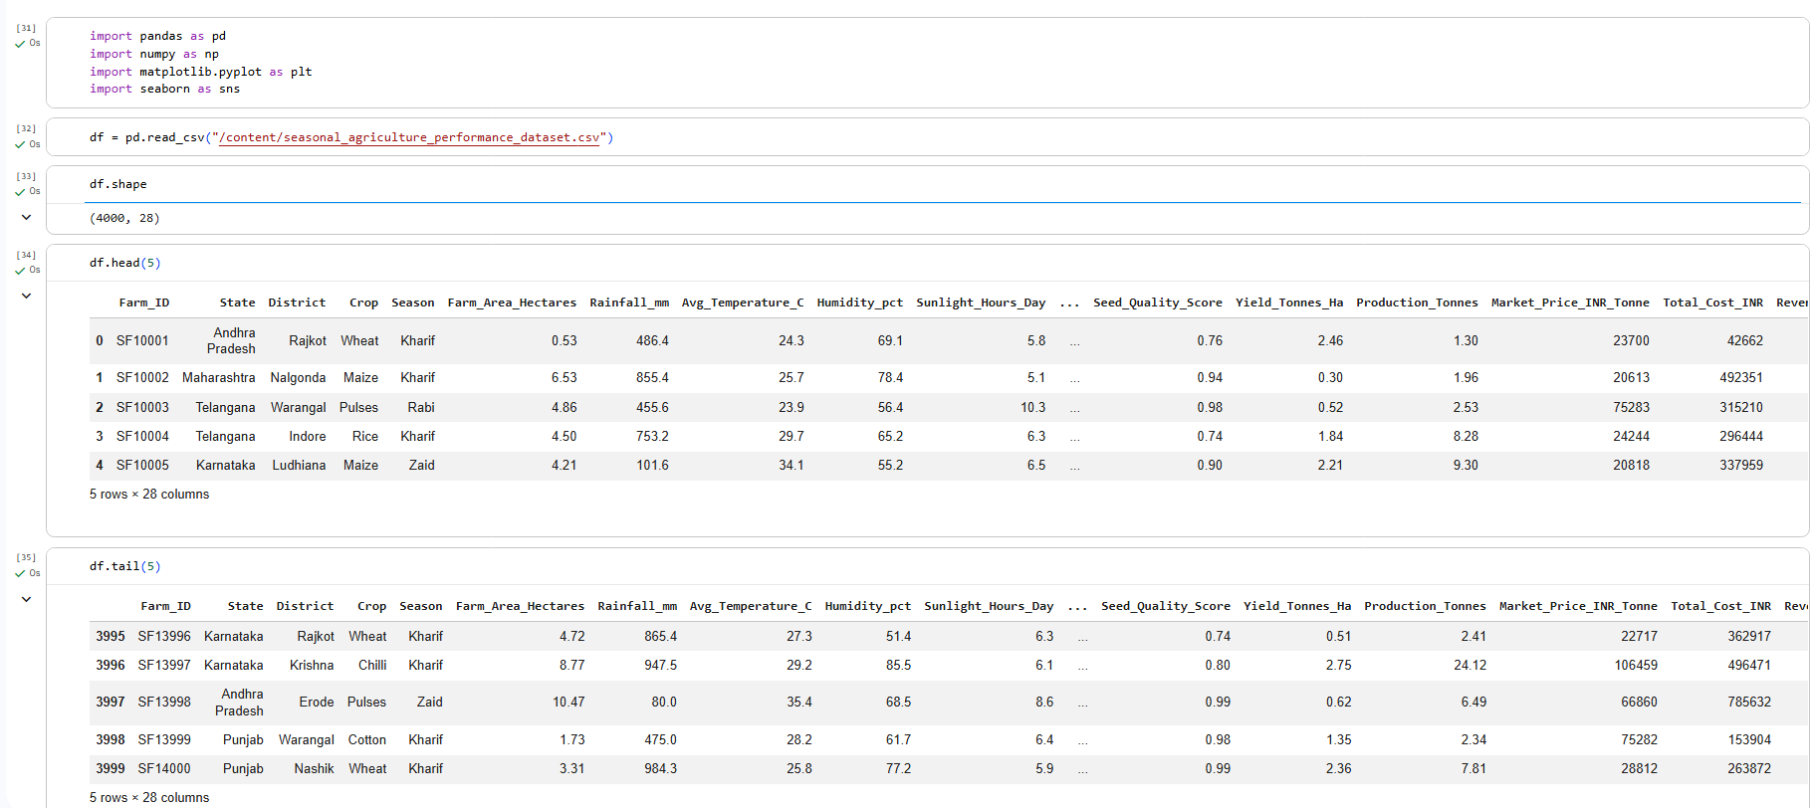
RESULTS

Slide 7
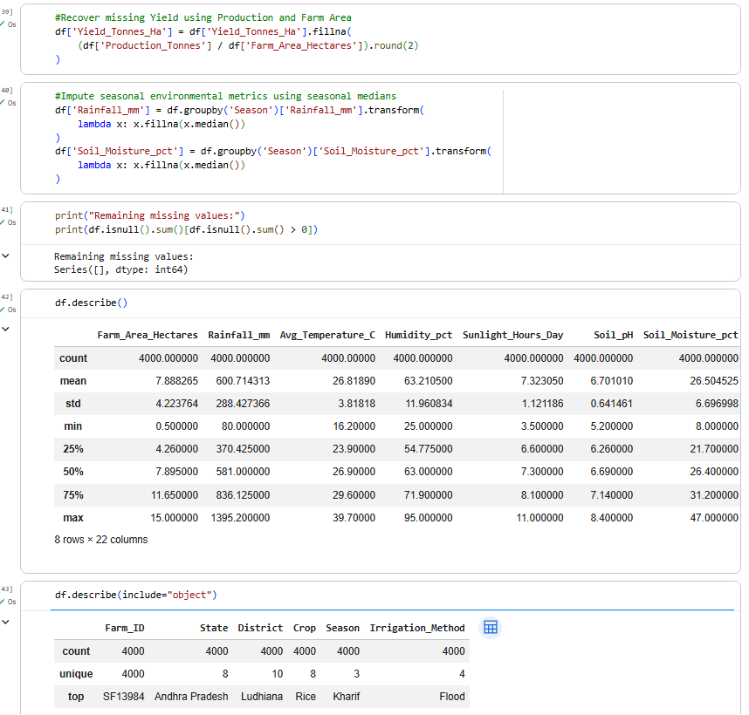
RESULTS
[Add screen shots of your code ]

Slide 8
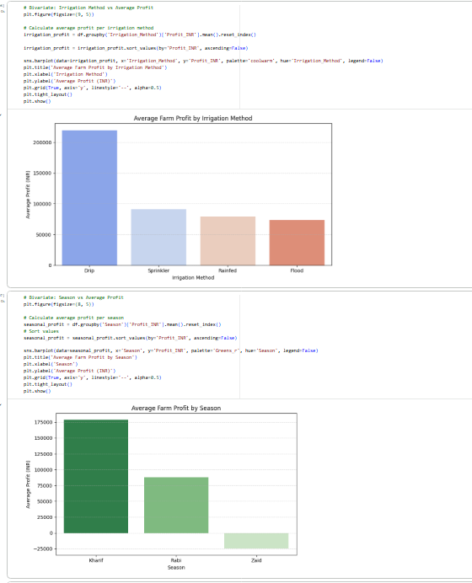
RESULTS
[Add screen shots of your code ]

Slide 9
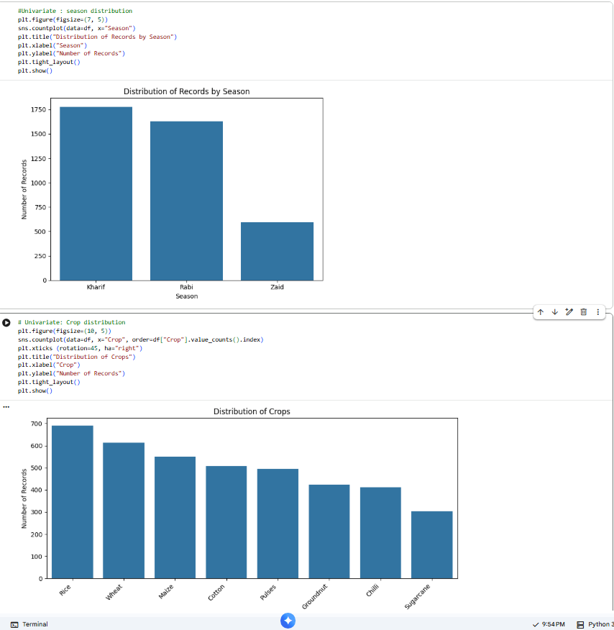
RESULTS
[Add screen shots of your code ]

Slide 10
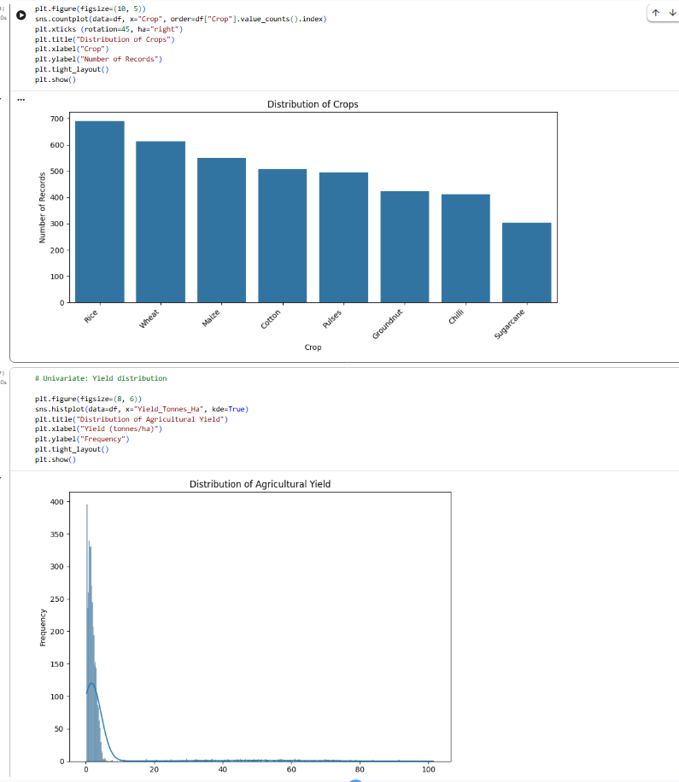
RESULTS
[Add screen shots of your code ]

Slide 11
Future scope
Predictive Machine Learning Modeling: Transition from retrospective descriptive analytics to building regression and ensemble models
Seasonal Crop & Irrigation Recommendation Engine: Build an intelligent decision-support system that takes soil NPK levels, seasonal climate projections, and farm area as inputs to prescribe optimal crop choices and irrigation methods.
Precision Input Optimization: Deploy mathematical optimization algorithms to calculate minimum threshold fertilizer and pesticide quantities, curbing input costs and lowering disease risks without hurting yield.
Integration with Live IoT & Satellite Weather Feeds: Expand static historical records into real-time telemetry pipelines by ingesting ground soil-moisture sensors, automated weather stations, and satellite NDVI imagery.
Dynamic Market Price Forecasting: Incorporate time-series forecasting (e.g., ARIMA, Prophet, or LSTM networks) on mandi market price variations to recommend optimal harvest and selling windows.
Interactive Web Dashboard Deployment: Package the notebook analytics pipeline into an interactive production web application (using Streamlit or Plotly Dash) enabling non-technical farmers and extension officers to simulate seasonal ROI scenarios.

Slide 12
GitHub Link
https://github.com/Harsh-Aanand/seasonal-agriculture-performance-analysis

Slide 13
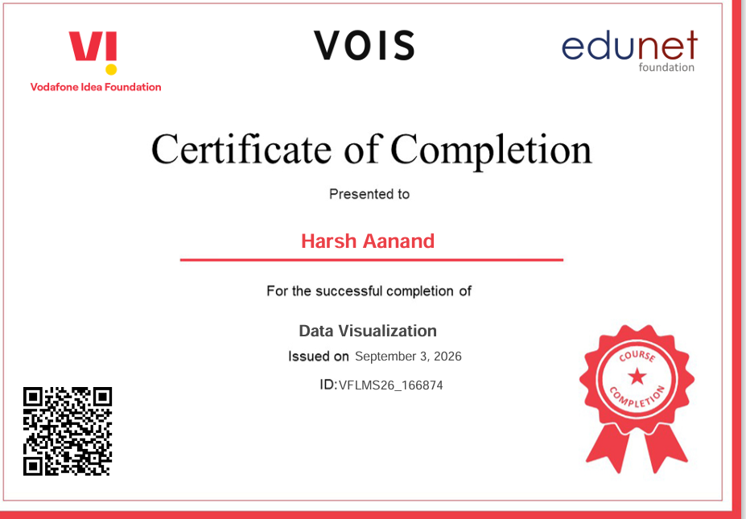
VOIS Course completion certificate -
Course name - Data Visualization

Slide 14
Thank you
.
.

