Slide 1


Slide 2
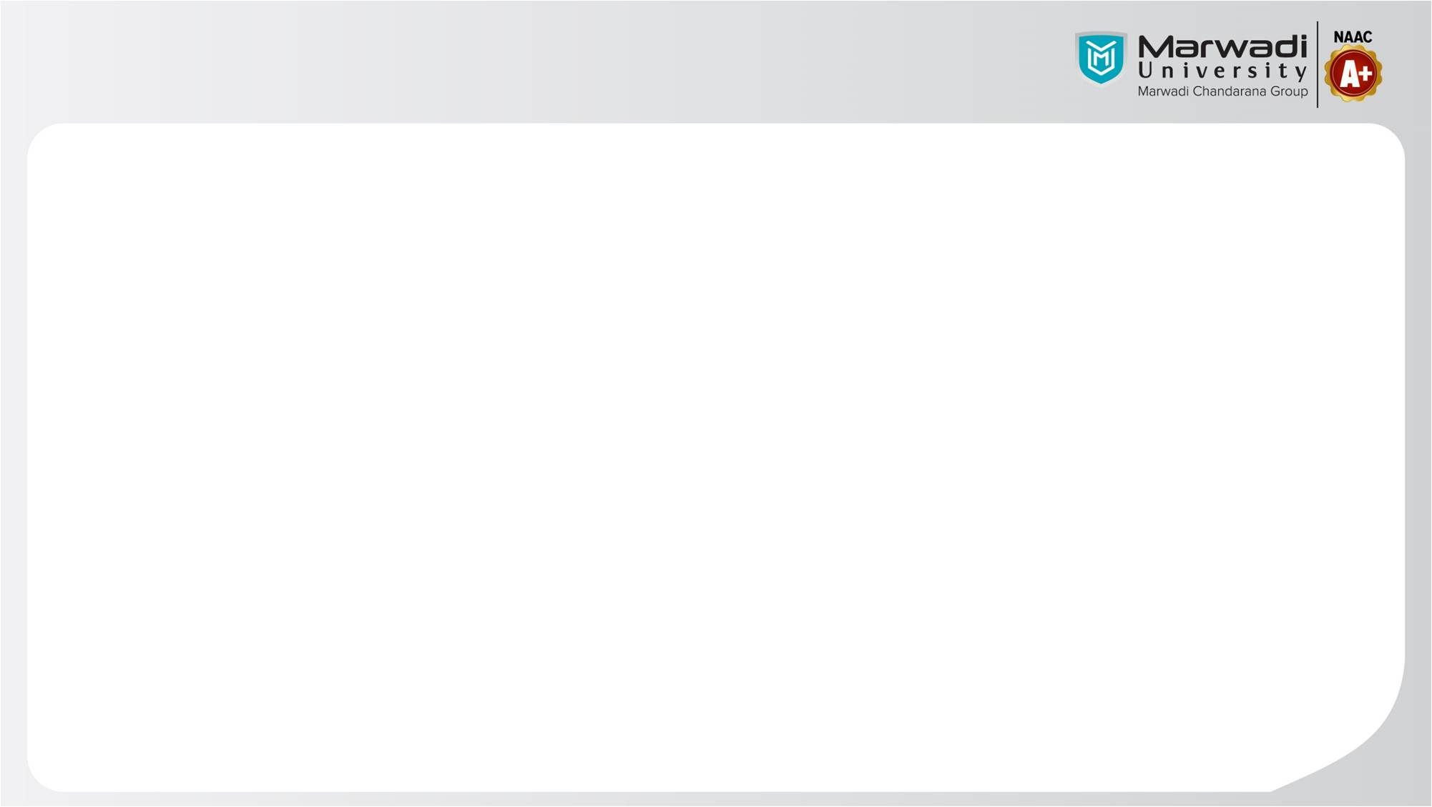
IDP (05MC0401)
Vidzy
Team Member 1: Harsh Bhupatkar (92400584097)
Guided By
Internal Guide: Prof. Amit Gohel
Faculty of Computer Application

Slide 3
Outline
Introduction to Vidzy
Problem Statement
Technology Used
System Architecture
Module Breakdown
Features
Flow Chart
Data Base Design
Project Screenshots
Future Enhancements
References

Slide 4

1. Introduction to Vidzy
Vidzy is a unified real-time communication platform designed to combine instant messaging and video communication within a single application. The project focuses on providing a mobile-first, scalable, and secure solution for personal and professional communication.
The application integrates one-to-one chat, direct video calling, and external meeting functionality, allowing users to seamlessly switch between text-based and video-based interactions. Vidzy is inspired by modern platforms such as WhatsApp, Microsoft Teams, and Google Meet, but is designed with a simplified and modular architecture suitable for extensibility.

Slide 5
2. Problem Statement
Existing video meeting apps are often complex for simple use.
Users need a faster way to start or join a meeting.
Many platforms require multiple steps before joining a call.
Heavy interfaces make the experience confusing for new users.
Free versions of major apps limit some features.
Today, uses need different applications for chatting, video calling and online meetings. This makes communication slow and inconvenient.
There is need for a single application that combines chat, video calls and external meetings in simple, secure and easy-to-use platform.

Slide 6
3. Technology Used
Technology | Purpose | Version/type | Platform Compatibility | Key Benefits
Flutter Framework | Cross-Platform Development | SDK 2.0+ | Android | Fast development
Fire Base | Real-Time Database | Cloud Database | Mobile | Scalable Storage
Zego Cloud SDK | Open Source Video Conferencing engine | NA | Mobile | Open Source, Easy integration, Chat feature.

Slide 7
4. System Architecture
Mobile App
Google Authentication
Firestore
(database & signalling)
Zego Cloud SDK
Meeting & Call Flow Control
Mobile Application(Flutter): Provides the user interface and controls chat, calls and meeting interactions.
Google Authentication(Firebase Auth): Authenticates users securely using Google Sign-In and manages user identity.
Cloud Firestore: Stores real-time data for chat messages, call signaling.
Zego Cloud SDK: Handles real-time audio and video streaming for calls and meetings.
Call & Meeting Management Logic: Controls call states, approvals and participant flow using Firestore.

Slide 8
5. Module Breakdown
1. Login Module
Handles Google Authentication, verifies identity, and creates a user session for secure and quick access.
2. Chat Module
Provides real-time one to one chat feature.
3. Direct Call Module
Enables instant video calling between users with incoming call notifications.
4. External Meeting Module
Allows users to host and join meetings using a unique meeting ID with controlled access.
5. Meeting Interface Module
Displays live video communication with basic in-meeting controls.
6. Backend/Database Module
Manages authentication, real-time data, signaling using Firebase.

Slide 9
6. Features
Google Authentication for secure and quick user login
One-to-One real time chat functionality
Video call initiation directly from chat
External meeting creation with unique meeting ID
Join meetings using meeting code
Real time audio and video communication using Zego Cloud
In-meeting controls: mute/unmute, camera on/off, leave meeting
Lightweight, clean and user-friendly mobile interface
Stable performance on android devices

Slide 10
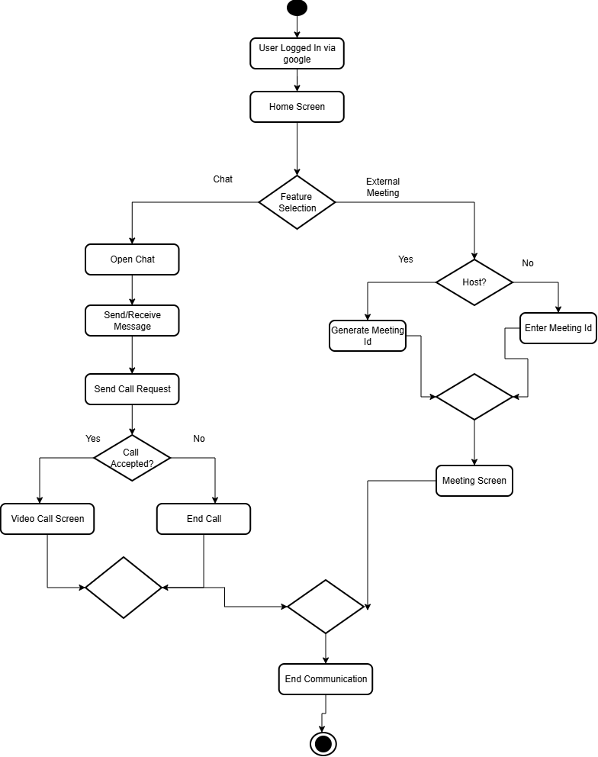
7. Flow Chart

Slide 11
8. Database Design
Collection: users
{
“id” : int,
“profilephoto” : String,
“username” : String
}
Collection: chats
{
"chatId" : String,
"participants" : List<String>,
"createdBy" : String,
"lastMessage" : String,
"lastMessageAt" : Timestamp,
"createdAt" : Timestamp
}
Collection: chats
{
"chatId" : String,
"participants" : List<String>,
"createdBy" : String,
"lastMessage" : String,
"lastMessageAt" : Timestamp,
"createdAt" : Timestamp
}
Sub-Collection: chats/{chatId}/messages
{
"messageId" : String,
"senderId" : String,
"text" : String,
"createdAt" : Timestamp
}
Collection: calls
{
"callId" : String,
"chatId" : String,
"initiatorId" : String,
"receiverIds" : List<String>,
"status" : String, // ringing | accepted | rejected | ended
"createdAt" : Timestamp
}

Slide 12
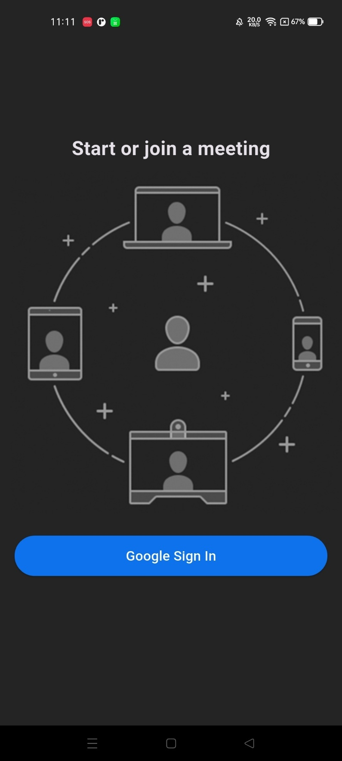
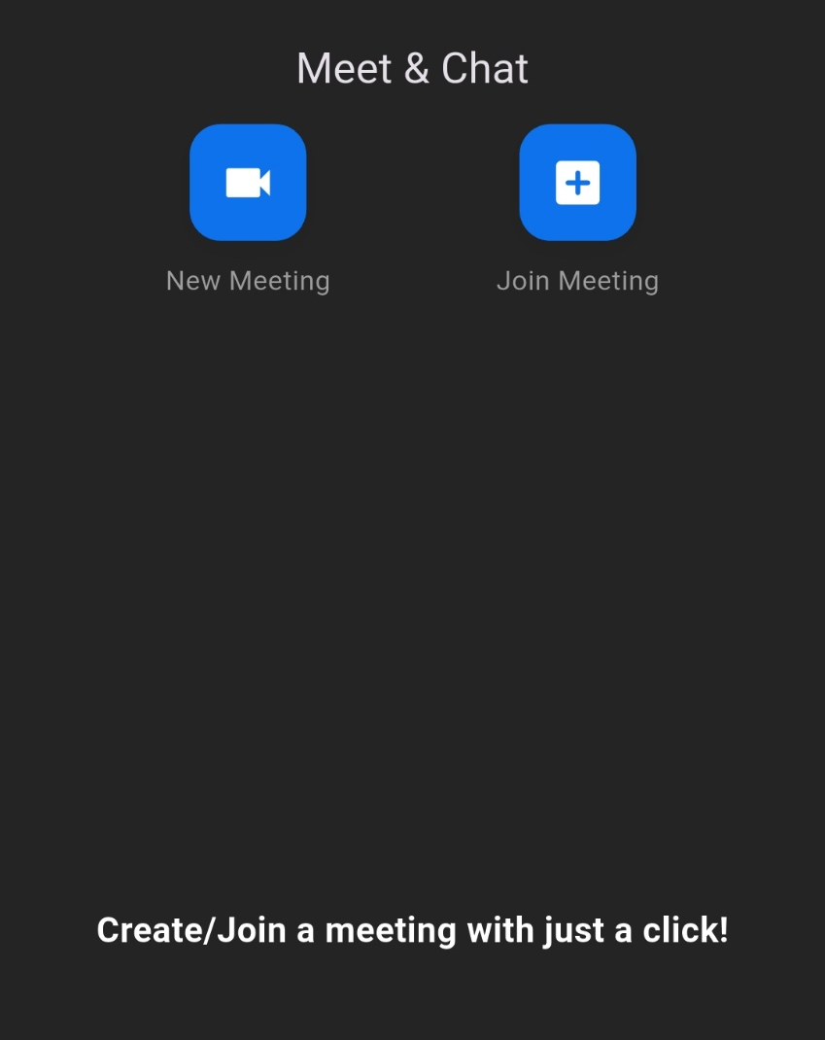
9. Project Screenshot
Login Screen
Meet & Chat Screen

Slide 13
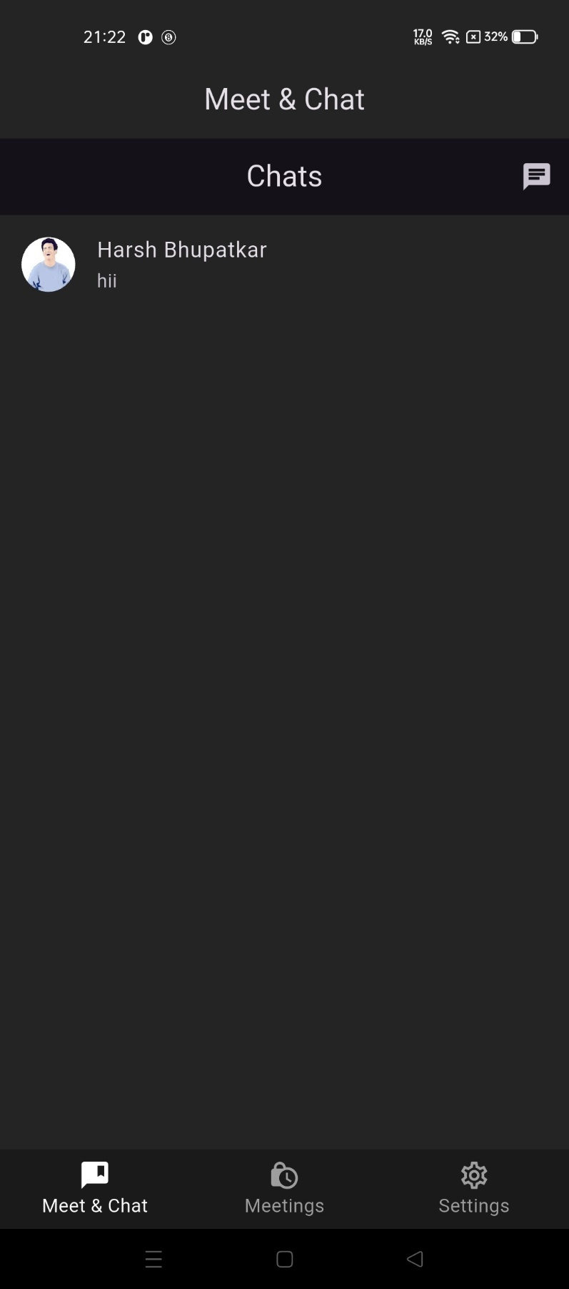
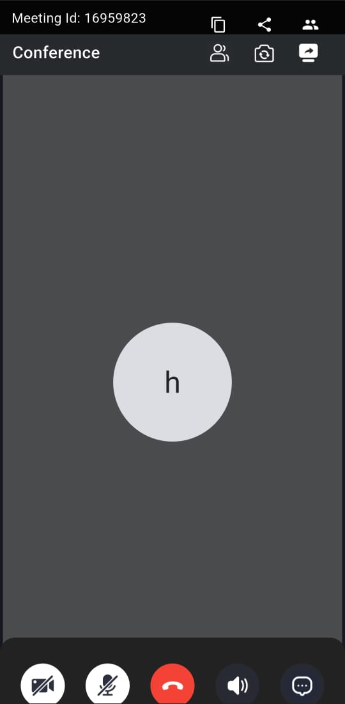
9. Project Screenshot
Chat Screen
Meeting Screen

Slide 14
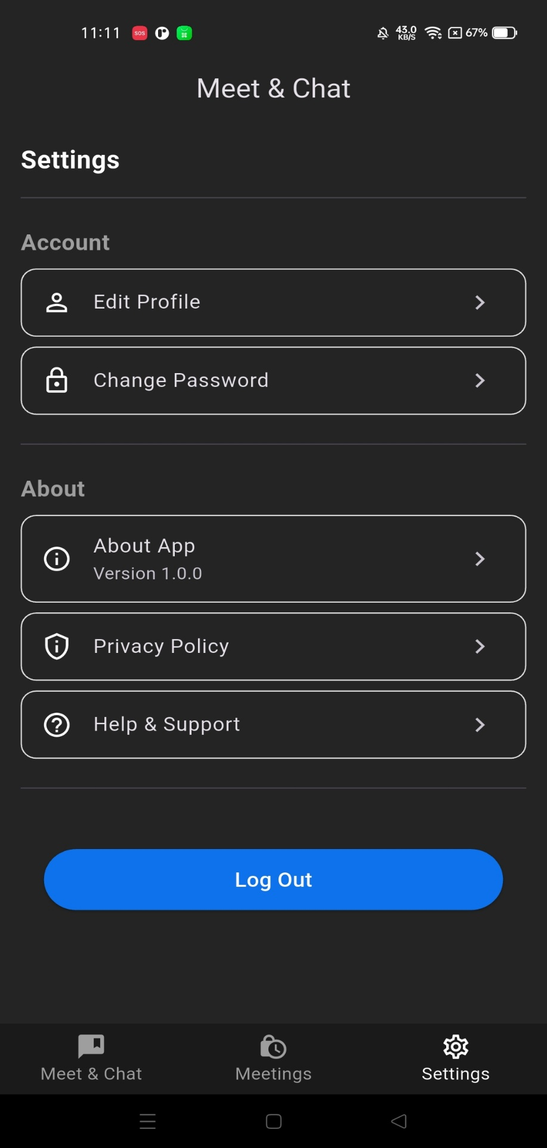
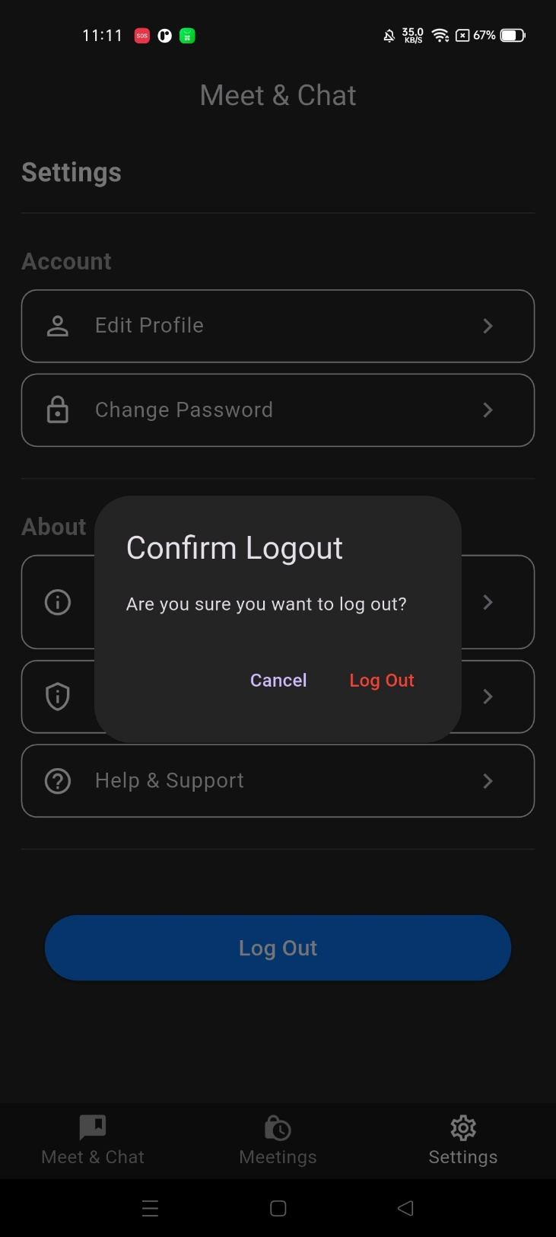
9. Project Screenshot
Setting Screen
Logout Screen

Slide 15
10. Future Enhancements
Smart Meeting Management: Add meeting scheduling with calendar integration and reminders to support professional and educational use cases.
Recording & Cloud Storage: Enable meeting recording with secure cloud storage for later playback, making vidzy useful for classes, training and business reviews.
Ai-Powered Collaboration : Introduce live transcripts, automated notes using speech-to-text, and enhanced chat features to improve communication and accessibility.
Platform & Admin Enhancements: Add analytics dashboards, admin controls, push notifications, and expand support to IOS and Web Platforms.
Scalability, Security & Performance: Improve reliability by migrating to dedicated Zego Cloud servers, implementing end-to-end encryption, and optimizing support for large meetings.

Slide 16
11. References
Flutter Documentation: https://flutter.dev/docs.
Google sign-in using firebase: https://developers.google.com/identity/sign-in.
Zego Cloud: https://www.zegocloud.com
Firebase: https://firebase.google.com/docs.
Pub.dev(For flutter packages): https://pub.dev/

Slide 17


