Slide 1

PROJECT PRESENTATION
ON
“RESUME BUILDER WEBSITE ”
GROUP NUMBER – 09
Submitted By:-
Sujay Gangwar
Harsh Saxena (I)
Utkarsh Sharma
Submitted To:-
Mr.Satish Singh Mekale
(Project Head)
Mr.Imtiyazul Haq
(Project Guide)

Slide 2
CONTENTS
Introduction.
Motivation.
Problem statement.
Literature review.
Requirements specification.
Methodology/Technique.
References

Slide 3
INTRODUCTION
As placement season of most of the colleges is going to start, making Resume is a very hectic work for all the students. Also, many companies judge the candidature of a student just by his/her Resume. So it is necessary for the student to think beyond the third dimension while making the Resume.
With this website we will be able to create the three common resume formats.
Chronological:-Lists your work history in reverse order, starting with your current or most recent job and working backwards.
Functional:-Focuses on skills and strengths important to employers. Omits specific dates, names, and places. De-emphasizes a spotty work history.
Combination:-Blends the flexibility and strength of the other two types of resumes.

Slide 4
MOTIVATION
Your resume describes your qualifications and what makes you unique. To stand out among other applicants, you need a resume that markets your strengths and match for the job.
A great resume:
Grabs the attention of employers and recruiters
Sells your strongest skills and accomplishments
Shows how you’re a match for a position or project
And most importantly, gets you a job interview!

Slide 5
PROBLEM STATEMENT
Resume Building is an important part in the life of a working Professional, or a Fresher Finding a job in a company. So everyone Needs to have resume which gives whole intro about the Person at one go to the company which is hiring. So the problem is Building Resume necessary in todays life.
The existing system is creating resumes manually either by using word or Google doc so there are some issues with the existing system.

Slide 6
LITERATURE REVIEW
As we begin down the path of creating the resume building website based on html, css and javascript that help the user to create an effective resume as per their requirements, it is important to note that we do not consider ourselves to be experts in this domain.
The future of web development is html and css. Html is a new standard in every place of web users.CSS is modern standard which illustrate the record in html language.
Javascript is used in today’s web application as a client script language and on the server side.

Slide 7
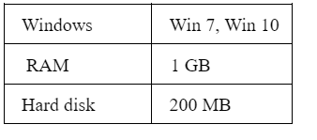
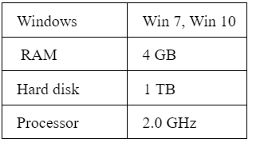
REQUIREMENT SPECIFICATION
Hardware Requirement
1.client side
2.server side

Slide 8
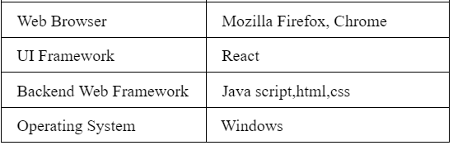

Software Requirement

Slide 9
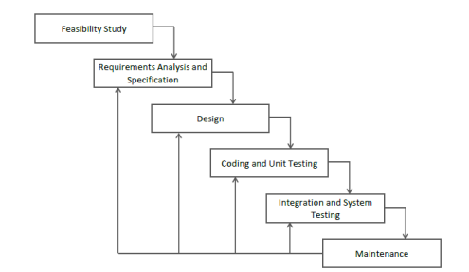
METHODOLOGY / TECHNIQUE
This website helps in building the best resume that helps in job placement.
The following methodology has been adopted.

Slide 10
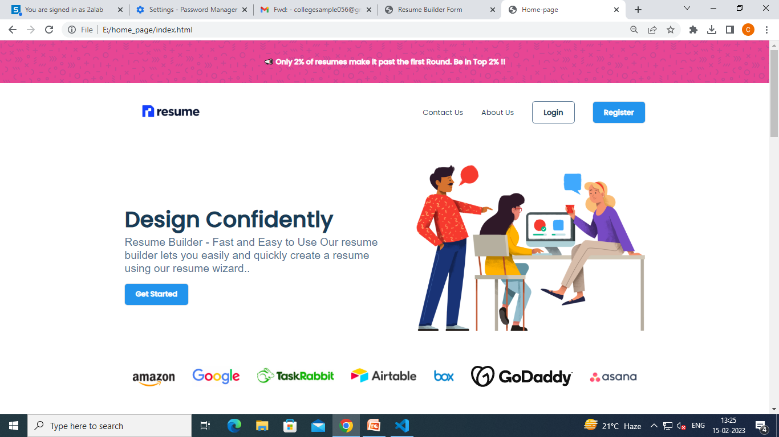
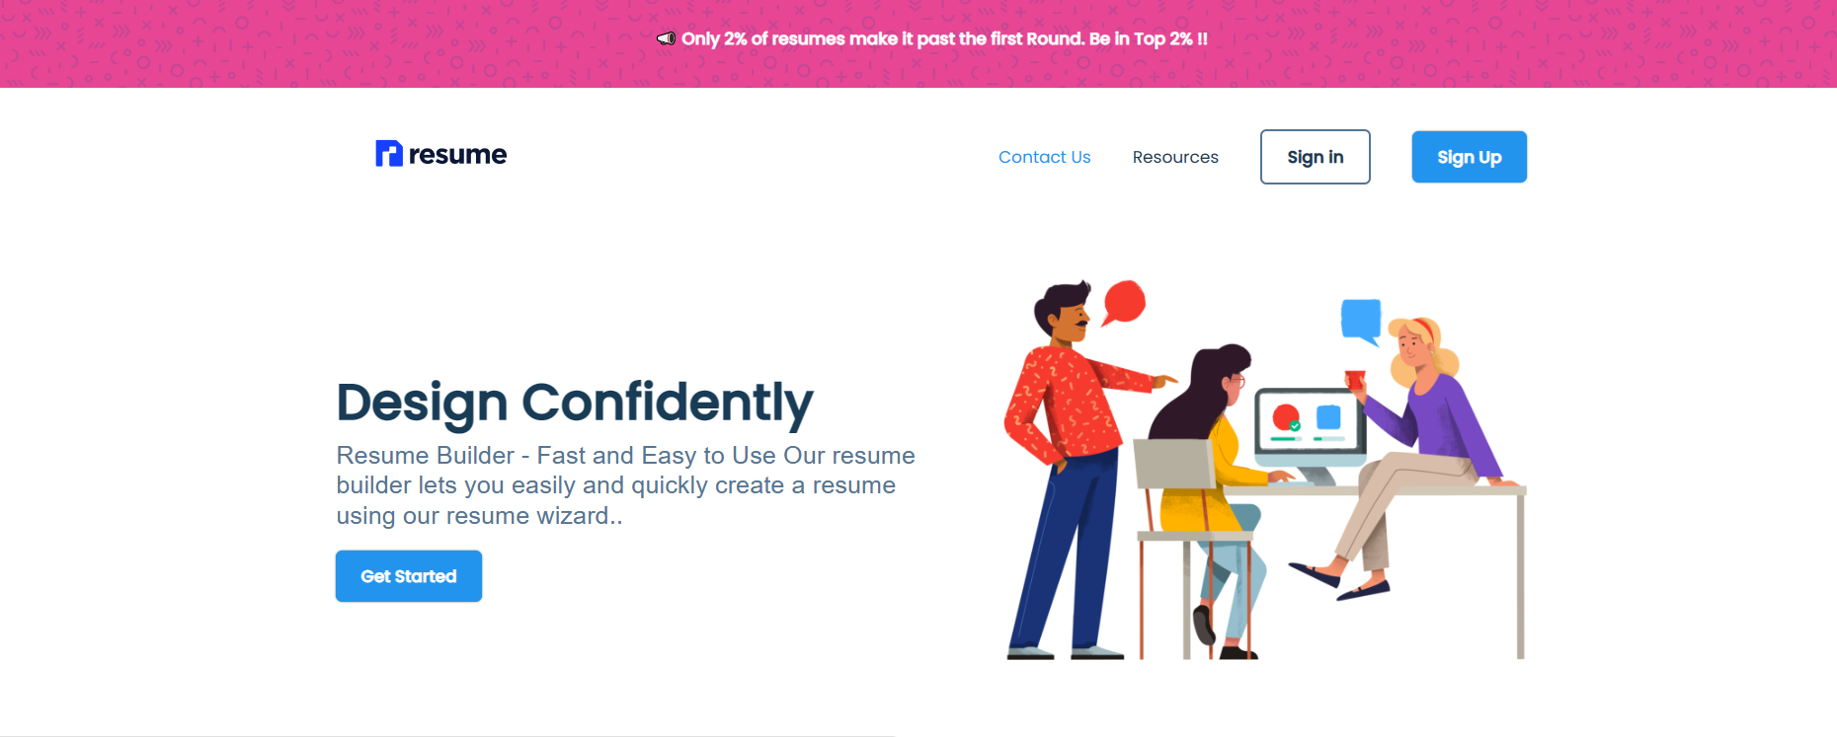
HOME PAGE SECTION

Slide 11

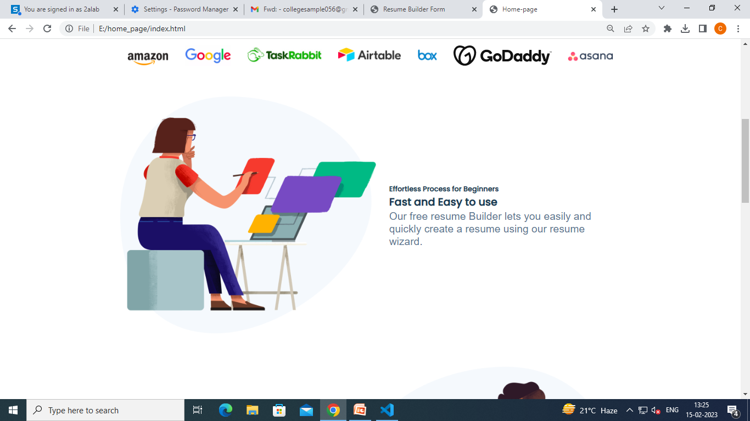
FEATURES OF OUR RESUME SITE

Slide 12
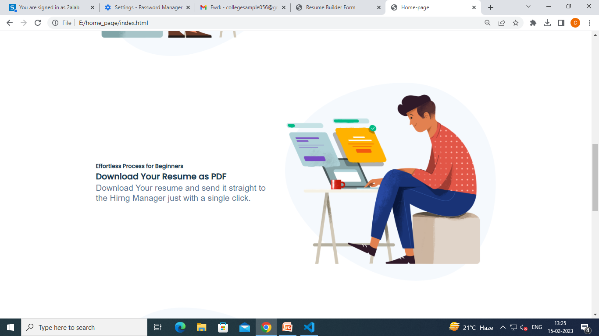

CONTD…

Slide 13
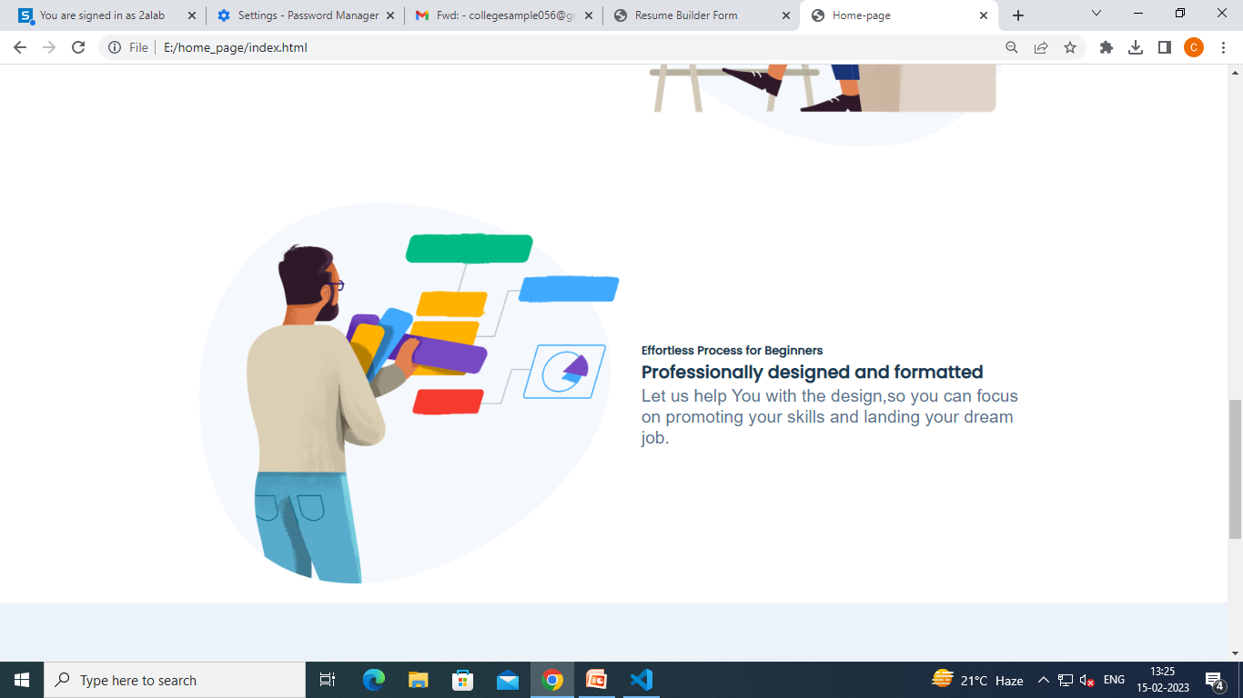

CONTD…

Slide 14
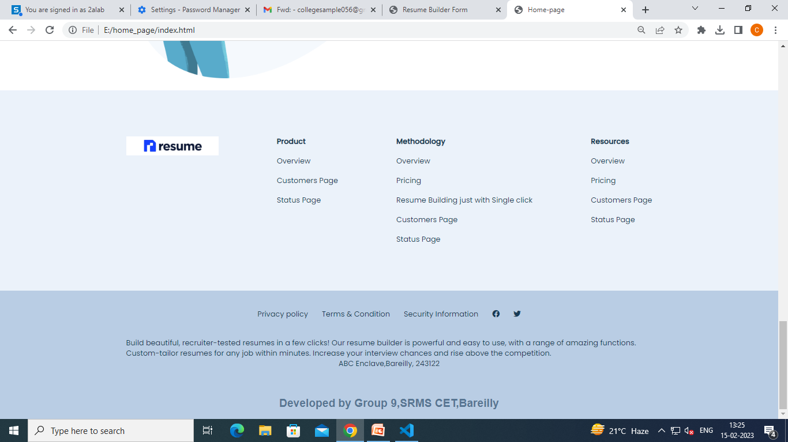
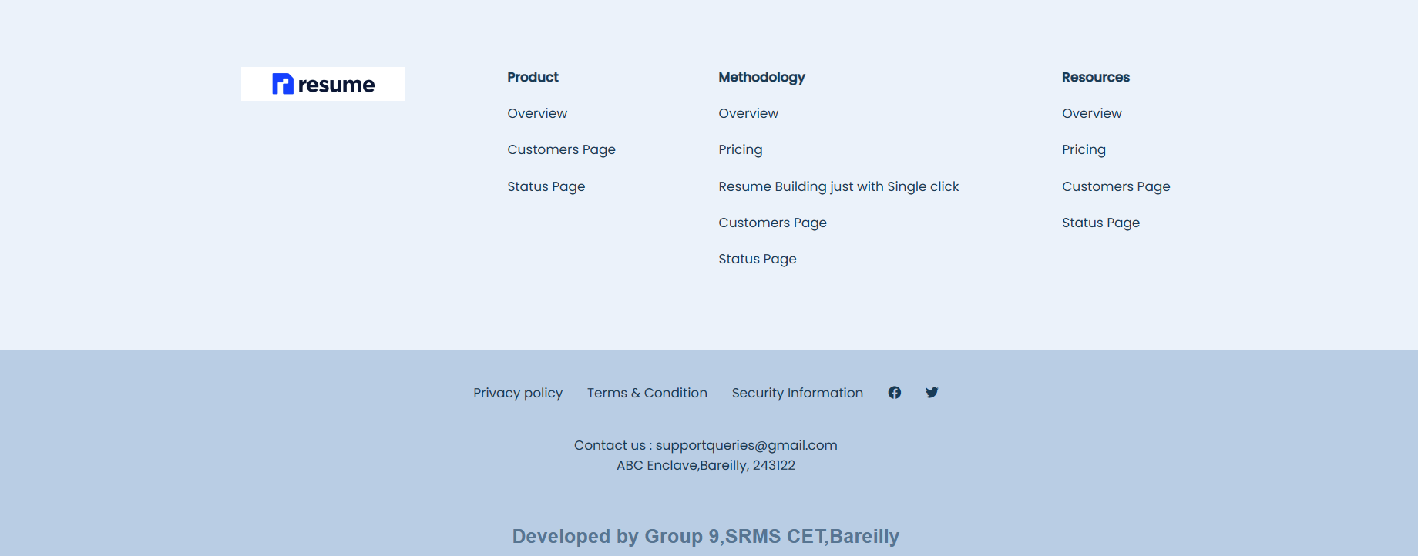
FOOTER SECTION/OTHER DETAILS

Slide 15
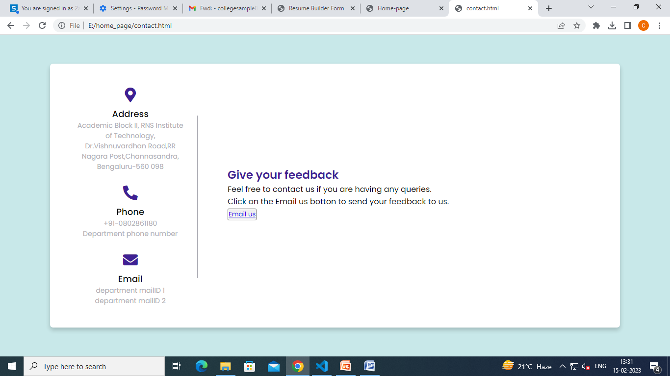
ABOUT US SECTION

Slide 16
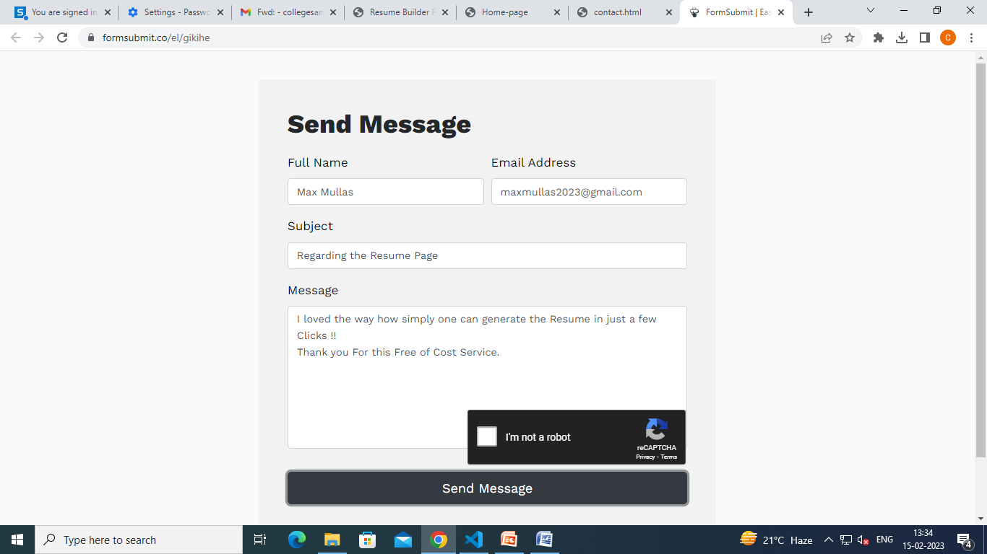
CONTD...

Slide 17
CONTD...

Slide 18
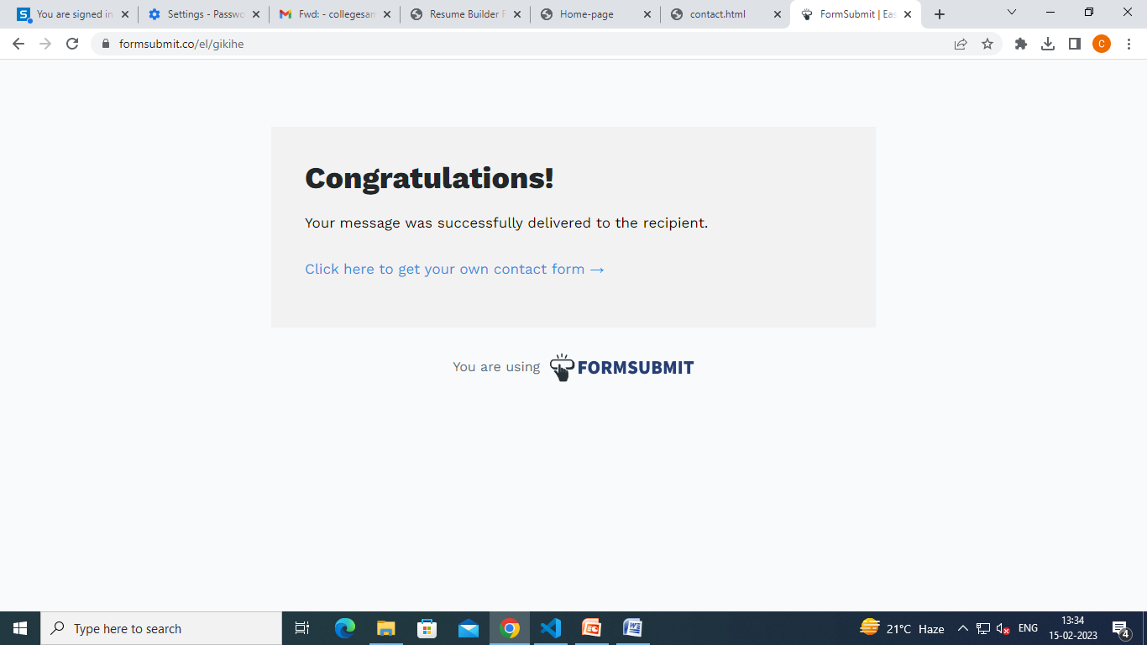
CONTD...

Slide 19
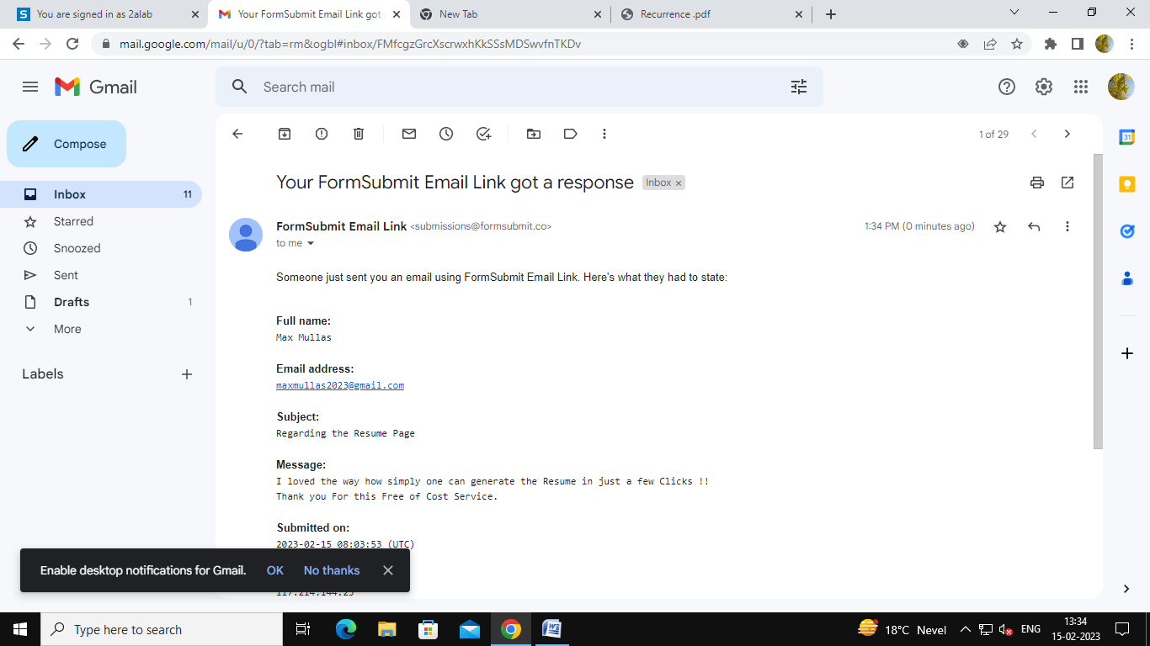
FEEDBACK RECEIVED...

Slide 20
FEEDBACK RECEIVED...

Slide 21


















Firebase Realtime Database
FLOWCHART OF FIREBASE REALTIME DATABASE
RESUME SECTION
LOGIN/
REGISTER
Sign-in
Firebase
Registration
Firebase Authentication
Firebase Storage

Slide 22
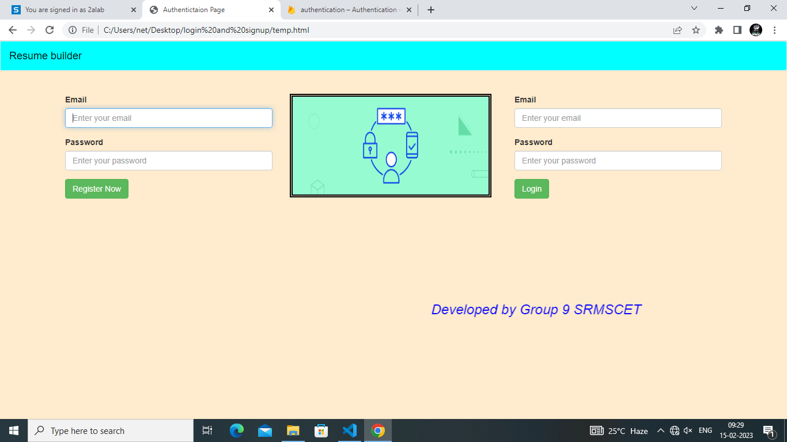
LOGIN/REGISTRATION SECTION

Slide 23
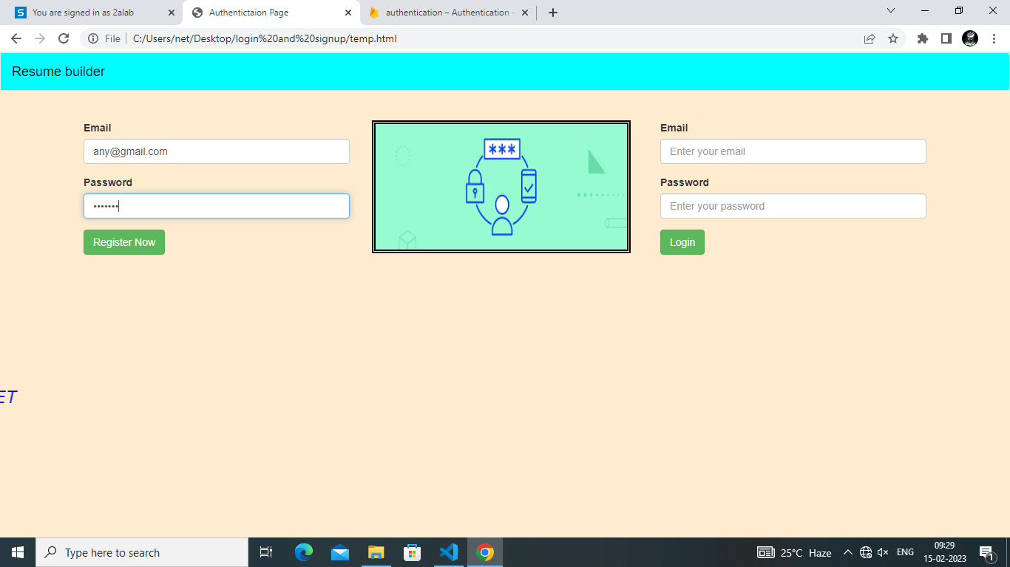
ENTERING REGISTRATION DETAILS

Slide 24
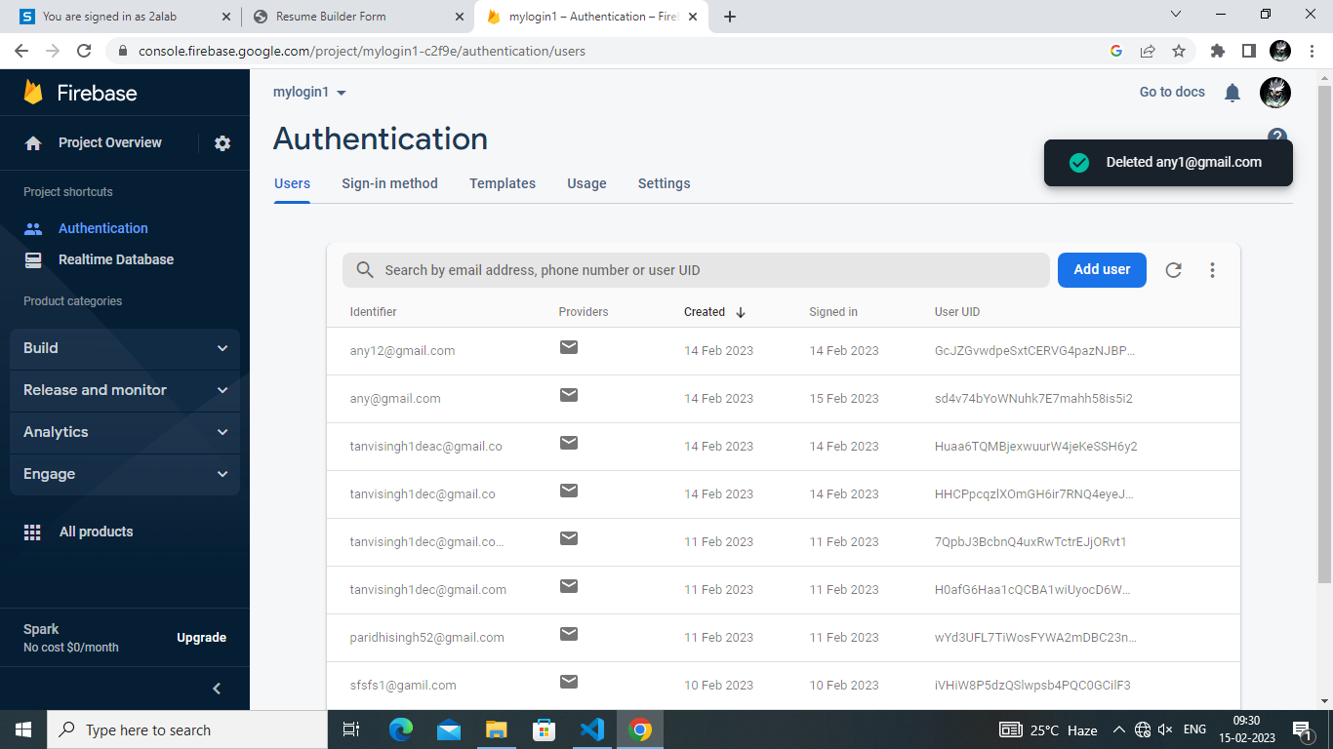
BEFORE REGISTRATION

Slide 25
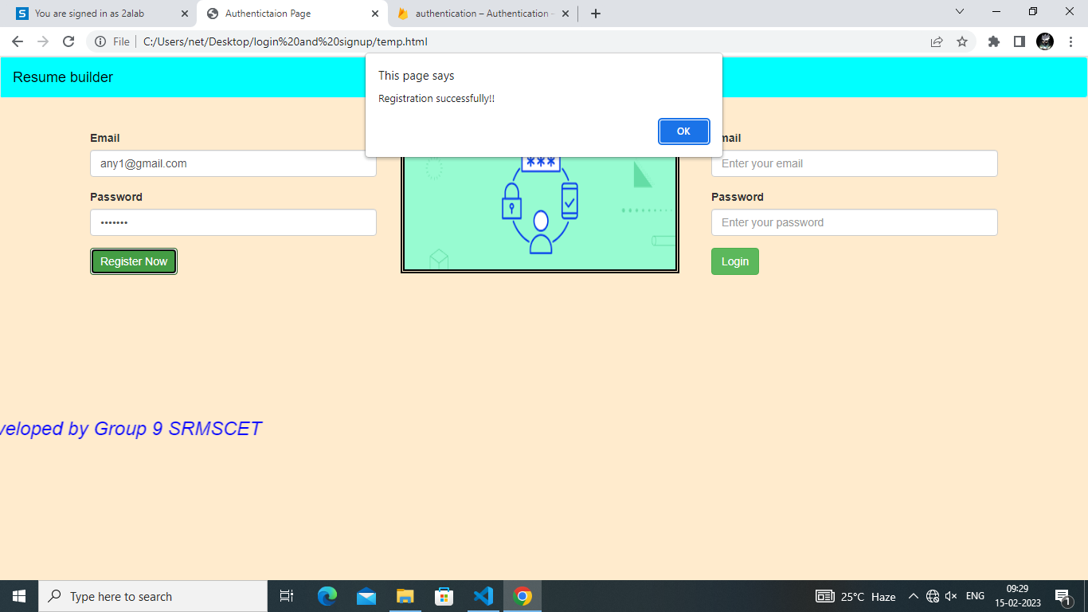
REGISTRATION POP-UP

Slide 26
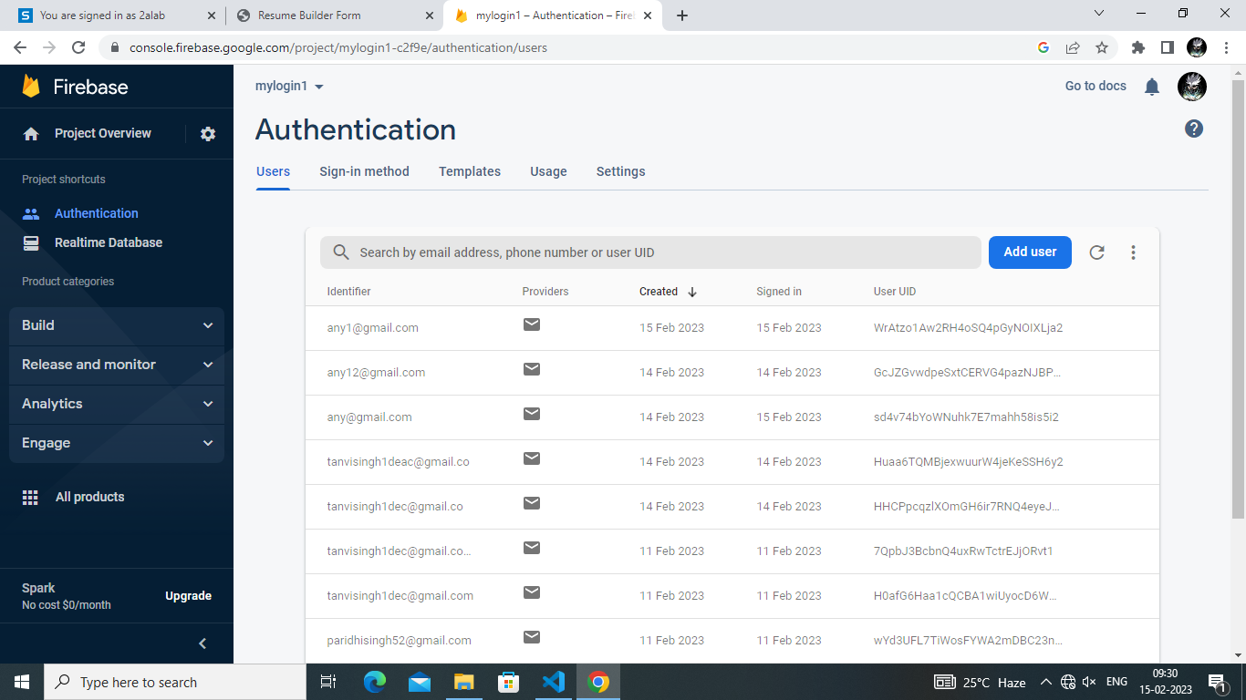
AFTER REGISTRATION

Slide 27
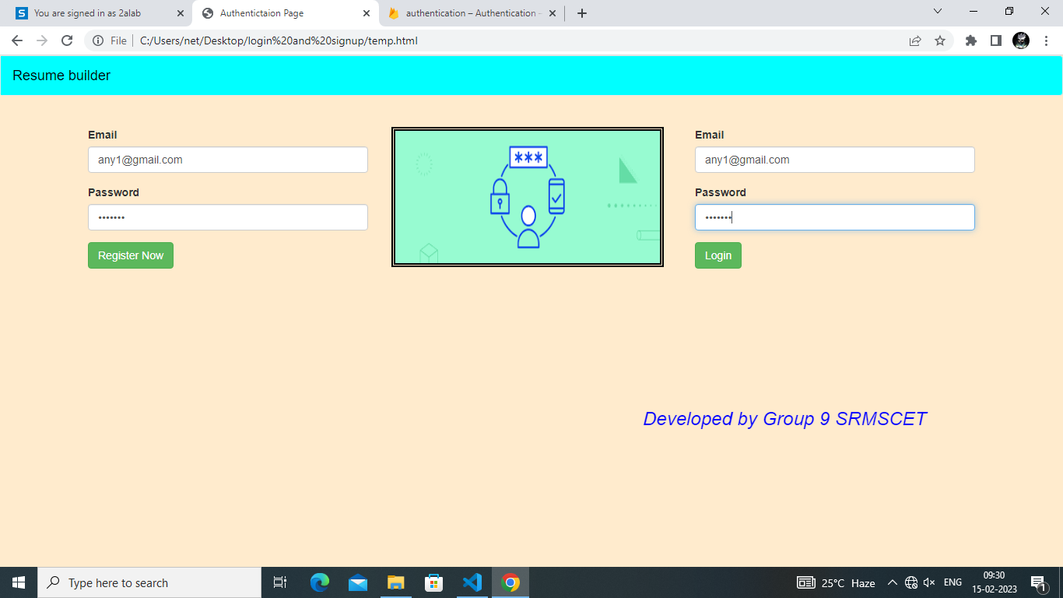
ENTERING LOGIN DETAILS

Slide 28
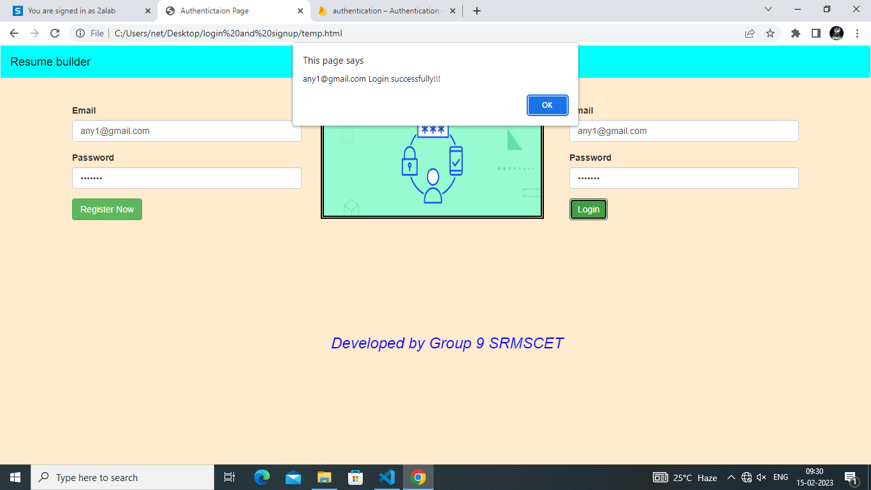
ENTERING LOGIN DETAILS

Slide 29
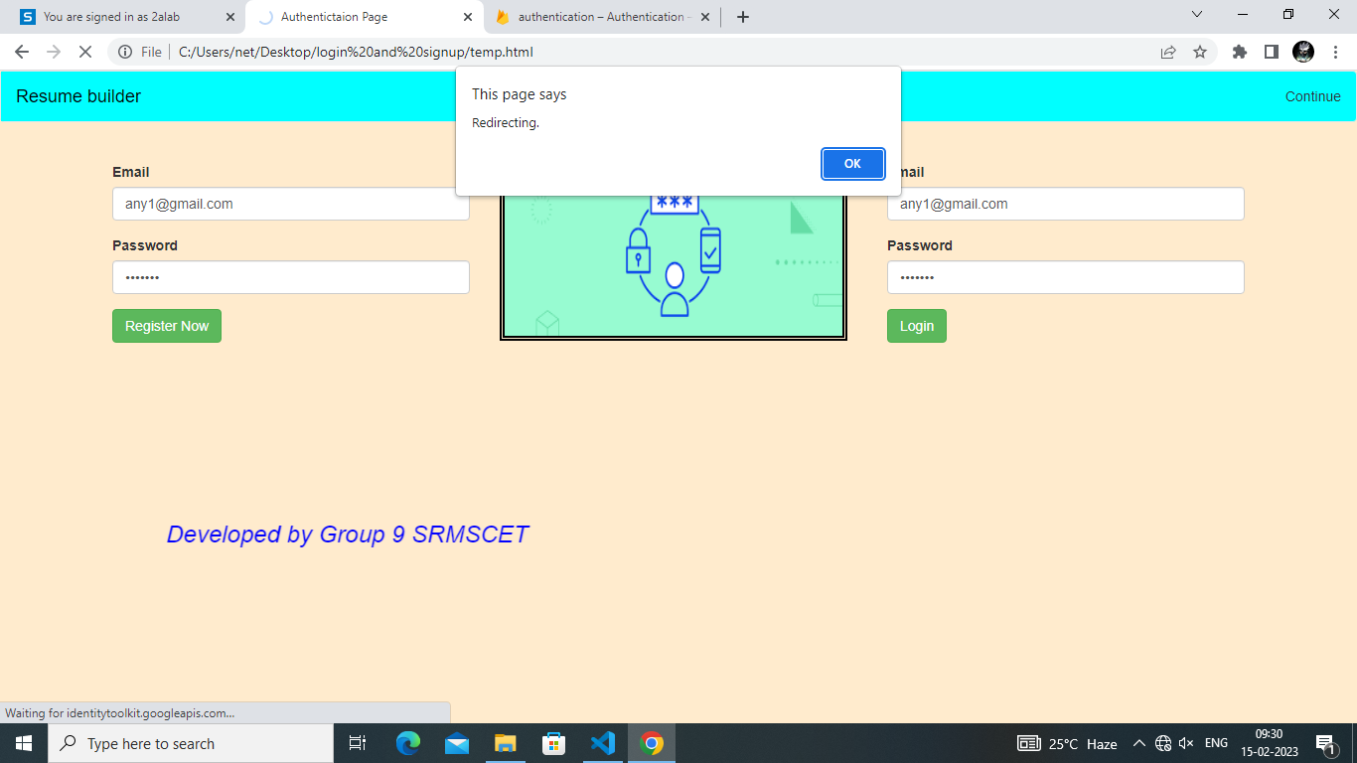
REDIRECTING TO RESUME MAKING

Slide 30
RESUME BUILDER SITE

Slide 31
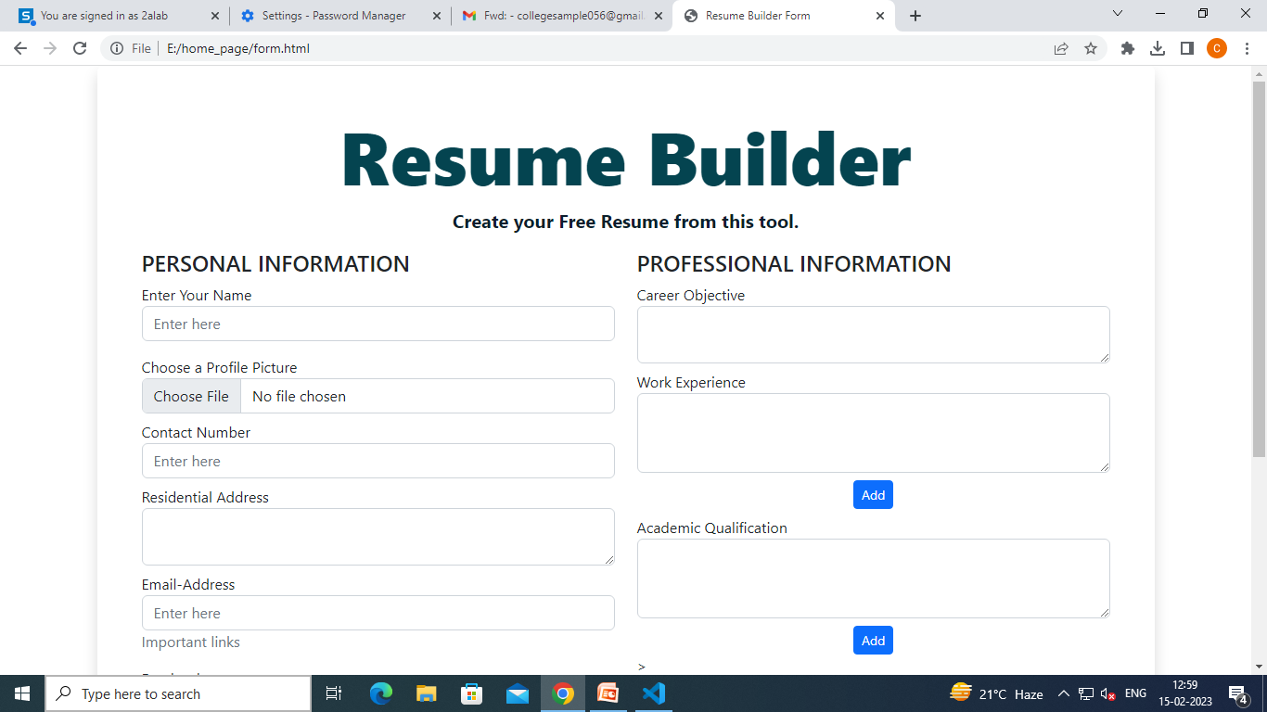
ENTERING DETAILS IN RESUME

Slide 32
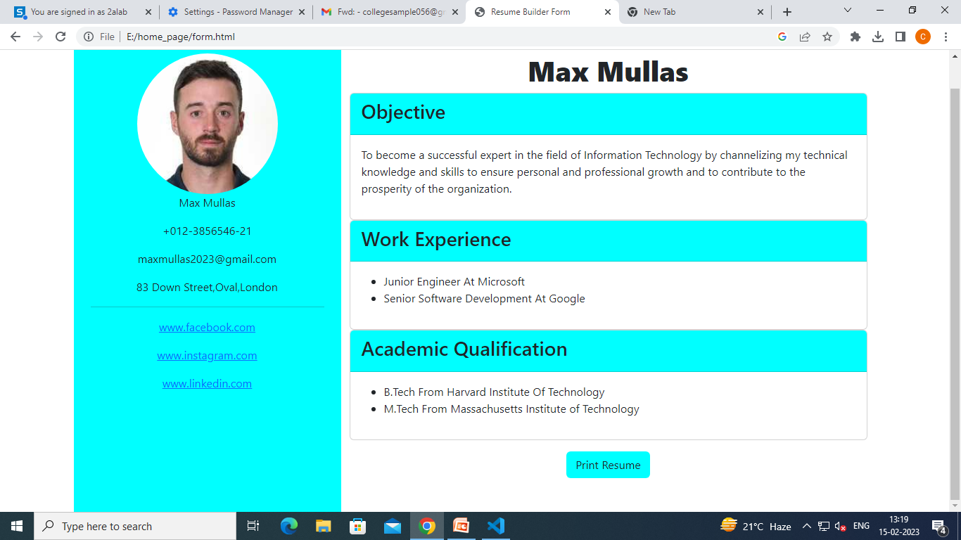
GENERATING RESUME

Slide 33
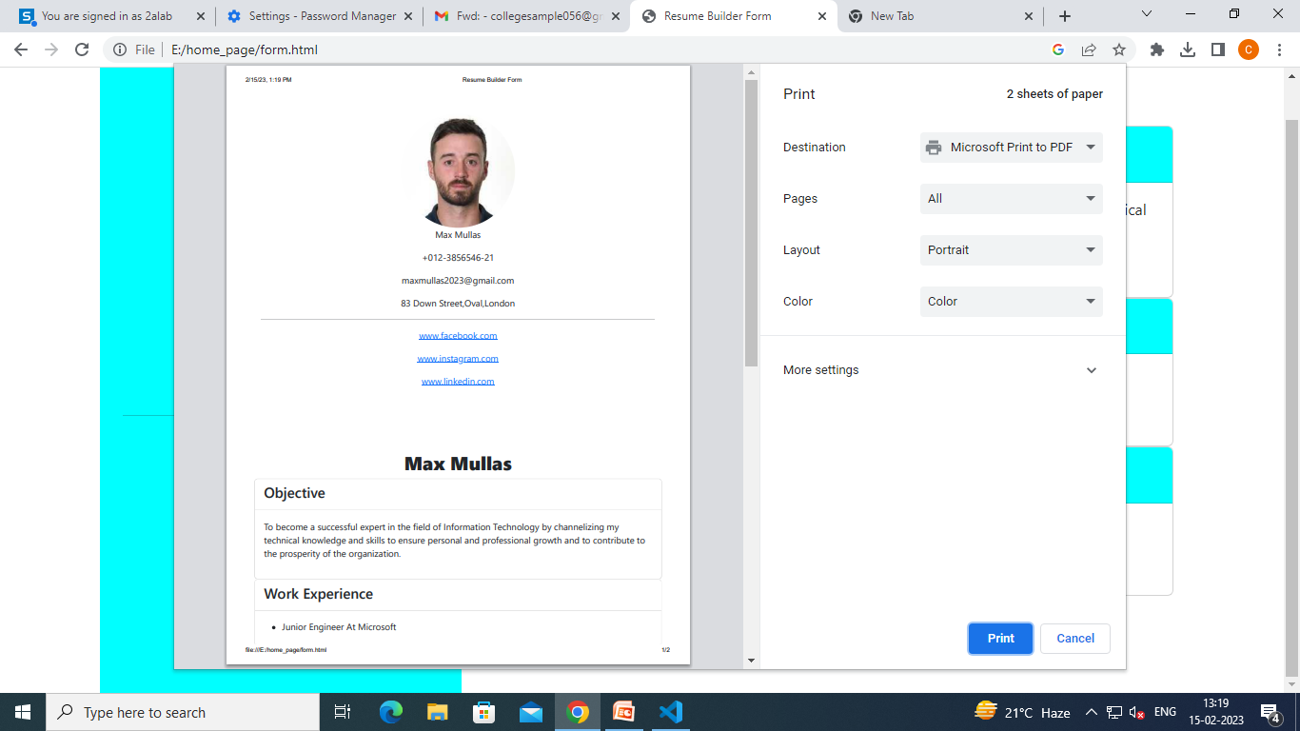
GENERATING PDF

Slide 34
REFERENCES
Sanja Delcev, Drazen Draskovic,” Modern JavaScript frameworks: A Survey Study”, 30-31 May 2018.
Mohit Bajpai, Ayush Jain, Chandan Kumar, Bhawani Shankar Purohit,”A Research Paper on Web Development Using HTML5 and CSS3”. Journal of Advanced Database Management & Systems. 2019
Grega Jakus1 , Matija Jekovec2 , Saso Tomazic 1 and Jaka Sodnik1,” New technologies for web development”,77(5): 273-280, 2010
www.crio.do.
www.tutorialspoint.com/sdlc/sdlc.

Slide 35
THANK YOU

