Slide 1

Parkinson's Disease Early Diagnosis using Machine learning and LLM
(GUIDED BY: Prof. PABITRA)
(MENTOR: DR. MRINAL ACHARYA)
PRESENTED BY:
BANSODE VASU SATYAWAN: 24BM6JP13
ISHU PATEL: 24BM6JP23​
SUSHANT SHEKHAR: 24BM6JP54​
GANTA DEEPAK: 24BM6JP18
UTKARSH ATTELA: 24BM6JP59
​

Slide 2
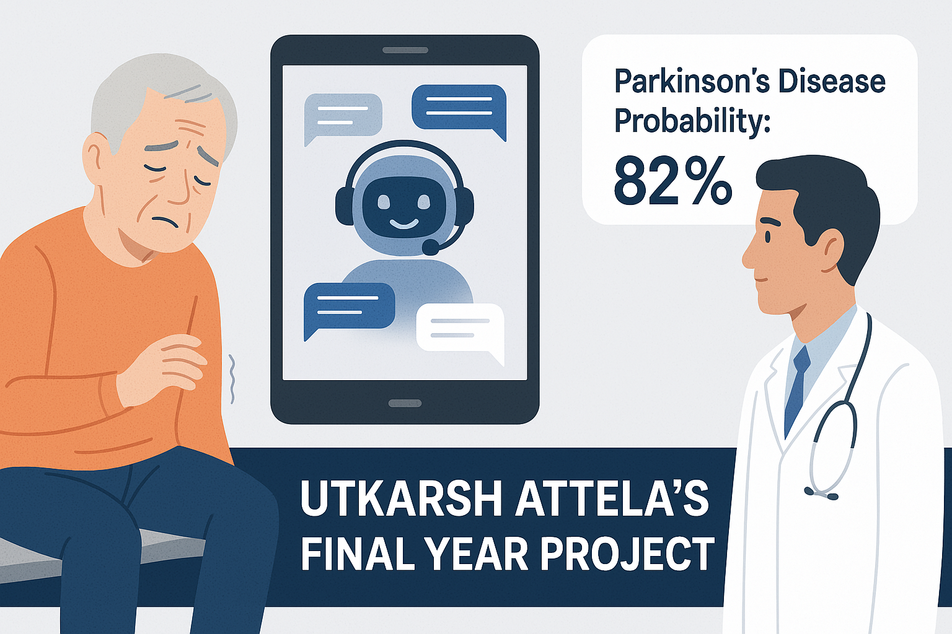
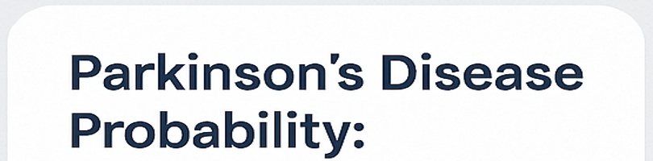
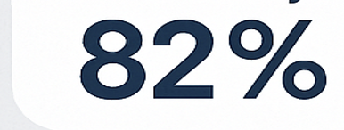

PROBLEM STATEMENT
Parkinson is serious non curable neuro degenerative disease affecting 2 out 1000 people.
Clinical assessments for diagnosis rely on extensive questionnaires, are time-consuming and often subjective making early detection difficult. In a country like India, conducting such assessments is extremely challenging.
India's language diversity also makes the clinical screening difficult to scale.
Our Objective is to create an develop an LLM-based self-screening tool that can engage users in natural language conversations.
For this, the LLM needs to process relevant questions and early diagnose the Parkinson’s Disease.

Slide 3
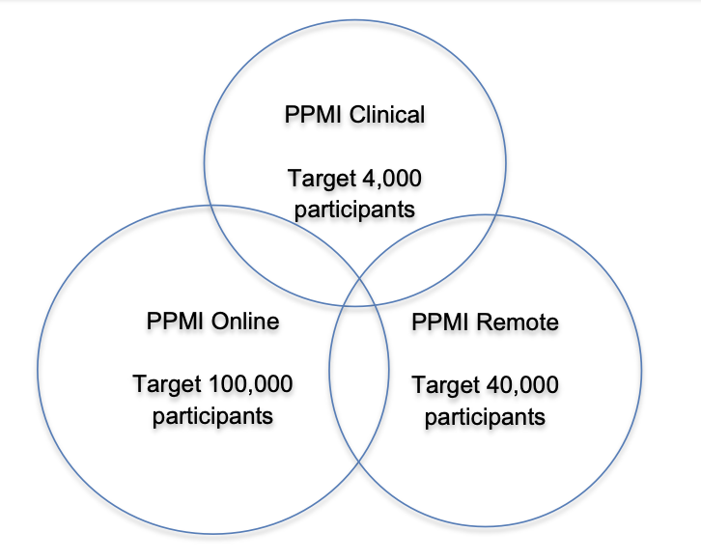
DATASET CREATION AND PREPROCESSING
DATASET
WHY PPMI ONLINE
PPMI DATA TYPES
DATA PREPROCESSING
Large, publicly available dataset designed to advance Parkinson’s Disease research.
Combines multiple data sources:
PPMI Clinical: In-depth, in-person clinical assessments.
PPMI Online: Large-scale self-reported questionnaire data.
PPMI Online:
Real-world, self-reported data from a broad population.
Reflects natural missingness, where participants may skip questions—ideal for building robust models.
Much larger sample size (~100,000 target participants) compared to PPMI Clinical (~4,000).
Covers both first visit and subsequent follow-ups.
Well-suited for creating ML and DL models that aim to detect early signs of Parkinson’s from questionnaire-based responses.
Selected data only from the first visit (screening event) to focus on early-stage, pre-diagnosis information.
Started with 890 questionnaire columns.
Merged multiple CSV files using Patient ID and Event ID.
Filtered for “Screening” event data only.
Dropped columns with >50% missing values, retaining only the relevant features.
Final dataset:
  143 questionnaire columns
  38,256 records
Creation of Dataset for LLM
Each column represents a question and each question is mapped to a keyword.
Full question texts were generated using GPT with few-shot prompting for clarity and consistency.
For each patient:
A dictionary was created with two keys:
  prompt: Concatenation of all answered questions and their responses.
  label: The patient's diagnosis status (if available).
Final dataset is a list of patient-level dictionaries.

Slide 4
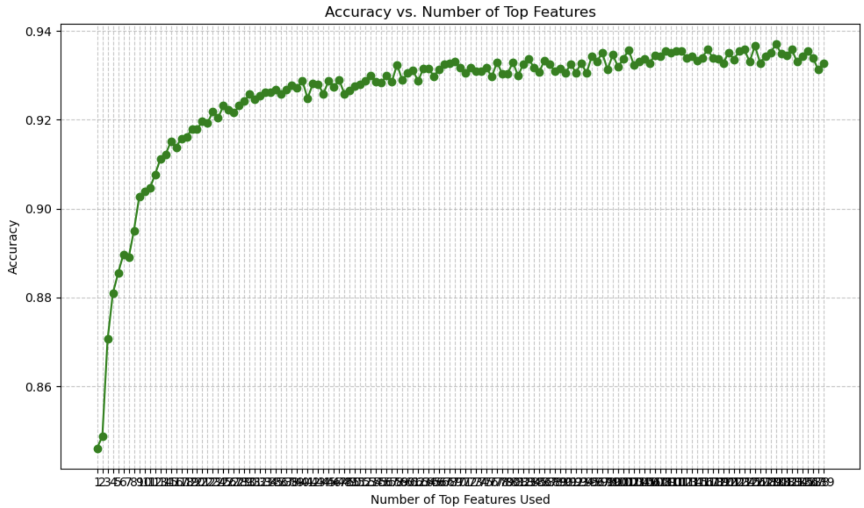
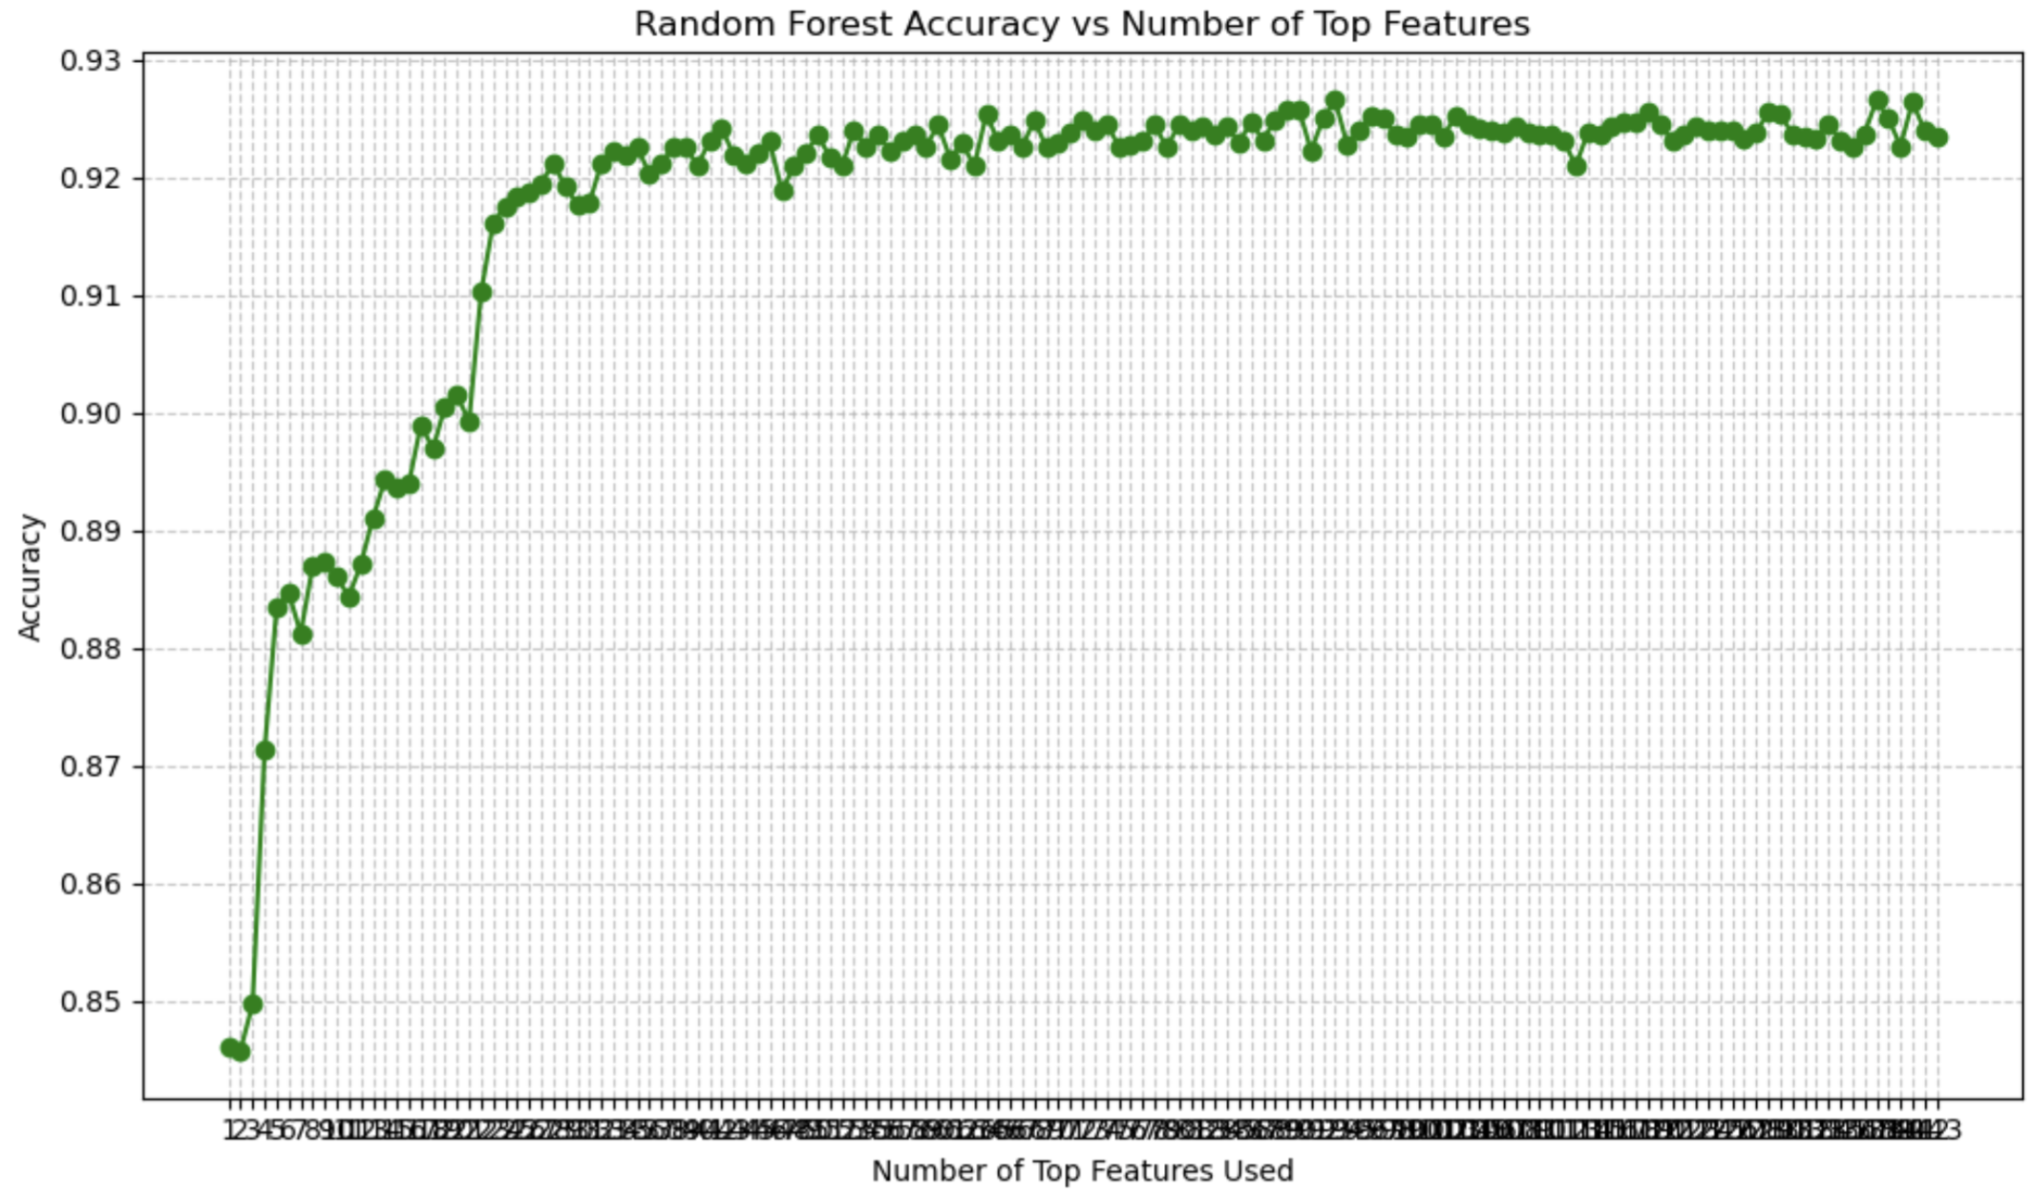
METHODOLOGY
Methodology
XG Boost
ANN
LLM Based
Random Forest
Data Imputation
Missing values imputed using Random Forest Imputer (MissForest library).
Achieved 39% imputation accuracy (evaluated on 5% randomly masked data)
Model Benchmarking
LLM model's performance was benchmarked on the complete dataset and the top 30 features dataset (obtained from XG Boost) against:
XG Boost and Random Forest
Trained and evaluated using an 80:20 train-test split from the imputed dataset.
Normalized feature importance scores were plotted in a scree plot; the dataset corresponding to the top 30 features (91.5% score) was selected from each model.
The models were retrained and evaluated on this dataset, with the one achieving the highest accuracy chosen for performance comparison of other models against the full dataset
ANN
Trained and evaluated using an 80:20 train-test split on Top 30 features.
Epochs = 50, Batch Size =128, Adam Optimizer, learning Rate = 0.001
Neural Network of Size = 30 x 128 x 64 x 32 x 1
XG Boost
Random Forest

Slide 5
METHODOLOGY
LLM Fine Tunning and Evaluation
  Model Selection
  Google's Flan-T5 Small, released in Oct 2022, enhances generalization through instruction tuning. It was chosen for its:
  1. Encoder-Decoder architecture (strong in classification and generalization)
  2. Suitability for limited computational resources
  3. Lightweight design (80M parameters)
  4. Superior performance on summarization, classification, and QA tasks.
  Training
  A linear classification head was added on top for the binary classification task.
  The model was trained on both the complete dataset and the top 30 features dataset, each randomly split in a 75:15:15 train-validation-test split. We used two methods for fine-tuning.
    LoRA with quantization (batch size 32)
    Enables efficient fine-tuning without changing the original weights
    Configured with rank 16, which provides expressive adaptive layers without exploding memory.
    4-bit quantization was used to compress the pretrained model weights to 4-bit (reduce memory,computational load)
  Finetuning (batch size 64)
  Updated all the model weights end-to-end.
  Trained only on the complete dataset.

Slide 6
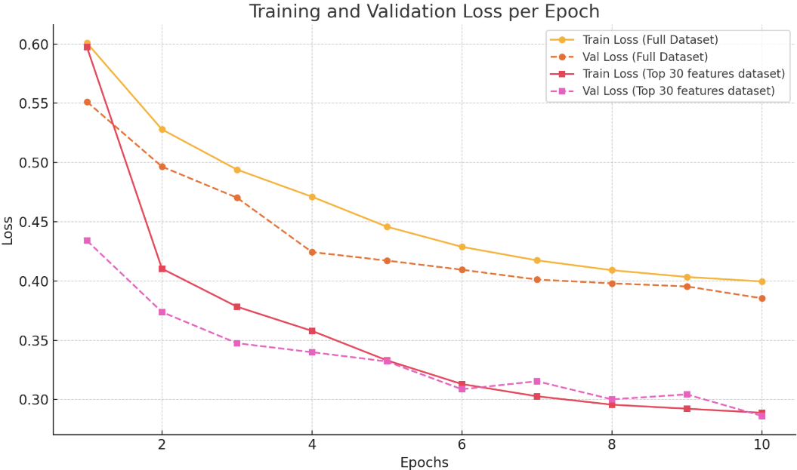
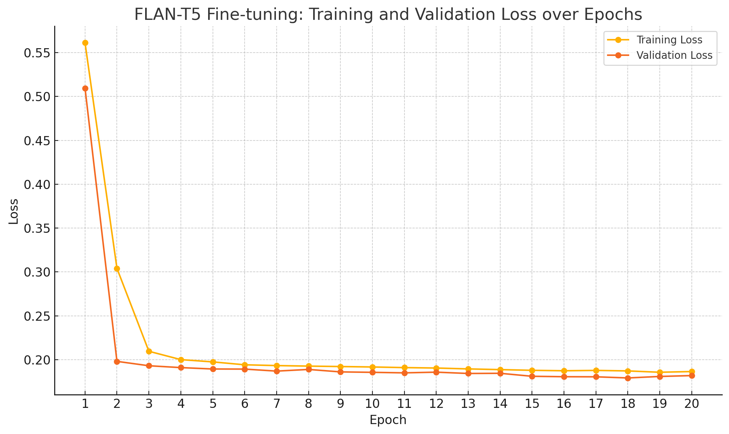
Results
Plot of Train and validation loss per epoch using google/flan-t5-small (LORA)
Model | Accuracy | Recall | F1 | Dataset
Benchmark
Random Forest | 90% |  |  | Complete dataset (143 features)
 | 89% |  |  | Top 30 features
XG Boost | 91.10% |  |  | Complete dataset (143 features)
 | 89.3% |  |  | Top 30 features
LLM Based
LLM with LORA | 83.41% | - | - | Full dataset (143 questionnaires)
 | 87.50% | - | - | Top 30 questionnaires
End-to-End Fine Tuning | 94.49% | - | - | dataset (Top 30 questionnaires)
Plot of Train and validation loss per epoch using Finetuning google/flan-t5-small
XGBoost achieved the highest accuracy (91.10%).
FLAN-T5 with LoRA reached 83.41% (full data) and improved to 87.50% with top 30 features
while end-to-end fine-tuning achieved the highest overall accuracy at 94.49%.

Slide 7
Conclusion and Future Scope
Results
The LLM with LoRA adaptation showed varying results based on the dataset used:
    It achieved 83.41% on the complete dataset.
    Accuracy improved to 87.50% for the top 30 features dataset, suggesting the model benefits from focused, high-signal input features.
    Fine-tuning LLM Brings Significant Gains:
  The end-to-end finetuned outperformed others with an accuracy of 94.49%, shows the effectiveness of task-specific fine-tuning.
  This result indicates that when LLMs are properly adapted and trained on the full data context, they can surpass traditional machine learning approaches.
Overall Conclusion
  While traditional models like XGBoost and ANN deliver strong performance with careful preprocessing and feature selection, finetuned LLMs demonstrate the highest potential, provided sufficient computational resources and domain-specific tuning.
  The improvement seen through finetuning (from 83–87% to 94.49%) underscores the viability of LLMs for structured prediction tasks even on medium-sized datasets and understand representation of the questions.
  Future Scope :
  1. Multimodal Data Integration
  2. Chain-of-Thought Reasoning
  3. Prompt-Based Adaptive Diagnosis

Slide 8
THANK YOU!!

