Slide 1
Staff Management System
By : Harsh Jindal

Slide 2
Introduction
The staff management is an application that is designed to reduce the manual work that is involved in storing the details of the staff. Without the staff , there would not be any proper functioning of the organization. Staff are the backbone of any company. Its an application that will track the records for all the staff of organization. This application will contain the details like name, email , phone number and salary etc.
Here in this project I used Reactjs for frontend , Spring boot for backend and MySQL for database

Slide 3
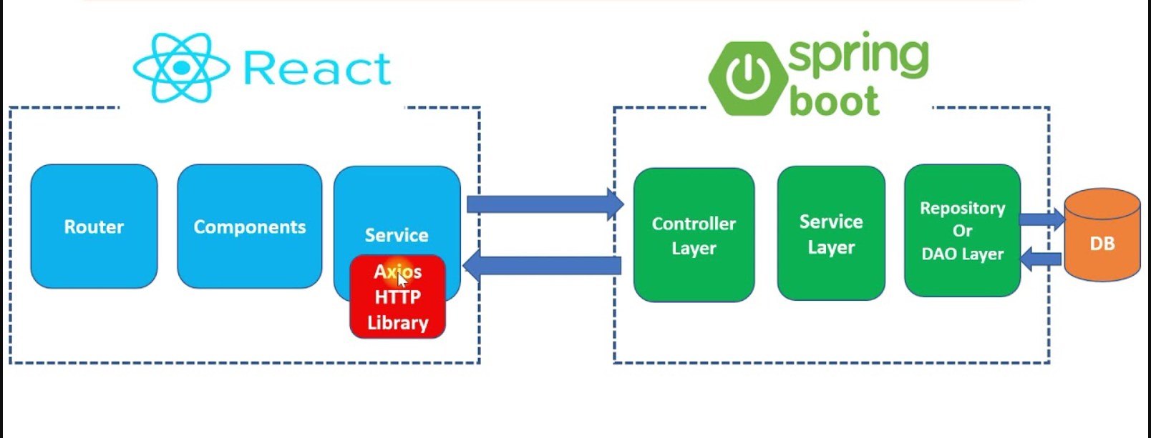
Project Overview

Slide 4
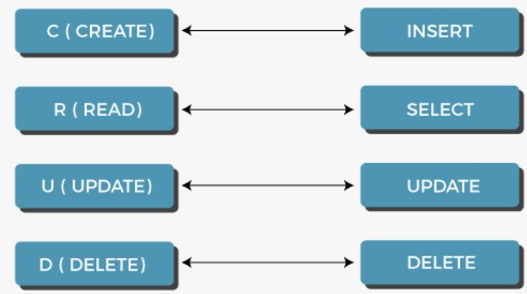
Features
We will develop CRUD features:
Add Details of staff such as Name, Phone, Email Id, & Mobile no.
Uses single form to add details one at a time.
Update Existing Details using the same form with prefilled previous data.
Delete any staff Detail with single click.
View any staff Detail with single click

Slide 5

Technology Stack
Server-side tools and technologies used -
Spring Boot
Maven
JDK
Embedded Tomcat
MySQL Database
Client-side tools and technologies used-
React
Modern JavaScript (ES6)
NodeJS and NPM
VS Code IDE

Slide 6
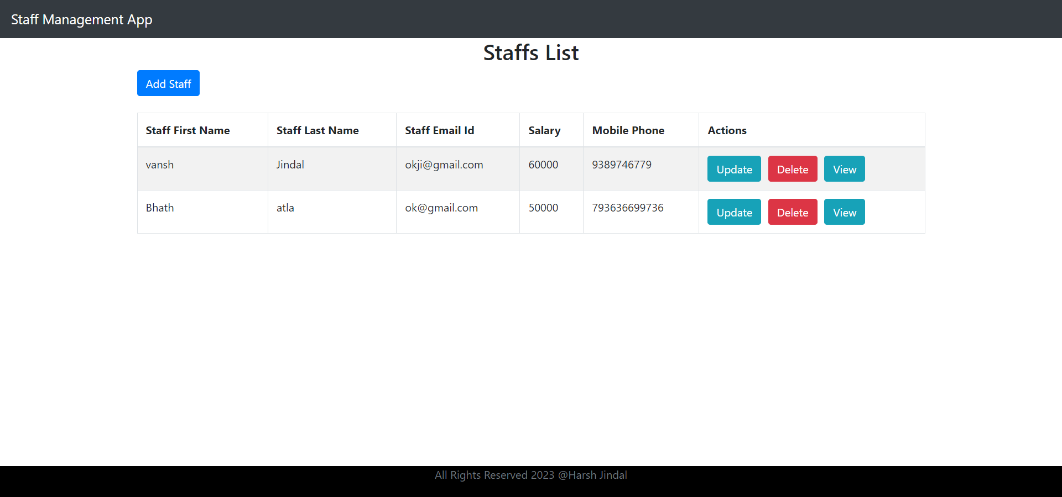
Screenshots
UI Home Page

Slide 7
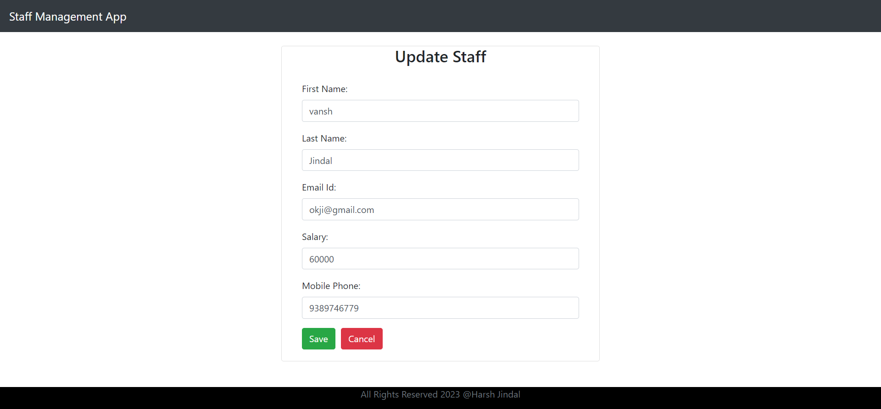
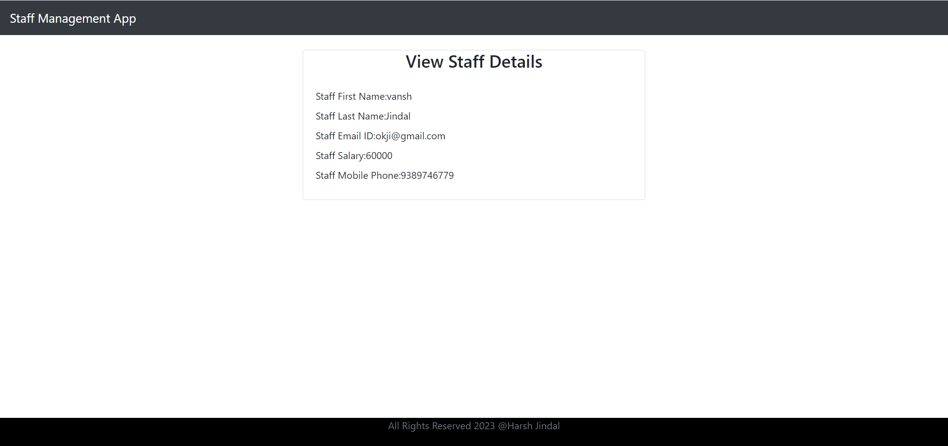
Screenshots
Update Info. Page
View Info. Page

Slide 8
Future Scope
Here are some opportunities we can explore to enhance the project's productivity and facilitate future improvements:
By incorporating role-based access control, password management, and staff profile pictures, we can enhance security and personalize user experiences.
Advanced search and filters, audit trail functionality, and performance management modules will provide valuable insights for decision-making and performance evaluation.

Slide 9
Conclusion
In conclusion, the Staff Management System is an essential tool that empowers our organization to efficiently handle staff-related processes and enhance overall productivity. By leveraging the power of ReactJS for frontend development, Spring Boot for backend functionality, and MySQL for data storage, we have created a feature application that streamlines staff management tasks.
Throughout the development process, we successfully implemented CRUD functionalities for managing staff records, allowing users to list, create, update, and delete employee information effortlessly. The system's user-friendly interface ensures smooth navigation, making it easy for staff members and managers to interact with the application.

Slide 10


