Slide 1
Navikenz Data Science Project
Project Name - Heart Attack Analysis & Prediction Dataset
Name – Harsh Jindal

Slide 2
Problem Description
The objective of this project is to check whether the patient is likely to be diagnosed with any
cardiovascular heart diseases based on their medical attributes such as gender, age, chest
pain, fasting sugar level, etc. this research work is aimed towards identifying the best
classification algorithm for identifying the possibility of heart disease in a patient.
Total number of rows are 303 and number of columns are 14 in this Dataset.

Slide 3
About Dataset
Age : Age of the patient
Sex : Sex of the patient
exang: exercise induced angina (1 = yes; 0 = no)
ca: number of major vessels (0-3)
cp : Chest Pain type chest pain type
Value 1: typical angina
Value 2: atypical angina
Value 3: non-anginal pain
Value 4: asymptomatic
trtbps : resting blood pressure (in mm Hg)
chol : cholestoral in mg/dl fetched via BMI sensor
fbs : (fasting blood sugar > 120 mg/dl) (1 = true; 0 = false)
rest_ecg : resting electrocardiographic results
Value 0: normal
Value 1: having ST-T wave abnormality (T wave inversions and/or ST elevation or depression of > 0.05 mV)
Value 2: showing probable or definite left ventricular hypertrophy by Estes' criteria
thalach : maximum heart rate achieved
target : 0= less chance of heart attack 1= more chance of heart attack

Slide 4

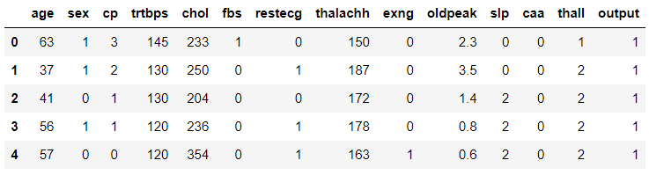
Heart Attack Analysis & Prediction Dataset

Slide 5
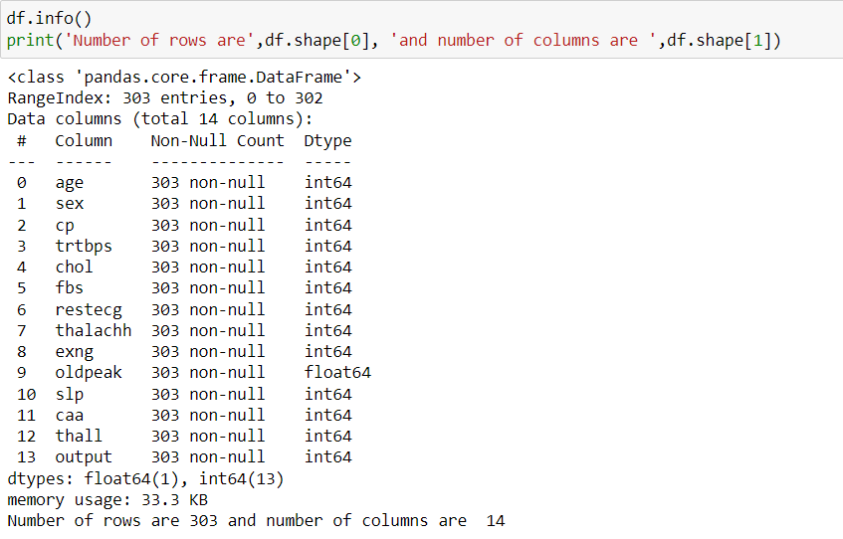
Data Cleaning Steps
Checking For info

Slide 6
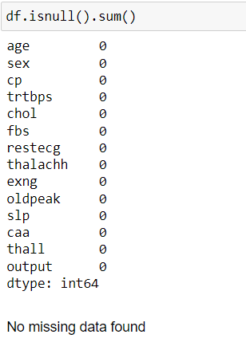
Data Cleaning Steps
CHECKING FOR MISSING VALUE

Slide 7
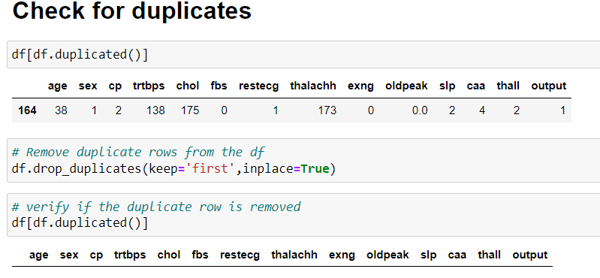
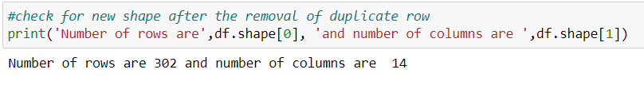
Data Cleaning Steps

Slide 8
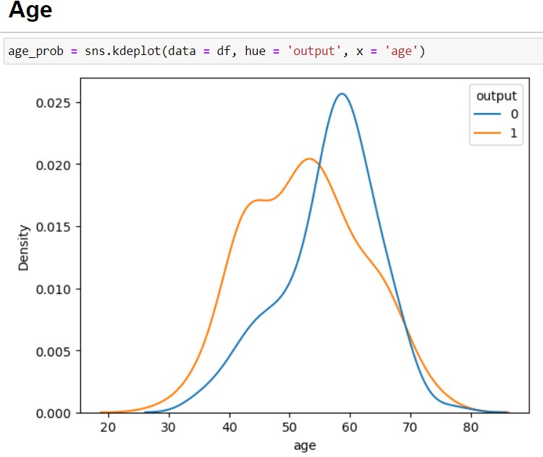
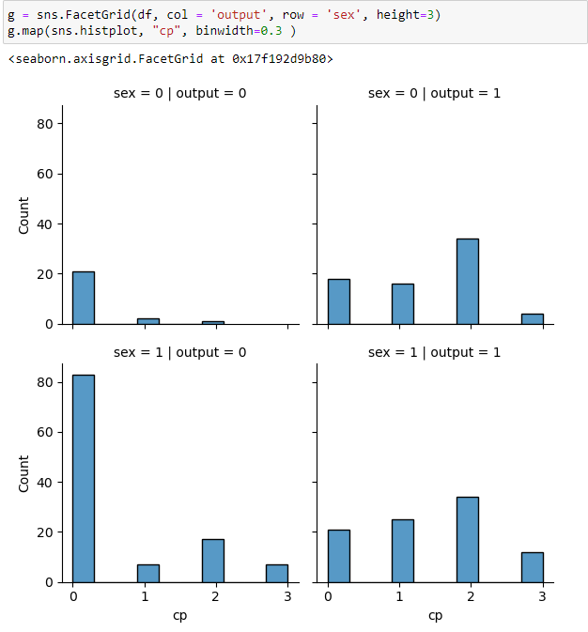
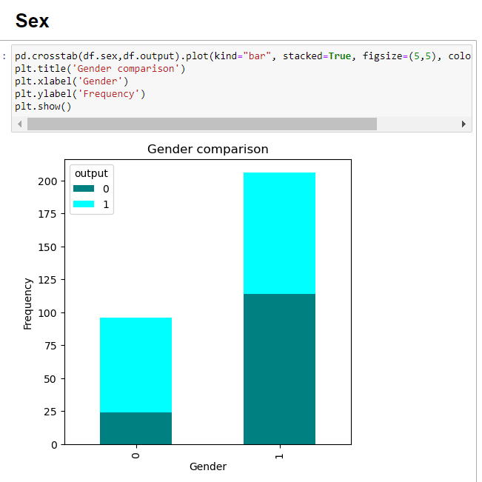
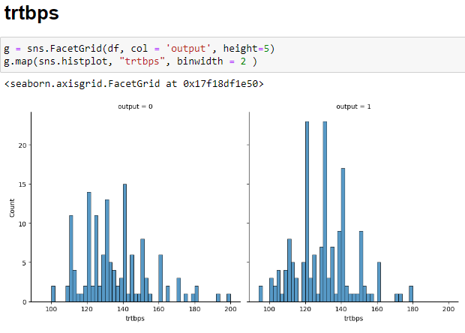
Data Visualization
- The fact that you're unlikely to get a heart attack if you survived your mid fifties.
- Males tend to have Heart Attack more than females
- The probability of men getting chest pain type 1 is 4 times higher than women getting it,
- For blood pressure: overall, it's a weak coorelation, but I managed to get the following information from the data.
At its normal state: there is no coorelation between getting a heart attack. Above 120: (Which is the bloob pressure normal state) it's more likely to get a heart attack. Above 160: there is no certanity a person would get a heart attack.

Slide 9
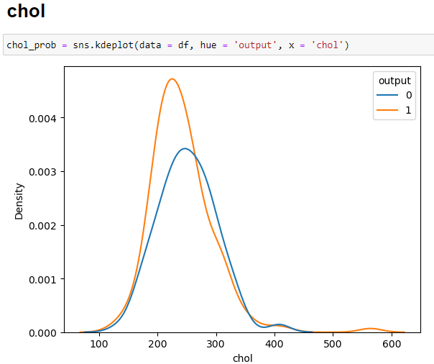
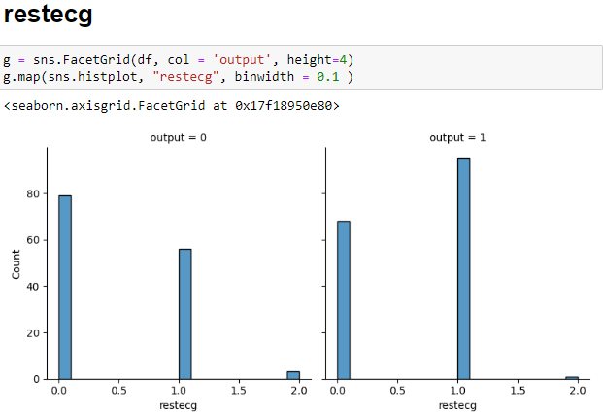
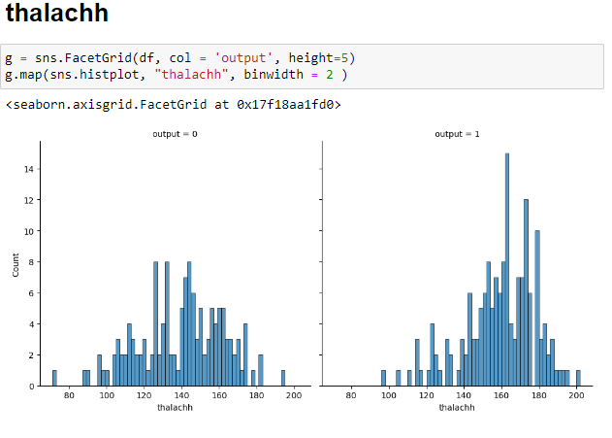
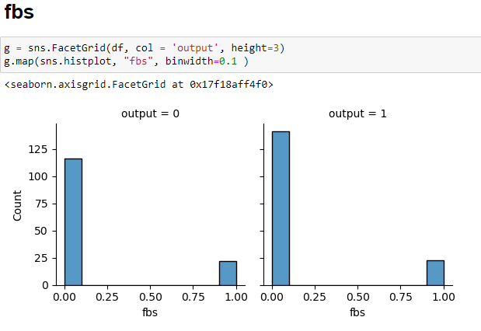
Data Visualization
- "restecg" column, idicating that the second type shows a problem in the heart. Well, the data also says so, as there is a higher chance of getting a heart attack with type 2.
- People with a higher amount of cholestrol in their blood are more likely to get a heart attack.
- Heart rate that is higher than 140 and getting a heart attack.
- higher blood sugar indicates a heart attack.

Slide 10
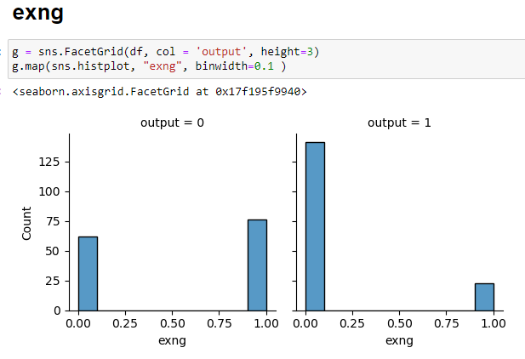
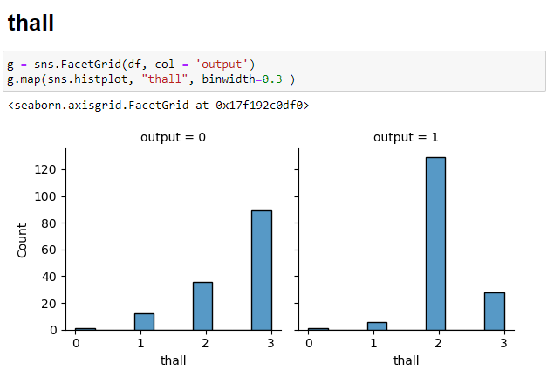
Data Visualization
- People who survived a previous stroke before has a higher chance of 50% to get a heart attack.
- for the "thall", type 2 indicates a higher probability of getting a heart attack.

Slide 11
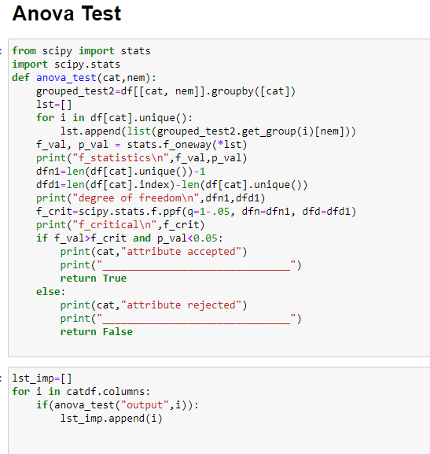
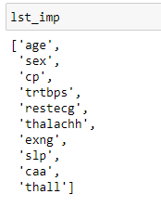
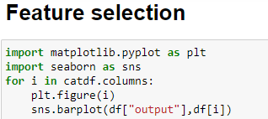
Feature Selection & Testing

Slide 12
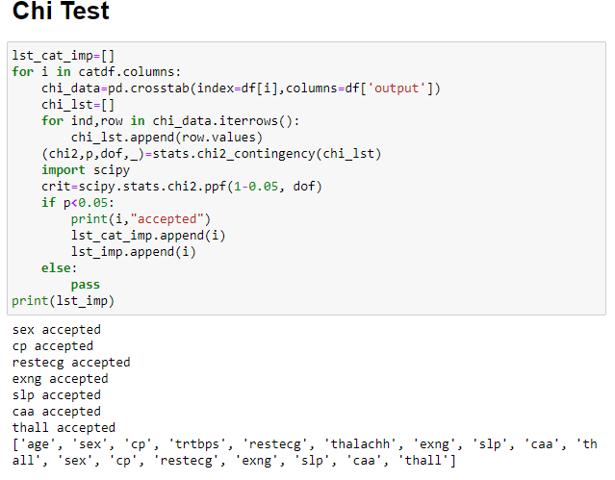
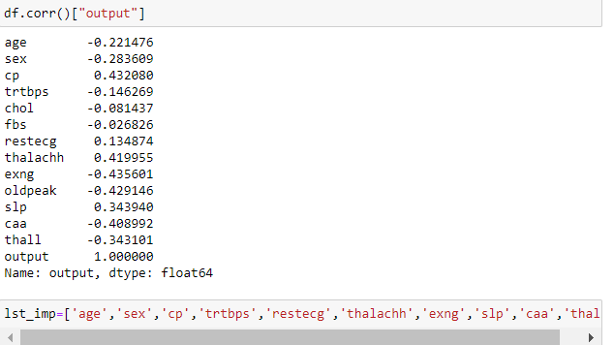
Feature Selection & Testing

Slide 13
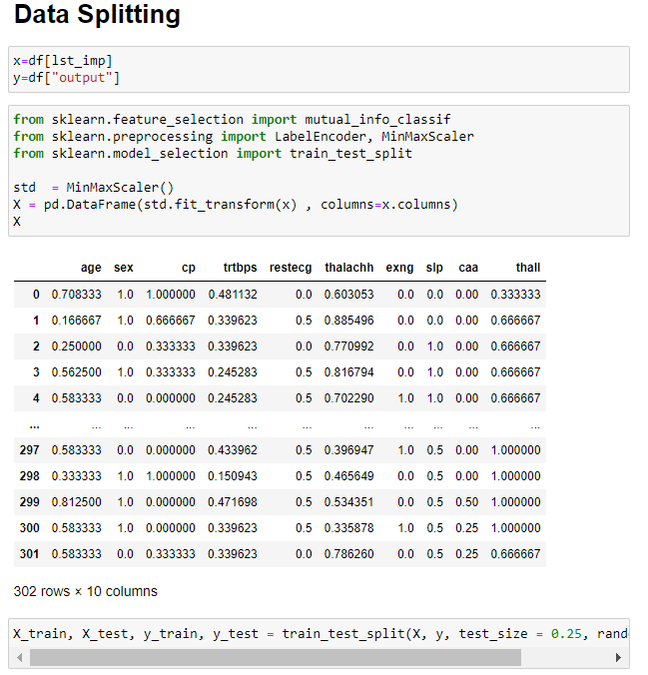
Data Splitting

Slide 14
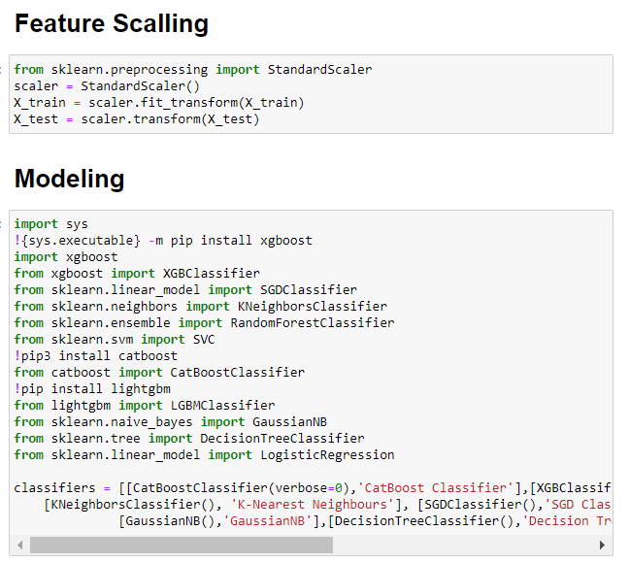
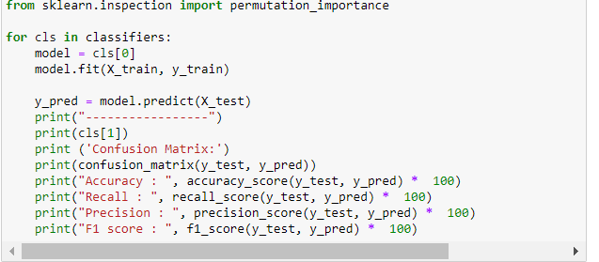
Feature Scalling & Modeling

Slide 15
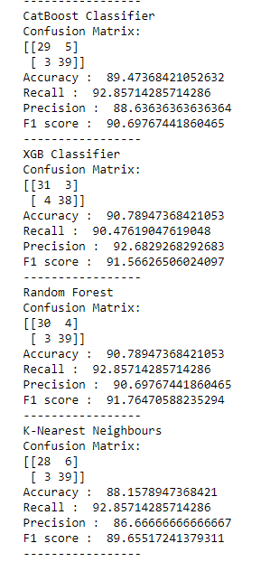
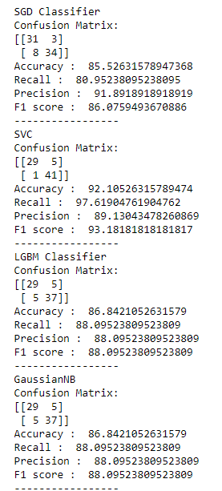
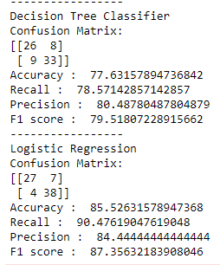
Modeling

Slide 16
Conclusion
According to the Modeling -
The best algorithm for predicting Heart Attack is SVC (Support Vector Classifier).
Accuracy : 92.10526315789474
Recall : 97.61904761904762
Precision : 89.13043478260869
F1 score : 93.18181818181817

Slide 17


