Slide 1
Campus Placement AI
AI-Powered Placement Intelligence
CHITKARA UNIVERSITY, RAJPURA
B.E. Artificial Intelligence & Machine Learning
HM
NK
VK
AY
PR
Harsh Mangla
2410992927
Nipun Kalra
2410993431
Vineet Kumar
2410993244
Ayush
2410993139
Pranav
2410992960
[Mentor / Faculty Name]
CAMPUS PLACEMENT AI · FINAL YEAR PROJECT
01 / 23
01 / 23

Slide 2
WHAT WE BUILT
Project Overview
KEY ATTRIBUTES
Student Profile
Eligibility
Azure AI
Foundry
+
Campus
Placement
Agent
+
RAG
Knowledge-Grounded
Academic Data
Skill Gap
Knowledge-Grounded
Skills & Projects
Preparation
Resume (PDF/DOCX)
+
Personalised
→
Target Role
AI Assistant
Personalised
Centralized
Centralized
Context-Aware
Context-Aware
profile · resume · AI · intelligence
01 / IDEA
02 / 23
02 / 23

Slide 3
WHY THIS MATTERS
The Problem
Information
Fragmentation
Manual
Comparison
No
Personalization
Placement criteria scattered
across notices, PDFs & portals
Students manually match profile
vs. eligibility criteria
Generic advice not tailored
to individual profiles
Unclear
Skill Gaps
Resume
Misalignment
No Central
Intelligence
No clear view of missing
vs. possessed skills
Resume not matched to
specific role requirements
No unified platform combining
profile, resume, and guidance
02 / PROBLEM
03 / 23
03 / 23

Slide 4
THE GAP
Existing Approach vs Ours
TODAY
OUR APPROACH
Search eligibility documents
Build student profile
Read PDFs / notices manually
Upload resume
Compare CGPA & backlog criteria
Select target company + role
VS
Check skills vs. job description
AI Foundry + RAG analysis
Read resume (no role context)
CENTRALISED
Eligibility · Skill Gap · Plan
Find generic preparation tips
GROUNDED
PERSONALISED
AI Placement Assistant
Prepare without gap analysis
conventional approach
campus placement ai
02 / PROBLEM
04 / 23
04 / 23

Slide 5
OUR ANSWER
Campus Placement AI
Profile
Intelligence
Resume
Intelligence
Knowledge
Grounded AI
Personalised
Outputs
→
→
→
Academic · Skills
Projects · Certs
PDF / DOCX parsing
Text extraction
Azure AI Foundry
RAG · gpt-4.1-mini
Eligibility · Gap
Prep · AI Chat
01 Eligibility Intelligence
02 Skill Gap Intelligence
03 Personalized Preparation
04 AI Placement Assistant
NEVER guarantees selection · Distinguishes missing info from confirmed gaps
03 / SOLUTION
05 / 23
05 / 23

Slide 6
WHAT WE SET OUT TO DO
Project Objectives
I
Centralise student placement information in one profile
II
Provide knowledge-grounded AI assistance via RAG
III
Analyse eligibility for target company & role
IV
Distinguish: SATISFIED · INFO MISSING · CONFIRMED GAP
V
Parse uploaded resumes (PDF/DOCX) into AI context
VI
Generate personalised, gap-focused preparation guidance
VII
Provide interactive AI assistant with conversation history
VIII
Create a scalable foundation for future placement intelligence
03 / SOLUTION
06 / 23
06 / 23

Slide 7
WHO BENEFITS
Target Users
Students
Placement
Cells
Recruiters /
Companies
PRIMARY · IMPLEMENTED
SECONDARY · FUTURE SCOPE
FUTURE SCOPE ONLY
— Build complete placement profile
— Manage RAG knowledge base
— Upload role requirements
— Upload resume for AI context
— Guide students at scale
— Candidate-role matching
— Check eligibility per criterion
— Cohort readiness monitoring
— Structured hiring intelligence
— Identify confirmed skill gaps
— Reduce manual counselling
— — not yet implemented —
— Get phase-based prep plan
— Ask AI placement questions
— Full conversation history
PRIMARY · IMPLEMENTED
SECONDARY · FUTURE SCOPE
FUTURE SCOPE ONLY
03 / SOLUTION
07 / 23
07 / 23

Slide 8
THE JOURNEY
End-to-End User Workflow
REGISTER
→
LOGIN
→
BUILD PROFILE
→
UPLOAD RESUME
→
SELECT ROLE
↓
RUN ANALYSIS · POST /api/analysis/{type}
↓
AZURE AI FOUNDRY · CampusPlacementAgent · RAG Knowledge · gpt-4.1-mini
↓
ELIGIBILITY
SKILL GAP
PREPARATION
AI ASSISTANT
04 / SYSTEM
08 / 23
08 / 23

Slide 9
TECHNICAL BLUEPRINT
System Architecture
Presentation
React 18 · TypeScript · Vite 5 · Tailwind CSS 3 · React Router v6
↕
API / Backend
Express.js 4 · TypeScript · REST API · JWT Auth · express-validator
↕
Data Layer
SQLite (better-sqlite3 v13) · 8 tables · WAL mode · FK constraints
↕
Docs Layer
multer v2.4 · pdf-parse (PDF) · mammoth (DOCX) · 5 MB limit
↕
AI / Cloud
@azure/ai-projects v2.7.0 · AIProjectClient · CampusPlacementAgent · gpt-4.1-mini · Responses API
↕
Auth / Sec
jsonwebtoken · bcryptjs (12 rounds) · Stateless JWT · Creds never reach frontend
Monorepo: /client (React/Vite) · /server (Express/TS) · npm run dev (concurrently)
04 / SYSTEM
09 / 23
09 / 23

Slide 10
THE AI ENGINE
Azure AI Foundry + RAG
IMPLEMENTATION
Placement Knowledge
SDK
@azure/ai-projects v2.7.0
Docs, requirements, role info
stored in Foundry project
Client
AIProjectClient(endpoint, DefaultAzureCredential)
↓
Retrieval
Agent Client
.getOpenAIClient({ azureConfig: { agentName } })
Relevant docs pulled based
on student query + context
API Call
openai.responses.create({ model, input })
↓
Model
gpt-4.1-mini (deployed in Foundry project)
Augmentation
Agent
CampusPlacementAgent (pre-configured + RAG)
Profile + resume text +
conversation history added
Context
Profile + Skills + Resume + Chat History
↓
Generation
Auth
DefaultAzureCredential (az login)
CampusPlacementAgent produces
grounded placement response
Rule
Azure creds never reach the React frontend
KNOWLEDGE-GROUNDED AI — not generic ChatGPT
05 / INTELLIGENCE
10 / 23
10 / 23

Slide 11
FEATURE I
Eligibility Intelligence
• Academic profile (CGPA, backlogs)
✓ SATISFIED
• Degree / Branch / Year
Requirement clearly met
based on available profile data.
• Technical skills list
CampusPlacement
Agent
+
RAG
• Projects & certifications
→
→
? INFO MISSING
• Resume text (uploaded)
• Target company & role
Data not provided — NOT treated
as a confirmed gap.
inputs to analysis
⚠ CONFIRMED GAP
⚑ KEY PRINCIPLE: "Information Missing ≠ Confirmed Skill Gap" · Platform does not guarantee selection.
Clearly lacking based on
available information.
05 / INTELLIGENCE
11 / 23
11 / 23

Slide 12
FEATURE II
Skill Gap Intelligence
REQUIRED SKILL
CLASSIFICATION
ACTION
Python Programming
✓ SATISFIED
No action needed
Data Analysis
✓ SATISFIED
No action needed
SQL / Databases
? INFO MISSING
Provide in profile
Machine Learning
⚠ CONFIRMED GAP
Focus in prep plan
Cloud Computing
⚠ CONFIRMED GAP
Azure/AWS fundamentals
Communication
? INFO MISSING
Add to profile/resume
— Illustrative example rows. Actual AI output is generated per student profile & target role.
05 / INTELLIGENCE
12 / 23
12 / 23

Slide 13
FEATURE III
Personalized Preparation Plan
Phase I
Foundation
• Complete student profile
Core concepts & prerequisites
• Target company & role
AI
Engine
+
RAG
Phase II
Core Skills
• Confirmed skill gaps only
→
→
Develop confirmed gap skills
• Resume context
Phase III
Role Preparation
Role-specific technical topics
inputs
Phase IV
Interview Prep
Aptitude, HR, technical rounds
Phase V
Final Readiness
Mock tests, revision, strategy
Preparation focuses ONLY on confirmed gaps — no wasted time on skills already present.
05 / INTELLIGENCE
13 / 23
13 / 23

Slide 14
FEATURE IV
Resume Intelligence
UPLOAD
VALIDATE
STORE
EXTRACT
PERSIST
INTEGRATE
PDF or DOCX · max 5 MB
MIME check + extension validation
Saved with unique filename
pdf-parse (PDF) · mammoth (DOCX)
extracted_text stored in SQLite
First 3000 chars in every AI call
→
→
→
→
→
• PDF Processing: pdf-parse · text layer extraction from searchable PDFs
• DOCX Processing: mammoth · Word documents to plain text
• File Handling: multer v2.4 · diskStorage · 5 MB limit · MIME validated
• AI Integration: Resume text prepended to eligibility, skill-gap & prep prompts
Note: Scanned/image PDFs without a text layer will not extract. Text-based PDFs and DOCX are fully supported.
05 / INTELLIGENCE
14 / 23
14 / 23

Slide 15
FEATURE V
AI Placement Assistant
ILLUSTRATIVE EXAMPLE (company from demonstration knowledge base)
TECHNICAL FLOW
Student
User question
What skills do I need for the Data Analyst role at TechNova?
↓
Last 6 messages
CampusPlacementAgent
Based on your profile and TechNova's requirements in our knowledge base: Python ✓ (you have it listed). SQL is not mentioned in your profile — I'd recommend adding it if you have experience, or treating it as a learning priority. Power BI and statistical modelling appear to be gap areas worth focusing on.
↓
Student profile
↓
Azure AI Foundry
↓
Student
RAG + Agent
Give me a 2-week plan to prepare for TechNova's aptitude test.
↓
AI response
CampusPlacementAgent
↓
Week 1 — Quantitative Aptitude: percentages, ratios, speed-time, data interpretation.
Week 2 — Logical Reasoning + Verbal Ability: pattern recognition, reading comprehension, mock tests with time management.
Saved to SQLite
05 / INTELLIGENCE
15 / 23
15 / 23

Slide 16
SECURITY
Authentication & Security
Register
email + password + fullName → bcrypt hash (12 rounds) → stored in users table
↓
Login
email + password → bcrypt.compare() → JWT signed (HS256, 7-day expiry)
↓
Every Request
Authorization: Bearer <token> → authenticateToken middleware
↓
Middleware
jwt.verify() → extract userId → attach to req.userId
↓
Route Access
req.userId scopes all DB queries — no cross-user data access
↓
AI Credential
DefaultAzureCredential (az login) — Azure credentials never reach frontend
Stateless JWT — no server-side sessions · helmet + cors headers applied on all routes
04 / SYSTEM
16 / 23
16 / 23

Slide 17
DATA LAYER
Database Architecture
SQLite · better-sqlite3 v13 · WAL mode · Foreign key constraints · CASCADE DELETE
users
id, email, password_hash, full_name, created_at, updated_at
profiles
id, user_id, university, degree, branch, graduation_year, cgpa, backlogs, preferred_role, target_company, onboarding_completed
skills
id, user_id, name, category, created_at
projects
id, user_id, name, description, technologies, created_at
certifications
id, user_id, name, issuer, year, created_at
resumes
id, user_id, filename, original_name, file_type, file_size, extracted_text, upload_date
analyses
id, user_id, type[eligibility|skill-gap|preparation], target_company, target_role, result, created_at
chat_messages
id, user_id, role[user|assistant], content, created_at
All tables: FOREIGN KEY (user_id) REFERENCES users(id) ON DELETE CASCADE · PRAGMA foreign_keys = ON
04 / SYSTEM
17 / 23
17 / 23

Slide 18
WHAT WE USED
Technology Stack
Frontend
Backend
Database & Auth
— React 18 → UI framework
— Express.js 4 → REST API
— SQLite (better-sqlite3 v13)
— TypeScript → Type safety
— TypeScript → Server type safety
— 8 tables · WAL mode · FK
— Vite 5 → Build / dev server
— ts-node-dev → Hot reload
— jsonwebtoken → JWT auth
frontend
backend
database & auth
— Tailwind CSS 3 → Styling
— express-validator → Inputs
— bcryptjs (12 rounds) → Hash
— React Router v6 → Routing
— helmet + cors → Security
— Stateless — no sessions
AI / Cloud
Doc Processing
Dev Tools
— lucide-react → Icons
— morgan → HTTP logging
— @azure/ai-projects v2.7.0
— multer v2.4 → file upload
— Node.js v24 → runtime
— AIProjectClient → Foundry SDK
— pdf-parse → PDF text extract
— concurrently → mono-repo
— CampusPlacementAgent (pre-built)
— mammoth → DOCX convert
— TypeScript 5.4 (client+server)
ai / cloud
doc processing
dev tools
— gpt-4.1-mini → deployed model
— 5 MB limit · MIME validated
— ESLint → code quality
— Responses API → inference
Not used: PostgreSQL · MongoDB · OpenAI direct API · Microservices · Production cloud · Multi-agent
04 / SYSTEM
18 / 23
— DefaultAzureCredential → auth
18 / 23

Slide 19
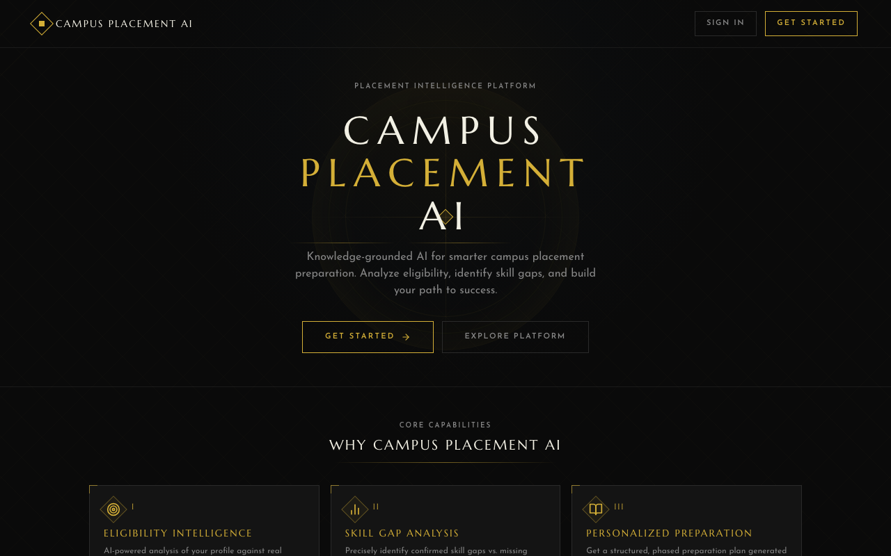
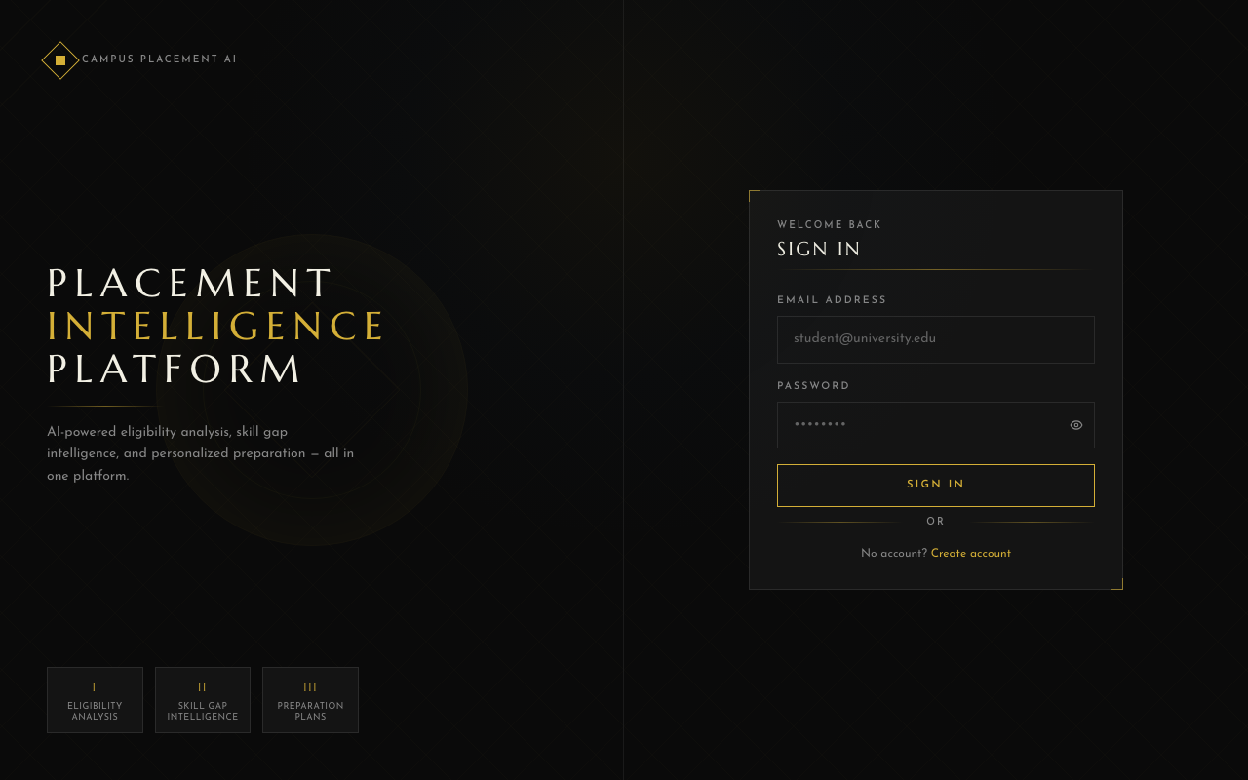
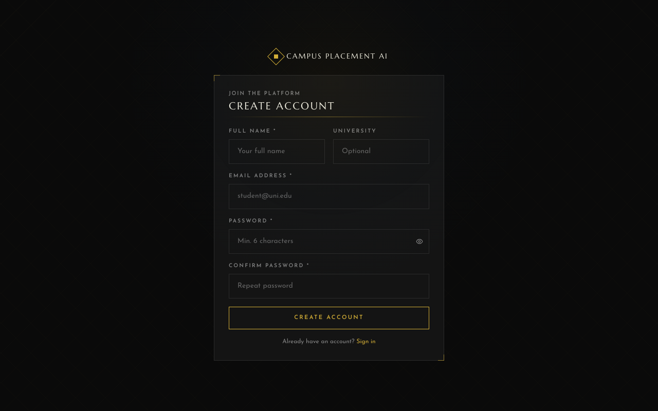
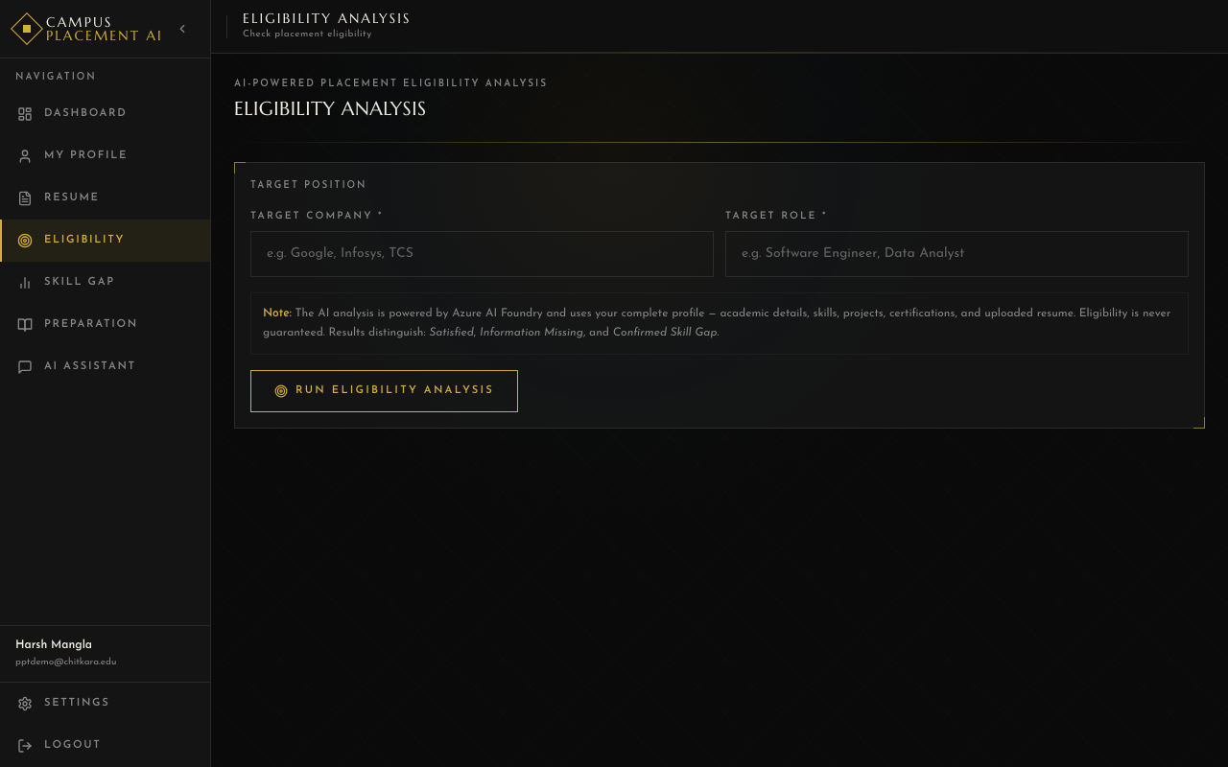
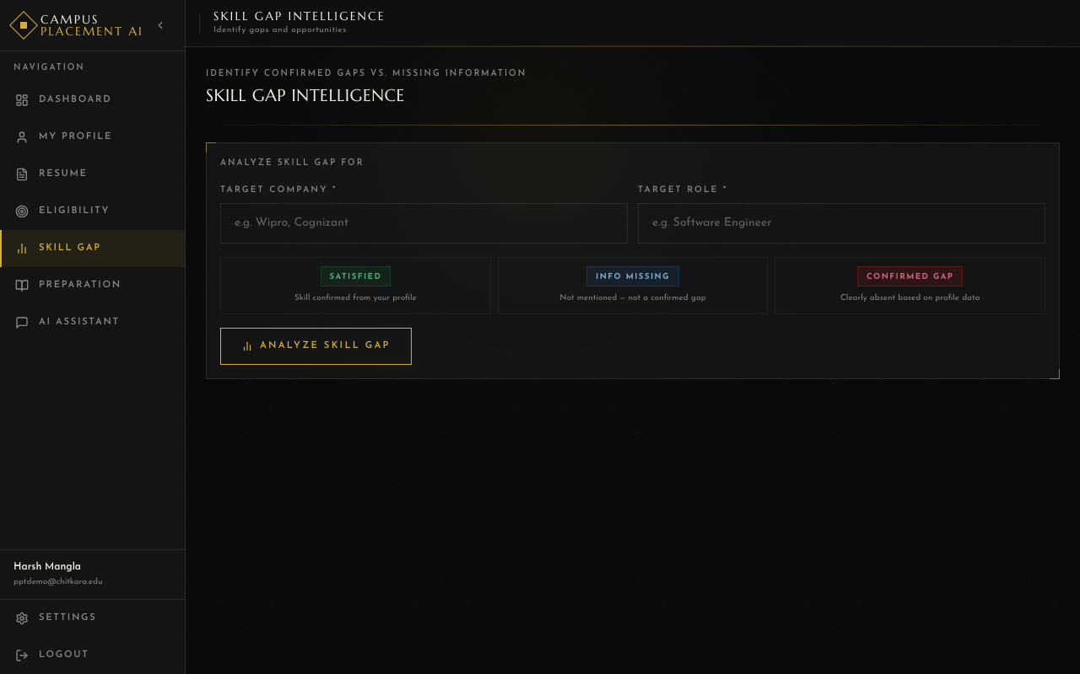
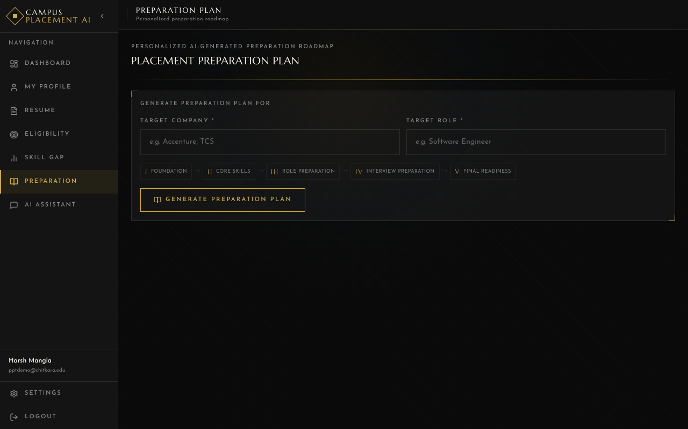
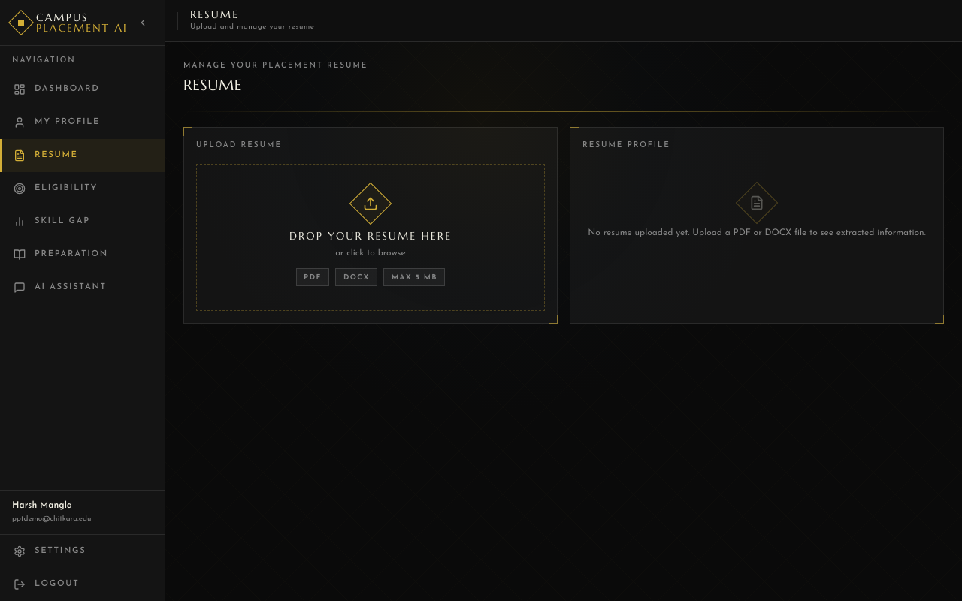
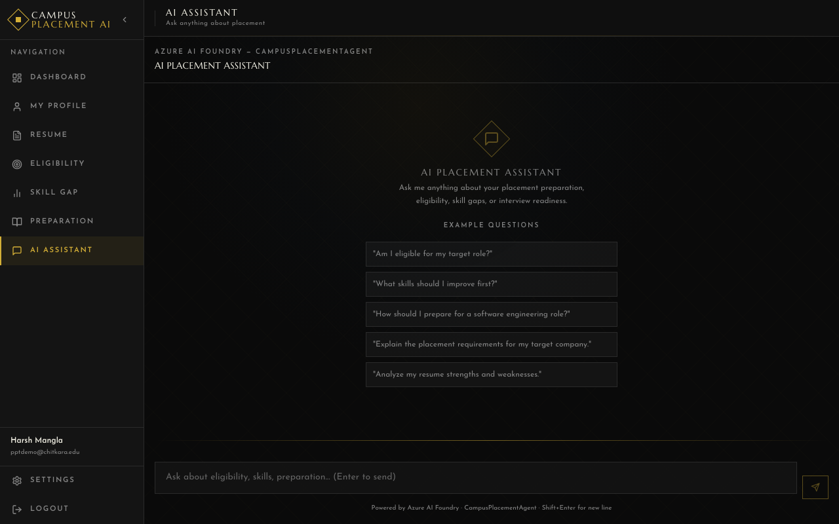
THE ACTUAL APPLICATION
Application Walkthrough
Landing Page
Login
Registration
Dashboard
[screenshot]
Dashboard
Eligibility Analysis
Skill Gap Analysis
Preparation Plan
Resume Upload
AI Assistant
06 / IMPACT
19 / 23
19 / 23

Slide 20
WHAT IT DELIVERS
Value of the Platform
For Students (Primary — Implemented)
For Institutions (Future Scope)
— One platform for all placement intelligence
— Centralised placement knowledge (RAG)
— Clear eligibility status per requirement
— Scalable AI guidance to entire cohort
— Precise gap vs. missing info distinction
— Consistent, knowledge-grounded advice
— Resume aligned to target role in AI context
— Foundation for placement analytics
— Phase-based, structured preparation focus
— Reduced manual counselling load
— Natural language AI placement chat
— Conversation history for follow-up questions
— Personalised — not generic advice
primary user value
future institutional value
All benefits listed are qualitative — no performance benchmarks or statistics are claimed.
06 / IMPACT
20 / 23
20 / 23

Slide 21
WHAT COMES NEXT · FUTURE SCOPE ONLY
Future Scope
None of the following are part of the current implemented application.
1
Multi-Agent Architecture
2
Advanced Resume Scoring
Specialised AI agents per domain
AI quality & role-alignment score
3
Interview Simulation
4
Recruiter Dashboard
Mock AI-generated interviews
Company-facing placement portal
5
Placement Cell Analytics
6
Voice AI Assistant
Cohort readiness & skill distribution
Speech-based placement chat
7
Multi-University Deployment
8
Live Job API Integration
Cloud SaaS serving many institutions
Real-time placement drive feeds
9
Learning Recommendations
10
Interview Practice
Curated resources per skill gap
Mock technical + HR interview rounds
06 / IMPACT
21 / 23
21 / 23

Slide 22
WRAPPING UP
Conclusion
Campus Placement AI transforms fragmented placement information into a centralised, knowledge-grounded AI experience — helping students understand exactly where they stand, what information they are missing, and how to prepare.
Student
Context
Resume
Intelligence
RAG
Knowledge
Azure AI
Foundry
Personalised
Analysis
+
+
+
+
WHERE THEY STAND
WHAT'S MISSING
HOW TO PREPARE
Eligibility per requirement
Information gaps vs. confirmed skill gaps
Phase-based personalised plan
"From placement information to placement intelligence."
06 / IMPACT
22 / 23
22 / 23

Slide 23
Thank You
Questions & Discussion
H
N
V
A
P
Harsh Mangla
Nipun Kalra
Vineet Kumar
Ayush
Pranav
2410992927
2410993431
2410993244
2410993139
2410992960
Harsh Mangla
Nipun Kalra
Vineet Kumar
Ayush
Pranav
CHITKARA UNIVERSITY, RAJPURA · B.E. AI & ML · Campus Placement AI
23 / 23
23 / 23

