Slide 1
Employee
Performance
Tracker
Team:
Harsh Mistry
Devang Patel
Prem Bhavsar
Paras Jain

Slide 2
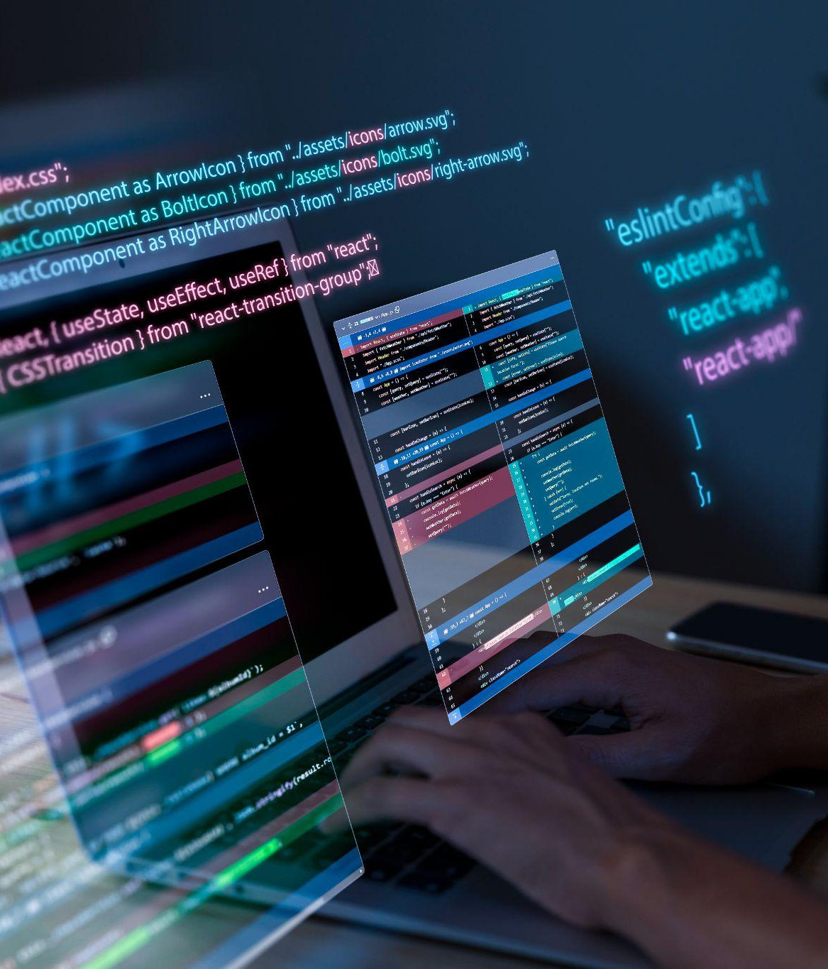
Goal:
Develop an employee tracking app to streamline performance monitoring and evaluation processes, enhancing efficiency and transparency.
Why Build It?
Efficiency: Automate tracking processes to reduce manual effort and minimize errors.
Transparency: Provide a centralized platform for fair and clear evaluations.
Data-Driven Decisions: Access comprehensive performance data for informed decision-making.
Employee Development: Facilitate constructive feedback and continuous improvement.

Slide 3
Technology Utilization
Python
Libraries Used
Python was chosen for its simplicity, versatility, and extensive library support, enabling rapid development of the employee tracking app with efficient automation and user-friendly interface design.
Graphical User Interface: PyQt5
Other Uses: PyAutoGui, PyPerClip, Subprocess, sys, PIL (Python Imaging Library), Threading

Slide 4
Functionalities
Activity Tracking:
Time Tracking:
Monitors user activity, including time spent within applications, opened applications, and edited files.
Tracks user interactions to provide insights into productivity and application usage patterns.
Records user punch-in and punch-out times to track working hours and breaks accurately.
Facilitates efficient management of employee schedules and attendance data.
Screenshot Capture:
Keyboard and Mouse Monitoring:
Captures screenshots at regular intervals, such as every 2 minutes, to visually record user activities.
Provides a comprehensive view of user actions and screen content for analysis and review purposes.
Tracks all keyboard clicks and mouse clicks to capture user inputs and interactions.
Offers detailed insights into user behavior and usage patterns for comprehensive performance analysis.

Slide 5
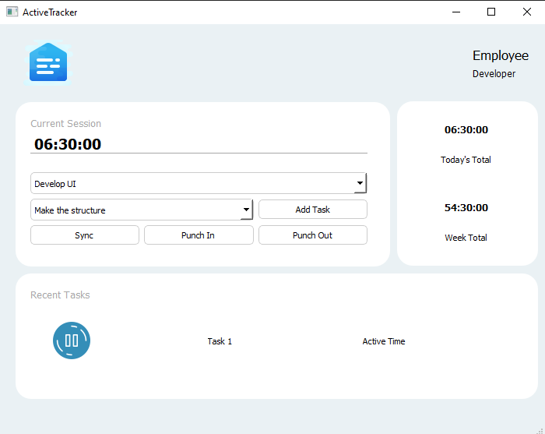
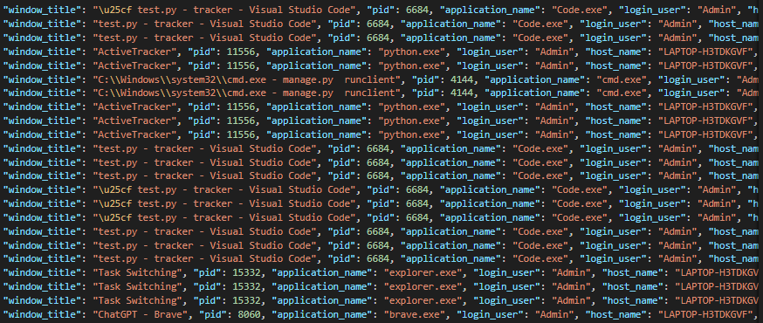
GUI to Interact
Tracker Log

Slide 6
Thank You

