Slide 1

Image Deblurring
Transforms blurry images into crystal clear photos
Team Members
Ritik Kumar
Harsh Prasad
Manas Raj

Slide 2
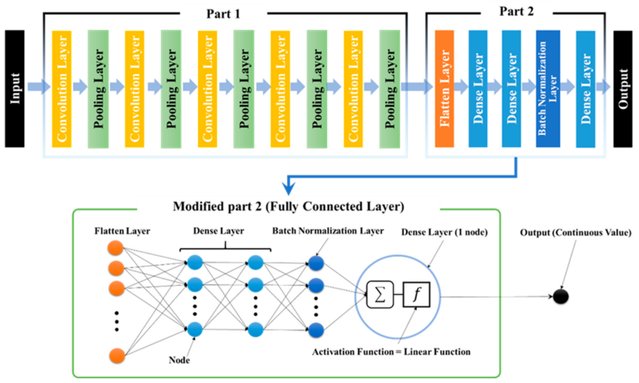
Underlying Model Architecture
Input: 128x128 image with 3 channels (RGB).
Part 1: Convolutional Layers (Feature Extraction)
5 convolutional layers with ReLU activation.
Downsampling via strided convolutions (reduces size from 128x128 to 5x5).
Captures spatial and feature hierarchies.
Part 2: Fully Connected Layers (Modified for Regression)
Flatten Layer: Converts 2D feature maps into a 1D vector.
Dense Layers: Fully connected layers process extracted features.
Batch Normalization Layer: Stabilizes learning and improves convergence.
Output Layer: A single node with a linear activation function for continuous value prediction.
Decoder (For Reconstruction in Autoencoder)
5 transposed convolutional layers.
Upsampling to restore image size (5x5 → 128x128).
Final layer uses Sigmoid activation for pixel intensity normalization.
2

Slide 3

Advantages
Enhanced image clarity
Improved OCR and AI Processing
Restoration of old and damaged photos
Security and Forensics
Medical Imaging benefits
3

Slide 4
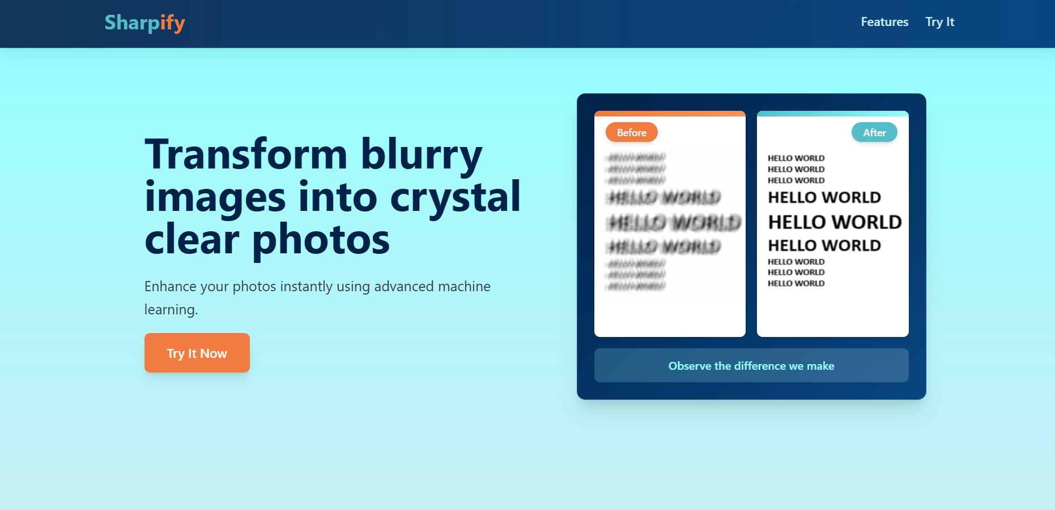
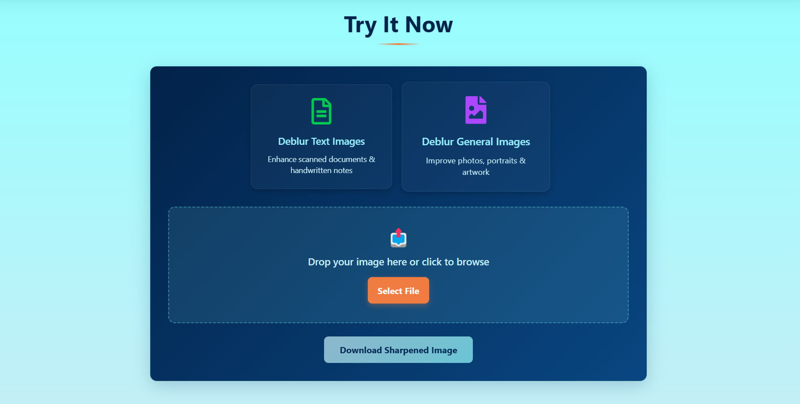

Snapshots of the MVP

Slide 5
Explore our work
MVP Link
https://sharpifyai.vercel.app
Github Repository
https://github.com/Harsh-Prasad09/Image-Deblurring
References
Convolutional Neural Network (CNN) for Image Detection and Recognition by Kamal Kumar Ghanshala, R.C Joshi, Rahul Chauhan https://www.researchgate.net/publication/332826568_Convolutional_Neural_Network_CNN_for_Image_Detection_and_Recognition

Slide 6
Thank You!

