Slide 1

Image Deblurring
Transforming blurry images into crystal clear photos
Team Members
Ritik Kumar
Harsh Prasad
Manas Raj

Slide 2
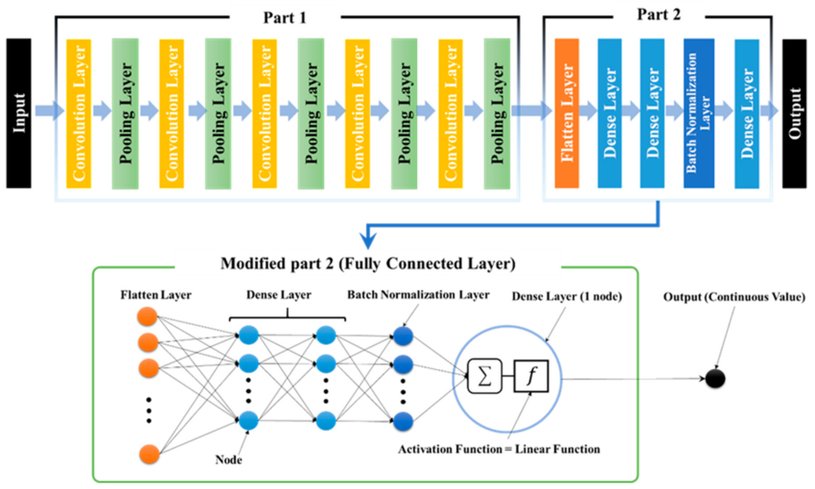
Underlying Model Architecture: CNN
Input: 128x128 image with 3 channels (RGB).
Part 1: Convolutional Layers (Feature Extraction)
5 convolutional layers with ReLU activation.
Downsampling via strided convolutions (reduces size from 128x128 to 5x5).
Captures spatial and feature hierarchies.
Part 2: Fully Connected Layers (Modified for Regression)
Flatten Layer: Converts 2D feature maps into a 1D vector.
Dense Layers: Fully connected layers process extracted features.
Batch Normalization Layer: Stabilizes learning and improves convergence.
Output Layer: A single node with a linear activation function for continuous value prediction.
Decoder (For Reconstruction in Autoencoder)
5 transposed convolutional layers.
Upsampling to restore image size (5x5 → 128x128).
Final layer uses Sigmoid activation for pixel intensity normalization.
2

Slide 3

Advantages
Enhanced image clarity
Improved OCR and AI Processing
Restoration of old and damaged photos
Security and Forensics
Medical Imaging benefits
3

Slide 4
Why CNN?
Understands Image Details: CNNs can recognize edges, textures, and patterns, which helps in sharpening blurry images.
Works Anywhere in the Image: Since CNNs use shared filters, they can detect blur no matter where it appears.
Focuses on Small Areas: CNNs analyze small parts of an image, making them great for spotting and fixing blurry regions.
Learns Automatically: The model learns directly from blurry and sharp image pairs, without needing manually created features.
Fixes Different Types of Blur: CNNs can correct various blurs like motion blur and Gaussian blur without needing separate models.

Slide 5
Why Machine Learning?
Adapts to different blur types.
Learns pattern, and not just rules.
Handles complex and unknown blurs.
No need to manually design filters.
Process images faster with the help of GPUs.
Gets better with more data over time.
Learns automatically with data.

Slide 6
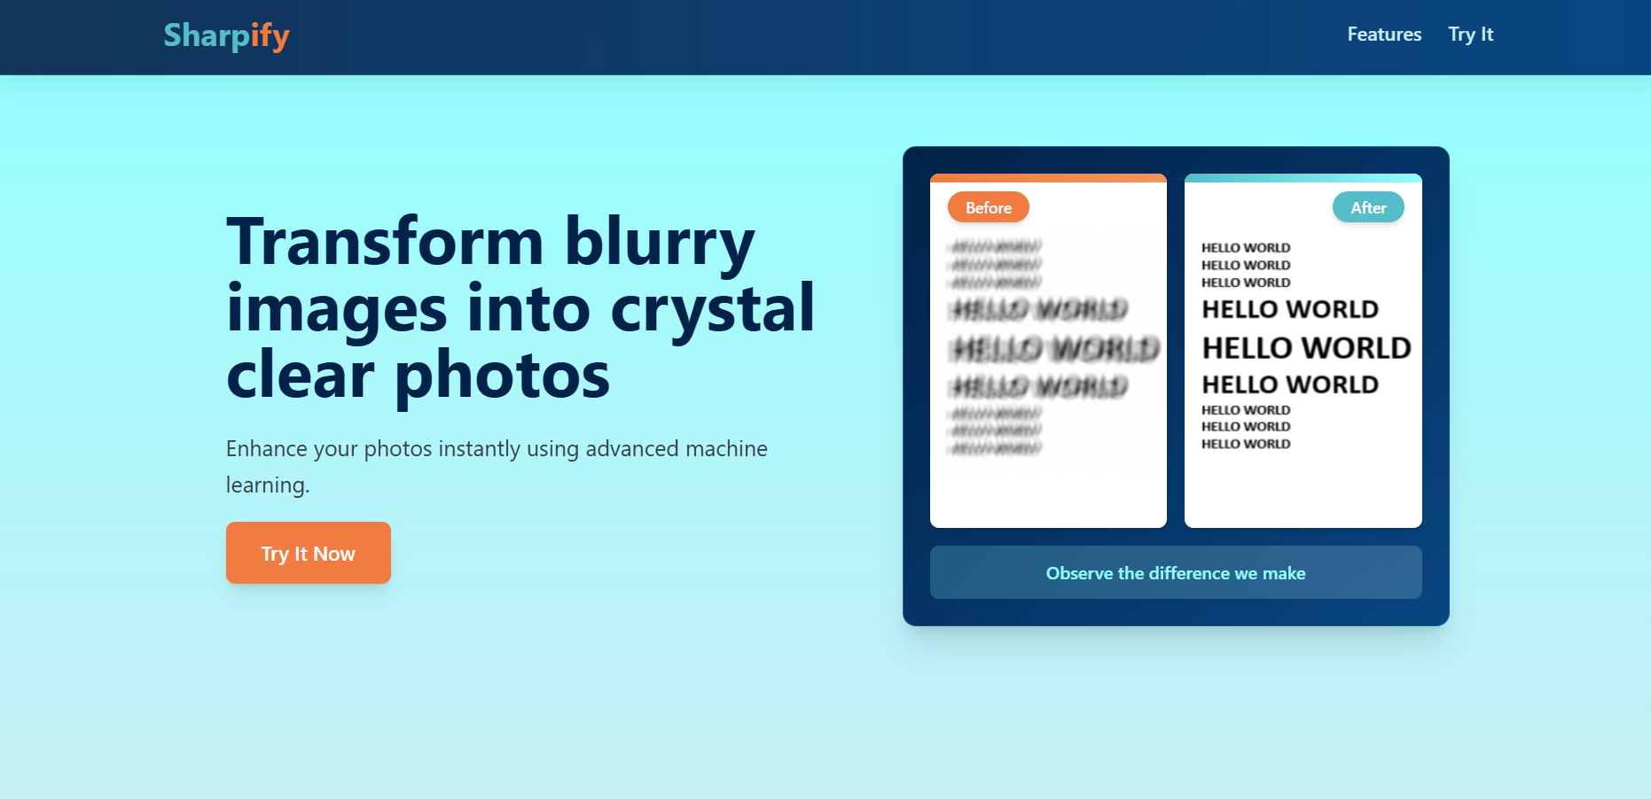
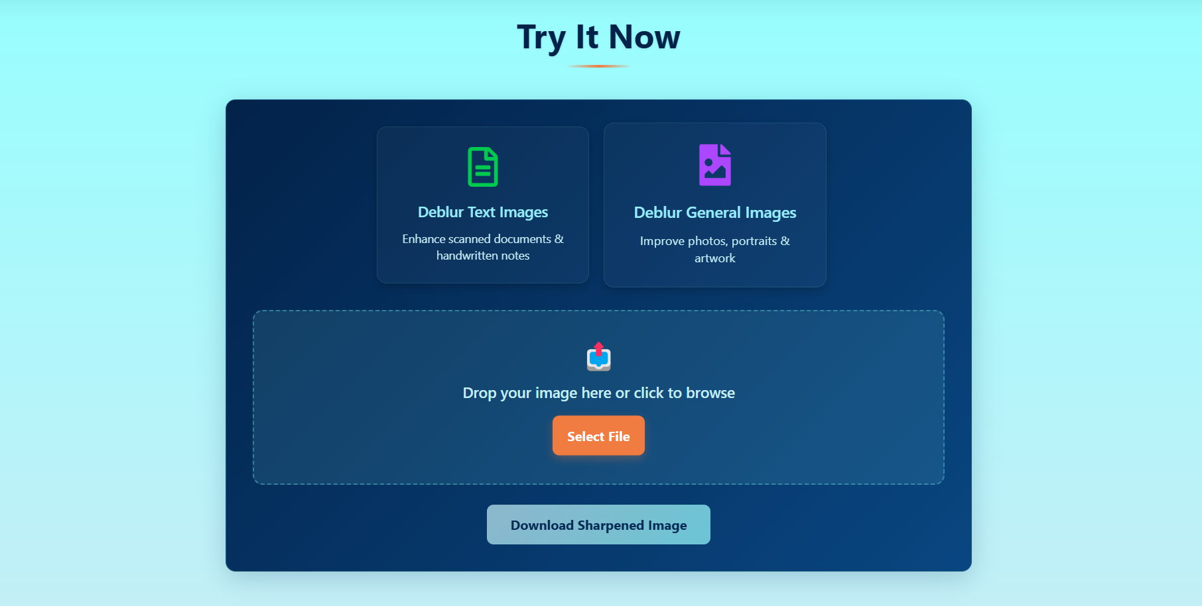

Snapshots of the MVP

Slide 7
Explore our work
MVP Link
https://sharpifyai.vercel.app
Github Repository
https://github.com/Harsh-Prasad09/Image-Deblurring
References
Convolutional Neural Network (CNN) for Image Detection and Recognition by Kamal Kumar Ghanshala, R.C Joshi, Rahul Chauhan https://www.researchgate.net/publication/332826568_Convolutional_Neural_Network_CNN_for_Image_Detection_and_Recognition

Slide 8
Thank You!

