Slide 1



GGP-PAAI Student Conference

Slide 2
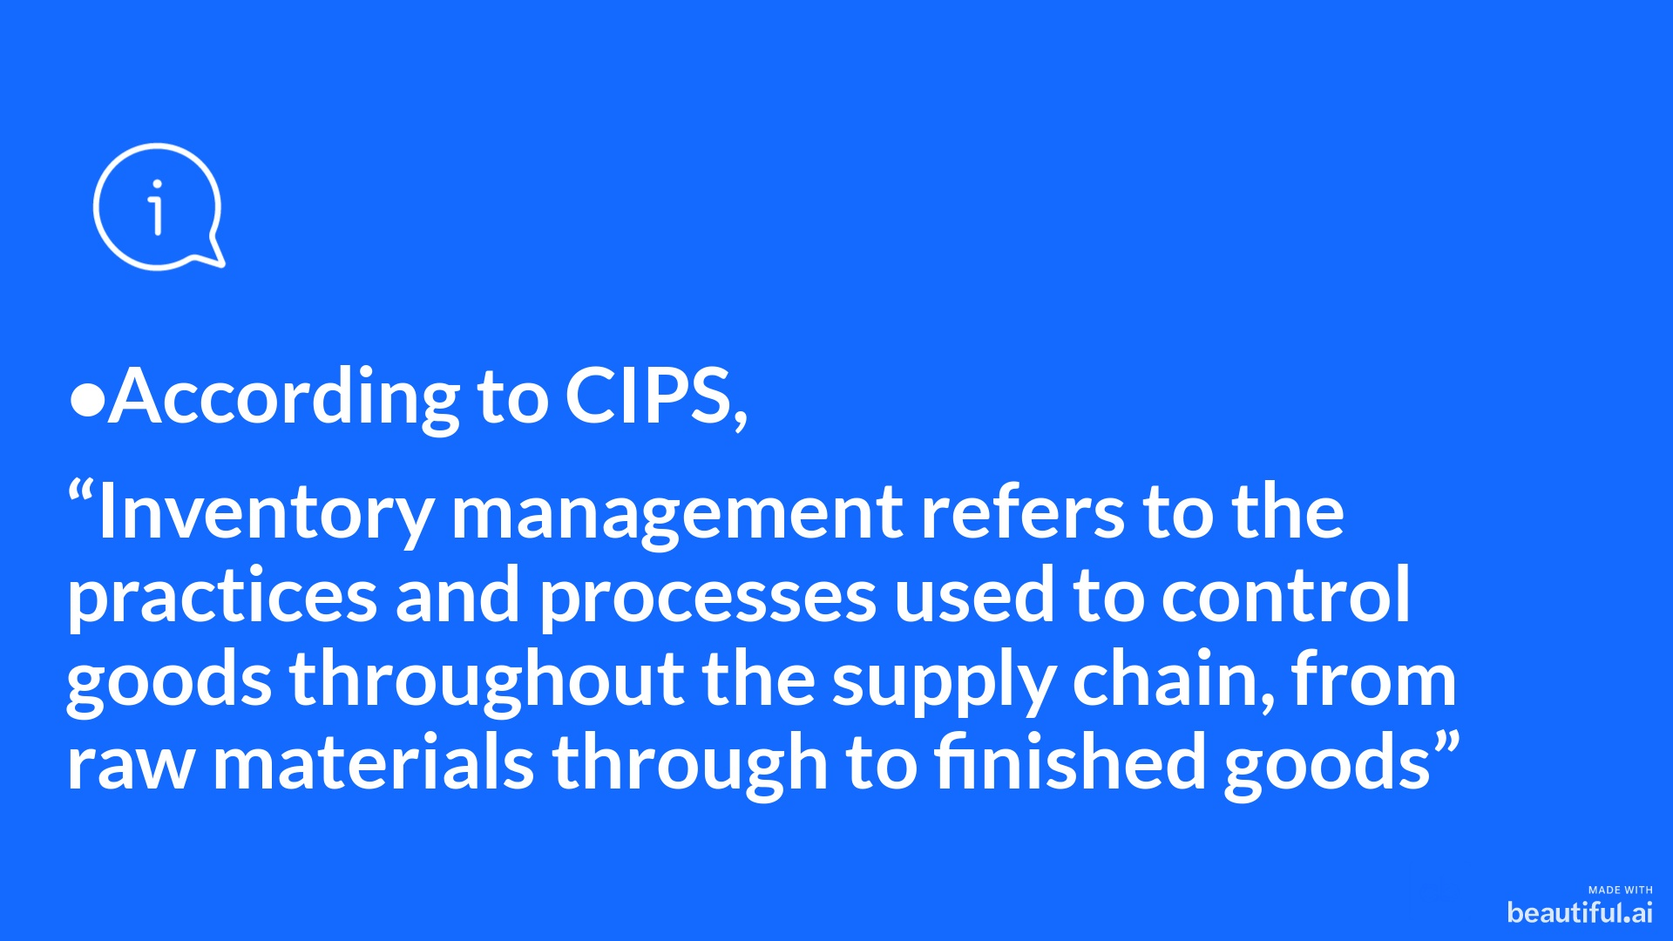

Slide 3
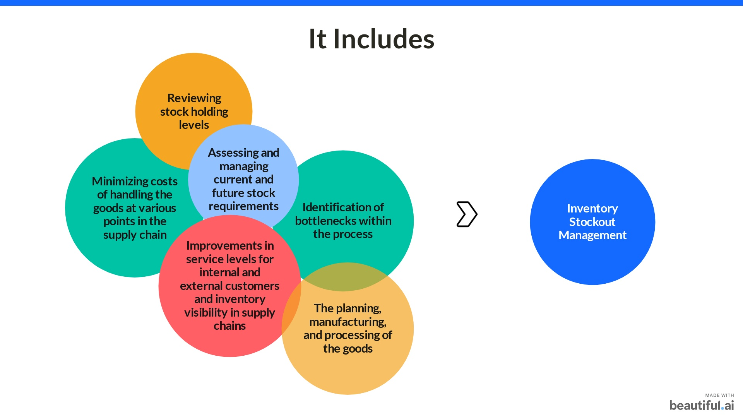

Slide 4
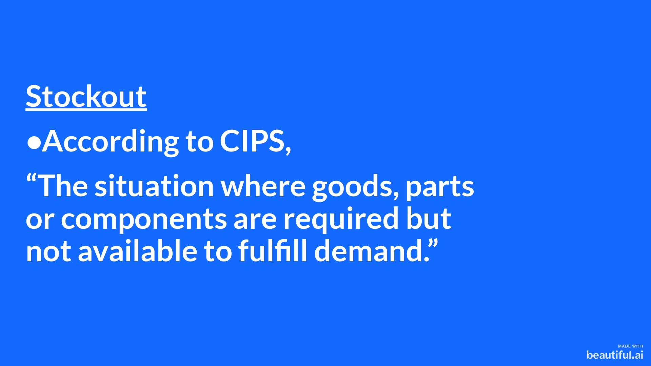

Slide 5
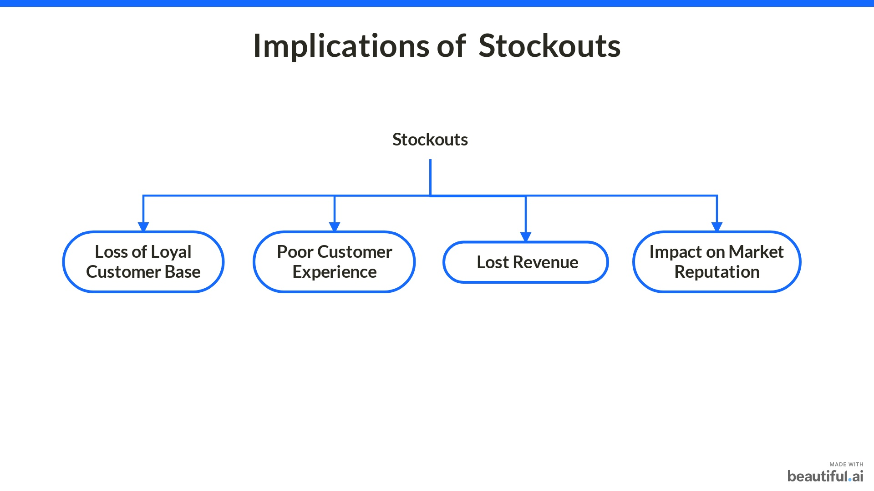

Slide 6
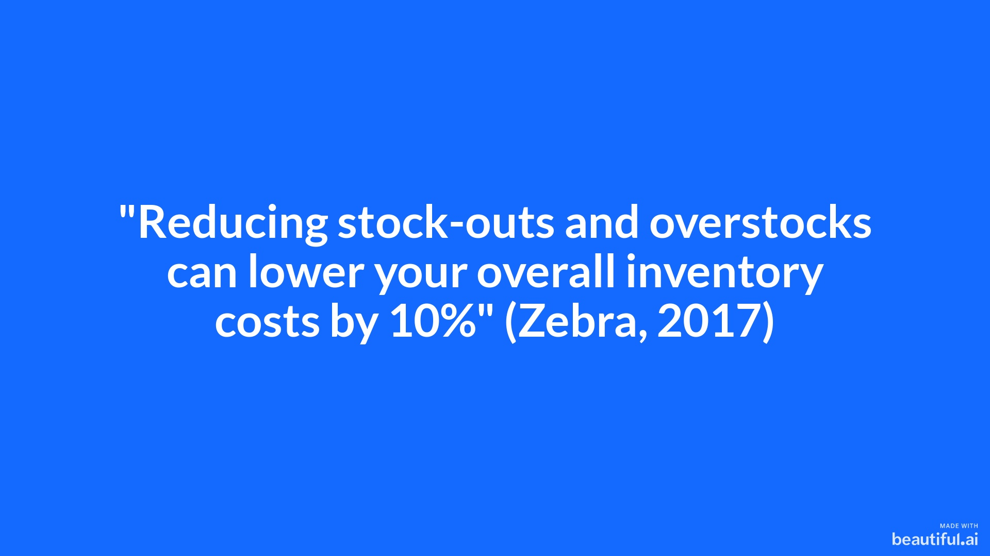

Slide 7
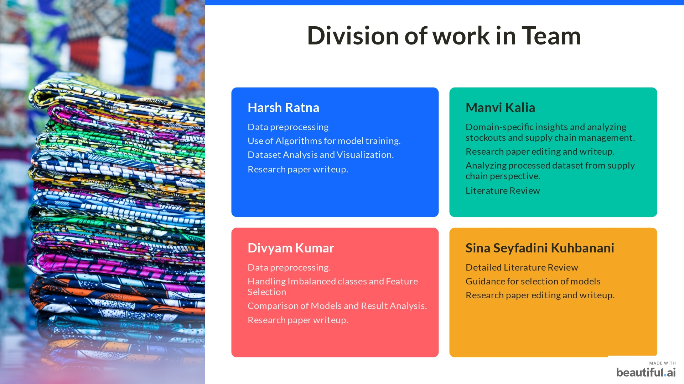

Slide 8
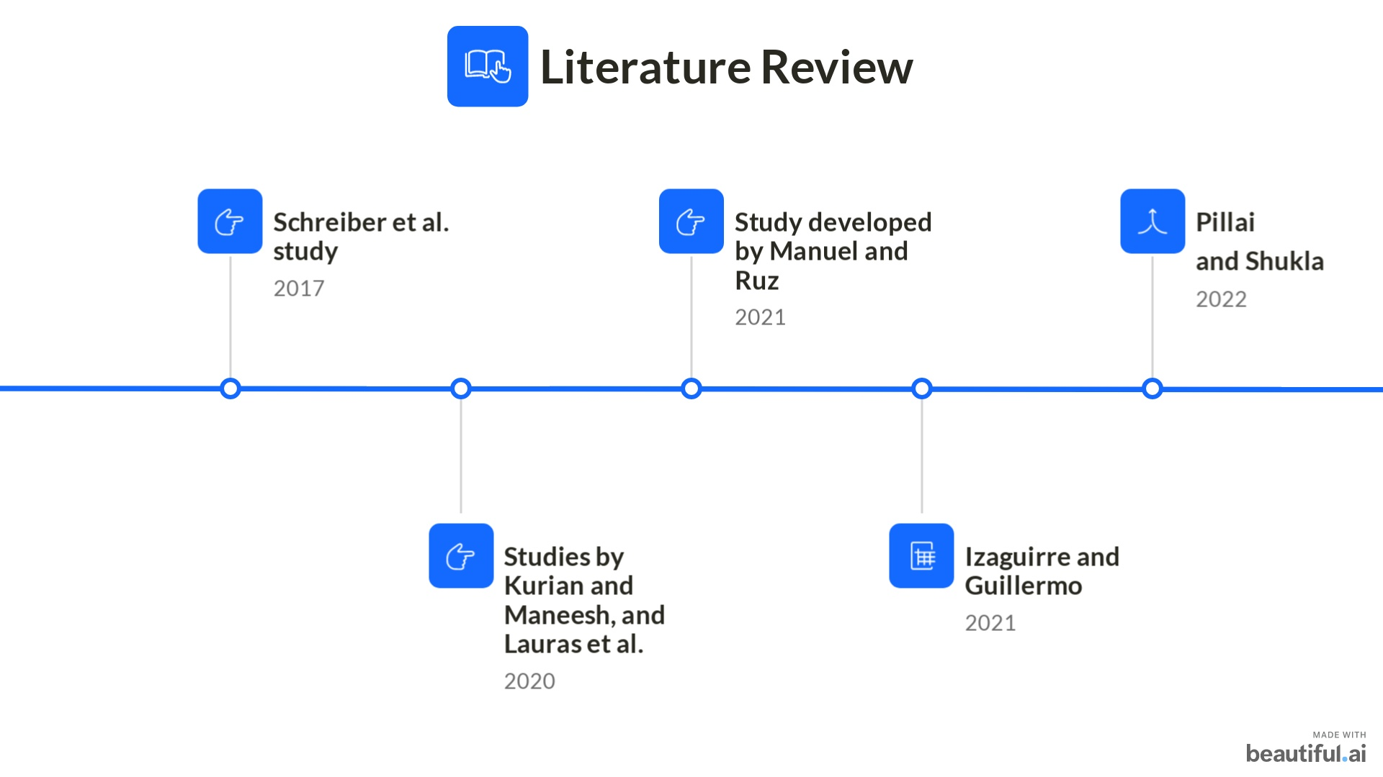

Slide 9


Slide 10
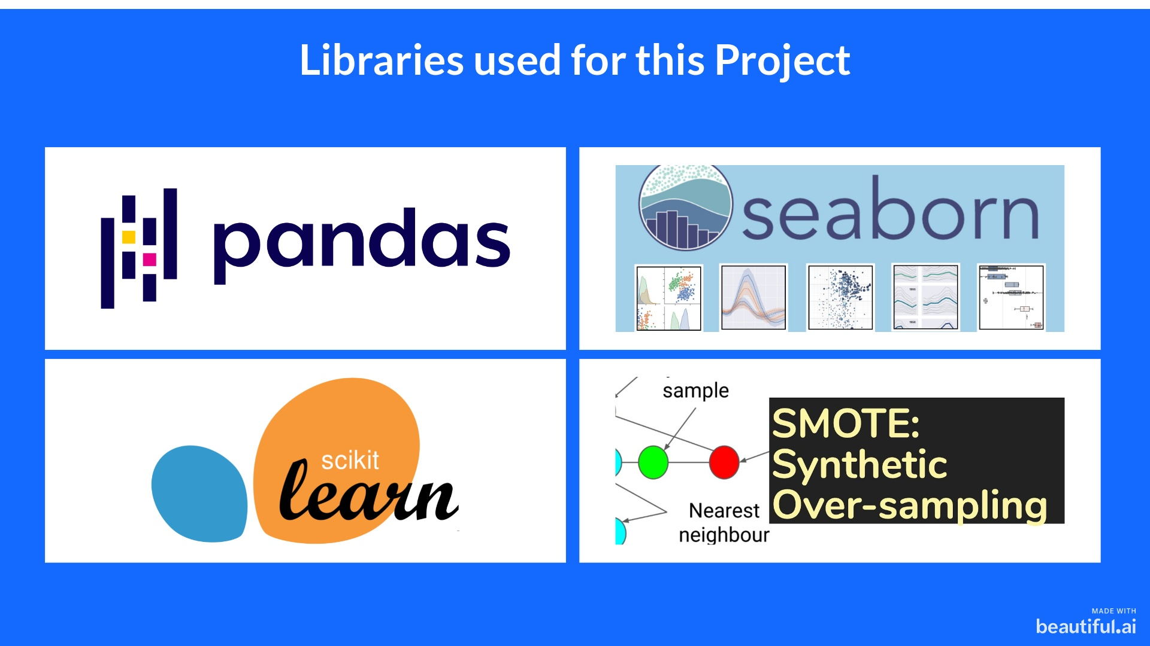

Slide 11
Dataset Used
We extracted the dataset from Kaggle containing 23 Features and 16,87,861 data points.
Sku | national_inv | lead_time | in_transit_qty | forecast_3_month | forecast_6_month
forecast_9_month | sales_1_month | sales_3_month | sales_6_month | sales_9_month | min_bank
potential_issue | pieces_past_due | perf_6_month_avg | perf_12_month_avg | local_bo_qty | deck_risk
oe_constraint | ppap_risk | stop_auto_buy | rev_stop | went_on_backorder
Link : https://www.kaggle.com/datasets/chandanareddy12/back-order-prediction

Slide 12
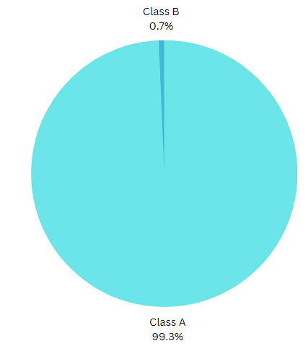
Imbalanced Dataset
Categories | Number of Data Points
Class A | 1676567
Class B | 11293

Slide 13
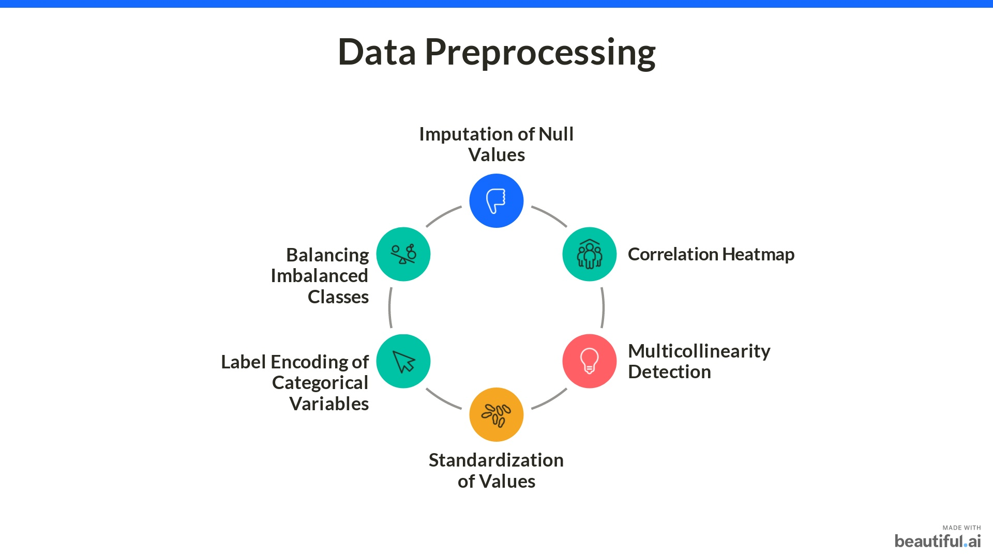

Slide 14
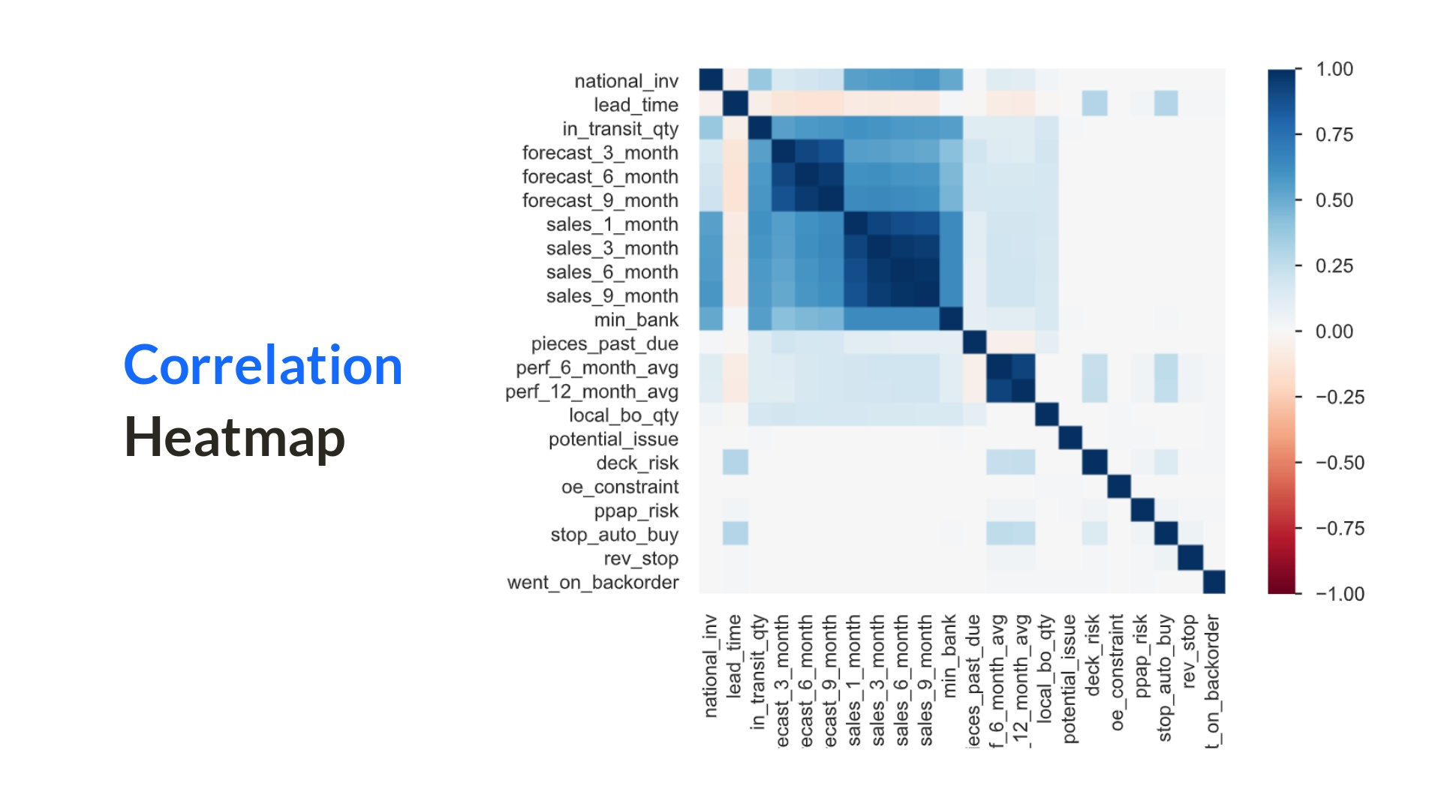

Slide 15
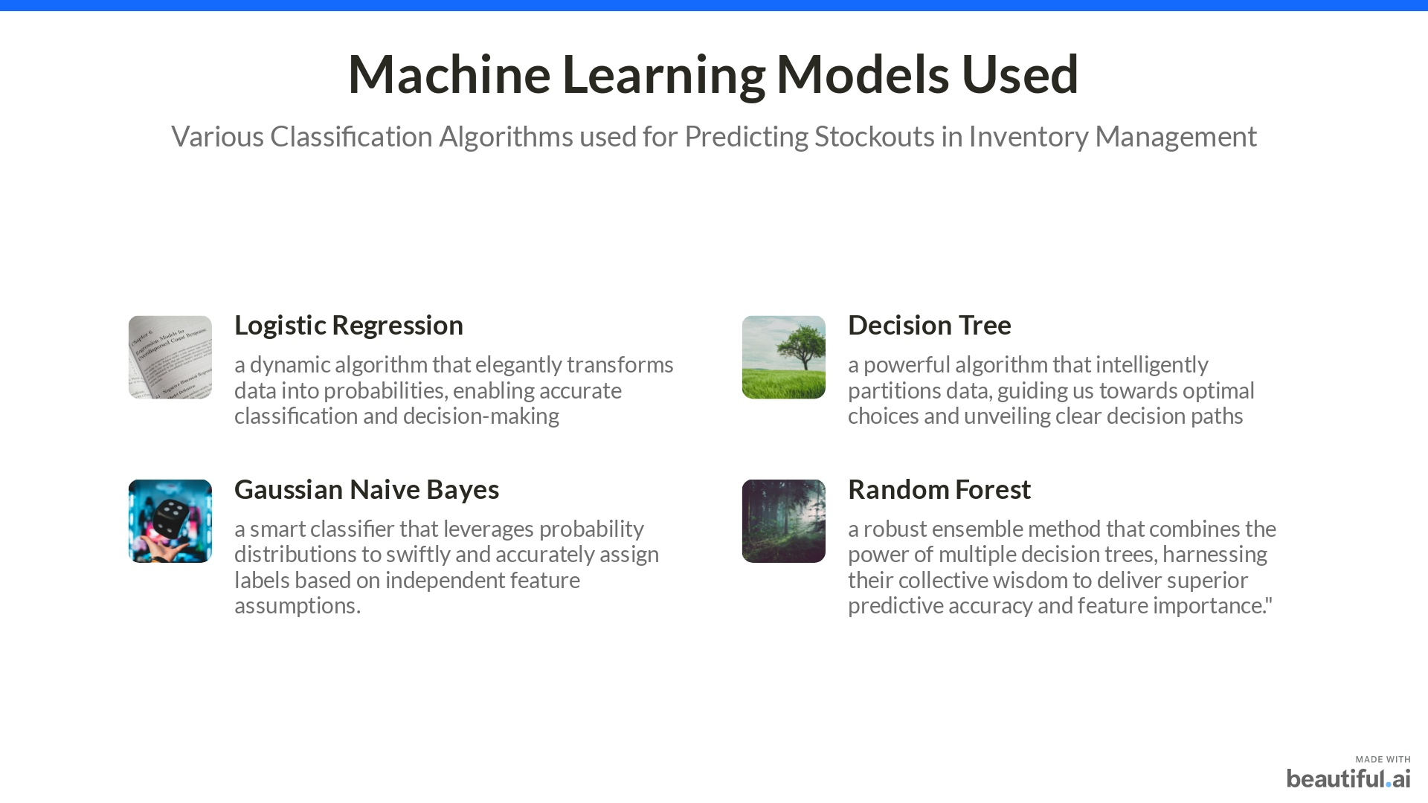

Slide 16
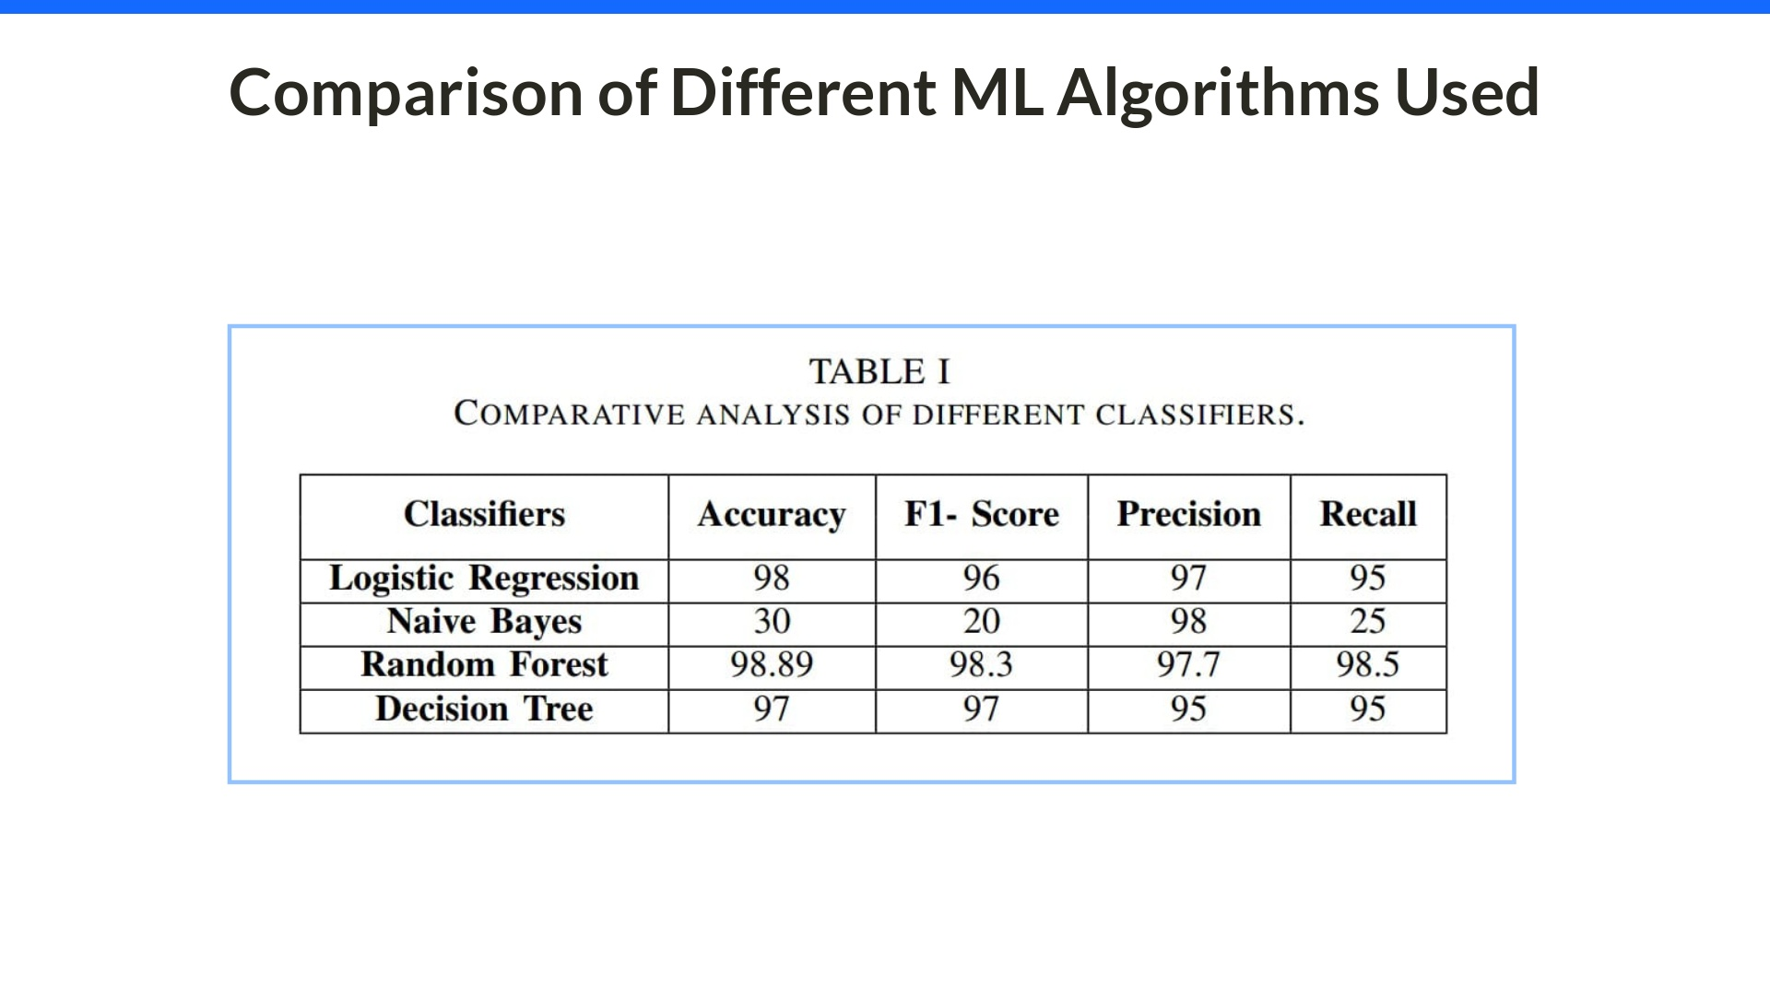

Slide 17
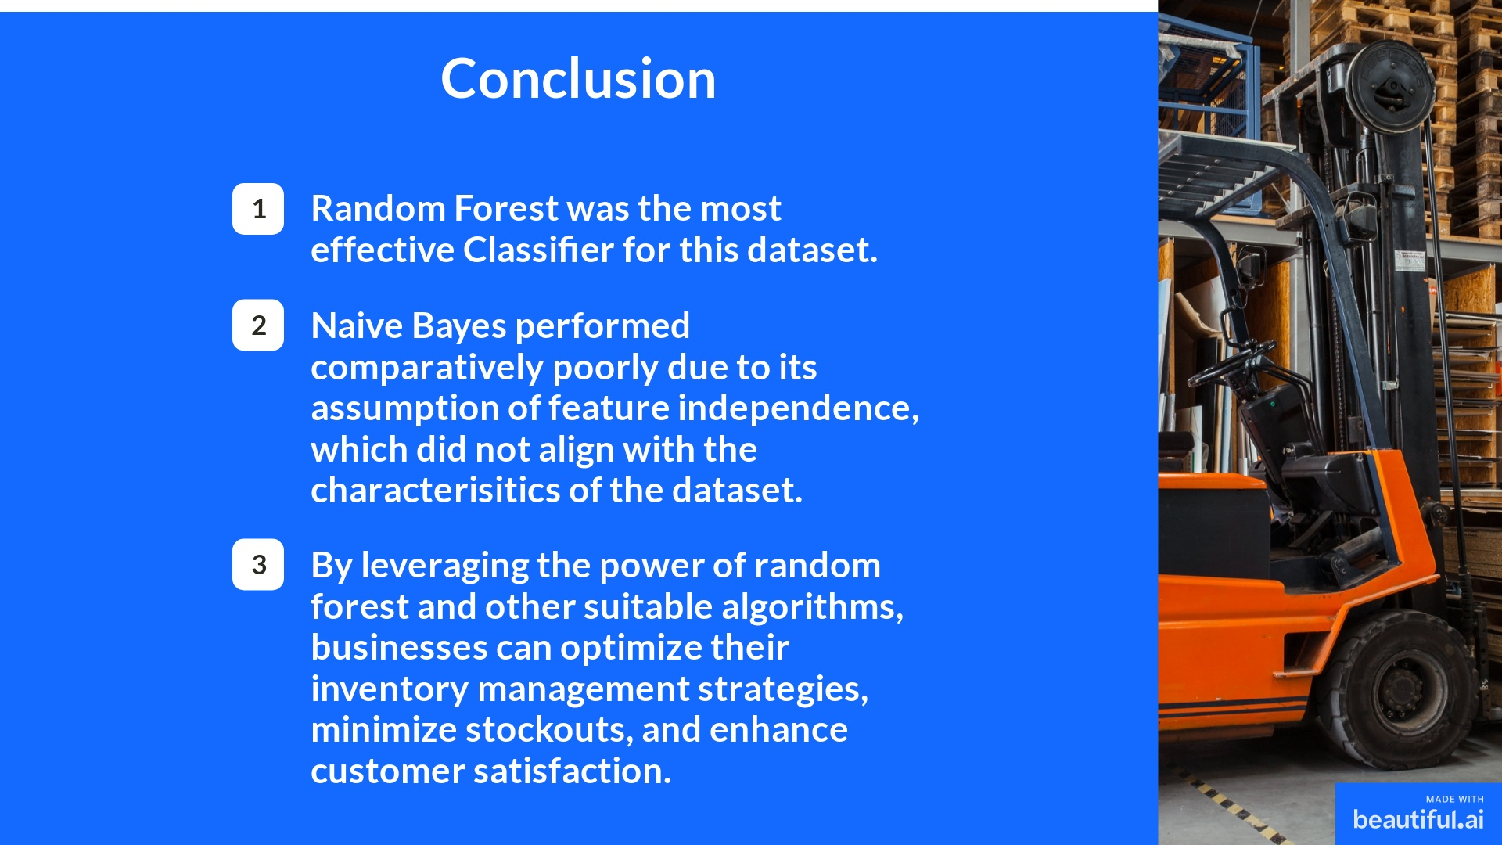

Slide 18
