Slide 1
CDP CHATBOT
Content Management Pipeline
From QA Pair Review to Intelligent Document Processing & RAG
Old Approach vs New Approach
Cooperstown Dreams Park | CDPGPT | Content Manager

Slide 2
Why the Change?
Limitations of the old approach and the need for a better pipeline
Challenges with Old Approach
What We Needed
> Manual QA pair review is time-consuming
> Admin must review each Q&A individually
> Status-based workflow (Correct / Incorrect / Junk) is rigid
> Suggestions are per-answer, no bulk content updates
> No support for ingesting documents, PDFs, or web content
> Knowledge base grows slowly — one QA at a time
> Upload entire documents at once (PDF, TXT, Images)
> Scrape website pages and auto-convert to knowledge
> Unified markdown format for easy editing by admin
> Automatic vector indexing for instant RAG retrieval
> Scalable — add hundreds of pages in minutes
> Admin edits content directly, changes reflect in chatbot

Slide 3
Old Approach — QA Pair Review System
Manual review of chatbot-generated Q&A pairs through the Config Admin panel
Workflow
1. User asks a question to the chatbot (CDPGPT)
2. Chatbot generates an answer from existing knowledge base
3. Admin reviews the QA pair in Conversation History (Config Admin panel)
4. Admin sets a Status: Correct / Incorrect / Partially Correct / Junk
5. If Incorrect or Partially Correct — admin provides a Suggestion (corrected answer)
6. Updated answer is saved back to the database for future use
Status Options
Key Components
Limitations
> Correct — answer is verified, no change
> Incorrect — answer is wrong, admin provides fix
> Partially Correct — needs minor corrections
> Junk — irrelevant, flagged for removal
> CDPGPT Conversation History page
> Filter by Year & Tournament
> Action button to open QA review
> Save button persists to database
> One QA pair at a time
> Reactive — only fixes after user asks
> No document/URL ingestion
> Slow knowledge base growth

Slide 4
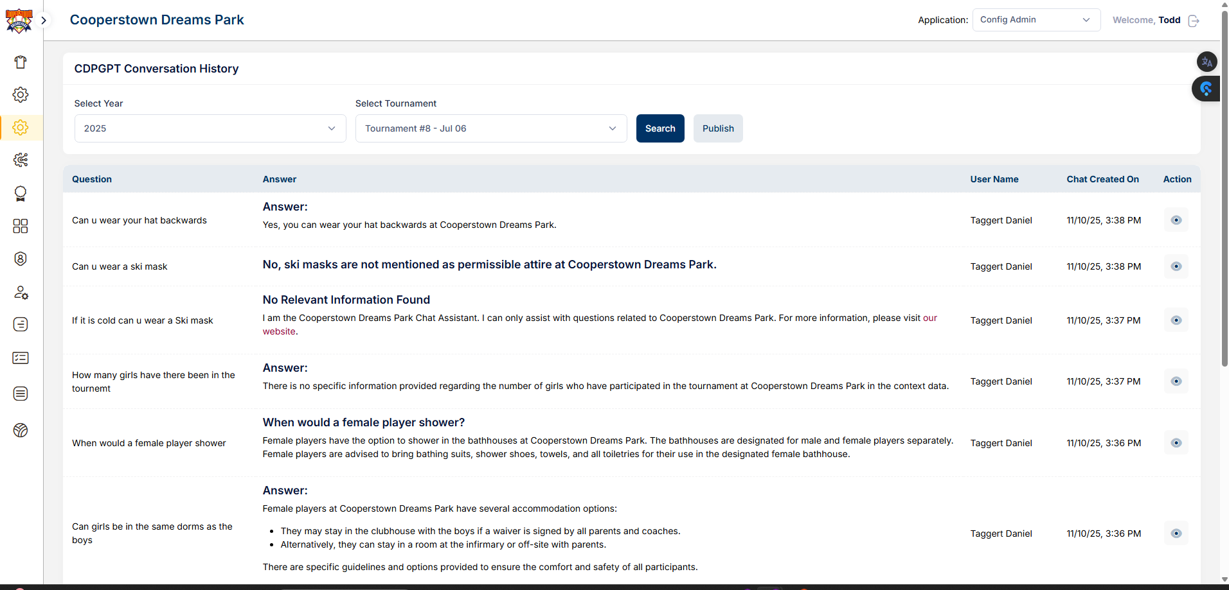
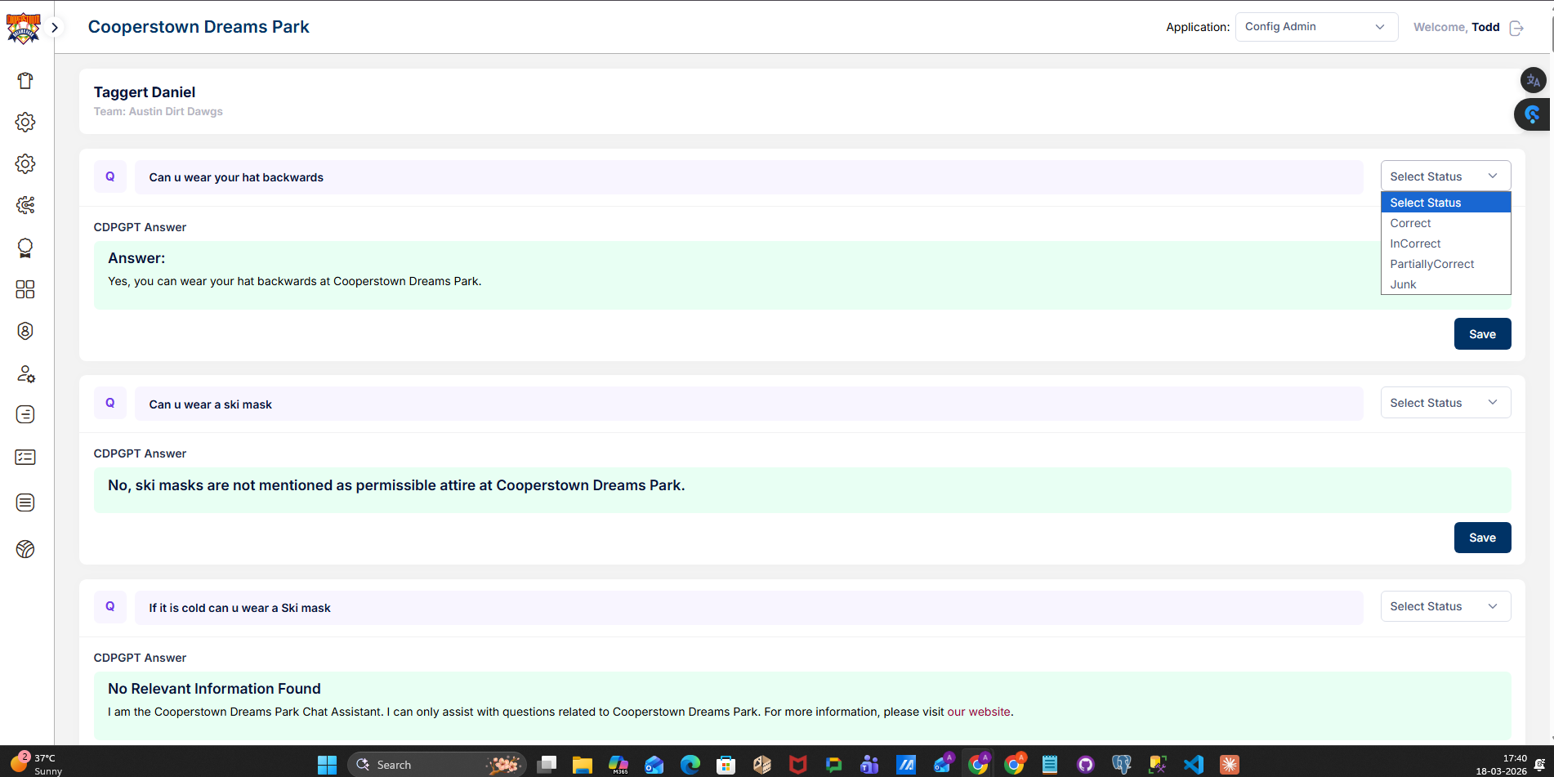
Old Approach — Screenshots
Config Admin panel: Conversation History & QA Pair Review with status management
CDPGPT Conversation History
QA Pair Review — Status Dropdown

Slide 5
New Approach — Document Upload & RAG Pipeline
Upload files or scrape URLs → auto-convert to Markdown → index in FAISS → RAG Chat
Pipeline Flow
1. Admin clicks Upload → chooses File Upload or URL
2. File: PDF / TXT / MD / Images are processed via Docling (OCR + structure extraction)
3. URL: Page is scraped with httpx, HTML converted to clean Markdown
4. Output saved as .md file with descriptive name (e.g. cooperstowndreamspark_com_testimonials.md)
5. Content is chunked (500 words, 50 overlap) → embedded via OpenAI text-embedding-3-small
6. Vectors stored in FAISS index → instantly searchable via RAG Chat
7. Admin can view, edit, or delete any .md file from the Files page
Input Sources
Processing
Storage & Retrieval
> PDF documents (OCR via Docling)
> Images: PNG, JPG, WEBP, BMP, TIFF
> Plain text (.txt) and Markdown (.md)
> Any website URL (auto-scrape)
> Docling extracts text, tables, images
> HTML → Markdown via BeautifulSoup
> Smart file naming from URL/filename
> Structured JSON + Markdown output
> FAISS vector index (L2 similarity)
> OpenAI text-embedding-3-small
> GPT-4o for answer generation
> Top-k configurable (1–20 chunks)

Slide 6
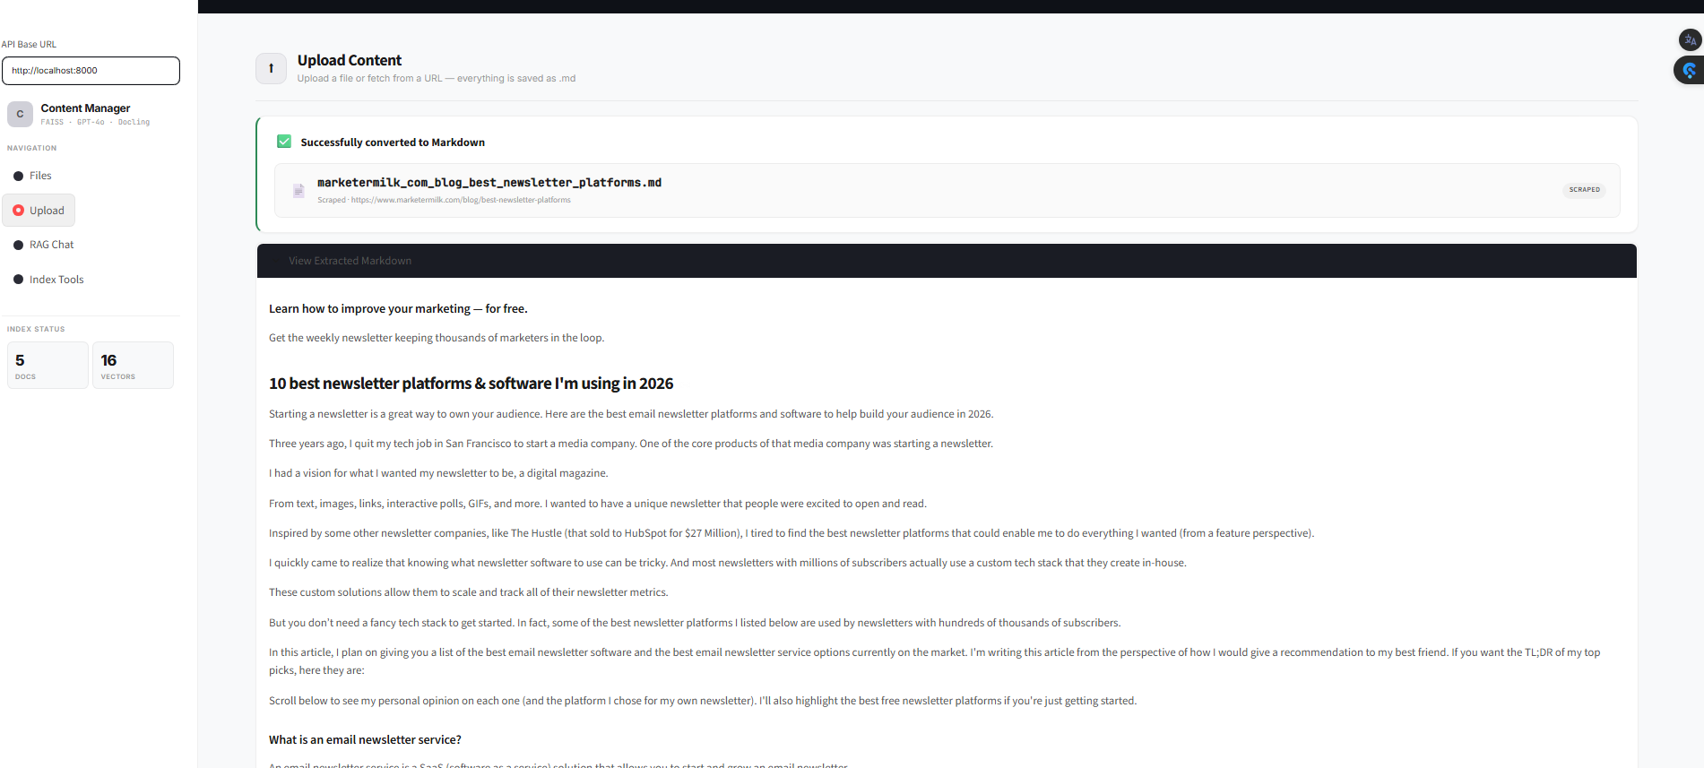
New Approach — Screenshot
Content Manager: Upload Content page with URL scrape and Markdown preview
Upload Content — URL Scrape with Live Markdown Preview

Slide 7
Old vs New — Comparison
Feature
Old Approach (QA Review)
New Approach (Content Manager)
Content Input
Chat-generated QA pairs only
PDF, TXT, Images, URLs
Admin Workflow
Review one QA pair at a time
Upload bulk files or scrape pages
Data Format
QA pairs in database
Markdown (.md) files
Editing
Status + Suggestion per answer
Edit full .md document directly
Knowledge Growth
Slow — one answer at a time
Fast — entire documents at once
Search / Retrieval
Database keyword lookup
FAISS vector similarity (RAG)
AI Model
GPT-based answer generation
GPT-4o + text-embedding-3-small
Scalability
Limited by QA volume
Upload 100s of pages in minutes
Content Sources
Only chatbot conversations
Any document or website

Slide 8
New Approach — Technical Architecture
Full stack: Streamlit frontend + FastAPI backend + FAISS vector store
Frontend Streamlit
->
Backend FastAPI
->
Processing Docling + BS4
->
Vector Store FAISS + OpenAI
> Content Manager UI
> File Upload / URL Scrape
> RAG Chat Interface
> Files Browser & Editor
> POST /upload — file processing
> POST /scrape — URL fetching
> POST /rag/query — RAG search
> GET /files — list all docs
> PDF OCR extraction
> Image text recognition
> HTML → Markdown conversion
> Table & structure parsing
> text-embedding-3-small
> Chunking (500w / 50 overlap)
> L2 similarity search
> GPT-4o answer generation
Data Flow Example
URL: cooperstowndreamspark.com/testimonials --> Fetch HTML with httpx --> Strip nav/footer/scripts --> Convert to Markdown --> Save as cooperstowndreamspark_com_testimonials.md --> Chunk into 500-word segments --> Embed each chunk via OpenAI --> Add to FAISS index --> Ready for RAG queries

Slide 9
Smart File Naming Convention
All content is stored as .md (Markdown) with human-readable names
URL Scraping — Name derived from URL path
cooperstowndreamspark.com/testimonials/
-->
cooperstowndreamspark_com_testimonials.md
example.com
-->
example_com.md
xyz.com/abc/def
-->
xyz_com_abc_def.md
xyz.com/page.html
-->
xyz_com_page.md
File Upload — Name derived from original filename
img 1.jpg
-->
img_1.md
Annual Report 2025.pdf
-->
Annual_Report_2025.md
sample_test_document.md
-->
sample_test_document.md
photo.png
-->
photo.md
Rule: All files are always stored and displayed as .md — the user never sees the original format. Conversion happens in the background automatically.

Slide 10
Key Benefits of the New Approach
01
10x Faster Content Ingestion
Upload entire documents or scrape full websites instead of reviewing one QA pair at a time
02
Unified Markdown Format
Everything stored as .md — easy to read, edit, and version control. Admin has full control over content
03
Automatic Vector Indexing
Content is chunked and embedded automatically via FAISS + OpenAI. Instantly searchable via RAG
04
Multi-Source Support
PDF, TXT, Images (OCR via Docling), Markdown files, and any website URL
05
Smart Naming
Files named from URLs (cooperstowndreamspark_com_testimonials.md) or original filenames — always .md
06
RAG-Powered Chat
GPT-4o generates answers grounded in your indexed documents with configurable top-k retrieval

Slide 11
Thank You
CDP Chatbot — Content Management Pipeline
Cooperstown Dreams Park | Powered by FAISS + GPT-4o + Docling
FastAPI
Streamlit
FAISS
OpenAI
Docling
BeautifulSoup

