Slide 1
RTO MANAGEMENT SYSTEM
BY GROUP - 13
202012050 - HARSH VELIYAT
202012051 - ISHA AGRAWAL
202012052 - SHUBHI AGARWAL
202018026 - AAKANKSHA SHAH

Slide 2
FUNCTIONAL REQUIREMENTS
An RTO has several departments identified by unique department numbers. Department also has a name and it’s office location (city and Pincode).
The request is approved by one employee and an employee can approve one or more appointment requests.
A user can apply for zero or more vehicle registration and each vehicle registration will be associated with only one user. Vehicle type can be LMV(Light Motor Vehicle),HMV(Heavy Motor Vehicle) and Trans.
Each registered vehicle can have at most one permits (TRANS(LGV, HGV) ).
A user applying for a License must select any one of the license types (Learner’s, Driving, International) for application process.
A user if found violating any of the traffic rules will have to pay an E-challan.A user can receive one or more E-challan per vehicle.

Slide 3
ENTITY RELATIONSHIP MODEL
Lab12_202012050-202012052_202018026_ERD_v5.pdf

Slide 4
RELATIONSHIP MODEL
Lab12_202012049-202012052_202018026_RelationalModel_v4.pdf

Slide 5
DATA DEFINITION LANGUAGE (DDL)
DEPARTMENT TABLE
CREATE TABLE DEPARTMENT(
DEPT_ID CHAR(10) PRIMARY KEY,
DEPT_NAME VARCHAR(50) CHECK (DEPT_NAME IN('PERMIT','ECHALLAN','LICENSE','VEHICLE
REGISTRATION')),
OFFICE_ID CHAR(10) REFERENCES OFFICE(OFFICE_ID) ON UPDATE CASCADE ON DELETE
RESTRICT );
APPOINTMENT TABLE
CREATE TABLE APPOINTMENT(
APP_ID CHAR(9) PRIMARY KEY,
APP_STATUS VARCHAR(10) CHECK (APP_STATUS IN ('PENDING','APPROVED','CANCELLED')),
APP_TYPE VARCHAR(20) CHECK (APP_TYPE IN
('LEARNERS','DRIVERS','INTERNATIONAL','PERMIT','VEHICLE REGISTRATION')),
TIME_STAMP TIMESTAMP,
USER_ID CHAR(10) REFERENCES USER_DETAILS(USER_ID) ON UPDATE CASCADE,
DEPT_ID CHAR(10) REFERENCES DEPARTMENT(DEPT_ID) ON UPDATE CASCADE );

Slide 6
PERMIT TABLE
CREATE TABLE PERMIT(
PER_ID CHAR(10) PRIMARY KEY,
PER_TYPE VARCHAR(3) CHECK (PER_TYPE IN ('LGV','HGV')),
VALIDITY DATE NOT NULL);
VEHICLE_REGISTRAION TABLE
CREATE TABLE VEHICLE_REGISTRATION(
LICENSE_PLATE_NO CHAR(10) PRIMARY KEY,
ENGINE_NO VARCHAR(20) NOT NULL,
CHASIS_NO CHAR(17) NOT NULL,
VEH_TYPE VARCHAR(5) CHECK (VEH_TYPE IN ('LMV','HMV', 'TRANS')),
TIME_STAMP TIMESTAMP NOT NULL,
PER_ID CHAR(10) REFERENCES PERMIT(PER_ID) ON UPDATE CASCADE,
USER_ID CHAR(10) REFERENCES USER_DETAILS(USER_ID) ON UPDATE CASCADE ON DELETE
RESTRICT);

Slide 7
DRIVING_LICENSE TABLE
CREATE TABLE DRIVING_LICENSE(
L_ID CHAR(15) PRIMARY KEY,
D_TYPE VARCHAR(50) CHECK (D_TYPE IN('LEARNERS','DRIVING','INTERNATIONAL')),
ISSUE_DATE DATE NOT NULL,
VALIDITY DATE NOT NULL,
USER_ID CHAR(10) REFERENCES USER_DETAILS(USER_ID) ON UPDATE CASCADE ON DELETE
RESTRICT);

Slide 8
QUERIES
Find the users who have not paid e-challan and how many times have they not paid the e-challan.
Relational Algebra:
σ PAYMENT.USER_ID IS NULL (USER_DETAILS ⋈
<USER_DETAILS.USER_ID=PAYMENT.USER_ID> PAYMENT ⋈ (PAYMENT.
USER_ID=ECHALLAN.USER_ID ℱ ECHALLAN.USER_ID,COUNT(ECHALLAN.USER_ID) (ECHALLAN))
SQL DML Statements:
SELECT E.USER_ID,COUNT(E.USER_ID) AS E_COUNT FROM USER_DETAILS AS U JOIN PAYMENT AS
P ON (U.USER_ID=P.USER_ID) RIGHT JOIN ECHALLAN AS E ON (E.USER_ID=P.USER_ID) WHERE
P.USER_ID IS NULL GROUP BY E.USER_ID;
Requirements:
A user has a Pan number, fname, lname,city, dob and contact number.
A user if found violating any of the traffic rules will have to pay an E-challan.
An E-challan entity has a E-challan id, amount to be paid and the type of challan .
A user can receive one or more E-challan per vehicle.

Slide 9
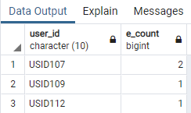
Output:

Slide 10
List all the users whose appointments have been cancelled more than two times.
Relational Algebra:
r1 <- σ (APPLICATION.APP_STATUS=”CANCELLED”)(APPOINTMENT)
r2 <- USER_ID ℱ COUNT(USER_DETAILS.USER_ID)-> COUNT_USER(r1)
r3 <- σ COUNT_USER > 2 (r2)
result <- π FNAME,LNAME,DOB,CITY,EMAIL,PAN_NO,COUNT_USER(ℱ COUNT (
USER_DETAILS.USER_ID )->COUNT_USER (USER_DETAILS) ⋈ (
USER_DETAILS.USER_ID=APPOINTMENT.USER_ID) (r3))
SQL DML Statements:
SELECT FNAME,LNAME,DOB,CITY,EMAIL,PAN_NO,COUNT(U.USER_ID) FROM USER_DETAILS AS U
JOIN APPOINTMENT AS A ON (U.USER_ID=A.USER_ID) WHERE
A.APP_STATUS='CANCELLED' GROUP BY U.USER_ID HAVING COUNT(U.USER_ID)>2;
Requirements:
A user has a Pan number, fname, lname,city, dob and contact number.Any authorized User can apply for one or more services.
The request is approved by one employee and an employee can approve one or more appointment requests.
An employee can reject an application if the user does not appear on the allotted day and might be asked to reschedule.

Slide 11
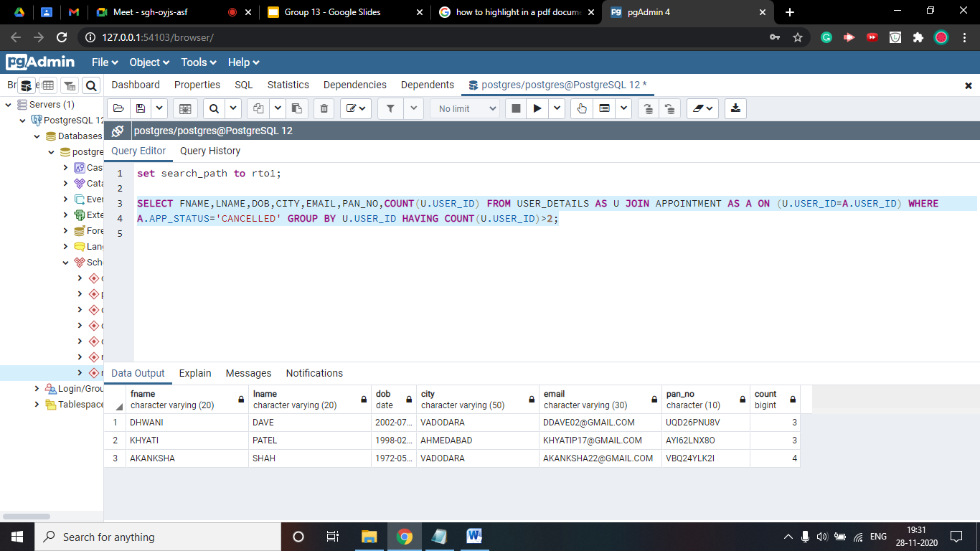
Output:

Slide 12
Find the users who have international license which is expiring in the year 2020.
Relational Algebra:
π FNAME,LNAME,DOB,CITY,EMAIL,PAN_NO, DRIVING_LICENSE.D_TYPE,
DRIVING_LICENSE.VALIDITY (σ D_TYPE=’INTERNATIONAL’ AND EXTRACT(YEAR FROM
DRIVING_LICENSE.VALIDITY)=’2020’ (DRIVING_LICENSE) ⋈
(DRIVING_LICENSE.USER_ID=USER_DETAILS.USER_ID) USER_DETAILS )
SQL DML Statements:
SELECT FNAME,LNAME,DOB,CITY,EMAIL,PAN_NO,D.D_TYPE,D.VALIDITY FROM USER_DETAILS AS U
JOIN DRIVING_LICENSE AS D ON (U.USER_ID=D.USER_ID) WHERE D_TYPE='INTERNATIONAL'
AND EXTRACT(YEAR FROM D.VALIDITY)='2020';
Requirements:
A user has a Pan number, fname, lname,city, dob and contact number.
A user applying for a License must select any one of the license types (Learner’s, Driving, International) for application process.
The users can apply for Driving License or International License only after a Learners License.
Driving and International License are valid for 10 years and then the user can reapply for them.

Slide 13
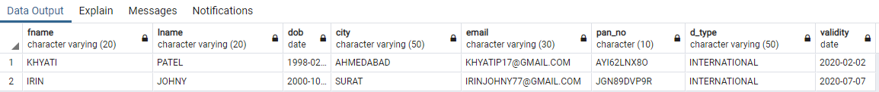
Output:

Slide 14
List details of all the users who have registered at least one vehicle.
Relational Algebra:
r1 <- USER_ID ℱ COUNT (USER_ID) ->V_COUNT (VEHICLE_REGISTRATION)
r2 <- σ V_COUNT >=1 (r1)
result <- π *, ℱ COUNT (VEHICLE_REGISTRATION.LICENSE_PLATE_NO)-> V_COUNT (ρ
USER_ID (USER_DETAILS ⋈ <USER_DETAILS.USER_ID= USER_DETAILS.USER_ID>
(USER_DETAILS)) r2)
SQL DML Statements:
SELECT * FROM USER_DETAILS AS U WHERE USER_ID IN (SELECT USER_ID FROM
VEHICLE_REGISTRATION WHERE USER_ID=U.USER_ID GROUP BY USER_ID HAVING
COUNT(USER_ID)>=1);
Requirements:
A user has a pan number, fname, lname,city, dob and contact number.
A user can apply for zero or more vehicle registration and each vehicle registration will be associated with only one user.
Vehicle type can be lmv(light motor vehicle),hmv(heavy motor vehicle) and trans.

Slide 15
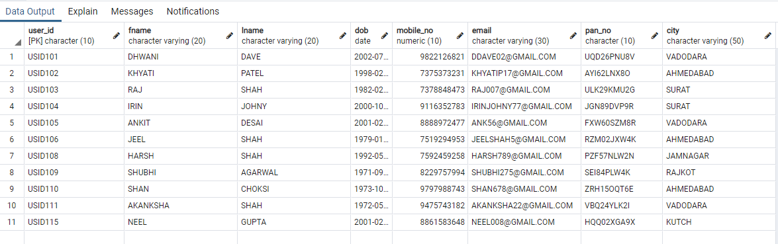
Output:

Slide 16
List details of all the user details who have all the types of driving license
Relational Algebra:
r1 <- π USER_DETAILS.USER_ID -> USER_ID, DRIVING_LICENSE. D_TYPE -> D_TYPE ((USER_DETAILS) X
DRIVING_LICENSE)
r2 <- r1 – DRIVING_LICENSE
r3 <- π USER_ID(r2)
Result <- π USER_ID (USER_DETAILS) – r3
SQL DML Statements:
SELECT USER_ID FROM USER_DETAILS
EXCEPT
SELECT USER_ID FROM
(SELECT D.D_TYPE,U.USER_ID FROM USER_DETAILS AS U CROSS JOIN DRIVING_LICENSE AS D
EXCEPT
SELECT D_TYPE,USER_ID FROM DRIVING_LICENSE ) AS R
Requirements:
A user has a Pan number, fname, lname,city, dob and contact number.
A user applying for a License must select any one of the license types (Learner’s, Driving, International) for application process.

Slide 17
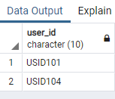
Output:

Slide 18
CONCLUDING REMARKS
Our main motive is to establish a database which reduces the RTO work manually and it helps to save the time of the user.
It will also help the R.T.O officials to maintain records systematically and reduces a lot of paperwork
and manual efforts.
When implemented the system would help in finding out repeat offenders.
It improves the security of the system by giving access to only the authenticated users.

