Slide 1
Application Programming Interface
A postman for the Web-Apps
NAME : Harsh Gupta
ROLL NUMBER : 22MT10023
EMAIL : harshxgupta931@gamil.com
PHONE NUMBER : 8434498363

Slide 2
What is an API ?
It is a go-between for different Software Platforms. It allows two unrelated applications to “talk” to each other.
It accesses data and features of other applications.
It is not a database or a server.
It is a code that governs the server’s Access point(s). AKA, a common language between developers.
It is SEAMLESS : We never know when a software role passes from one application to the other.

Slide 3
Why do we need API?
When accessing another app's data or functionality, requesting a spreadsheet or manually importing data is inefficient and cumbersome.
Storing and maintaining the data locally would quickly lead to outdated information.
Instead, it would be preferable for the app to provide an API (Application Programming Interface) that allows direct querying and retrieval of the desired data.
APIs enable efficient access to specific data without the need for additional manipulation or investigation.
By utilizing an API, the data remains up to date automatically, making it a more efficient way to obtain and integrate the desired information.

Slide 4
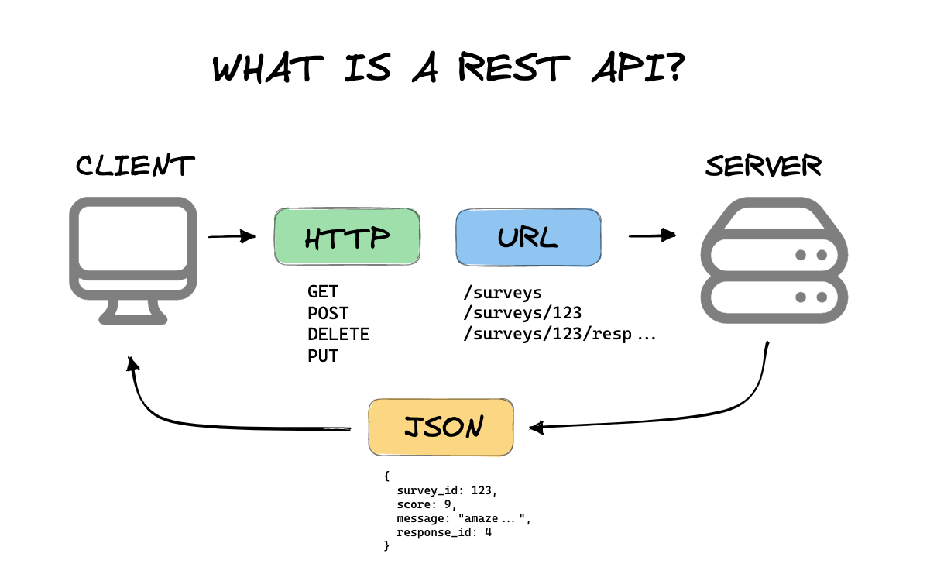
What is REST API ?
REpresentational State Transfer (REST) is a software architectural style that was created to guide the design and development of the architecture for the World Wide Web.
REST defines a set of constraints for how the architecture of an Internet-scale distributed hypermedia system, such as the Web, should behave.
Includes several constraints like:
Stateless
Client – Server
Cacheable
Layered

Slide 5
Stateless
The requests from the client to the server must consist of all the vital information. This information can be in the form of query string parameters, body parameters, part of a URL, or headers, thus making the server understand the requests. The URL identifies the resources uniquely, and the body holds the state of the requesting resource. On processing the client’s request, the server sends a response to the client through status, headers, or body.
Client-Server Architecture
The client-server architecture enables a separation of concerns, in layman terms, separating the client from the servers. This enhances the scalability of the server components, and the portability of the user interface across diverse platforms.

Slide 6
Cacheable
For faster and better performances, developers create applications that are often cacheable. To enable the caching, one has to implicitly or explicitly label the server response as non-cacheable or cacheable.
If the server response is labelled as cacheable, then the browser or application cache can reuse the response data for the future equivalent responses.
Layered System
This allows the application to limit the component behavior making it more stable. Such architecture enhances the application’s security as the component’s interaction gets limited to the layer itself. This provides stability due to the shared caches. Also, it supports load balancing.

Slide 7
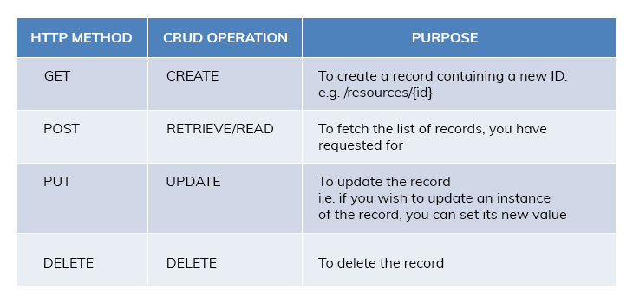
REST API Methods : Below given are the 4 main methods

Slide 8

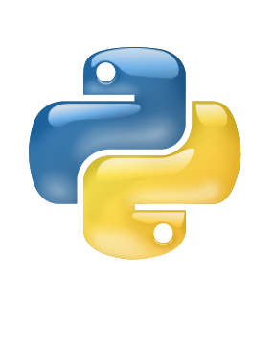
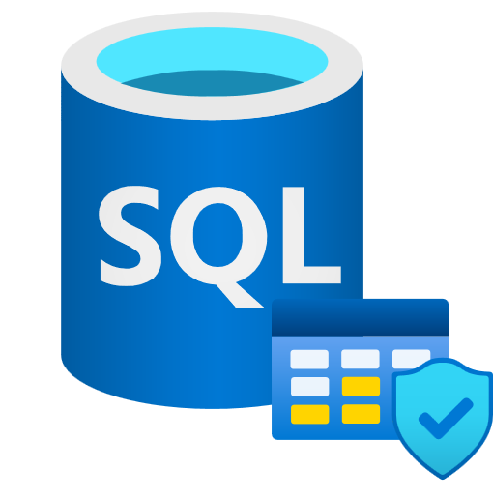
Creating a basic API
We can create a basic API using Python, pymysql and Flask. We can use Flask as a library inside the python code. For an API, we may also require a set of data or a database. We can use the freesqldatabase.com website to create a free SQL database.
Firstly create a connection between the database and the Flask app using the connector variable, db(here). We will then use the cursor function on the connector variable to use SQL commands and create the table and its columns. We will then use the cursor function on the connector variable to use SQL commands on the table created.

Slide 9
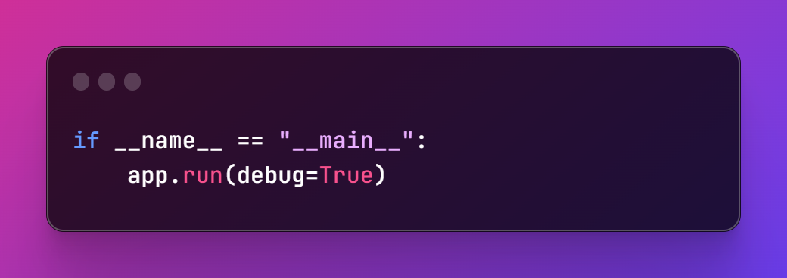
Setting up App routes
For the Flask App created we can set up different routes through which the request contexts traverse the response-query cycle.
All the app routes can have a set of methods predefined, that are meant(allowed) to be used via that route. The methods include GET, POST, PUT, DELETE, etc.
Each route contains a view function which returns the Response on each Request made. It may however not return a response each time.
Some methods also return a Redirect that is a URL to navigate to.
We have to run the API Response-query cycle using the following code below.
It starts up a server on the localhost:5000/{app.route_name}

Slide 10
Testing the made API and JSON FILE
We can Test out the Flask App which is a simple API by using a software called Postman. It allows us to Use different REST API methods with ease.
The API returns Response as a JSON file in a HTML server. Then We can use the JSON file in our program.
We use the jsonify function to convert Python Strings to json. The jsonify() function is useful in Flask apps because it automatically sets the correct response headers and content type for JSON responses, and allows you to easily return JSON-formatted data from your route handlers. This makes it easier and more convenient to create APIs that return JSON data.
Below is an example of a JSON context we used in our API
{
"author": "Chinua Achebe",
"country": "Nigeria",
"imageLink": "images/things-fall apart.jpg",
"language": "English",
"link":"https://en.wikipedia.org/wiki/Things_Fall_Apart\n",
"pages": 209,
"title": "Things Fall Apart",
"year": 1958,
}

Slide 11
Using a public API on a CLI
We can use the “cURL” library in command prompt(for windows) to access a Public API.
What is cURL : cURL is a free and open Source Software. cURL is a command-line tool and application library used to transfer data to or from a server.
→To use cURL to run your REST web API call, use the cURL command syntax to construct the command.
→To create the endpoint in the call, append the REST URI that you constructed in Construct a request to this URL:
curl https://<HOST_OR_IP>/<BASE_INSTALL_DIR>/rest/

Slide 12
cURL syntax
cURL syntax consists of <options> and <URL>:
→ curl [options………][URL…………..]
There are several useful options that we can use to control our requests :
-X or –request → HTTP method to be used
-I or –include → include the response headers
-d or –data → The data to be sent to the API
-H or –header → Any additional headers to be sent

Slide 13
We can use HTTP methods in cURL
GET method :
without parameters → curl https://jsonplaceholder.typicode.com/posts
With parameters → curl https://jsonplaceholder.typicode.com/posts?userid=5
POST method :
→ curl -X POST -d "userId=5&title=Post Title&body=Post content." https://jsonplaceholder.typicode.com/posts

Slide 14
PUT method :
→curl -X PUT -H "Content-Type: application/json" \-d '{"userid": 5, "title": "New Post Title", "body": "New post content."}" \https://jsonplaceholder.typicode.com/posts/5
DELETE method :
→Curl –X DELETE https://jsonplaceholder.typicode.com/posts/5

Slide 15
