Slide 1
Predicting Myocardial Infarction Risk
Team 49
GAUTAM KRISHNA – PES2UG24CS169
HARSH JHA – PES2UG24CS182

Slide 2
1. Problem Statement
Objective: predict low/high myocardial infarction (MI) risk from 13 clinical features.
Study both supervised classification and unsupervised patient clustering.
Build a reproducible ML pipeline with leakage-controlled preprocessing and held-out evaluation.
Academic prediction system only; not a clinically validated diagnostic tool.

Slide 3
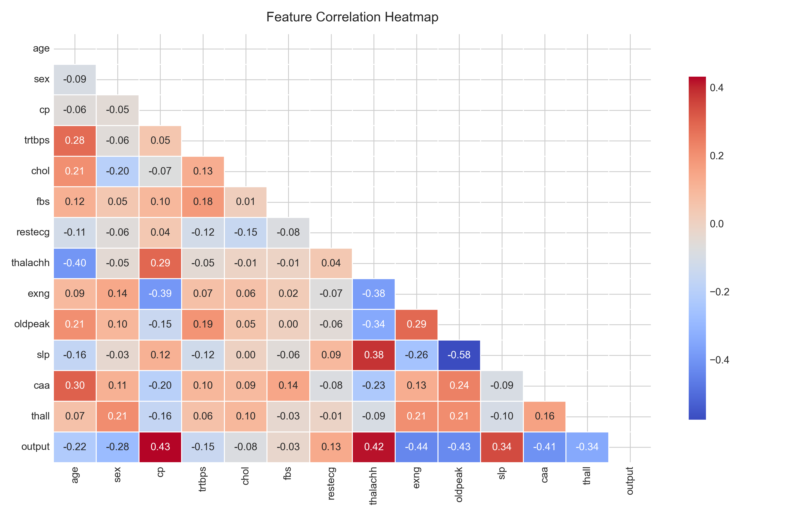
2. Dataset & Preprocessing
Heart Attack Analysis & Prediction Dataset: 303 records and 13 predictors.
Binary target: output = 0/1 for low/high MI risk.
0 missing values; 1 exact duplicate was removed → 302 unique records.
60/20/20 stratified train/validation/test split.
Scaling is encapsulated inside Scikit-learn Pipelines to avoid data leakage.

Slide 4
3. Methodology
Unsupervised: PCA, K-Means and DBSCAN.
Supervised: Logistic Regression, Elastic Net, GBM, Bagging, Random Forest, SVM (Linear/RBF/Polynomial), and MLP.
Hyperparameter tuning: 3-repeat 10-fold stratified cross-validation.
Metrics: AUROC, Accuracy, Precision, Recall and F1-score.
Additional analysis: calibration, threshold tuning, bootstrap CIs and interpretability.

Slide 5
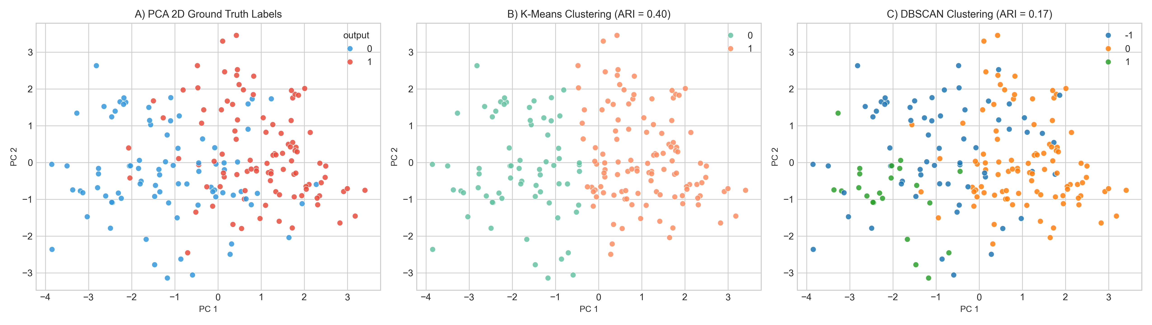
4. Unsupervised Learning
PC1 + PC2 explain 33.30% of cumulative variance; 9 PCs capture ≥90%.
Best K-Means ARI = 0.4003 using 11 PCA components.
Best DBSCAN ARI = 0.1548 at ε = 2.69 and min_samples = 5.
Low ARI and cluster overlap indicate that supervised decision boundaries are needed for accurate risk prediction.

Slide 6
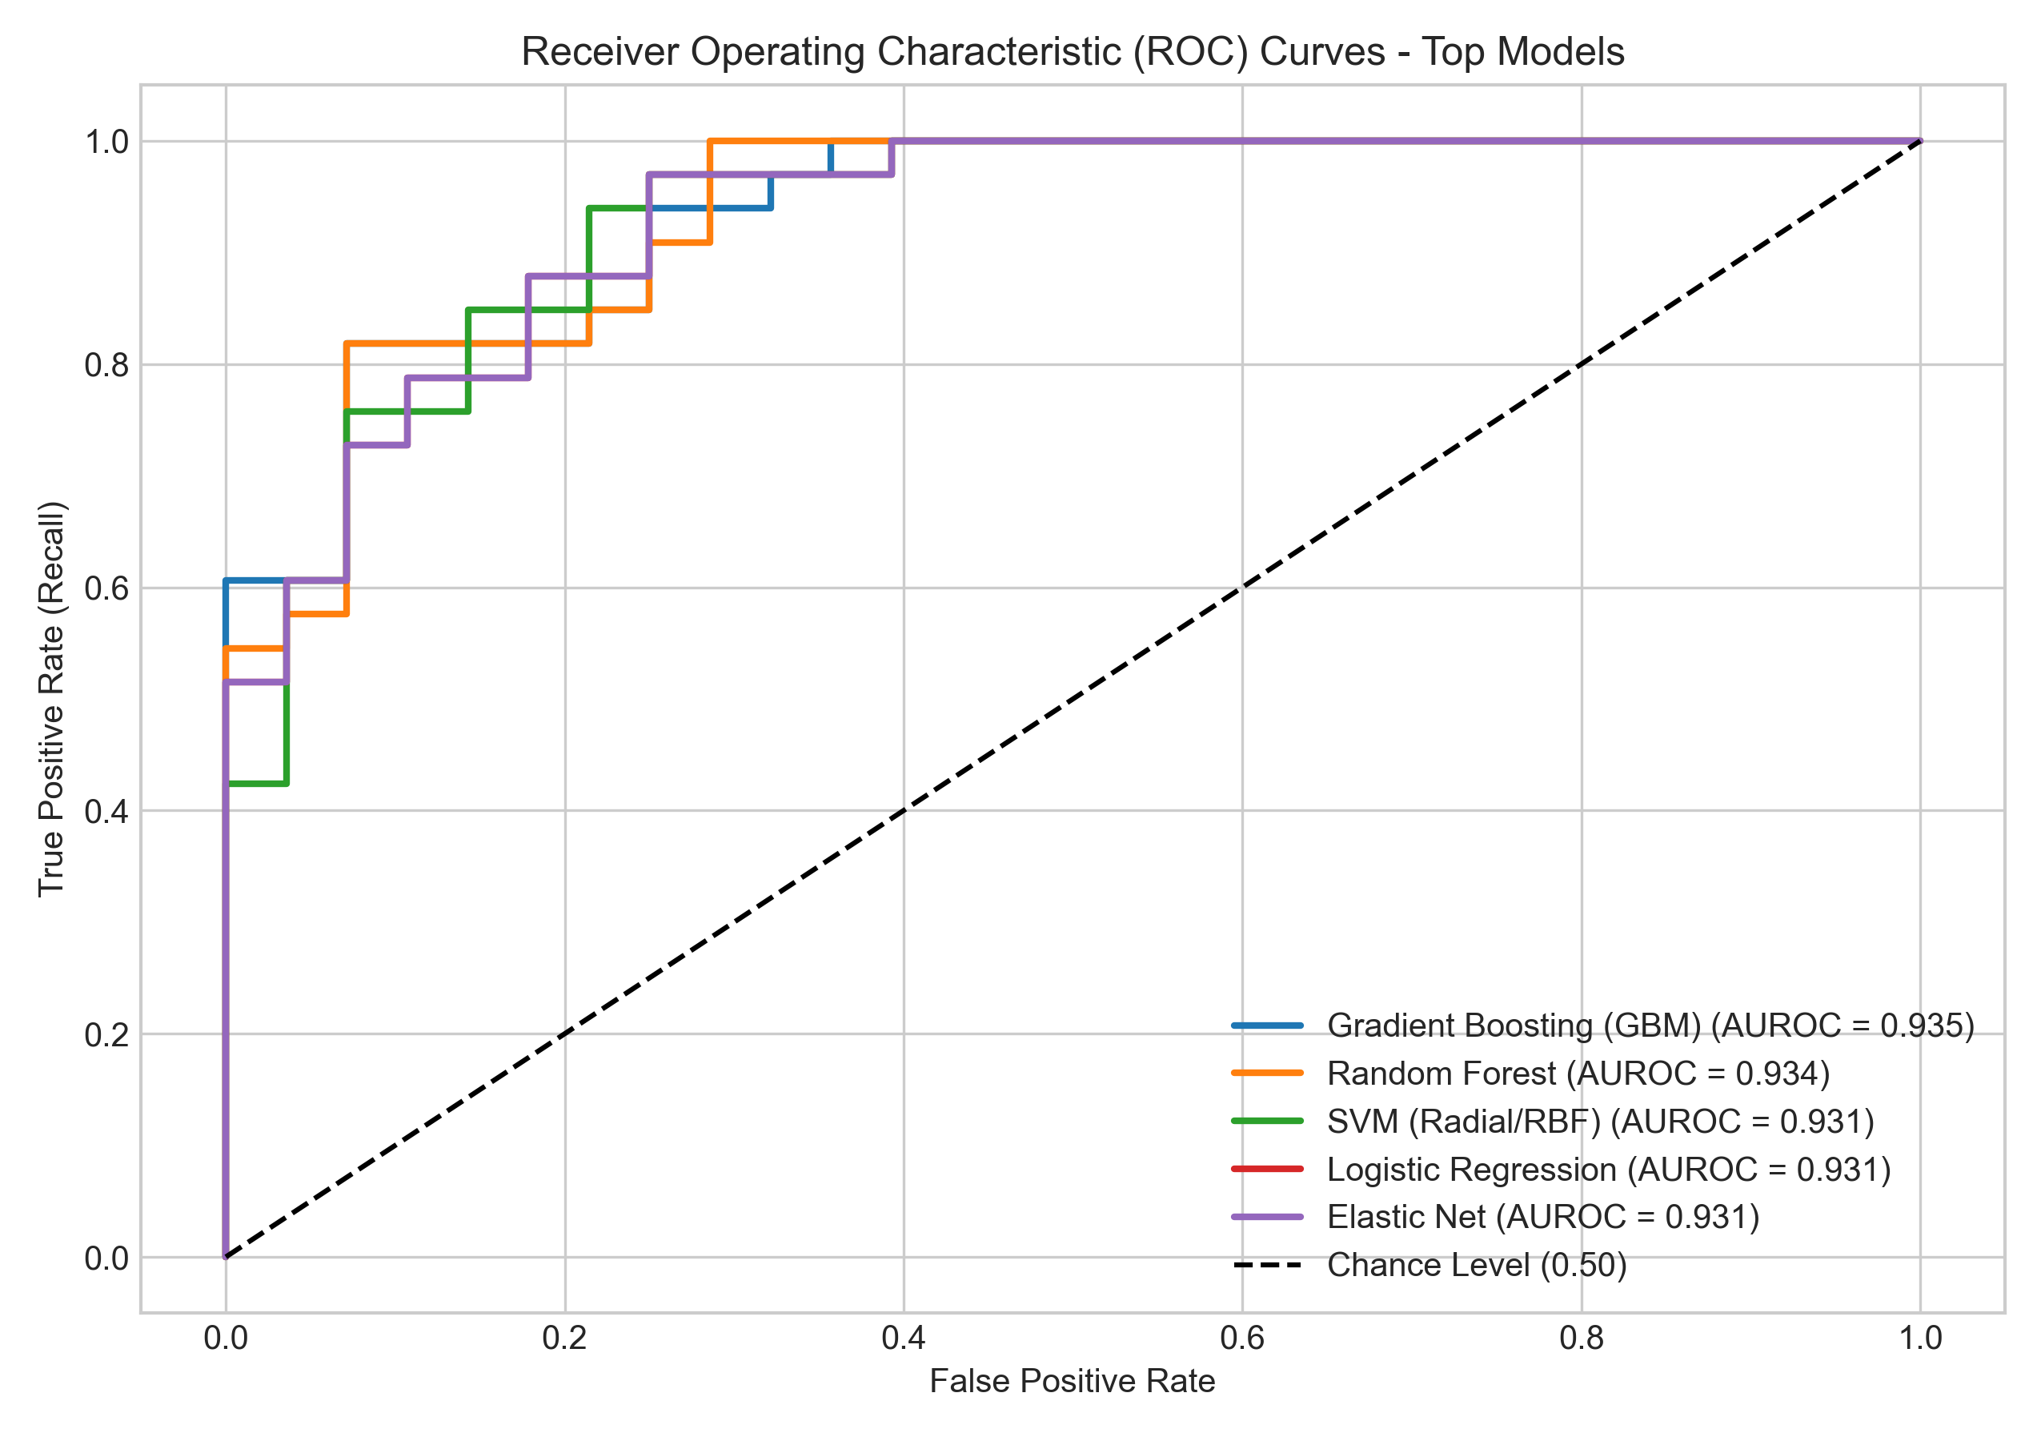
5. Supervised Learning — Held-Out Test Results
Model | AUROC | Accuracy | Recall | F1
Gradient Boosting | 0.935 | 0.852 | 0.939 | 0.873
Random Forest | 0.934 | 0.820 | 0.879 | 0.841
SVM-RBF | 0.931 | 0.869 | 0.939 | 0.886
Logistic Regression | 0.931 | 0.869 | 0.970 | 0.889
Elastic Net | 0.931 | 0.869 | 0.970 | 0.889
GBM achieved the highest AUROC (0.9351).
Logistic Regression / Elastic Net achieved the highest recall (0.9697) and F1 (0.8889).

Slide 7
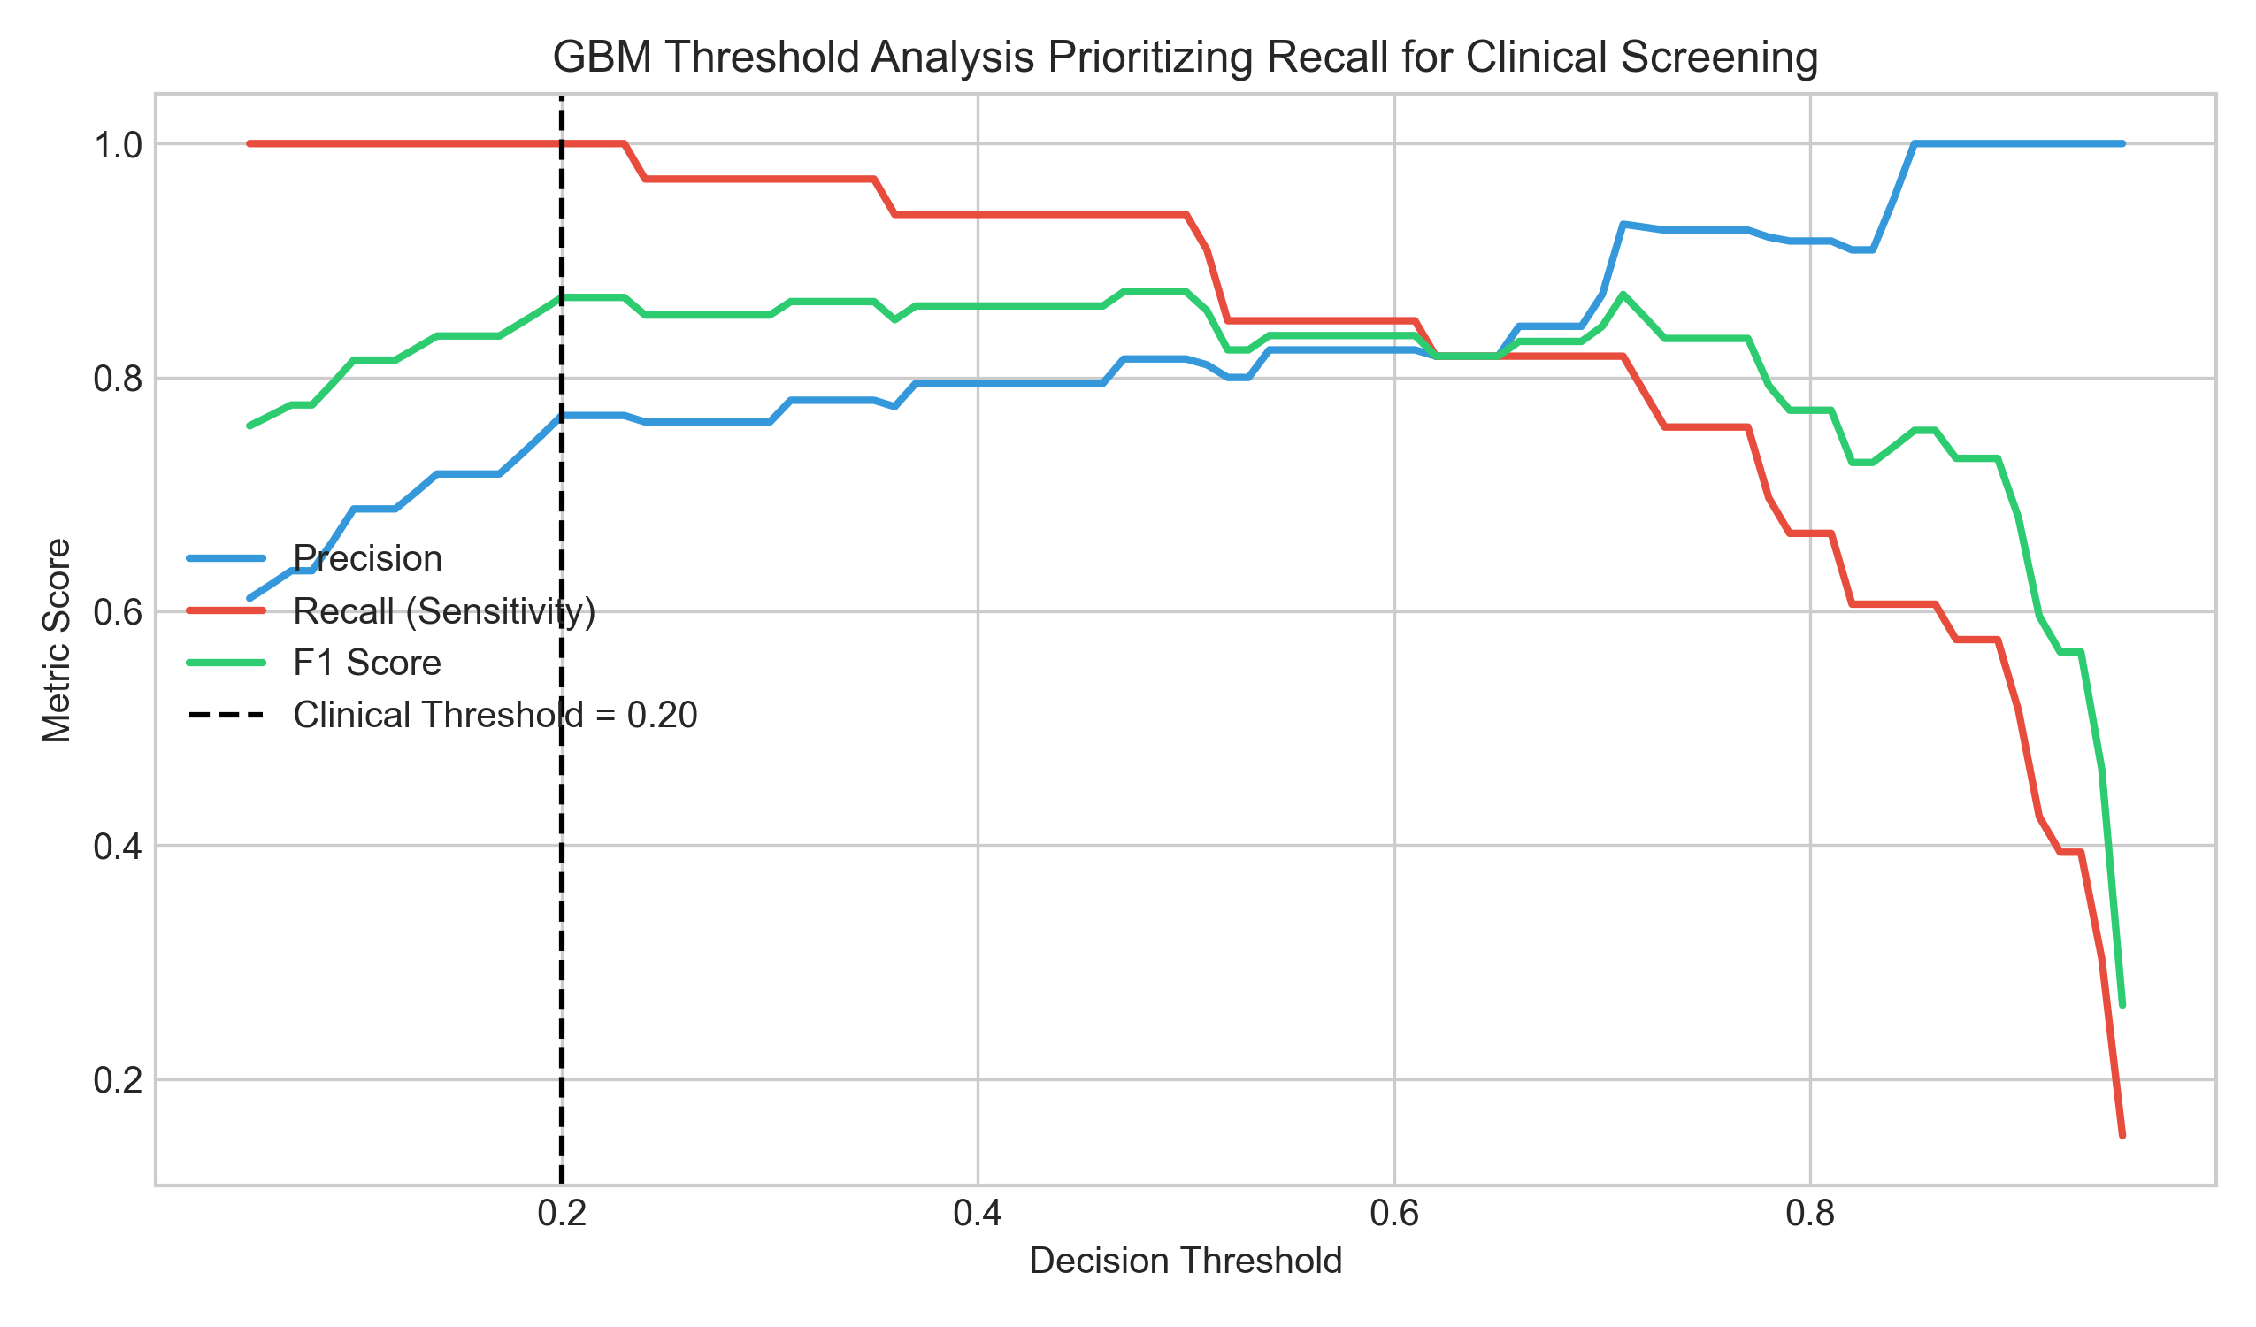
6. Clinical Threshold Analysis
For screening, false negatives are especially important.
GBM probability threshold was lowered from the default to T = 0.20.
Recall increased to 1.0000 (100% sensitivity) with 0 false negatives.
At T = 0.20: Precision = 0.7674, F1 = 0.8684; 33 TP, 18 TN, 10 FP, 0 FN.
This is a screening-oriented threshold, not a clinical treatment recommendation.

Slide 8
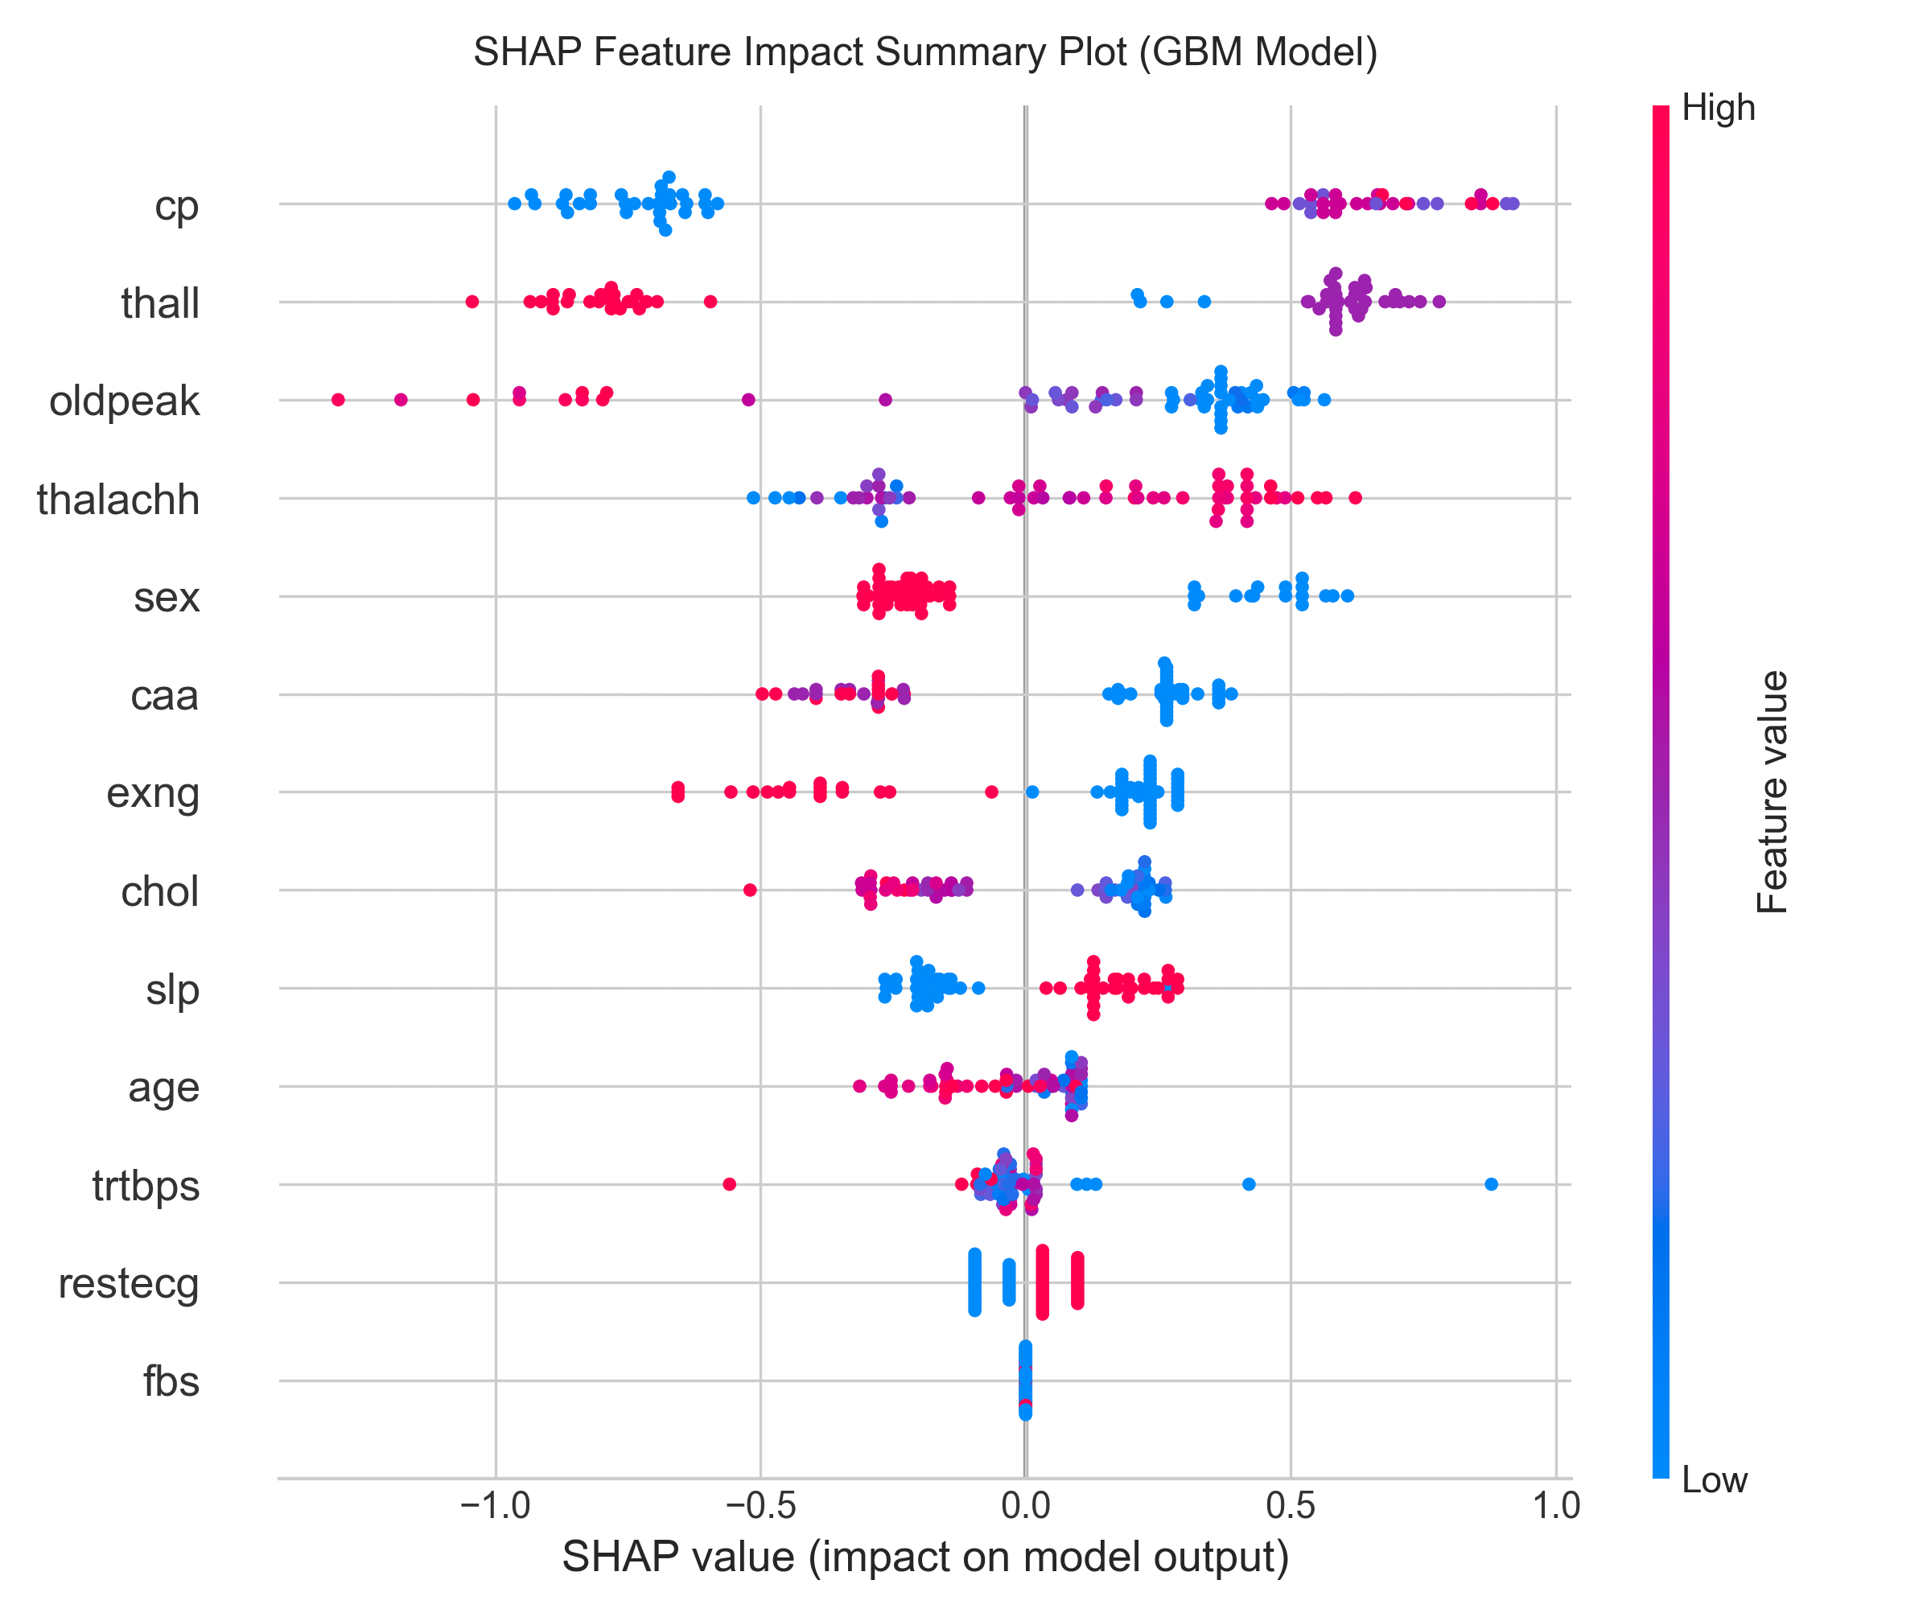
7. Model Interpretability
Logistic Regression odds ratios: cp OR = 1.829; thalachh OR = 1.539; exng OR = 0.643.
Permutation importance and Tree SHAP identified cp, slp, oldpeak and thalachh as important predictors.
Interpretability helps explain which features influence model predictions.

Slide 9
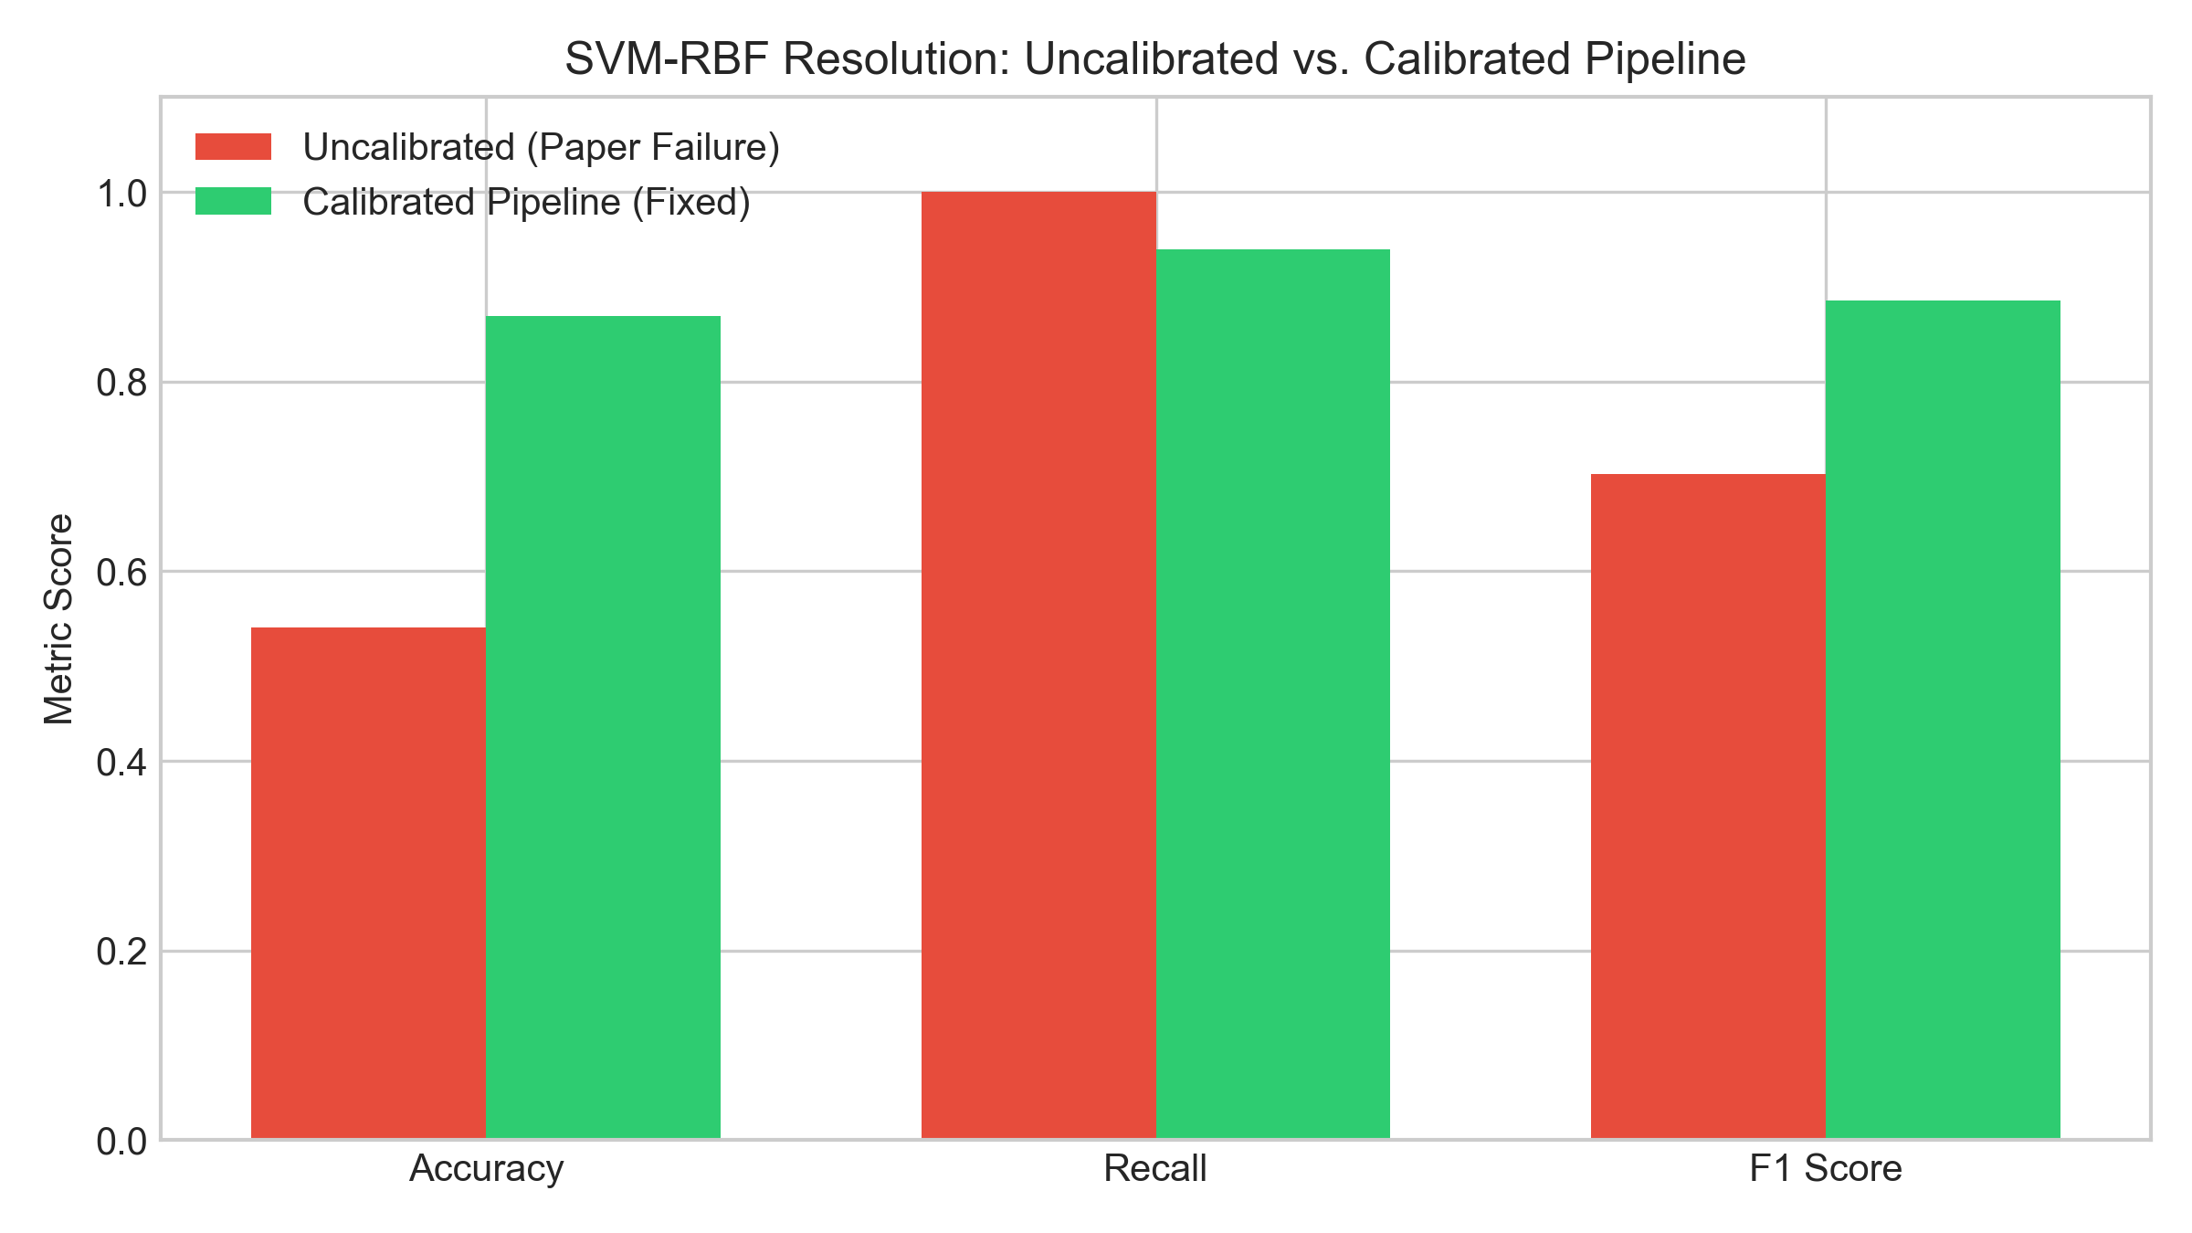
8. SVM-RBF: Failure Mode & Fix
The benchmark paper reported severe SVM-RBF collapse under an unscaled configuration.
Our pipeline scales features within training folds and tunes C/γ with cross-validation.
Calibrated SVM-RBF achieved AUROC = 0.9307, Accuracy = 0.8689, Recall = 0.9394 and F1 = 0.8857.
This demonstrates the importance of scaling and hyperparameter tuning.

Slide 10
9. Conclusion
Supervised models substantially outperformed unsupervised clustering for risk classification.
GBM produced the highest AUROC (0.9351), while Logistic Regression/Elastic Net produced the strongest recall and F1 at the default threshold.
Threshold tuning demonstrated a recall-first screening configuration with zero false negatives on the held-out test set.
The project extends the benchmark with leakage-controlled pipelines, broader model comparison and interpretability.
Limitations: small public dataset and no external clinical validation.

Slide 11
10. References
Shi, K., Bechler, K., & Ho, V. (2021). Predicting myocardial infarction risk using supervised and unsupervised machine learning methods. Stanford CS229 Project Report.
Heart Attack Analysis & Prediction Dataset, Kaggle.
Pedregosa et al. (2011). Scikit-learn: Machine Learning in Python.
Lundberg & Lee (2017). A Unified Approach to Interpreting Model Predictions.

