Slide 1


ENSE 805 - Project Presentation
Community Animal Safety Video Game
25 February 2025
Prepared by
Dev Joshi
Harsh Pandya

Slide 2
Introduction
Safe Paws is a 2D educational game designed to teach children (ages 6-10) safe interactions with pets using interactive storytelling and gamification. Players navigate real-world scenarios, make choices, and receive instant feedback to reinforce proper pet safety behaviors. The game aims to enhance engagement and retention, addressing the limitations of traditional teaching methods by making pet safety education fun, interactive, and easily understandable for young learners.

Slide 3

UN Sustainable Goals

Slide 4
Key Learnings from the Course Applied in Safe Paws
We used the idea of digital learning spaces to create an interactive game where children can actively engage with pet safety lessons instead of just reading about them.
Technology stewardship helped us choose the right tools, like Godot Engine, ensuring the game is easy to use, accessible, and works well across different devices.
By applying gamification and knowledge management, we turned pet safety education into a fun, interactive experience where kids learn through real-world scenarios and instant feedback.
Understanding how technology connects with communities guided us in designing a game that can be used in schools, pet adoption centers, and community programs to make learning more effective.

Slide 5

Current Status of Project
Current Status: Early Development (Status: Yellow – On Track but Facing Challenges)
The team is in the first stage of game development, focusing on storyline design and gameplay mechanics.
The first scenario, "Meeting a Dog ," has been developed, teaching children to ask permission before petting.
Godot Engine is being used for development, with initial game assets integrated.
Key Challenges:
Scene structuring and dialogue management within Godot needs improvement.
Player interaction and event handling optimization to ensure a smooth experience.
Balancing educational content with engaging gameplay mechanics.
Next Steps:
Refining story integration, interaction system, and scene transitions.
Developing a playable prototype for initial testing.
Expanding game scenarios and refining feedback mechanisms.

Slide 6
Research Paper Progress
The introduction of the research paper is divided into the following key parts:
Motivation & Context:
Highlights the lack of engaging pet safety education for children in Saskatchewan.
Discusses local statistics (1,200 dog bite cases in 2019) and the need for a technological solution.
Emphasizes limitations of traditional teaching methods (brochures, lectures).
Game Design & Educational Framework:
Showcases scenarios like "Meeting a Dog on a Leash" and "Encountering a Stray Animal".
Emphasizes real-time feedback and interactive decision-making for effective learning.
Developed using Godot Engine, ensuring 2D optimization, offline playability, and accessibility.
Objectives & Long-Term Vision:
Focuses on reducing pet-related injuries while fostering empathy toward animals.
Highlights scalability beyond Saskatchewan, making Safe Paws a global educational tool.
Ensures Safe Paws remains free, accessible, and easy to use for children.

Slide 7
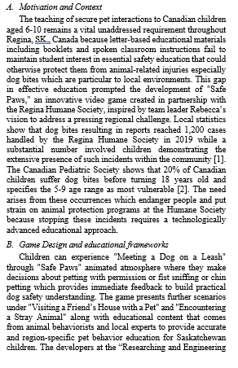
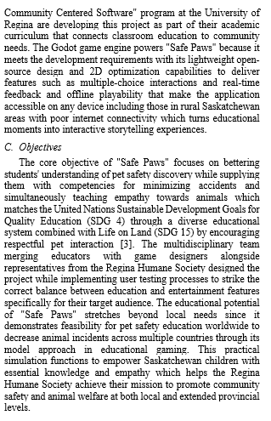

Slide 8

Thank You

