Slide 1
TEMPORAL CLOUD
CI/CD Pipeline Orchestrator
Production-Grade Delivery Infrastructure
.NET 8 | Temporal Cloud | Docker | React Dashboard | GitHub Actions

Slide 2
PROBLEM FRAMING
What Teams Actually Need
SECTION 1 — PROBLEM FRAMING
Confidence
Visibility
Control
Every commit reaching production has been built, tested, versioned, and verified through identical stages — no shortcuts, no drift.
See exactly where every pipeline is, what failed, and why — without digging through runner logs or parsing webhook payloads.
Pause, resume, cancel, or rerun any pipeline stage without rebuilding from scratch or SSHing into a runner.
Most CI/CD systems solve for the happy path. Production needs the unhappy path handled just as well.

Slide 3
PROBLEM FRAMING
Where Pipelines Break in Production
• Duplicate SCM events — Trigger duplicate workflows, duplicate publishes, and repeated deployments to the same environment
• Flaky build/test runners — Cause cascading retries across long-running work, amplifying cost and latency
• Partial publishes — Leave orphaned image tags without manifests, or manifests without final digests
• DEV failures propagating to QA — Broken builds reach higher environments when gates are weak or bypassed
• Version drift between build and deploy — Pipelines that rebuild introduce non-determinism between what was tested and what was deployed
• Workflow code changes — Non-determinism in orchestration path breaks in-flight pipelines during worker rollout

Slide 4
PROBLEM FRAMING
Design Assumptions & Constraints
We Assume
We Constrain
Source control is the single source of truth (push, PR, merge, tag)
Build and test must complete before versioning
Every branch deploys to DEV; only main progresses to QA
Container registry is the artifact boundary
Operators need real-time intervention capability
External systems (runners, registries, deploy tools) perform execution work
Publish once, deploy the same image digest forward — no rebuild drift
GitVersion runs only after required gates pass
Failures are contained — a DEV failure never reaches QA
Idempotent activities for safe retries
Task queues isolate failure domains
Deterministic workflow code — all I/O lives in activities

Slide 5
PROBLEM FRAMING
Success Looks Like
✓ Zero duplicate deployments from duplicate webhook events
✓ Sub-15-minute pipeline from push to DEV deployment
✓ Any failure diagnosable within 60 seconds via dashboard or Temporal UI
✓ Operators can pause, resume, cancel without SSH access or runner credentials
✓ Workflow code can be updated without breaking in-flight pipelines
✓ Full audit trail via Temporal event history and 9 custom search attributes
✓ One command to run locally — docker-compose up --build

Slide 6
SECTION 2
Opinionated Architecture
Why this design, and what we traded for it

Slide 7
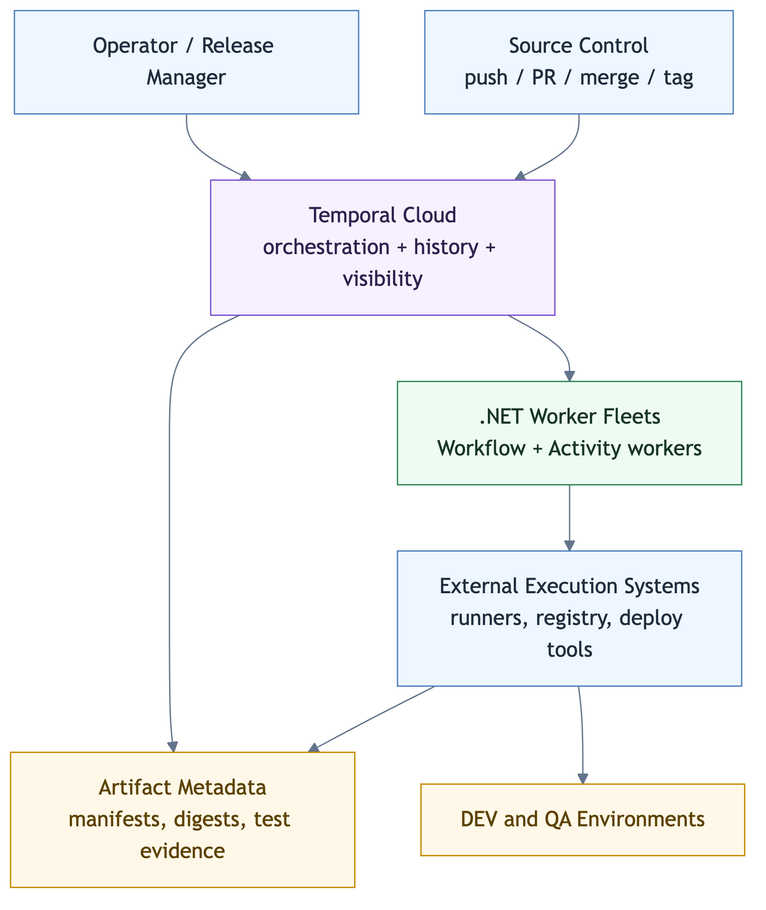
ARCHITECTURE
System Context
Temporal Cloud is the orchestration engine. External systems perform all execution work. Workers are the bridge.

Slide 8
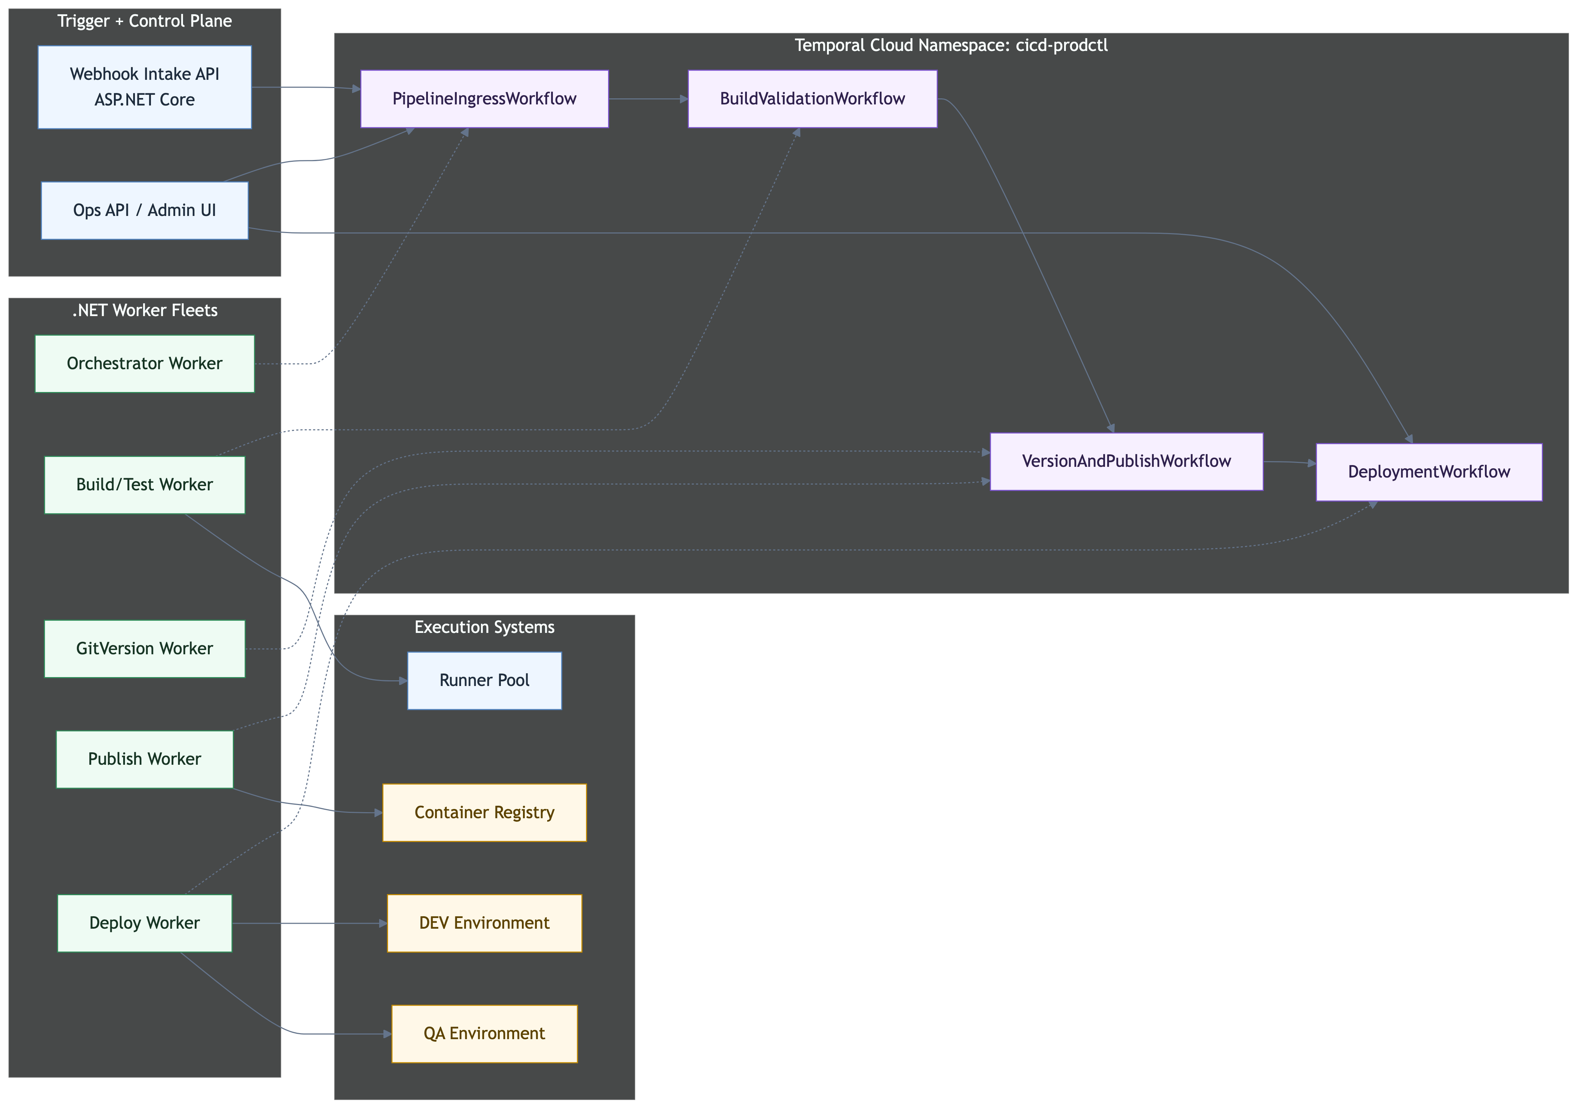
ARCHITECTURE
Component Architecture
4 workflows, 5 task queues, 5 dedicated workers — each workflow stage has its own failure domain.

Slide 9
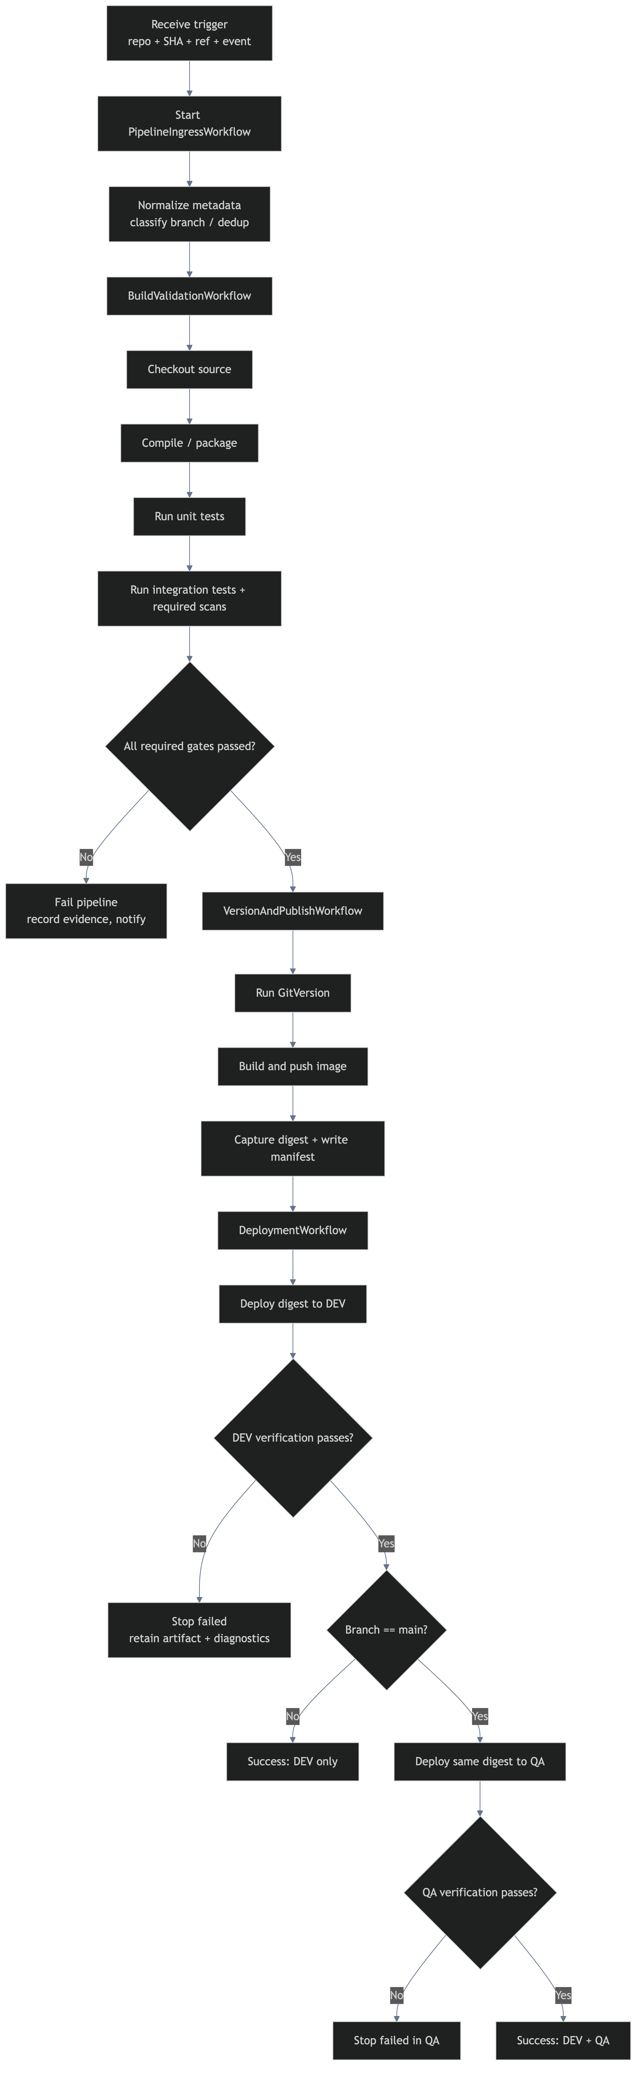
ARCHITECTURE
End-to-End Pipeline Flow

Slide 10
ARCHITECTURE
Four Workflows, Clear Boundaries
PipelineIngress
BuildValidation
VersionAndPublish
Deployment
Normalize, classify, deduplicate, dispatch child workflows
cicd.pipeline.orchestrator
Checkout, build, unit tests, integration tests, required scans
cicd.build.test
GitVersion, image build, registry push, digest capture, manifest
cicd.gitversion / cicd.publish
Deploy to DEV, verify, branch gate, deploy to QA (main only)
cicd.deploy
→
→
→
Each workflow is a Temporal child workflow with its own identity, history, and retry scope. Parent orchestrates the chain.

Slide 11
ARCHITECTURE
Task Queues as Failure Domains
Orchestrator
Build & Test
GitVersion
Publish
Deploy
All 4 workflows + ingress activities
cicd.pipeline.orchestrator
Checkout, compile, test, scan
cicd.build.test
Version computation
cicd.gitversion
Image push, manifest
cicd.publish
DEV & QA deploy + verify
cicd.deploy
Containment boundaries: Temporal Cloud holds durable state. Task Queues isolate each failure domain. A flaky runner pool does not block version computation. Each queue scales independently.

Slide 12
ARCHITECTURE
Branch-Aware Pipeline Policy
Branch Type | Build & Test | GitVersion | Publish | Deploy DEV | Deploy QA
main | Yes | Yes | Yes | Yes | Yes
feature/* | Yes | Yes | Yes | Yes | No
release/* | Yes | Yes | Yes | Yes | No
hotfix/* | Yes | Yes | Yes | Yes | No
All branches go through the full build → test → version → publish → DEV deploy path. Only main continues from DEV to QA.

Slide 13
ARCHITECTURE
9 Custom Search Attributes
Attribute | Type | Purpose
CicdPipelineStatus | Keyword | Current pipeline execution status
CicdBranch | Keyword | Git branch name for filtering
CicdRepository | Keyword | Repository identifier
CicdCommitSha | Keyword | Full commit SHA for traceability
CicdStage | Keyword | Current pipeline stage
CicdPipelineStartedAt | DateTime | Workflow start timestamp
CicdSemVer | Keyword | Computed semantic version
CicdImageDigest | Keyword | Immutable container image digest
CicdTriggerType | Keyword | webhook, manual, or scheduled
Example query: CicdPipelineStatus = 'Failed' AND CicdBranch = 'main'. These power the dashboard, operational queries, alerting rules, and audit reporting.

Slide 14
ARCHITECTURE
Why Temporal — And What We Traded
What We Get
What We Accept
Durable execution — workflows survive worker restarts and infrastructure failures
Built-in retry policies with exponential backoff and heartbeats
Signal / Query / Update for operator control without custom state management
Event history for complete audit trail of every decision
Search attributes for operational visibility at scale
Child workflows for stage isolation and independent retry scopes
Versioning for safe workflow code changes
Service accounts with API keys for clean automation boundaries
Temporal Cloud dependency — managed service as control plane
Determinism constraints — no I/O in workflow code, all side effects in activities
Learning curve for .NET SDK patterns and replay semantics
Additional infrastructure — 5 worker fleets to operate
Operational complexity — more moving parts than a monolithic CI/CD
What we intentionally did not choose: monolithic pipeline runner (Jenkins), event-driven choreography (no central state), custom queue + state machine (rebuild Temporal poorly).

Slide 15
SECTION 3
Production Readiness
Failure handling, versioning, and observability

Slide 16
PRODUCTION READINESS
Failure Amplification Map
Failure Source | How It Amplifies | Control | Recovery
Duplicate SCM events | Duplicate workflows, publishes, deployments | Idempotency keys + workflow ID deduplication | Resume existing execution
Flaky build/test runners | Repeated long-running work, false failures | Separate task queues, bounded retries, short timeouts | Rerun failed stage only
Bad repo checkout | Wrong version, wrong tags, publish confusion | Full history checkout, explicit branch/ref context | Fail before publish, fix config
Partial publish | Tag without manifest, or manifest without digest | Publish + manifest tracked separately, idempotent writes | Replay publish/manifest stage safely
DEV deploy failure | Broken build reaches higher environments | QA blocked unless DEV succeeds | Hold in DEV-failed state, rerun after fix
QA deploy failure | Unstable release candidate partially progressed | No downstream continuation after QA fail | Keep artifact + evidence, retry or promote successor
Workflow code change | Non-determinism in orchestration path | Replay tests before worker rollout | Verify with history replay before shifting traffic

Slide 17
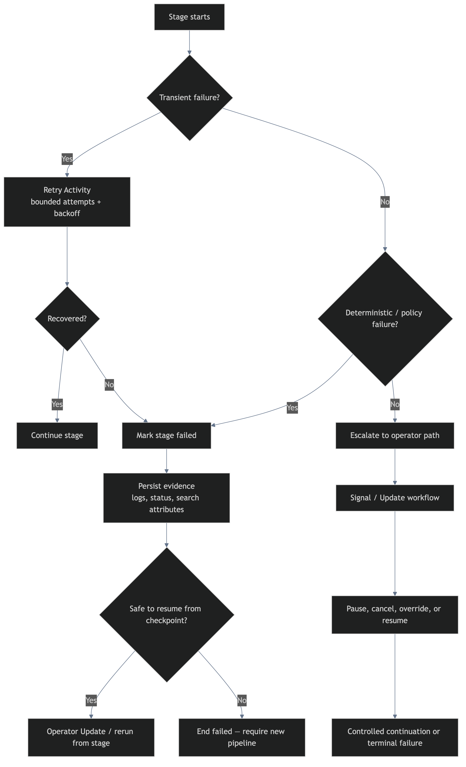
PRODUCTION READINESS
Failure Recovery Control Flow
Transient failures retry automatically. Deterministic failures fail fast. Everything else escalates to the operator path.

Slide 18
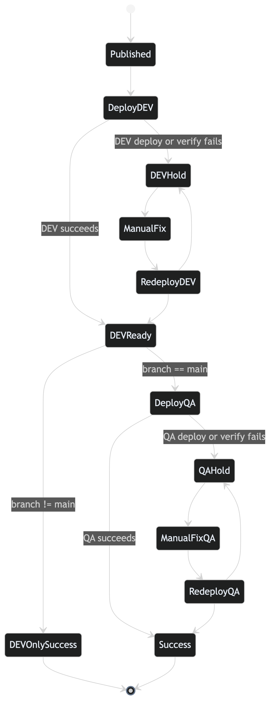
PRODUCTION READINESS
Deployment Recovery Model
Failed deployments enter a hold state. Operators can fix and redeploy without starting a new pipeline. The same published digest is reused.

Slide 19
PRODUCTION READINESS
Retry Policies & Timeout Budget
Activity | Timeout | Heartbeat | Max Attempts | Backoff
Checkout Source | 5 min | — | 3 | Exponential
Build / Package | 15 min | 60s | 2 | Exponential
Unit Tests | 10 min | 60s | 2 | Exponential
Integration Tests | 20 min | 120s | 2 | Exponential
Required Scans | 15 min | 60s | 2 | Exponential
GitVersion | 2 min | — | 3 | Exponential
Image Build | 20 min | 120s | 2 | Exponential
Image Push | 10 min | 60s | 3 | Exponential
Deploy to Env | 10 min | 60s | 3 | Exponential
Verify Env | 5 min | 30s | 3 | Exponential
Heartbeats detect dead workers. Non-retryable errors (PolicyViolation, AuthenticationError, ConfigurationError) fail fast. Everything else gets bounded exponential backoff.

Slide 20
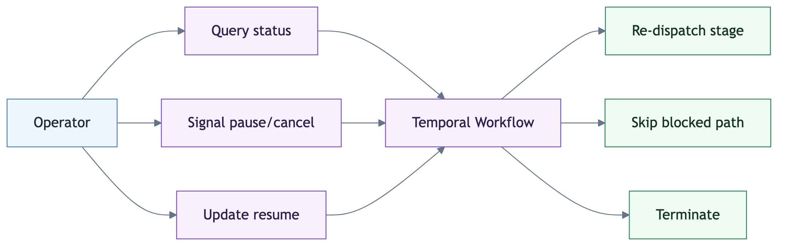
PRODUCTION READINESS
Operator Controls
API Endpoints
GET /api/ops/pipelines/{id}/status
POST /api/ops/pipelines/{id}/pause
POST /api/ops/pipelines/{id}/cancel
POST /api/ops/pipelines/{id}/resume
POST /api/ops/deployments/start
GET /api/ops/pipelines?repo=X&status=Y
GET /health
GET /health/temporal
Three Temporal Primitives
Query — read current stage, failures, pause state
Signal — pause or cancel from outside
Update — validated resume with operator override

Slide 21
PRODUCTION READINESS
Safe Workflow Code Changes
Determinism Guarantee
Replay Testing
Digest-Based Deploys
All workflow code is deterministic. Side effects (network calls, file I/O, timers) live exclusively in activities. Temporal replays workflow decisions from event history.
Before rolling out new worker code, replay existing workflow histories against the new code to verify compatibility. Catches non-determinism before it reaches production.
Published image digests are immutable. The same digest that passed DEV verification is deployed to QA. No rebuild drift. No "works on my machine."
Worker Rollout Strategy
1. Deploy new worker code alongside existing workers
2. Run replay tests against production workflow histories
3. Shift traffic to new workers via Temporal versioning
4. Drain old workers after in-flight workflows complete

Slide 22
SECTION 4
Phased Path Forward
Three phases from safety to autonomy

Slide 23
PATH FORWARD
Phase 1 — Safety & Visibility
Delivered
CURRENT STATE
• All 4 workflows operational with correct stage ordering and child workflow orchestration
• 9 search attributes registered and populated on every workflow execution
• Pipeline deduplication via deterministic workflow IDs
• Failure containment boundaries enforced — DEV protects QA
• React dashboard with real-time pipeline status (3s detail polling, 5s list polling)
• Operator controls: pause, cancel, resume via REST API and dashboard
• Docker Compose with 14 services for local development and demo
• GitHub Actions CI pipeline (build, test, Docker image matrix)
• Comprehensive test suite: unit tests, workflow tests, integration tests
• Health check endpoints for API and Temporal connectivity

Slide 24
PATH FORWARD
Phase 2 — Reliability & Scale
Next
PLANNED
• Replay testing suite for workflow determinism validation before every deploy
• Worker fleet auto-scaling per task queue based on queue depth and latency
• Metrics export: workflow latency, activity failure rates, queue depth, heartbeat lag
• Alert rules based on search attributes and Temporal Cloud metrics
• Multi-repository support with shared worker pools and per-repo configuration
• Temporal Cloud namespace isolation: staging namespace for pre-production testing
• Load testing with concurrent pipeline submissions and failure injection
• Structured logging with correlation IDs across all workers and API

Slide 25
PATH FORWARD
Phase 3 — Optimization & Autonomy
Future
ROADMAP
• Auto-rollback on QA verification failure with configurable policy
• Canary deployment support with progressive traffic shifting
• Pipeline templates for different project types (library, service, frontend)
• Self-service onboarding for new repositories — config-driven, no code changes
• Cost optimization: worker right-sizing based on queue utilization metrics
• Advanced operator controls: stage skip, forced promotion, targeted rollback
• Integration with incident management and change advisory boards
• Multi-cloud deploy targets (AWS, GCP, Azure) with environment abstraction

Slide 26
SECTION 5
Success Criteria
How we measure success, when we step back

Slide 27
SUCCESS CRITERIA
How We Measure Success
Reliability
Speed
Zero duplicate deployments from duplicate webhook events
Zero partial publishes — every publish produces a manifest with a digest
Failed pipelines diagnosable within 60 seconds via dashboard or Temporal UI
No DEV failure ever propagates to QA
Push to DEV deploy under 15 minutes for standard builds
Push to QA under 20 minutes for main
Operator pause/resume round-trip under 5 seconds
Dashboard reflects stage changes within 3 seconds
Visibility
Operator Confidence
100% of pipelines searchable by repository, branch, status, and commit
Dashboard shows real-time stage progression with failure details
Every workflow decision recorded in Temporal event history
Search attribute queries enable alerting and reporting
Any pipeline can be paused/resumed/cancelled without SSH
Failure evidence preserved in workflow history and search attributes
Redeploy from hold state without rebuilding
New team members productive with controls within 30 minutes

Slide 28
SUCCESS CRITERIA
When the System Runs Itself
Maturity indicators for hands-off operation
● Teams trigger pipelines and walk away — no babysitting, no refreshing logs
● Failures self-classify — transient retries recover automatically, deterministic failures report immediately
● Operators intervene < 5% of the time — on-call for pipelines is rare, not routine
● New repositories onboard in minutes — config-driven, no code changes required
● Workflow code changes deploy safely — replay testing catches issues before production
The goal is not to build the most sophisticated pipeline system. It is to build one that teams trust enough to stop thinking about.

Slide 29
SECTION 6
Architecture Walkthrough & Demo
Live system running in Docker Compose

Slide 30
DEMO
14 Services, One Command
Infrastructure
Startup
PostgreSQL 16 — Temporal backend storage
Temporal Server — auto-setup with namespace cicd-prodctl
Temporal UI — workflow visibility on port 8080
Temporal Init — registers 9 search attributes
docker-compose up --build
Service | URL
Dashboard | localhost:3001
API | localhost:5100
Temporal UI | localhost:8080
Temporal gRPC | localhost:7233
Application
API Server — ASP.NET Core on port 5100
5 Workers — Orchestrator, BuildTest, GitVersion, Publish, Deploy
Dashboard — React + nginx on port 3001
All services on a shared Docker bridge network. Workers connect to Temporal via temporal:7233.

Slide 31
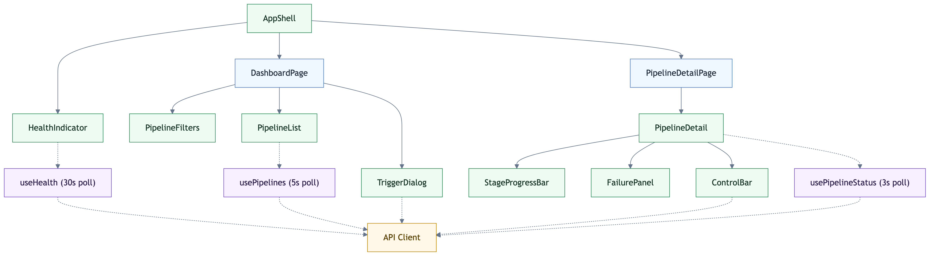
DEMO
Pipeline Dashboard
Pipeline List
Stage Progress
Operator Controls
Filter by repo & status. Each row shows StatusBadge with color-coded state.
11-stage visual bar from Received through VerifyingQA. Active/completed/failed indicators.
Pause, cancel, resume buttons. Inline error messages. Loading state during mutations.

Slide 32
DEMO
Demo: Push to Deploy
1
Start the stack — docker-compose up --build
2
Trigger a pipeline via webhook — curl -X POST http://localhost:5100/api/webhooks/github -H 'Content-Type: application/json' -d '{"repository":"test/repo","ref":"refs/heads/main","commitSha":"abc1234567890","eventType":"push"}'
3
Watch the dashboard — Stages progress from Received through BuildValidation, VersionAndPublish, to Deployment
4
Open Temporal UI (localhost:8080) — See workflow execution history, search attributes populated, child workflow chain
5
Demonstrate operator control — Pause a running pipeline from the dashboard, observe Paused state, then resume with operator ID
6
Show failure handling — Trigger a pipeline that fails at build stage, inspect FailurePanel with evidence and diagnostic data

Slide 33
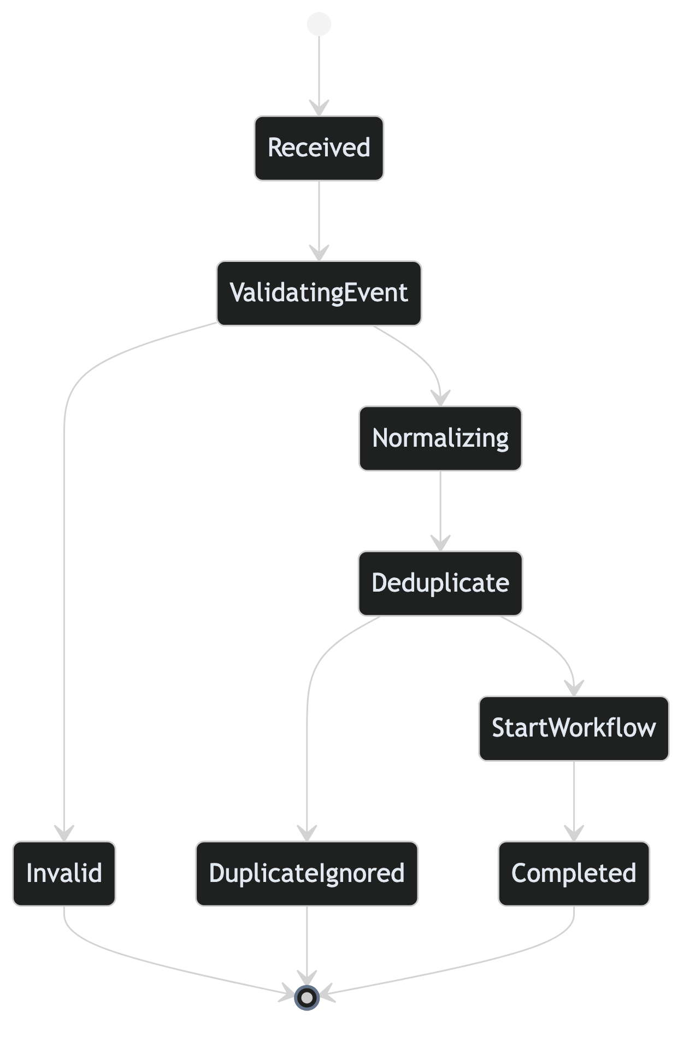
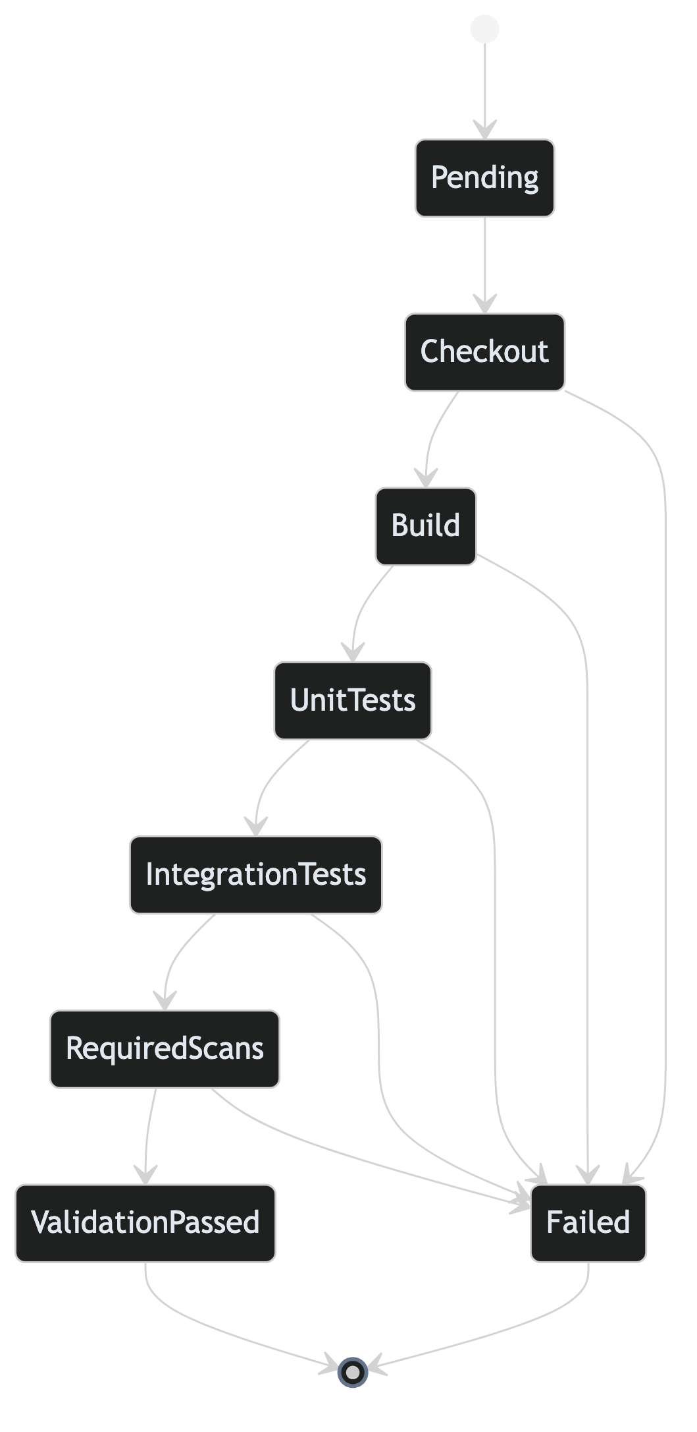
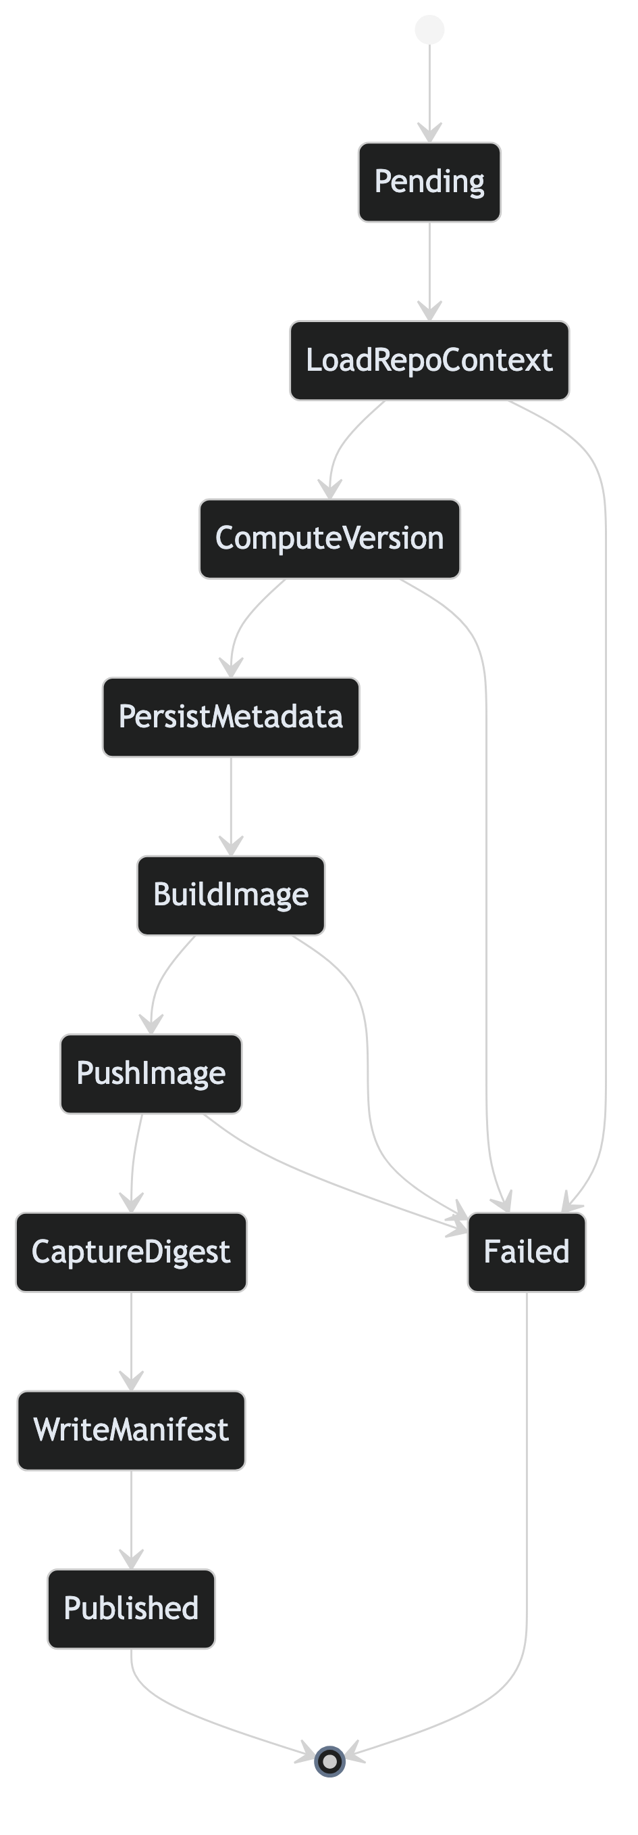
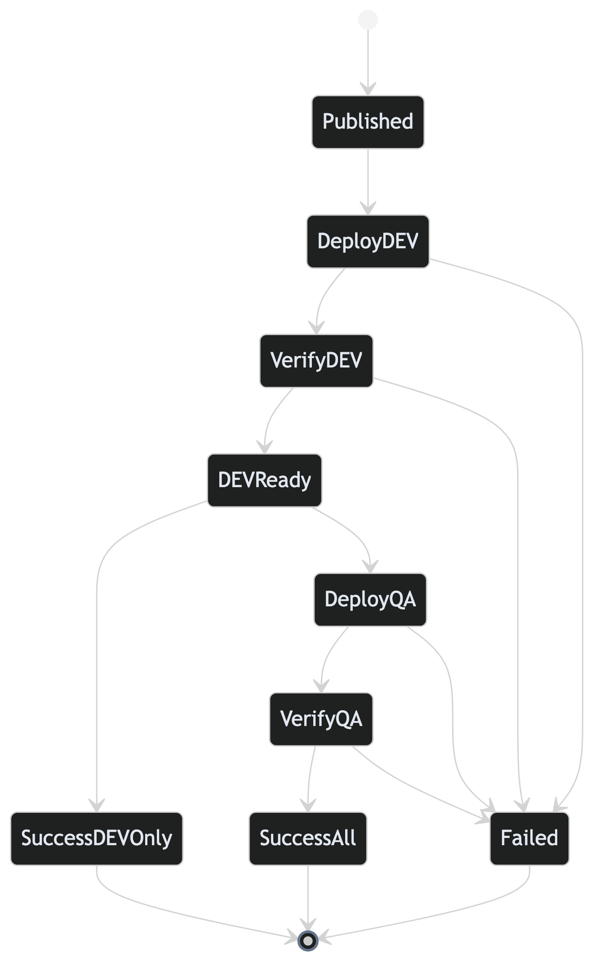
DEMO
State Machines: Every Stage Accounted For
Pipeline Ingress
Build Validation
Version & Publish
Deployment

Slide 34
Thank You
Production-grade CI/CD orchestration with Temporal Cloud
4
Workflows
5
Task Queues
14
Docker Services
9
Search Attributes
Dashboard
localhost:3001
API
localhost:5100
Temporal UI
localhost:8080
.NET 8 | Temporal Cloud | 4 Workflows | 5 Workers | 14 Docker Services | React Dashboard

