Slide 1

SMART INDIA HACKATHON 2026
KISAN SETU
Farmer Procurement Slot and Queue Management System
Problem Statement ID: [ENTER SIH PS ID]
Problem Statement Title: Digital Mandi Procurement Slot and Queue Management
Theme: Agriculture, FoodTech and Rural Development
PS Category: Software
Team ID: [ENTER REGISTERED TEAM ID]
Team Name: [ENTER REGISTERED TEAM NAME]
Notes:
Replace the three bracketed registration fields before SIH submission. The remaining title-page details reflect the Kisan Setu working prototype.

Slide 2
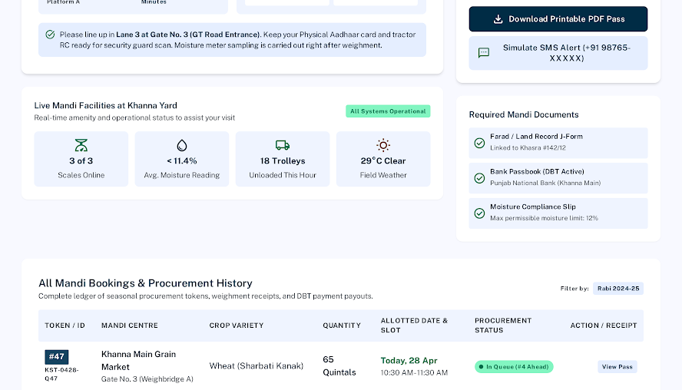
KISAN SETU
KISAN
SETU
PROPOSED SOLUTION AND FARMER WORKFLOW
A capacity-aware procurement journey
01
Register or sign in
Phone-style login mapped to a secure account identity
02
Reserve a mandi slot
Choose centre, date, time and produce quantity
03
Receive token and gate pass
A digital record prepares the farmer for entry
04
Track the live queue
Realtime status shows the current position
05
Complete procurement
Procurement and recorded payment status reach the inbox
Farmer dashboard design: token, booking status, queue position, gate pass and history
Unique design: one role-aware login, admin-only operator creation, capacity-linked slots and realtime farmer notifications
Notes:
The screenshot comes from the supplied Kisan Setu Stitch design package. It represents the implemented dashboard structure; figures visible inside it are design-reference sample values.

Slide 3
TECHNICAL APPROACH
KISAN
SETU
SYSTEM ARCHITECTURE AND OPERATIONAL WORKFLOW
USERS
WEB INTERFACES
SUPABASE SERVICES
DATA MODEL
Farmer
Public portal
HTML + CSS + JavaScript
Authentication
Phone mapped to internal email
profiles
centres + slots
bookings
notifications
Mandi
Operator
PostgreSQL + Row Level Security
Role and centre isolation
Operator queue
Centre-scoped actions
Realtime booking changes
Farmer and admin views update
Administrator
Admin portal
Centres, slots, bookings, staff
Edge Function
Secure operator account creation
Admin configures centre and capacity
Farmer books a slot and receives token
Operator advances procurement status
Realtime update and notification reach farmer
Notes:
Architecture reflects the current repository: plain static frontend, Supabase Auth, PostgreSQL with RLS, Realtime subscriptions, database triggers and the deployed create-staff Edge Function.

Slide 4
FEASIBILITY AND VIABILITY
KISAN
SETU
WORKING MVP, IMPLEMENTATION RISKS AND PILOT PATH
WORKING PROTOTYPE; PILOT HARDENING NEXT
Key risks and controls
Implemented prototype
Risk | Control / next hardening step
Weak mandi connectivity | Lightweight pages and retry states; offline gate-pass access is planned
Simultaneous slot booking | Unique slot-token constraints; move token allocation into one database transaction
Incorrect role access | Server-assigned roles, route guards and Row Level Security on every table
Low staff adoption | Touch-friendly operator queue, centre-scoped screens and short assisted onboarding
Responsive farmer, operator and admin portals
Five-table procurement data model with RLS
Booking and notification subscriptions
Admin-only operator provisioning via Edge Function
Local prototype connected to a hosted Supabase backend
Pilot path
1. One mandi and one operator shift 2. Measure wait, no-shows and slot use 3. Expand after security review
Notes:
The readiness statements describe features implemented in the current Kisan Setu workspace. Atomic token allocation remains a planned production-hardening step and is not presented as complete.

Slide 5
IMPACT AND BENEFITS
KISAN
SETU
EXPECTED OUTCOMES AND PILOT MEASUREMENT
FARMER
MANDI OPERATIONS
Planned arrival replaces uncertain waiting
Live queue and payment status reduce repeated enquiries
Capacity-based windows smooth gate inflow
Operators work from one ordered, centre-scoped queue
GOVERNMENT
ENVIRONMENT
Booking-to-payment history supports audit review
Centre utilisation reveals where capacity is constrained
Shorter queues can reduce engine idling
Fewer avoidable trips reduce local congestion
Pilot success measures
Median gate wait
Arrival within booked window
No-show rate
Token-to-procurement time
Payment status visibility
Notes:
Impact statements are expected outcomes for pilot validation, not measured claims. The pilot will establish baselines and compare results by mandi, date and operating shift.

Slide 6
RESEARCH AND REFERENCES
KISAN
SETU
PRIMARY REFERENCES AND WORKING PROTOTYPE EVIDENCE
Government and domain references
Technology references
National Agriculture Market (e-NAM)
https://enam.gov.in/web/
Department of Food and Public Distribution
https://dfpd.gov.in/
Smart India Hackathon 2026 idea presentation format
Supplied SIH template and submission instructions
Supabase Authentication
https://supabase.com/docs/guides/auth
Row Level Security
https://supabase.com/docs/guides/database/postgres/row-level-security
Realtime Postgres changes and Edge Functions
https://supabase.com/docs/guides/realtime/postgres-changes
https://supabase.com/docs/guides/functions
WORKING PROTOTYPE
Local demo: http://localhost:8080/ Source modules: public portal, operator queue, admin command, Supabase migrations and create-staff function
Notes:
References: https://enam.gov.in/web/ ; https://dfpd.gov.in/ ; https://supabase.com/docs/guides/auth ; https://supabase.com/docs/guides/database/postgres/row-level-security ; https://supabase.com/docs/guides/realtime/postgres-changes ; https://supabase.com/docs/guides/functions . Prototype evidence comes from the Kisan Setu workspace supplied in this task.

