Slide 1
COURSE: 21CSE458T — WIRELESS AND MOBILE COMMUNICATION
Comparative Analysis of Wireless Signal Propagation Models
(Free Space, Okumura and Hata)
Numerical Simulation, Empirical Validation & RF Engineering Case Study using MATLAB & Python
PROJECT TEAM MEMBERS (B.Tech CSE, 7th Semester)
• Harsh Yadav (Reg No: RA2311003011546) • Utkarsh Dabas (Reg No: RA2311003011550) • Tamanna Singh (Reg No: RA2311003011570)

Slide 2
21CSE458T — WIRELESS & MOBILE COMMUNICATION
Slide 2: Introduction & Motivation
• What is Path Loss? The fundamental reduction in power density of an electromagnetic wave as it propagates.
• Formulation: Expressed in decibels as PL(dB) = 10 * log10(Pt / Pr).
• Crucial Importance in Wireless Design: Governs cellular coverage radius, base station transmitter sizing, link budgeting, and frequency reuse planning.
• Why Theoretical Models Fall Short: Real environments exhibit reflection, diffraction, scattering, and building clutter that deviate sharply from ideal inverse-square decay.
• Project Objective: Compare Free Space, Okumura, and Hata models using numerical simulation in MATLAB and Python.

Slide 3
21CSE458T — WIRELESS & MOBILE COMMUNICATION
Slide 3: Theoretical Foundation: Free Space Path Loss (FSPL)
• Friis Transmission Theory: Assumes unobstructed, vacuum line-of-sight (LOS) propagation between isotropic antennas.
• Governing Formula: L_fspl(dB) = 20*log10(d) + 20*log10(f) + 32.44 [d in km, f in MHz].
• Inverse-Square Law (n = 2): Signal power attenuates strictly at 20 dB per decade of distance.
• Free Space Constant (32.44): Derived directly from 20*log10(4*pi / c) with unit conversions.
• Role in Wireless Engineering: Serves as an absolute theoretical lower bound on signal loss; unattainable in terrestrial clutter.

Slide 4
21CSE458T — WIRELESS & MOBILE COMMUNICATION
Slide 4: Empirical Foundation: Okumura Propagation Model
• Historical Background: Developed by Yoshihisa Okumura (1968) from extensive drive-test measurements in Tokyo, Japan.
• Classic Nomogram Methodology: Graphical curves of median attenuation A_mu(f, d) plotted relative to free space.
• Open Area Empirical Correction: Standard formulation for rural/open terrain:
Correction(dB) = -4.78*(log10(f))^2 + 18.33*log10(f) - 40.94
L_okumura = L_hata + Correction
• Physical Behavior: Open area attenuation is ~28.5 dB lower than dense urban loss at 900 MHz.

Slide 5
21CSE458T — WIRELESS & MOBILE COMMUNICATION
Slide 5: Empirical Foundation: Hata Urban Model
• Closed-Form Standardization: Formulated by Masaharu Hata (1980) to convert Okumura's graphical curves into mathematical equations.
• Mobile Antenna Correction Factor (Small/Medium City):
a(h_re) = (1.1*log10(f) - 0.7)*h_re - (1.56*log10(f) - 0.8)
At f = 900 MHz, h_re = 1.5 m -> a(h_re) = 0.00 dB.
• Urban Path Loss Equation:
L_hata(dB) = 69.55 + 26.16*log10(f) - 13.82*log10(h_te) - a(h_re) + [44.9 - 6.55*log10(h_te)]*log10(d)
• Distance Decay Exponent: For h_te = 30 m, slope is 35.22 dB/decade (effective n ~ 3.52).

Slide 6
21CSE458T — WIRELESS & MOBILE COMMUNICATION
Slide 6: Simulation Parameters & Benchmark Setup
• Standard Cellular Benchmark Configuration:
- Carrier Frequency (f): 900 MHz (Standard GSM-900 / 3G / LTE Band 8)
- Base Station Antenna Height (h_te): 30 meters (Macrocell tower)
- Mobile Station Antenna Height (h_re): 1.5 meters (Handheld receiver)
- Distance Range (d): 1 km to 20 km (Macrocellular coverage zone)
• Computational Methodology: Vectorized distance array d = 1:0.1:20 km for smooth plotting.
• Outputs: Tabular comparisons at 1 km steps and publication-grade graph export.

Slide 7
21CSE458T — WIRELESS & MOBILE COMMUNICATION
Slide 7: Simulation Methodology & Dual Engine Pipeline
• Dual Implementation Architecture: Identical algorithms implemented in both Python 3 and MATLAB.
• Python Engine (path_loss_simulation.py): NumPy vectorized array arithmetic with Matplotlib visualization.
• MATLAB Engine (path_loss_simulation.m): Native matrix operations with grid, legends, and high-res figure export.
• Execution Workflow:
1. Parameter bounds validation (f in 150-1500 MHz, h_te in 30-200 m).
2. Evaluate correction factors a(h_re) and rural open-area factor.
3. Vectorized calculation of L_fspl, L_okumura, and L_hata.
4. Console tabular reporting and graphical export (path_loss_graph.png).

Slide 8
21CSE458T — WIRELESS & MOBILE COMMUNICATION
Slide 8: Numerical Simulation Results (Tabular Comparison)
• Exact Quantitative Readings at Key Distance Benchmarks:
- At 1 km: Free Space = 91.52 dB | Okumura = 97.90 dB | Hata = 126.40 dB
- At 2 km: Free Space = 97.55 dB | Okumura = 108.50 dB | Hata = 137.01 dB
- At 5 km: Free Space = 105.50 dB | Okumura = 122.52 dB | Hata = 151.02 dB
- At 10 km: Free Space = 111.52 dB | Okumura = 133.12 dB | Hata = 161.63 dB
- At 15 km: Free Space = 115.05 dB | Okumura = 139.32 dB | Hata = 167.83 dB
- At 20 km: Free Space = 117.55 dB | Okumura = 143.73 dB | Hata = 172.23 dB
• Discrepancy at 20 km: Hata urban model predicts 54.68 dB higher loss than Free Space!

Slide 9
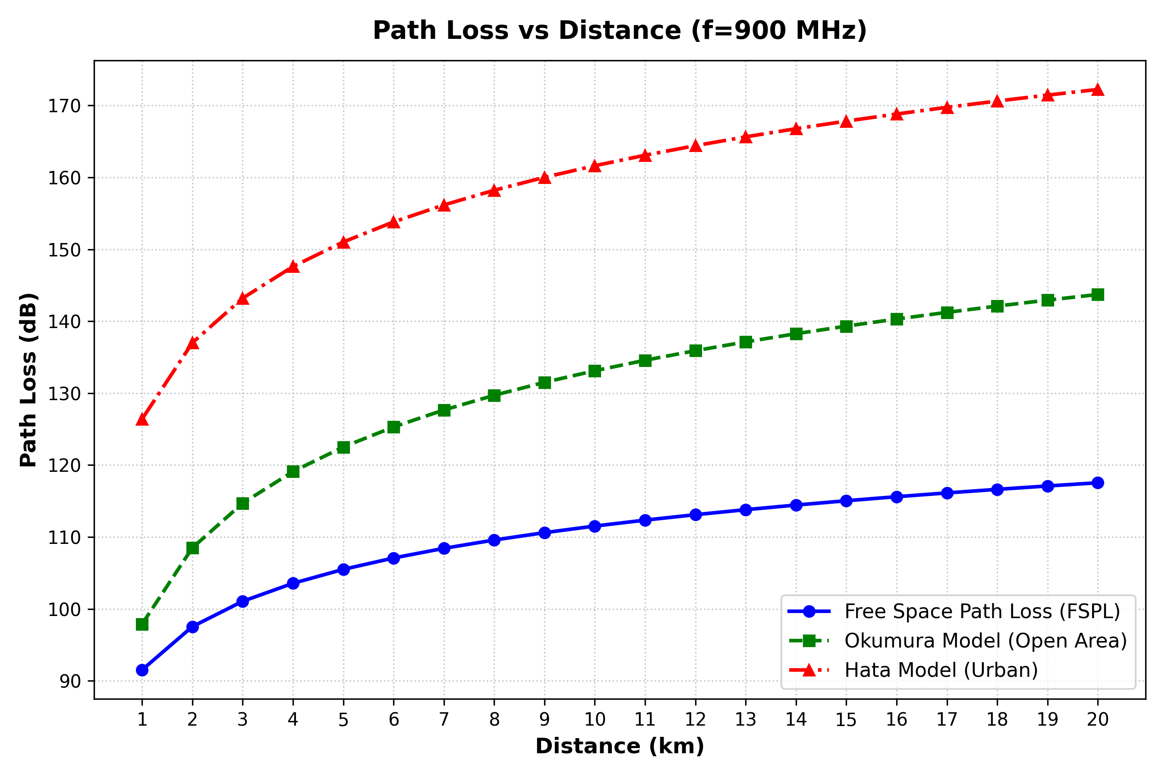
21CSE458T — WIRELESS & MOBILE COMMUNICATION
Slide 9: Comparative Path Loss Visualization
• Visual Analysis of path_loss_graph.png:
- Blue Dash-Dot Curve: Free Space Path Loss (slope = 20 dB/decade)
- Green Dashed Curve: Okumura Open Area (slope = 35.22 dB/decade)
- Red Solid Curve: Hata Urban Model (slope = 35.22 dB/decade)
• Visual Curve Separation: Curves diverge sharply with distance due to the exponent difference (n=2 vs n=3.52).
• Constant Urban-Rural Delta: Hata urban curve sits exactly 28.5 dB above Okumura open-area curve at all distances.

Slide 10
21CSE458T — WIRELESS & MOBILE COMMUNICATION
Slide 10: Quantitative Divergence Analysis
• At 1 km Distance:
- Hata Urban vs Free Space: 126.40 - 91.52 = +34.88 dB penalty.
- Okumura Open vs Free Space: 97.90 - 91.52 = +6.38 dB penalty.
• At 20 km Distance:
- Hata Urban vs Free Space: 172.23 - 117.55 = +54.68 dB penalty.
- Okumura Open vs Free Space: 143.73 - 117.55 = +26.18 dB penalty.
• Physical Meaning of 54.68 dB Penalty:
- 10^(54.68 / 10) = 293,765 times more signal attenuation in linear power!
- Demonstrates why cellular networks cannot rely on free-space equations.

Slide 11
21CSE458T — WIRELESS & MOBILE COMMUNICATION
Slide 11: Environmental Clutter & Physical Decay Mechanisms
• Ground Reflection & Multipath: Two-ray destructive interference accelerates signal decay from 1/d^2 to 1/d^4 at long ranges.
• Rooftop Diffraction (Knife-Edge): Signals diffract over building rows, introducing 20-30 dB of non-line-of-sight (NLOS) shadow loss.
• Street Canyon Scattering: Multipath reflections from concrete building facades cause Rayleigh fading and severe local attenuation.
• Foliage & Canopy Losses: Open areas experience minor seasonal attenuation, while dense urban areas suffer continuous clutter.

Slide 12
21CSE458T — WIRELESS & MOBILE COMMUNICATION
Slide 12: Cellular Network Planning & Link Budget Implications
• Macrocell Link Budget Example (900 MHz):
- Transmit Power (Pt): +43 dBm (20 W tower amplifier)
- Base Station Antenna Gain: +15 dBi | Mobile Gain: 0 dBi
- Receiver Sensitivity (P_min): -104 dBm
- Maximum Allowable Path Loss (MAPL): 43 + 15 - (-104) = 162 dB
• Real Coverage Impact:
- Free Space: Coverage would exceed 100 km (completely unrealistic).
- Hata Urban: Maximum coverage radius is restricted to ~10.4 km.
- Result: Cellular engineers must deploy microcells and frequency reuse.

Slide 13
21CSE458T — WIRELESS & MOBILE COMMUNICATION
Slide 13: Model Assumptions & Validity Boundaries
• Free Space Model Validity: Outer space satellite communications or cleared microwave links with 100% 1st Fresnel zone clearance.
• Hata Model Operating Boundaries:
- Frequency (f): 150 MHz to 1500 MHz (Unsuitable for 3.5 GHz 5G NR)
- Base Station Height (h_te): 30 m to 200 m (Tower above average rooftop)
- Mobile Height (h_re): 1 m to 10 m (Handheld or vehicular terminal)
- Distance (d): 1 km to 20 km (Cannot be used for indoor or microcells < 1 km)
• Warning: Applying Hata for d < 1 km yields mathematically unstable values.

Slide 14
21CSE458T — WIRELESS & MOBILE COMMUNICATION
Slide 14: Future Scope: 5G/6G & Machine Learning Extensions
• Extension to High-Frequency Bands: COST-231 Hata (up to 2 GHz), mmWave models (28 GHz / 39 GHz / 60 GHz).
• 3GPP Standardized Propagation Models: 3GPP TR 38.901 for Urban Micro (UMi), Urban Macro (UMa), and Indoor Office (InH).
• 3D Ray-Tracing Simulation: Incorporating high-resolution 3D GIS building databases and LiDAR elevation scans.
• AI/ML Predictive Path Loss: Neural network regressors trained on real-time drive-test data to predict path loss with < 3 dB RMSE.

Slide 15
21CSE458T — WIRELESS & MOBILE COMMUNICATION
Slide 15: Conclusion & Academic References
• Summary of Findings:
1. Free Space is an idealized lower bound (optimistic by 35 to 55 dB).
2. Okumura Open Area represents ideal rural deployment (moderate decay).
3. Hata Urban is the essential baseline for macrocellular link budgeting.
• Academic References:
[1] T. S. Rappaport, Wireless Communications: Principles and Practice, 2nd ed., Prentice Hall, 2002.
[2] Y. Okumura et al., 'Field strength and its variability in VHF and UHF land-mobile radio service,' Rev. Elec. Commun. Lab., vol. 16, pp. 825-873, 1968.
[3] M. Hata, 'Empirical formula for propagation loss in land mobile radio services,' IEEE Trans. Veh. Technol., vol. VT-29, no. 3, pp. 317-325, 1980.

