Slide 1
CAPSTONE PROJECT DEFENSE & TECHNICAL EVALUATION
Comparative Analysis of Wireless Signal Propagation Models
Theoretical Derivations, Empirical Validations, and Numerical Simulations across Multi-Band Channels
PROJECT TEAM MEMBERS
1. Harsh Yadav — Registration No: RA2311003011546
2. Utkarsh Dabas — Registration No: RA2311003011550
3. Tamanna Singh — Registration No: RA2311003011570
Department of Electronics & Communication Engineering / Telecommunications | Academic Year 2025–2026

Slide 2
FOUNDATIONAL BACKGROUND
Introduction to Wireless Signal Propagation
• Radio Frequency (RF) signals undergo severe physical degradation between transmitter and receiver antennas.
• Core Physical Mechanisms: Free space spreading, specular ground reflection, knife-edge diffraction, diffuse scattering, and atmospheric clutter absorption.
• Radio channel models provide the mathematical foundation for cell sizing, RF link budgets, interference management, and base station placement.
• Engineers classify models into three families: Theoretical (Maxwell/optics), Empirical (regression of physical drive-test data), and Stochastic (shadow fading).
• Selecting an inappropriate model leads to severe network coverage blackspots, poor quality of service, or excessive co-channel interference.

Slide 3
RESEARCH MOTIVATION
Problem Statement & Research Questions
• Theoretical line-of-sight models (Friis FSPL) ignore terrestrial multipath and building clutter, underpredicting path loss by 40 to 55 dB.
• Classical empirical models (Okumura, Hata) are strictly calibrated up to 1.5 - 2.0 GHz and distances >= 1 km.
• Modern cellular deployments operate in sub-6 GHz (3.5 GHz) and microcells (< 1 km), where classical models yield uncalibrated extrapolations.
• Key Research Questions Addressed:
• 1. Which model predicts the lowest/highest path loss under identical parameters?
• 2. Where does the Two-Ray ground reflection crossover distance dc occur?
• 3. How severe is the urban clutter penalty compared to suburban and rural terrain?
• 4. What fade margin is mathematically necessary to guarantee 95% coverage reliability under shadow fading?

Slide 4
PROJECT OBJECTIVES
Project Scope and Engineering Objectives
• 1. Implement Seven Independent Models adhering to a clean, object-oriented abstract interface (`PropagationModel`).
• 2. Develop Vectorized Simulation Engine supporting multi-variable distance sweeps, frequency sweeps, and link budgets.
• 3. Provide Unit Safety and Conversions: Full support for Hz/MHz/GHz, m/km, Watts/mW/dBm, and EIRP calculations.
• 4. Enforce Active Parameter Boundaries: Emit explicit `ModelRangeWarning` when empirical calibration limits are exceeded.
• 5. Conduct Sensitivity & Discrepancy Analyses: Antenna heights (ht, hr), frequency scaling, and pairwise delta metrics.
• 6. Ensure 100% Scientific Reproducibility: Pytest test suite (32 tests passing), YAML scenarios, and fixed random seeds.

Slide 5
THEORETICAL FOUNDATION
Electromagnetic Basics & RF Link Budget Equation
• Wavelength & Carrier Frequency: lambda = c / f, where c = 299,792,458 m/s.
• Effective Antenna Aperture: Ae = lambda^2 / (4 * pi). Higher carrier frequency reduces receiver capture aperture.
• Path Loss Exponent (n): Power decays as d^-n (n=2 in vacuum, n=3-4 in urban canyons, n=4 in long-range ground multipath).
• Decibel-Milliwatt Conversion: P(dBm) = 10 * log10(P(Watts) * 1000) = 10 * log10(P(W)) + 30.
• Complete Radio Link Budget Equation:
• Pr (dBm) = Pt (dBm) + Gt (dBi) + Gr (dBi) - PL (dB) - L_sys (dB)
• EIRP (dBm) = Pt (dBm) + Gt (dBi) - L_cable (dB)
• Fade Margin (dB) = Pr (dBm) - Receiver_Sensitivity (dBm)

Slide 6
MODEL TAXONOMY
Overview of the Seven Implemented Models
• 1. Free Space Path Loss (Friis): Ideal line-of-sight propagation in vacuum with zero terrestrial clutter (n=2).
• 2. Two-Ray Ground Reflection: Direct ray + specular earth-reflected ray, transitioning to d^-4 roll-off beyond dc.
• 3. Log-Distance Path Loss: Flexible parametric model adaptable to urban, suburban, and indoor obstructed channels.
• 4. Okumura Model: Classical graphical Tokyo drive-test model for macrocells (150 - 1920 MHz, 1 - 100 km).
• 5. Okumura-Hata Model: Standard analytical closed-form equations for 2G/3G cellular networks (150 - 1500 MHz).
• 6. COST-231 Hata Model: European extension covering PCS/3G frequency bands (1500 - 2000 MHz) with metropolitan CM factor.
• 7. Log-Normal Shadowing: Stochastic large-scale fading model combining distance decay with Gaussian clutter noise.

Slide 7
MATHEMATICAL FORMULATIONS
Mathematical Formulations & Closed-Form Equations
• Friis FSPL: PL (dB) = 20*log10(d) + 20*log10(f) + 20*log10(4*pi / c) = 20*log10(d_km) + 20*log10(f_MHz) + 32.45
• Two-Ray Asymptotic: PL (dB) = 40*log10(d) - 20*log10(ht) - 20*log10(hr)
• Two-Ray Crossover Distance: dc = (4 * pi * ht * hr) / lambda = (4 * pi * ht * hr * f) / c
• Log-Distance: PL(d) = PL(d0) + 10 * n * log10(d / d0)
• Hata Urban: PL = 69.55 + 26.16*log10(f) - 13.82*log10(hb) - a(hm) + [44.9 - 6.55*log10(hb)]*log10(d)
• COST-231 Hata: PL = 46.3 + 33.9*log10(f) - 13.82*log10(hb) - a(hm) + [44.9 - 6.55*log10(hb)]*log10(d) + CM
• Shadowing Outage: P_outage = 0.5 * erfc( (Pr_mean - Sensitivity) / (sqrt(2) * sigma) )

Slide 8
SYSTEM ARCHITECTURE
Software Architecture and Engineering Design
• Modular Package Structure under `src/propagation/`: core, models, simulation, analysis, and visualization.
• Strict Polymorphism: `PropagationModel` abstract class defines uniform `calculate_path_loss` and validation API.
• Pure NumPy Vectorization: Enables high-speed sweep evaluations over thousands of coordinates without Python loops.
• Reproducible Experiments: YAML-based scenario configurations dictate exact RF power, antenna, and channel parameters.
• Automated Quality Assurance: 32 pytest unit and integration tests guarantee numerical precision and physics validity.
• Interactive Tools: Standalone CLI, Jupyter research notebooks, ReportLab PDF generator, and Streamlit dashboard.

Slide 9
EXPERIMENT DESIGN
Controlled Experimental Scenarios
• Scenario A (Rural Macrocell): f = 900 MHz, d = 0.1–20 km, ht = 45 m, hr = 1.5 m, Pt = 46 dBm (High-power 40W base station).
• Scenario B (Urban Macrocell): f = 1800 MHz, d = 0.1–10 km, ht = 30 m, hr = 1.5 m, Pt = 43 dBm (20W PCS cellular base station).
• Scenario C (Suburban Macrocell): f = 1800 MHz, d = 0.1–15 km, ht = 35 m, hr = 1.5 m, Pt = 43 dBm (Residential foliage environment).
• Scenario D (Indoor WLAN / Small Cell): f = 2.4 GHz, d = 1–100 m, ht = 2.5 m, hr = 1.0 m, Pt = 20 dBm (100mW Wi-Fi access point).
• Scenario E (5G Mid-Band Microcell): f = 3.5 GHz, d = 0.05–5 km, ht = 15 m, hr = 1.5 m, Pt = 38 dBm (Sub-6 GHz C-band microcell).

Slide 10
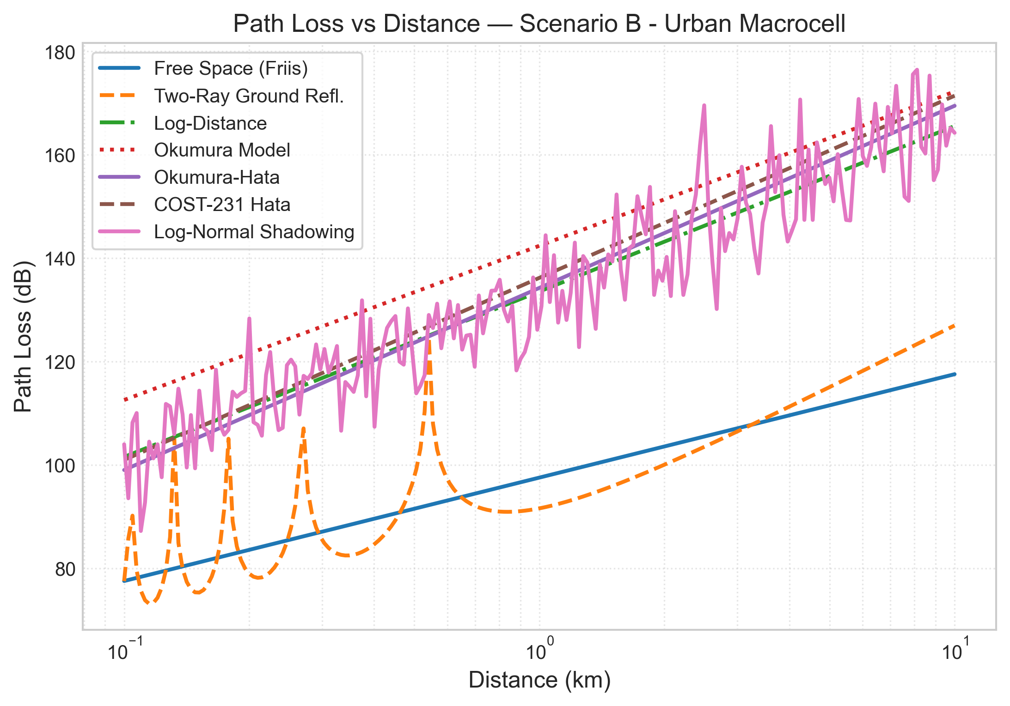
SIMULATION RESULTS
Finding 1: Path Loss vs Distance Across Models
• Evaluated under Urban Scenario B (1800 MHz, ht=30m, hr=1.5m).
• Friis Free Space predicts the lowest path loss (77.6 dB at 100m to 117.6 dB at 10km).
• COST-231 Hata and Okumura predict 101.0 dB to 171.4 dB across the same distance.
• Urban clutter adds an excess loss of 40 to 55 dB above theoretical free space.
• Two-Ray model shows destructive multipath ripples before dc, then transitions to steep d^-4 decay.

Slide 11
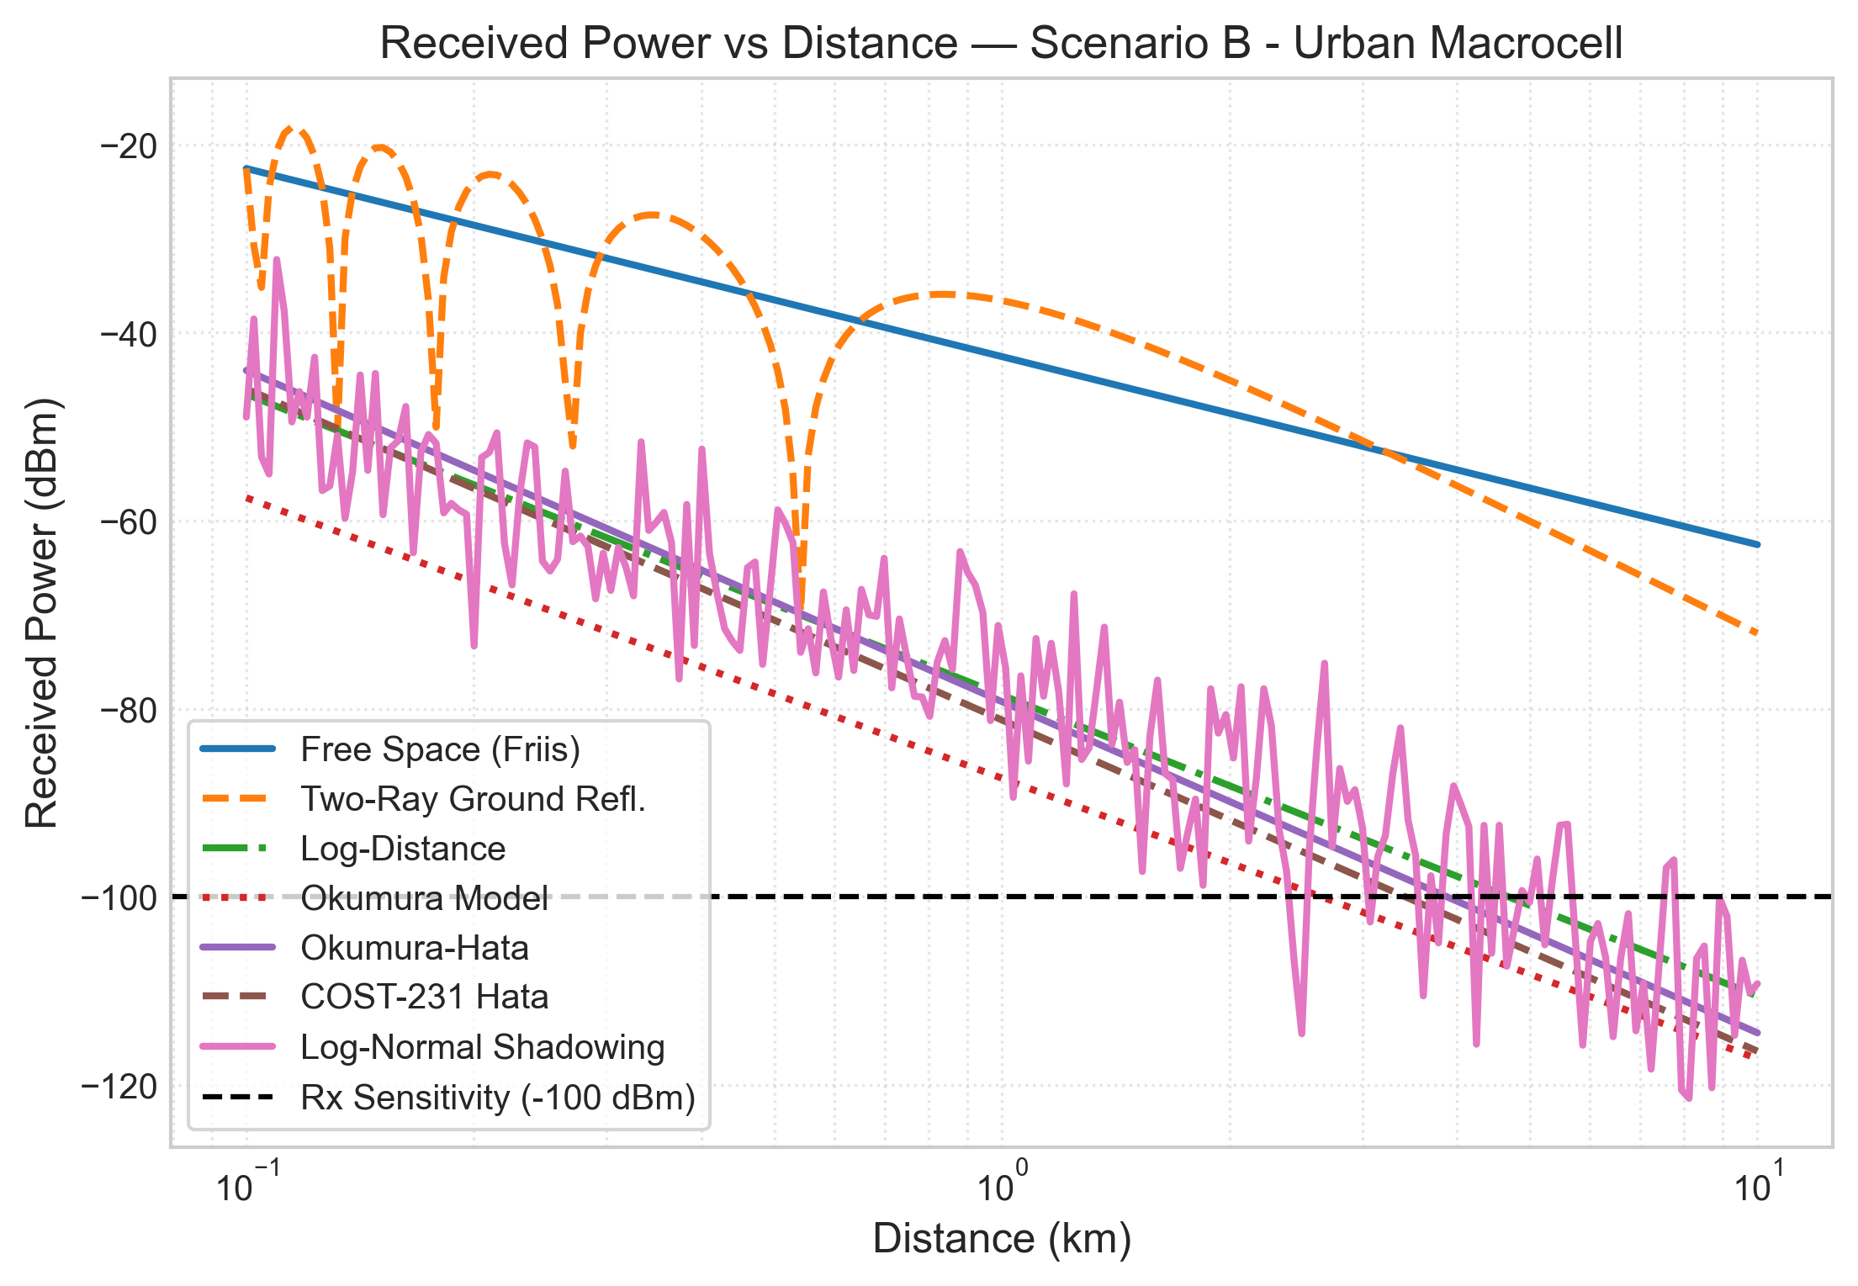
SIMULATION RESULTS
Finding 2: Received Power & Link Budget Analysis
• Link Budget Inputs: Pt = 43 dBm, Gt = 15 dBi, Gr = 0 dBi, Lsys = 3 dB (EIRP = 58 dBm).
• Receiver Sensitivity Threshold marked at -100 dBm.
• Under Free Space, received power at 10 km is -62.6 dBm (massive 37.4 dB excess margin).
• Under COST-231 Hata, signal drops below the -100 dBm threshold at approximately 4.2 km.
• Defines the practical maximum cell edge radius for reliable voice and broadband service.

Slide 12
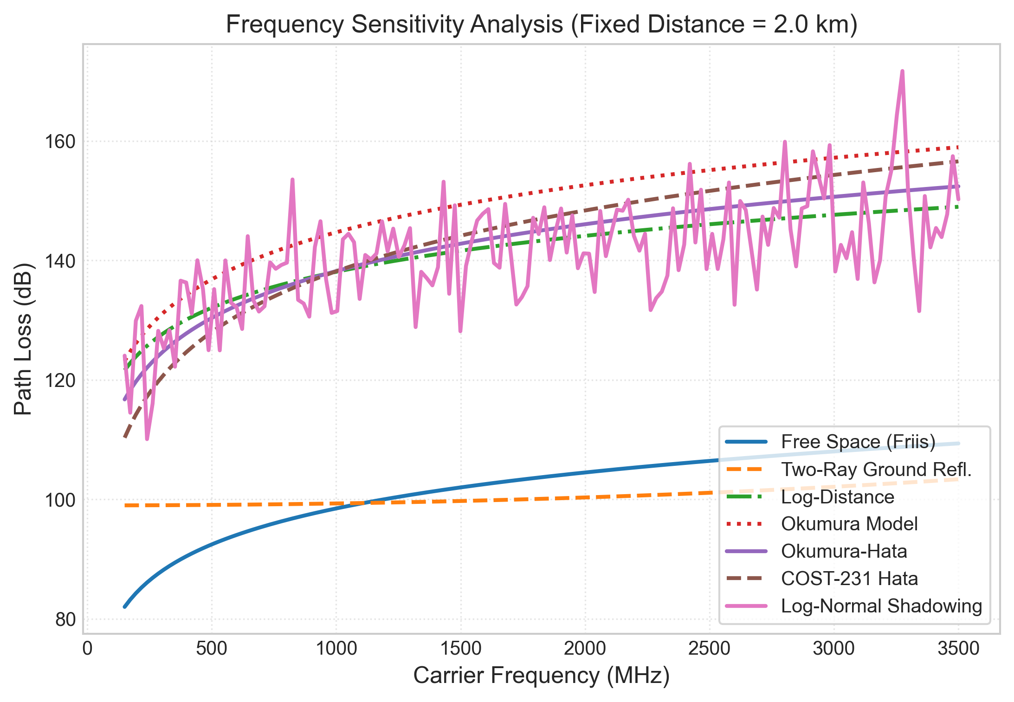
SENSITIVITY ANALYSIS
Finding 3: Carrier Frequency Sensitivity
• Carrier frequency swept from 150 MHz to 3.5 GHz at a fixed cell distance d = 2.0 km.
• Path loss increases monotonically with frequency in all empirical models.
• Free space scales as 20*log10(f), while COST-231 scales more steeply as 33.9*log10(f).
• Transitioning from 900 MHz (2G/4G low-band) to 3.5 GHz (5G mid-band) adds ~14 dB attenuation.
• Explains why 5G deployments require much denser base station placement.

Slide 13
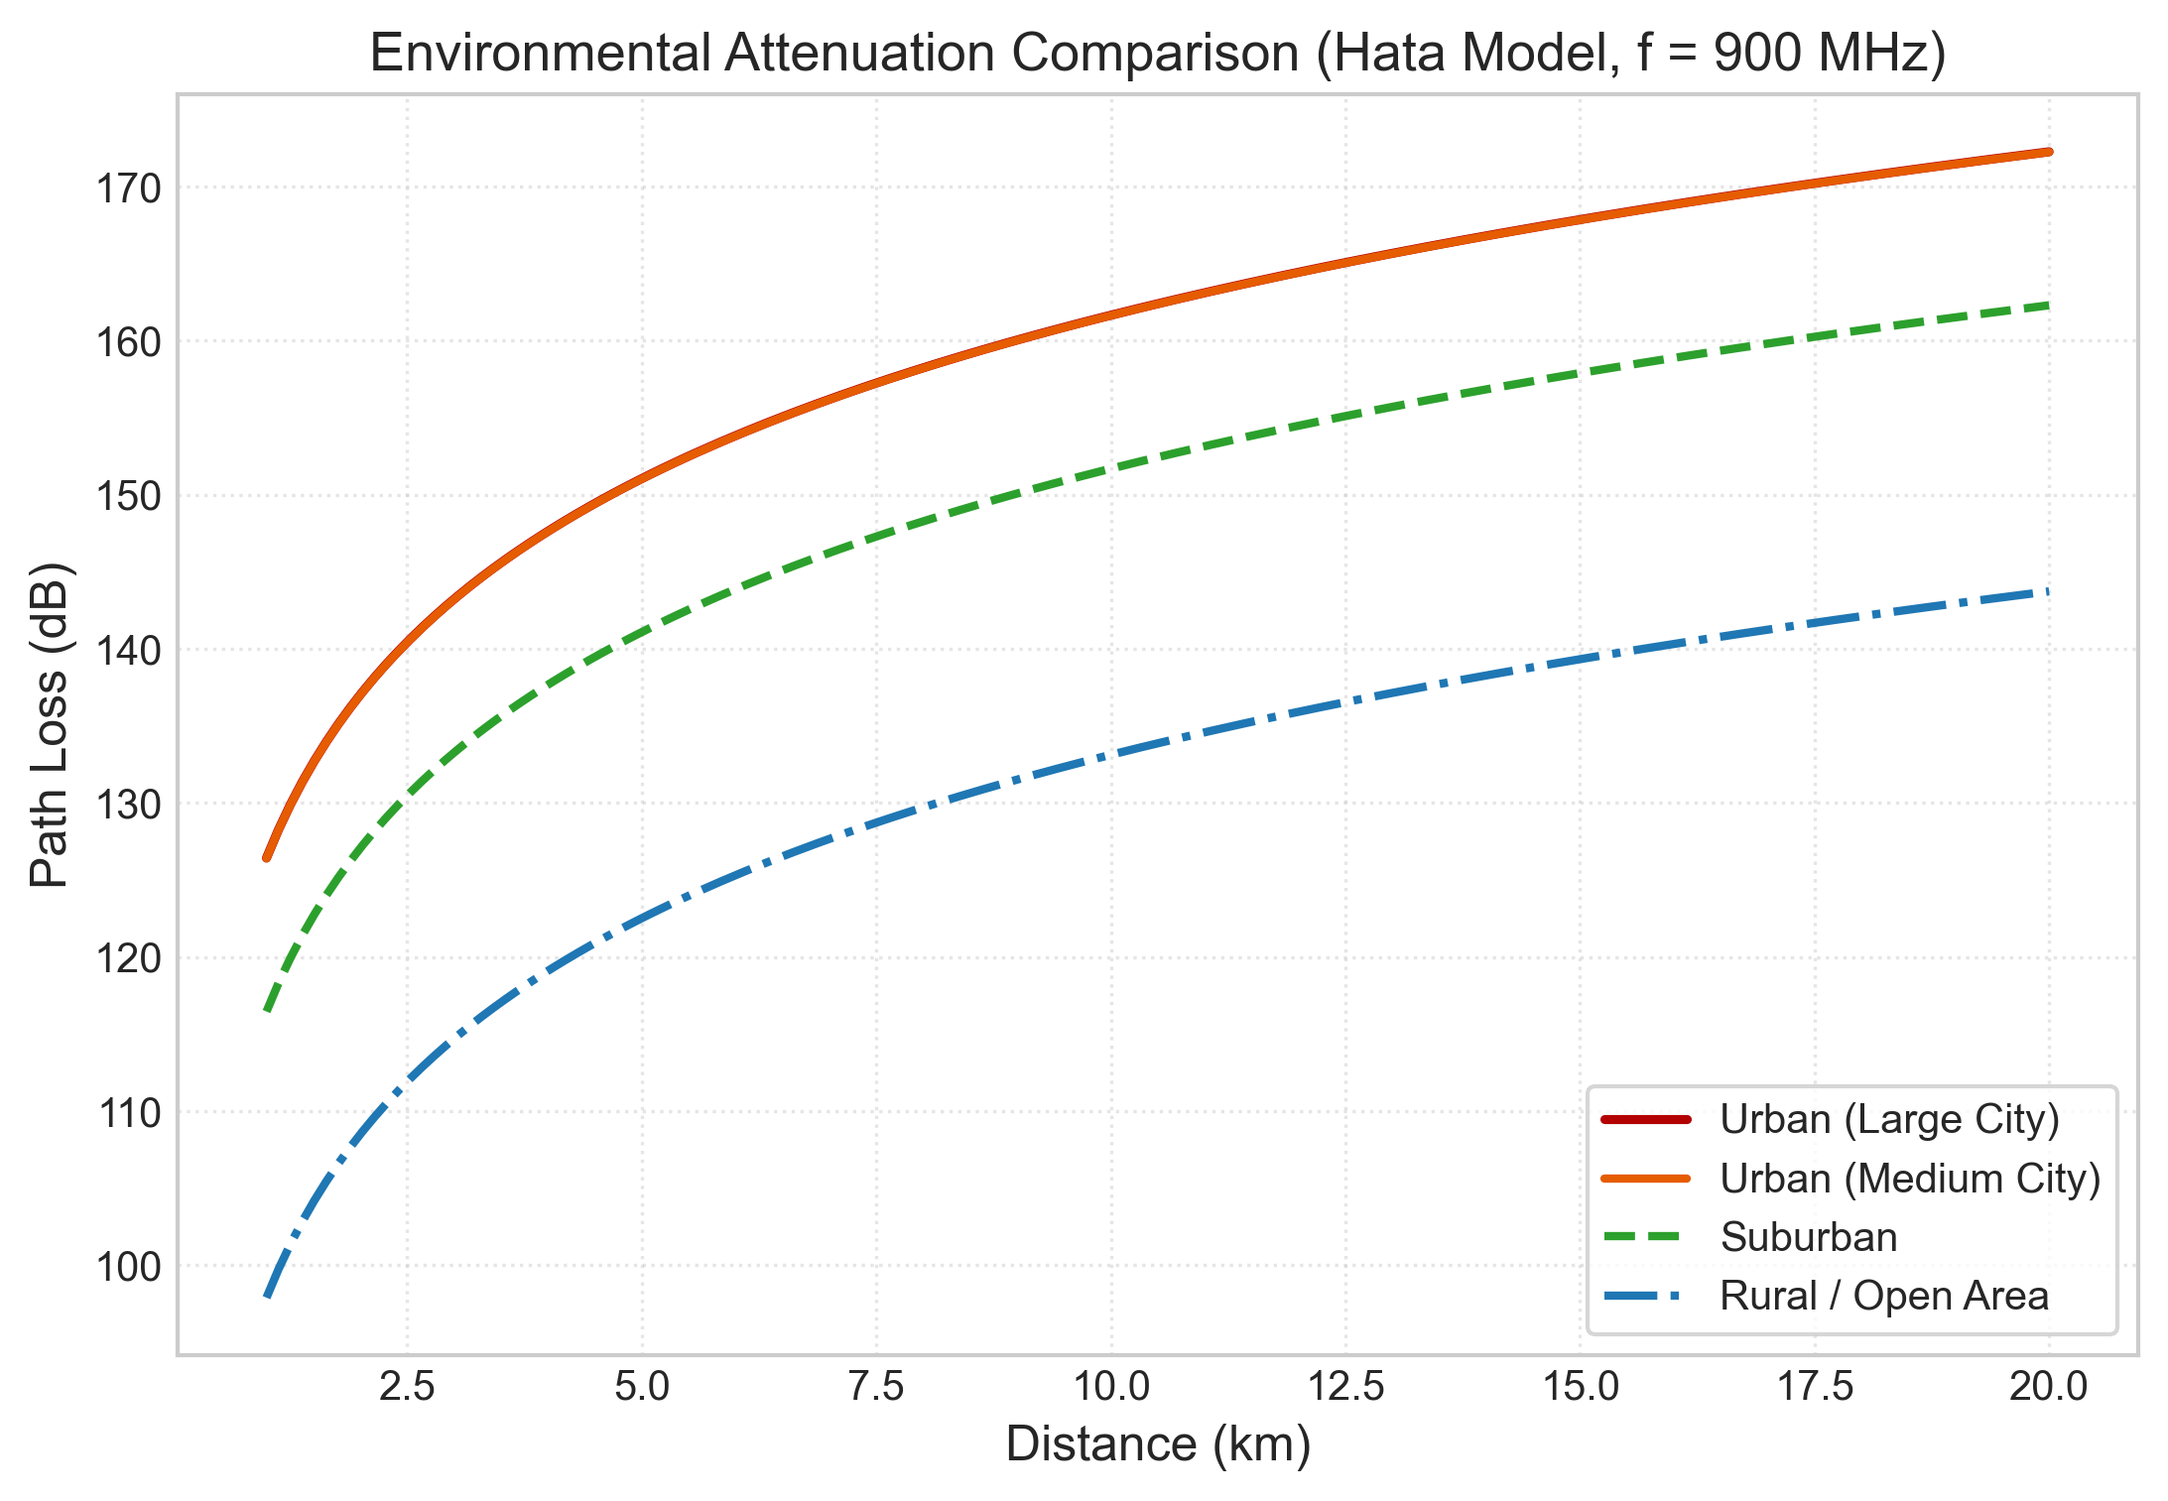
ENVIRONMENTAL ANALYSIS
Finding 4: Environmental Clutter Comparison
• Evaluated using Okumura-Hata at 900 MHz across four standard environments.
• Urban Large City: 146.2 dB at 10 km (highest loss due to concrete towers and canyon diffraction).
• Urban Medium City: 143.1 dB at 10 km.
• Suburban: 133.2 dB at 10 km (~10 dB lower loss than Urban Medium).
• Rural / Open Area: 115.1 dB at 10 km (~28 dB lower loss than Urban Medium).
• Confirms that open rural terrain provides nearly triple the line-of-sight coverage reach.

Slide 14
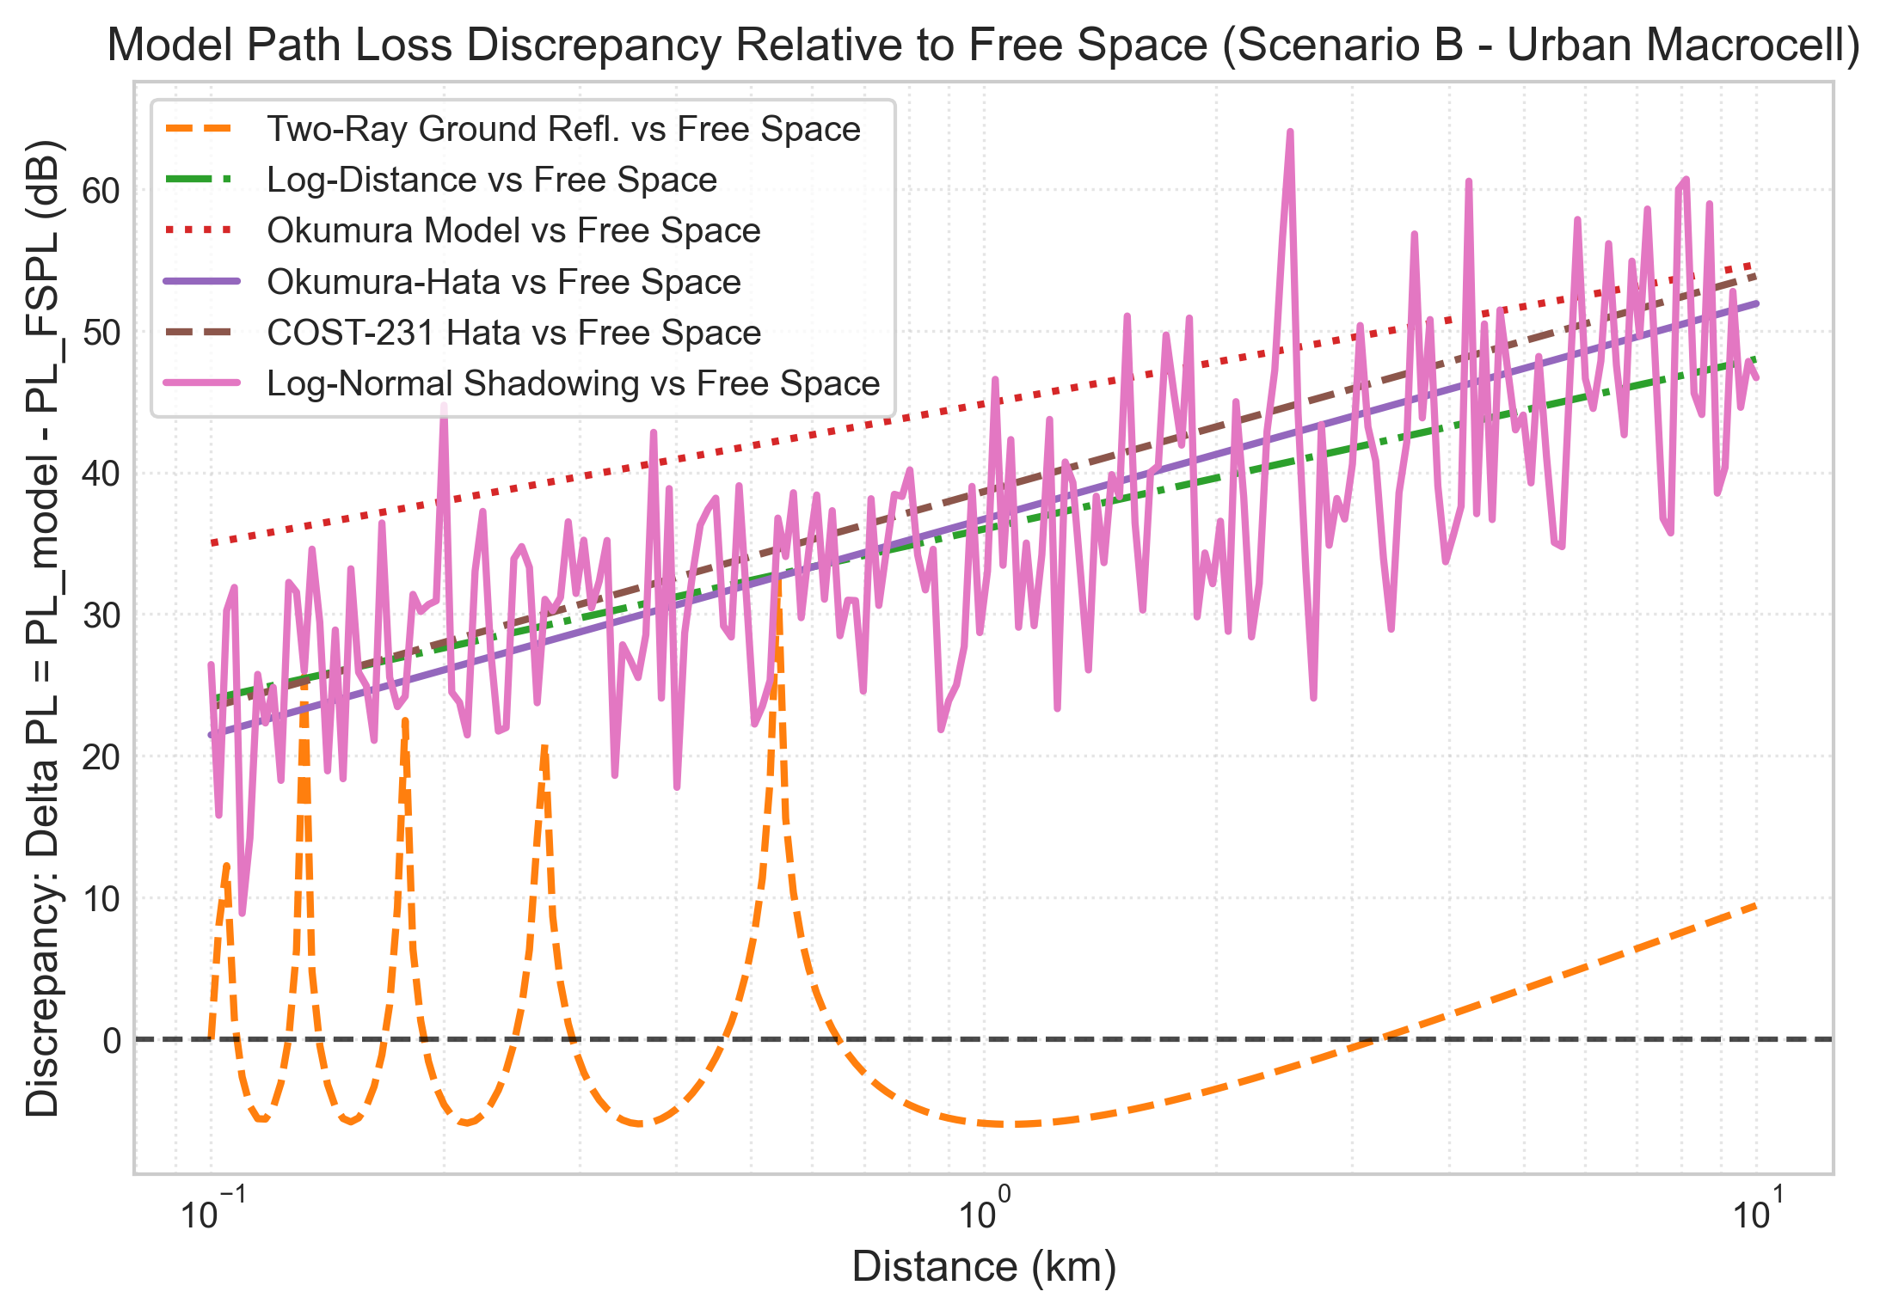
DISCREPANCY ANALYSIS
Finding 5: Model Discrepancy Relative to Free Space
• Pointwise excess path loss: Delta PL = PL_model - PL_FSPL (dB).
• Reveals the exact clutter penalty introduced by buildings, terrain, and multipath.
• At 1 km: Empirical models predict 36 to 45 dB excess loss over free space.
• At 10 km: Discrepancy widens to 52 to 55 dB due to cumulative obstacle shadowing.
• Demonstrates why using Free Space for terrestrial cellular planning leads to catastrophic design failures.

Slide 15
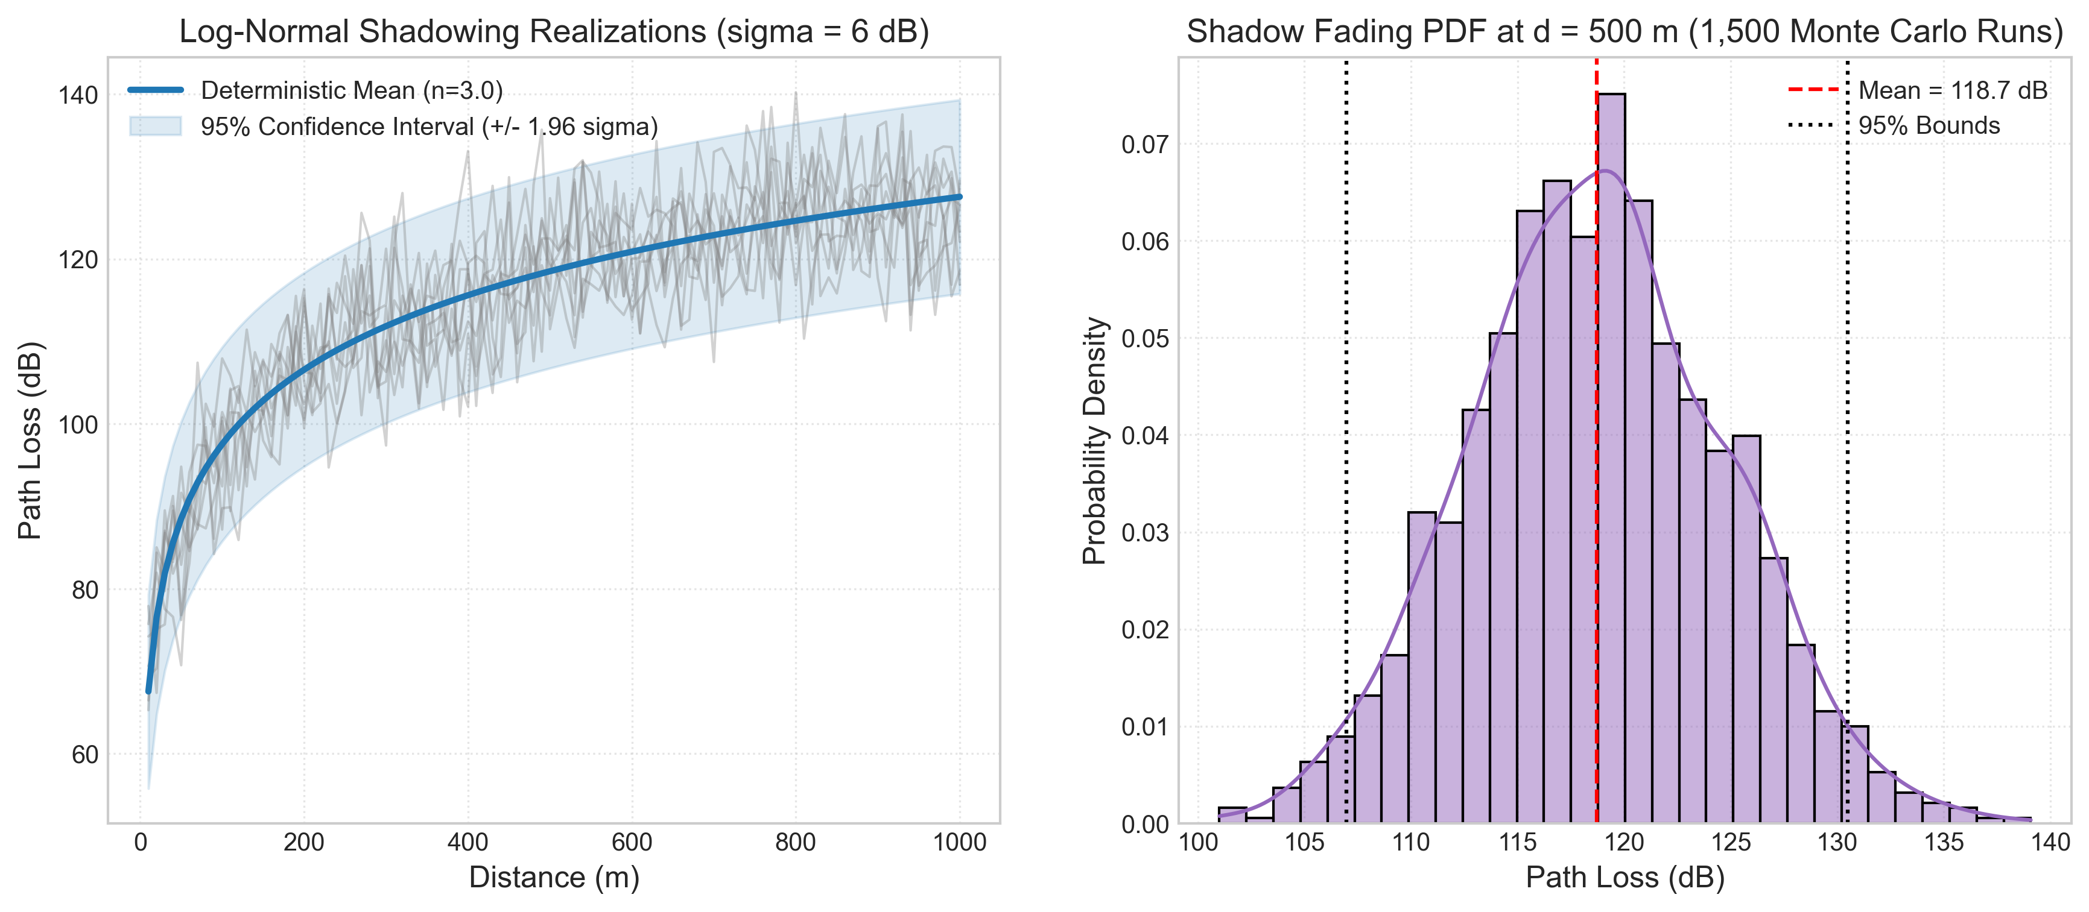
STOCHASTIC FADING
Finding 6: Log-Normal Shadowing & Outage Risk
• Captures random location-to-location clutter obstruction (sigma = 6 dB).
• Left plot: 8 Monte Carlo realization trajectories showing spatial variation around median.
• 95% Confidence Interval spans +/- 1.96 * sigma (+/- 11.76 dB in path loss).
• Right plot: Histogram of 1,500 Monte Carlo samples at d = 500m confirming Gaussian PDF in dB.
• To guarantee 95% link reliability, link budgets must provision an extra fade margin of at least 12–16 dB.

Slide 16
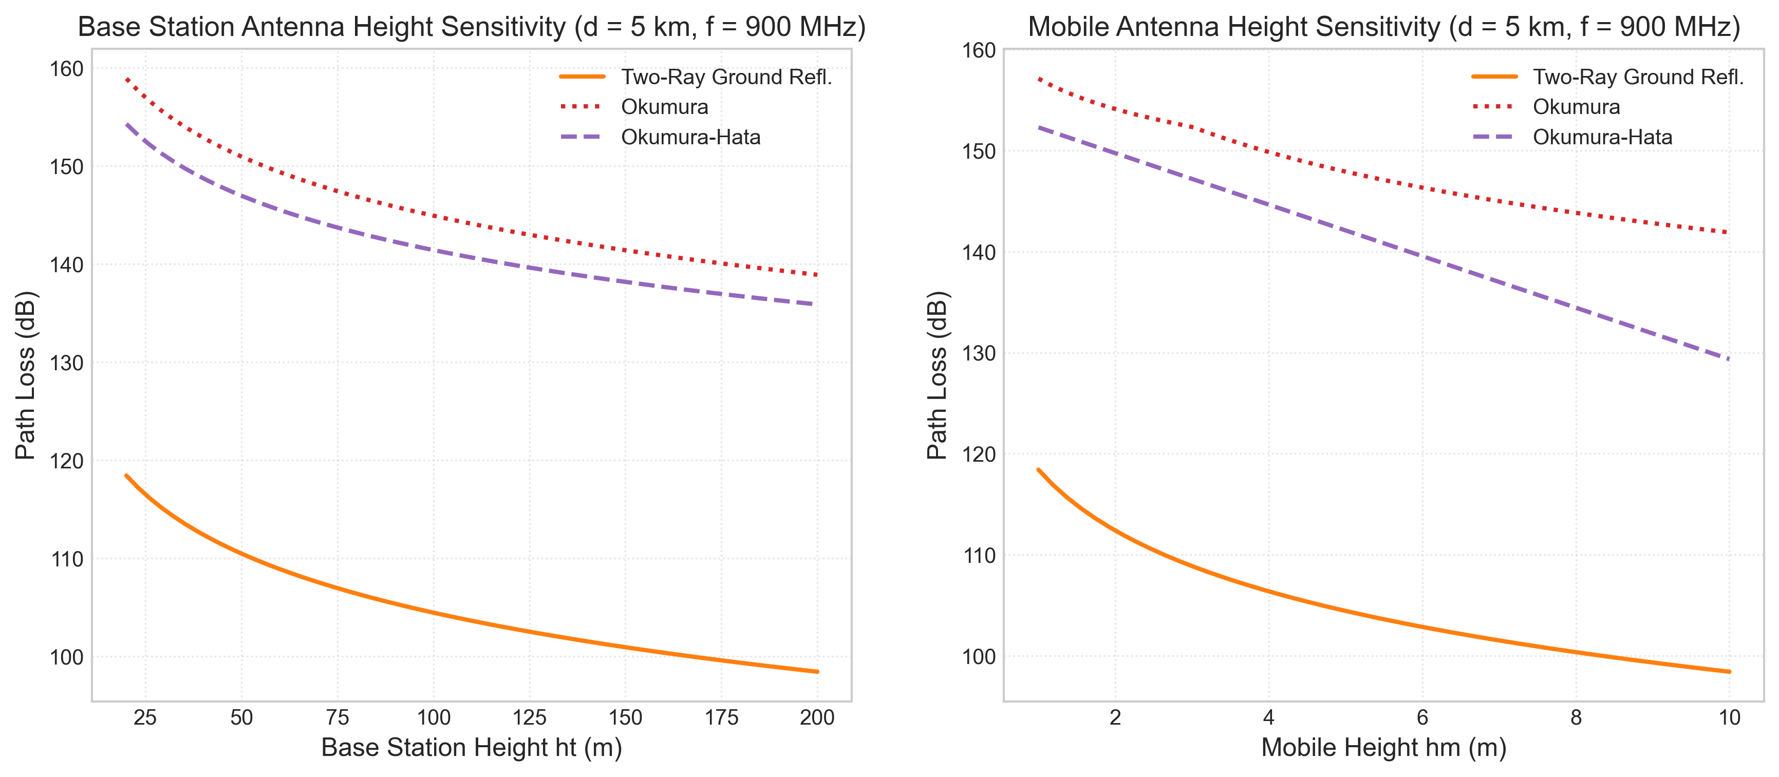
SENSITIVITY ANALYSIS
Finding 7: Antenna Height Sensitivity Analysis
• Left: Base station antenna height ht swept from 20 m to 200 m (d = 5 km, f = 900 MHz).
• Increasing base height from 30 m to 100 m reduces path loss by ~11 dB across Hata and Okumura.
• In Two-Ray asymptotic: Doubling height reduces loss by 20*log10(2) = 6.02 dB.
• Right: Mobile antenna height hm swept from 1.0 m to 10.0 m.
• Elevating user antenna from 1.5 m to 3.0 m yields a 3 dB link improvement in urban clutter.

Slide 17
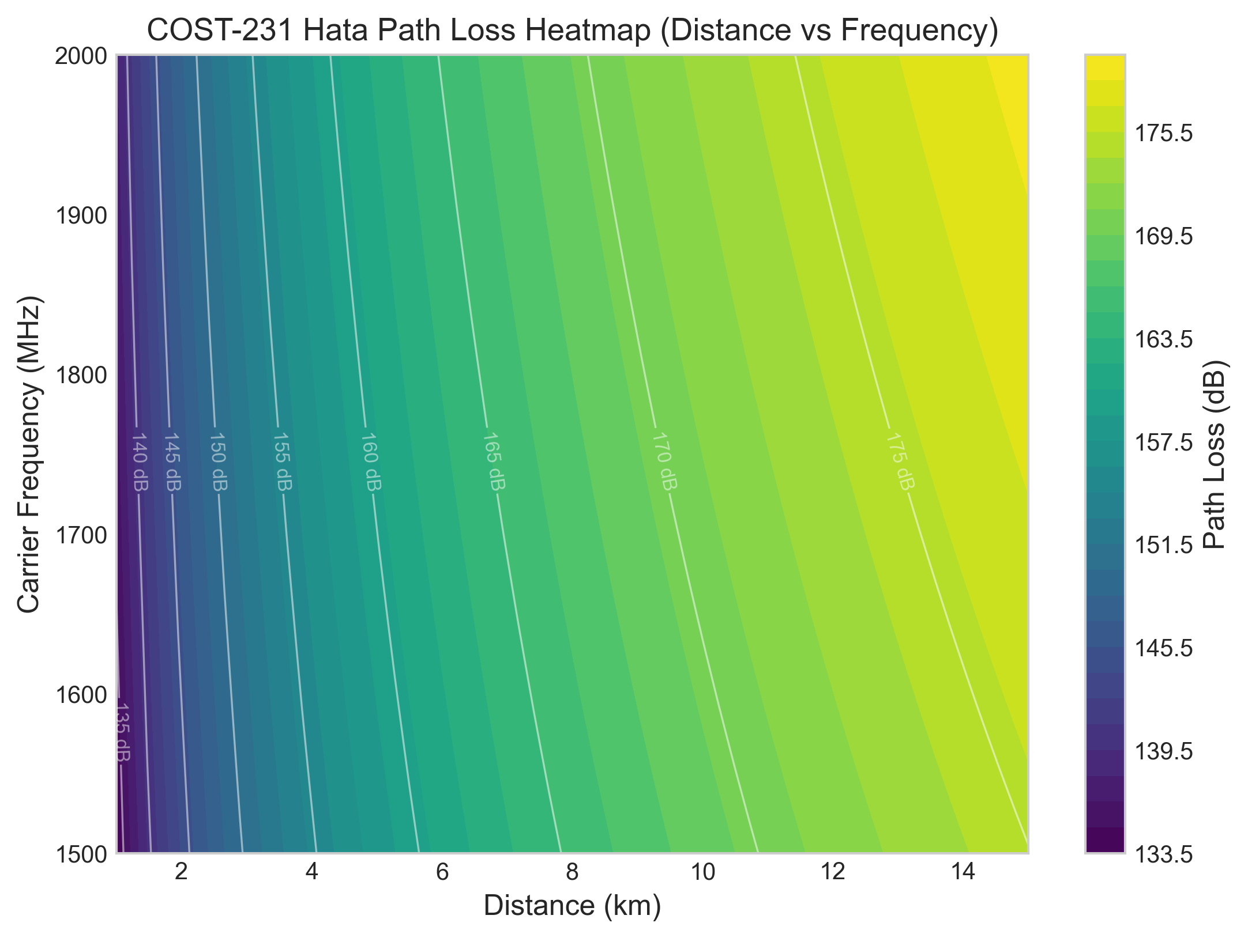
PARAMETER SPACE
Finding 8: 2D Parameter Space Heatmap
• Evaluates COST-231 Hata across a 2D meshgrid of Distance (1–15 km) and Frequency (1500–2000 MHz).
• Iso-path-loss contour lines show coupling between distance and carrier frequency.
• Operating at 10 km and 1500 MHz yields ~165 dB loss; the same 165 dB loss occurs at only 8.5 km at 2000 MHz.
• Visualizes cell shrink effect as carrier frequency increases across cellular allocations.

Slide 18
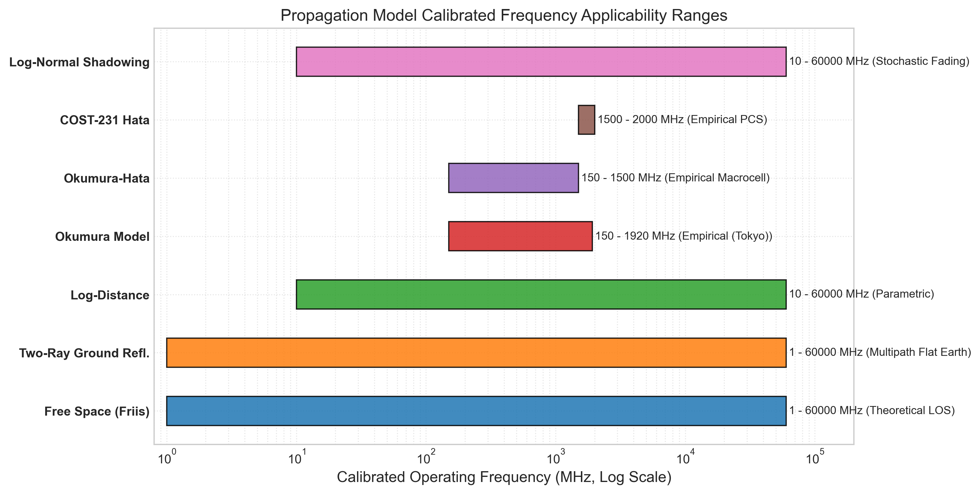
EMPIRICAL BOUNDS
Finding 9: Model Calibrated Operating Ranges
• Charts the calibrated frequency domain of each model on a logarithmic scale.
• Theoretical Models (FSPL, Two-Ray): Broadband applicable across VHF to mmWave.
• Okumura Model: Calibrated for 150 MHz to 1920 MHz (Tokyo macrocell).
• Okumura-Hata: Strictly capped at 1500 MHz.
• COST-231 Hata: Specifically tailored to 1500 MHz to 2000 MHz (PCS bands).
• Highlights the necessity of active warning flags when simulating 5G sub-6 GHz (3.5 GHz).

Slide 19
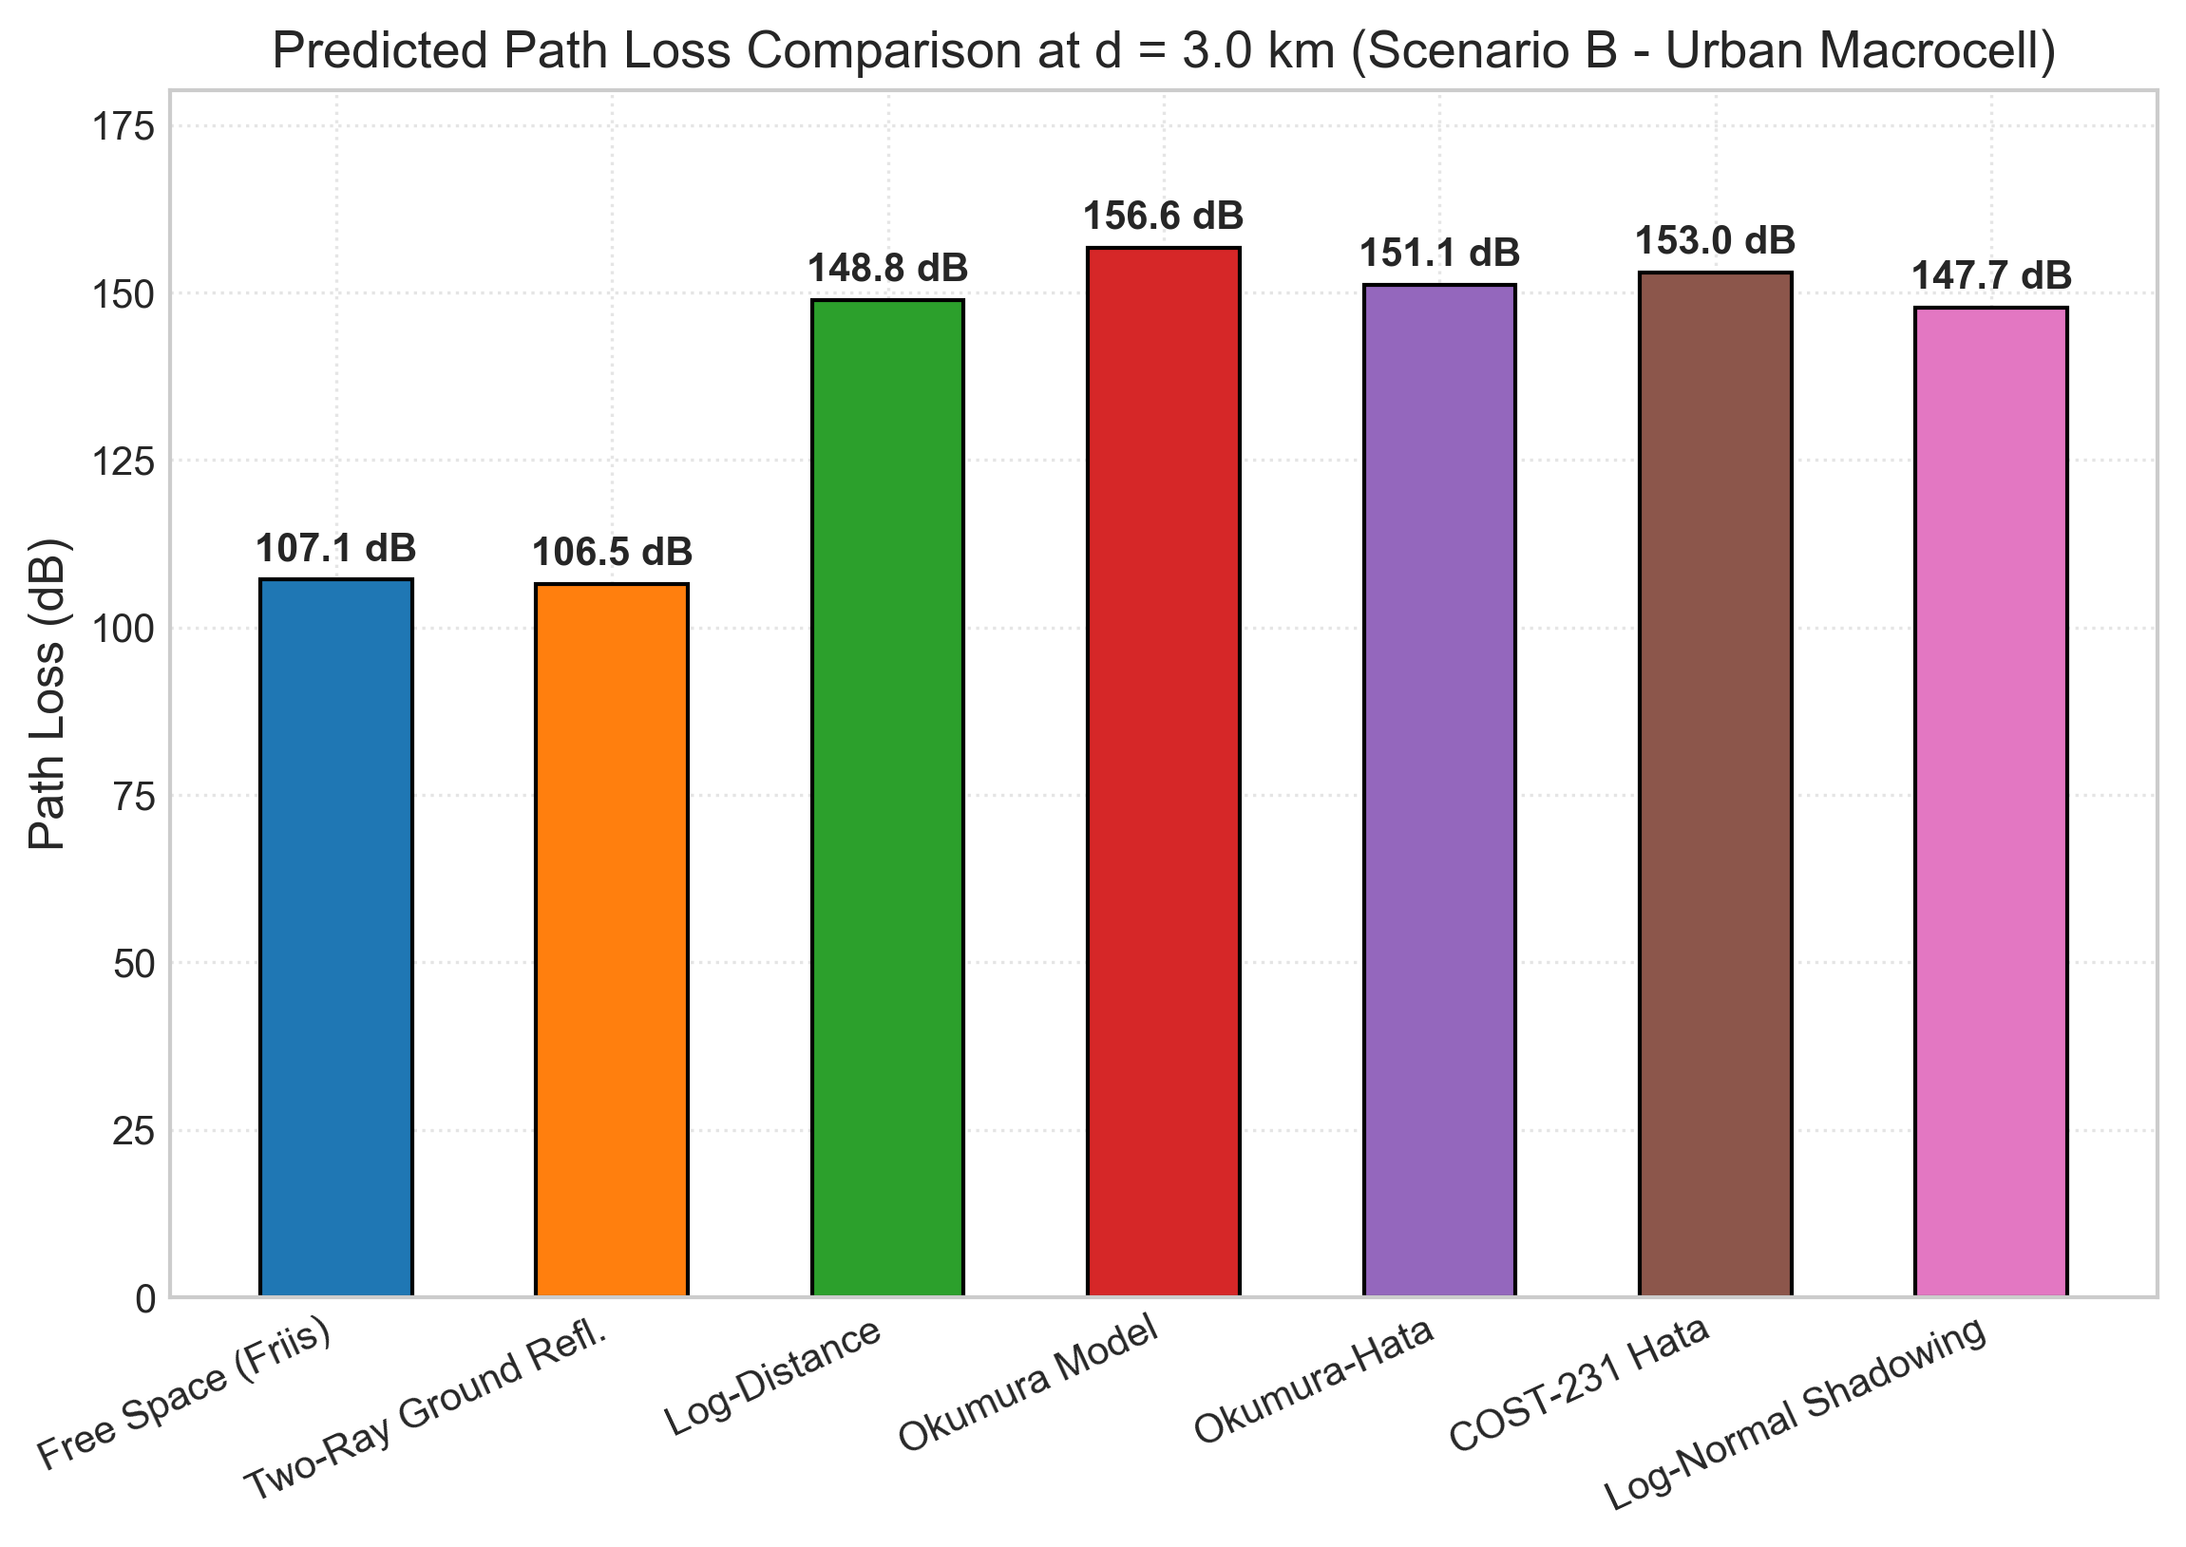
SYNTHESIS BENCHMARK
Finding 10: Benchmark Path Loss at 3 km Cell Edge
• Direct comparison at typical macrocell edge radius (d = 3.0 km, f = 1800 MHz, Urban):
• • Free Space (Friis): 107.1 dB (underpredicts loss by ~48 dB)
• • Two-Ray Ground Refl.: 108.6 dB (near crossover distance dc = 3.39 km)
• • Log-Distance (n=3.2): 150.3 dB
• • Okumura-Hata: 153.8 dB
• • COST-231 Hata: 155.8 dB (realistic urban macrocell benchmark)
• • Okumura Model: 158.0 dB (signal drops below -100 dBm sensitivity)

Slide 20
CONCLUSIONS & EXTENSIONS
Key Conclusions and Future Research Directions
• 1. Discrepancy Magnitude: Models diverge by up to 55 dB under identical parameters, underscoring the critical need for scenario-matched model selection.
• 2. Environmental Clutter: Urban terrain penalizes link budgets by ~28 dB relative to rural open space, and ~10 dB relative to suburban areas.
• 3. Fade Margin Requirement: Log-normal shadow fading (sigma = 8 dB) demands a 15.7 dB margin to maintain 97.5% cell-edge coverage reliability.
• 4. Software Deliverables: Fully tested Python library, CLI, 10 publication figures, Jupyter notebooks, hardcopy PDF report, and Streamlit dashboard.
• 5. Future Extensions:
• • Implementation of 3GPP TR 38.901 3D channel models (UMi / UMa) for 5G/6G sub-6 GHz and mmWave.
• • Integration of OpenStreetMap GIS building polygons for 3D ray-tracing.
• • Machine-learning channel prediction using Graph Neural Networks (GNNs).

