Slide 1
CAPSTONE PROJECT DEFENSE & EVALUATION
Comparative Analysis of Wireless Signal Propagation Models
Theoretical Derivations, Empirical Validations, and Numerical Simulations across Multi-Band Channels
PROJECT TEAM MEMBERS:
1. Harsh Yadav — Reg No: RA2311003011546
2. Utkarsh Dabas — Reg No: RA2311003011550
3. Tamanna Singh — Reg No: RA2311003011570
Department of Electronics & Communication Engineering | Academic Year 2025–2026

Slide 2
ACADEMIC RESEARCH PRESENTATION
Introduction to Wireless Signal Propagation
• Radio Frequency (RF) signals undergo severe physical degradation between transmitter and receiver.
• Primary propagation mechanisms include Free Space Loss, Specular Reflection, Diffraction over building edges, and Clutter Absorption.
• Radio channel models provide the mathematical foundation for cell sizing, link budgets, and interference mitigation.
• Engineers classify models into three families: Theoretical (Maxwell/optics), Empirical (measurement fits), and Stochastic (fading).
• Selecting an inappropriate model leads to severe network coverage blackspots or excessive interference.

Slide 3
ACADEMIC RESEARCH PRESENTATION
Problem Statement & Research Motivation
• Theoretical models (Friis FSPL) ignore multipath and terrain clutter, severely underpredicting path loss.
• Classical empirical models (Okumura, Hata) are strictly calibrated up to 1.5 - 2.0 GHz and distances >= 1 km.
• Modern cellular systems operate across sub-6 GHz (3.5 GHz) and microcells (< 1 km), where classical models produce out-of-domain extrapolation errors.
• Network planners lack a unified, reproducible framework that compares all standard models under identical link budget parameters.
• Objective: Build an open-source, mathematically verified framework to quantify model discrepancies and boundaries.

Slide 4
ACADEMIC RESEARCH PRESENTATION
Project Scope and Core Objectives
• 1. Implement 7 distinct propagation models adhering to a unified, vectorized Python interface.
• 2. Implement standard RF link budget calculations (EIRP, Received Power, Fade Margin).
• 3. Evaluate model behavior across 5 controlled scenarios (Urban, Suburban, Rural, Indoor, 5G Mid-band).
• 4. Quantify model divergence, percentage differences, and parameter sensitivity (antenna heights, frequencies).
• 5. Characterize shadow fading through Monte Carlo realizations and closed-form outage probabilities.
• 6. Ensure 100% reproducibility via automated pytest suites and YAML-based experiment pipelines.

Slide 5
ACADEMIC RESEARCH PRESENTATION
Fundamental Electromagnetic Concepts & Unit Safety
• Wavelength & Frequency: lambda = c / f, where c = 299,792,458 m/s.
• Effective Antenna Aperture: Ae = lambda^2 / (4 * pi). Higher frequency reduces effective aperture.
• Path Loss Exponent (n): Governs the rate of power decay (n=2 in vacuum, n=3-4 in urban canyons, n=4 in ground multipath).
• Decibel Notation: Power in dBm = 10 * log10(Power in mW). Decibels allow linear addition across the RF link.
• Link Equation: Pr (dBm) = Pt (dBm) + Gt (dBi) + Gr (dBi) - PL (dB) - L_sys (dB).

Slide 6
ACADEMIC RESEARCH PRESENTATION
Overview of the Seven Implemented Models
• 1. Free Space Path Loss (Friis): Ideal unobstructed line-of-sight vacuum baseline.
• 2. Two-Ray Ground Reflection: Direct LOS + earth reflection, exhibiting d^-4 decay beyond dc.
• 3. Log-Distance Model: Generalized parametric model with environment-dependent exponent n.
• 4. Okumura Model: Classical graphical Tokyo macrocell model (150 - 1920 MHz).
• 5. Okumura-Hata Model: Analytical closed-form equations for urban, suburban, and rural cells.
• 6. COST-231 Hata Model: European PCS extension covering 1500 - 2000 MHz with city factor CM.
• 7. Log-Normal Shadowing: Stochastic model combining distance decay with Gaussian clutter noise.

Slide 7
ACADEMIC RESEARCH PRESENTATION
Mathematical Equations and Conventions
• FSPL (dB) = 20*log10(d) + 20*log10(f) + 20*log10(4*pi / c)
• Two-Ray Asymptotic: PL (dB) = 40*log10(d) - 20*log10(ht) - 20*log10(hr)
• Two-Ray Crossover: dc = (4 * pi * ht * hr) / lambda
• Log-Distance: PL(d) = PL(d0) + 10*n*log10(d / d0)
• Hata Urban: PL = 69.55 + 26.16*log10(f) - 13.82*log10(hb) - a(hm) + [44.9 - 6.55*log10(hb)]*log10(d)
• COST-231 Hata: PL = 46.3 + 33.9*log10(f) - 13.82*log10(hb) - a(hm) + [44.9 - 6.55*log10(hb)]*log10(d) + CM
• Shadowing Outage: P_outage = 0.5 * erfc( (Pr_mean - Sensitivity) / (sqrt(2) * sigma) )

Slide 8
ACADEMIC RESEARCH PRESENTATION
Software Architecture and Methodology
• Modular OOP Design: 'PropagationModel' base class guarantees strict interface polymorphism.
• NumPy Vectorization: Eliminates python loops, enabling real-time array evaluations over thousands of points.
• Active Boundary Validation: Emits 'ModelRangeWarning' when parameters exceed calibration bounds.
• Reproducible Experiments: Predefined YAML scenarios dictate exact transmitter, antenna, and channel inputs.
• Automated Testing Suite: 32 pytest unit and integration tests guarantee numerical and physical correctness.

Slide 9
ACADEMIC RESEARCH PRESENTATION
Controlled Experimental Scenarios
• Scenario A (Rural): f = 900 MHz, d = 0.1-20 km, ht = 45 m, hr = 1.5 m, Pt = 46 dBm (High-power macrocell).
• Scenario B (Urban): f = 1800 MHz, d = 0.1-10 km, ht = 30 m, hr = 1.5 m, Pt = 43 dBm (PCS cellular macrocell).
• Scenario C (Suburban): f = 1800 MHz, d = 0.1-15 km, ht = 35 m, hr = 1.5 m, Pt = 43 dBm (Residential area).
• Scenario D (Indoor): f = 2.4 GHz, d = 1-100 m, ht = 2.5 m, hr = 1.0 m, Pt = 20 dBm (WLAN / Small cell).
• Scenario E (5G Mid-Band): f = 3.5 GHz, d = 0.05-5 km, ht = 15 m, hr = 1.5 m, Pt = 38 dBm (C-Band microcell).

Slide 10
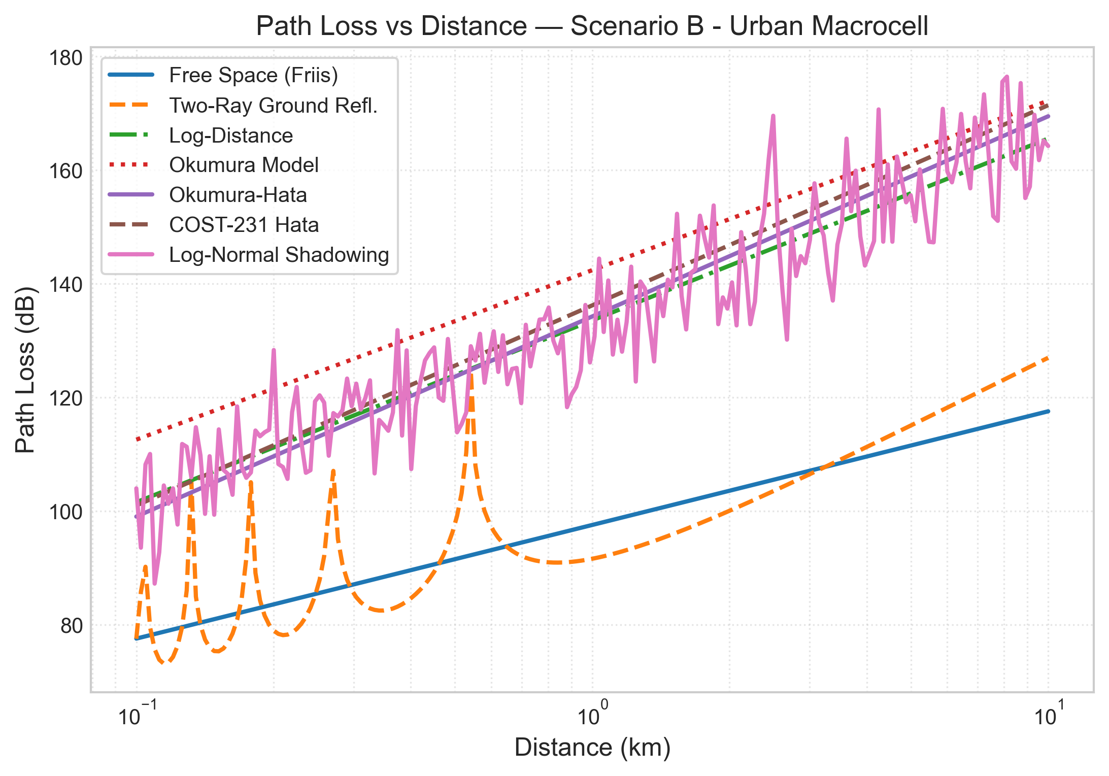
ACADEMIC RESEARCH PRESENTATION
Numerical Finding 1: Path Loss vs Distance
• Friis Free Space predicts the lowest path loss (77.6 to 117.6 dB).
• Urban empirical models (COST-231, Okumura) predict 101 to 172 dB.
• Clutter penalty exceeds 50 dB at a 10 km cell edge.
• Two-Ray model shows multipath ripples before d_c, then rolls off at 40 dB/dec.

Slide 11
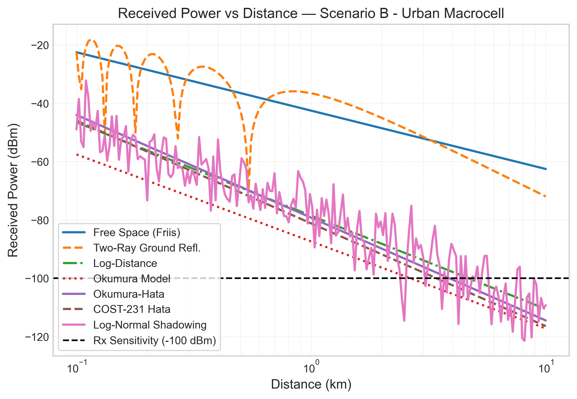
ACADEMIC RESEARCH PRESENTATION
Numerical Finding 2: Received Power vs Distance
• EIRP = 58 dBm (Pt = 43 dBm, Gt = 15 dBi).
• Receiver sensitivity threshold marked at -100 dBm.
• Under Free Space, cell radius extends well beyond 10 km.
• Under COST-231 Hata, signal drops below threshold at ~4.2 km (cell edge limit).

Slide 12
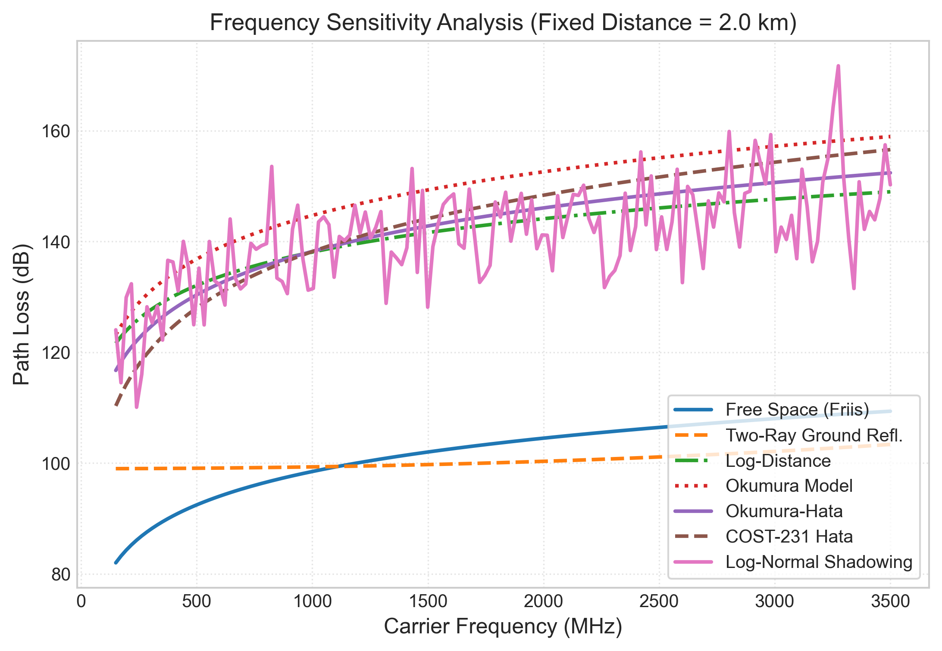
ACADEMIC RESEARCH PRESENTATION
Numerical Finding 3: Frequency Sensitivity
• Carrier frequency swept from 150 MHz to 3.5 GHz at fixed d = 2.0 km.
• Path loss increases with frequency: 20*log10(f) in FSPL and 33.9*log10(f) in COST-231.
• Scaling from 900 MHz to 3.5 GHz adds ~14 dB attenuation.
• Highlights the severe coverage penalty of high-frequency 5G bands.

Slide 13
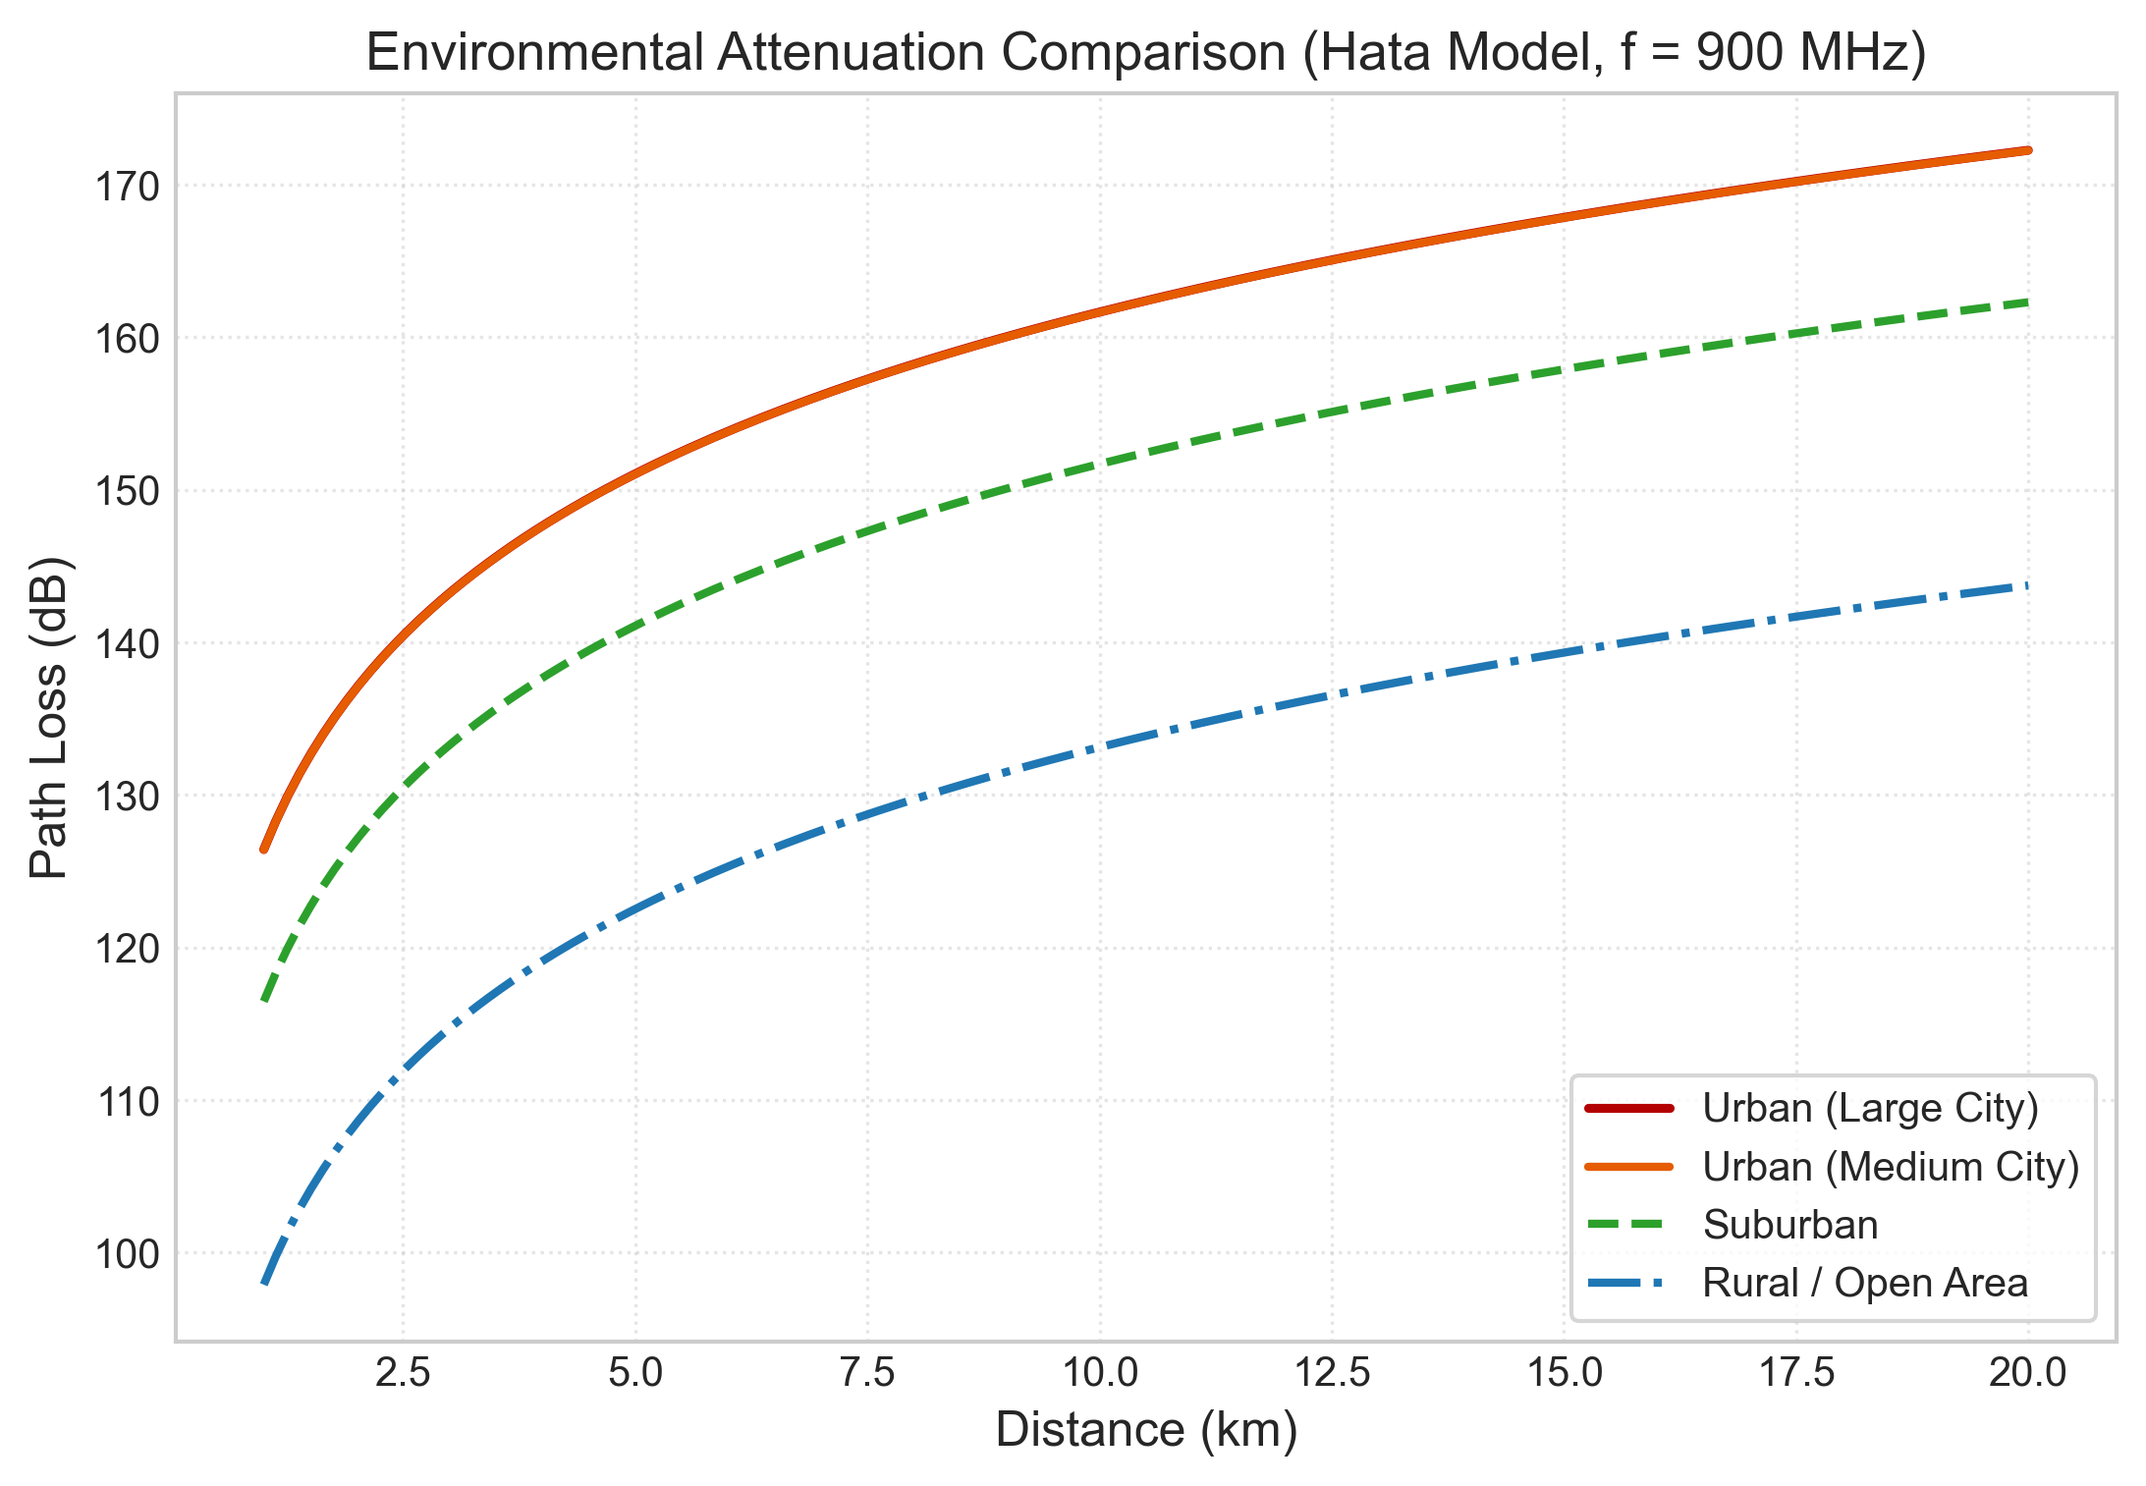
ACADEMIC RESEARCH PRESENTATION
Numerical Finding 4: Environmental Clutter Effects
• Hata formulation evaluated at 900 MHz across environments.
• Urban Large City: 146.2 dB at 10 km.
• Urban Medium City: 143.1 dB at 10 km.
• Suburban: 133.2 dB (~10 dB lower loss than Urban Medium).
• Rural Open: 115.1 dB (~28 dB lower loss than Urban Medium).

Slide 14
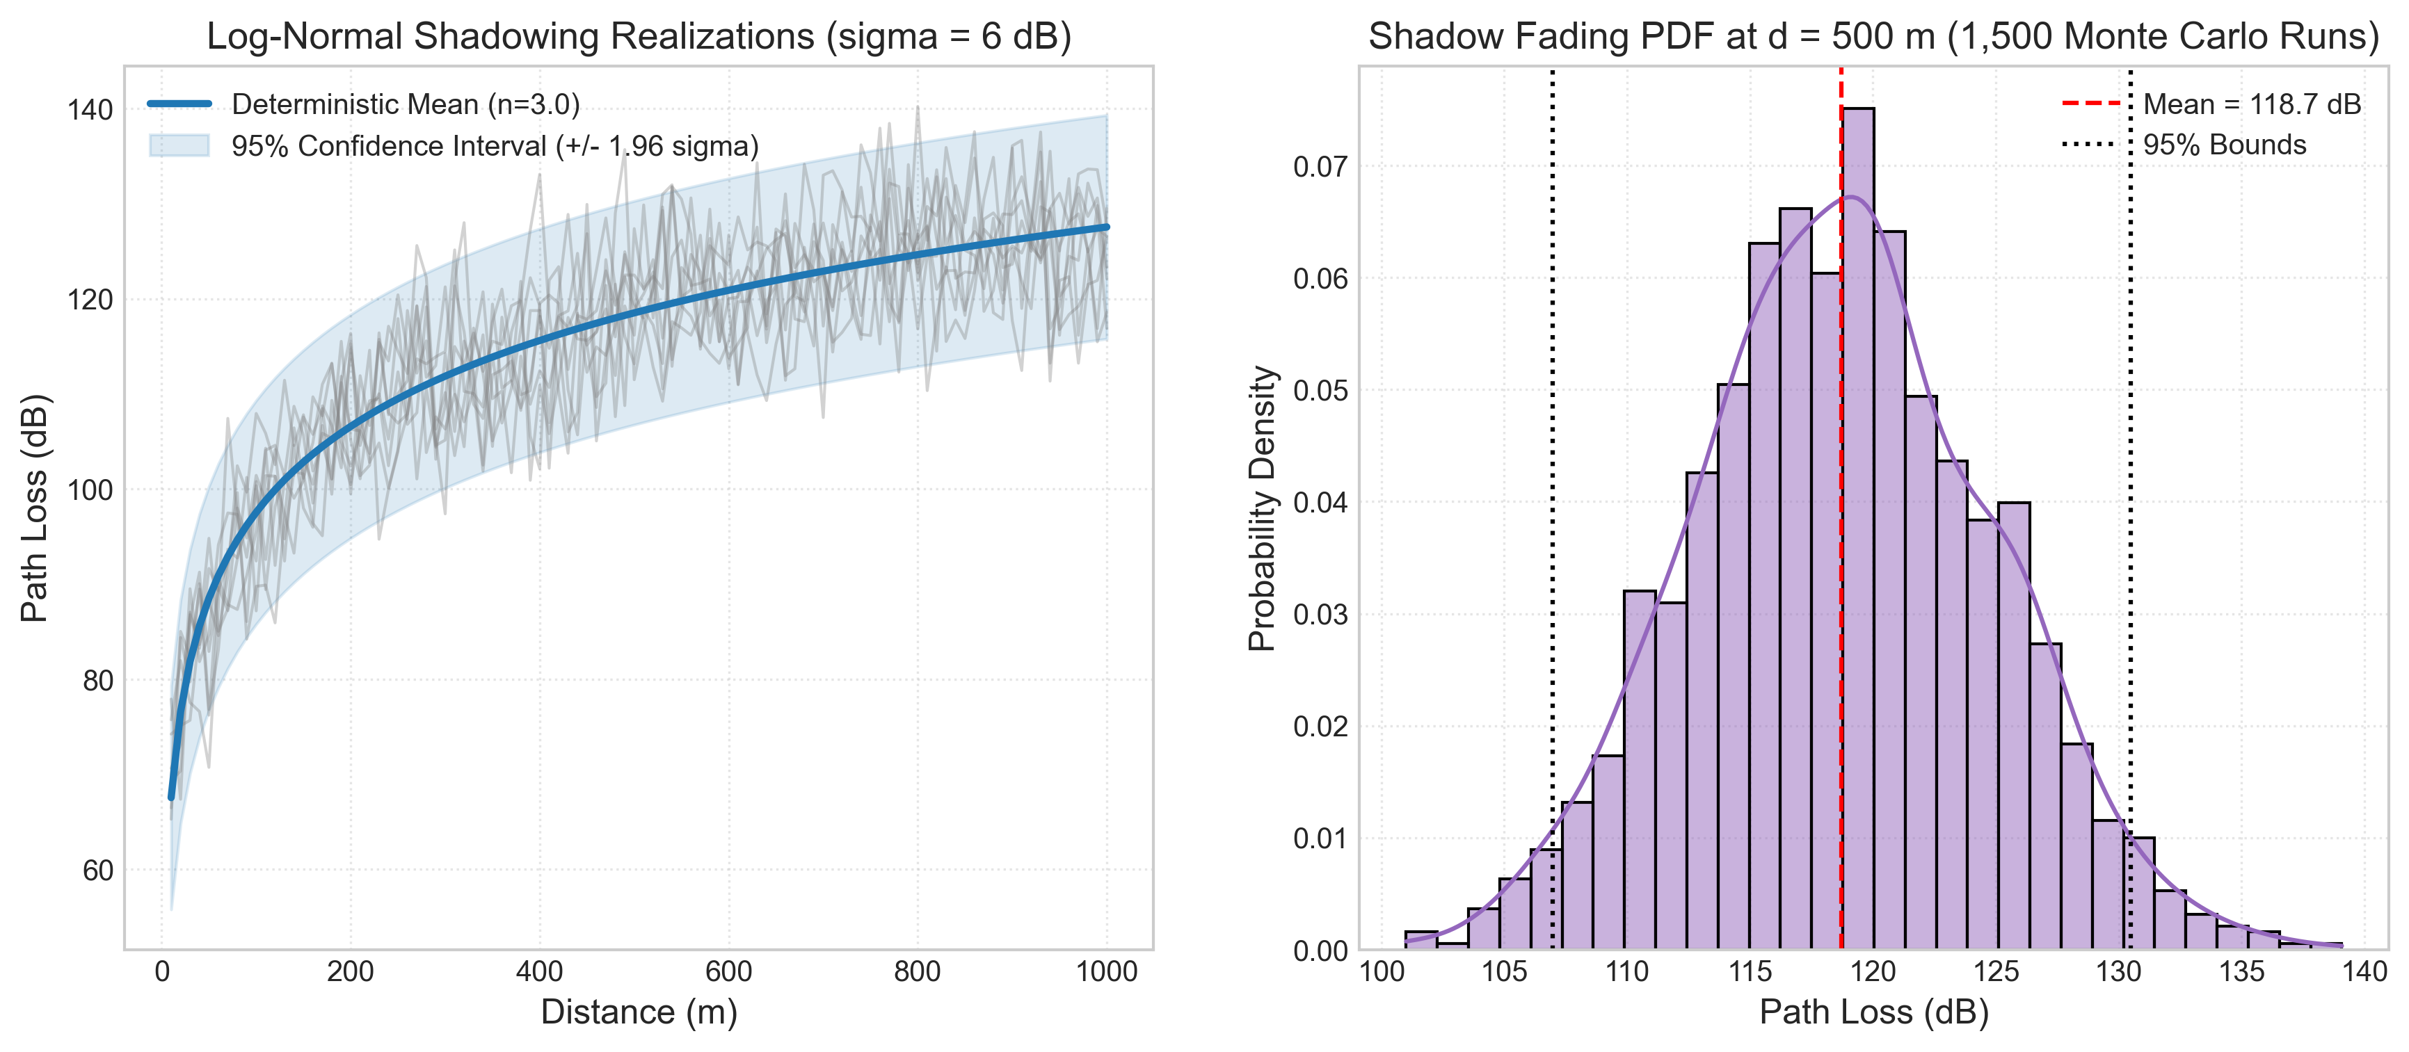
ACADEMIC RESEARCH PRESENTATION
Numerical Finding 5: Log-Normal Shadowing & Outage
• Simulates location-to-location clutter variation (sigma = 6 dB).
• Deterministic median path loss bounded by 95% confidence intervals (+/- 1.96 sigma).
• Monte Carlo analysis (1,500 runs) verifies a Gaussian PDF in decibels.
• Requires 12–16 dB fade margin to prevent cell-edge outages.

Slide 15
ACADEMIC RESEARCH PRESENTATION
Formal Comparative Analysis Matrix
Model | Classification | Calibrated Range | Primary Engineering Takeaway
Free Space | Theoretical | Broadband (d > 0) | Underestimates loss by 40-55 dB in cities
Two-Ray | Theoretical | 1 MHz - 60 GHz | Exhibits d^-4 decay beyond crossover distance dc
Log-Distance | Empirical | Calibrated range | Highly versatile through configurable exponent n
Okumura | Empirical | 150 - 1920 MHz, 1-100 km | Classical graphical standard; uncalibrated < 1 km
Okumura-Hata | Empirical | 150 - 1500 MHz, 1-20 km | Closed-form standard for 2G/3G macrocells
COST-231 Hata | Empirical | 1500 - 2000 MHz, 1-20 km | Standard for 1.8-2.0 GHz; invalid for 5G > 2 GHz
Shadow Fading | Stochastic | All frequencies | Requires 12-16 dB fade margin for 95% coverage

Slide 16
ACADEMIC RESEARCH PRESENTATION
Key Findings, Conclusions & Next Steps
• Discrepancy Magnitude: Models diverge by up to 55 dB under identical distance and frequency parameters.
• Model Suitability: Theoretical models provide vital physical bounds; empirical and stochastic models are essential for cellular planning.
• Extrapolation Danger: Empirical models (Hata, COST-231) cannot be naively applied to 5G C-Band (3.5 GHz) or mmWave.
• Complete Implementation: Fully tested Python library, CLI, 10 publication figures, Jupyter notebooks, hardcopy PDF report, and Streamlit dashboard.
• Future Enhancements: Integration of 3GPP TR 38.901 3D channel models, OpenStreetMap GIS ray tracing, and ML-based channel prediction.

