Slide 1

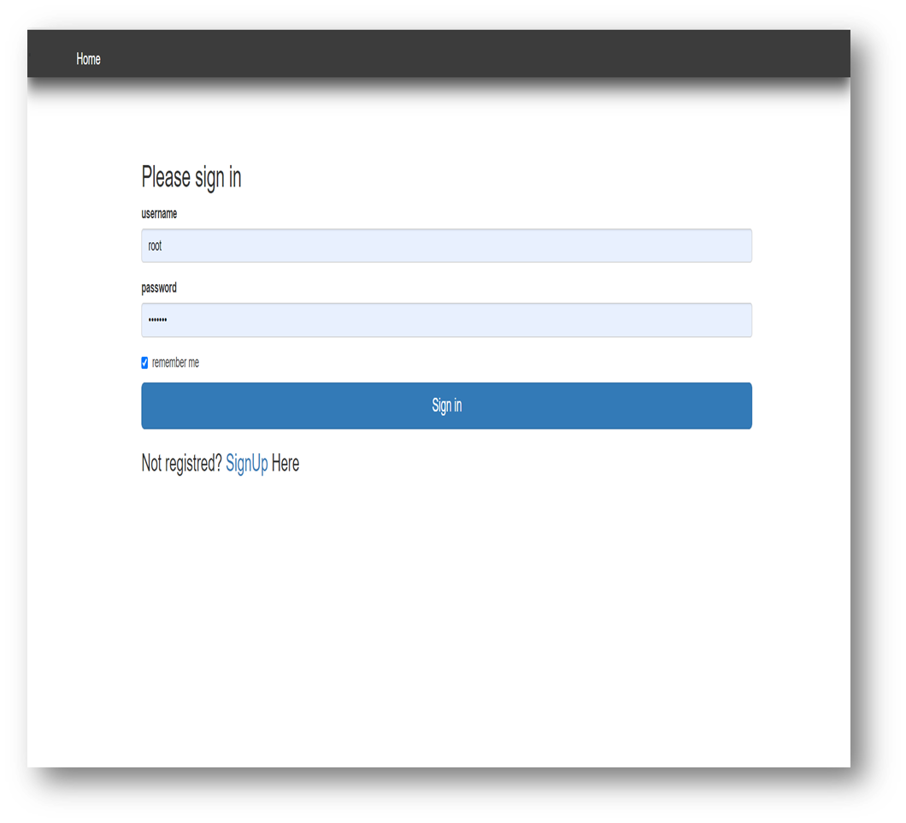
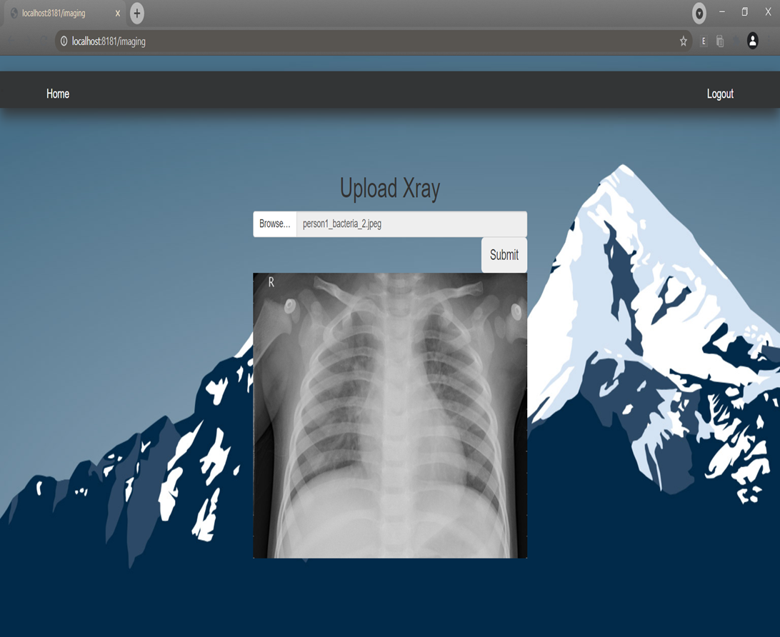
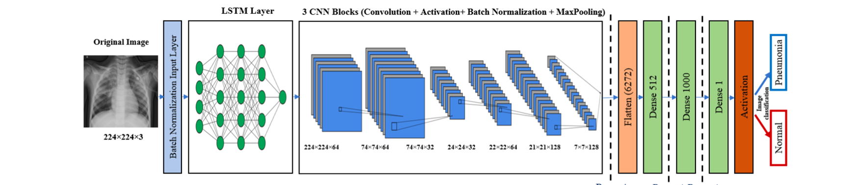
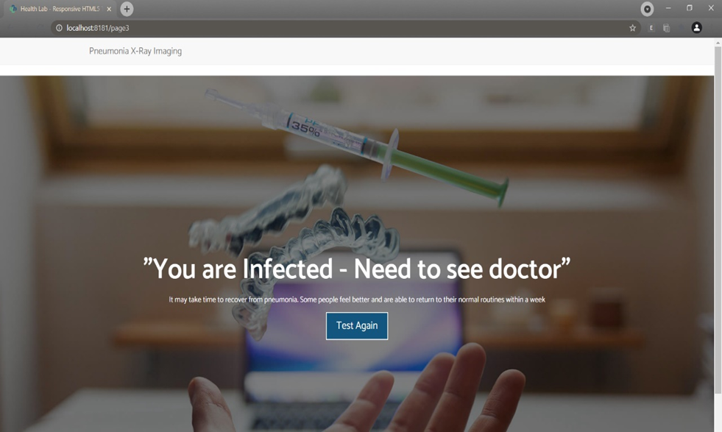
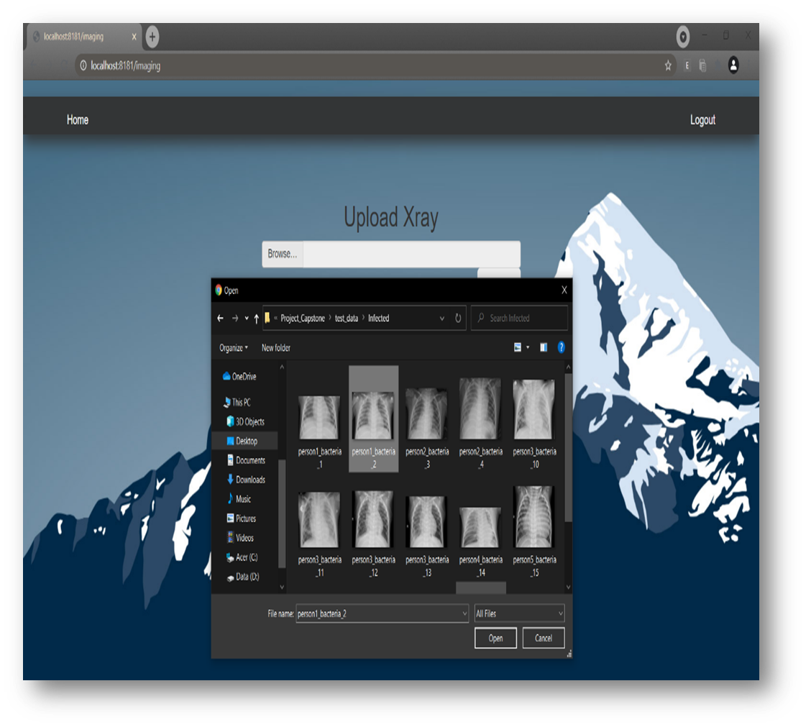
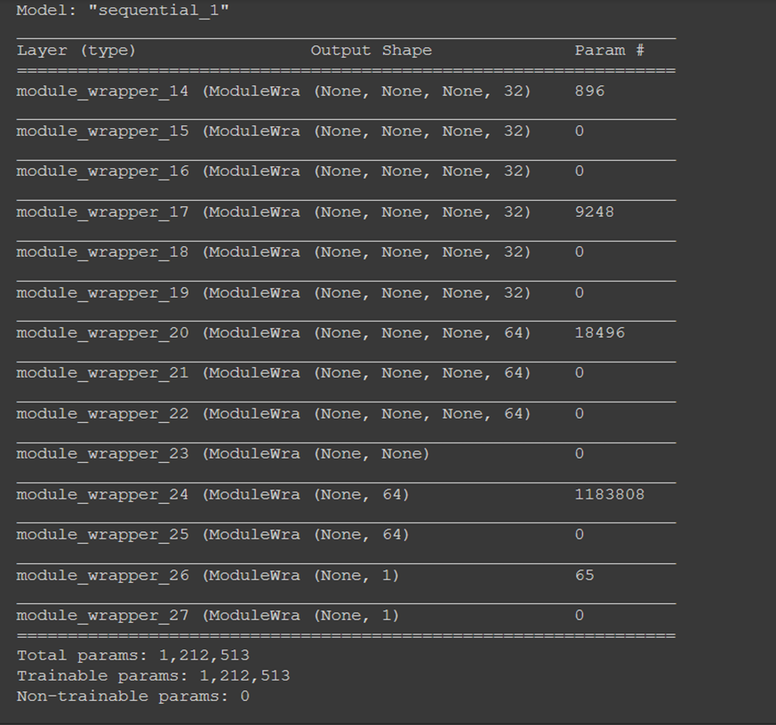
INVESTIGATION OF X-RAY IMAGE OF LUNGS USING CNN BASED TECHNIQUES FOR PNEUMONIA DETECTION
Harsh Shukla| Prof. Arun Kumar G. | SCOPE
Introduction
Results
This project is about developing a computer aided system i.e., CAD for the purpose of autonomous detection of pneumonia via the use of x-rays. In this we will train a Convolutional Neural Network model with multiple layers using a big data set. This project will in the form of a web app with a machine learning model connected to it to process the uploaded image and show result.
In this project, we developed a pneumonia detection web application through the use of Flask for web development and deep learning techniques for processing and scanning chest x-ray image. While there are some system which exist, they have accuracy problems and high time consumption problems due to their larger architectures. Therefore, we have tried to make a simplistic, less time consuming and more accurate pneumonia detection project.
Output:
Motivation
Early diagnosis of pneumonia is a vital matter. It is mainly done through the use of CXR analysis but many small places don’t have resources or radiologists. That’s why we have tried making a deep learning model for CAD of pneumonia.
SCOPE of the Project
Developing a web application using flask and machine learning model to develop a computer assisted diagnostic system to detect pneumonia via the use of chest x-ray.
For detecting pneumonia via CXR by uploading them
Fast and accurate diagnostic
Methodology
System Architecture
Proposed Methodology
Data set:
The dataset has been divided into 3 folders train, test and val and contains subfolders for each image category (Pneumonia/Normal). There are 5,216 X-Ray images (JPEG) and a couple of categories (Pneumonia/Normal). Chest X-ray images (anterior-posterior) were selected from retrospective cohorts of pediatric patients of 1 to five years old from Guangzhou Women and Children’s center , Guangzhou. All chest X-ray imaging was performed as a neighbourhood of patients’ routine clinical care. For the analysis of chest x-ray images, all chest radiographs were initially screened for internal control by removing all inferiority or unreadable scans. The diagnosis for the images were then graded by two expert physicians before being cleared for training the AI system. In order to account for any grading errors, the evaluation set was also checked by a 3rd expert.
Data pre-processing:
In this step the image data is converted to NumPy array, and it is normalized to avoid overfitting. Also, the images are reshaped and rescaled to fit into our models. The labels of the images are then encoded to make it compatible with the proposed CNN model.
Data splitting:
In this process train and test images are separately taken from the dataset so manually data splitting is not required in this case.
Deep Learning Model:
We use a convolutional neural network model. Our cnn model is basically made of 2 tiers. The first tier may be a pretrained model liable for image pre-processing, like resizing, augmentation, data splitting, and data normalization. Data normalization is employed for re-scaling the image’s pixel value to the interval. The second tier works on feature extraction and image classification using different types of deep learning models which is made and trained by us.
Conclusion
We are creating a method here to diagnose pneumonia complications easily and reliably without the need for doctors to waste too much time searching through records and screening tests to examine the severity. And here we train some pneumonia-affected images of people and normal people to diagnose a person's problem and suggest the medicines they need. We do all this by applying different algorithms to the machine learning and making a deep learning model which is connected to a website developed via flask. While testing the x rays, we get an accuracy of 98-99 per cent and if we test and train more x rays, we get more accuracy.
References
1.iiChouhan,iV.;iSingh,iS.K.;iKhamparia,iA.;iGupta,iD.;iTiwari,iP.;iMoreira,iC.;iDamasevicius,iR.;ideiAlbuquerque,iV.H.C.iAiNoveliTransferiLearningiBasediApproachiforiPneumoniaiDetectioniiniChestiX-rayiImages.iAppl.iSci.i2020,i10,i559.
2.iiLujánjGarcía,iJ.E.;iYáñezjMárquez,iC.;iVilluendasjRey,iY.;iCamachojNieto,iO.iAiTransferiLearningiMethodiforiPneumoniaiClassificationiandiVisualization.iAppl.iSci.i2020,i10,i2908.i
3.iAntin,iB.;iKravitz,iJ.;iMartayan,iE.iDetectingiPneumoniaiiniChestiXraysiwithiSupervisediLearning;iSemanticscholariOrg.:iAlleniInstituteiforiArtificialiintelligence,iSeattle,iWA,iUSA,i2017.i

