Slide 1

-Pratik dhoriyani (18ce024) -Dharmesh goraniya (18ce026) -harsh hirpara (18ce030) -pruthil hirpara (18ce031) -dhruv kachhadiya (18ce037)
Software group project
Re-image : Image editor

Slide 2
Content
Introduction
Modules of Project
Diagram
Tools / Technologies used
Implementation / Screenshots
Reference

Slide 3
INTRODUCTION
Re-Image is free online picture resizer, compressor, format converter, de-hazer web-application tool.

Slide 4
continue
With this, one don’t have to download any software or application. One can resize your pictures and images very quickly.
One can simply browse to website and upload the images wants to shrink.

Slide 5

continue
The file formats supported by Simple Image Resizer include JPEG, JPG, PNG, BMP and GIF.
Using format conversion feature, one can converts image from one format to another (eg. jpg to png, png to jpg, jpg to pdf). This Image Converter supports converting image to the following formats: JPG, PNG, PDF, GIF, BMP, TIFF, WEBP.

Slide 6
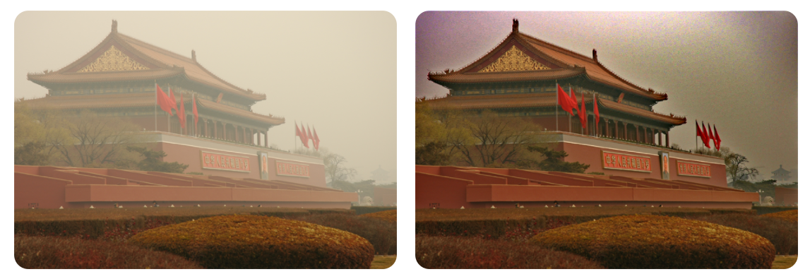
continue
It can also useful to remove fog or haze form your photo online and as a response one will get final photo or image which having high quality and enhanced clear image.

Slide 7
Modules of project
Image Compressor
Image Format Converter
Image Resizer
Image De-Hazer (Fog Remover)

Slide 8
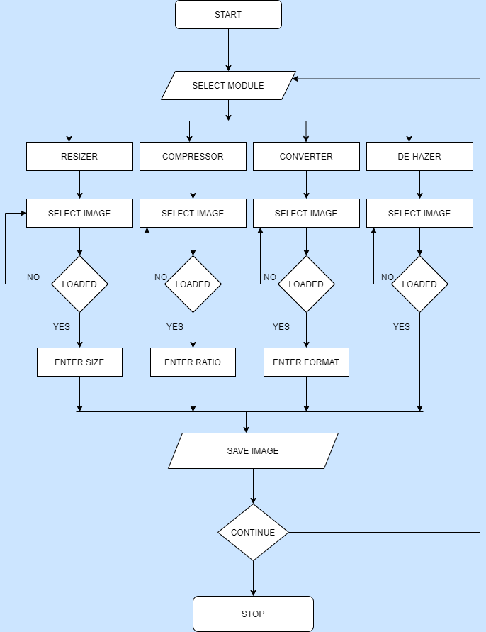
diagram

Slide 9






tools / Technologies used
Django
Python
HTML, CSS, Java Script
Jupyter Notebook
Visual Studio Code
Python Server (To Deploy Web-app)

Slide 10
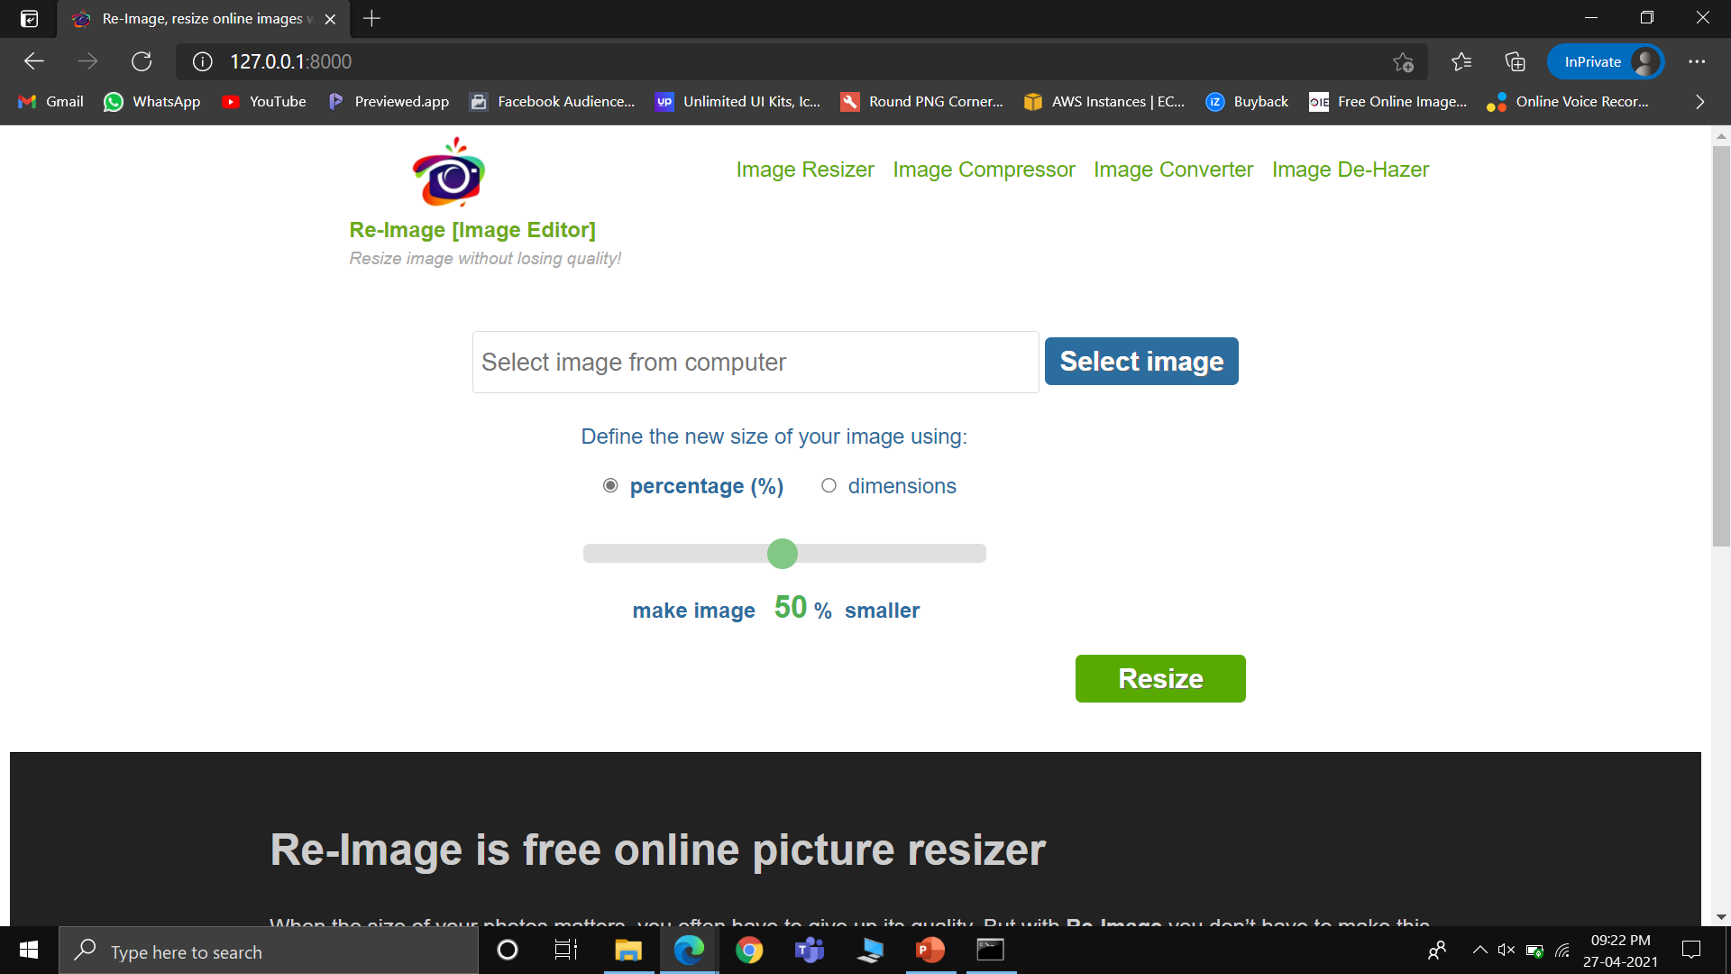
Implementation/SCREENSHOTS

Slide 11
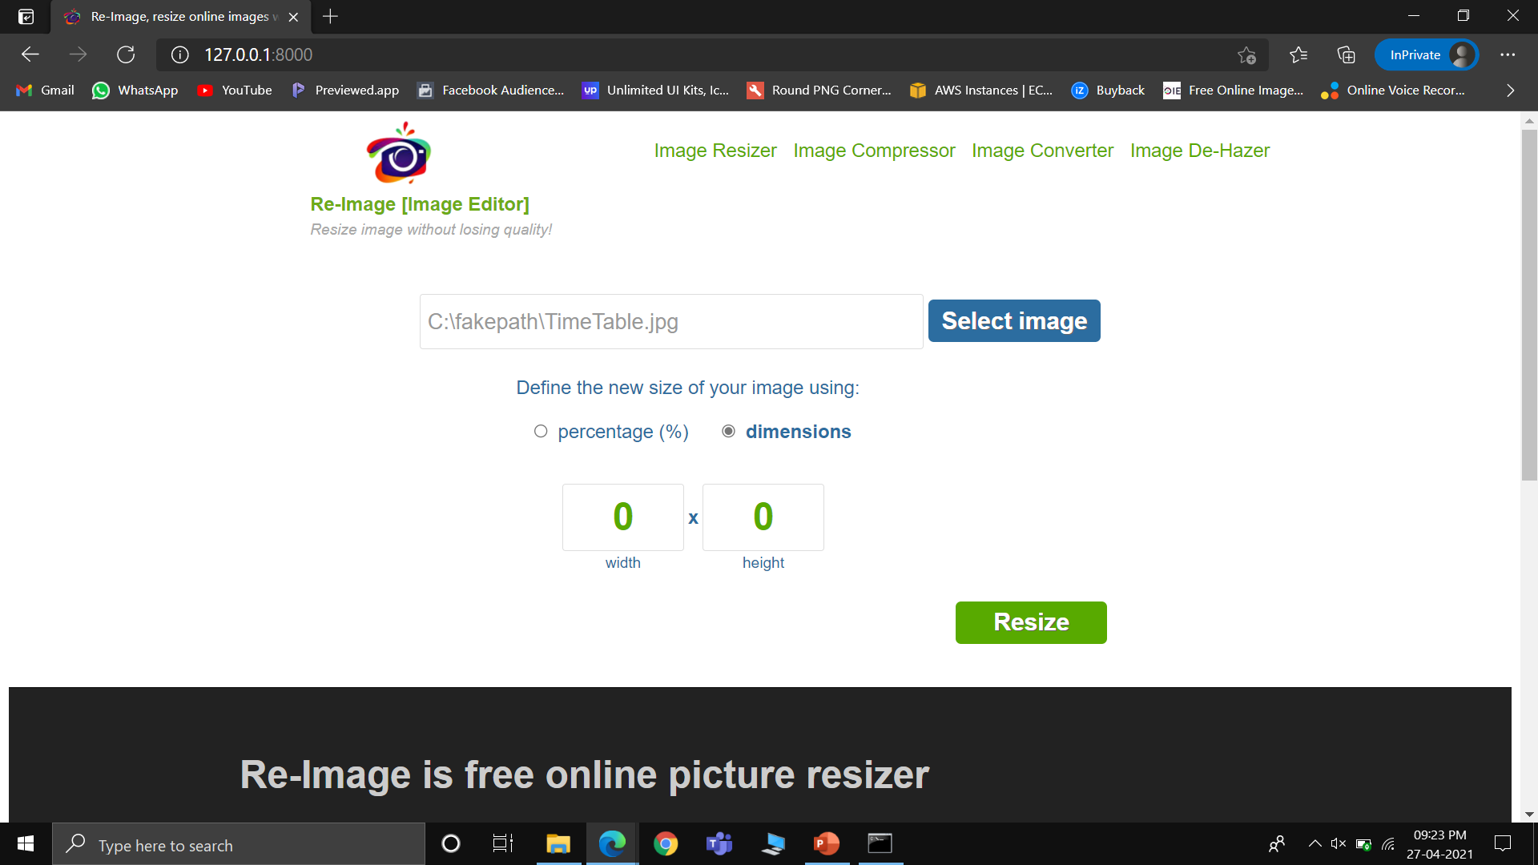
Implementation/SCREENSHOTS

Slide 12
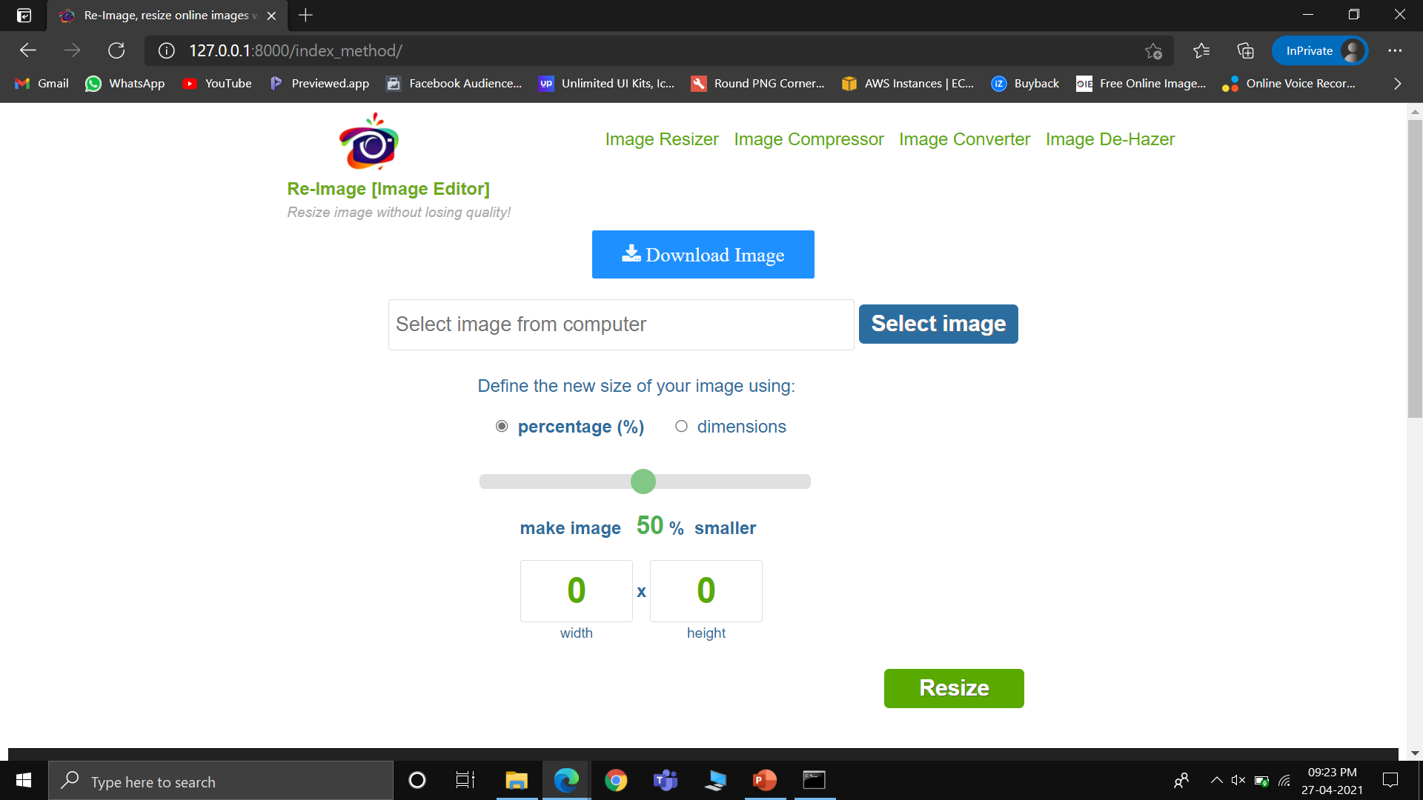
Implementation/SCREENSHOTS

Slide 13
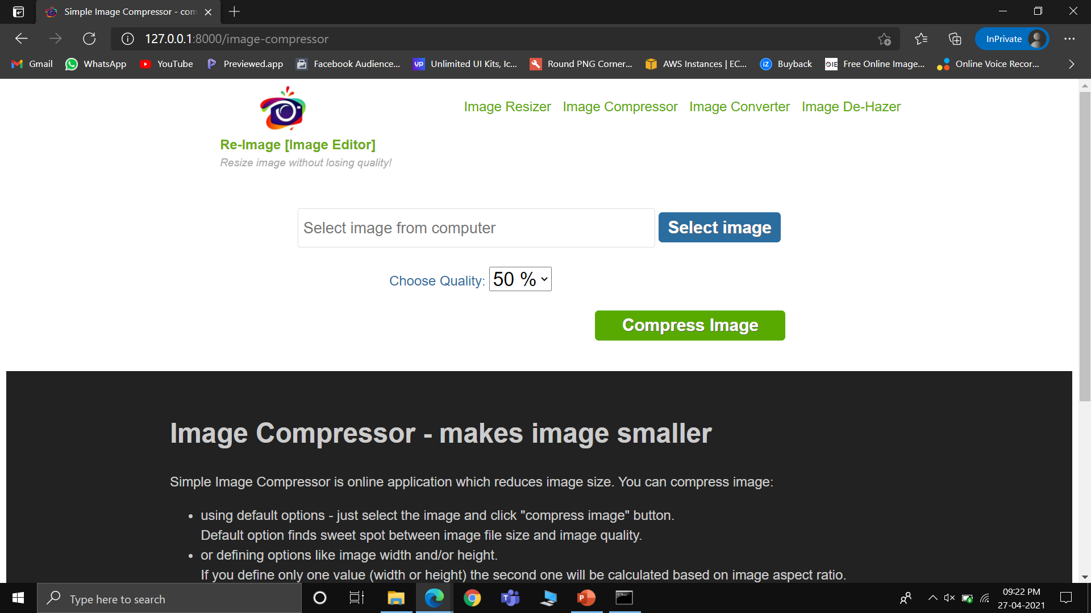
Implementation/SCREENSHOTS

Slide 14
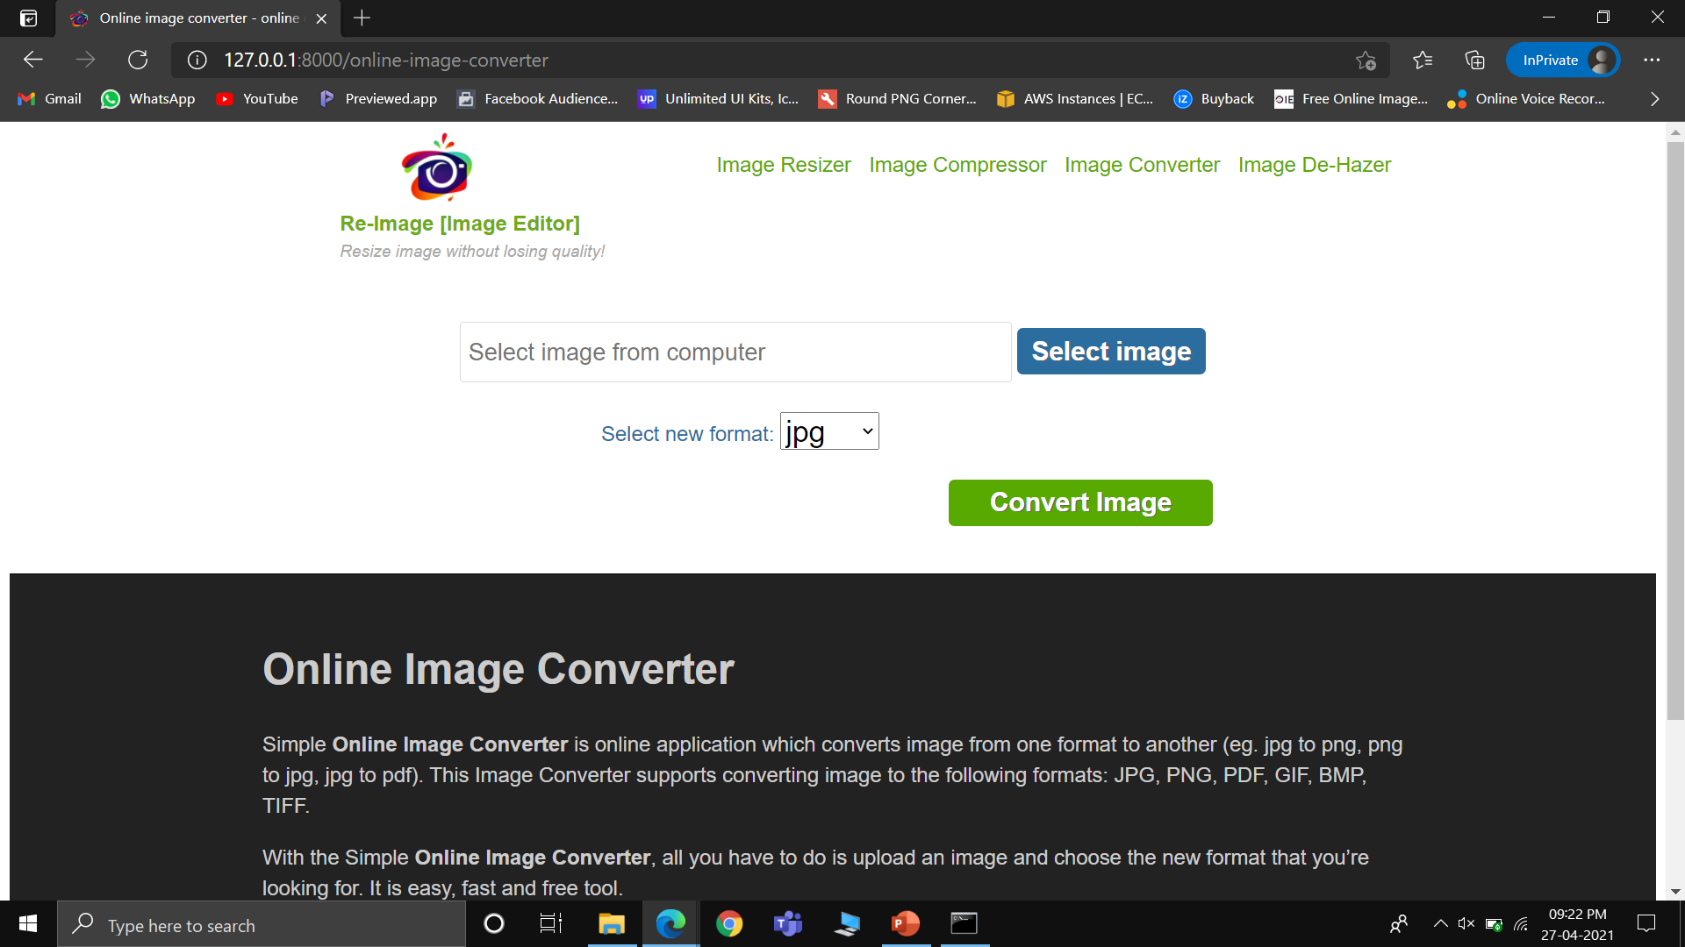
Implementation/SCREENSHOTS

Slide 15
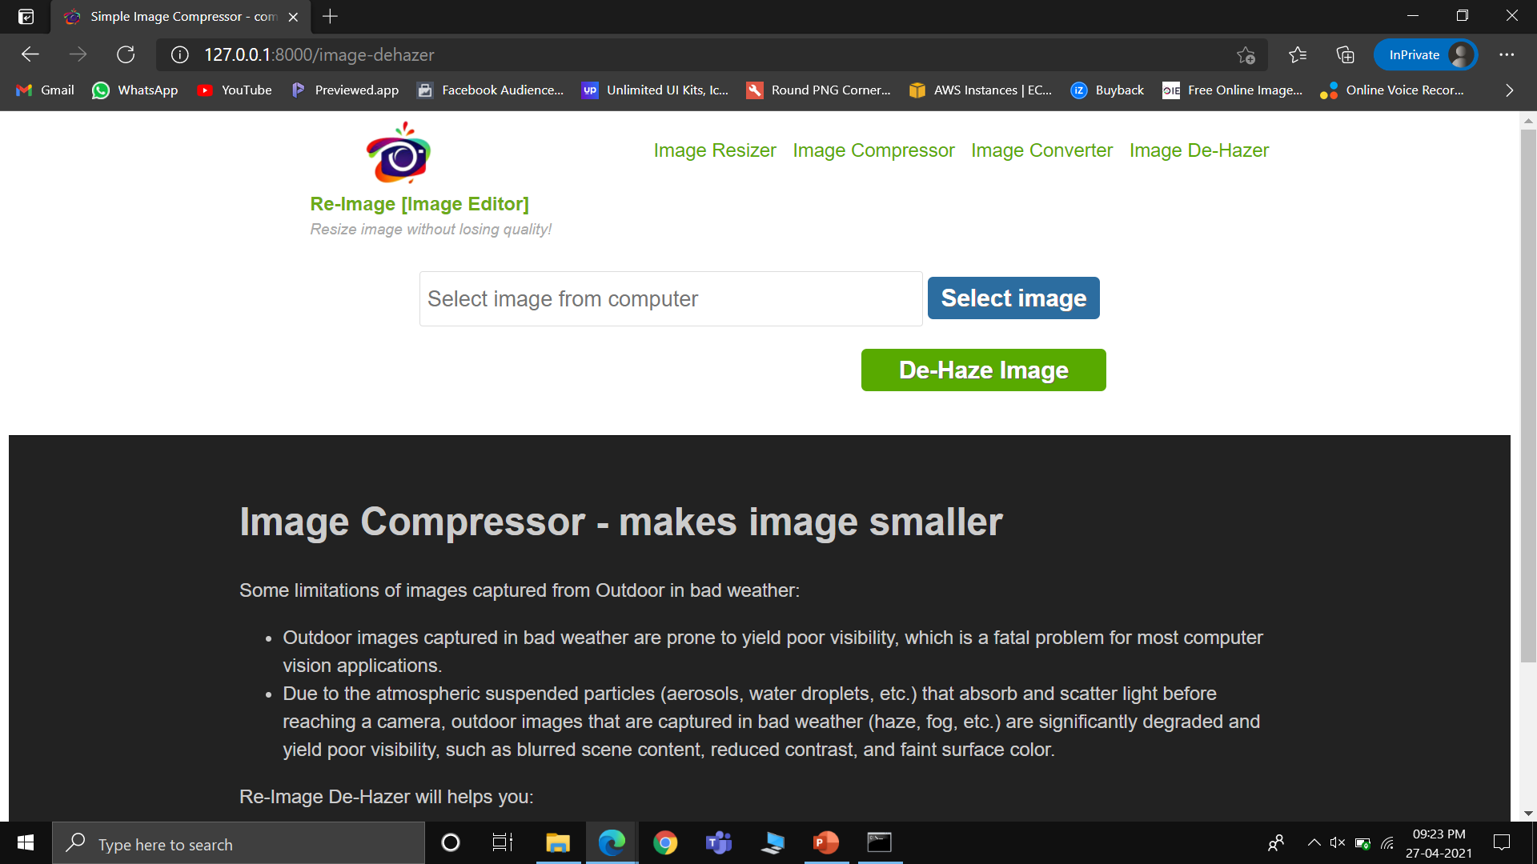
Implementation/SCREENSHOTS

Slide 16
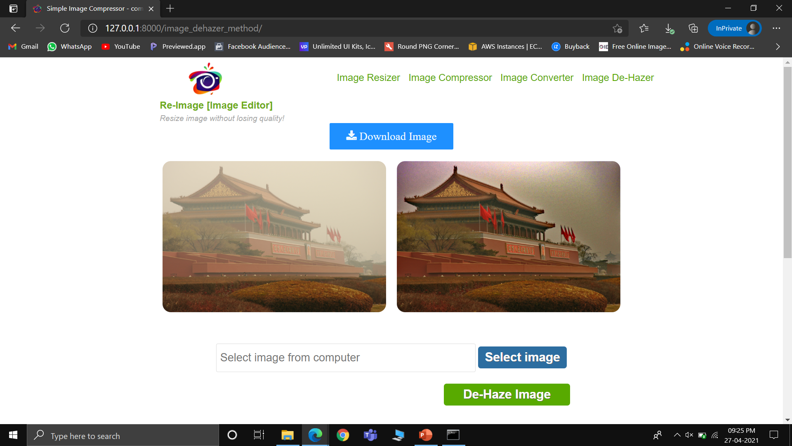
Implementation/SCREENSHOTS

Slide 17
REFERENCE
Single Image Dehazing Python
https://github.com/Utkarsh-Deshmukh/Single-Image-Dehazing-Python
Image Conversion (JPG ⇄ PNG/JPG ⇄ WEBP) with Python
https://medium.com/@ajeet214/image-type-conversion-jpg-png-jpg-webp-png-webp-with-python-7d5df09394c9
Python Pillow - Resizing an Image
https://www.tutorialspoint.com/python_pillow/python_pillow_resizing_an_image.htm
Compress images using Python and PIL
https://www.geeksforgeeks.org/how-to-compress-images-using-python-and-pil/

Slide 18
Thank you

