Slide 1
Associative Memory

Slide 2
Introduction
Associative memory is also known as content addressable memory (CAM) or associative storage or associative array. It is a special type of memory that is optimized for performing searches through data, as opposed to providing a simple direct access to the data based on the address.
It can store the set of patterns as memories when the associative memory is being presented with a key pattern, it responds by producing one of the stored pattern which closely resembles or relates to the key pattern.
It can be viewed as data correlation here. input data is correlated with that of stored data in the CAM.

Slide 3
Importance of associative memory
Associative memory, also known as Content Addressable Memory (CAM), plays a vital role in modern computing because it allows data to be accessed by content rather than by physical address. Unlike conventional memory systems where the processor must know the exact location of data, CAM enables fast retrieval through pattern matching. This makes it extremely efficient for applications that demand rapid searching, correlation, and recognition.
The importance of associative memory lies in its ability to provide parallel search operations, meaning multiple stored patterns can be compared with the input simultaneously. This significantly reduces search time, making it highly suitable for time-critical tasks. For example, in networking, CAM is widely used in routers and switches for high-speed address lookup and packet forwarding. In security systems, it allows instant verification and authentication by matching input keys with stored patterns. Similarly, in artificial intelligence and pattern recognition, associative memory helps in recalling stored data even when the input is partial or noisy, much like how human memory functions.

Slide 4
It forms of two type:
auto associative memory network : An auto-associative memory network, also known as a recurrent neural network, is a type of associative memory that is used to recall a pattern from partial or degraded inputs. In an auto-associative network, the output of the network is fed back into the input, allowing the network to learn and remember the patterns it has been trained on. This type of memory network is commonly used in applications such as speech and image recognition, where the input data may be incomplete or noisy.
hetero associative memory network : A hetero-associative memory network is a type of associative memory that is used to associate one set of patterns with another. In a hetero-associative network, the input pattern is associated with a different output pattern, allowing the network to learn and remember the associations between the two sets of patterns. This type of memory network is commonly used in applications such as data compression and data retrieval.

Slide 5
How Does Associative Memory Work?
In conventional memory, data is stored in specific locations, called addresses, and retrieved by referencing those addresses. In associative memory, data is stored together with additional tags or metadata that describe its content. When a search is performed, the associative memory compares the search query with the tags of all stored data, and retrieves the data that matches the query.
Associative memory is designed to quickly find matching data, even when the search query is incomplete or imprecise. This is achieved by using parallel processing techniques, where multiple search queries can be performed simultaneously. The search is also performed in a single step, as opposed to conventional memory where multiple steps are required to locate the data.

Slide 6
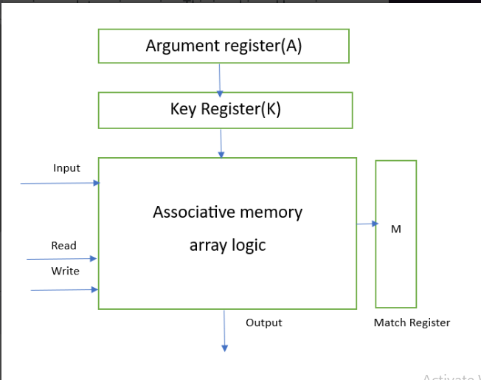
Hardware organization of associative memory:-

Slide 7
Argument Register: It contains words to be searched. It contains 'n' number of bits.
Match Register: It has m-bits, One bit corresponding to each word in the memory array. After the making process, the bits corresponding to matching words in match register are set to '1'.
Key Register: It provides a mask of choosing a particular field/key in argument register. It specifies which part of the argument word need to be compared with words in memory.
Associative Memory Array: It combines word in that are to be compared with the arguments word in parallel. It contains 'm' words with 'n' bit per word.

Slide 8
Applications of Associative memory :-
Memory Allocation Format
Associative memory is mainly used in specialized memory allocation structures.
It enables direct access to data by comparing the input with stored contents, instead of searching through memory addresses sequentially.
This makes memory allocation and retrieval faster and more efficient.
Database Management Systems (DBMS)
Widely used in databases to quickly search and retrieve records based on content.
CAM allows searching without knowing the exact memory address of the record.
Improves query performance in large-scale data systems.
Networking
Essential in routing tables for high-speed networks.
Helps routers and switches quickly determine the best path to a destination network by matching the destination address with stored routing entries.
Reduces latency and increases data transfer efficiency in communication systems

Slide 9
Disadvantages of Associative memory :-
Fast Data Retrieval – Data is accessed by content rather than by address, reducing search time significantly.
Parallel Search Capability – Can compare the input with all stored entries simultaneously, speeding up operations.
Fault Tolerance – Can retrieve correct or approximate results even if the input is incomplete or noisy.
Efficiency in Specialized Applications – Useful in networking (routing tables), databases, image processing, and AI where rapid lookups are critical.
Human-like Recall – Mimics associative recall in the brain, making it suitable for pattern recognition and machine learning applications.

Slide 10
Advantages of Associative memory :-
Limited Storage Capacity – Can store fewer patterns compared to traditional memory systems.
Power Consumption – Parallel searching requires more power, making CAM less energy-efficient.
High Hardware Cost – Implementation of CAM requires complex circuitry, making it more expensive
than conventional memory.
Complexity in Design – The architecture is more complicated, leading to higher design and manufacturing challenges.
Risk of Overlapping Patterns – If stored patterns are too similar, errors in retrieval may occur due to ambiguity.

