Slide 1

Global Trend Diffusion
Data-Driven Analysis of Cross-Market Trend Transmission Between US and India
Harsh Gupta

Slide 2
Introduction

Slide 3
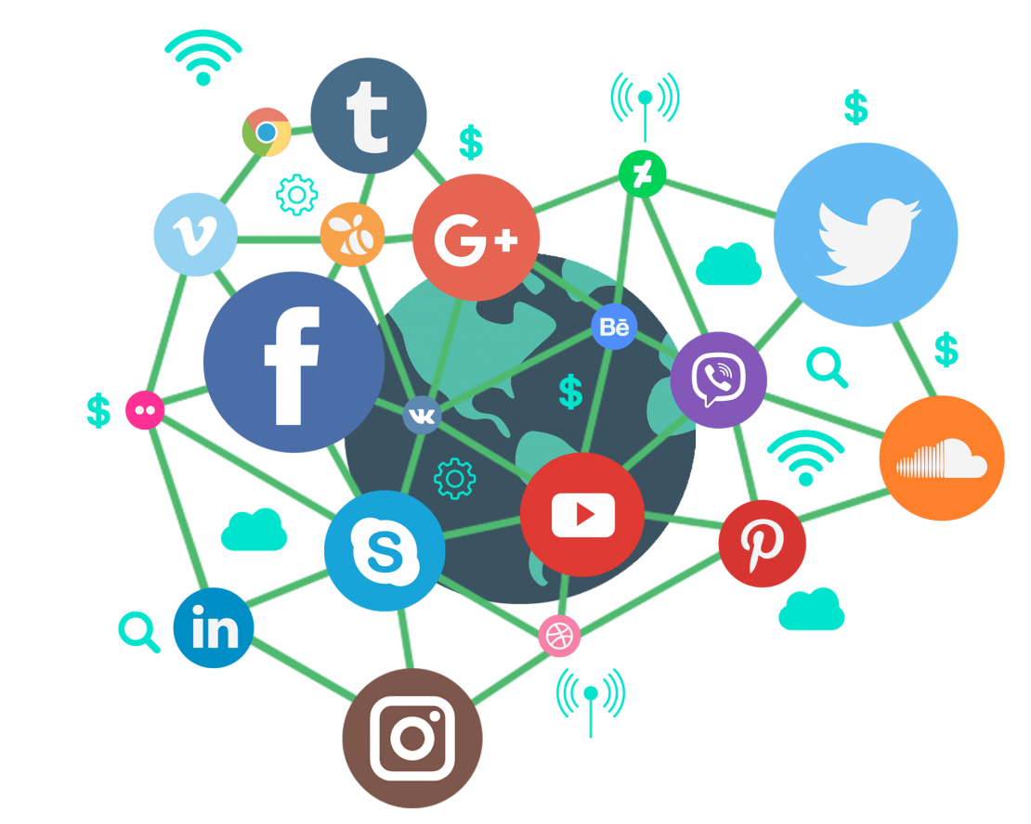
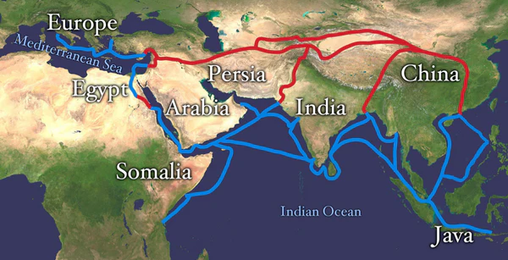
What is Global Trend Diffusion
Global Trend Diffusion describes how ideas, products, and viral moments travel from one market to another.
Trend diffusion always existed but it used to be slow.
Example: Tea took centuries to spread across cultures.
Today, social media accelerates diffusion to days or weeks.
Dalgona Coffee went from a Korean video to a global trend in days

Slide 4
Why This Matters

Slide 5




Social media creates global demand instantly
Global hype triggers local product innovation
Virality = Sales
Global hype → local products
India is a rapidly growing, trend-sensitive market
Knowing diffusion timing improves brand strategy
Large digital population accelerates adoption
Right timing = more sales, fewer missed chances

Slide 6
What we already know?

Slide 7
Literature Review
Algorithmic Global Broadcast
Global Cultural Flow on Social Media
Data-Driven Viral Marketing
Cross-Market Demand Measured Through Search
Gerbaudo (2024) shows how TikTok’s algorithm pushes viral content across borders, enabling U.S.-origin trends to reach global audiences within hours
Sun (2024) demonstrates that platforms accelerate cross-cultural adoption of trends, explaining how cultural products popular in the U.S. quickly gain visibility among audiences.
Theodorakopoulos, Theodoropoulou, and Klavdianos (2025) shows that combining big data analytics, influencer activity, and platform signals helps track how viral hype forms and spreads
Choi & Varian (2012) find that Google Trends can predict economic activity in real time, and Goel et al. (2010) show that search volume can forecast product interest and market demand.

Slide 8
Research Questions & Objectives

Slide 9








Research Questions
RQ 1
RQ 2
RQ 3
RQ 4
Does social-media-driven hype in the U.S. correlate with subsequent consumer attention in India?
How long does it take for a trend to diffuse from the U.S. to India (i.e., the diffusion lag)?
Do different product categories (beauty, lifestyle, beverages, toys) exhibit different diffusion speeds?
Does online sentiment differ between U.S. and Indian audiences for the same trending product?

Slide 10
Data Sources & Platform Limitations

Slide 11



Google Trends
YouTube Data
Measures public curiosity and demand patterns in both the U.S. & India.
YouTube videos + comments provide insight into global engagement and sentiment
Why it matters:
Detects genuine spikes in attention
Enables U.S. → India diffusion lag measurement
Strong proxy for consumer interest
Why it matters:
Comments reflect real consumer opinions
Shows global vs. local excitement around products
Supports sentiment comparison across markets
Amazon Data
Reddit & X/Twitter
Pagination capped, scraping blocked,
and no public sales data available.
Large-scale text collection and trend timelines not feasible under free tiers.
Why it matters:
Cannot retrieve complete review history
Historical bestseller rank not accessible
No reliable sales estimation possible
Why it matters:
No historical search / discussion timeline
Rate limits block bulk data collection
Only small manual samples possible

Slide 12
Methodology
Product & Keyword Selection
Google Trends Analysis
YouTube Data Processing
Trend Diffusion Modeling
Identify trending products & choose consistent search keywords
Mapped viral items to U.S. & India Google Trends keywords.
Ensures clean, comparable trend signals.
Extract weekly search interest from both countries
Measured correlation and identified U.S. → India peak differences.
Used to estimate diffusion lag.
Scrape video views, timestamps, and user comments
Spikes in views often reflect real-world demand interest, Acts as a proxy for purchase intention / hype cycle
Understanding consumer reactions
Compute:
Correlation between U.S. & India attention
Diffusion Lag: difference in peak interest timing
Category differences: beauty vs lifestyle vs toys
Sentiment shifts: whether reactions differ by country

Slide 13
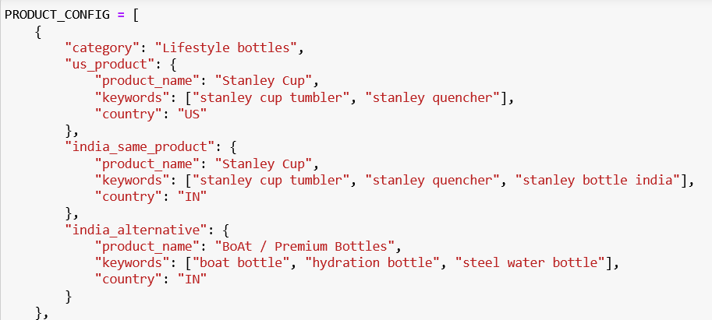
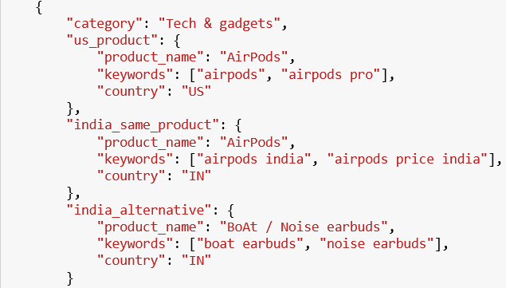
Product & Keyword
Selection

Slide 14
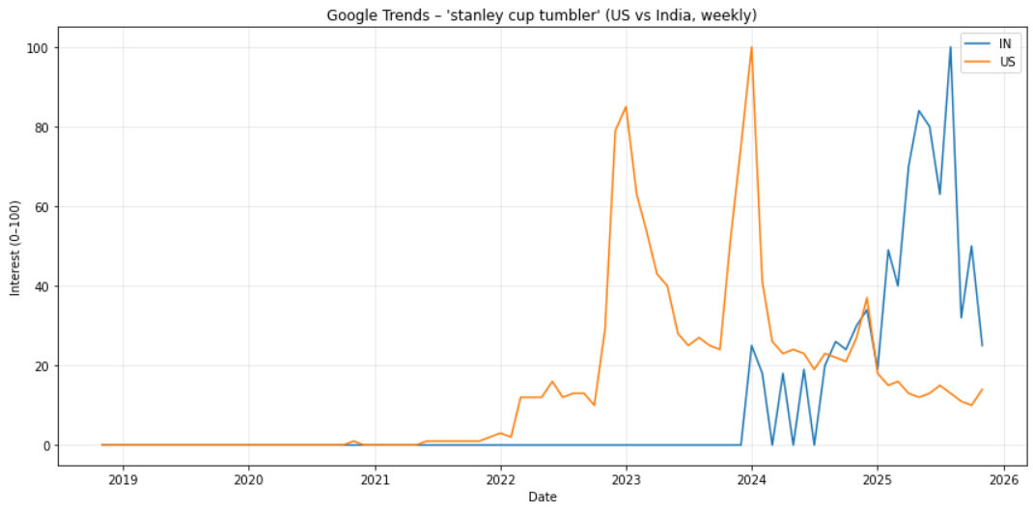
Google Trends Analysis
Stanley Bottle is the product in focus and later will be extended to other products
Initial trend line gives us the idea about what time frame to focus on.
A clear gap in interest can be seen between the two countries. This can answer RQ1 & RQ2

Slide 15
YouTube Data Processing
Trends Data to time bound YouTube search
Metadata and comment data
YouTube Data As Proxy for sales and attention
Sentiment towards the product
Top 250 videos from each quarter within the given time frame along with max of 2000 comments were scraped.
Country of origin for video was determined based on channel country and other features such as language, channel name etc.
Video date published is being used as the proxy for attention assuming video is made because there is a demand.
Comment dates were analysed to extract the demand and sales proxy
Comments are being analysed to understand how people are reacting to the product in both the countries.
To avoid exhausting the API quota, google trends data was used to time bound the search for video.

Slide 16
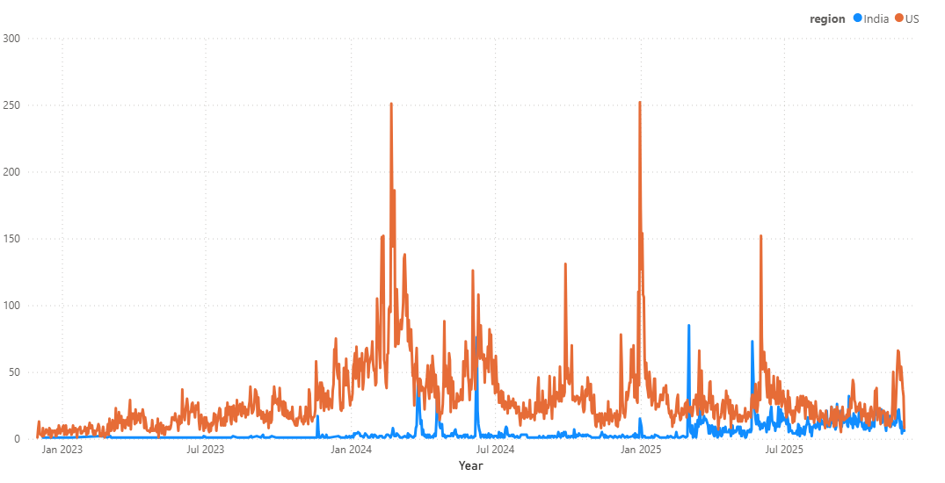
YouTube Data Processing

Slide 17
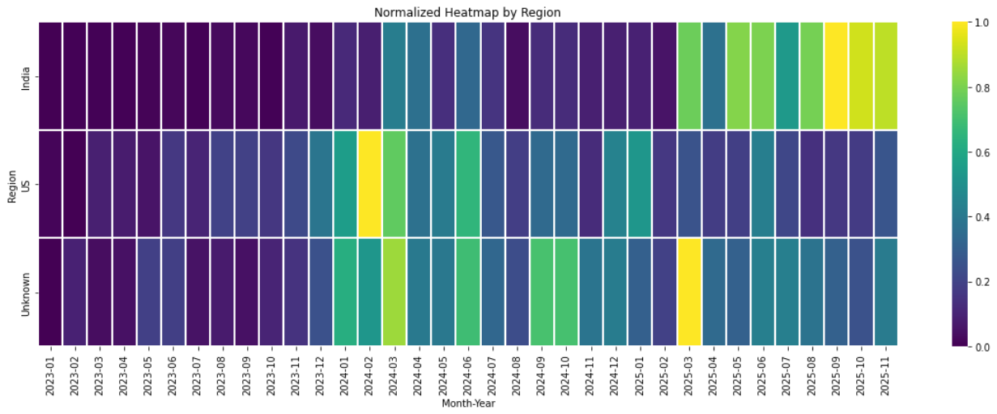
Trend Diffusion Modeling

Slide 18
Work to be done
How will your data and methods help answer your research questions?
Identify potential challenges and how you plan to address them.

Slide 19
References
Gerbaudo, Paolo. 2024. Social Media Clusters: TikTok and the Algorithmic Transformation of Social Media. SAGE Publications.
(Article DOI: https://doi.org/10.1177/14614448241304106)
Sun, Muyao. 2024. Cultural Diffusion and Global Flow on TikTok: Short-Form Video and Cross-Border Digital Culture. Advances in Social Sciences Research Journal.
Theodorakopoulos,et al 2025. Interactive Viral Marketing Through Big Data Analytics, Influencer Networks, AI Integration, and Ethical Dimensions. Journal of Theoretical and Applied Electronic Commerce Research.
(https://www.mdpi.com/0718-1876/20/2/115)
Choi, Hyunyoung, and Hal R. Varian. 2012. Predicting the Present with Google Trends. Economic Record 88(s1): 2–9.
Goel, Sharad, Jake M. Hofman, Sébastien Lahaie, David M. Pennock, and Duncan J. Watts. 2010. Predicting Consumer Behavior with Web Search. Proceedings of the National Academy of Sciences, 107(41): 17486–17490.

Slide 20


