Slide 1

Mlflow for experiment Tracking and Model Management
Made By:
Harsh Raj Gupta

Slide 2
About me
A world where chemical reactions whisper their secrets through data, where algorithms predict the perfect film for a cozy night in, and where nature's intricate patterns hold the key to optimizing processes. This is the world I see, the one I'm eager to build with the chisel of code and the mortar of machine learning.
I'm not just a Chemical Engineer in the making, I'm a data alchemist. I see molecules not just as building blocks, but as stories waiting to be told. Stories etched in numbers, patterns whispering with potential. And my tools? AI, ML, and data science – the incantations with which I translate these whispers into real-world solutions.
My academic journey in Chemical Engineering has endowed me with a robust understanding of mathematical and engineering principles. Beyond my coursework, my passion for exploring the field of data science and machine learning has led me to delve into projects that bridge theory with tangible outcomes.
My GitHub repository showcases a diverse collection of collaborative ML-DL projects, ranging from movie recommendations to face detection and generative adversarial networks. Through these projects, I have honed my skills in translating theoretical concepts into practical, tangible outcomes
And it's not just about lines of code. Delving deeper into the code, I wield data structures like intricate tools, crafting stacks and queues that orchestrate calculations, sculpting efficient arrays and trees to organize information, and weaving algorithms like spells to uncover hidden patterns within data. This mastery, honed in C++, translates seamlessly to Python's swift execution and Java's enterprise-grade robustness, empowering me to build solutions that are not just elegant, but also remarkably efficient.
A data alchemist ready to turn problems into possibilities, challenges into catalysts for change, fuelled by the power of code and data to unlock the universe's secrets.

Slide 3
WORKFLOW:
Entire Workflow is managed by Prefect
INPUT DATA
(Obtained through Web scrapping)
Data Splitting into train and test
Data Preprocessing:
1.Removing stop words, converting into lowercase, removing special characters, etc
Feature Extraction
1. Applying bag of words on processed text input
2. Mapping ratings with positive, negative, and neutral label.
All the models are logged using Mlflow for experiment tracking and Model management
Model{Ready for Deployment}
Can be integrated with a web application created using Flask and then deployed on AWS EC2
Creating a Pipeline of Different Machine Learning Classification Algorithms with hyperparameter tuning along with model evaluation.

Slide 4
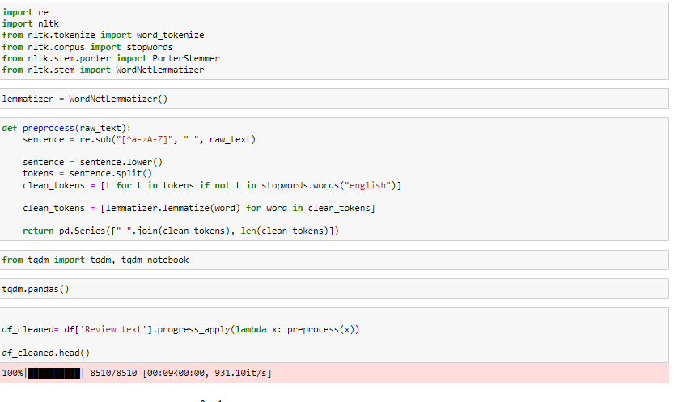
Data Preprocessing and Mapping of output with labels like positive, negative and neutral

Slide 5
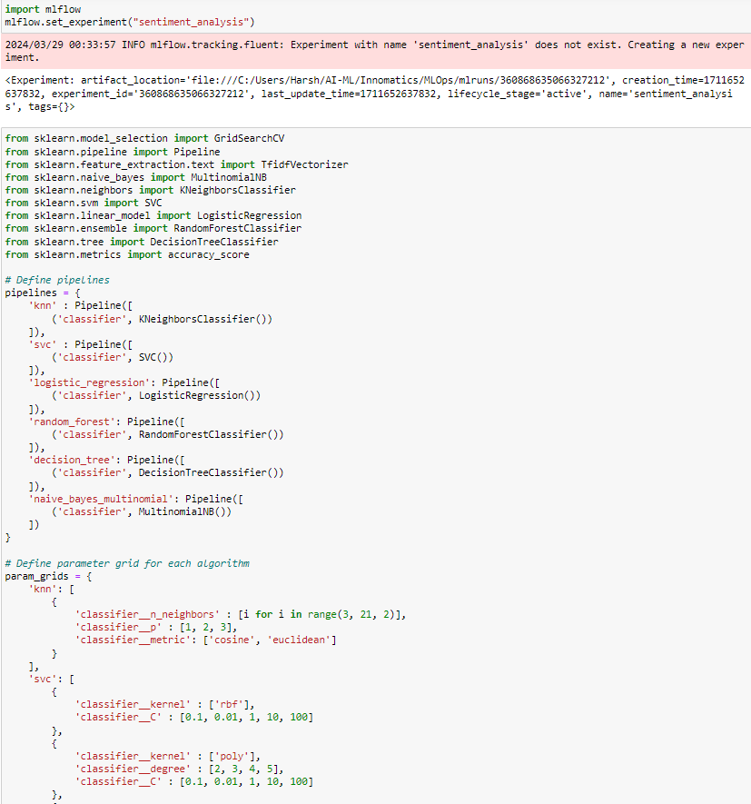
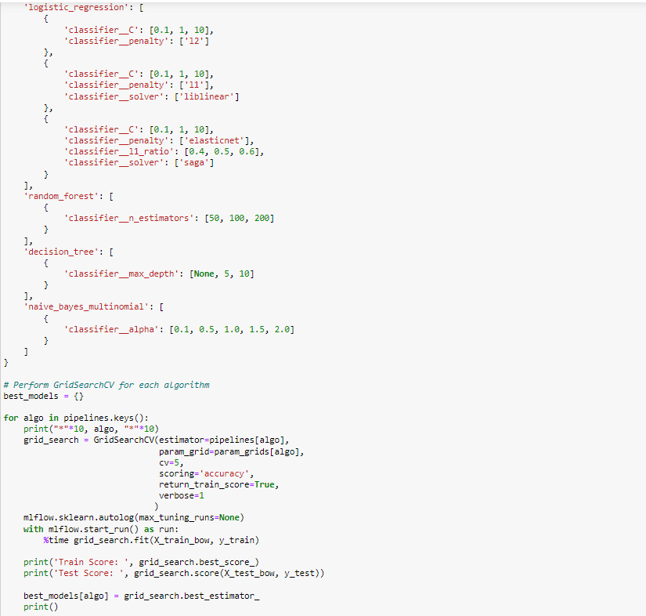
Model Pipeline

Slide 6
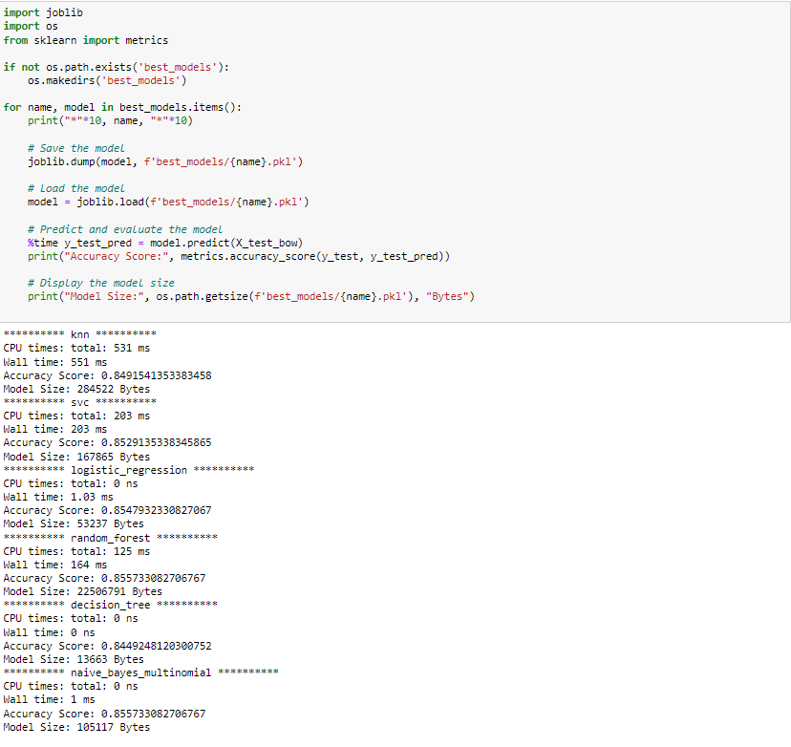
Result of All Models which have been trained on the data set along with their accuracy score

Slide 7
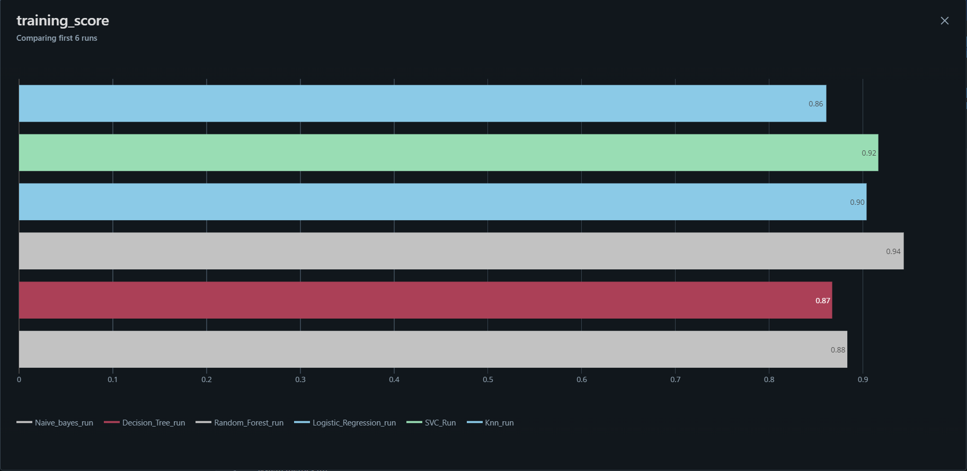
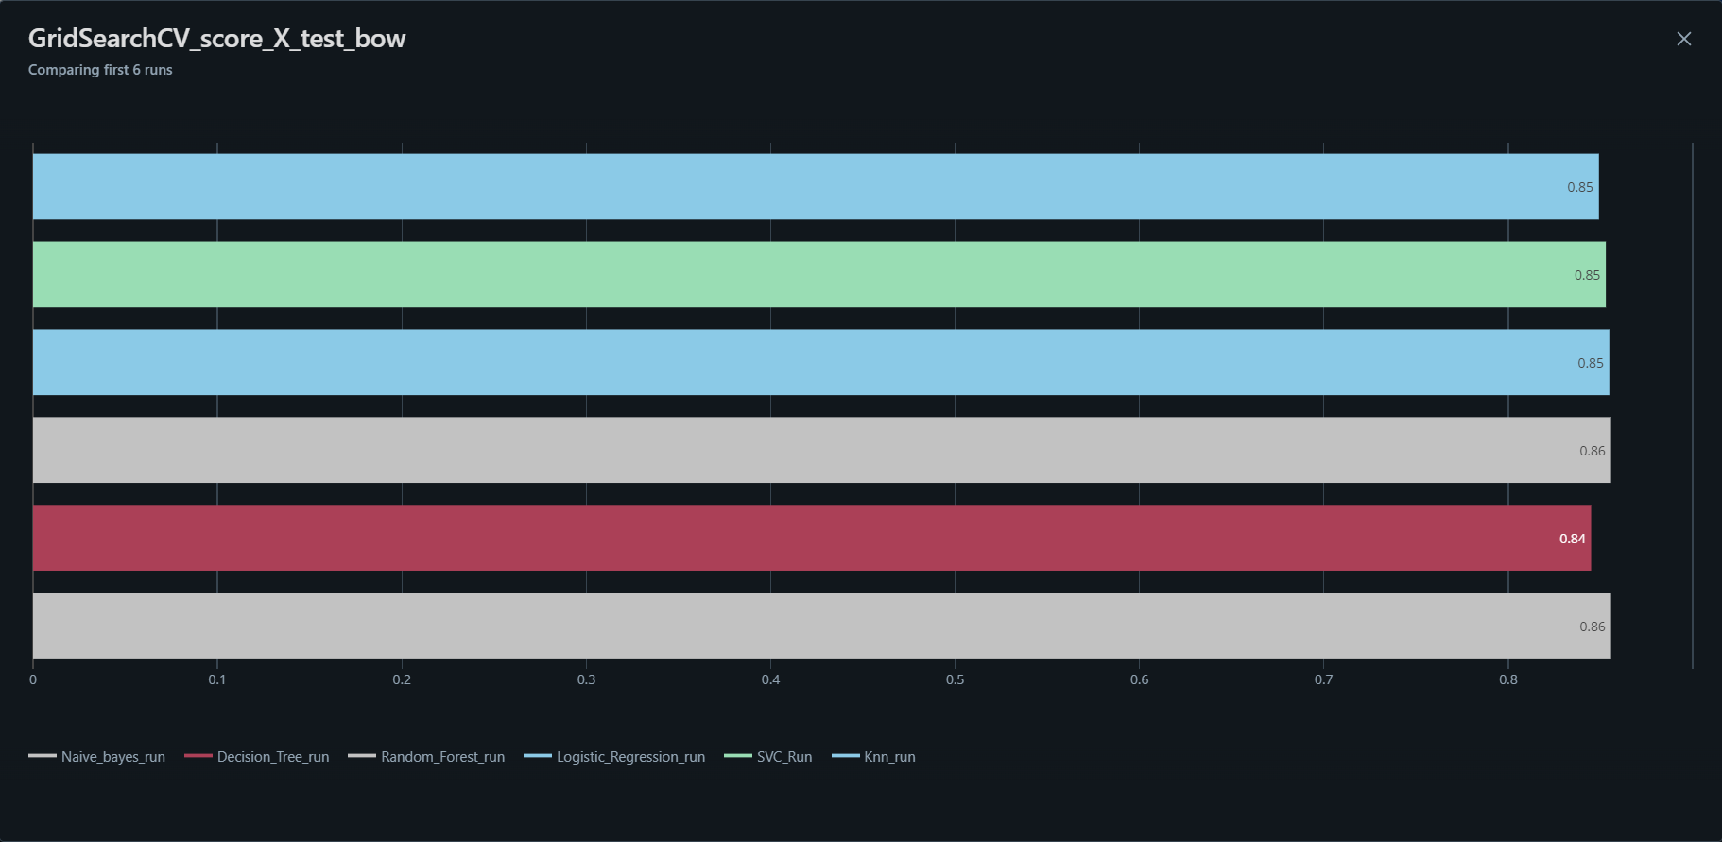
Training and Test Score of all the models

Slide 8
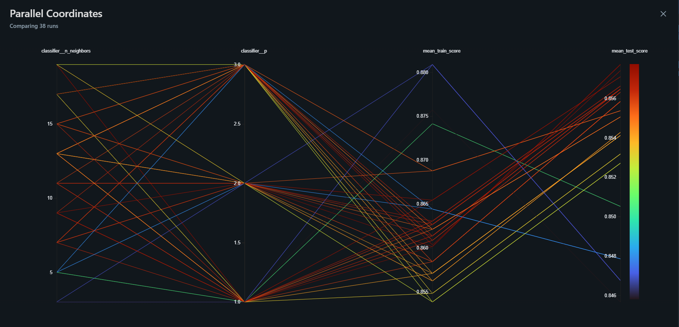
K_nearest Neighbor Classifier Model

Slide 9
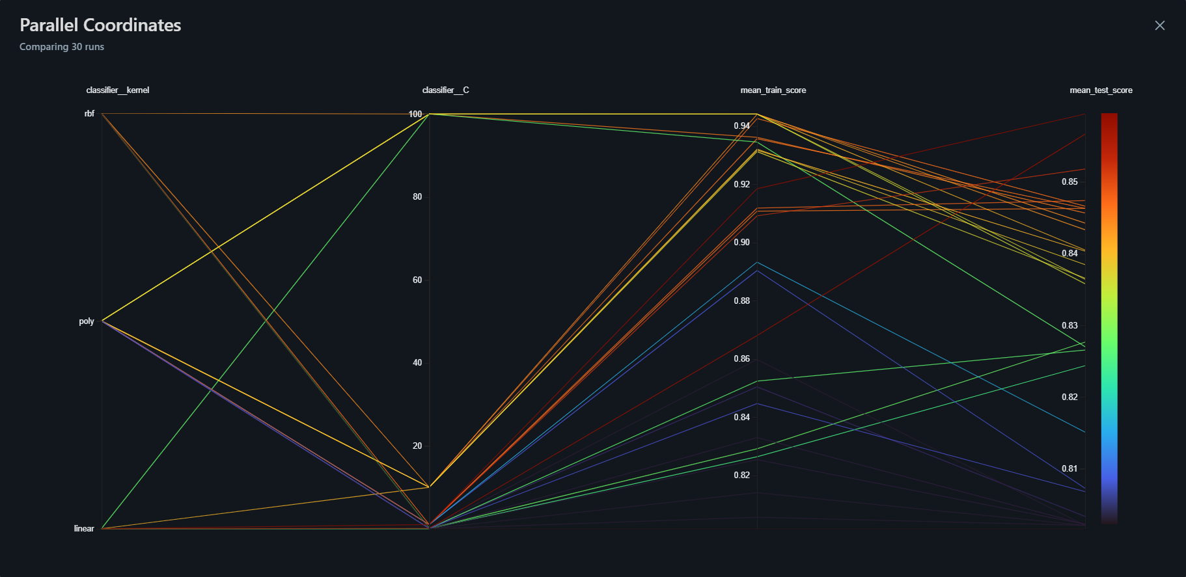
Support Vector Classifier Model

Slide 10
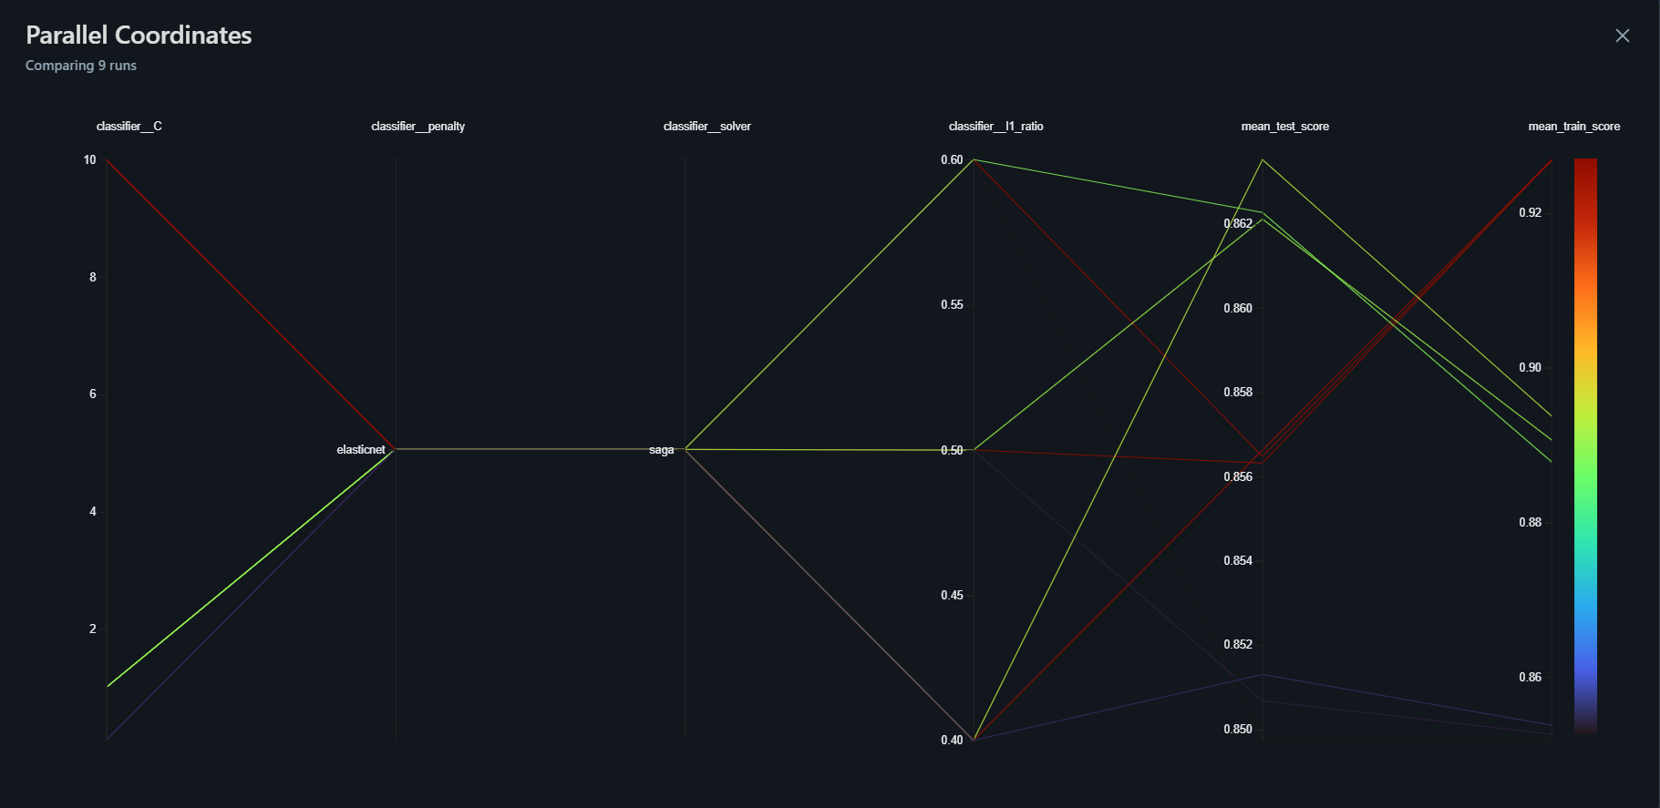
Logistic Regression Model

Slide 11
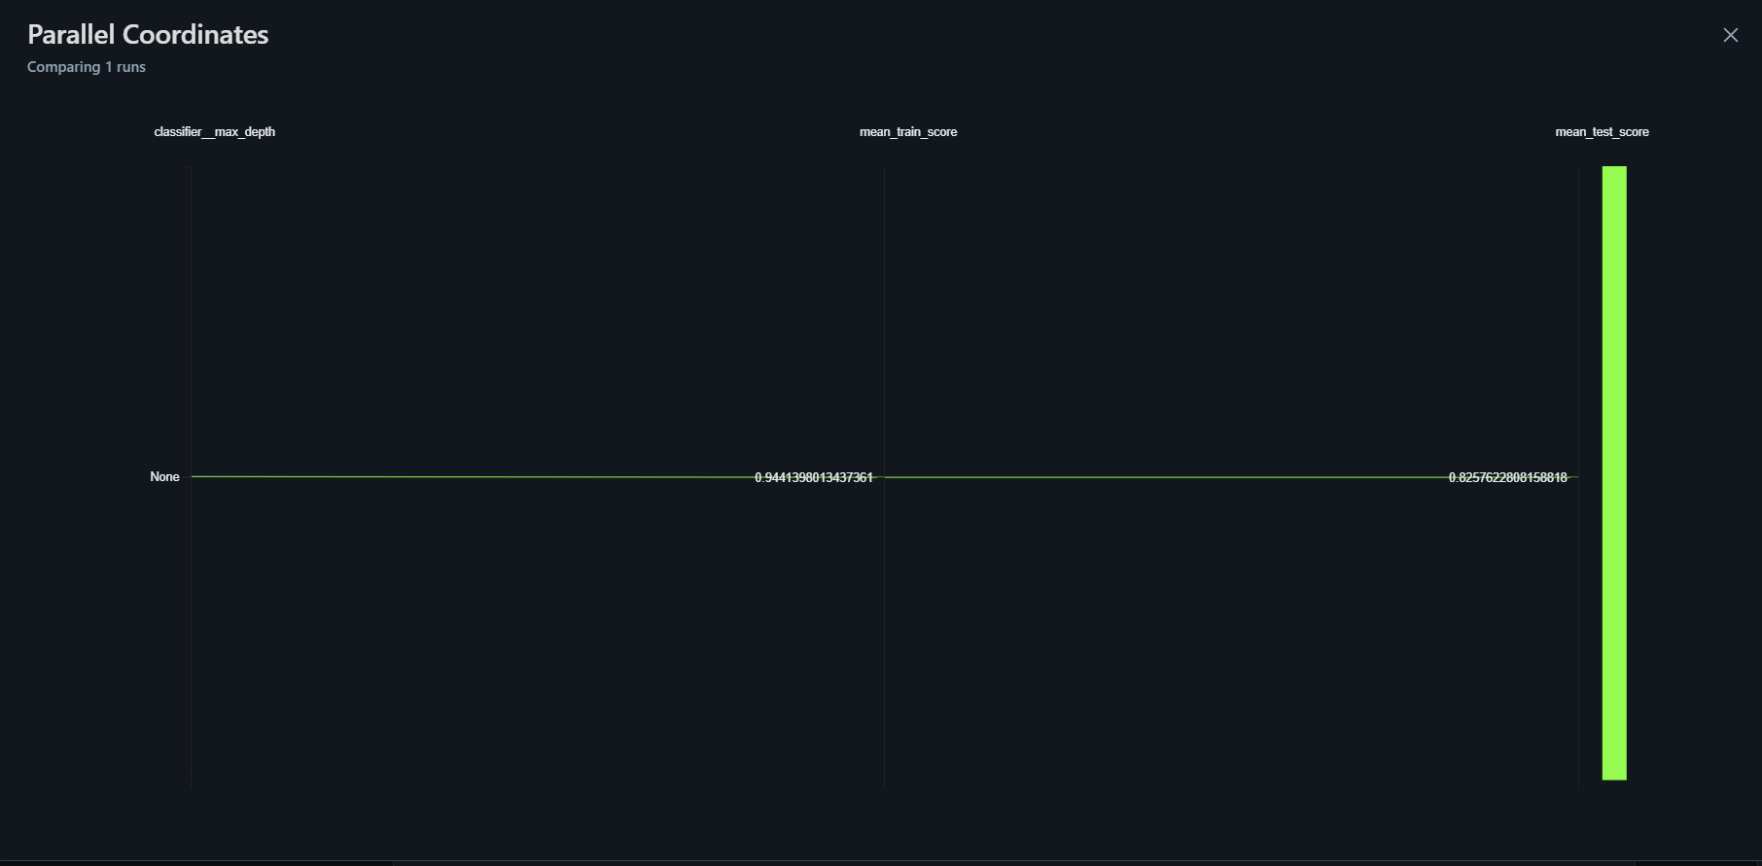
Decision Tree Model

Slide 12
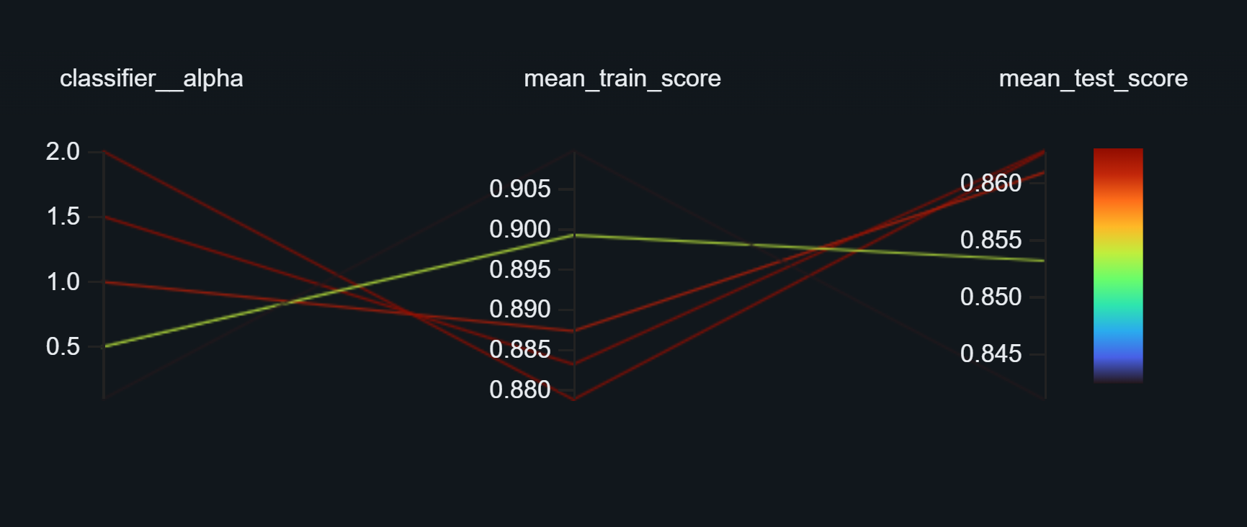
Naive Bayes Model

Slide 13
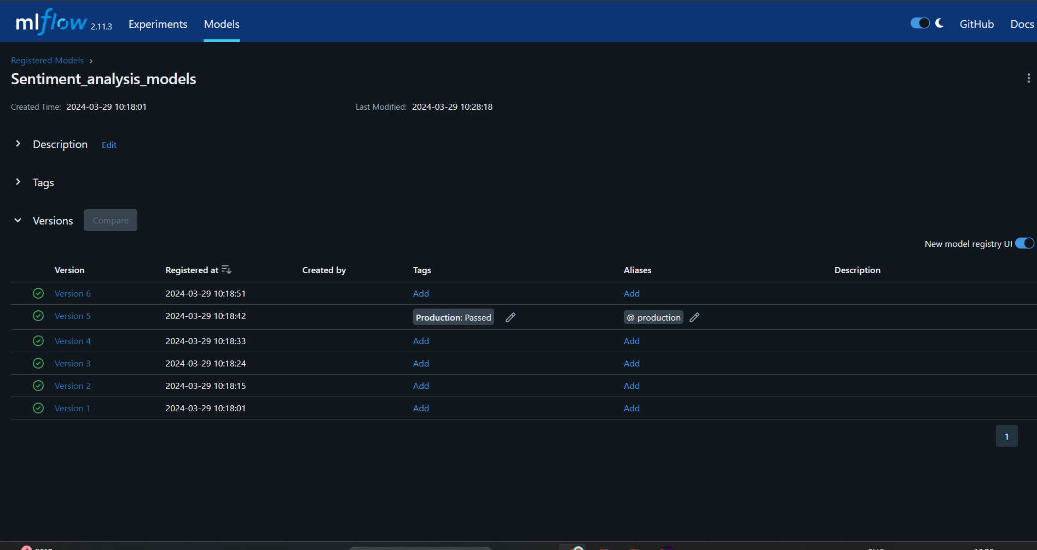
All the models have been logged and based on the train and test accuracy score, the Decision tree model has been selected for production.

Slide 14
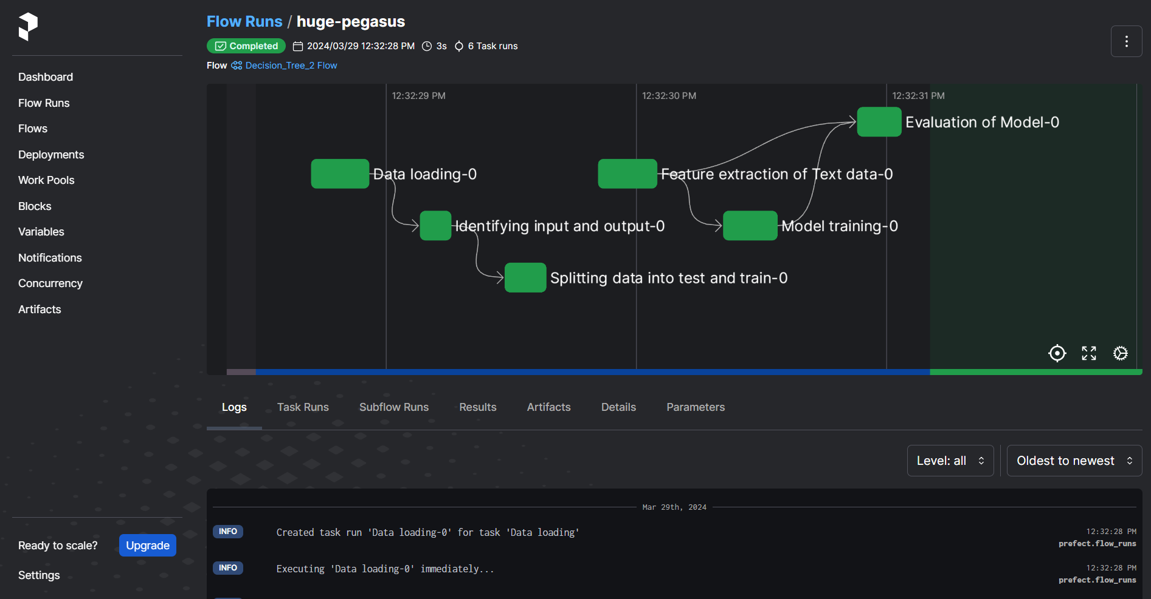
Entire Workflow is being managed by Prefect

Slide 15
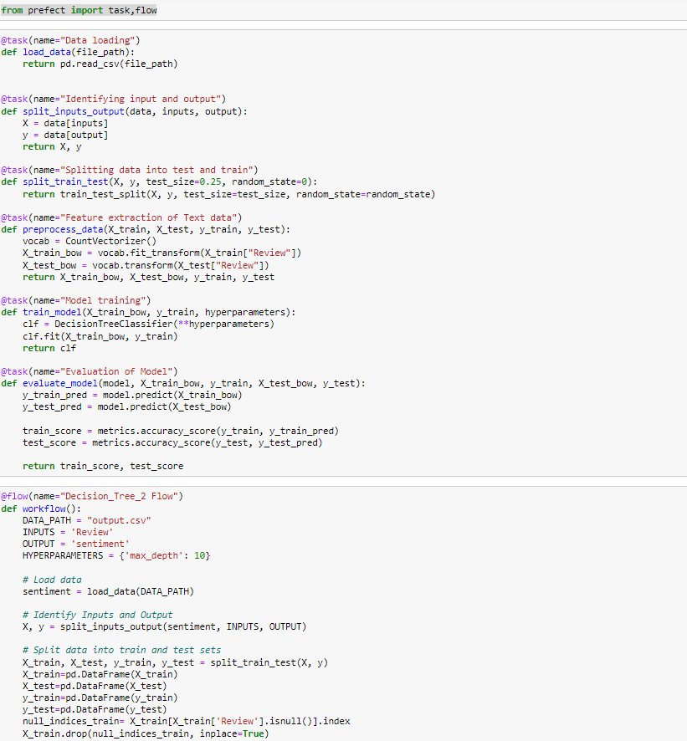
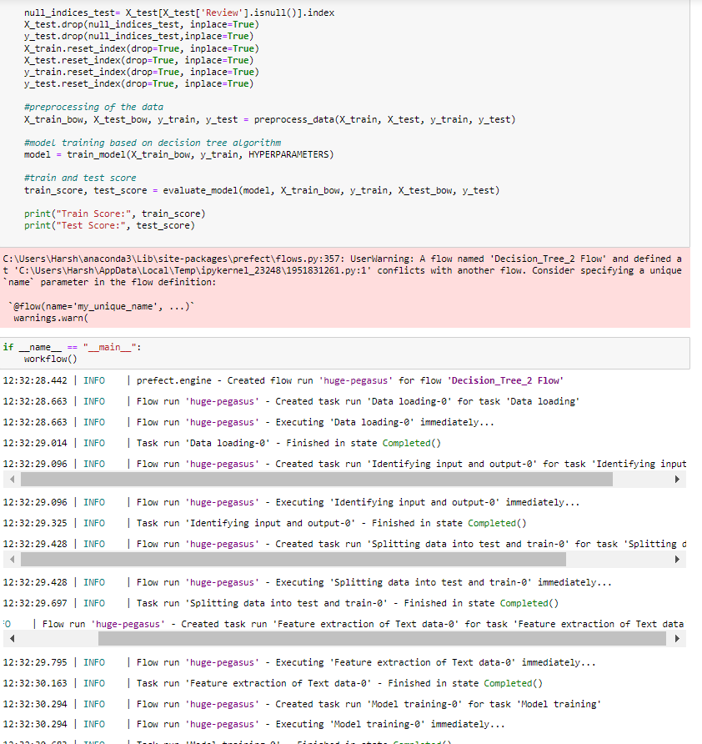

Slide 16

THANK YOU

