Slide 1
Hangman
By:
Sunil Sakariya (17DCS055)
Bhomik Gandhi (D18DCS078)
Harsh Shah (D18DCS079)

Slide 2
Introduction
This is a Python script of the classic game “Hangman”. The word to guess is represented by a row of dashes. If the player guess a letter which exists in the word, the script writes it in all its correct positions. The player has 10 turns to guess the word. You can easily customize the game by changing the variables.

Slide 3
Key features
Obtain a hidden word from a remote computer on the internet.
Manage the game play: getting the player guess, evaluating it, and updating the game board.
Determining if the game is won or lost.
Allow the user to specify an alternate user interface.

Slide 4
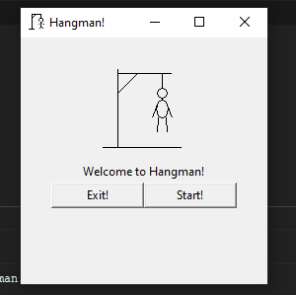
Implementation

Slide 5
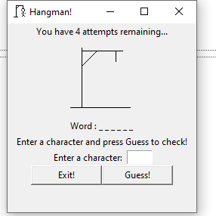
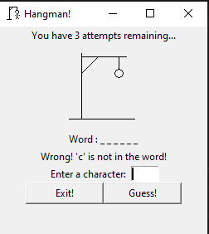

Slide 6
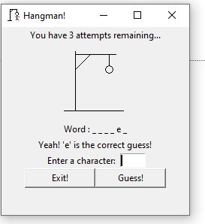
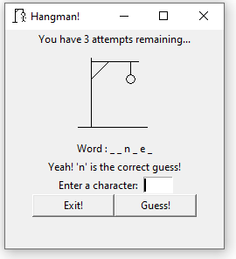

Slide 7
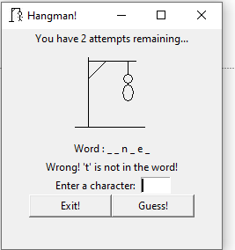
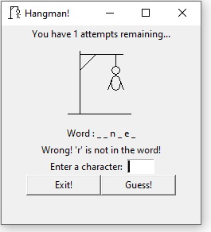
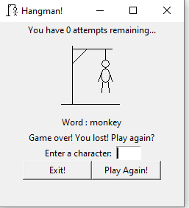

Slide 8
Thankyou

