Slide 1
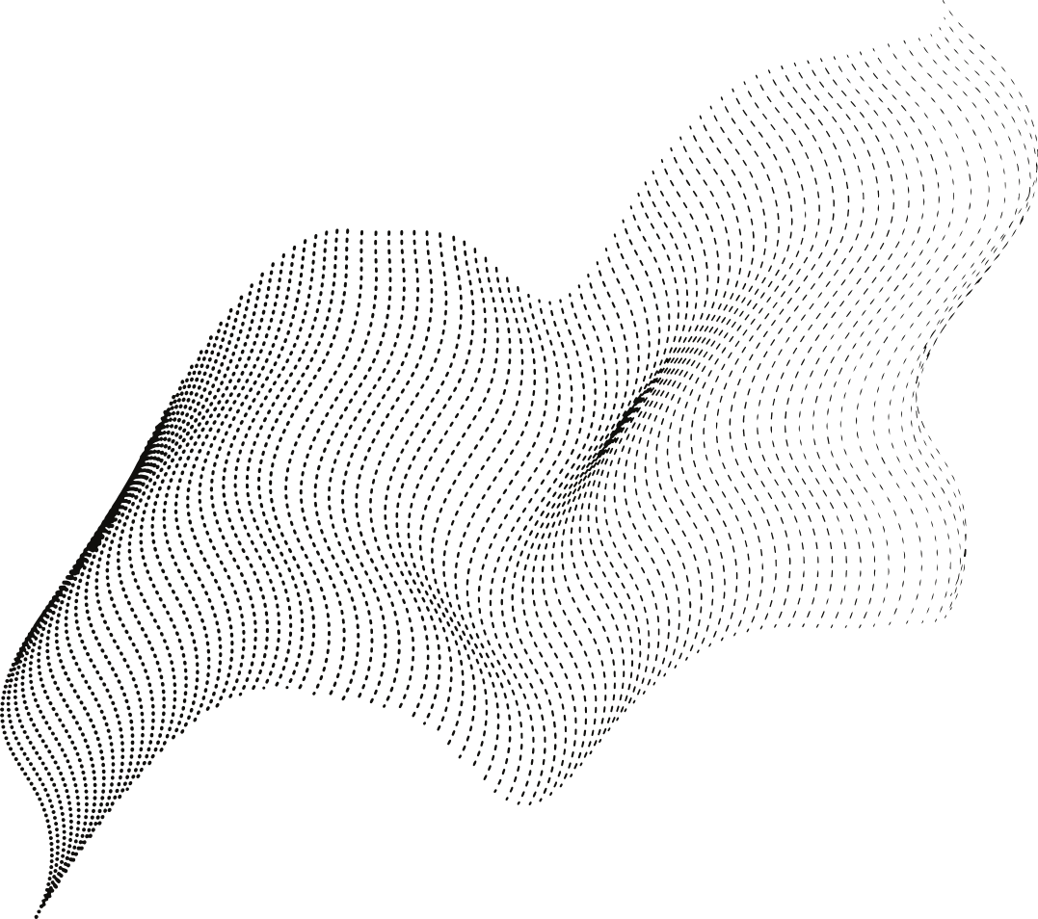
STRATEGY
As of now, we have 3 tables and a lot of data
We also have the relation between all 3 tables
The plan of this project will be executed in following manner..................
Task 1
Task 2
Task 3
All 3 tables will be joined using relative columns. We will then have access to the information about the exact timestamp, transaction, category of item, and corresponding storage temperature.
More data if possible is gathered and included in aavailable dataset, giving more accurate results. Data is preprocessed and made it suitable to train a model on.
Machine learning model is trained on data. Given all the information it should accurately be able to predict the optimal number of quantity to stock by predicting the exact amount of selling of particular item given time

