Slide 1


Presentation on AI Health Symptom Checker Using Large Language Models
Guided By: Presented By:
Prof. Kapil Sahu (Internal Guide) Harsh Verma(0827IT243D04)
Mr. Suraj Gupta(External Guide) Yogendra Kurmi(0827IT231151)
Yesh Sen(0827IT231150) Vivek Carpenter (0827IT231148)

Slide 2
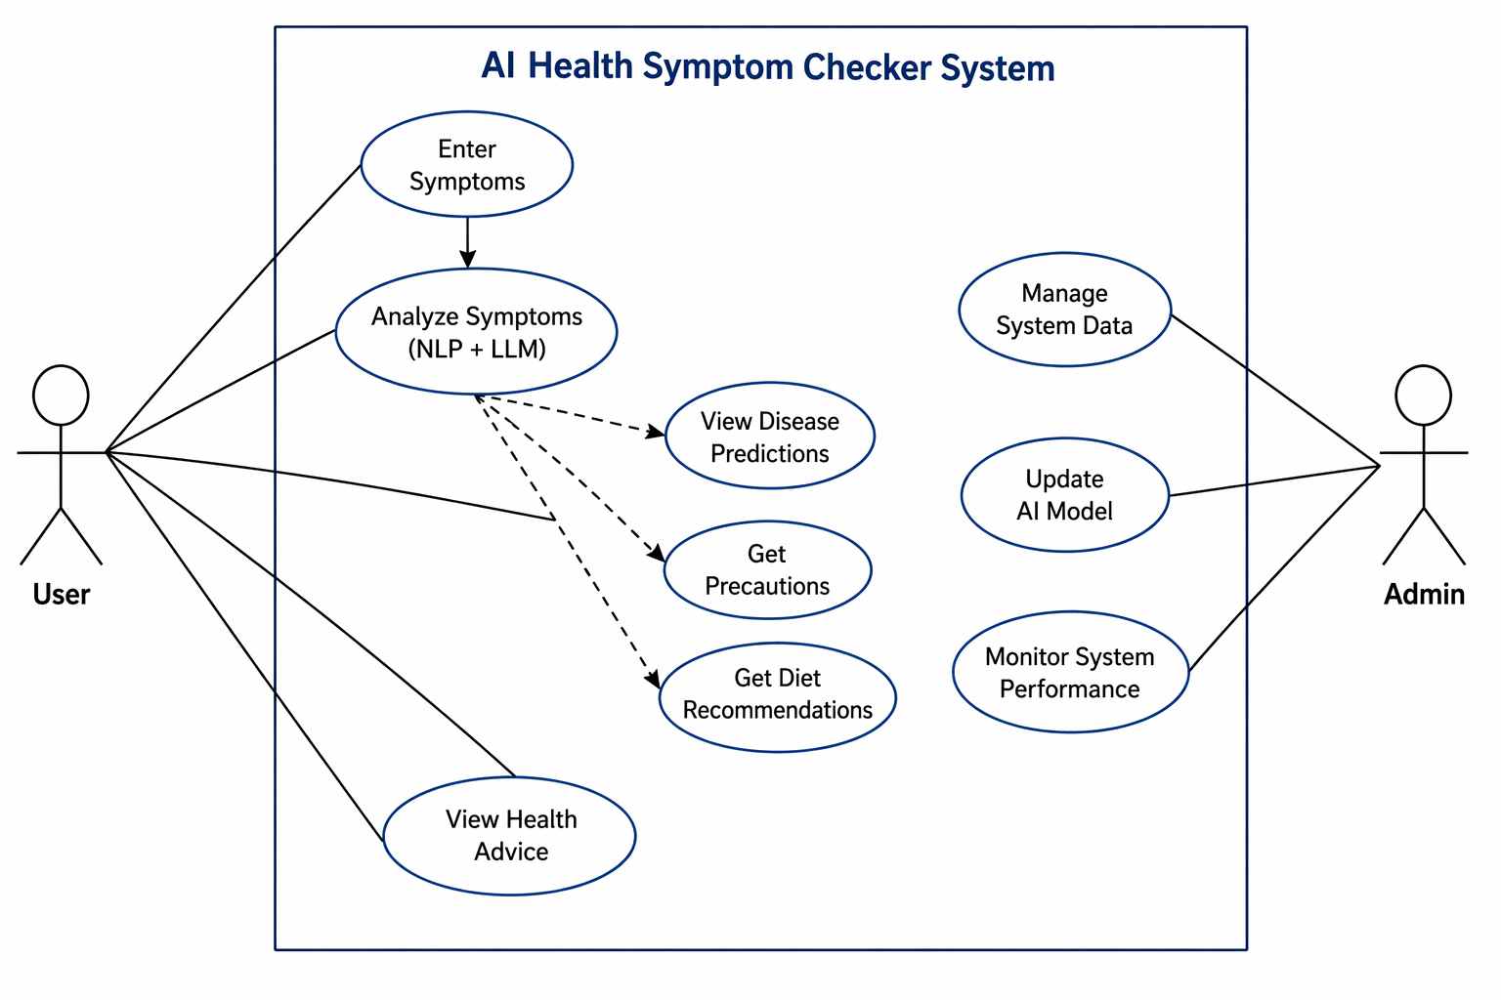
Use Case Diagram

Slide 3
Use Case Diagram
This diagram represents the functional overview of the AI Health Symptom Checker System. It illustrates the interaction between two main actors: the User and the Admin. The User interacts with the system by entering symptoms in natural language, which are then analyzed using NLP and Large Language Models (LLMs). Based on this analysis, the system provides possible disease predictions, precautionary measures, diet recommendations, and general health advice.
The Admin is responsible for managing system operations, including maintaining system data, updating the AI model for improved accuracy, and monitoring overall system performance. The diagram highlights how the system processes user input and delivers intelligent health insights while being maintained and optimized by the admin.
Overall, this use case diagram demonstrates the workflow and interactions within the system, showing how AI is utilized to provide preliminary health guidance in a user-friendly manner.

Slide 4
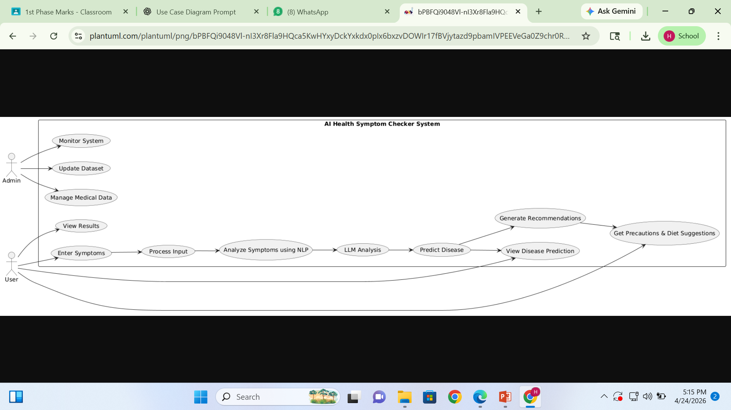
Data Flow Diagram

Slide 5
Data Flow Diagram
The Use Case Diagram of the **AI Health Symptom Checker System** represents the interaction between users and the system functionalities. The primary actor is the **User**, who enters symptoms in natural language and receives disease predictions along with precautions and diet recommendations. The system processes the input using Natural Language Processing (NLP) and Large Language Models (LLMs) to analyze symptoms and generate meaningful health insights.
An additional actor, **Admin**, is responsible for managing and updating the medical database and monitoring system performance. The diagram highlights the overall workflow, including symptom input, data processing, disease prediction, and result generation. It helps in understanding how different components of the system interact to provide a user-friendly and intelligent healthcare assistance solution.

Slide 6
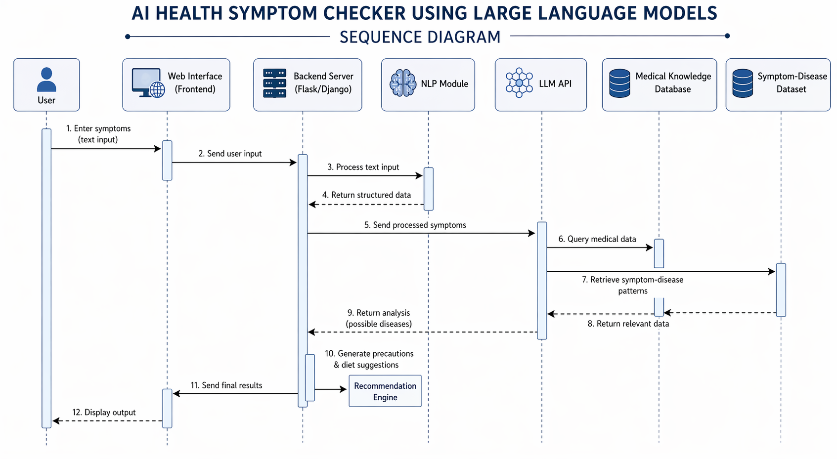
Sequence Diagram

Slide 7
Sequence Diagram
The Sequence Diagram of the **AI Health Symptom Checker System** illustrates the step-by-step interaction between system components over time. The process begins when the user enters symptoms through the web interface, which sends the data to the backend server. The backend processes the input using the NLP module to convert it into structured data.
This processed data is then sent to the LLM API, which interacts with the medical knowledge database and symptom-disease dataset to analyze the symptoms. Based on this analysis, the system predicts possible diseases and generates recommendations such as precautions and diet suggestions.
Finally, the backend sends the results to the web interface, which displays the output to the user. This diagram clearly shows the flow of data and communication between different modules in a structured and sequential manner.

Slide 8
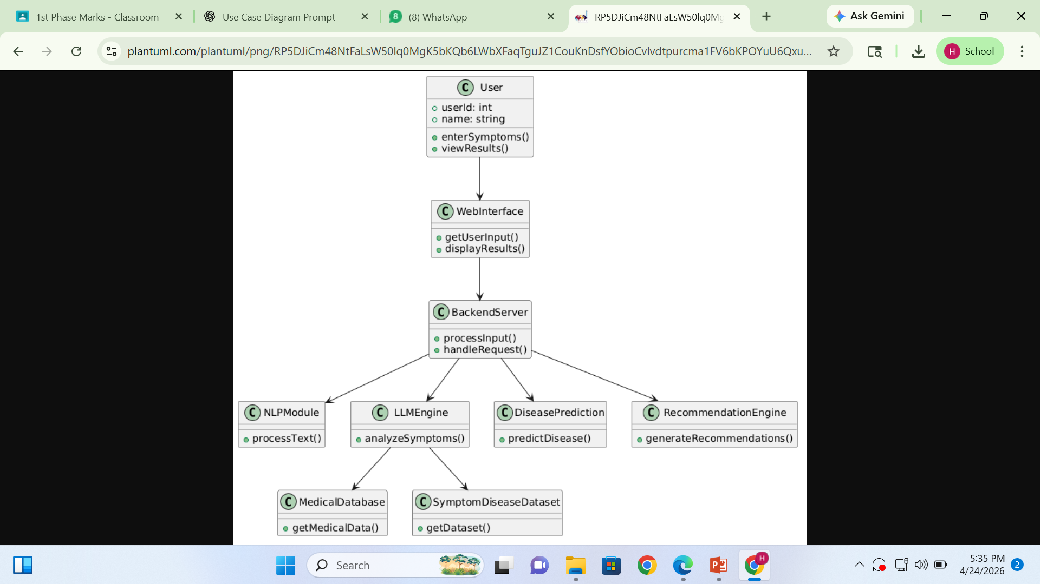
Class Diagram

Slide 9
Class Diagram
The Class Diagram of the **AI Health Symptom Checker System** represents the structure of the system by showing its main classes and their relationships. The **User** interacts with the system through the **Web Interface**, which communicates with the **Backend Server** to process requests.
The backend uses the **NLP Module** to process user input and the **LLM Engine** to analyze symptoms. The LLM interacts with the **Medical Database** and **Symptom-Disease Dataset** to retrieve relevant information. Based on this analysis, the **Disease Prediction** class identifies possible diseases, while the **Recommendation Engine** generates precautions and diet suggestions.
.

Slide 10
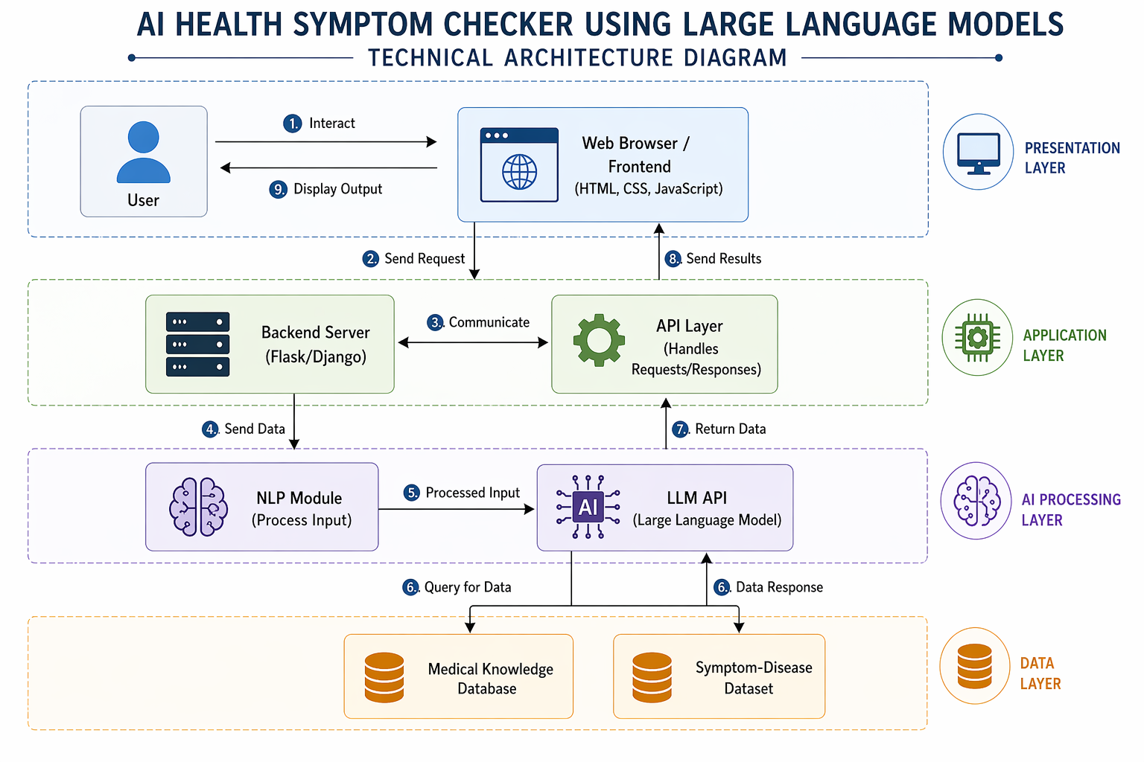
Technical Architecture Diagram

Slide 11
Technical Architecture Diagram
The Technical Architecture Diagram of the **AI Health Symptom Checker System** illustrates the overall system structure divided into multiple layers. The presentation layer includes the user and web interface, where users enter symptoms and view results.
The application layer consists of the backend server and API layer, which handle user requests and manage communication between components. The AI processing layer includes the NLP module and LLM API, which analyze user input and generate intelligent predictions.
The data layer contains the medical knowledge database and symptom-disease dataset, which provide necessary information for analysis. The diagram clearly shows how data flows between layers, enabling efficient symptom analysis, disease prediction, and recommendation generation.
.

Slide 12
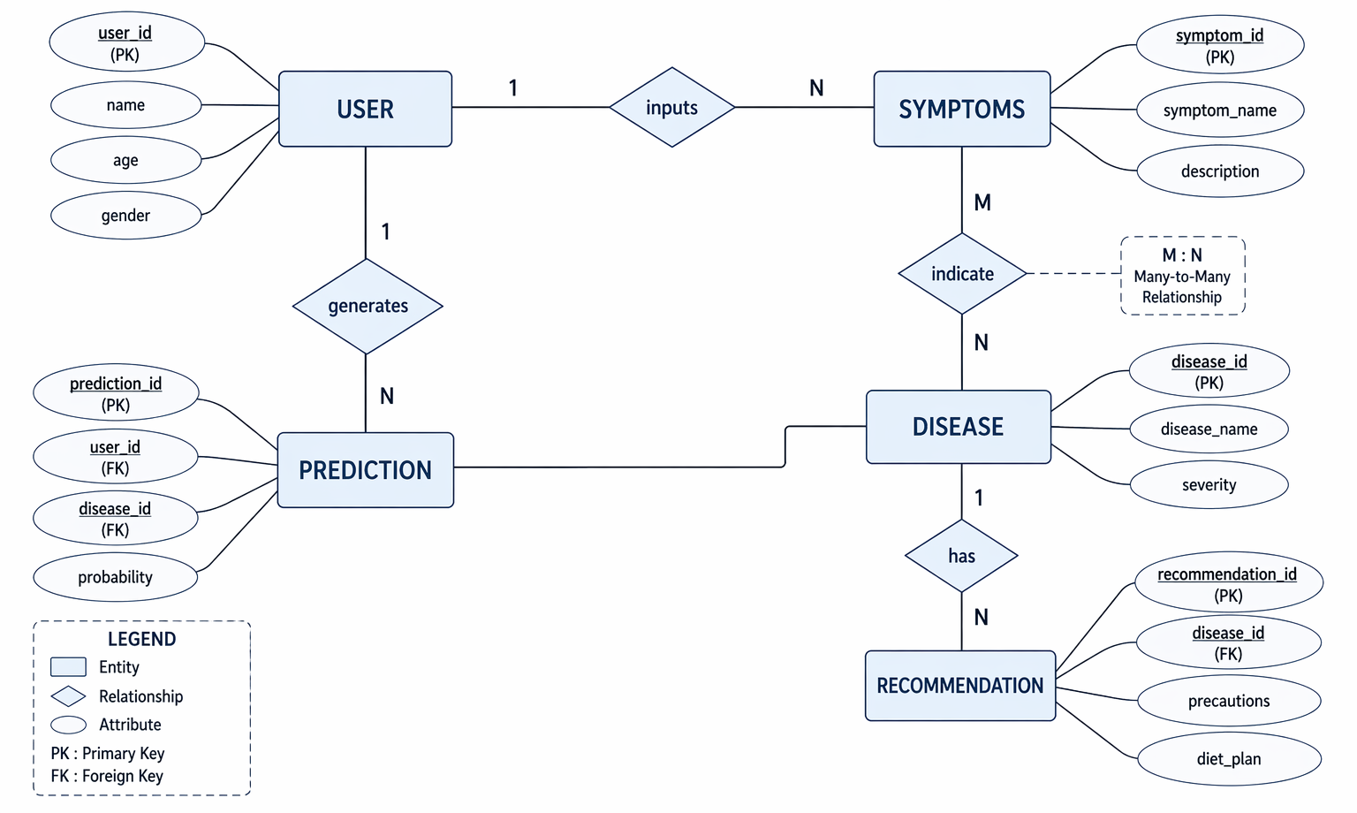
E-R Diagram

Slide 13
E-R Diagram
The ER Diagram of the **AI Health Symptom Checker System** represents the structure of the database and the relationships between different entities. The main entities include User, Symptoms, Disease, Prediction, and Recommendation.
A user provides symptoms, which are linked through a one-to-many relationship. Symptoms are associated with diseases through a many-to-many relationship, indicating that one symptom can relate to multiple diseases and vice versa. The system generates predictions that connect users with possible diseases, along with a probability value.
Each disease is associated with recommendations such as precautions and diet plans. This diagram helps in understanding how data is stored, organized, and connected within the system to support intelligent health analysis and recommendations.
.

Slide 14
Thank you

