Slide 1
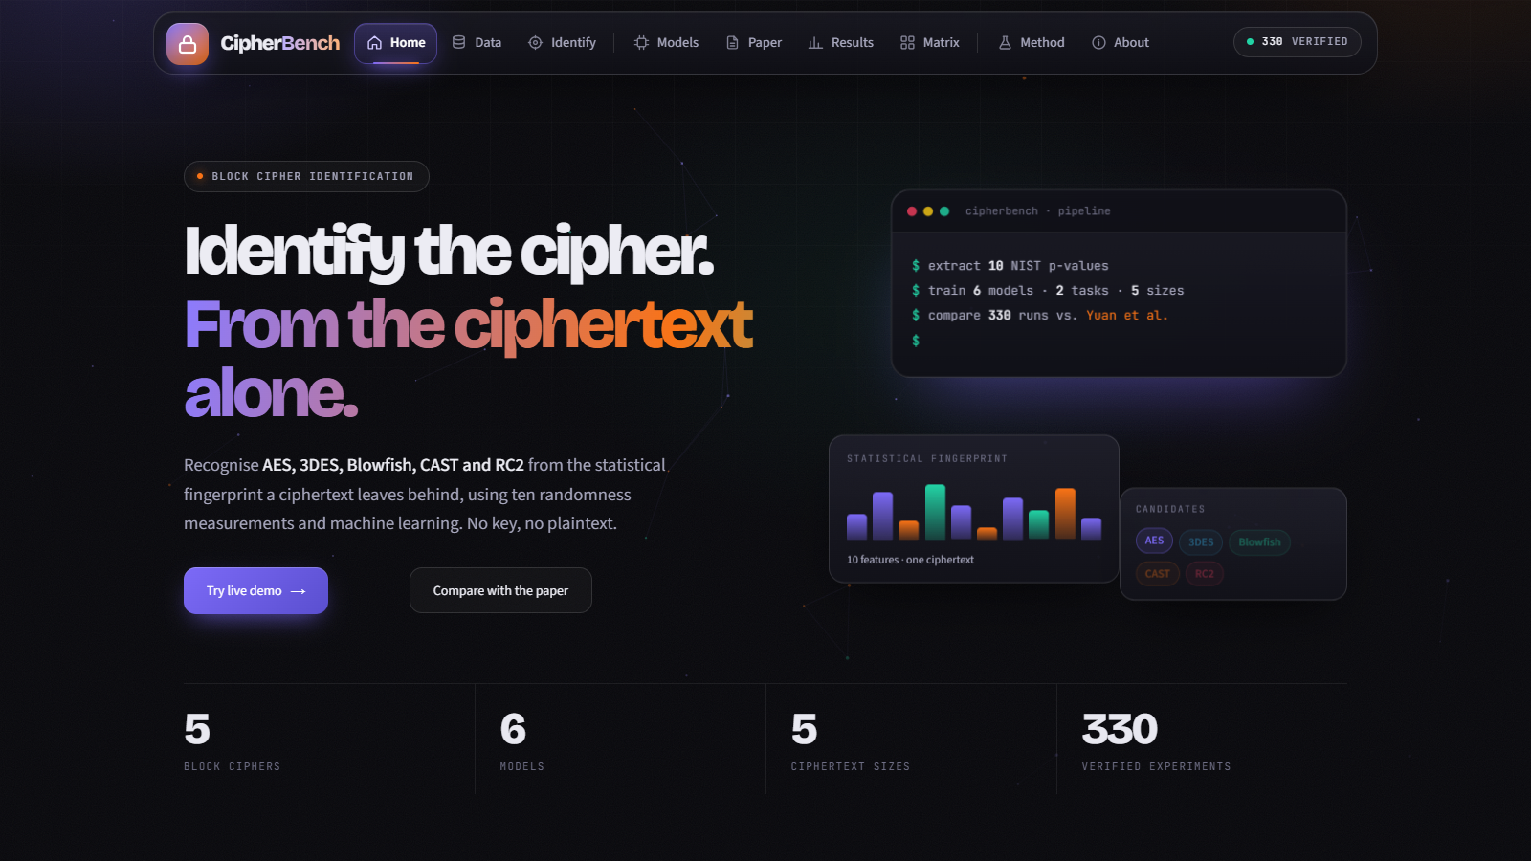


MAHARAJA SURAJMAL INSTITUTE OF TECHNOLOGY
Department of Information Technology · New Delhi
MINOR PROJECT · FINAL PRESENTATION
CIPHERBENCH
localhost:8501
Block Cipher Identification using Machine Learning
AES · 3DES · Blowfish · CAST · RC2, recognised from ten NIST statistical features
Presented by
Sanyam Kumar (02996303123)
Aayush Ahuja (35496303123)
Harsh Ramrakhiani (35296303123)
Supervisor
Dr. Bharti Sharma
Live application: Streamlit

Slide 2





RESEARCH OBJECTIVES
A structured path from the base paper to a working system
RO1
RO2
RO3
RO4
RO5
Study Existing Research
Define Approach & Gap
Reproduce the Benchmark
Extend with Neural Nets
Deliver End to End
Review cipher-identification literature and the base paper: Yuan et al. (2022), hybrid KNN + Random Forest.
Use NIST p-values as features; note the paper evaluates only four classical models and no neural baseline.
Implement SVM, KNN, RF and HKNNRF and evaluate them on the 55 datasets.
Add an MLP and a 1-D CNN and test them under the identical split and metrics.
Verify 330 experiments and ship an interactive app to explore, run and compare them.
IDENTIFY THE CIPHER. FROM THE CIPHERTEXT ALONE.
CIPHERBENCH

Slide 3



THE PROBLEM: A CIPHERTEXT HAS NO LABEL
Before anyone can analyse an encryption, they must know which algorithm produced it
Good ciphers look random
CIPHERTEXT SAMPLE
9f 3a c1 7e 04 b8 5d 22 e6 91 0c 47 ad 68 fb 13
5e c9 70 2b 8a d4 16 f0 39 bc 62 07 e5 9d 4a 81
c3 1f 76 a8 0e 5b d2 94 3d e7 28 b1 6c f5 0a 4e
Their output is designed to be indistinguishable from noise, so the label is hidden by design.
?
Randomness has texture
Statistical randomness tests can still differ slightly from one algorithm to another.
AES
3DES
Blowfish
Our idea
CAST
RC2
Measure ten NIST tests per ciphertext and let a classifier learn the differences.
Which of five block ciphers made this?
IDENTIFY THE CIPHER. FROM THE CIPHERTEXT ALONE.
CIPHERBENCH

Slide 4



DATASET: 55 NIST FEATURE FILES
Ciphertext samples reduced to ten randomness p-values each
DATASET SPECIFICATIONS
Files
55 CSVs (5 five-class + 50 binary)
5
50
Ciphers
AES, 3DES, Blowfish, CAST, RC2
five-class files
binary files
Features
10 NIST test p-values
One per ciphertext size
10 cipher pairs × 5 sizes
Ciphertext sizes
1KB, 8KB, 64KB, 256KB, 512KB
Five-class split
400 train / 100 test
10
5
Binary split
160 train / 40 test (per pair)
features per row
ciphertext sizes
Split method
Stratified 80/20, fixed seed
NIST p-values, used as-is
1KB up to 512KB
IDENTIFY THE CIPHER. FROM THE CIPHERTEXT ALONE.
CIPHERBENCH

Slide 5
TEN MEASUREMENTS. ONE FINGERPRINT.
The NIST randomness tests whose p-values form each feature vector
01
02
03
04
05
Approximate Entropy
Cumulative Sums
Discrete Fourier
Block Frequency
Linear Complexity
Regularity of overlapping bit patterns
Drift of the running sum
Periodic structure in the spectrum
Balance of ones inside blocks
Shift-register style structure
aetPValue
custPValue
dtfPValue
fwbtPValue
lrobPValue
06
07
08
09
10
Monobit
Random Excursions
Excursions Variant
Runs
Serial
Overall balance of ones and zeros
Walk visits to fixed states
Total visits across many states
Length of uninterrupted bit runs
Frequency of m-bit patterns
mtPValue
retPValue
revtPValue
runsPValue
stPValue
These ten columns are consumed as-is by every model: no scaling, no feature selection, matching the base paper.
IDENTIFY THE CIPHER. FROM THE CIPHERTEXT ALONE.
CIPHERBENCH

Slide 6

CIPHERBENCH PIPELINE
From raw ciphertext to a cipher prediction
Ciphertext
NIST Tests
10 Features
6 ML Models
Identification
Encrypted sample from one of five ciphers
Ten randomness tests run on the sample
One p-value per test forms the fingerprint
SVM · KNN · RF · HKNNRF · MLP · CNN
Predicted cipher and class probabilities
1 Stratified split
2 Train
3 Evaluate
4 Record
Seeded 80/20 train and test, identical for every model
Fit on the training split only (deep nets carve validation from it)
Accuracy, precision, recall, F1 and confusion matrix on held-out test
One row per experiment into the results CSV / JSON
IDENTIFY THE CIPHER. FROM THE CIPHERTEXT ALONE.
CIPHERBENCH

Slide 7



SIX MODELS, ONE QUESTION
Four classifiers reproduce the base paper; two neural networks are our extension
SVM
KNN
RF
SUPPORT VECTOR MACHINE
K-NEAREST NEIGHBOURS
RANDOM FOREST
Maximum-margin boundary between classes.
Labels a sample by its closest neighbours.
Votes across many randomised decision trees.
BASE PAPER
BASE PAPER
BASE PAPER
HKNNRF
MLP
CNN
HYBRID KNN + RF
MULTI-LAYER PERCEPTRON
1-D CONVOLUTIONAL NET
The paper's method: forest leaves feed a KNN vote.
Small feed-forward network on the ten features.
Convolutions over the ordered feature vector.
BASE PAPER
EXTENSION
EXTENSION
IDENTIFY THE CIPHER. FROM THE CIPHERTEXT ALONE.
CIPHERBENCH

Slide 8
HOW HKNNRF AND THE DEEP MODELS WORK
Implemented in src/models and evaluated under one shared protocol
HKNNRF · the base paper's hybrid
MLP and 1-D CNN · extension
10 features
Random Forest
Leaf-index
one-hot
+ original
features
KNN
vote
Keras models wrapped to behave like scikit-learn classifiers.
Validation data is carved from the training split only, never the test set.
Early stopping; seeds set through keras.utils.set_random_seed.
Class labels mapped consistently so binary and five-class runs stay comparable.
The paper has no neural baseline, so MLP/CNN are reported on their own.
The forest learns which leaf each training sample lands in.
Leaf indices are one-hot encoded and concatenated with the original ten features.
A k-nearest-neighbour classifier votes in that enriched space.
Goal: combine the forest's learned partitions with KNN's local decisions.
IDENTIFY THE CIPHER. FROM THE CIPHERTEXT ALONE.
CIPHERBENCH

Slide 9
EXPERIMENT DESIGN: 330 RUNS
Every model on every task and every ciphertext size
6
×
5
×
11
=
330
MODELS
SIZES
TASKS
EXPERIMENTS
11 tasks
Same protocol everywhere
1 five-class task: all five ciphers at once
10 binary tasks: every pair of ciphers (AES vs 3DES, AES vs Blowfish, … CAST vs RC2)
55 dataset files feed these tasks
One fixed seed and stratified 80/20 split
Metrics: accuracy, precision, recall, F1 (weighted)
Results stored as a single verified CSV + JSON, read directly by the app
IDENTIFY THE CIPHER. FROM THE CIPHERTEXT ALONE.
CIPHERBENCH

Slide 10
RESULTS: MEAN ACCURACY
Averaged over all ciphertext sizes (and all ten pairs for binary)
Reading the numbers: all six models sit close to chance level. The features carry only a weak cipher signal on this data, which we report rather than hide.
IDENTIFY THE CIPHER. FROM THE CIPHERTEXT ALONE.
CIPHERBENCH

Slide 11
FIVE-CLASS ACCURACY BY CIPHERTEXT SIZE
Test accuracy on 100 held-out samples per cell; best in each column highlighted
Model | 1KB | 8KB | 64KB | 256KB | 512KB | Mean
SVM | 0.13 | 0.10 | 0.10 | 0.16 | 0.16 | 0.130
KNN | 0.21 | 0.19 | 0.24 | 0.19 | 0.22 | 0.210
RF | 0.22 | 0.21 | 0.16 | 0.21 | 0.21 | 0.202
HKNNRF | 0.11 | 0.14 | 0.14 | 0.25 | 0.18 | 0.164
MLP | 0.24 | 0.22 | 0.10 | 0.22 | 0.15 | 0.186
CNN | 0.26 | 0.11 | 0.15 | 0.21 | 0.18 | 0.182
Chance for five classes is 0.20. Best single cell: HKNNRF at 256KB (0.25).
Small test sets are noisy. One sample is 1 point of accuracy, so single cells vary a lot.
IDENTIFY THE CIPHER. FROM THE CIPHERTEXT ALONE.
CIPHERBENCH

Slide 12
COMPARISON WITH THE BASE PAPER
Yuan et al. (2022), Tables 3 and 5, against our verified results (mean over five sizes)
Honest reading: the paper's HKNNRF advantage (0.30 five-class, 0.70 binary) is not reproduced here. MLP and CNN have no paper counterpart.
IDENTIFY THE CIPHER. FROM THE CIPHERTEXT ALONE.
CIPHERBENCH

Slide 13


KEY FINDINGS
What 330 verified experiments tell us
Near-chance everywhere
Deep nets do not win
Five-class accuracy is 0.13 to 0.21 (chance 0.20); binary is 0.50 to 0.51 (chance 0.50). No model is reliably better than guessing.
MLP and CNN match the classical models but take about 5 to 6 s per run against 0.02 to 0.07 s for SVM, KNN and RF.
Paper gap is open
Likely reasons
HKNNRF's reported edge over the other three is not seen with our splits: it is 0.16 five-class against RF at 0.20.
Very small test sets (40 to 100 samples) make results noisy, and ten p-values may hold little cipher-specific signal. These are hypotheses to test next.
IDENTIFY THE CIPHER. FROM THE CIPHERTEXT ALONE.
CIPHERBENCH

Slide 14



ENGINEERING RIGOUR
Why the numbers can be trusted, even when they are modest
Seeded and stratified
Fixed random seed and stratified 80/20 split for every model, so runs are repeatable.
No test leakage
MLP and CNN take their validation set from training data only; the test set is touched once for the final prediction.
One verified result set
All 330 rows live in a single CSV + JSON that the app reads directly. No database needed.
Automated tests
A 17-test suite covers data loading, models, metrics and the pipeline.
Reproducible commands
pip install, run the test suite, run the experiment matrix, launch the app: four commands.
IDENTIFY THE CIPHER. FROM THE CIPHERTEXT ALONE.
CIPHERBENCH

Slide 15
SYSTEM ARCHITECTURE
How the repository fits together
SVM · KNN · RF
data/
data_loader
metrics + runner
scikit-learn baselines
55 NIST feature CSVs (5 five-class, 50 binary)
Stratified, seeded train/test split; feature names
accuracy, precision, recall, F1, confusion matrix; experiment matrix runner
HKNNRF
custom hybrid estimator
MLP · 1-D CNN
Keras wrappers
Streamlit application
experiments/results · 330 rows, CSV + JSON
Home
Data
Identify
Models
Paper
Results
Matrix
Method
About
app/streamlit_app.py reads the results file and the datasets directly, and trains any of the six models live from the Identify page. Styling in app/style.css, motion in app/effects.js. No database or network service is required.
IDENTIFY THE CIPHER. FROM THE CIPHERTEXT ALONE.
CIPHERBENCH

Slide 16
THE APPLICATION: HOME
A guided story from the problem to the evidence
localhost:8501
1
Floating navigation with nine pages; the badge shows the verified result count
2
Hero explains the task; terminal card mirrors the real pipeline
3
Live counters read from the results file: 5 ciphers, 6 models, 5 sizes, 330 experiments
4
Eight scroll sections lead to the live demo and paper comparison
IDENTIFY THE CIPHER. FROM THE CIPHERTEXT ALONE.
CIPHERBENCH

Slide 17
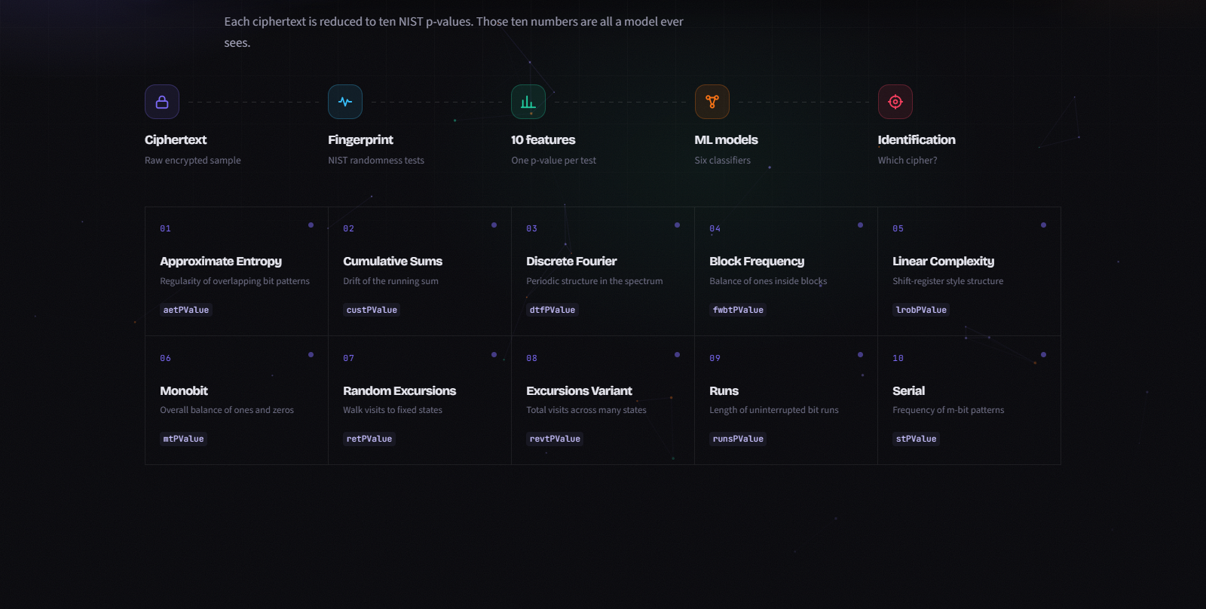
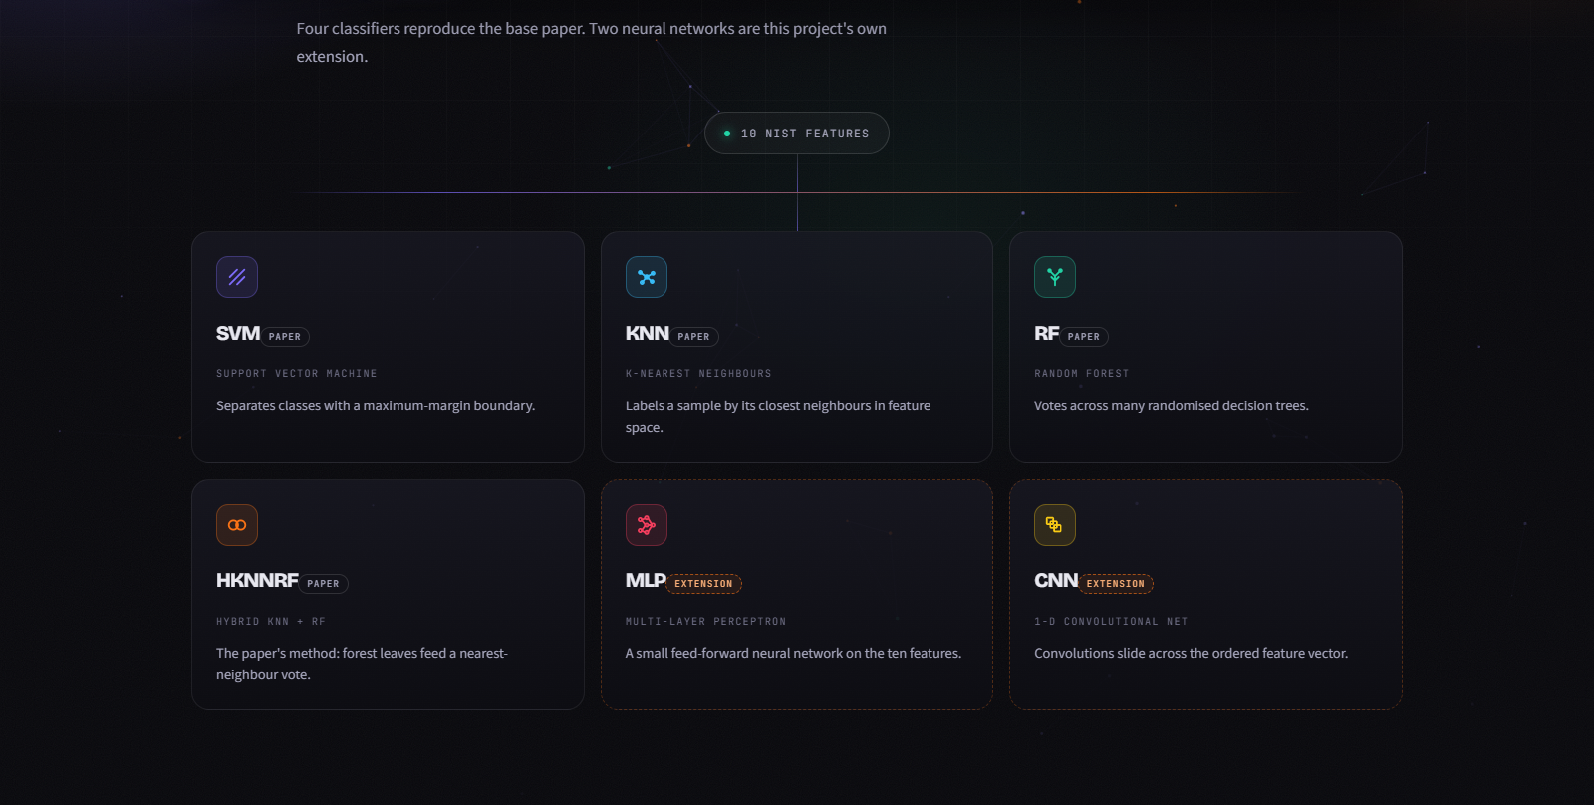
HOME: FINGERPRINT AND MODELS
The method explained visually inside the app
localhost:8501
localhost:8501
Pipeline and the ten NIST features
Model ecosystem
Ciphertext, fingerprint, features, models, identification, followed by the ten features and what each measures.
Six model cards; MLP and CNN carry a dashed border and an Extension badge to separate them from the base paper.
IDENTIFY THE CIPHER. FROM THE CIPHERTEXT ALONE.
CIPHERBENCH

Slide 18
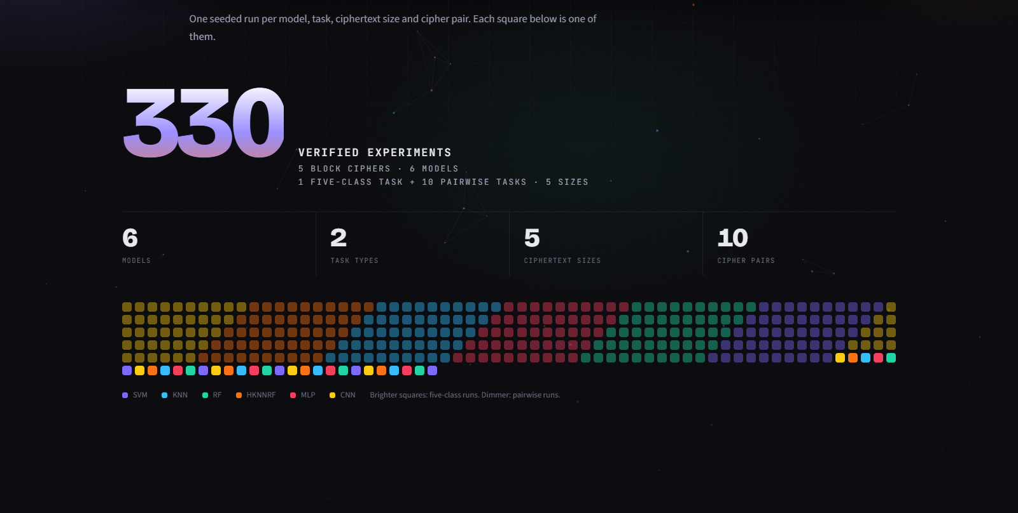
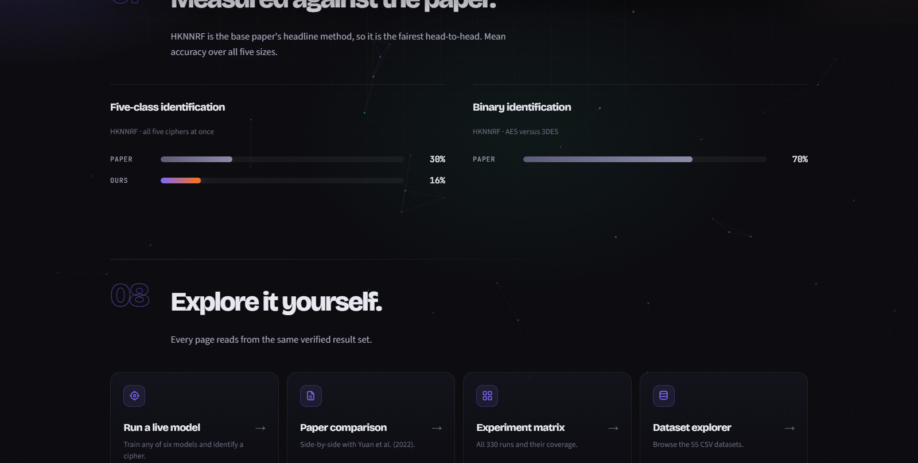
HOME: EXPERIMENTS AND EVIDENCE
All 330 runs at a glance, and how they compare with the paper
localhost:8501
localhost:8501
The 330-run grid
Measured against the paper
One square per experiment, coloured by model; a counter animates up to the verified total.
HKNNRF paper-versus-ours bars are computed live from the base-paper tables and the results file.
IDENTIFY THE CIPHER. FROM THE CIPHERTEXT ALONE.
CIPHERBENCH

Slide 19
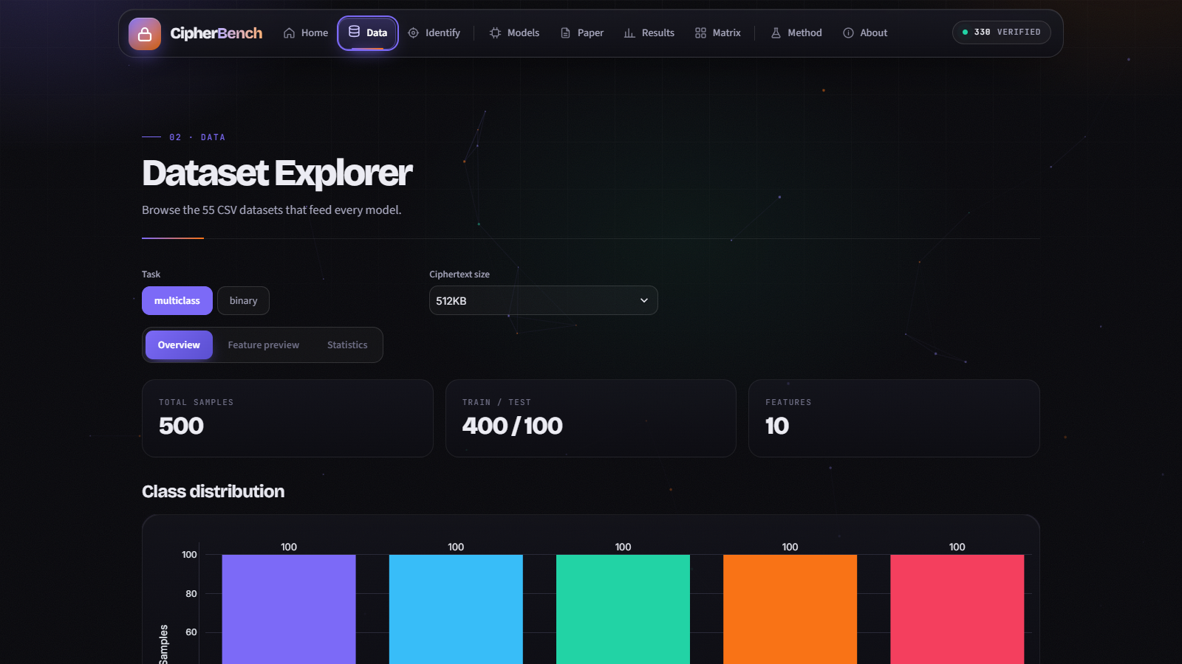
DATASET EXPLORER
Browse the 55 CSV datasets behind every model
localhost:8501
1
Choose the task (five-class or binary), ciphertext size and, for binary, the cipher pair
2
Overview tab shows sample counts and class balance of the train/test split
3
Feature preview and statistics tabs expose the ten NIST columns before any model is trained
IDENTIFY THE CIPHER. FROM THE CIPHERTEXT ALONE.
CIPHERBENCH

Slide 20
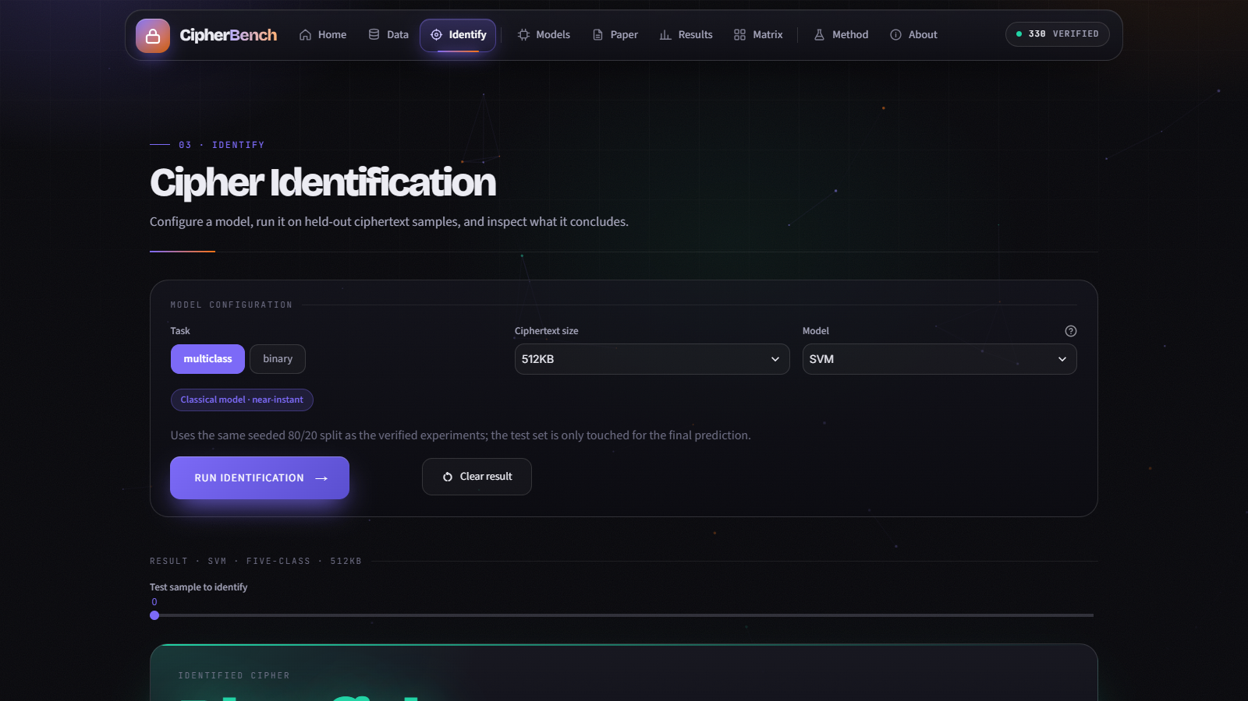
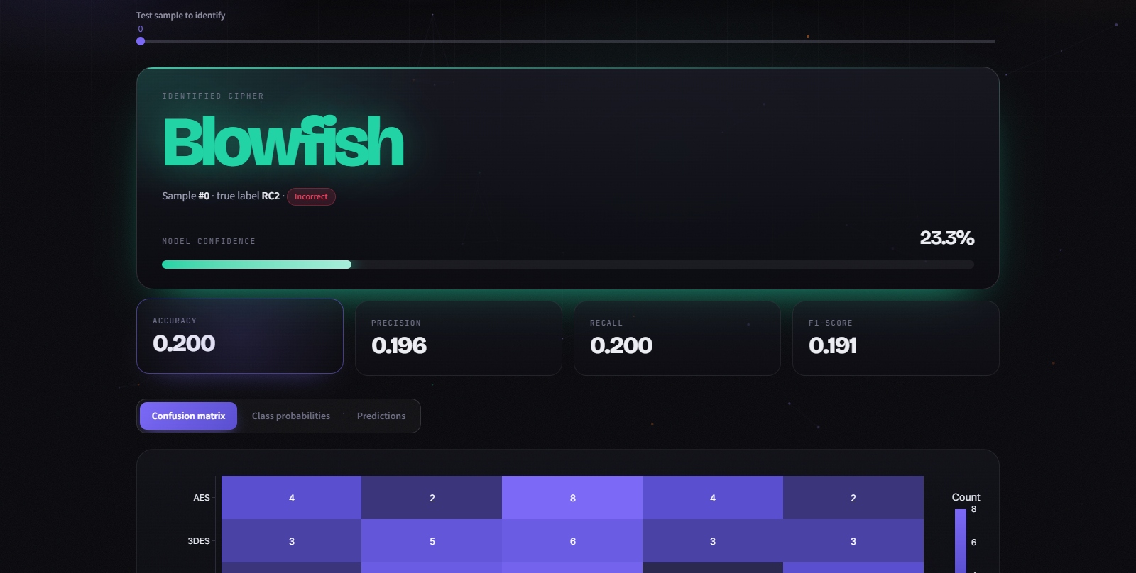
LIVE CIPHER IDENTIFICATION
Train any of the six models in the browser and inspect what it concludes
localhost:8501
localhost:8501
2
Result shows the predicted cipher, true label and the model's confidence for the chosen test sample, then accuracy, precision, recall and F1
1
Configure task, size, model and pair; MLP and CNN are included
IDENTIFY THE CIPHER. FROM THE CIPHERTEXT ALONE.
CIPHERBENCH

Slide 21
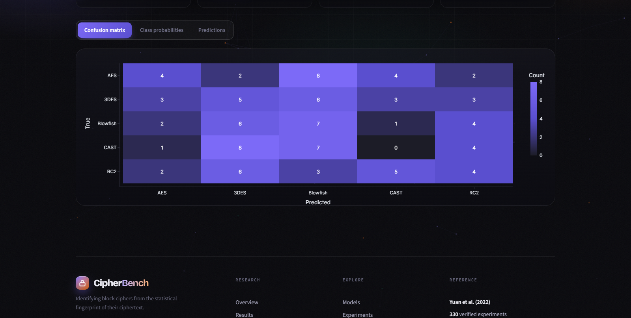
IDENTIFY: CONFUSION MATRIX AND ANALYSIS
Where a model is right, where it confuses ciphers
localhost:8501
1
Confusion matrix of true versus predicted cipher across the held-out test set
2
Class-probability tab shows the model's belief per cipher for one sample
3
Predictions tab lists test rows with correct/incorrect highlighted
4
Cached training: revisiting a configuration does not retrain
IDENTIFY THE CIPHER. FROM THE CIPHERTEXT ALONE.
CIPHERBENCH

Slide 22
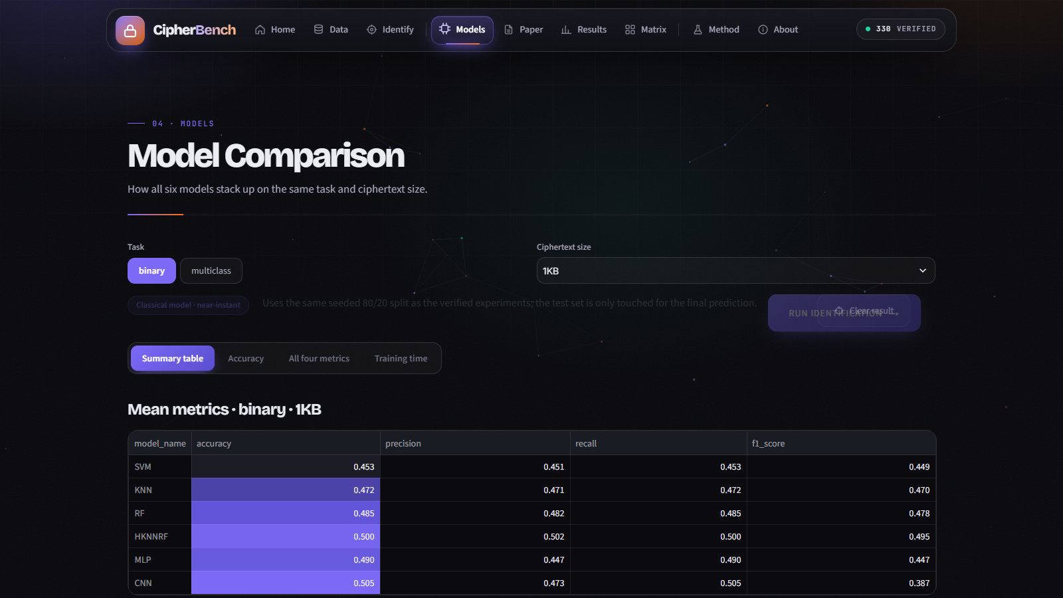
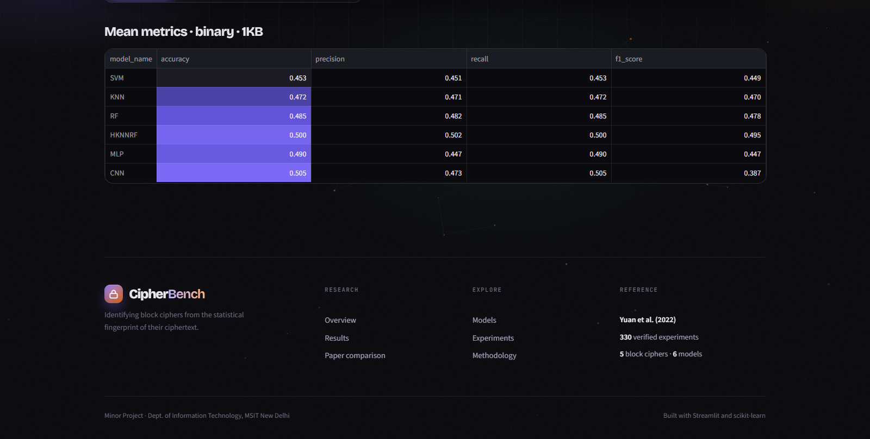
MODEL COMPARISON
All six models on the same task and size
localhost:8501
localhost:8501
Summary tables and heatmap-styled metrics
Charts per metric
Pick a task and size; the mean accuracy, precision, recall, F1 and training time for every model appear side by side.
Accuracy, all-four-metrics and training-time views make the cost of the neural networks obvious.
IDENTIFY THE CIPHER. FROM THE CIPHERTEXT ALONE.
CIPHERBENCH

Slide 23
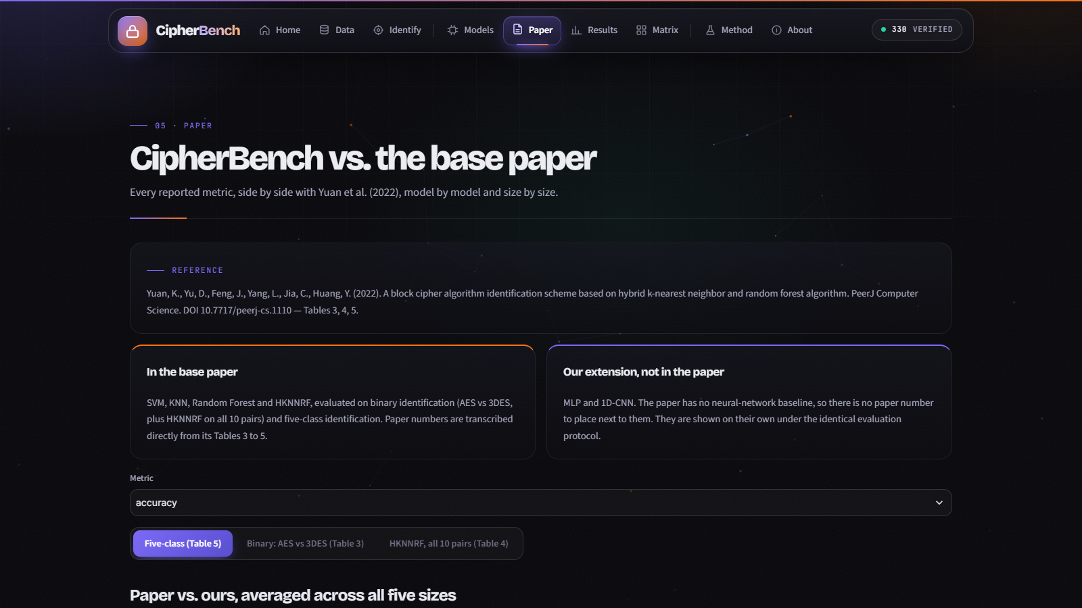
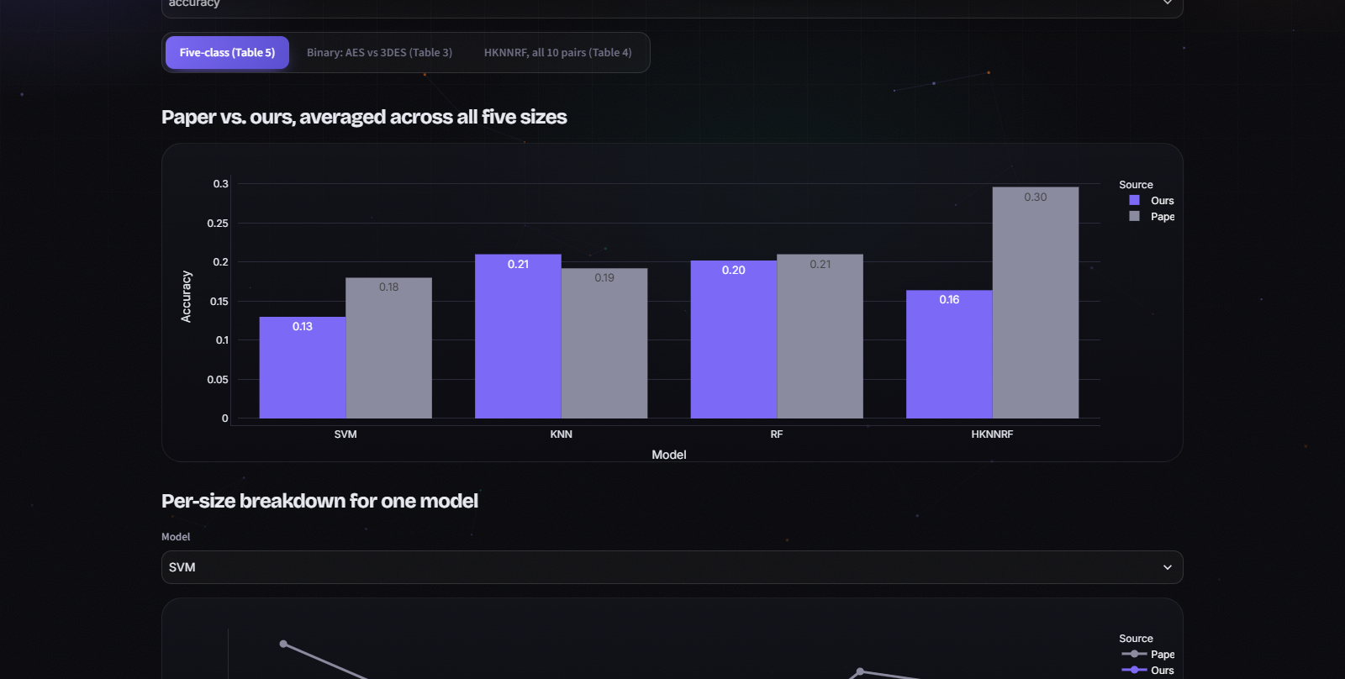
PAPER COMPARISON PAGE
Built so an examiner can check every number against the source
localhost:8501
localhost:8501
1
Paper numbers are transcribed from Tables 3, 4 and 5; the citation and DOI are shown on the page
2
Three tabs: five-class, AES versus 3DES, and HKNNRF across all ten pairs; MLP and CNN shown as extensions
IDENTIFY THE CIPHER. FROM THE CIPHERTEXT ALONE.
CIPHERBENCH

Slide 24
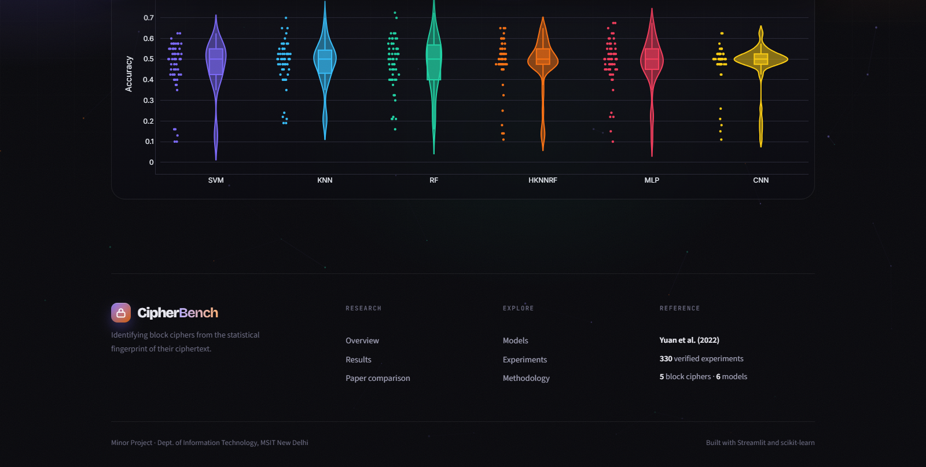
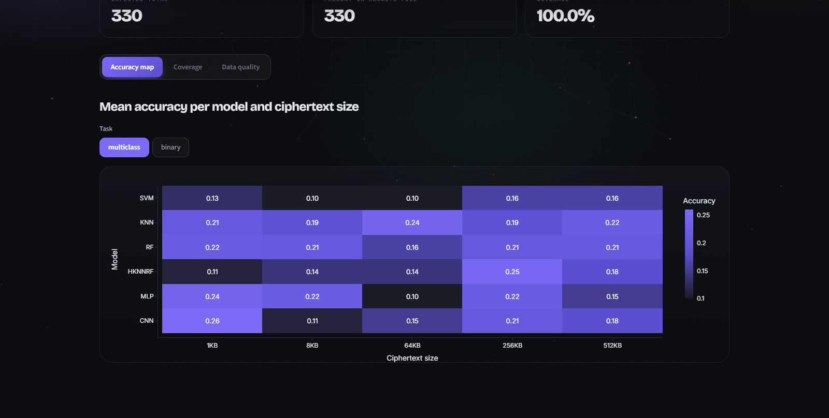
RESULTS AND EXPERIMENT MATRIX
Filter, inspect and download every verified run
localhost:8501
localhost:8501
Results
Experiment matrix
Filter by model, task and size; view distributions and the full table, and download it as CSV.
Expected versus present runs (330 of 330), a mean-accuracy heatmap per model and size, and a data-quality check.
IDENTIFY THE CIPHER. FROM THE CIPHERTEXT ALONE.
CIPHERBENCH

Slide 25

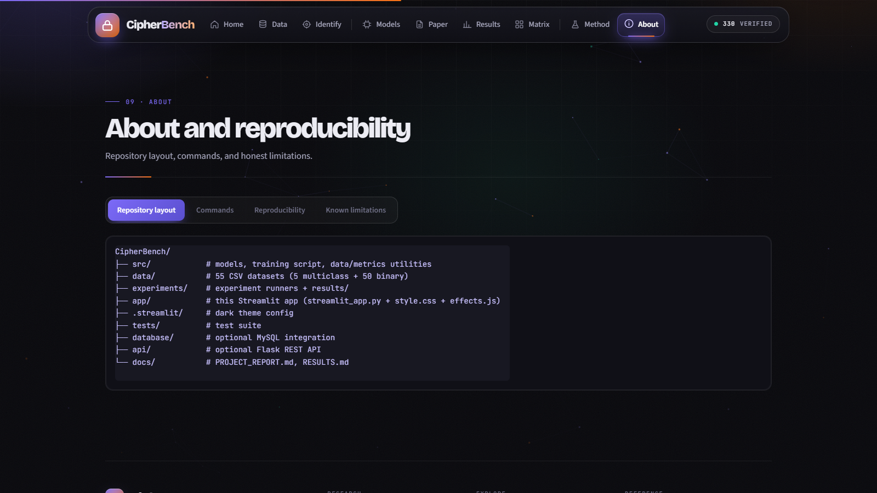
METHODOLOGY AND REPRODUCIBILITY
Documented inside the app itself
localhost:8501
localhost:8501
Method
About
Features, models, evaluation protocol and how results are compared with the paper.
Repository layout, run commands, reproducibility notes and known limitations.
IDENTIFY THE CIPHER. FROM THE CIPHERTEXT ALONE.
CIPHERBENCH

Slide 26

LIMITATIONS AND FUTURE WORK
What we know is missing, and what we would do next
Known limitations
Next steps
Accuracy is near chance, so no model can yet identify a cipher reliably.
Test sets are small: 100 samples five-class, 40 samples binary.
One seed per experiment; no confidence intervals yet.
Only ten summary features; the raw ciphertext bytes are not used.
Repeat over many seeds and report mean ± spread.
Generate larger datasets per cipher and size.
Try richer features, or learn directly from ciphertext bytes.
Study which of the ten tests carry any signal at all.
IDENTIFY THE CIPHER. FROM THE CIPHERTEXT ALONE.
CIPHERBENCH

Slide 27
CONCLUSION
What CipherBench delivers
330
6
9
17
verified experiments
models, one protocol
app pages
automated tests
6 models × 5 sizes × 11 tasks, one clean result set
4 from the base paper plus MLP and CNN
explore, run live, compare with the paper
all passing
Bottom line. We rebuilt the base paper's benchmark, extended it with two neural networks, verified every result and packaged it in an app anyone can run. The honest outcome is that ten NIST p-values give only a weak cipher signal on this data. That makes CipherBench a solid, reproducible baseline for stronger features and larger datasets.
IDENTIFY THE CIPHER. FROM THE CIPHERTEXT ALONE.
CIPHERBENCH

Slide 28
CIPHERBENCH
Thank you
Questions and live demonstration
Sanyam Kumar (02996303123) · Aayush Ahuja (35496303123) · Harsh Ramrakhiani (35296303123)
Supervisor: Dr. Bharti Sharma · Maharaja Surajmal Institute of Technology

